Slide 1
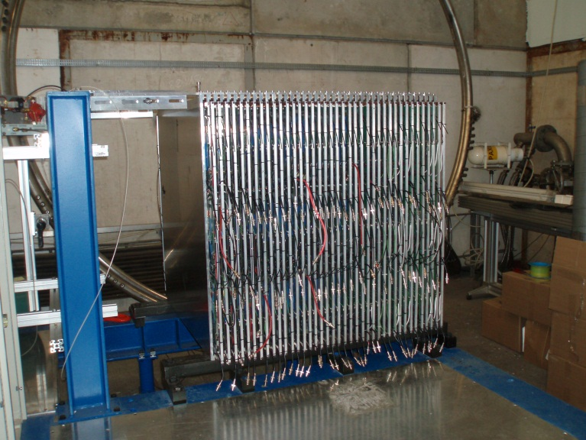


DHCAL and the DBD
José Repond
Argonne National Laboratory
CALICE Collaboration Meeting
September 17 – 19, 2012
Cambridge, UK

Slide 2
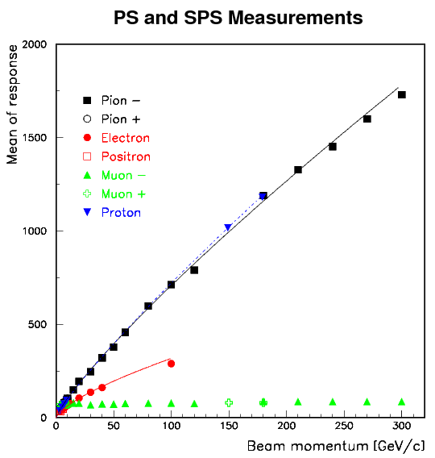
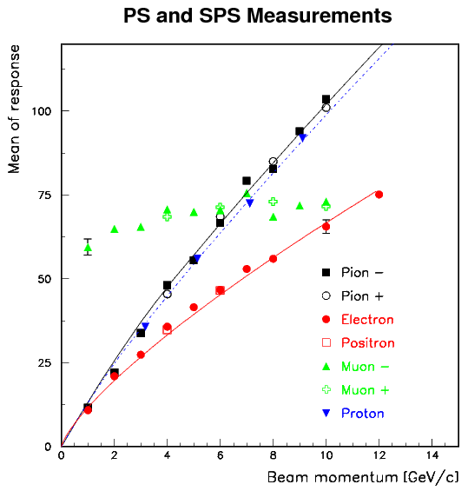
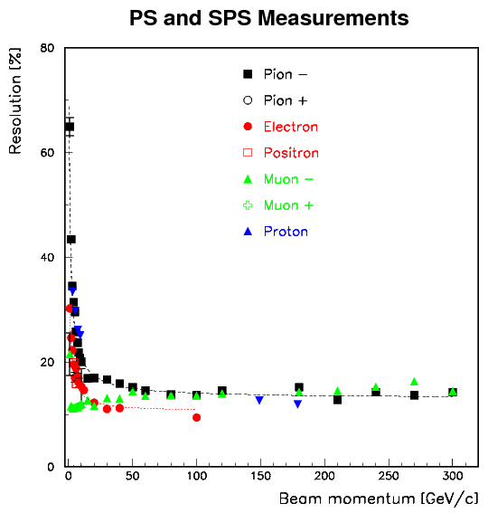
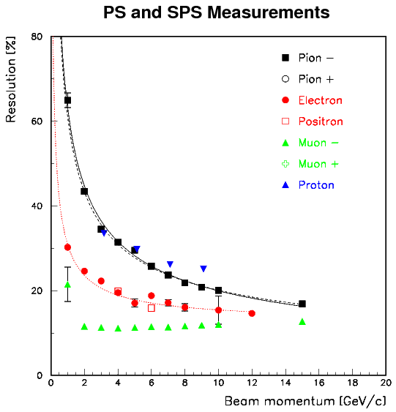
Text almost final…
Would like to include results from CERN
- Analysis essentially completed as much as currently possible
- Note being drafted (should be released within 1 – 2 weeks)
- Goal is to present these results as preliminary in Arlington

Slide 3
SiD DBD
Lei Xia contact person for the DHCAL
Recent activity to come up with a concept/design for the HCAL
Some of it will find its way into the DBD

