Slide 1
On Multipole Measurements, Optics and Magnet Swapping
Glen White, SLAC
July 6 2012
To Swap, or not to Swap, that is the question: Whether 'tis Nobler in the mind to suffer The Slings and Arrows of outrageous Fortune, Or to take Arms against a Sea of troubles…
Apologies to W. Shakespeare.

Slide 2
Overview
Summary of status of multipole measurements and inclusion in simulation models
Reminder of swapping criteria and expected effect on ATF2 optics
Tracking studies for current optics with and without swaps
Discussion and recommendations for swap decision
Discussion and recommendations for removal of QD0/QF1 BPMs

Slide 3
Status of Multipole Measurements
Last exhaustive study by Mark and Mika in March 2011
Confirmed details of measurement (co-ordinate system, direction of coil rotation, units used etc) and confirmed proper implementation in MAD description.
Tracking cross-checked MAD, SAD, MADX and Lucretia.
http://www.slac.stanford.edu/~mdw/DropBox/baisha/
Results of multipole determination were incorporated in v4.4 of ATF2 lattice (and carried forward to v4.5)
http://code.google.com/p/atf2flightsim/source/browse/#svn%2Ftrunk%2FATF2%2FFlightSim%2FlatticeFiles%2Fsrc%2Fv4.5

Slide 4
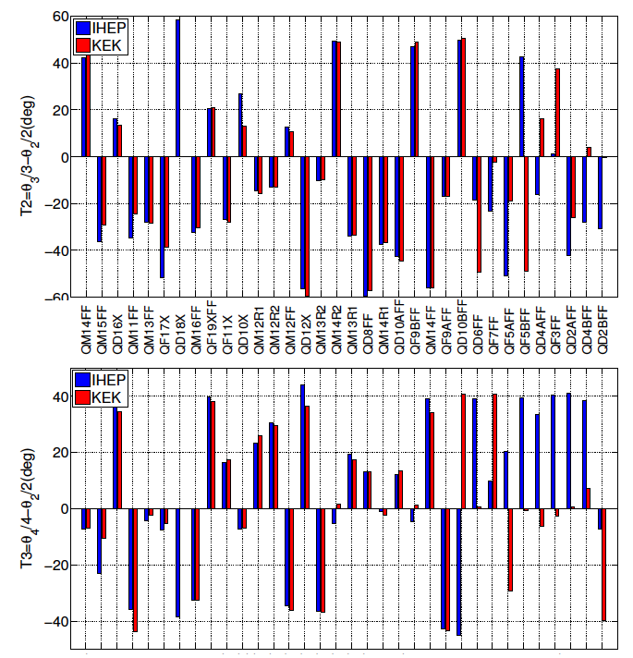
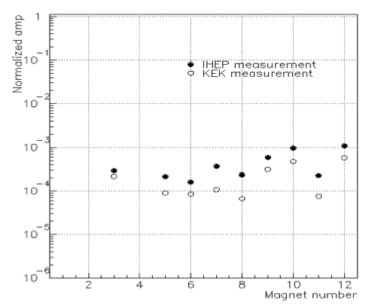
Reliability of Multipole Measurements
… courtesy of Mika and Sha
Most QEA’s had reproducibility few 1e-4
Last batch not so good, but IHEP measurements were in some way “rushed” and we perhaps have good reason to discard these…
Expected level of accuracy of tilt measurements ~0.2mrad

Slide 5
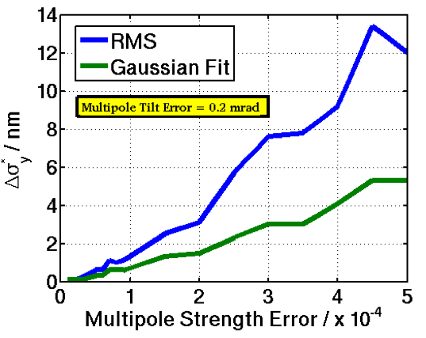
Sensitivity to Errors on Multipole Measurements (BX2.5BY1 optics and old (worse) multipole definitions)
Effect on IP beam size of absolute errors on multipoles.
Expect weak scaling with errors of order those expected.

Slide 6
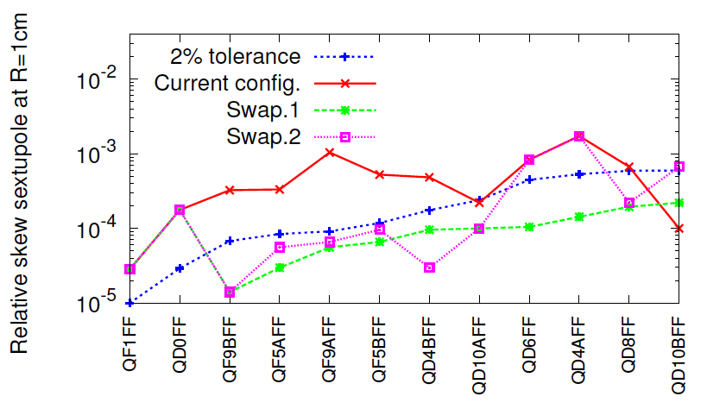
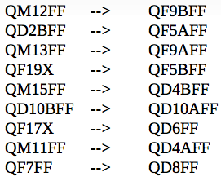
QEA Magnet Swap Suggestion By Edu Marin
Proposed swaps based on skew-sextupole tolerances (“Swap 1”)

Slide 7
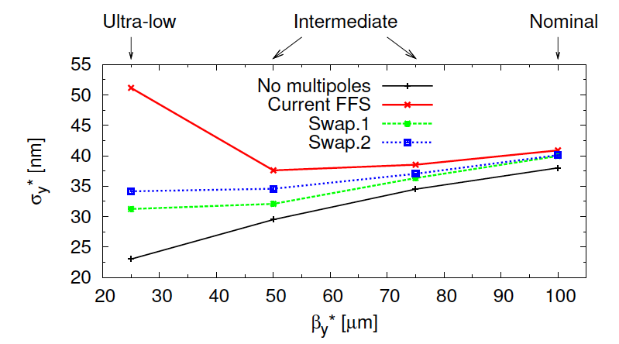
Effect of Magnet Swap on Tracked Beam size for optimized lattice (v4.5 BX2.5BY1 lattice, emit_x=2nm)
Very little effect for this configuration.
Need to check for larger emit_x (3-4nm)

Slide 8
ATF2 Tracking Models
Consider 4 optics configurations
BX10BY1
Optics optimised for 40mm x 0.1mm IP beta with quads tuned to give ~35nm IP sigma_y
BX10BY1(S)
As above but with the proposed magnet swaps
BX10BY1*
BX2.5BY1 optics re-matched to BX10BY1 just using matching quads and considering linear Twiss
The running configuration for May and June
BX10BY1*(S)
As above but with the proposed magnet swaps
Consider 4 beam configurations
Nominal conditions (matched and 2nm x 12pm emittance)
T + E
Twiss and emittance as measured by OTR 5/25 (3.8nm x 25pm emittance)
T
Just alter twiss parameters to OTR measured values
E
Just change input emittances
Tracking by Lucretia
Found 10k macro-particles gives unstable answers for some of these configurations, changed to using 20k which is more stable, some numbers changed a little since last presentation.

Slide 9
Tracking Results
Config | BX10BY1 | BX10BY1(S) | BX10BY1* | BX10BY1*(S)
T + E (σ_{x} /um) (σ_{y} / nm) | 10.2 57.6 / 68.5 | 9.8 60.9 / 70.0 | 9.0 81.3 / 110.2 | 8.9 76.8 / 100.9
T (σ_{x} /um) (σ_{y} / nm) | 6.9 36.3 / 37.6 | 6.5 39.9 / 43.4 | 6.3 50.0 / 61.8 | 6.2 48.3 / 57.2
E (σ_{x} /um) (σ_{y} / nm) | 12.3 54.0 / 55.4 | 12.1 54.5 / 57.7 | 13.0 70.0 / 83.0 | 13.0 67.0 / 76.4
Nominal (σ_{x} /um) (σ_{y} / nm) | 8.8 36.0 / 36.5 | 8.8 35.8 / 37.1 | 9.4 44.3 / 49.4 | 9.5 43.3 / 46.6
IP y sizes shown “gauss fit / RMS”
Swapping magnets
For BX10BY1 no change for nominal, slightly worse for others
For BX10BY1* slightly improved in all cases
Effect of Twiss mismatch
Minimal for BX10BY1, significantly degrades IP beam sizes for BX10BY1*
Effect of emittance dilution
Severe in both optics cases
Optics matching effect
BX10BY1 significantly better than BX10BY1* everywhere

Slide 10
Considerations For Swapping QEA Magnets
Already engaged in hardware program to improve IPBSM over summer.
Swapping magnets (if taken into account with optics tuning) can only help (no downside for optics, tuning etc) in principal, if only marginally (for Goal 1)
But swap procedure is not risk-free, some damage could occur during swaps, databases need to be changed, mistakes could be made etc
All other things being equal, would prefer to change 1 thing at a time (IPBSM and magnet configurations)
Should only perform swap if there is a clear benefit for doing so…

Slide 11
Reasons for Swapping QEA Magnets
If we decide to trust in the multipole measurements
Optics re-matching and simulations show desired beam size reachable without swapping
Tuning simulation also shows tuning should work (see talk in 13th ATF2 project meeting)
Can we simplify re-matching if swap magnets?
Maybe, what is benefit? Improved tolerance to errors greater than that considered in simulation so far? Would need more simulations to properly assess…
If we believe multipoles are considerably larger than that of our current understanding
In this case swapping may have larger benefit than that considered here (for Goal 1)
No clear evidence as of now that the multipole components, as installed, are any different than indicated by the measurements.
In this case, then we have no clear justification as to which swaps to make, would need to re-measure all magnets
My suggestion
The risks in performing the swap (this summer) out-weigh any potential benefits and we should defer

Slide 12
Considerations for QD0/QF1 BPM Removal
It has been observed that the S-BPM feed-throughs have non-negligible magnetic fields (few 100 Gauss?)
Should we split the magnets and remove the BPMs?
See previous slide on wanting to keep magnet setup unchanged if possible
Removing BPMs not un-tolerable, have 2 other BPMs in final doublet area, but all other things being equal would prefer to keep if possible
Feed-through is ~5cm upstream from magnet coils, is this measured field expected to have an effect on the multipole components in a noticeable way?
Rough impression from Cherrill Spencer (SLAC magnet engineer) is “probably not”
Recommendation
Before deciding to remove BPMs, do more study to evaluate effect of the feed-through field on the magnet multipoles
Make more measurements between the feed-through and the magnet above and below the beamline
Over the summer SLAC can use such data to try and evaluate expected effect on multipole components
Can also consider other remedies?
Remove feed-through in-place
Wrap feed-through in magnetic shielding material (can do with beam tests to asses effect)

