Slide 1
Model Response of SK1FF Scan
Glen White, SLAC
July 12 2012

Slide 2
Overview
Model expected response from a scan of the strength of the FFS skew-sextupole magnet SK1FF.
Use data from SK1FF scans on February 23 and June 15.
Convert M to beam size by usual formula with C “fudge factor” suggested by Okugi.
For each set of repeated reading per scan point, get mean and standard deviation statistics for plotting.

Slide 3
Overview
Model expected response to SK1FF scan using Lucretia particle-tracking through ATF2 model (including measured multipoles)
Optics set to BX10BY1*
Use respective OTR measurements for generating input beam for simulations.
Feb: Emit_x / Emit_y = 4.6um / 39nm (normalised)
BMAG = 1.1 / 1.0
June: Emit_x / Emit_y = 9.5um / 63nm
BMAG = 1.6 / 1.1
For SK1FF use 0.3364 T.m⁻¹ / A integrated strength conversion

Slide 4
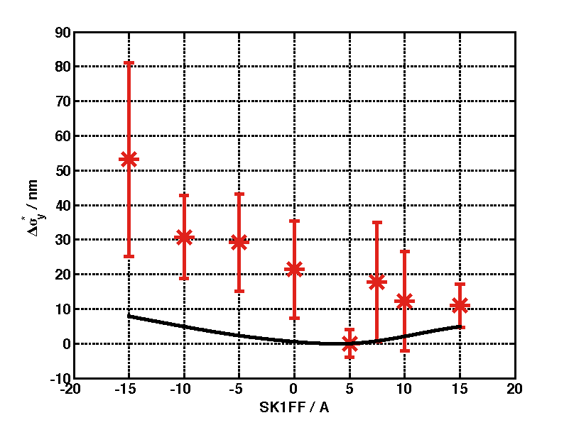
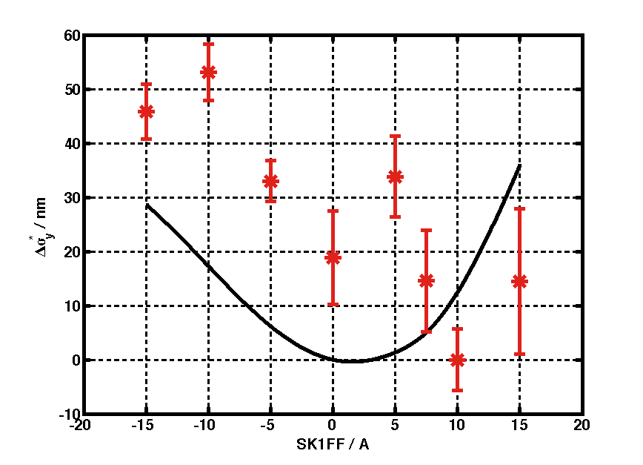
Data and Model Responses
Feb Data
June Data
Data (C factor =1)
Plot data-min(data) to show delta-responses.
Model response is considerably different with different optics properties
Model response is slightly asymmetric (as expected due to non-optimal optics configuration), but not to the degree hinted at by data.

Slide 5
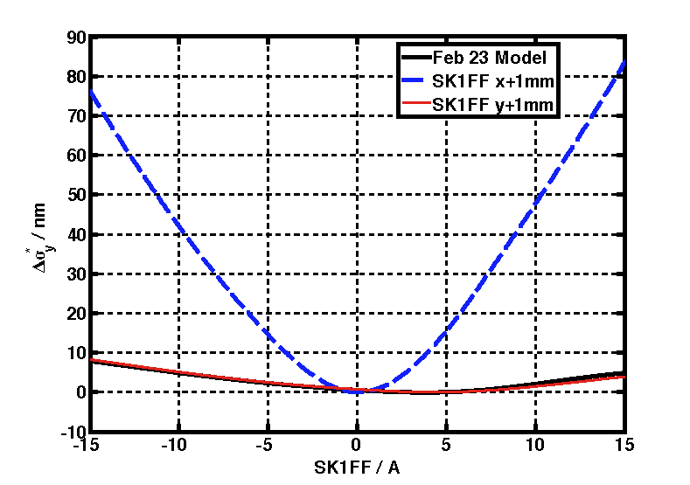
Model Response with Offset in SK1FF
Response not sensitive to vertical offset
Strong change in response with horizontal offset
Response in this case is dominated by <x’y> and η_{y} induced aberrations
Makes the response more symmetric around 0, not as indicated by data. Maybe fairly well aligned?

Slide 6
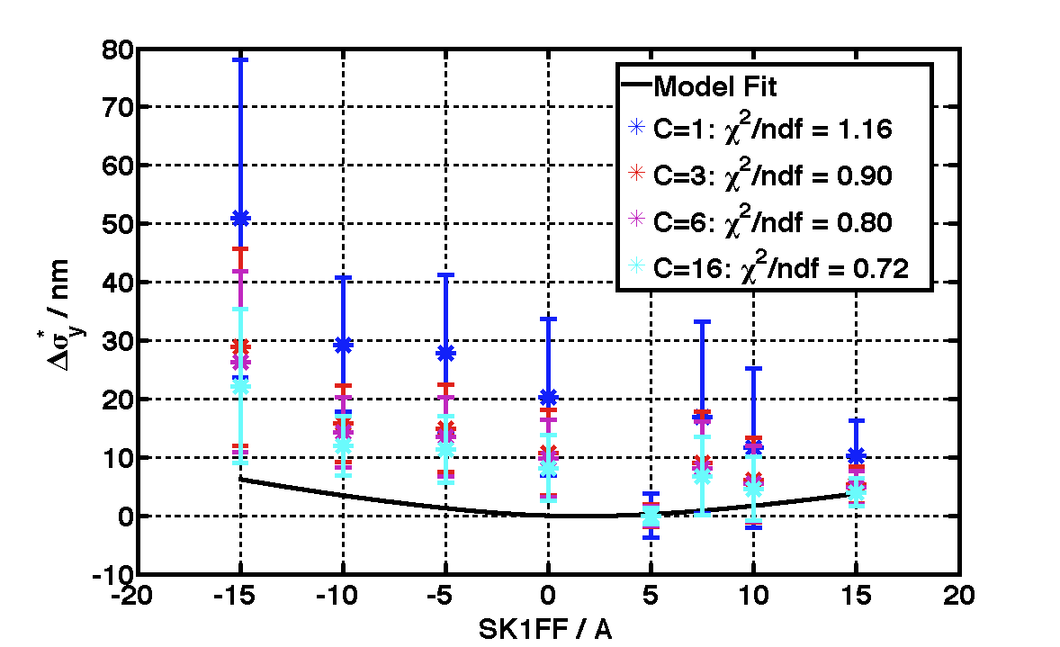
Vary C Fudge Parameter February Data
Fit includes fitting x and y offset of SK1FF
Increasing C parameter increases estimated beam size and reduces expected response more in line with Model
But C ~>10 -> beam size estimate > 400nm (from 160)
Also CHI2 statistics unreasonably low, not enough to exclude model for any fit parameter, need better errors

Slide 7
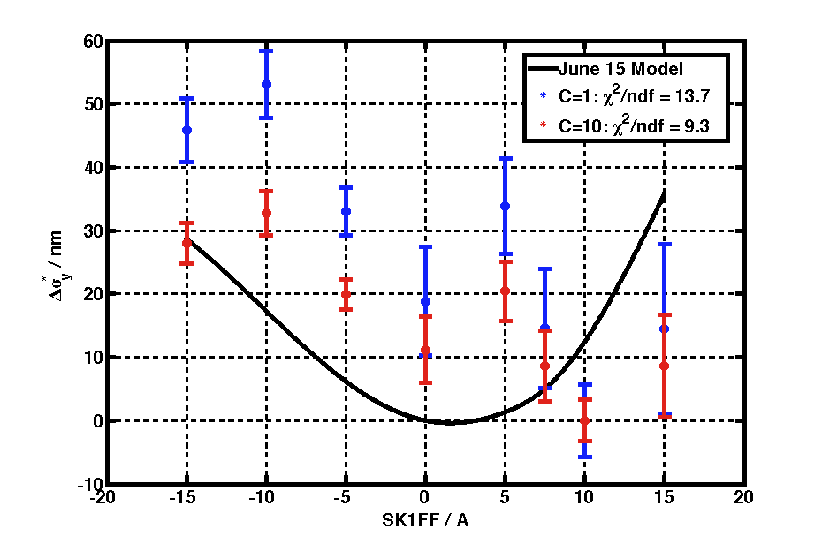
June Data
Fit results exclude model as realistic representation of data.
p value <0.001

Slide 8
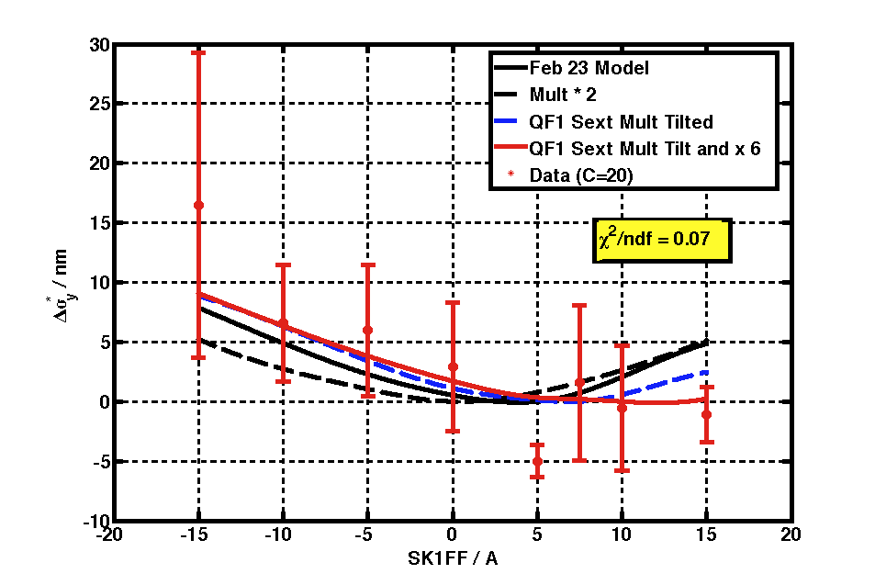
February Data
Add QF1FF sextupole multipole to fit
Set to max tilt (pure skew) and 6 times measured strength
Adding skew-sextupole field generates a model response more like the data suggest
CHI2 statistic shows this is “over-modelled”, data errors are too large to rely on model fit parameters to draw conclusions.

Slide 9
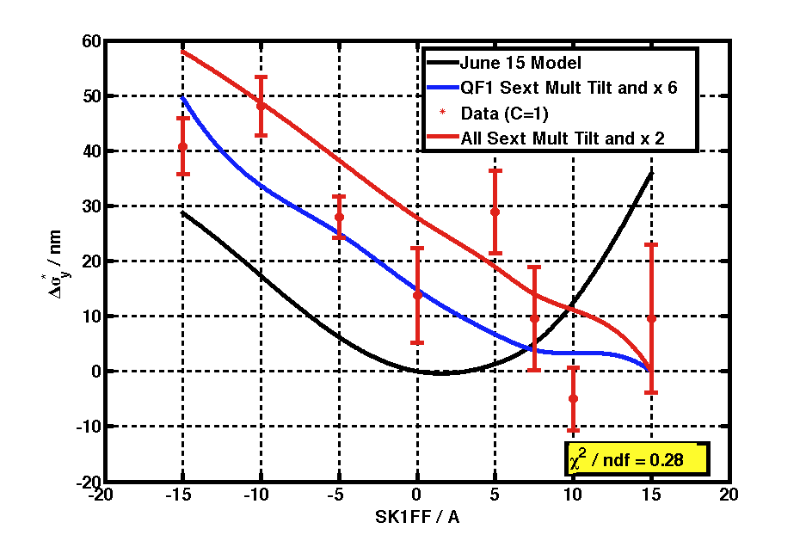
June Data
Can model trend in data by either introducing increased skew-sextupole component in just QF1FF as before, or for all multipoles at a smaller rate of increase.
Fit gave C value of unity here.
Again, errors seem artificially high for the given fit.
This could be a fake effect, e.g. from the variance in the spread of repeated data points for different SK1FF currents.

Slide 10
Conclusions
June data gives most statistically significant information.
Rules out expected model as a good description of SK1FF scan data.
Data trend can be modelled with an increase in skew-sextupole multipole strengths.
Either uniquely in QF1FF or distributed throughout FFS.
Spread in data points yields errors for this analysis which seem artificially high. Need more reproducibility in IPBSM measurements to draw firmer conclusions.

