Slide 1
Status of IPBSM Improvement
N. Terunuma, KEK
2012/July/13 ATF2 Weekly Meeting

Slide 2
Present Status
Design of the new layout has been done.
Items for the laser handling have been ordered and they will be delivered soon. Some of items will be prepared on a case by case basis but no critical item remains.
  Base plates and mounts for items (ordered, 2 weeks for delivery)
  Movers (delivered)
  Optical holders and supports (delivered)
  Lens and Prisms (use present one at first) … for improvement (ordered, mid of August for delivery)
Schedule
July 23 ~ August … assemble the new layout, alignment
~ September ~ … checkout of the system
October 15~ … beam test; laser wire etc.

Slide 3
New Base Plates
Mount each devices that should be move together to adjust the relative position to IPBPM; i.e., electron beam.
Explicitly define the laser path by reference lines.

Slide 4
Relative Alignment
- BSM and IP(BPM) -
For a beam, the reference to the IP is the center of IP-BPM.
IP-BPM is mounted in the vacuum chamber and it may be near the center of chamber.
The alignment of a chamber on the vertical table is not well defined because we can not copy the BPM center on the chamber surface.
Therefore we have to align the BSM toward the IP(-BPM) by directory checking IP by lasers.
This relative alignment will be fixed by future upgrade of IP chamber with new BPMs.

Slide 5
Laser Alignment to IP
Target at IP
Adjust a laser path as designed on the vertical table.
Define the IP by putting a target on the alignment guide of the IPBPM.
A laser hits the target then find the displacement.
Adjust the base-plate position to minimize the displacement.
Lasers will be guided to IP within 1 mm or less.
A sheet target can be used in the alignment of two lasers for 174 degree mode.

Slide 6
Focal lens positioning
The initial positioning of the focal lens will be done by a mechanical reference.
A spot size measurement at about 10cm from IP should be done as a cross check.
A 10x laser expander will be used to enlarge the spot of the alignment laser.
Finally positioning the lens will be tuned by the IP screen and also by an electron beam.
Focal lens on the mover
Target at IP

Slide 7
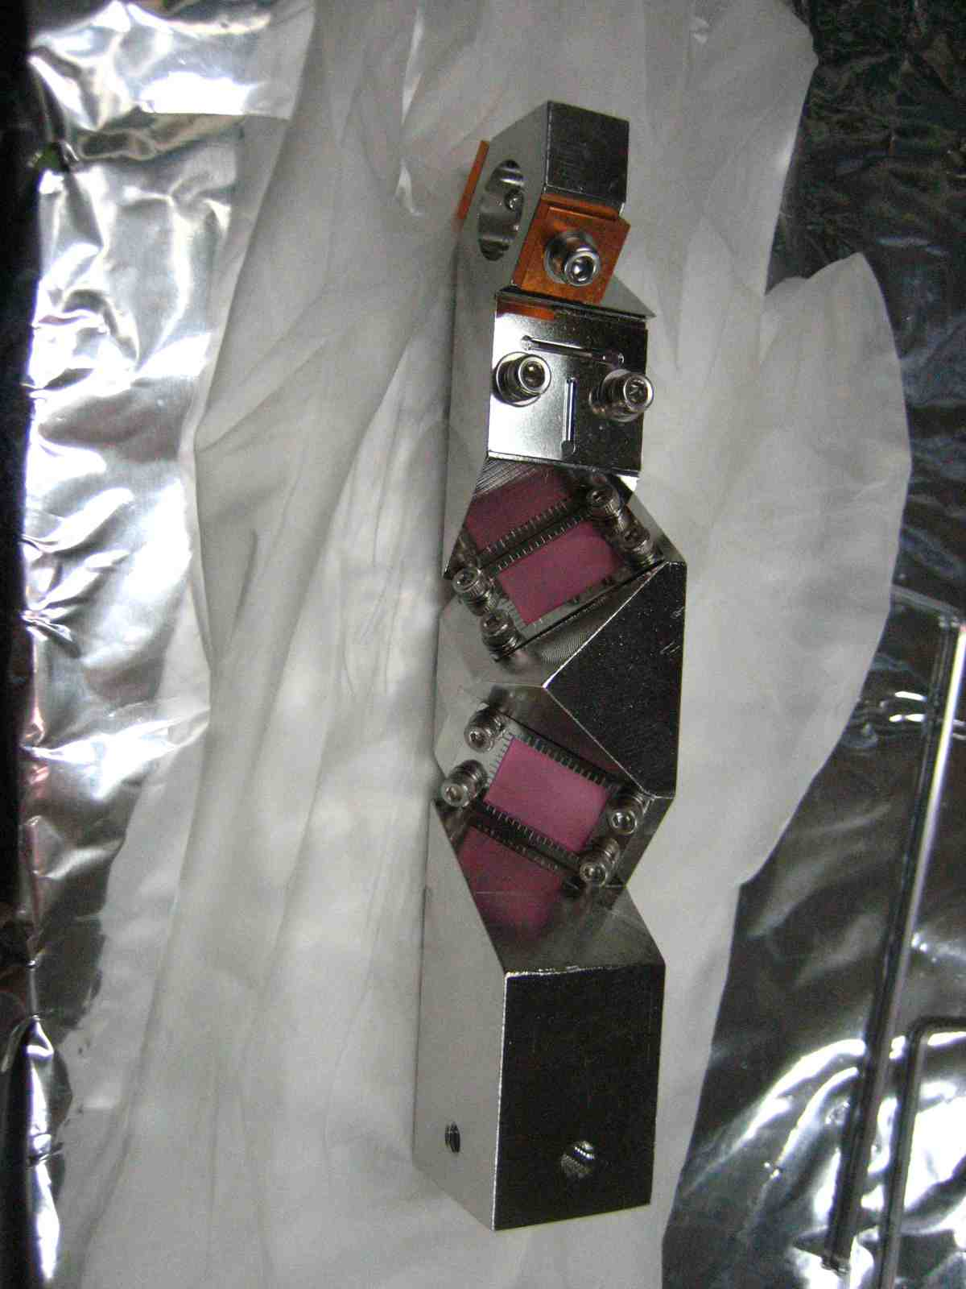
IP Screen Alignment
  Is the IP screen on the IP?
  It may be near but not sure.
  Beam and laser are aligned on the screen surface. Is the crossing point same for all mode?
  On the screen for 2-30, we could overlap the beam and 2-30 lasers but could not for 174 lasers. It seems that it is limited by design. Modified?
  Use a dedicated screen for 174, then the Z-position of a screen surface may be different. Therefore a crossing position of a beam and lasers may not be same as that of 2-30’s.
  Can we go around these angles during the beam tuning?
  At lease one of the 174 laser should be seen on the screen for 2-30.
  Check the dimensions

Slide 8
Upgrade Examples
Prism on a Mover for 2-8 selection
1.5 inch → 2.0 inch
Increase acceptance for 8-degree and for future upgrade

Slide 9
Upgrade Examples
Delay line for fringe phase control
Old: Use two prisms and a laser passes one of them (BK7 crystal).
  laser intensity ~20% loss
  Divergence will be increased
  Two lasers at IP has different intensity and spot size
New:
All mirror delay line
  No difference between two lasers at IP

Slide 10
Assembling Steps
Setup the laser injection line
Tune the 30-degree mode up to the focal lens
Tune the 174-degree mode up to the focal lens
Tune the 2-8-degree mode up to the focal lens when the prism mover is available
Setup the delay unit when available
Tune all mode to IP and adjust base plate positions
Adjust the IP screen
Setup and calibrate the laser detector; position, power and profile
Checkout; long-term stability of the system etc.

