Slide 1
IP Multiknob Generation and Performance for ATF2
Glen White, SLAC
July 20, 2012

Slide 2
Identification of Required Multiknobs
Add all possible error sources to model of ATF2 lattice
Run tracking-based simulation of initial tune-up procedures (steering, BBA, dispersion/coupling correction etc)
See earlier talks
Calculate beam aberrations present at IP
Generate multiknobs to remove aberrations, and apply with realistic errors etc
Evaluate tuning performance, review multiknob selection and iterate

Slide 3
Identified Required Multiknobs from Simulations
See earlier talks for details
Dominant aberrations that simulations identified as requiring correction to reach <40nm IP vertical beam size:
<x’y>
Vertical Dispersion
Vertical Waist Offset
T322
T326
Also want to keep IP horizontal beam size under control if possible, so include following aberrations in multipole set:
Horizontal Waist Offset
Horizontal Dispersion
Total of 7 aberrations to control
Ignore η’ knob at IP as it is not strongly introduced by the other knobs, does not contribute to IP beam size and is better controlled by other dispersion correction system.

Slide 4
Generation of Multiknobs
Calculate linear response of desired set of aberrations at IP to desired set of potential knob coefficients from particle tracking.
Form linear response matrix equation:
M.K = A
K = vector of knob coefficients
A = vector of IP aberration gradients
M = response matrix
Use Matlab “lscov” function to solve linear least-squares problem:
(A-M.K)’.diag(W).(A-M.K)
Use weight vector W to control solution to give approximately orthonormal knobs.

Slide 5
Choice of Multiknob Coefficients
Options for coefficients:
x/y moves of the 5 FFS sextupoles
Roll moves of the 5 FFS sextupoles
Do not strongly couple to desired aberrations
Complicates mover solutions
Strength changes of the 5 FFS sextupoles
Do not strongly couple to desired aberrations
Not desirable as requires dynamic re-computation of mover-based knob coefficients for significant changes
Roll/offsets of quads on movers
QD0/QF1 roll useful for IP <x’y> / η
But strongly steers so not so useful when IPBSM in operation
Skew-quads
Already used to correct coupling in EXT, can be used for <xy> term but not desirable
EXT dispersion correction system
Limited resolution, non-local, hard to orthogonally target η and η’ at IP phase.
Preferred solution is to exclusively use x/y moves of FFS sextupoles

Slide 6
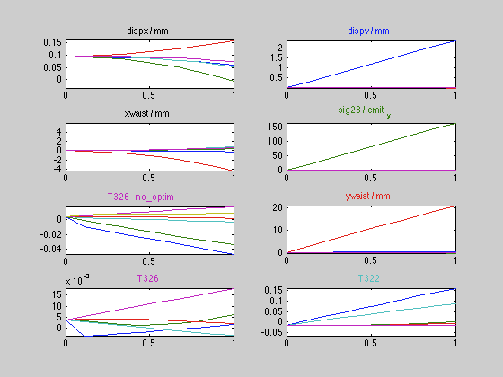
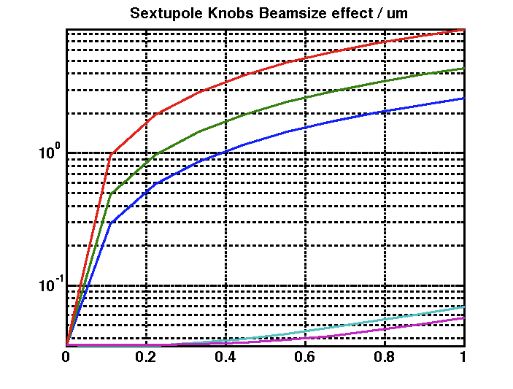
Assess Multiknob Performance BX2.5BY1 Lattice
Scan each multiknob across max range dictated by mover system
Minimise cross-talk between shown aberrations by tuning weighting factors.
Not possible to completely eliminate dispy / T322 / T326 cross-talk
Shown is optimised solution to give best tuning performance
Worst is T322, here implies limit to dispersion correction of ~<0.5mm to be able to correct with T322 knob

Slide 7
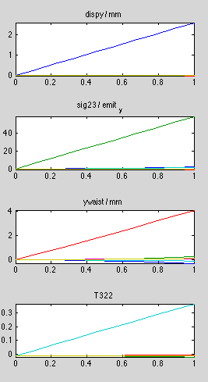

Notes on Second-Order Terms
As seen in previous slide, especially important to design dominant tuning knobs to couple minimally into second-order knobs, otherwise they introduce a magnitude of effect that cannot be mitigated by the second-order correction knobs themselves.
By limiting correction devices to just x/y moves of FFS sextupoles, not possible to do this perfectly. But good enough, just, based on simulation.
Can improve the multiknob set significantly in theory by introducing the rotation of QD0 as one of the knob coefficients.
See corresponding knob tests on the left
This should be considered an upgrade route if we suspect second-order effects are hindering final stage tuning efforts.
Need to spend time making sure beam very well centred on QD0FF magnet and that the mover system commands pure roll when demanded.
Difficulties mainly due to non-linear response of T326 term to vertical sextupole moves.

Slide 8
Notes on BX10BY1 Lattice
The optimised optics solution for this lattice wants to set SF5FF very close to 0 in strength
This restricts the multiknob solution to only use the other 4 sextupoles
BX2.5BY1 uses SF5,SD4,SF1,SD0
BX10BY1 uses SF6,SD4,SF1,SD0
This has the effect of introducing T324 as another dominant aberration, reducing the range of the dispersion correction to only ~200um and reducing the orthogonality with the second-order terms.
From this aspect, it is probably better to use BX2.5BY1 lattice, or re-assess matching of BX10BY1 lattice to enforce larger SF5FF strength.

Slide 9
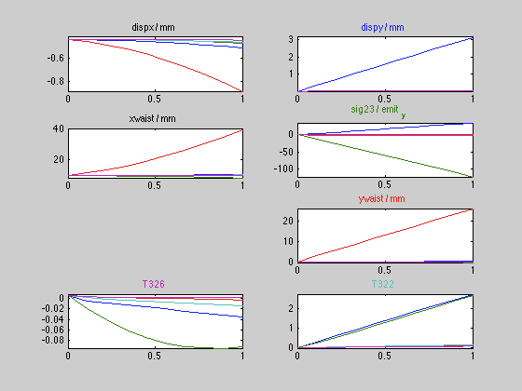
Notes on Currently In-Use Multiknobs
Response of Multiknobs currently programmed into control system (with corresponding lattice)
% Contamination for a given knob from other knobs (degree of non-orthogonality)
Knob | Defined Here | In-Use
η_{y} | 0.1 % | 1 %
<x’y> | 0.2 % | 40.6 %
α_{y} | 2.8 % | 2.1 %
T322 | 184 % | 2432 %
T326 | 21 % | 2411 %
Currently in-use multiknob definitions have orthogonality 1-2 orders of magnitude worse than optimal.
Second-order terms are especially bad.
SK1FF also strongly generates T322 & T326- could be that current multiknobs have generated a lot of this term, which would explain why SK1FF wants to be ran at higher than expected current. Can test this theory by switching multiknobs

Slide 10
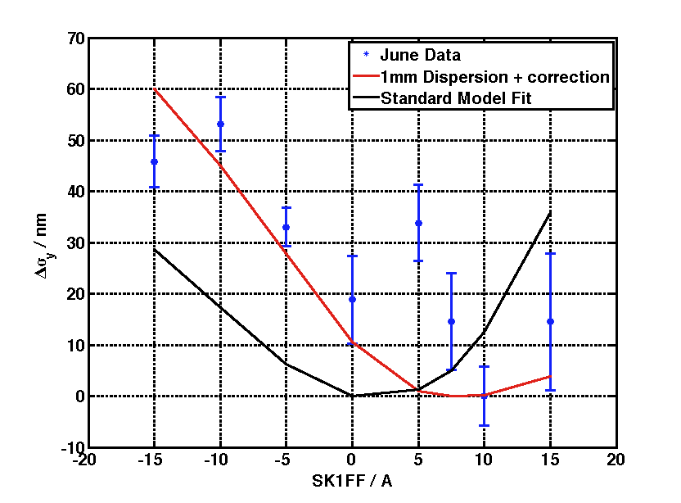
Simulation of SK1FF Scan with 1mm IP Dispersion + Correction
Simulation of ATF2 with June parameters (as for last week’s analysis)
Add 1mm of dispersion at IP phase to model.
Correct with dispersion multiknob.
Scan SK1FF
Much better fit than with no dispersion multiknob present.
SK1FF generates T322, T326 and T366 terms at IP.
This corrects for some of the detrimental effect of the multiknob, but not all (about 10nm out of 60nm)

Slide 11
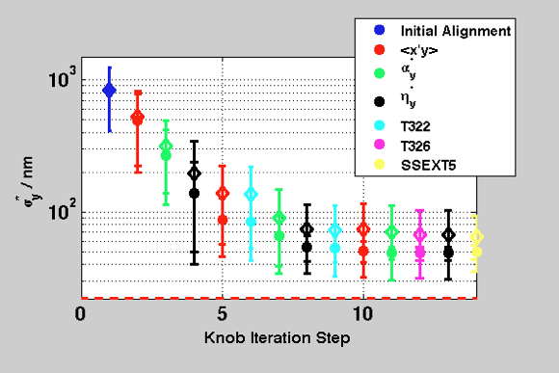
Multiknob Tuning Comparison
For old study of BX2.5BY1 lattice.
Comparison of tuning simulation tuned multiknobs vs. in-use at time multiknobs.
Clear difference seen when tuning <100nm region.
Simulations have optimistic starting conditions (e.g. dispersion and coupling).
Difference will be more pronounced with larger initial aberrations due to more cross-talk to second-order terms.
Important to test expected tuning performance of multiknobs before put to use
Will repeat above study for current optional multiknob configurations

Slide 12
Conclusions/Recommendations
Build orthogonal knobs, designed to remove calculated aberrations based on errors introduced into lattice and tuning simulations.
Using x/y FFS sextupole moves works, just, in simulation.
Emphasis on good orthogonality design and control of expected second-order terms shown to be critical in <100nm tuning regime.
Can be improved by implementation of QD0 roll with some additional alignment/control work.
Some problems identified with BX10BY1 lattice, suggest using BX2.5BY1 lattice or re-assess BX10BY1 matching.
Existing multiknob definitions seem to have some serious problems
Non-optimal orthogonality in <x’y>, T322 and T326 knobs
Blow-up of T322 and T326 terms by <x’y> and Disp_y knobs could account for some or all of the currently observed limits in spot-size tuning
Model of SK1FF scan with dispersion knob set at ~1mm describes observed behaviour based on SK1FF coupling to T322 and T326 terms introduced by the mutiknob.
Switch multiknob definitions to use optimised knobs which don’t have the above problems?
At least check optimised knobs vs. current with SK1FF scan in future beam tests…?

