Slide 1
Status of IPBSM Improvement
N. Terunuma, KEK
2012/Aug/24 ATF2 Weekly Meeting

Slide 2
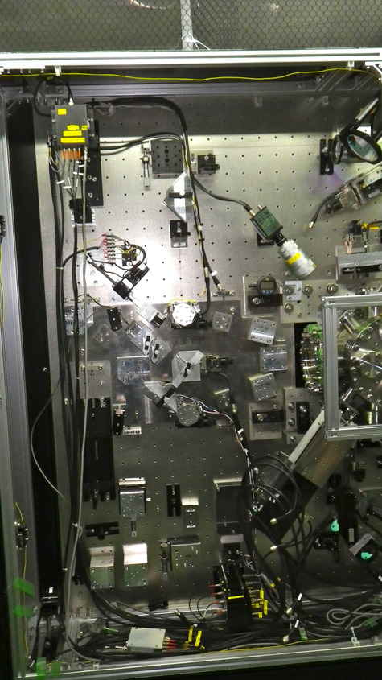
Aug. 6 … Cleanup the previous IPBSM optics on the vertical table.

Slide 3
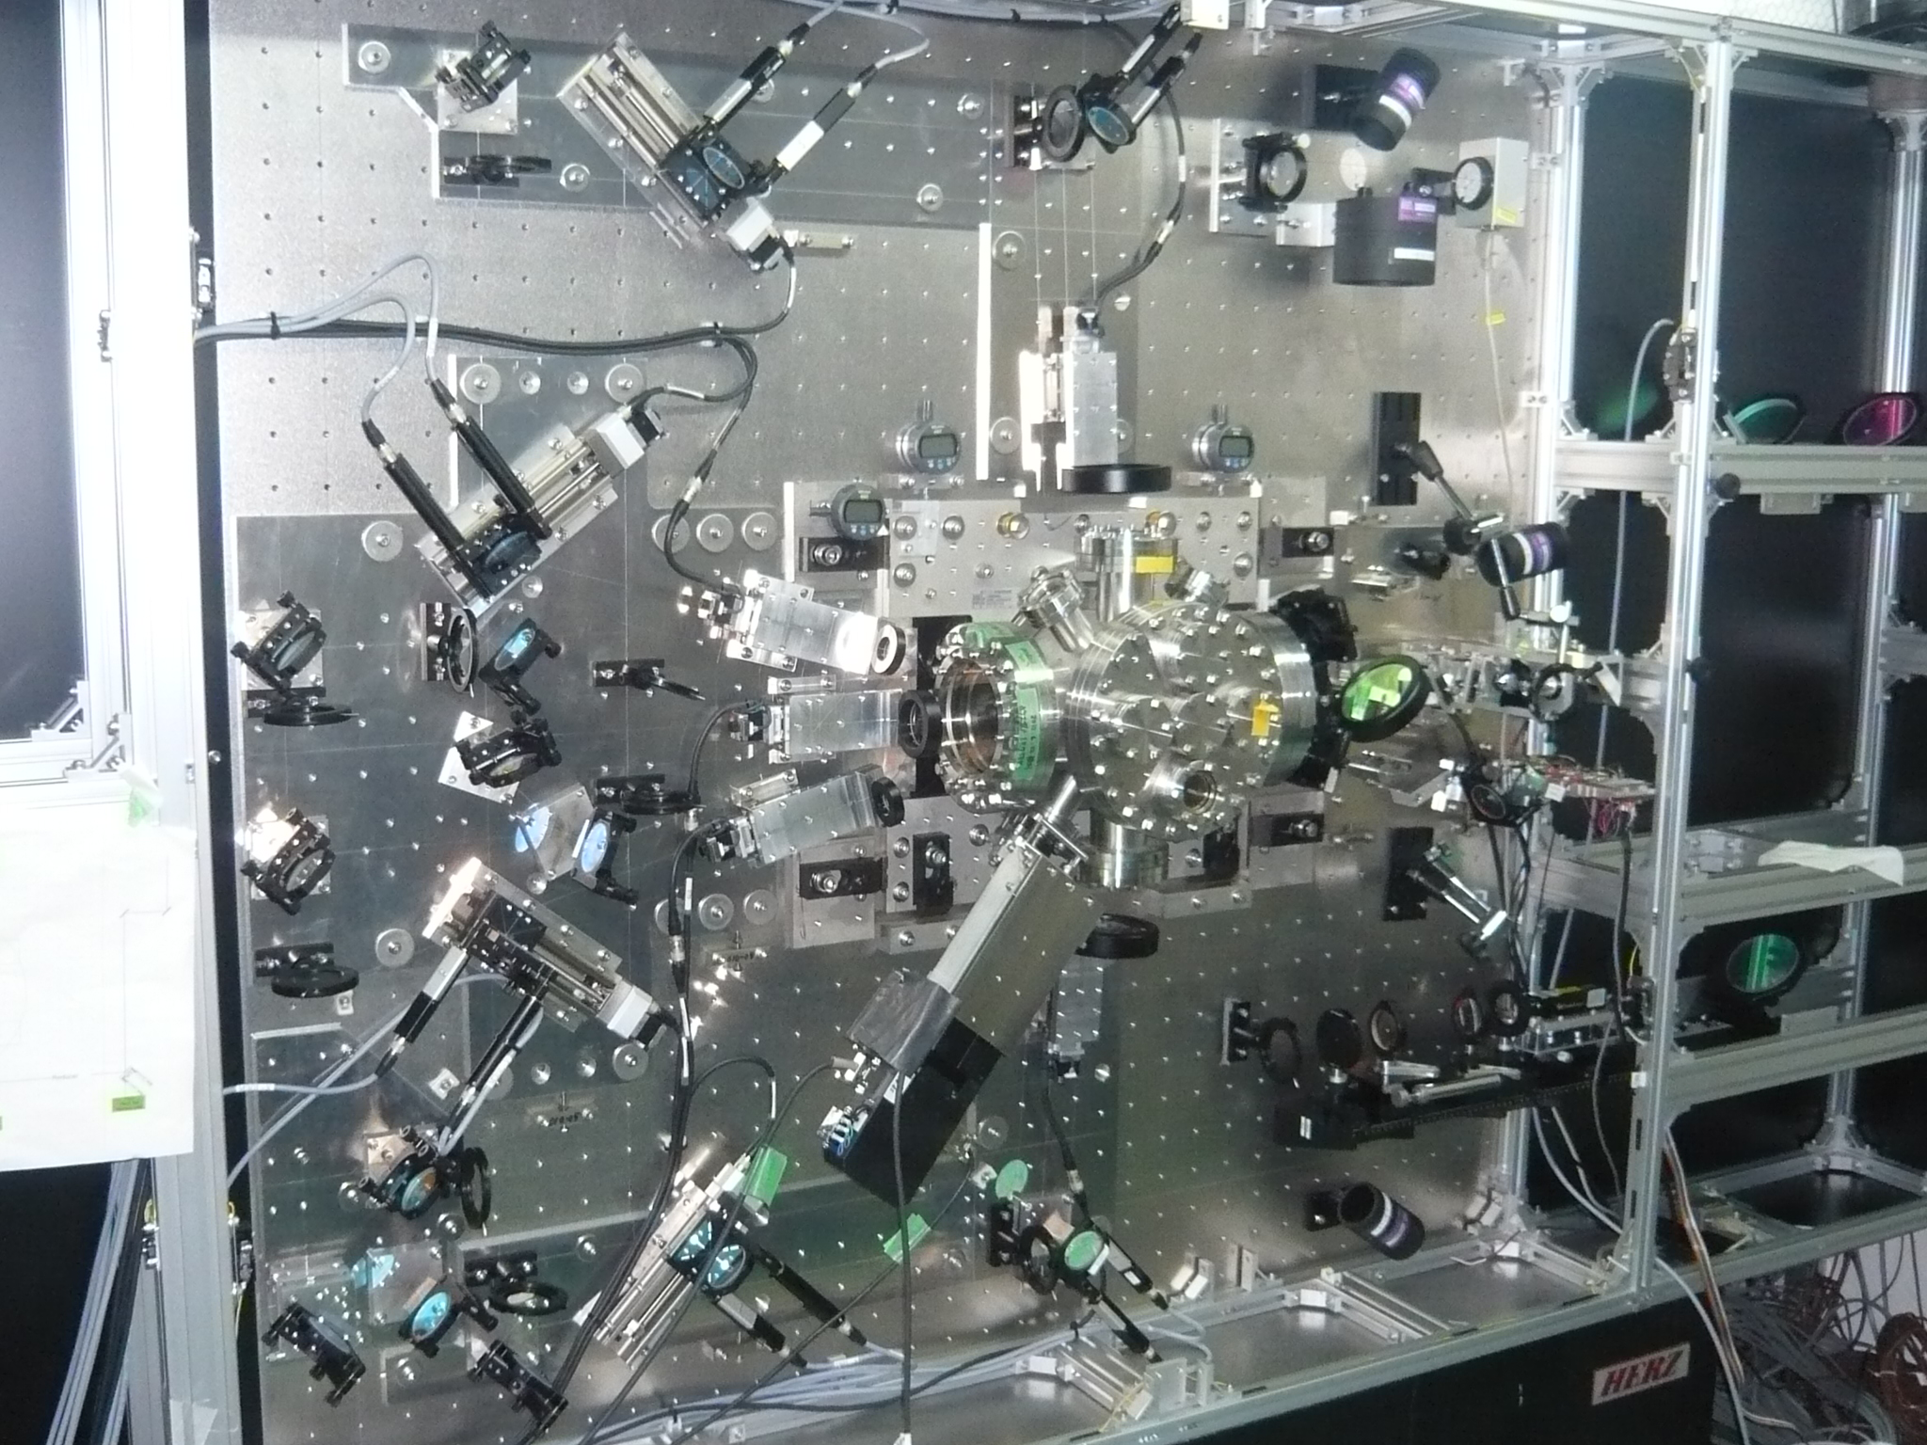
Installation of the new IPBSM system is under way.
2012/Aug/23 N.Terunuma

Slide 4
Installation Status
Basic remote control has been established via EPICS
All mirror stages for the crossing mode control
All mirror actuators for the angle control
Following parts will be available and installed soon.
Piezo delay line for the fringe phase scan
2 inch Prism for 2~8 degree angle control
Alignment target at IP
Alignment laser was installed on the vertical table.
Laser handling for 2~8 degree mode was confirmed up to the prism area.
Laser handling both 30 and 174 degree modes were confirmed up to IP.

Slide 5
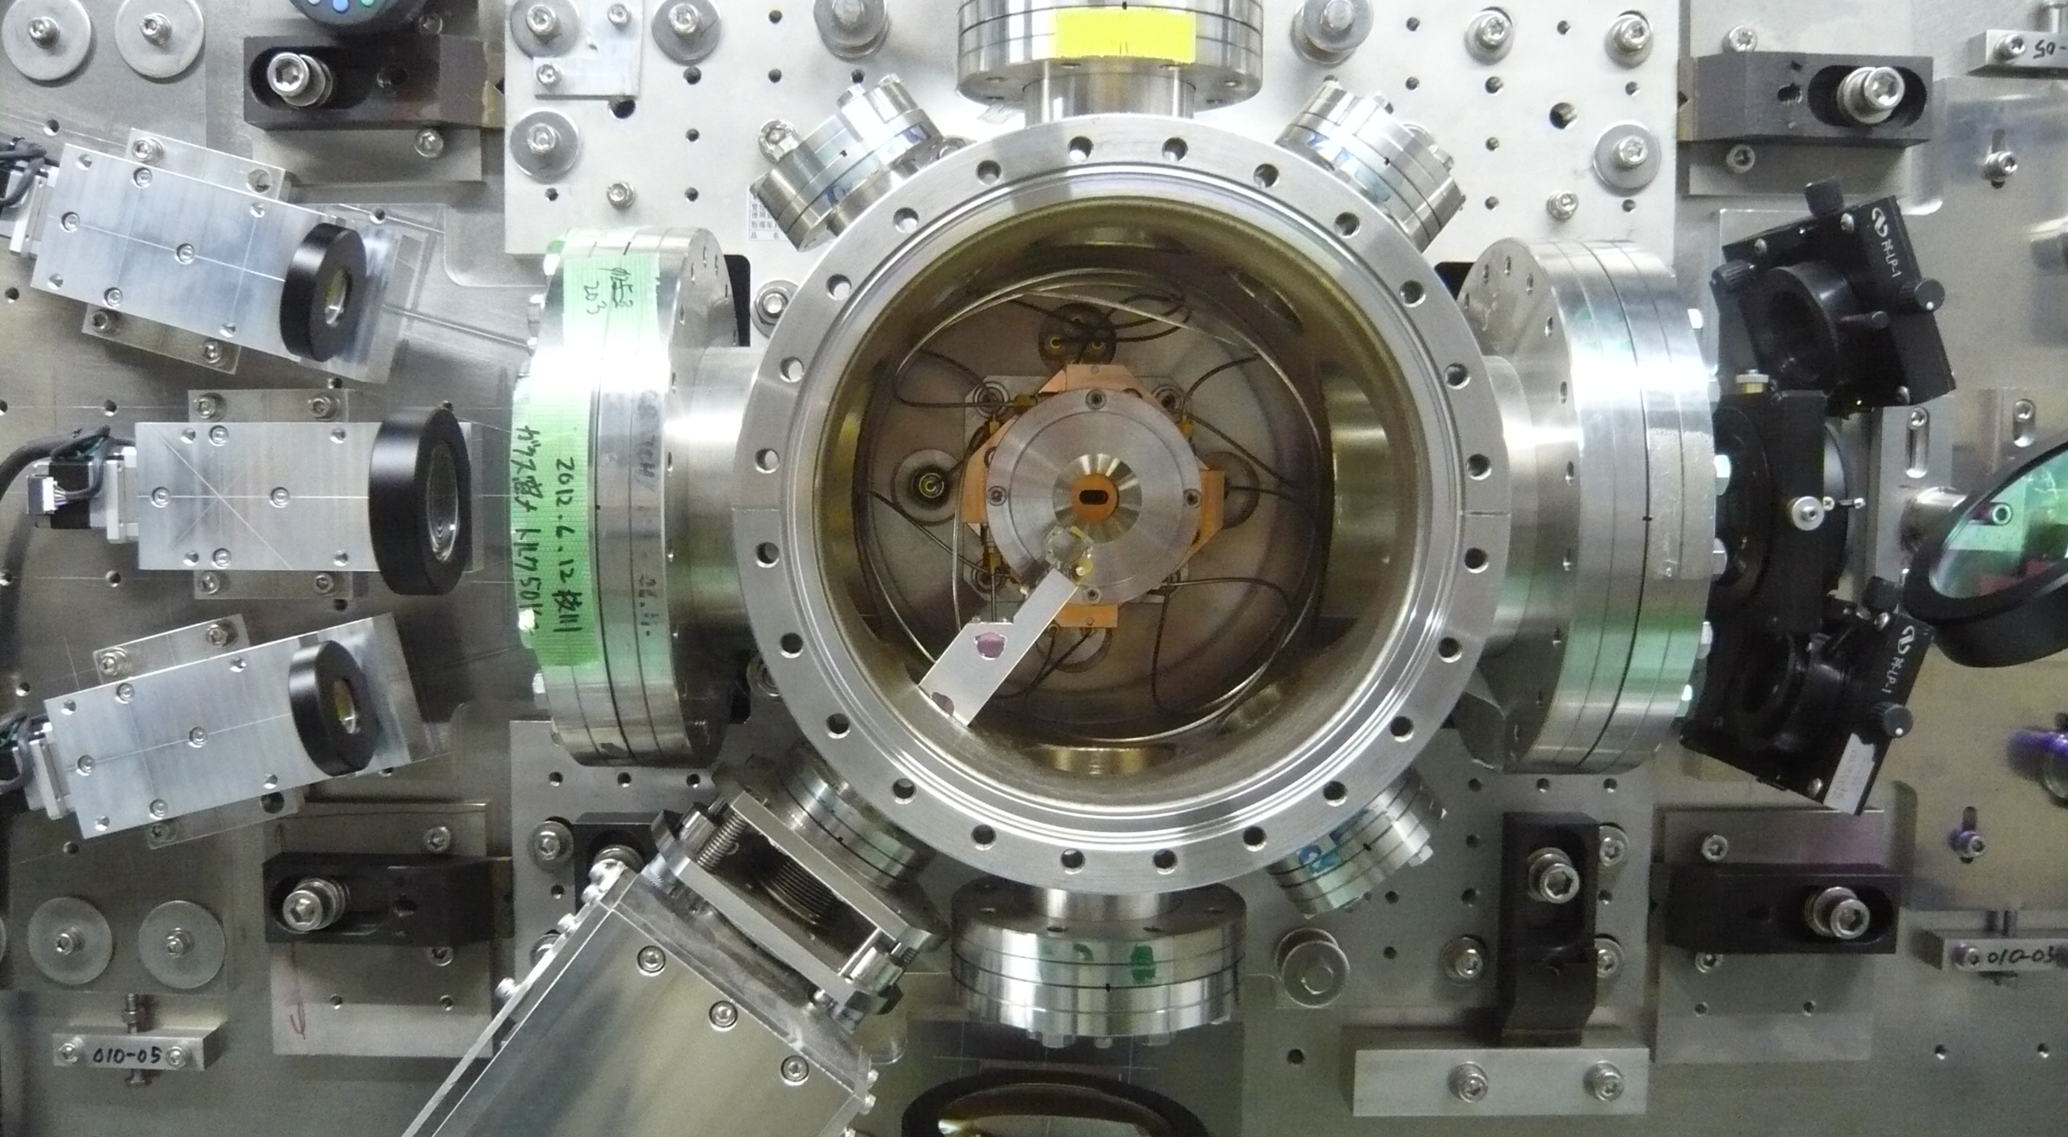
IP devices; 2012/Aug/23

Slide 6
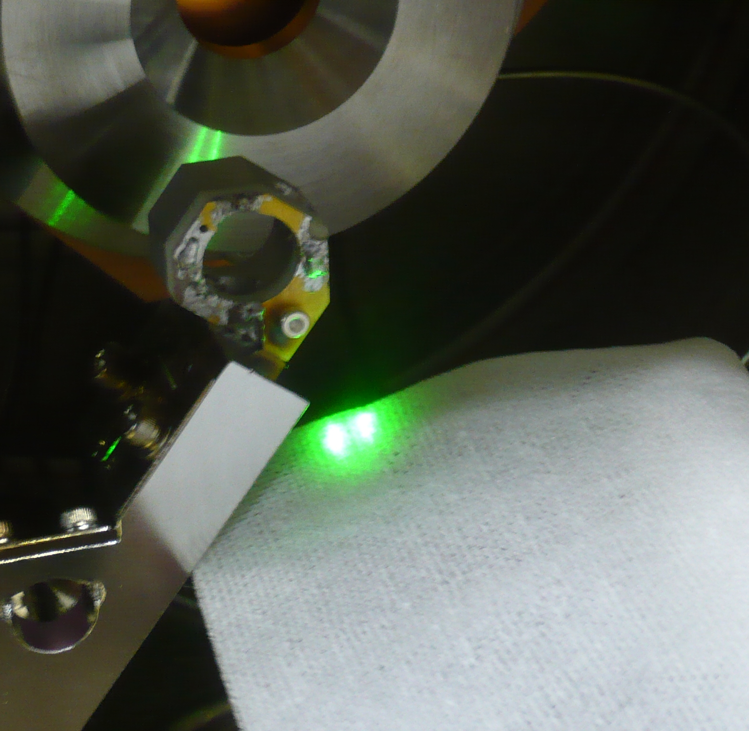
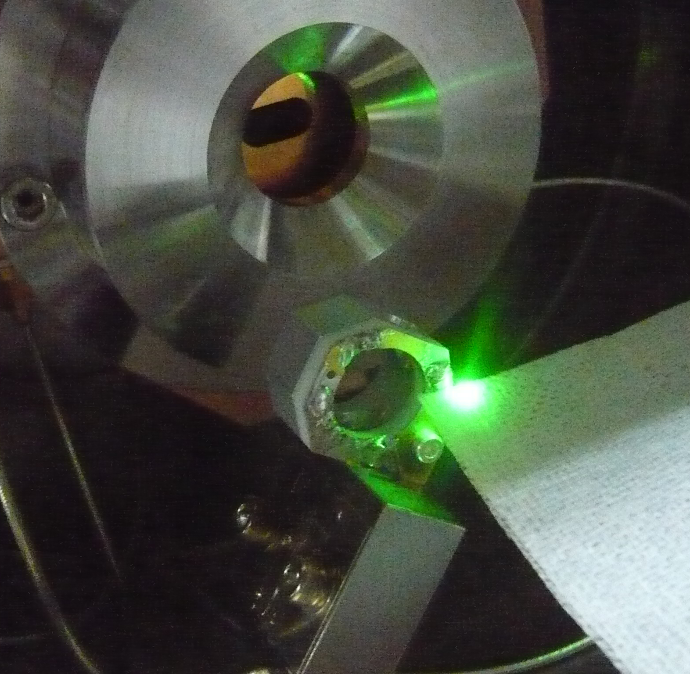
174 degree lasers and IP screen/wire
Two lasers; incoming and outgoing. IP screen is at lowest OFF position.
Near the IP target; Lasers are very close to the target. It has to be modified.

Slide 7
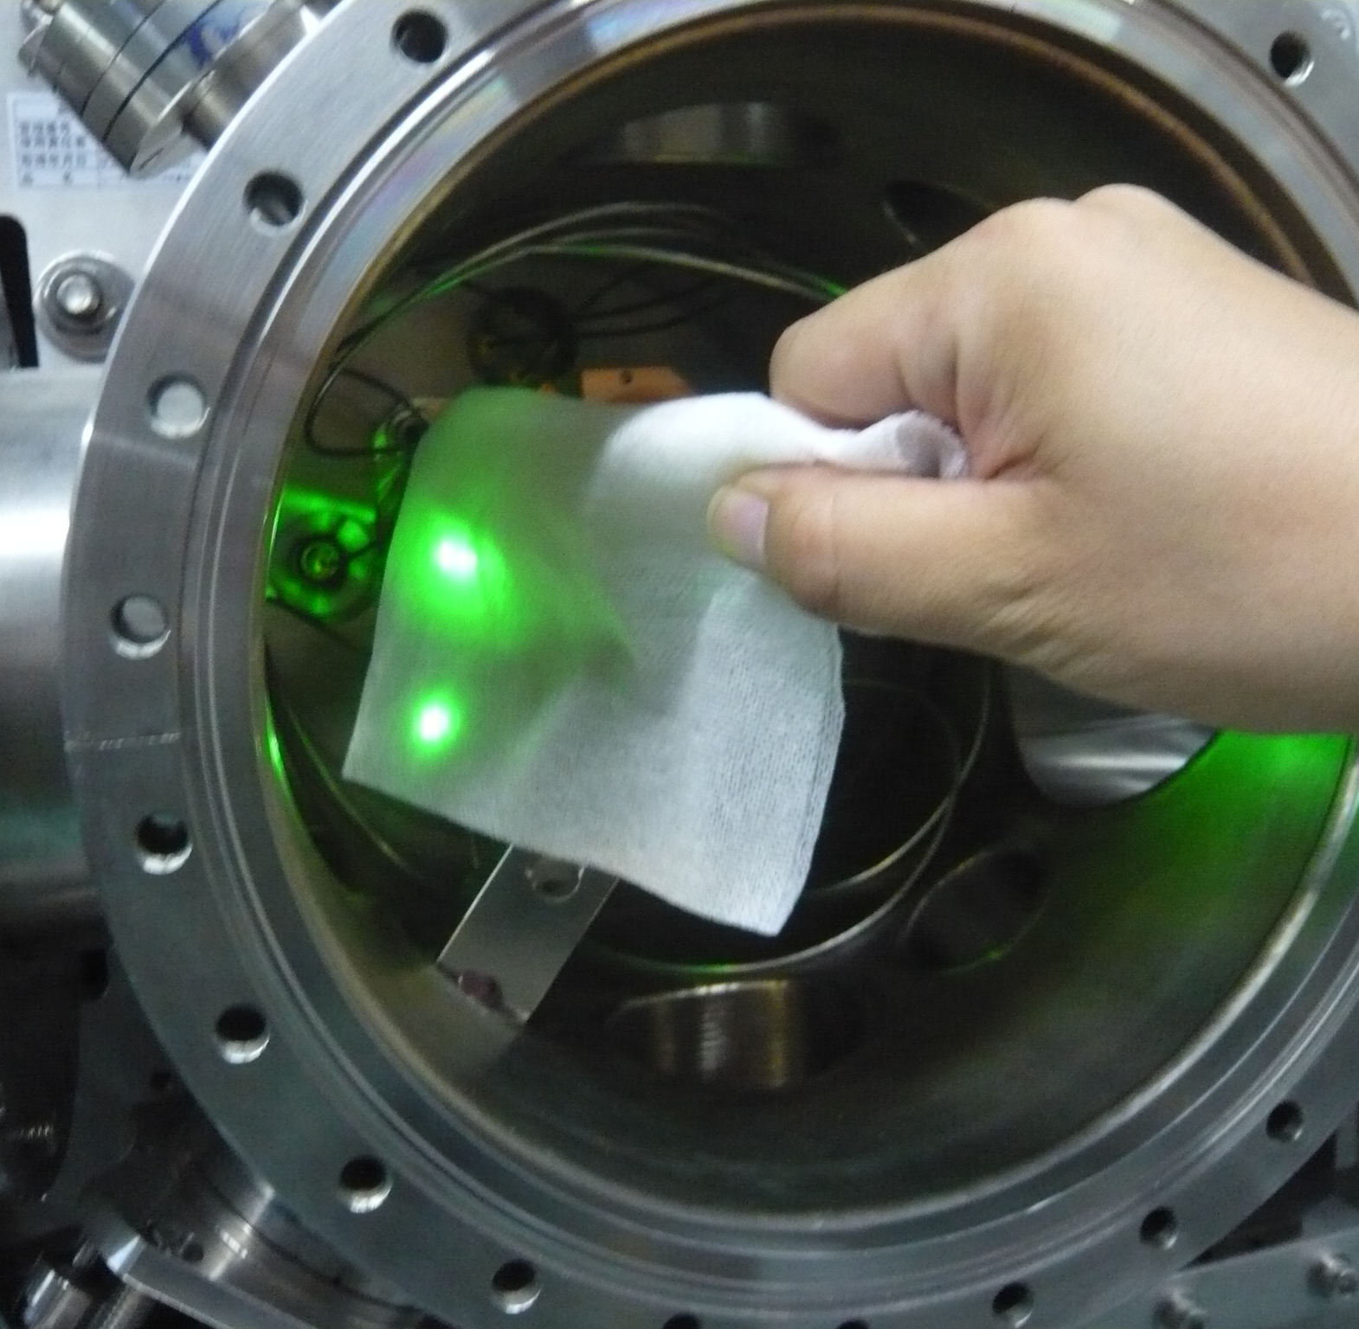
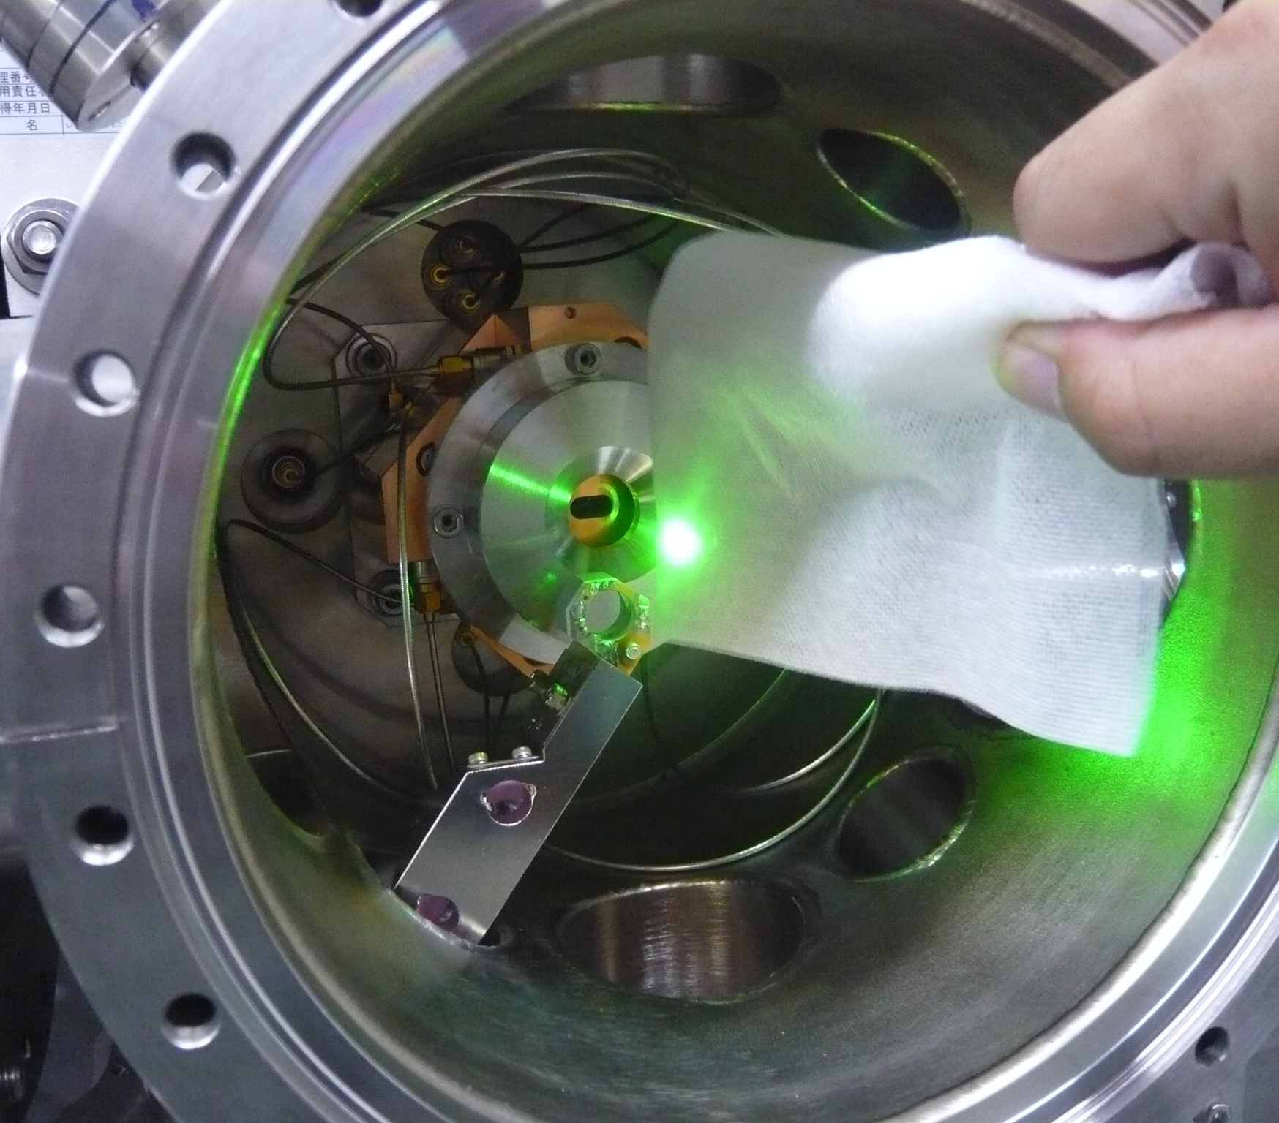
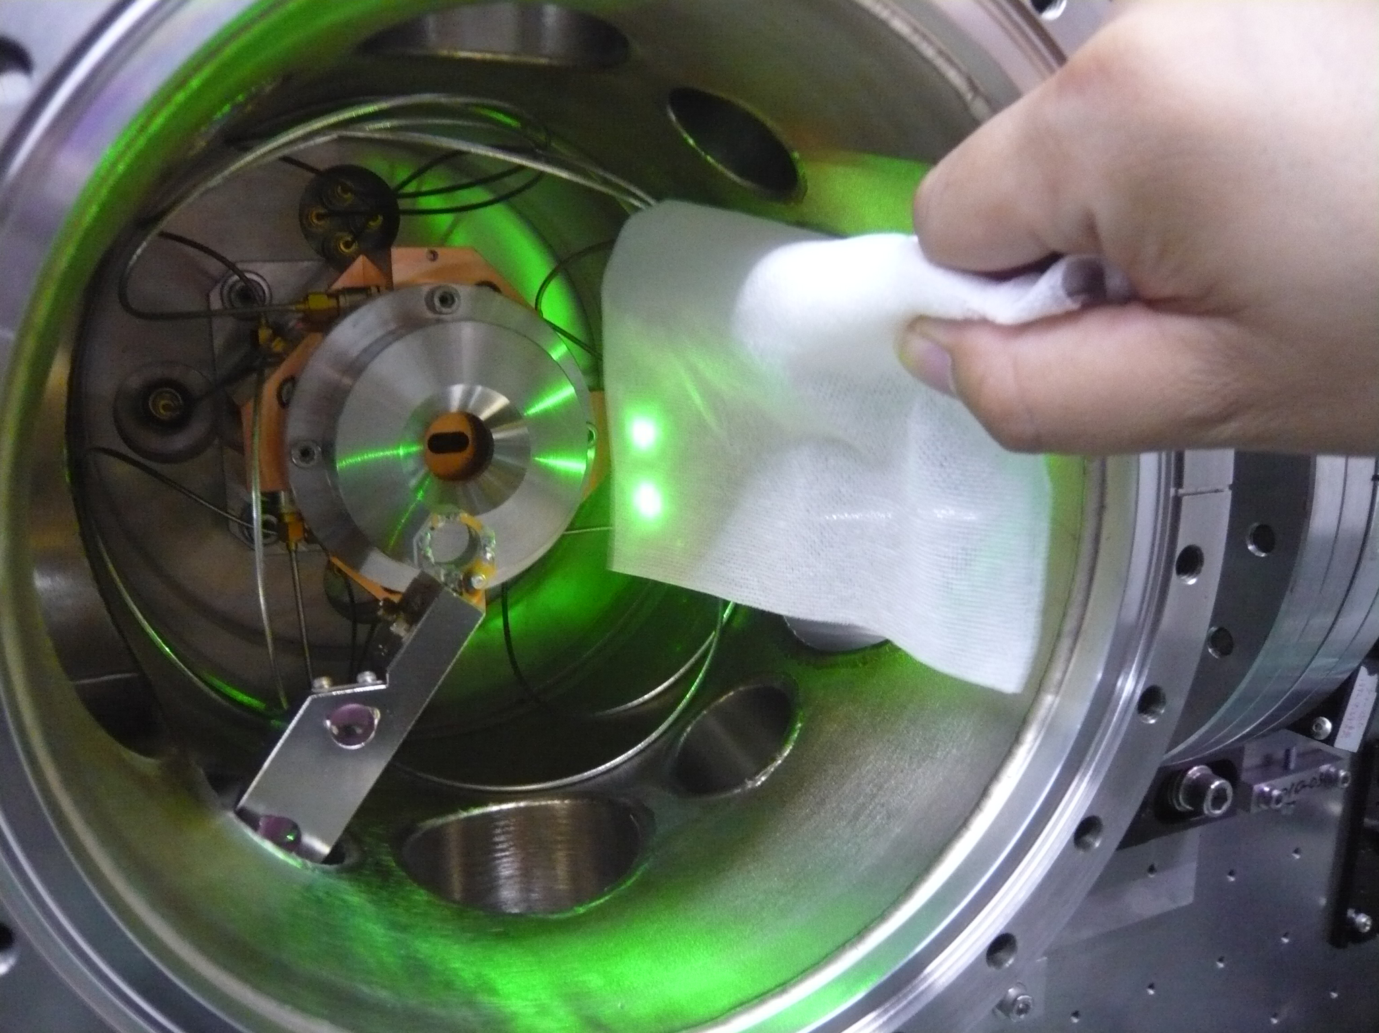
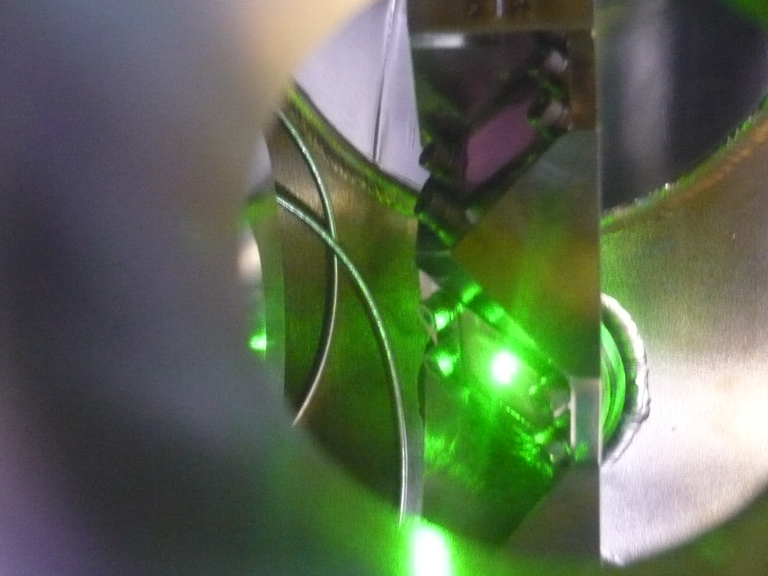
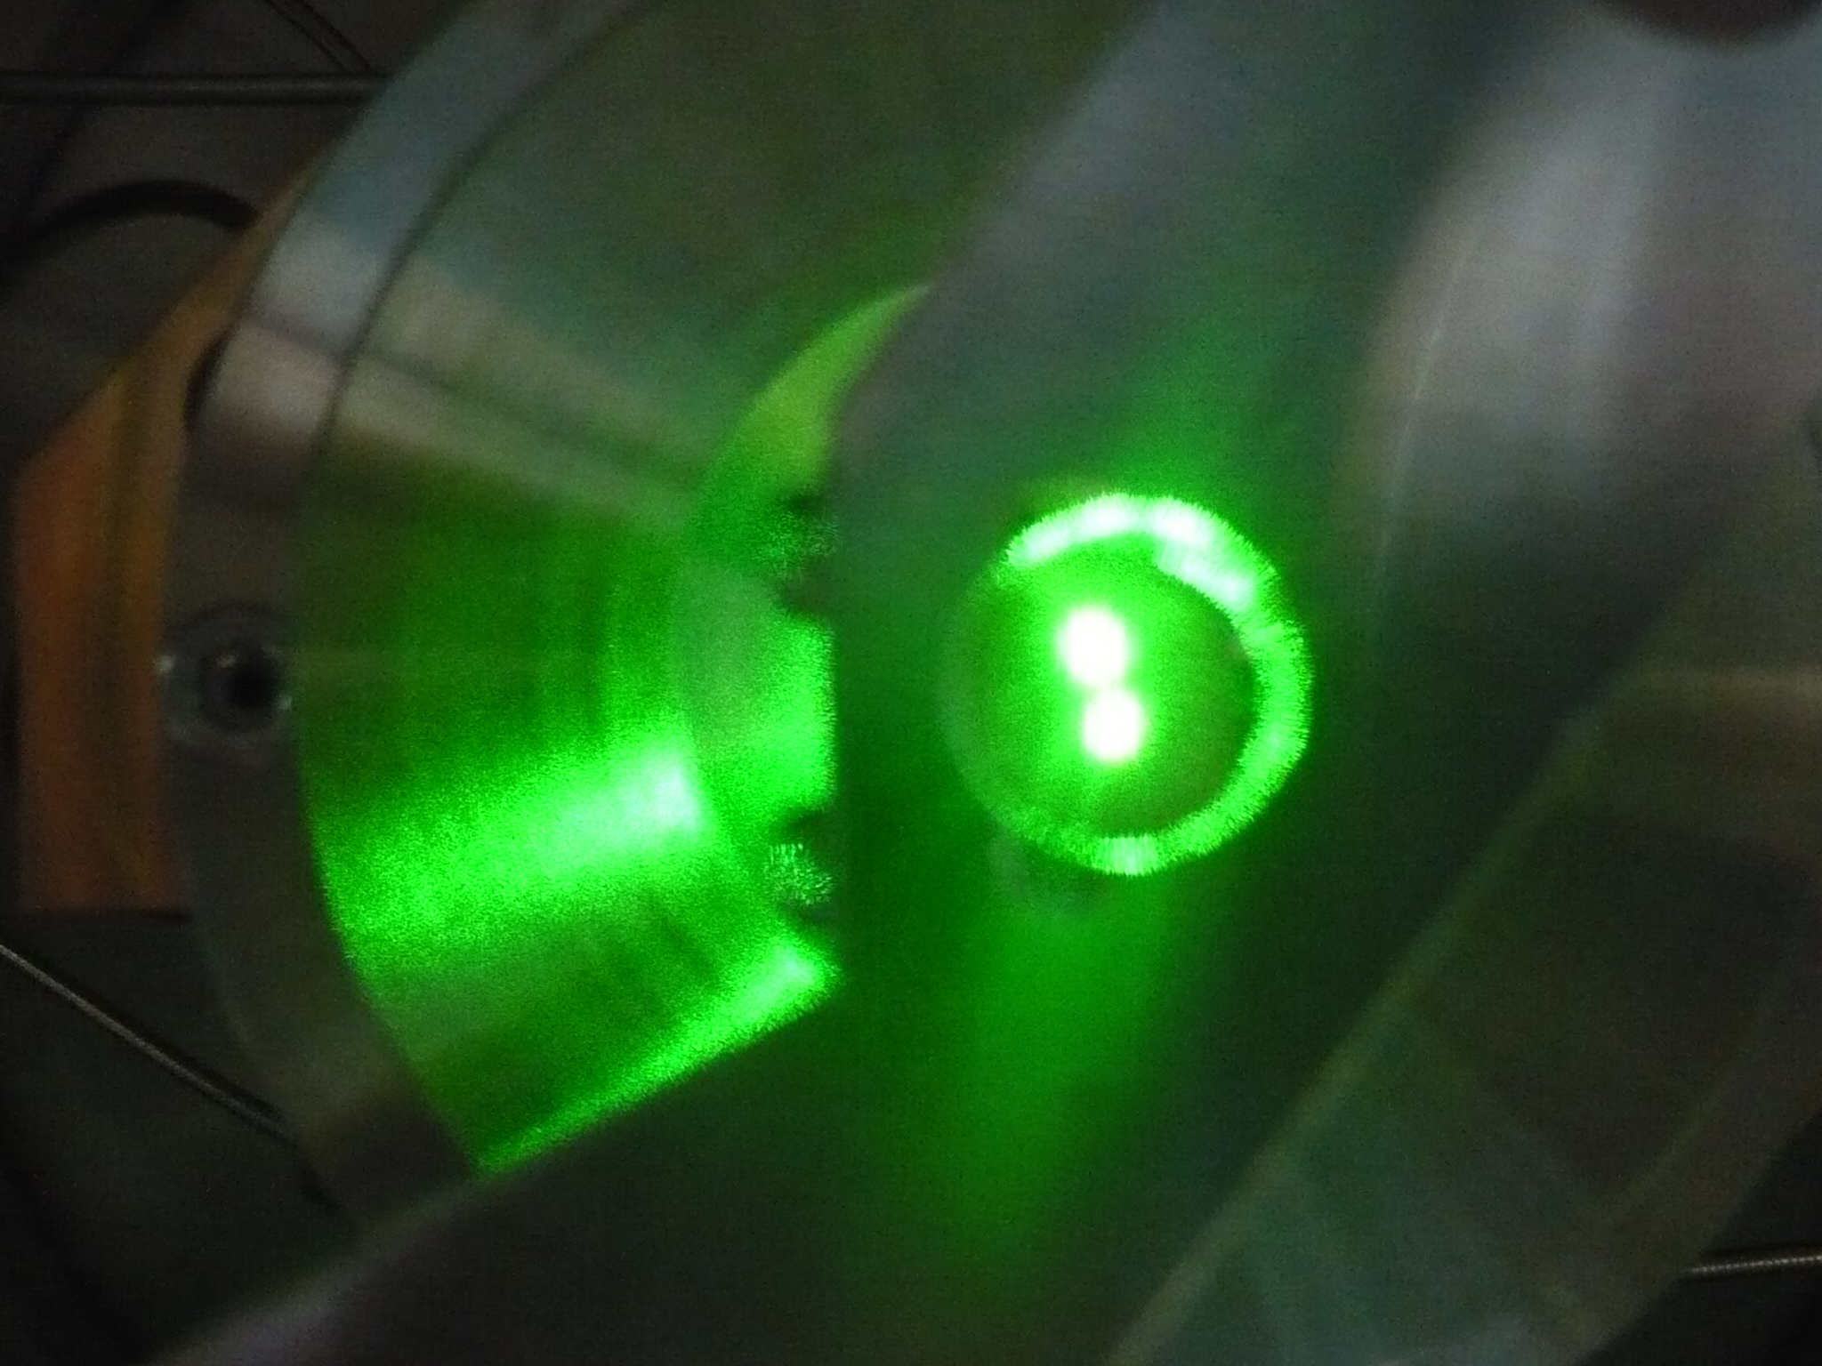
30 degree mode
IP screen for 2~8
and 30 mode
- Front view -
IP screen for 2~8 and 30 mode
Back view –
Laser was displaced

Slide 8
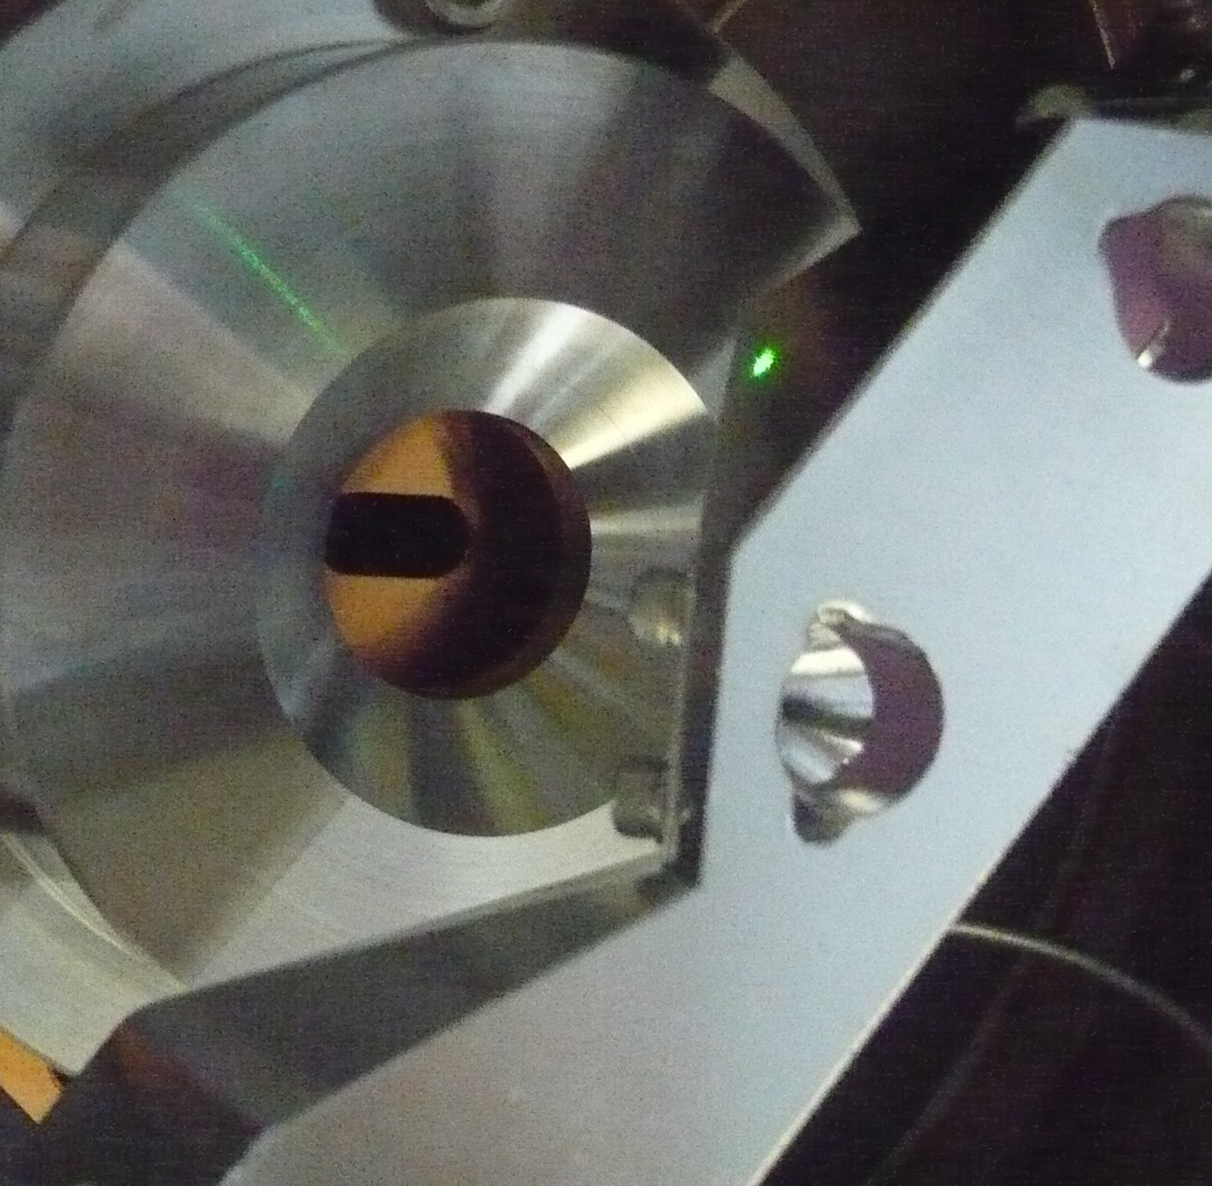
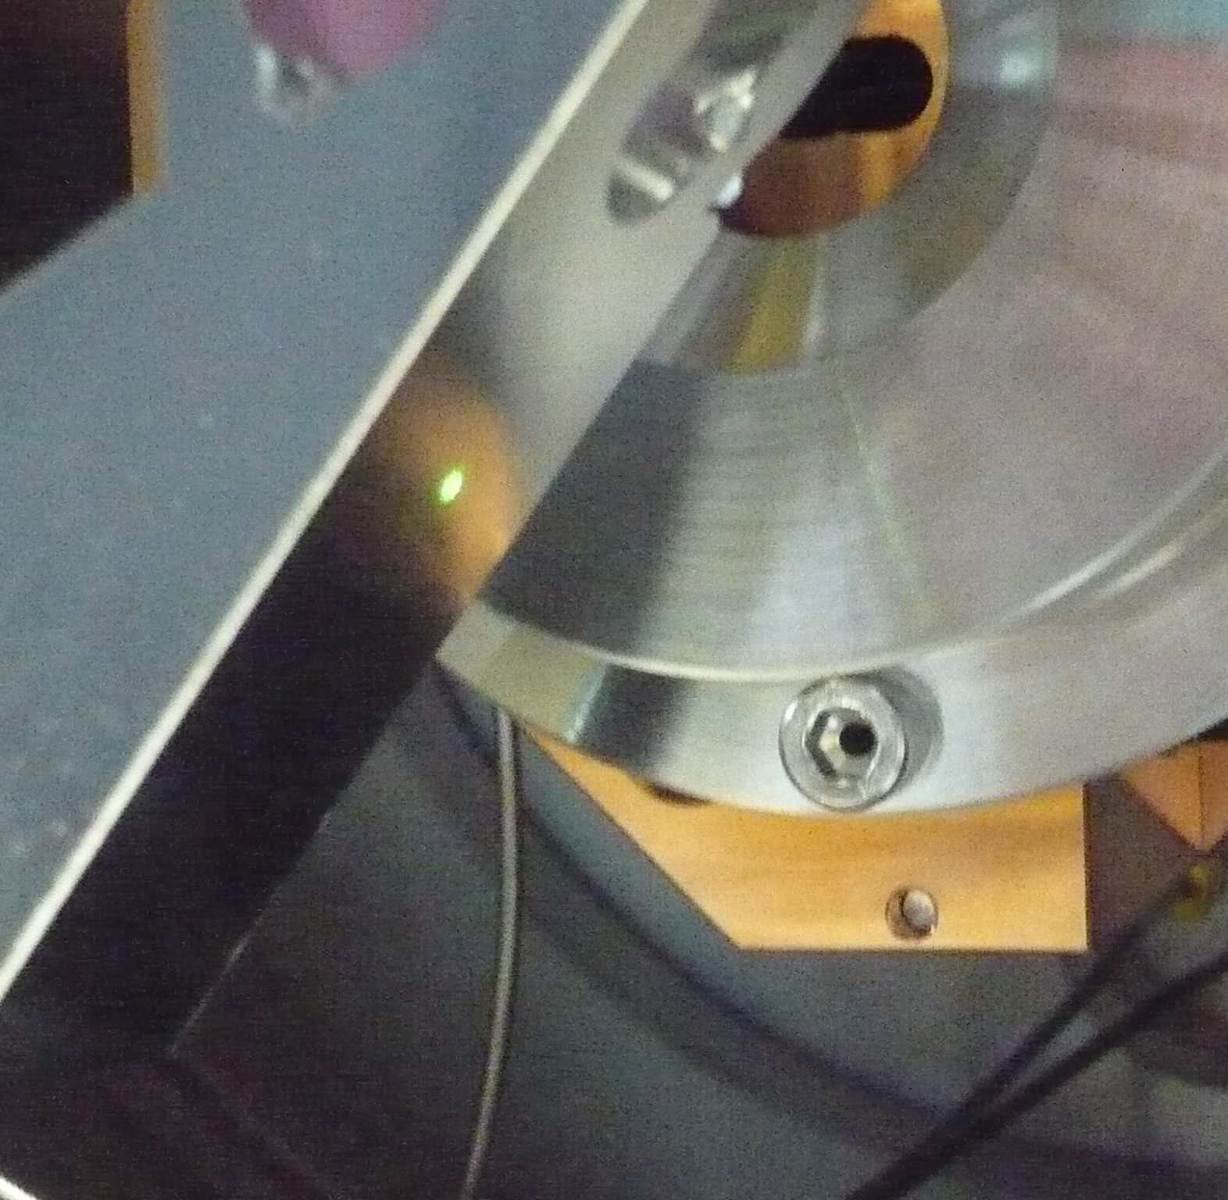
2~30 screen and 174 laser
174 upper laser
Screen is parallel to the laser. No way to detect.
174 lower laser

Slide 9
Summary
Installation of the new laser control is ongoing as planned.
Remaining parts will be installed in a few weeks.
New IP screen have to be prepared
increase the margin for 174 control
lasers for each crossing mode have to be detected on the same screen

Slide 10
Additions

Slide 11
Laser Alignment to IP
Target at IP
Adjust a laser path as designed on the vertical table.
Define the IP by putting a target on the alignment guide of the IPBPM.
A laser hits the target then find the displacement.
Adjust the base-plate position to minimize the displacement.
Lasers will be guided to IP within 1 mm or less.
A sheet target can be used in the alignment of two lasers for 174 degree mode.

Slide 12
Focal lens positioning
The initial positioning of the focal lens will be done by a mechanical reference.
A spot size measurement at about 10cm from IP should be done as a cross check.
A 10x laser expander will be used to enlarge the spot of the alignment laser.
Finally positioning the lens will be tuned by the IP screen and also by an electron beam.
Focal lens on the mover
Target at IP

