Slide 1
Low-Q IP-BPM Schedule
Siwon Jang
KNU

Slide 2
IP-BPM Schedule
IP BPM schedule
  Reference cavity (middle of October)
    Frequency tuning parts
  Electronics (middle of October)
    Phase shifter program, fabrication
  Beam test at November
    Purpose: To check total system of IP-BPM at end of Linac of ATF2
    Test list: reference cavity sensitivity test, electronics test with phase shifter, etc.

Slide 3
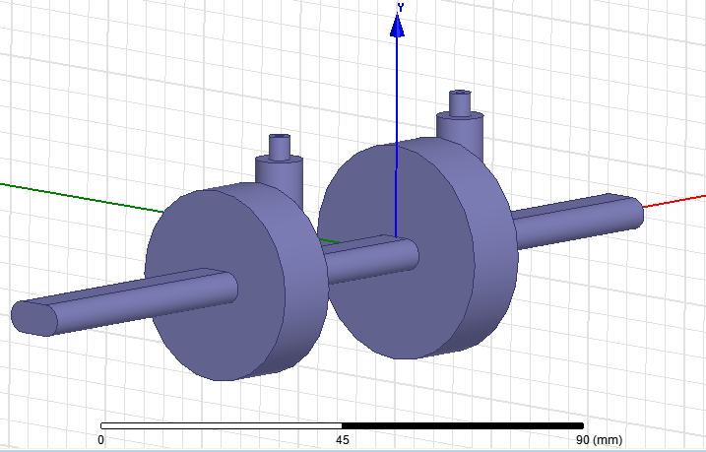
Fabrication of Ref. cavity BPM
The fabrication of Ref. cavity will be finished at middle of October.
Ref. cavity BPM
Y Ref. cavity
 | f₀ (GHz) | R (mm) | Length
X-port | 5.712 | 20.52 | 12 mm
Y-port | 6.426 | 18.28 | 12 mm
L
R
R
L
X Ref. cavity

Slide 4
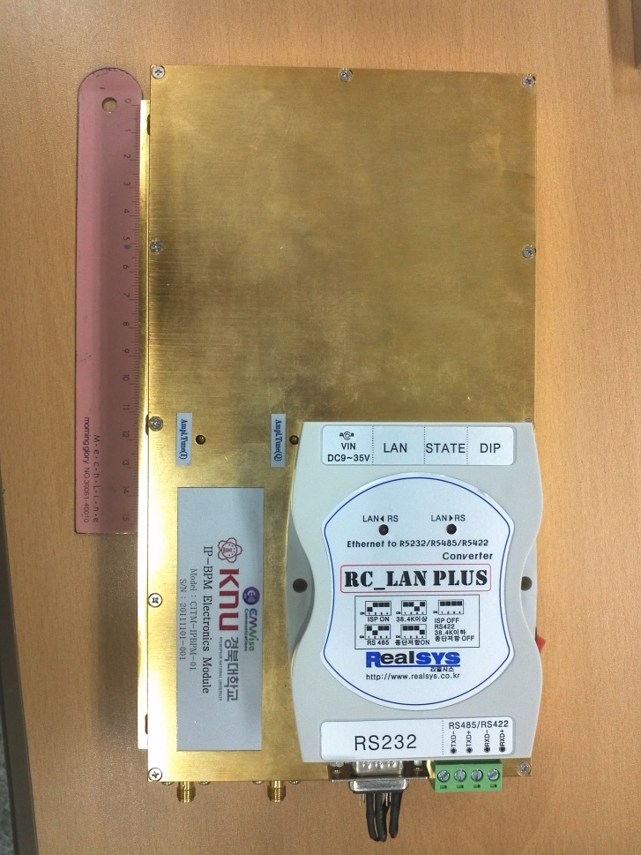
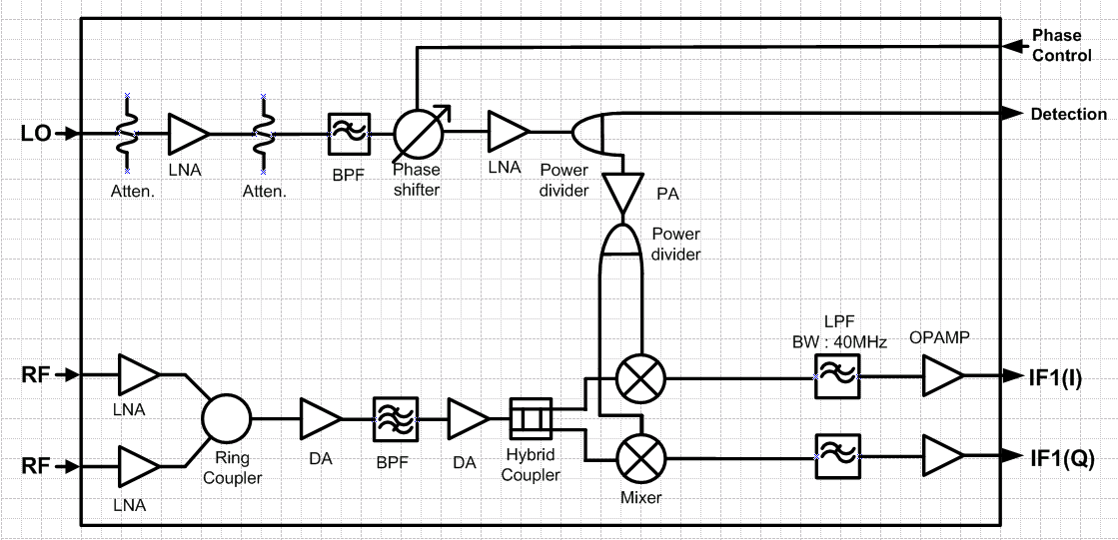
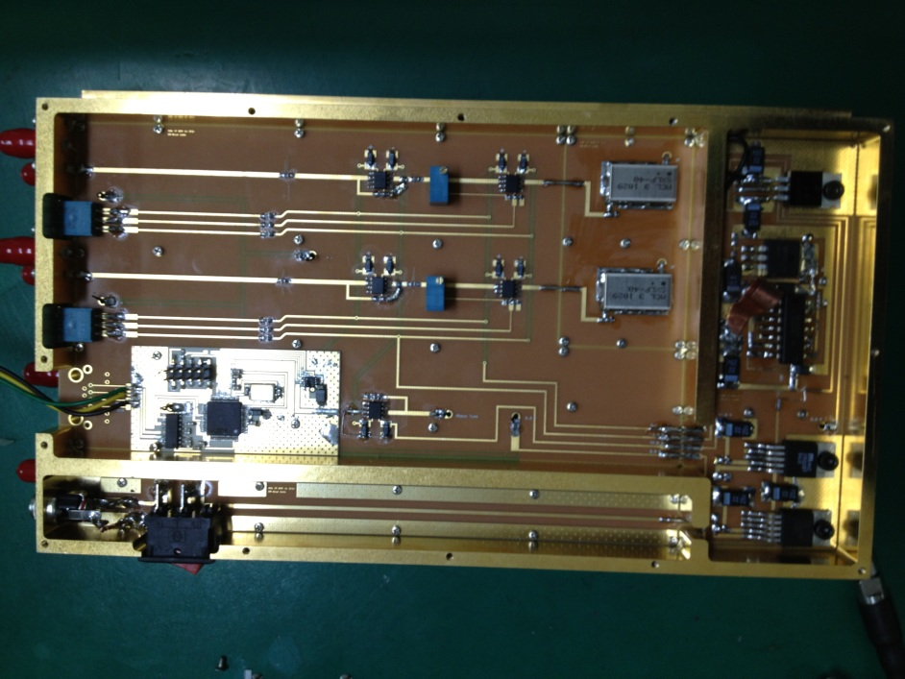
Fabrication of Electronics
The fabrication of electronics will be finished at middle of October.
The electronics total conversion gain was changed to 30~35dB (before 54dB).
-Therefore, we should check electronics sensitivity again.
Phase shifter can be control remotely.

Slide 5
Beam test scheme at November
The purpose of beam test at end of Linac are to check total system and preparation of IP-region test.
Existing Linac chamber have not enough space to install three IP-BPMs.
(It will be check once more.)
Therefore, the test will use double block cavity BPM as before test.
In last beam test at end of Linac, there are no enough cables to connect all cavity port. So, we need more cables at least more than 6 cables. ( 2 X-port cables + 2 Y-port cables + 2 Reference cables)
Three LAN cables are need to control phase shifter.
IP-Chamber
For linac test
ZH1P
Steering
magnet
ZV1P
Steering
magnet
ZH2P
Steering
magnet
ZV2P
Steering
magnet
ML2P
Strip-line BPM
ML3P
Strip-line BPM
Ref
BPM1
BPM2
beam
Reference
cavity
68cm
68cm
68cm
68cm
313cm
154cm

Slide 6
Summary
All of fabrication will be finished at middle of October.
The beam test at November will perform at end of Linac to check total system and to prepare IP-region test.
After the test, two block of IP-BPM will send to LAL to install IP-chamber.

