Slide 1
Personal Opinion of FF optics
at the beginning of 2012 Autumn Run
Toshiyuki OKUGI, KEK
ATF2 weekly meeting
2012 / 9 / 14

Slide 2
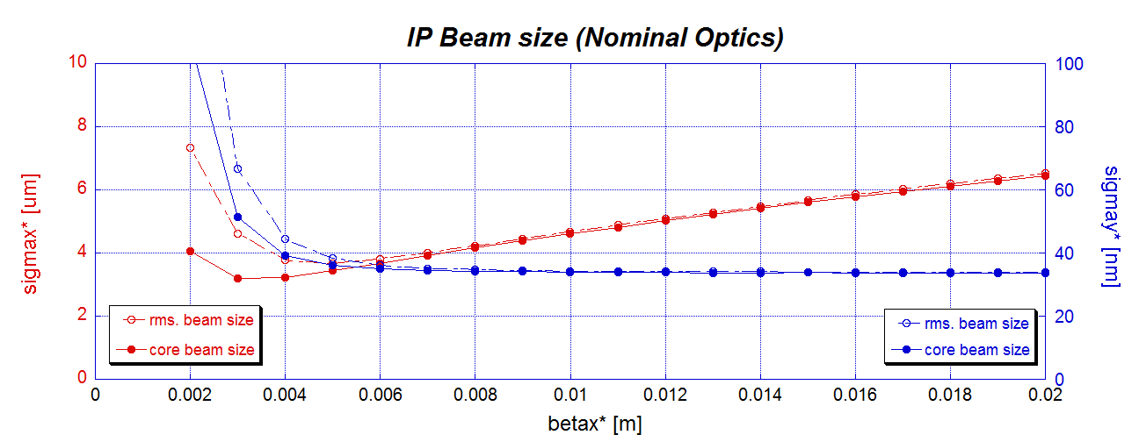
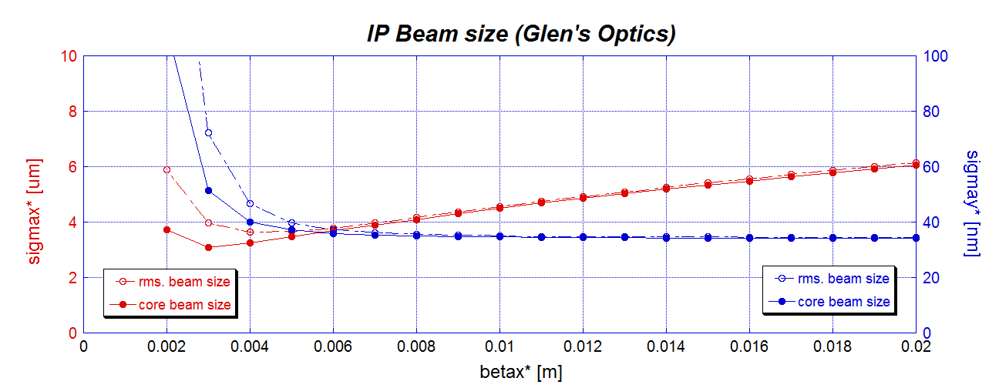
Presented at ATF2 meeting at 2012/7/20
IP beam sizes with measured multipole errors
emitx = 2nm
emity = 12pm
betay* = 0.1mm
after Y24 Y46 Y22 Y26
Y66 Y44 correction
betax*’s are changed
by changing matchng quads.
No significant difference
after correction

Slide 3
Beam Optics ?
No clear difference for Nominal Optics & Glen’s 2.5x1 optics,
when we applied the sextupole and skew sextupole corrections.
Since the nominal optics is a ILC like optics,
I recommend to use “Nominal FF optics”.
Horizontal Beta Function ?
Large betax*
Advantages
decrease the effects of the multipole errors
- the 12poles and 6poles for QF1 will be improved from spring run,
but we don’t know the other multipole effects.
decrease the coupling effect of <x’y>
make some margin to horizontal emittance growth.
already understood the IP-BSM background from QF1FF (horizontal).
Disadvantages
increase the effect of the beam tilt <xy>
-> We have already tried the tilit correction with QKs.
I recommend to use 10x1 optics at the beginning of 2012 autumn run.

Slide 4
Backup

Slide 5
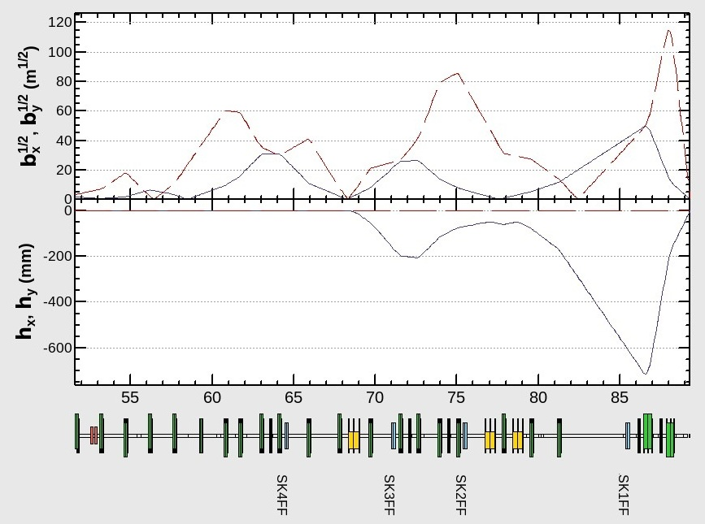
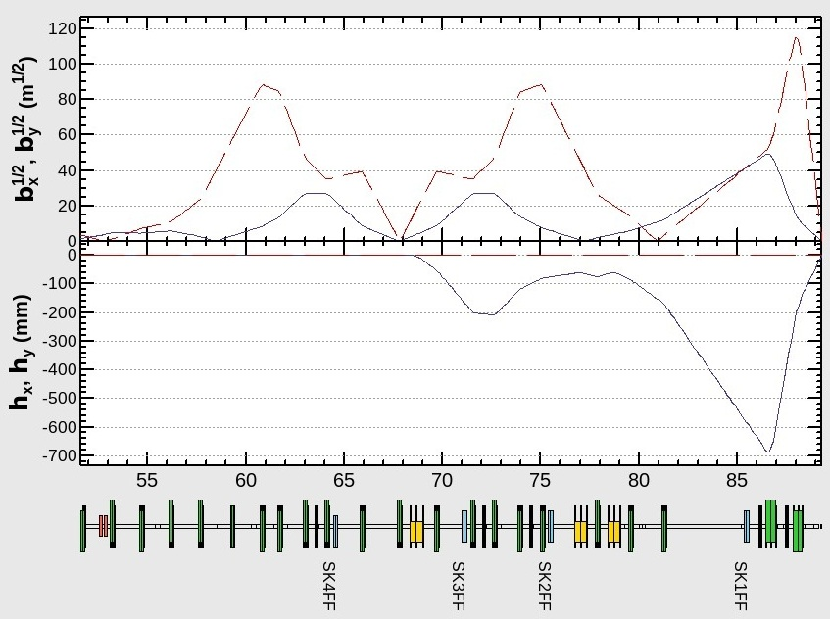
Presented at ATF2 meeting at 2012/7/20
FF optics (Glen’s optics & Nominal optics )
Glen’s 2.5x1 Optics
Same betax at QF1FF
Nominal2.5x1 Optics

Slide 6
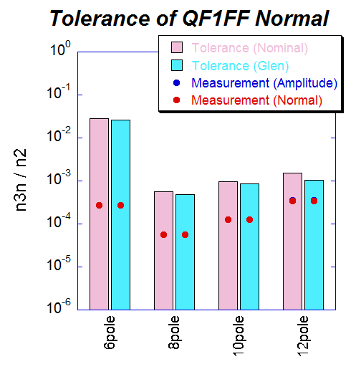
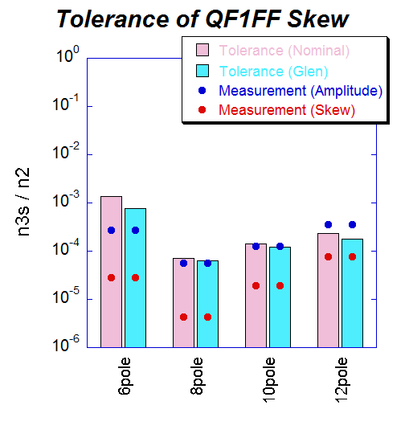
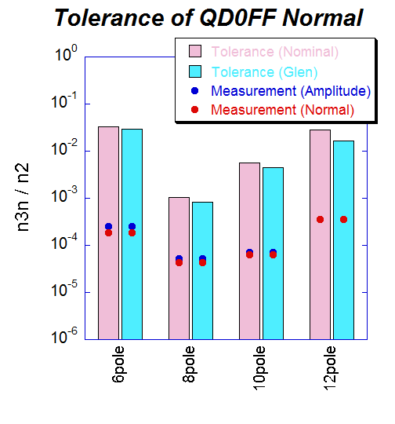
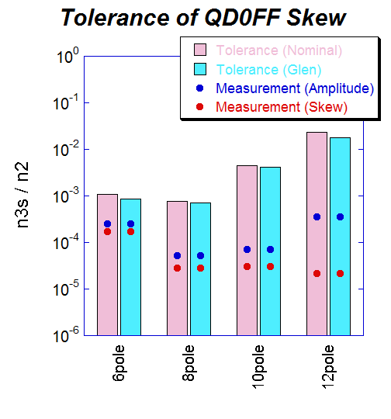
Tolerances for Multipole Errors for Final Doublet
Red ; Nominal 2.5x1
Blue; Glen’s 2.5x1
emitx = 2nm
emity = 12pm
with Y24 Y46 Y22 Y26
Y66 Y44 correction
No significant difference
after correction
a little bit large tolerances
for nominal optics

Slide 7
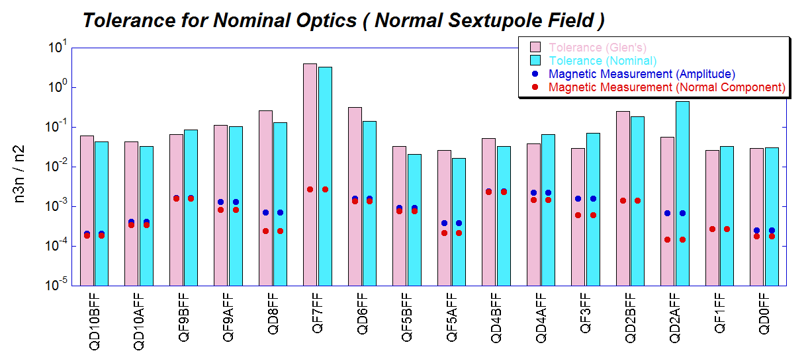
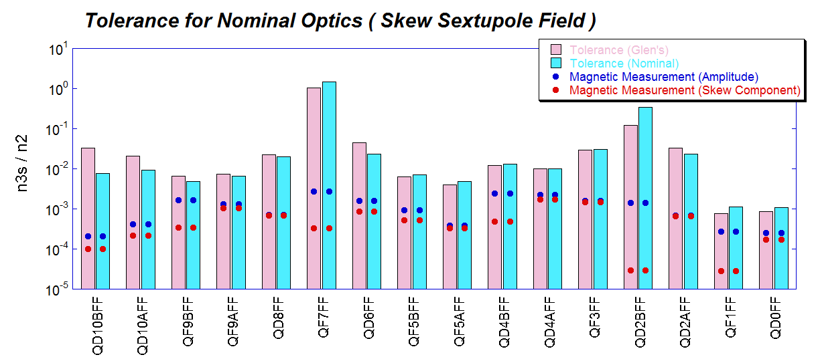
Tolerances of Sextupole Field Errors for FF Quads
Red ; Glen’s 2.5x1
Blue; Nominal 2.5x1
emitx = 2nm
emity = 12pm
with Y24 Y46 Y22 Y26
Y66 Y44 correction
No significant difference
after correction

