Slide 1
ATF2 Tuning Updates
Glen White, SLAC
Sept. 20 2012

Slide 2
Overview
Clarification of studies to understand June 2012 data
  Simulated response of SK1FF with June fitted optics parameters + dispersion source
  Beta matching tolerances
  All beam tracking with Lucretia
V.5 ATF2 optics
QF1FF replacement update

Slide 3
June 2012 Beam Conditions
Optics 10x1 (rematched from 2.5x1)
  Include all measured multipole components in quads, bends, kickers and sextupole magnets
OTR measured beam parameters (parameters fitted back to IEX match point):
  Emit_x = 3.8 nm
  Beta_x = 14.5 m
  Alpha_x = 1.2
  Emit_y = 25 pm
  Beta_y / Alpha_y set as nominal

Slide 4
IP Beam Size Descriptions
RMS beam size, quoted as 5 numbers:
  (1) RMS projection at IP
  (2) RMS projection with [3,6] correlation (dispersion) removed
  (3) RMS projection with [3,6] and [2,3] (<x’y> coupling term) correlations removed
  (4) RMS projection with all first-order correlations removed
  (5) RMS projection with all first and second-order correlations removed
FIT beam size
  Fit a gaussian profile to the core of the beam projection at IP, quoting width of gaussian

Slide 5
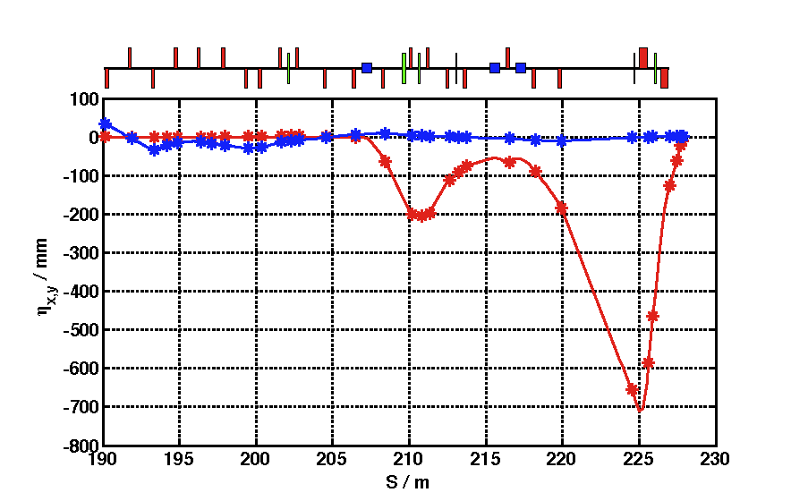
Vertical Dispersion Sources
@ QM16FF:
η_{y} = 33.92 mm
η_{y}’ = -20.61 mrad
@ IP:
η_{y} = 1.0 mm
η_{y}’ = 0.0 mrad
Track beam from entrance of FFS (QM16FF)
Generate +1mm of vertical dispersion at IP in one of 2 ways:
  Generate initial beam with shown dispersive correlations at QM16FF
  Offset QD0FF magnet vertically by -740 um
Correct using sextupole-based vertical dispersion multiknob in use during June operations

Slide 6
Beam Tracking (no Correction)
Condition | RMS Vertical Beam Size at IP / nm
 | (1) | (2) | (3) | (4) | (5)
Design emittance and Twiss | 45 | 45 | 45 | 45 | 37
June emittance and Twiss / no multipoles | 105 | 105 | 105 | 105 | 54
June emittance and Twiss | 104 | 104 | 104 | 104 | 54
QD0FF vertical offset / no multipoles | 815 | 102 | 102 | 102 | 54
QD0FF vertical offset | 828 | 105 | 105 | 105 | 54
Incoming dispersion / no multiples | 808 | 102 | 102 | 102 | 54
Incoming dispersion | 807 | 105 | 105 | 105 | 54

Slide 7
Beam Tracking (Correction with Dispersion Multiknob):
Condition | RMS Vertical Beam Size at IP / nm
 | (1) | (2) | (3) | (4) | (5)
QD0FF vertical offset / no multipoles | 152 | 152 | 104 | 104 | 54
QD0FF vertical offset | 139 | 139 | 112 | 112 | 54
Incoming dispersion / no multiples | 151 | 151 | 106 | 106 | 54
Incoming dispersion | 148 | 148 | 113 | 113 | 54
Correction with Dispersion AND Coupling Multiknobs:
Condition | RMS Vertical Beam Size at IP / nm
 | (1) | (2) | (3) | (4) | (5)
QD0FF vertical offset / no multipoles | 104 | 104 | 104 | 104 | 54
QD0FF vertical offset | 112 | 112 | 112 | 112 | 54
Incoming dispersion / no multiples | 106 | 106 | 106 | 106 | 54
Incoming dispersion | 113 | 113 | 113 | 113 | 54

Slide 8
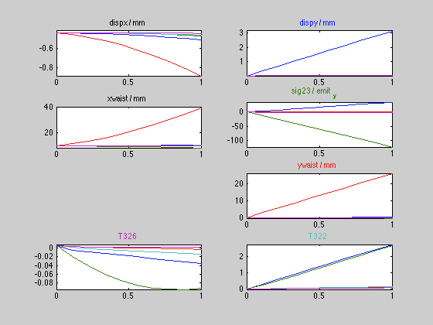
Multiknob Responses
Non-orthogonality with coupling correction
  Dispersion correction generates coupling
Also small amount of second-order beam size contribution (~5 nm RMS) from T322 and T326 terms when multipoles present

Slide 9
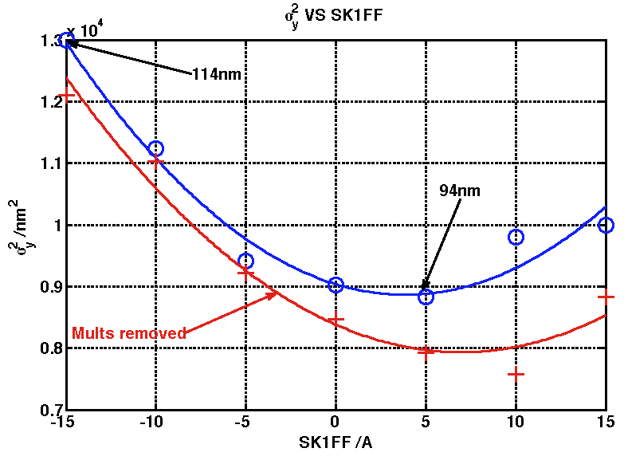
SK1FF Scan After Dispersion Correction
SK1FF corrects for residual coupling
Asymmetric beam size distribution as observed in June
Minimum of fit dependent upon residual coupling as well as any additional skew-sextupole terms
FIT beam sizes shown

Slide 10
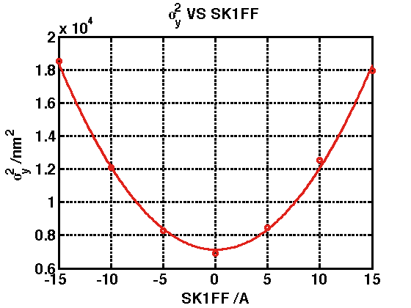
SK1FF Scan With Dispersion And Coupling Correction
No asymmetry seen with expected multipole components and corrected dispersion and coupling for each scan point
Second-order contribution is insignificant
  (as opposed to that theorised in previous presentation)
RMS beam sizes shown

Slide 11
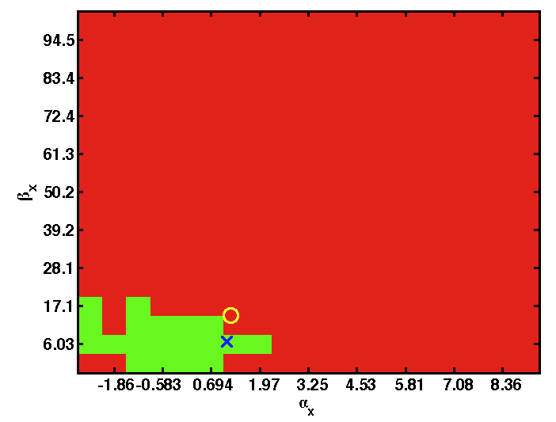
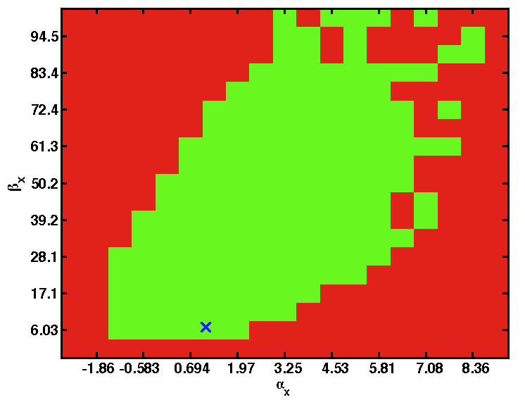
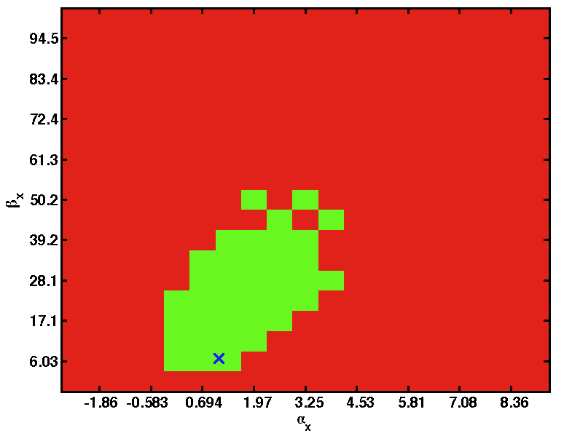
Vertical Beam Size Tolerance to Horizontal Beta Match
v4.5 BX10BY1 lattice
2nm horizontal emittance (left)
June (3.8 nm) horizontal emittance (right)
  Inset = June lattice + Y emit (circle = measured twiss parameters)
Green = vertical (RMS (4)) beam size <39 nm (after first-order corrections)
  [Inset = < 90nm]

Slide 12
V.5.0 Optics Available
Available on Flight Simulator subversion repository lattice directory
  http://code.google.com/p/atf2flightsim/source/browse/#svn%2Ftrunk%2FATF2%2FFlightSim%2FlatticeFiles%2Fsrc%2Fv5.0
  XSIF and Lucretia file formats
    .saveline and .mat extensions
BX10BY1 lattice
  All multipoles as in v.4.5 for now (QF1FF replacement still pending)
  Removed KEX2 quad and sextupole field (KEX2 removed)
New components
  3 new skew-sextupoles (v4.5 SK1FF -> SK3FF)
    SK1FF, SK2FF, SK3FF, SK4FF
  IP feedback kicker

Slide 13
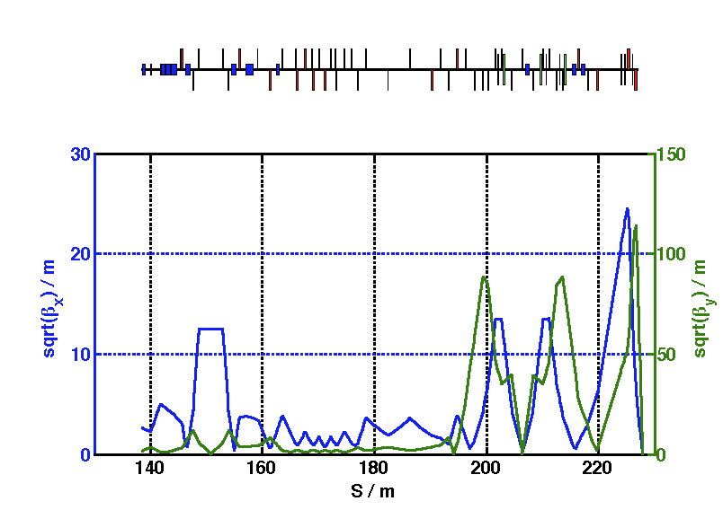
V 5.0 Optics Matching and Tracking
Matched with waists at MFB1FF (horizontal) and MFB2FF (vertical) in MAD using QD21X, QM(16:12)FF.
  QF21X was found to be necessary to keep FB waists
Tracked IP beam sizes (Lucretia)
  10 um x 35 nm (no multipoles)
  10 um x 40 nm (all multipoles)

Slide 14
Rematch Sextupoles with Lucretia
Try re-matching sextupole strength to minimise IP beam size in presence of multipoles
Can get design (37 nm) IP vertical beam size with below values
  Same with multipoles switched off
  NB: force SF5FF not to reduce in value to maintain tuning capability of sextupole system
SIGMA_Y=37nm:
SD0FF: Lucretia: +21.66974284 (T.m) K2: +49.97250747 K2L: +04.99725075 I: 7.37255944 (A)
SF1FF: Lucretia: -14.76999747 (T.m) K2: -34.06103223 K2L: -03.40610322 I: 5.01071205 (A)
SD4FF: Lucretia: +61.98265762 (T.m) K2: +142.82650898 K2L: +14.29379594 I: 27.24028031 (A)
SF5FF: Lucretia: -03.42946817 (T.m) K2: -07.90251636 K2L: -00.79086829 I: 1.07188021 (A)
SF6FF: Lucretia: +24.84119592 (T.m) K2: +57.24151606 K2L: +05.72861828 I: 10.72236363 (A)

Slide 15
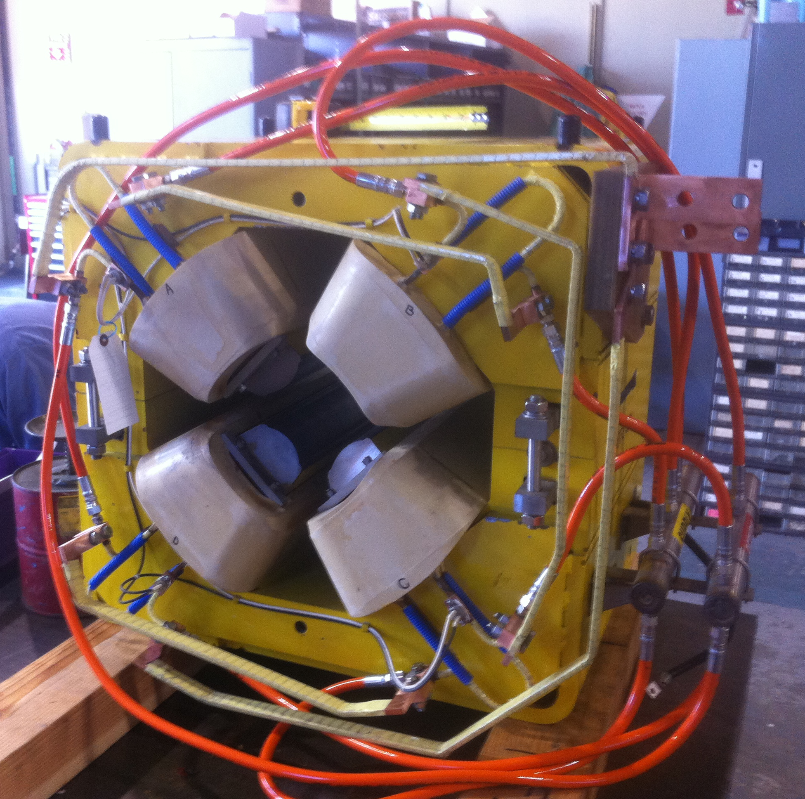
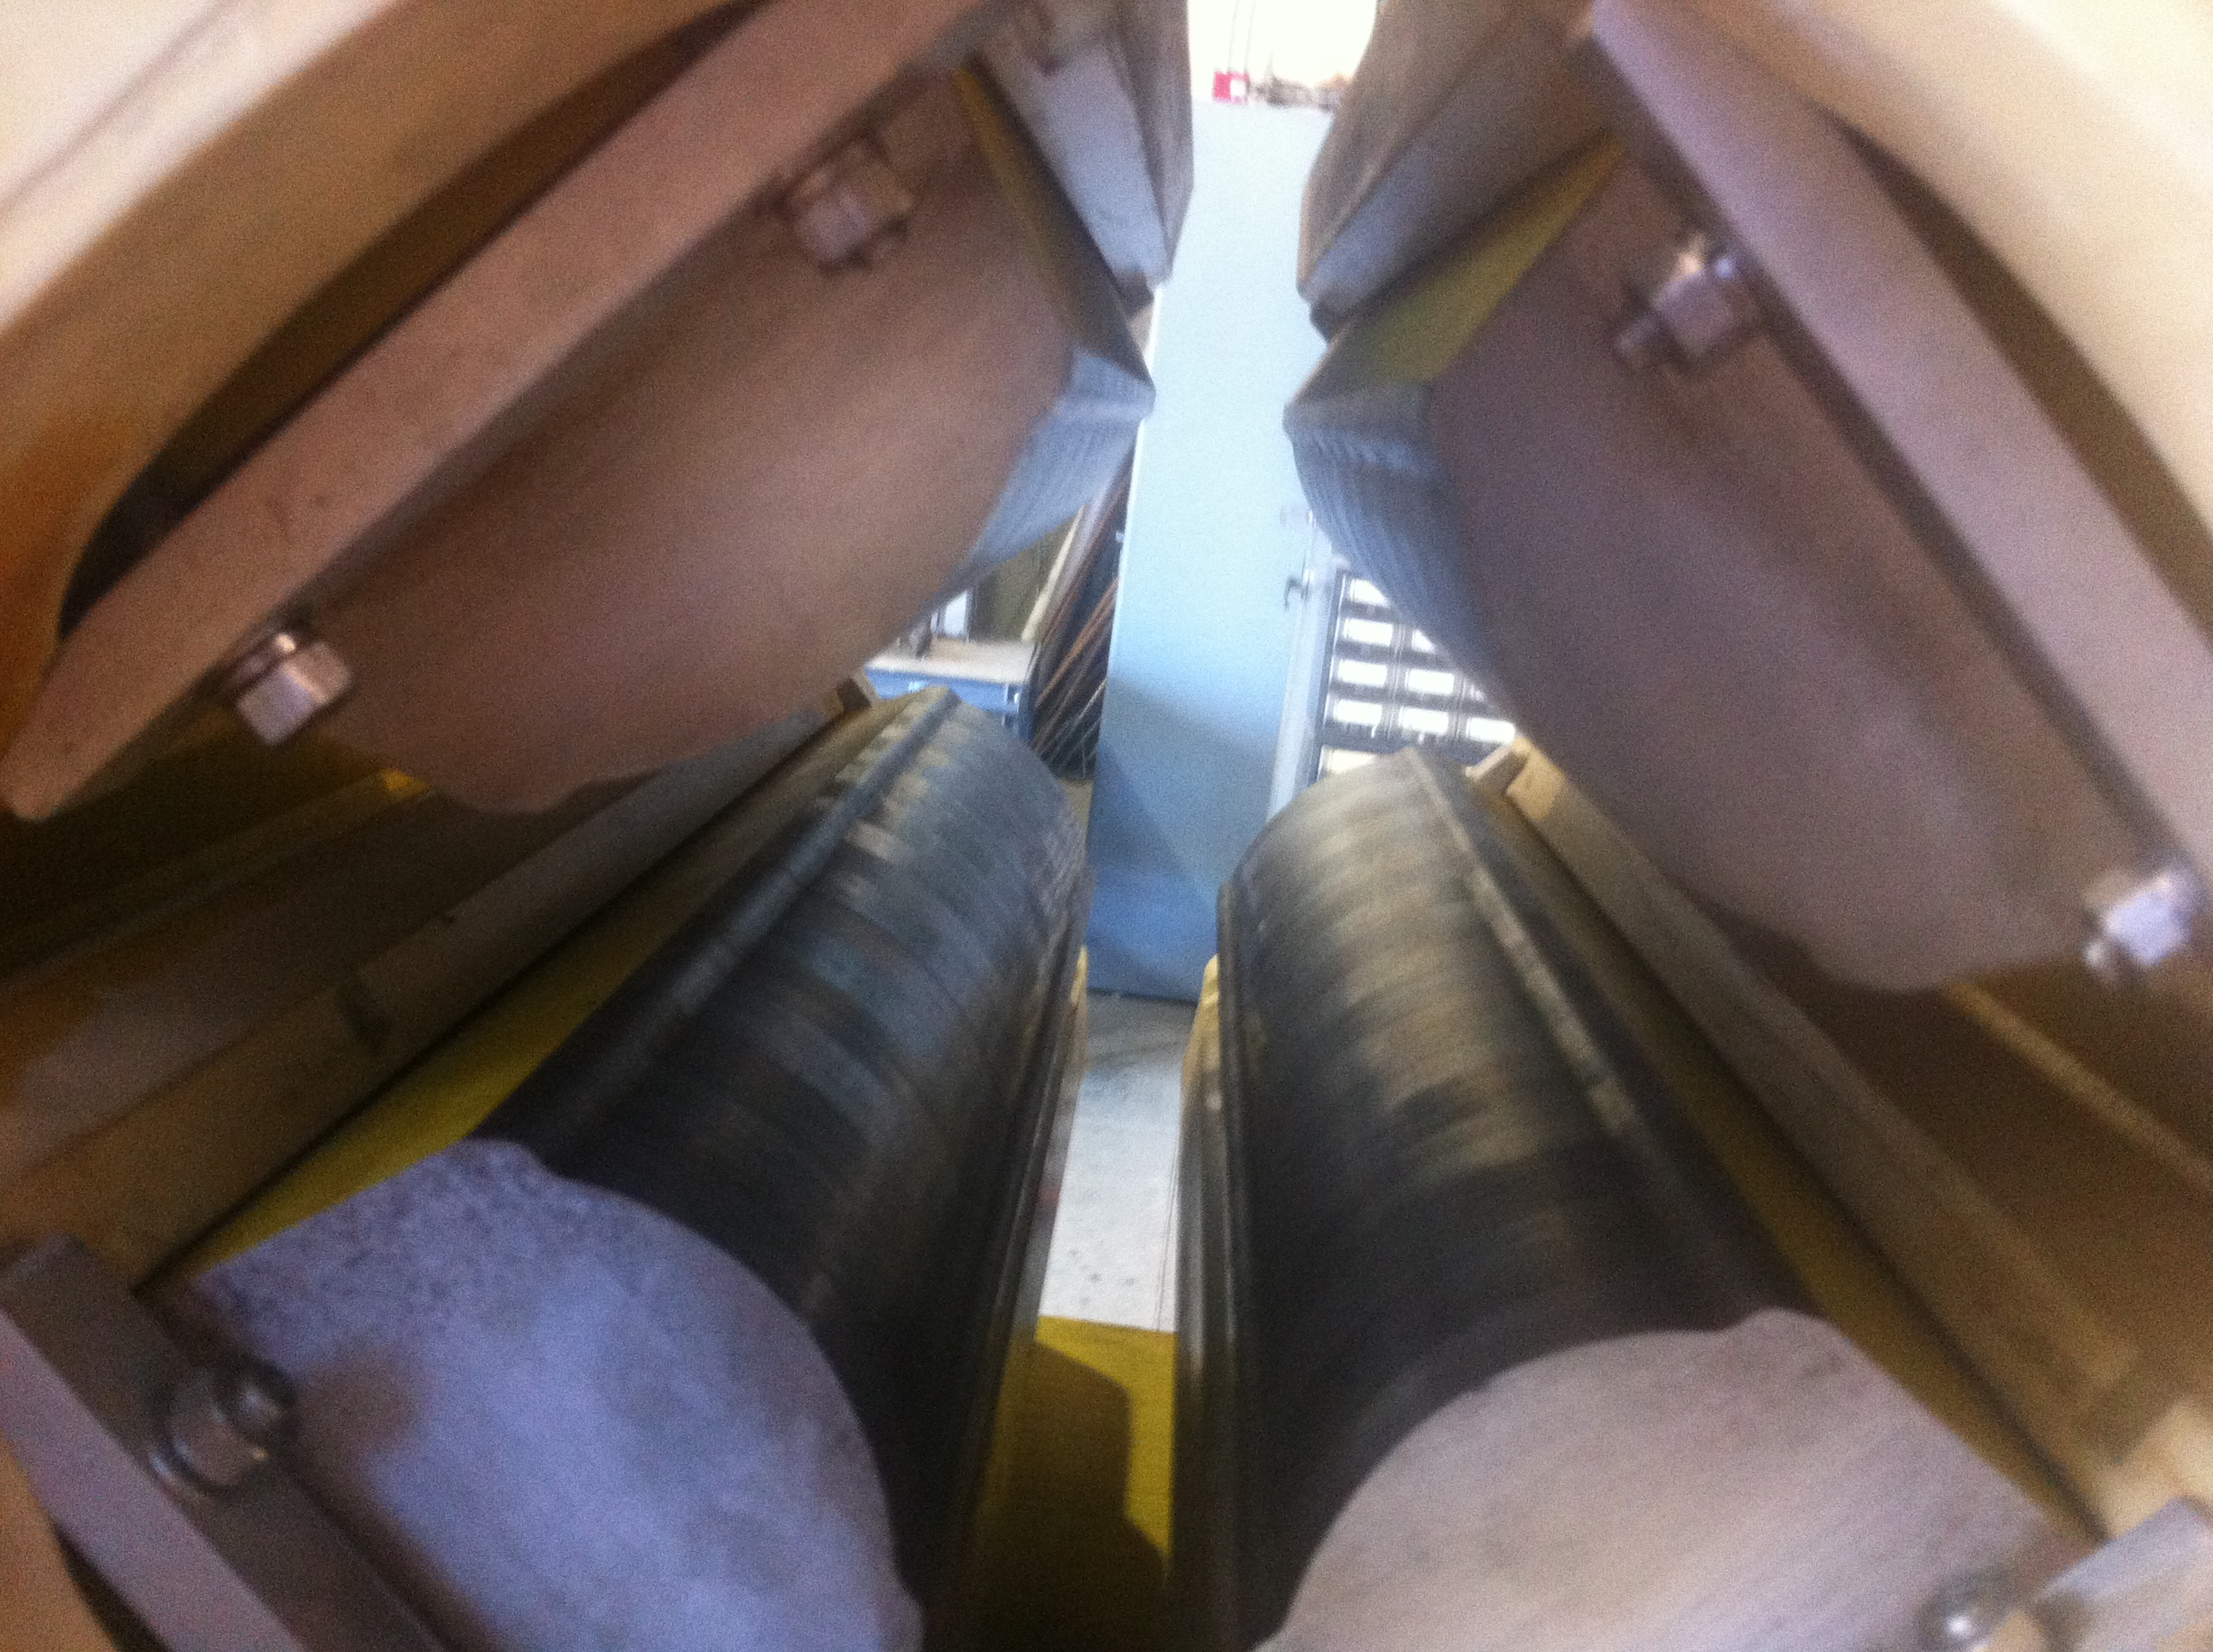
QF1FF Replacement Update
PEPII LER quad refurbished for our use
Currently undergoing multipole measurements + BPM feed-through tests
Hopefully ship next week? (if paperwork time allows)
Weight confirmed at 1188.4 kg

