Slide 1
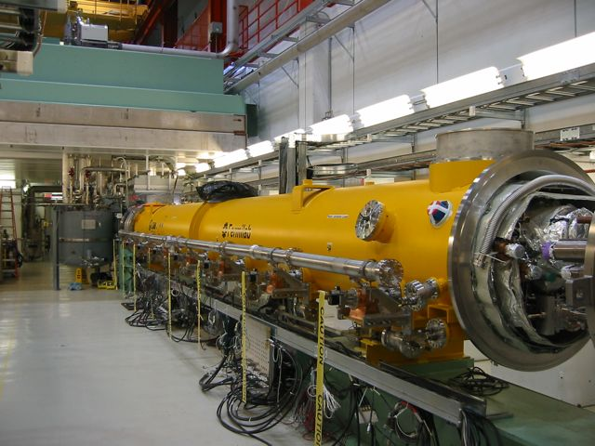
NML/RFCA002 Status
ILC Cryomodule meeting
3 July 2012
E. Harms

Slide 2
Status
Couplers installed
  <1 week from beginning warm conditioning
  Couplers under vacuum
  Warm RF measurements completed, coupler motion verified
All signal connections made and verified
Vacuum leak discovered on 2φ circuit during final leak check at NML

Slide 3
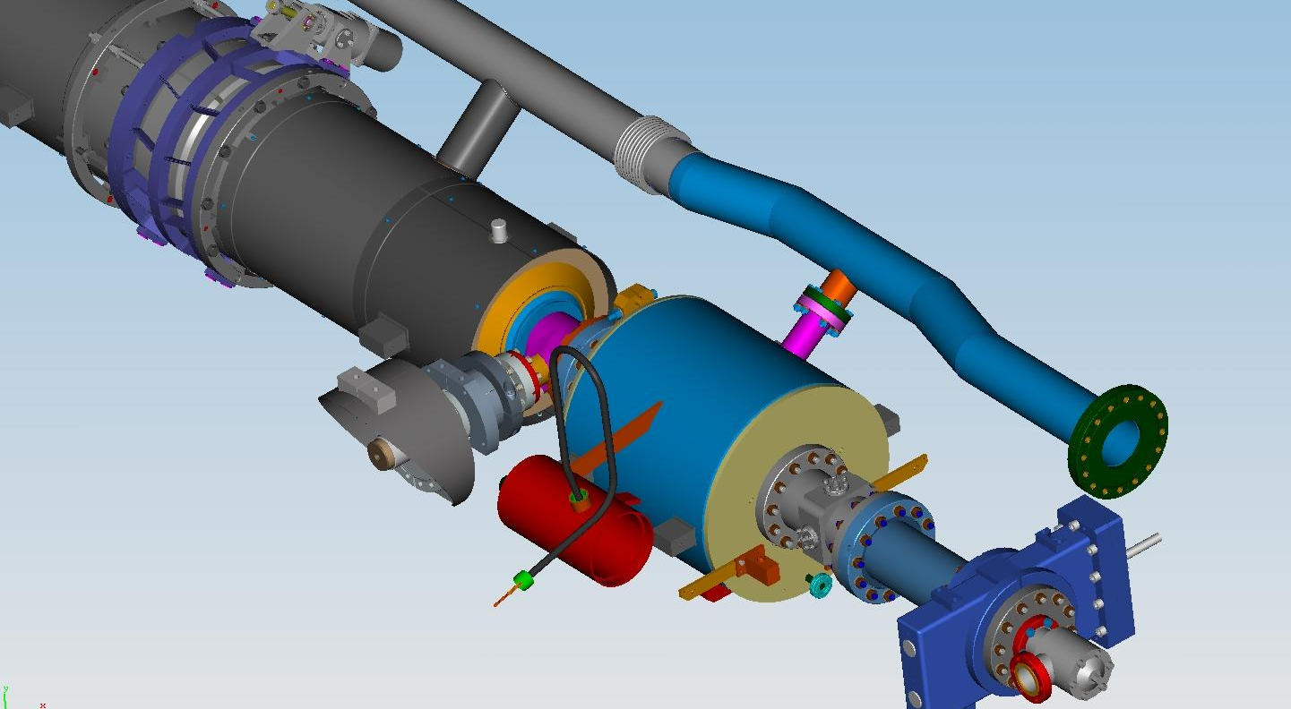
2φ leak
Courtesy of Tug Arkan/TD
From the in-situ leak checks at NML, the leak is located within the close vicinity of the Ti bellows between the magnet and cavity #8 on the 2-phase pipe

Slide 4
Repair Options
Courtesy of Tug Arkan/TD
In-situ in the NML cave – not feasible due to tight space and reachability limit (~1 meter inside from downstream end) to the area to locate the exact location of the leak
In-situ at NML floor – does not seem feasible due to reachability limit to the area for any kind of repair even we can locate the exact location of the leak
At CAF-ICB (partial cold mass disassembly)
At CAF-ICB and CAF-MP( (full cold mass disassembly)

Slide 5
Repair Plan
CM-2 prepared for removal and transport including leak checks on all circuits – no other leaks found
Transport from NML to ICB – completed 26 June
  Max. quad acceleration = 0.23 g (vertical)
  Max. isolation fixture acceleration = 0.2 g (vertical)
  Max. base frame acceleration = 0.45 g (vertical)
Diagnosis, repair, and full checkout – estimate 7-9 weeks
  RF checks and cable disconnects in progress
  Plan for disassembly prepared by Tug
  Estimate 2 weeks to extract cold mass assembly
  Diagnosis and repair to follow

Slide 6
Meanwhile…
Photoinjector Gun installed and aligned on girder
  Initial checks in progress
  First RF soon (July)

Slide 7
Thank you for your attention

