Slide 1
STF accelerator status
(RFgun + capture cryomodule operation)
H. Hayano, 07032012

Slide 2
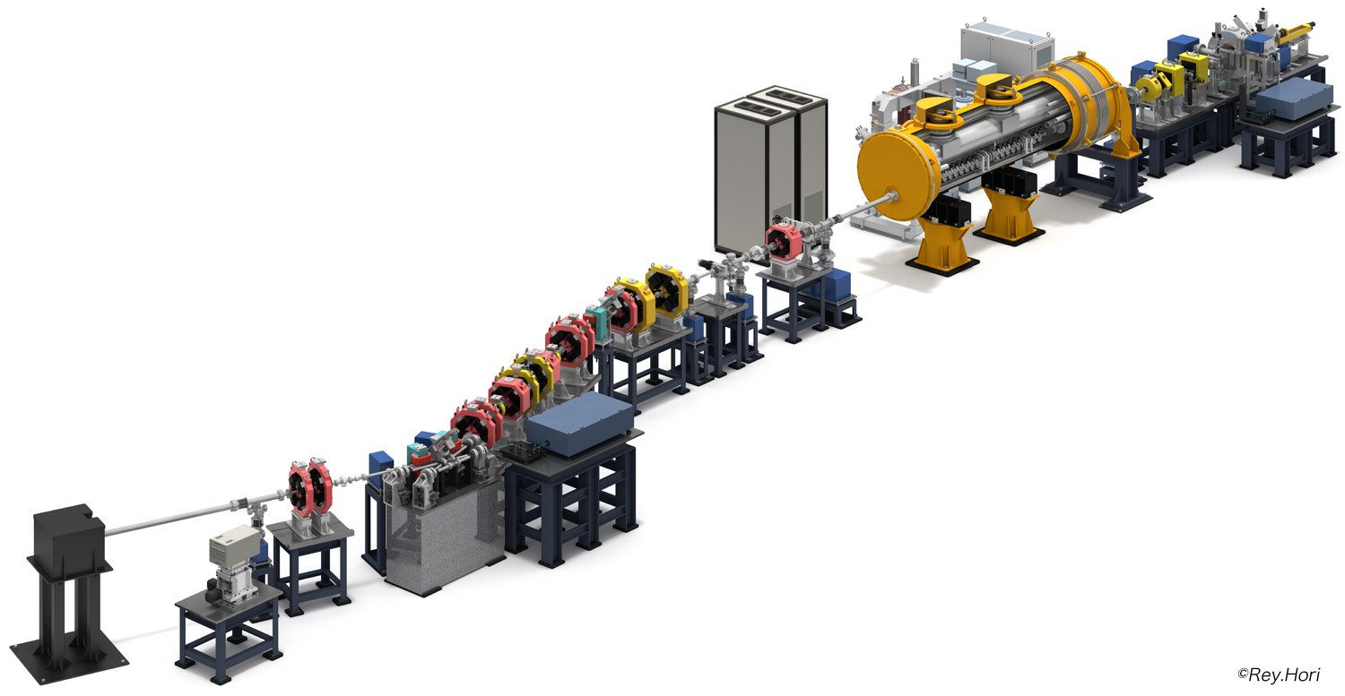
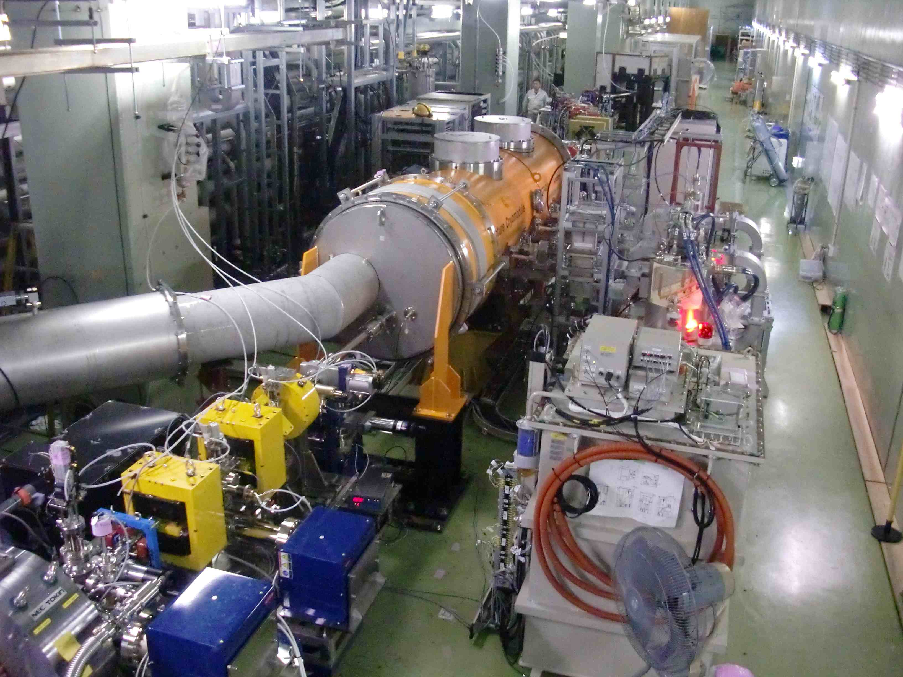
STF Quantum-Beam experiment
KEK-STF
Quantum-Beam Accelerator
High-flux X-ray by Inverse-Comton scattering
10mA electron beam （40MeV, １ｍｓ, ５Ｈｚ）
4-mirror laser resonator cavity
head-on collision with beam
photocathode RFgun
Capture cryomodule ( 2 SC cavities )
collision point
(Laser, electron beam)
Target: 1.3 x 10¹⁰ photons/sec 1%bandwidth
2012. Feb : cool-down started,
April-June : beam acceleration

Slide 3
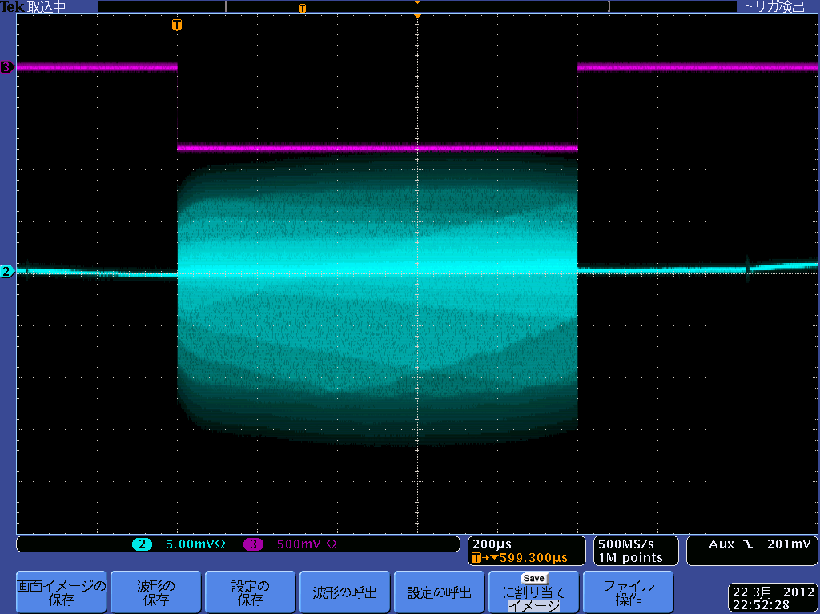
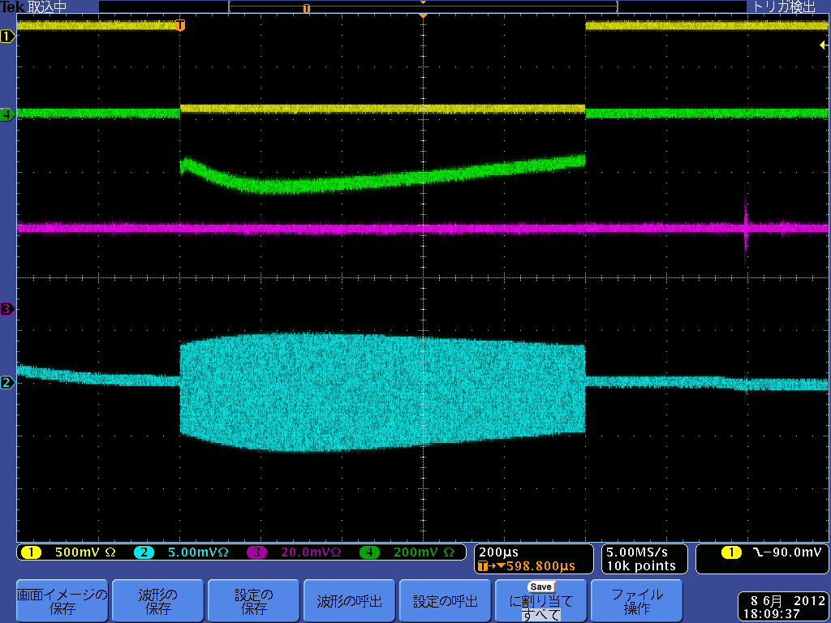
STF QB accelerator commissioning (April-June 2012)
Accelerator commissioning for beam extraction, acceleration, and 1ms beam
Beam extraction
Beam on gate
Fiber Beam loss monitor
1ms
PIN Beam loss monitor
BPM signal
1ms Beam extraction from RF-gun (Mar.22,2012)
1ms
20% of full-beam power operation
40MeV, 15pC/bunch, 162500bunches
（June, 2012）
ー＞ILC beam （1ms length） acceleration
ILC beam intensity （6.6mA)
Accelerated Beam bunches
beam acceleration
40MeV, 41pC/bunch, 28bunches（April, 2012）

Slide 4
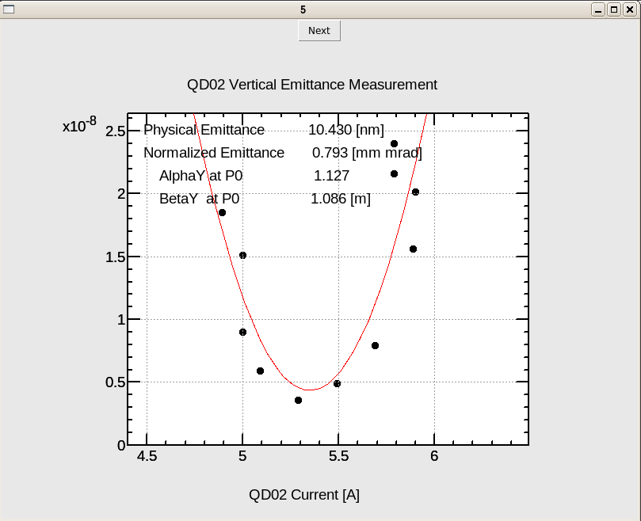
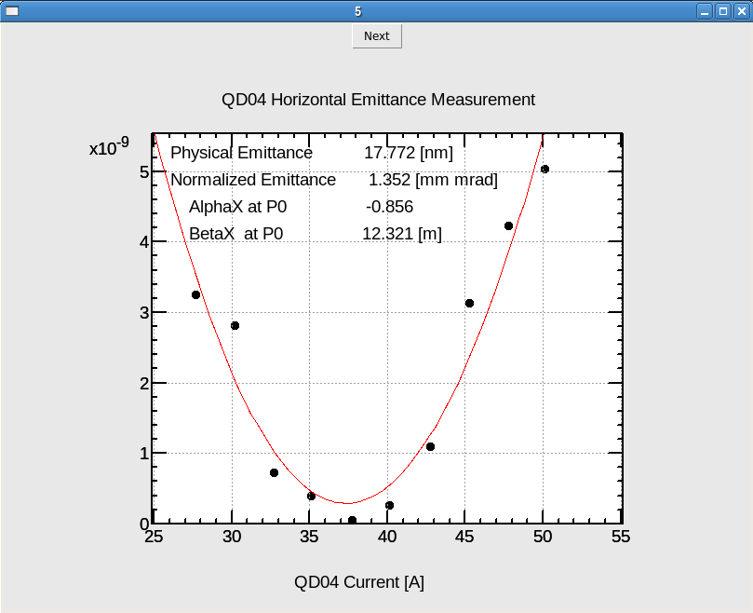
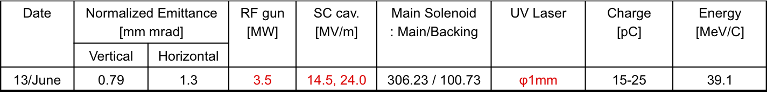
Beam emittance of STF accelerator
Swap
ε_{x}, ε_{y} ：0.8 – 1.3 x 10⁻⁶ @ 15-25pC/bunch, 39MeV（close to the design）

Slide 5
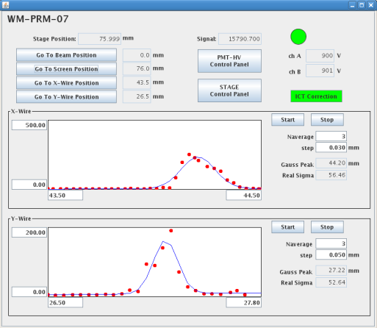
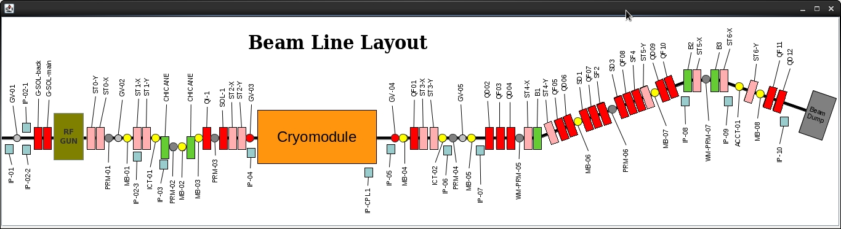
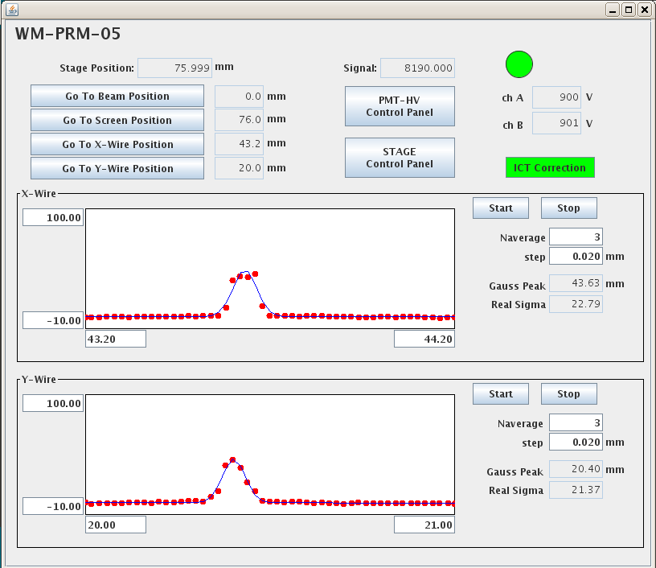
Beam size measurement June 21,2012
Second wire scanner
σ_{x}：56.5 µm
σ_{y}：52.6 µm
collision point
RF gun 3.5 MW, SC cav 14.5 & 25.5 MV/m
40 MeV, 35 - 40 pC, 40 bunches
First Wire scanner:
σ_{x}：22.8 µm
σ_{y}：21.3 µm
Still beam line Tuning is necessary

Slide 6
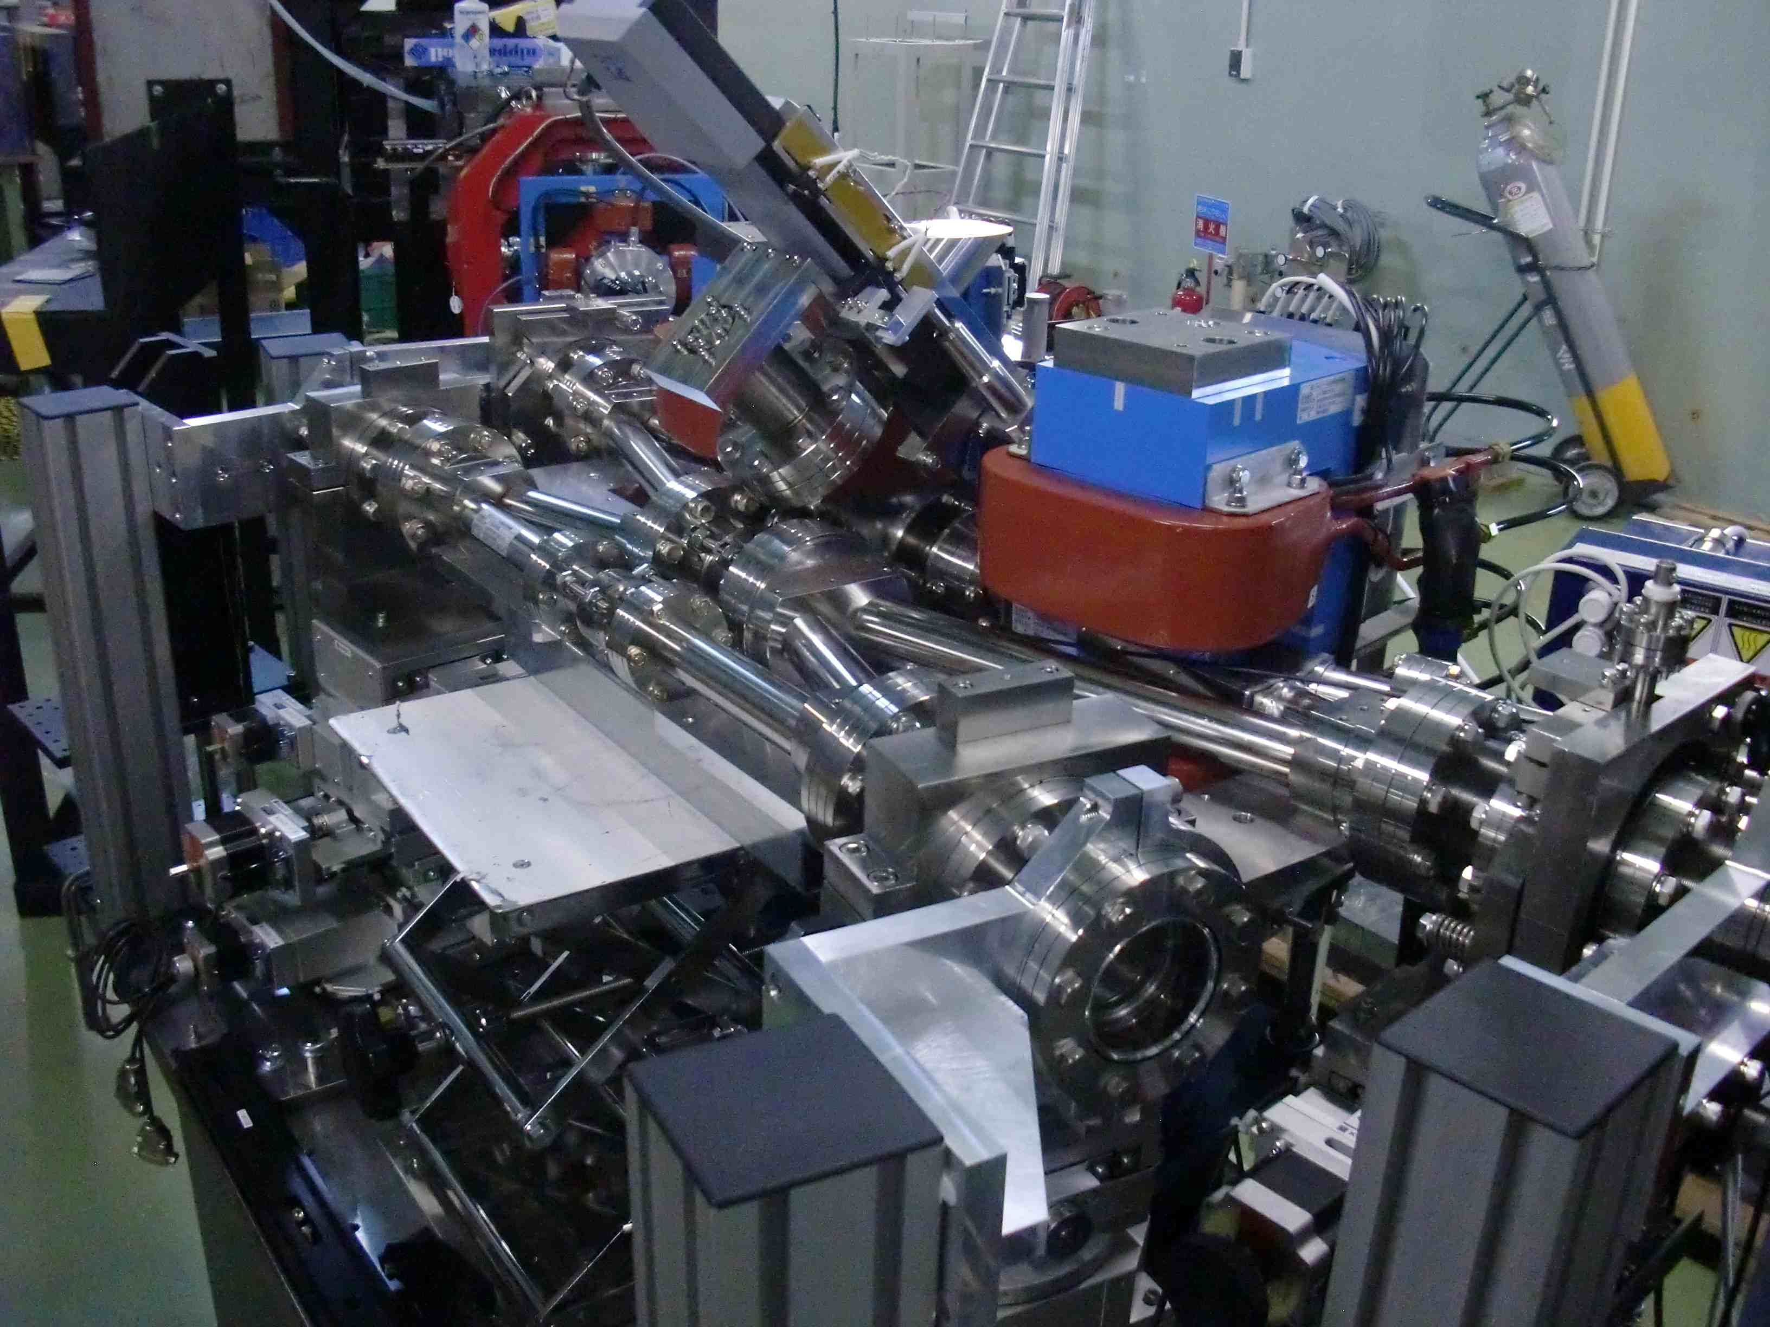
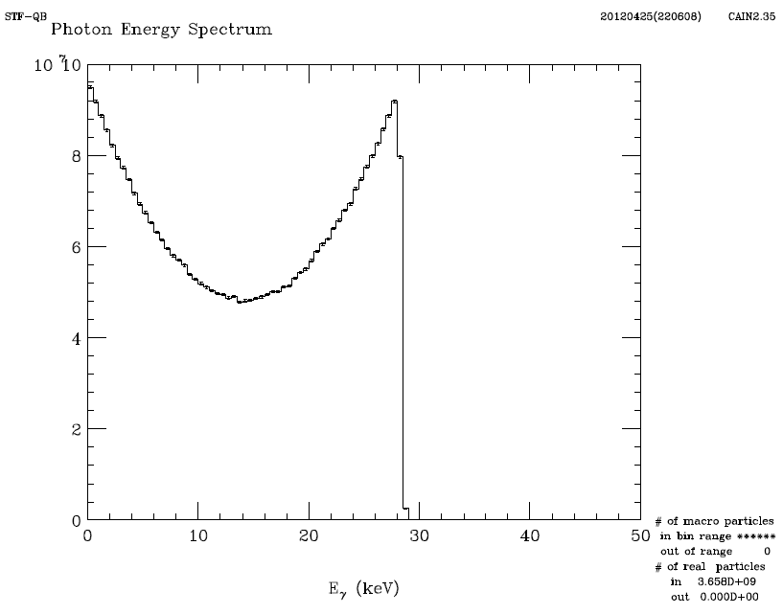
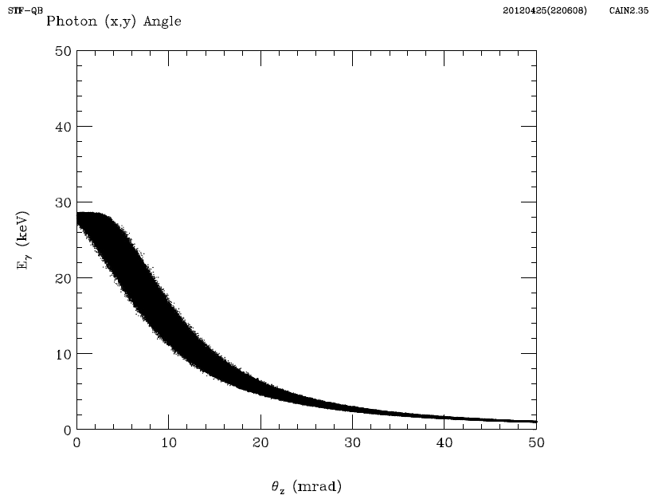
Plan of X-ray generation by Inverse-compton scattering
collision will be started in September
4-mirror laser accumulation, head-on with e-beam
40MeV, head-on collision
max. 28 keV X-ray
 | Electron | Laser
Energy | 40MeV | 1.17eV (λ=1064nm)
Energy spread | 0.1% (rms)
Beam size(rms) | 10μm | 10μm
Pulse width(FWHM) | 12ps | 12ps
Intensity | 61.5 pC/bunch | 50mJ/pulse
Number of bunches | 162500 | ----
Emittance | 0.5π mm mrad
Collision angle | 0deg (Head on)
Rep. Rate | 5Hz
target: 1.3x10¹⁰ photons/sec/1%bw

