Slide 1
ZH (H -> tau tau) Study Current Status
Shin-ichi Kawada
(AdSM, Hiroshima Univerisity)

Slide 2
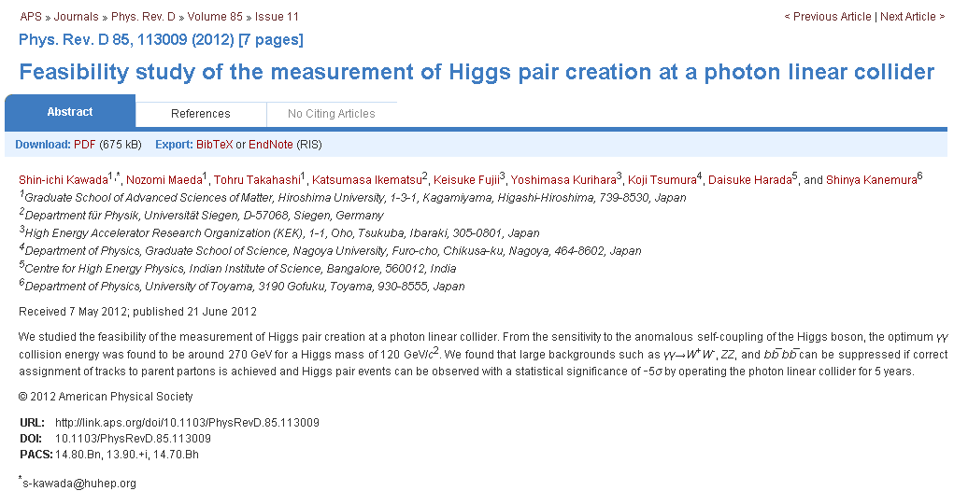
AA -> HH paper published !
Phys. Rev. D 85, 113009

Slide 3
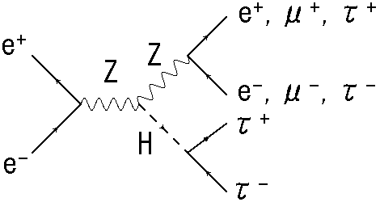
H -> tau tau
CM energy = 250 GeV, M_{H} = 120 GeV/c²
Signal (leptonic mode)
e+e- -> ZH -> (e+e-) (tau+tau-) or (mu+mu-) (tau+tau-)
first step

Slide 4
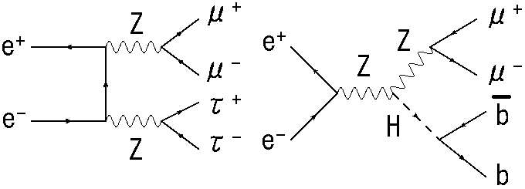
Possible backgrounds
4 leptons background
H -> others
4 leptons
H -> others

Slide 5
Event samples
LOI sample
signal: eeH, mumuH(H -> tautau and H -> others are included in this sample file)
BG: 4 leptons
eeee
eemumu
eetautau
mumumumu
mumutautau
tautautautau

Slide 6
Event reconstruction
Step 1: finding isolated leptons
I adopted most energetic positive-charged track and most energetic negative-charged track as the isolated leptons.
Step 2: 2-jet clustering

Slide 7
Event selection (1)
Cut 0 (pre-selection)
1 positive-charged track
1 negative-charged track
2-jet
Z candidate

Slide 8
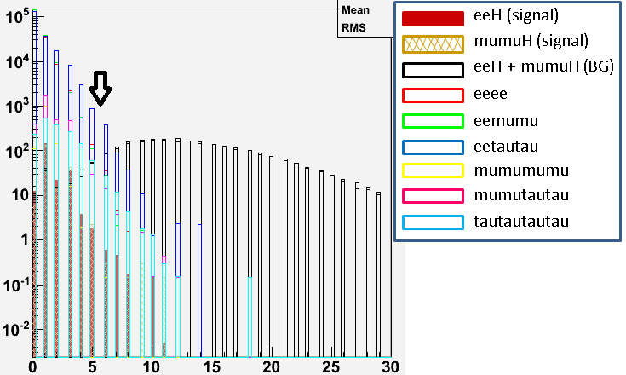
Event selection (2)
In order to separate signal and H -> others.
Cut 1: # of tracks in a jet <= 5
Cut 2: # of pfos <= 25
Cut 1

Slide 9
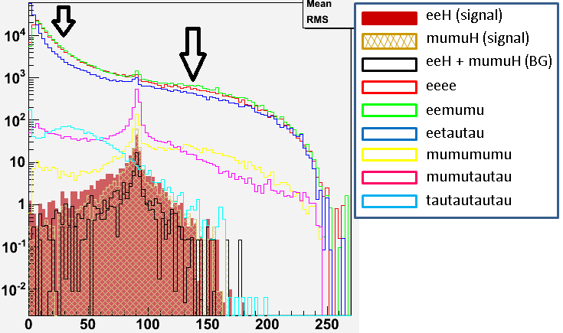

Event selection (3)
Cuts for Z candidate
Cut 3: 30 < M_{Z} < 140
Cut 4: 20 < E_{Z} < 150
Cut 5: -0.98 < $\cos{θ}$_{negative} < 0.95
Cut 6: -0.95 < $\cos{θ}$_{positive} < 0.98
Cut 7: -0.98 < $\cos{θ}$_{betweenchargedtracks} < 0.4
Cut 3

Slide 10
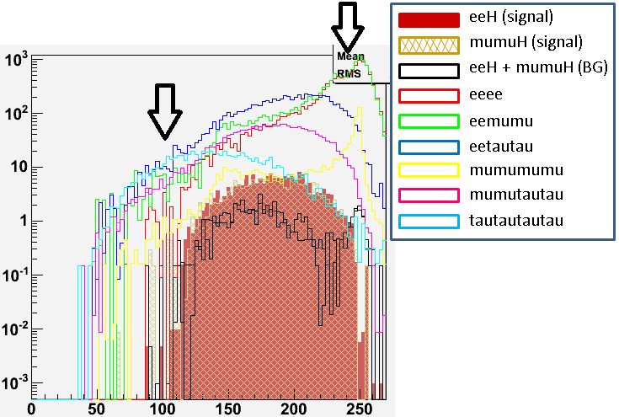

Event selection (4)
Cut 8: 100 < visible energy < 240
Cut 9: |$\cos{θ}$_{missmom}| < 0.98
Cut 8

Slide 11
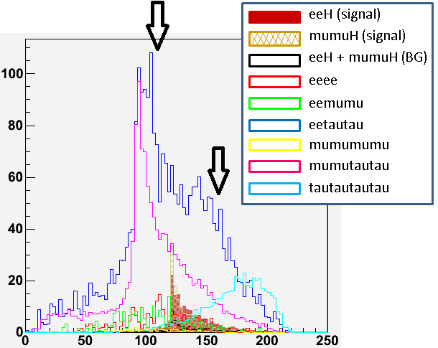

Event selection (5)
Cuts for jets (H candidate) and recoil mass
Cut 10: M_{jj} < 140
Cut 11: |$\cos{θ}$_{j}| < 0.98
Cut 12: 115 < recoil mass < 160
Cut 12

Slide 12
 | eeH (sig) | mumuH (sig) | eeH (BG) | mumuH (BG) | 4e | 2e2mu | 2e2tau | 4mu | 2mu2tau | 4tau
No Cut | 228.0 | 210.8 | 2546 | 2386 | 242749 | 271835 | 238089 | 1698 | 3468 | 1730
Cut 0 | 222.7 | 200.1 | 2541 | 2377 | 190052 | 193349 | 197964 | 1248 | 3217 | 1683
Cut 1 | 221.0 | 198.8 | 75.23 | 62.05 | 189973 | 193295 | 196726 | 1248 | 3188 | 1622
Cut 2 | 220.4 | 198.0 | 61.79 | 52.77 | 189966 | 193293 | 196388 | 1248 | 3181 | 1598
Cut 3 | 208.6 | 192.8 | 57.05 | 51.57 | 54603 | 57429 | 37194 | 852.8 | 2416 | 903.4
Cut 4 | 208.6 | 192.8 | 57.04 | 51.57 | 53558 | 56275 | 36251 | 805.2 | 2387 | 903.1
Cut 5 | 200.3 | 183.8 | 55.37 | 49.90 | 27250 | 29905 | 16120 | 748.2 | 2210 | 819.4
Cut 6 | 193.3 | 177.0 | 53.79 | 47.95 | 13148 | 15148 | 7803 | 695.4 | 2069 | 763.3
Cut 7 | 187.9 | 171.1 | 52.32 | 46.87 | 11042 | 12459 | 6631 | 653.0 | 1908 | 690.6
Cut 8 | 185.6 | 168.7 | 44.91 | 39.49 | 5168 | 6073 | 6189 | 337.7 | 1834 | 597.4
Cut 9 | 181.6 | 163.4 | 42.76 | 36.80 | 815.5 | 839.4 | 4991 | 39.93 | 1517 | 560.2
Cut 10 | 179.9 | 163.1 | 42.45 | 36.78 | 530.7 | 596.8 | 4628 | 39.92 | 1508 | 548.1
Cut 11 | 173.5 | 156.0 | 39.95 | 34.32 | 177.5 | 207.2 | 2652 | 30.86 | 1365 | 490.7
Cut 12 | 140.5 | 135.0 | 30.03 | 29.06 | 54.26 | 62.88 | 948.2 | 9.529 | 405.0 | 122.0

Slide 13

Very preliminary results
Signal efficiency = 62.8 %
Significance = 6.26 <--> $Δ$Br(H -> tau tau)/Br(H -> tau tau) = 16 %
almost suppressed: eeee (242749 -> 54.26), eemumu (271835 -> 62.88), mumumumu (1698 -> 9.529)
remained: eetautau (238089 -> 948.2), mumutautau (3468 -> 405.0), tautautautau (1730 -> 122.0)

Slide 14
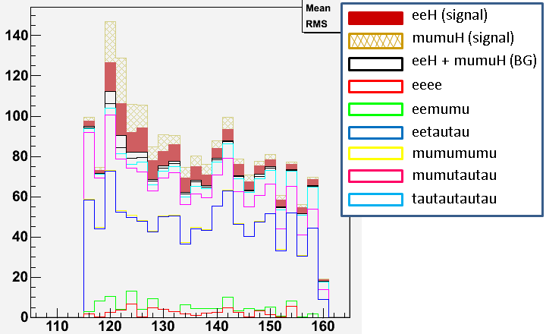
Recoil mass distribution (after all cuts)
(stacked histogram)
signals
mumutautau
eetautau

Slide 15
Current problems
The selection method of isolated lepton is too simple. Optimization is needed.
The precision 16 % is not enough. The analysis for qqH is needed.

Slide 16
Summary
Significance = 6.26 (precision = 16 %)
leptonic mode signal (eeH and mumuH)+ 4 leptons BG
signal efficiency = 62.8 %
Need optimization for selecting isolated leptons.
Analysis for qqH (hadronic mode) is needed.

