Slide 1


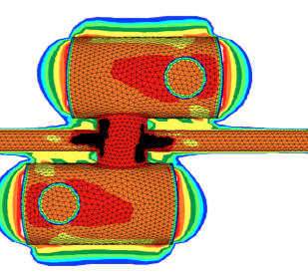
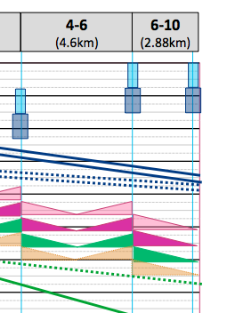
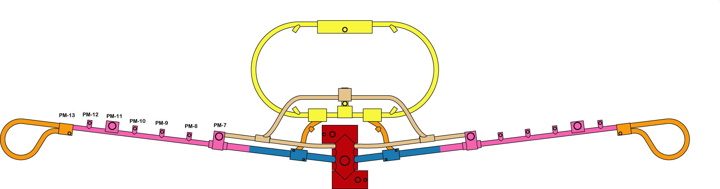
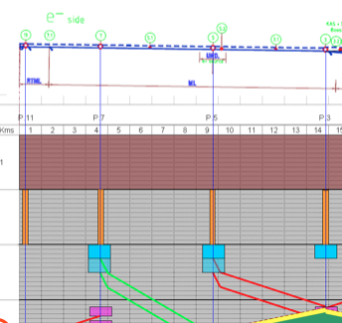
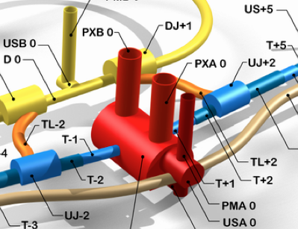
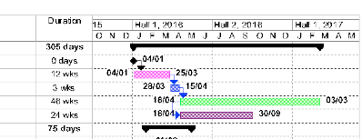
ILC DRAFT CONSTRUCTION SCHEDULE
Flat topography & Mountainous sites
K Foraz & M Gastal
Many thanks to J Osborne, A Kosmicki, H Mainaud Durand, J Paterson for their help

Slide 2
Objectives and scope
To provide a consolidated project construction schedule
  For flat topography sites (Americas, Europe)
  Mountainous region site (Asia)
European site primarily used for flat topography
Focus on the critical path
From excavation to commissioning of the facility
Using LHC and XFEL project construction data
To integrate new data
  ARUP studies for IR
  Granada 2011 workshop
  Draft ILC PIP (Project Implementation Planning)
  Commissioning priorities
  Output of KILC2012
Many parameters can be tuned and affect this draft scenarios
  Tolerance to co-activity, number of teams deployed…

Slide 3
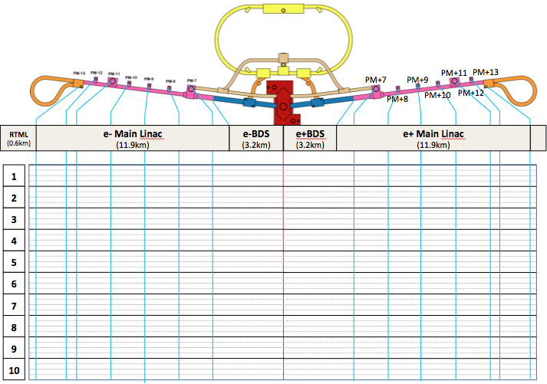
Schedule Format – Flat Topography (FT)
To follow work progress in time and space
ILC layout
(not to scale)
Shafts
position
Distances (to scale)
~ 30km

Slide 4
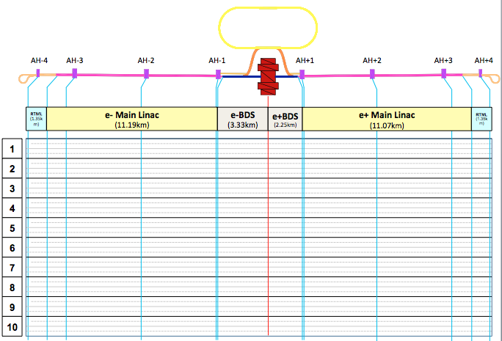
Schedule Format – Mountainous Region (MR)
To follow work progress in time and space
ILC layout
(not to scale)
Access
tunnels
position
Distances (to scale)
~ 30km

Slide 5
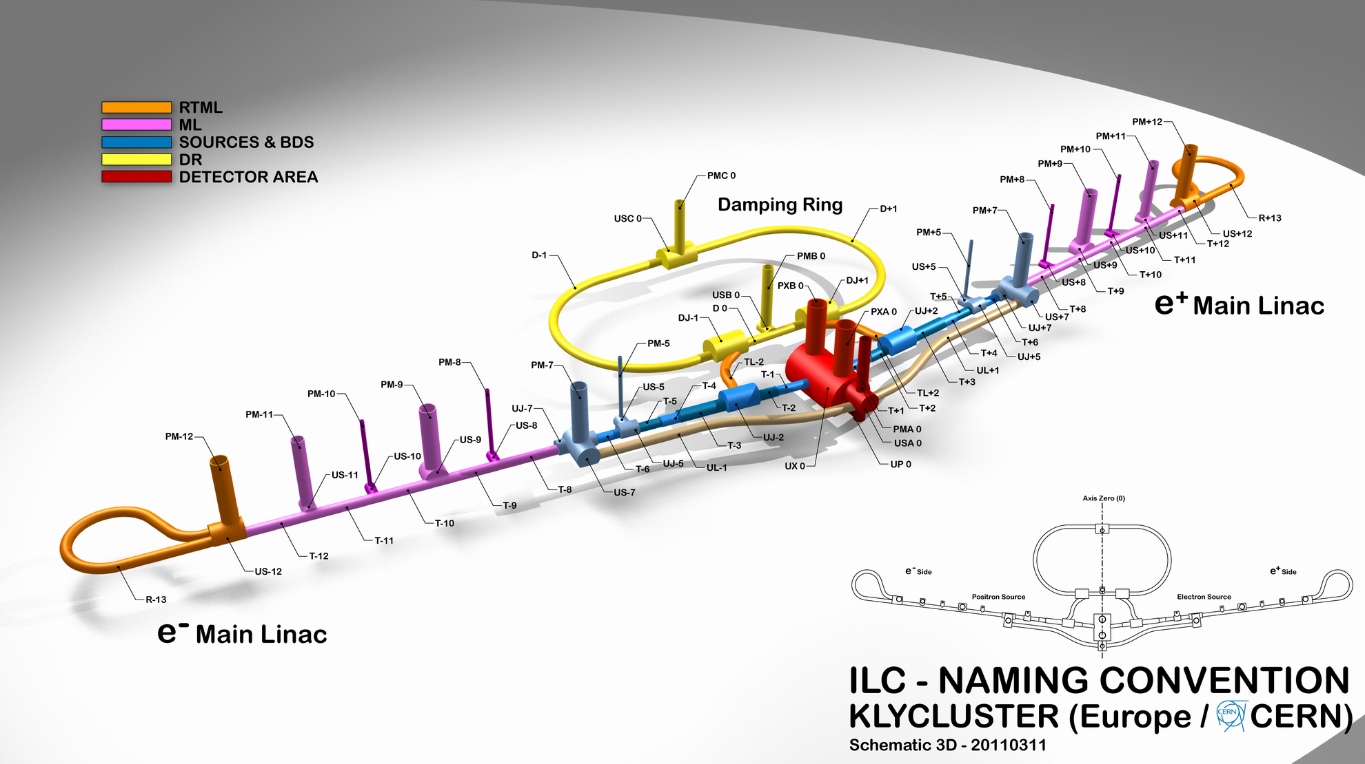
Schedule Format
To follow work progress in time and space
Using latest
naming convention

Slide 6
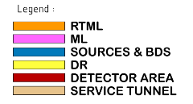
Schedule Format
To follow work progress in time and space
Only for
IR, BDS,
ML & RTML

Slide 7
Schedule Format
To follow work progress in time and space
Time line
In years

Slide 8
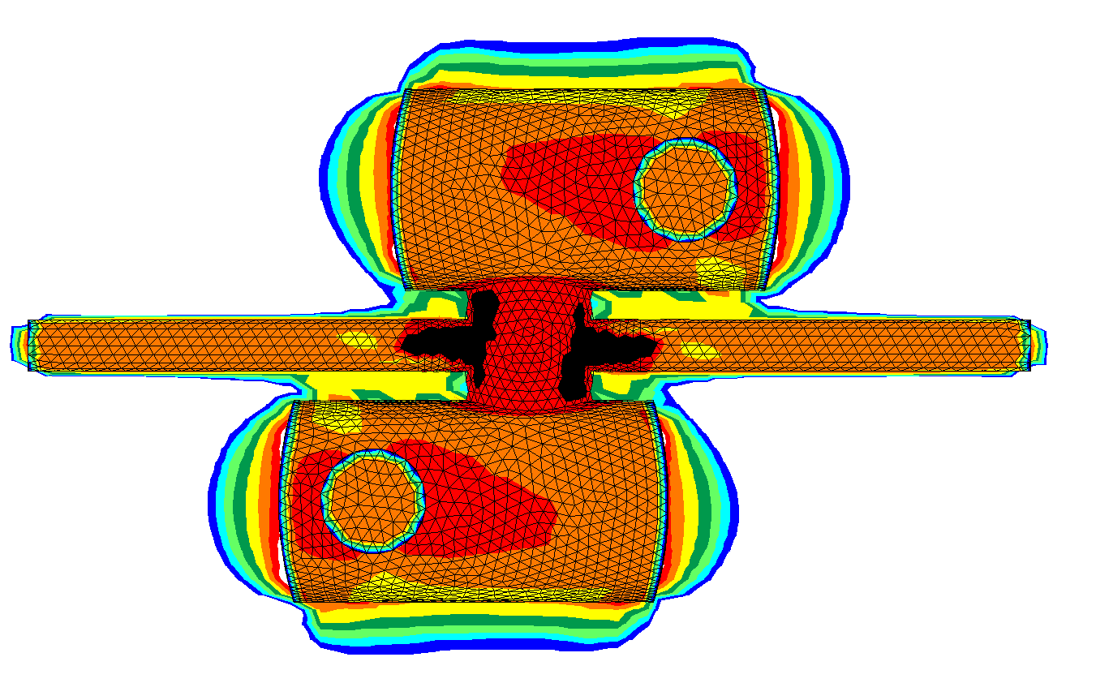
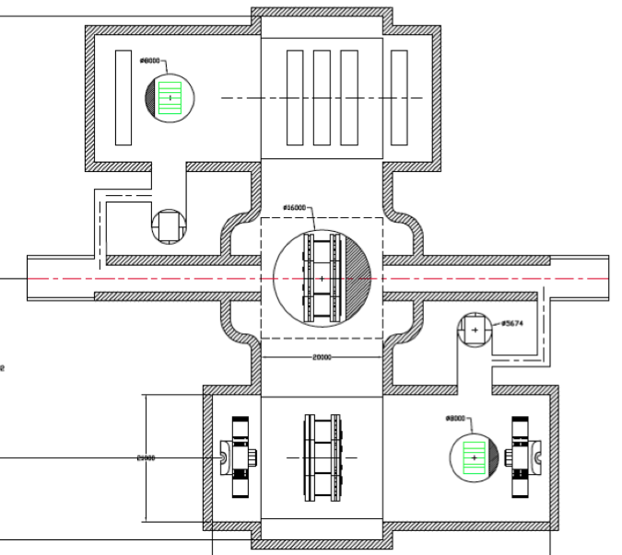
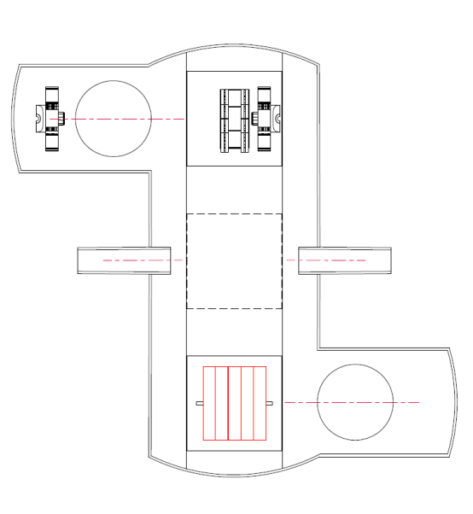
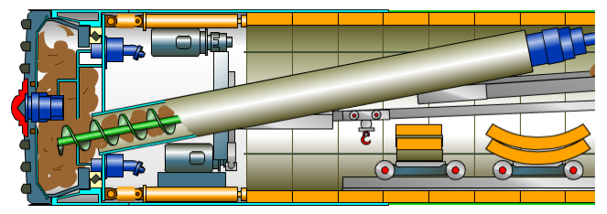
Strategic aspects for FT sites
Result of the ARUP/J Osborne studies recommends minimising stress concentration on the IP by excavating and finishing the interaction cavern before tackling the tunnels and service caverns
TBMs launched from adjacent shafts (PM7) and extracted from an IR shaft
  Allows time for finishing of IR cavern
Recommendations were made for CLIC IR
Compatible with both the 2 and 3 shaft IR layouts

Slide 9
Strategic aspects for FT sites
The BDS tunnel and part of the main linac have a diameter of 8m
  To minimise cost and speed up excavation
The rest of the main linac consists of 5.2m diameter tunnel
TBMs cannot be refurbished to accommodate both tunnel sizes
2 different machines have to be used
We are now looking at a 4 TBM scenario in DBS, ML, RTML (2x5.2 + 2x8)
5.2m Ø tunnel
8m Ø tunnel

Slide 10
Strategic aspects
Requests for early commissioning will set priorities for the delivery of parts of the ILC complex
When designing the construction schedule, an attempt was made to deliver some components as early as possible:
  Damping Rings
  PLTR
  BDS & ML up to PM7/AH1
An attempt to design a detailed schedule of the commissioning period will be shown
DR
PLTR
BDS

Slide 11
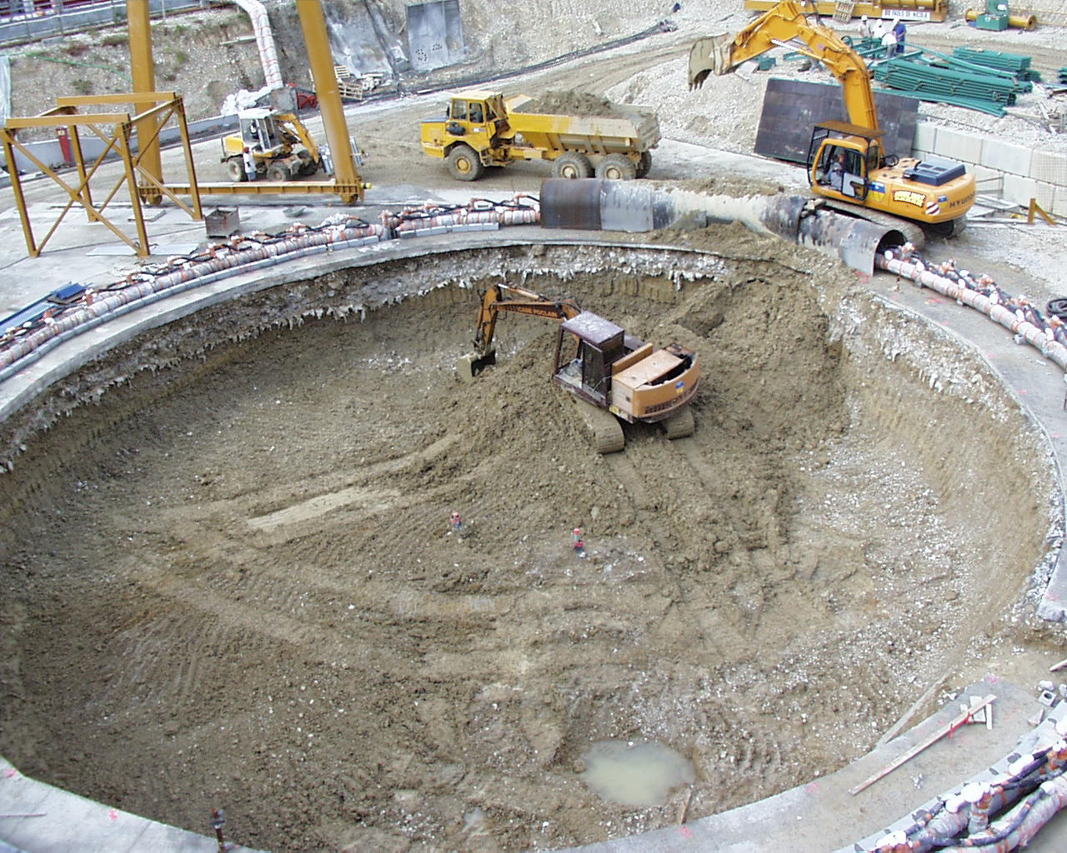
Year 1 – Construction kick-off
FT - Excavation of shafts in parallel
  IR: PX0, PXA0, PXB0
  ML: PM+7, PM-7
  DR: PMA0, PMB0
  1 year per shaft
MR – Excavation of access tunnels
  All 9 of them
  AH1, AH2, AH3, AH4, IP
Launch construction of detector assembly halls on the surface
Launch construction of service buildings

Slide 12
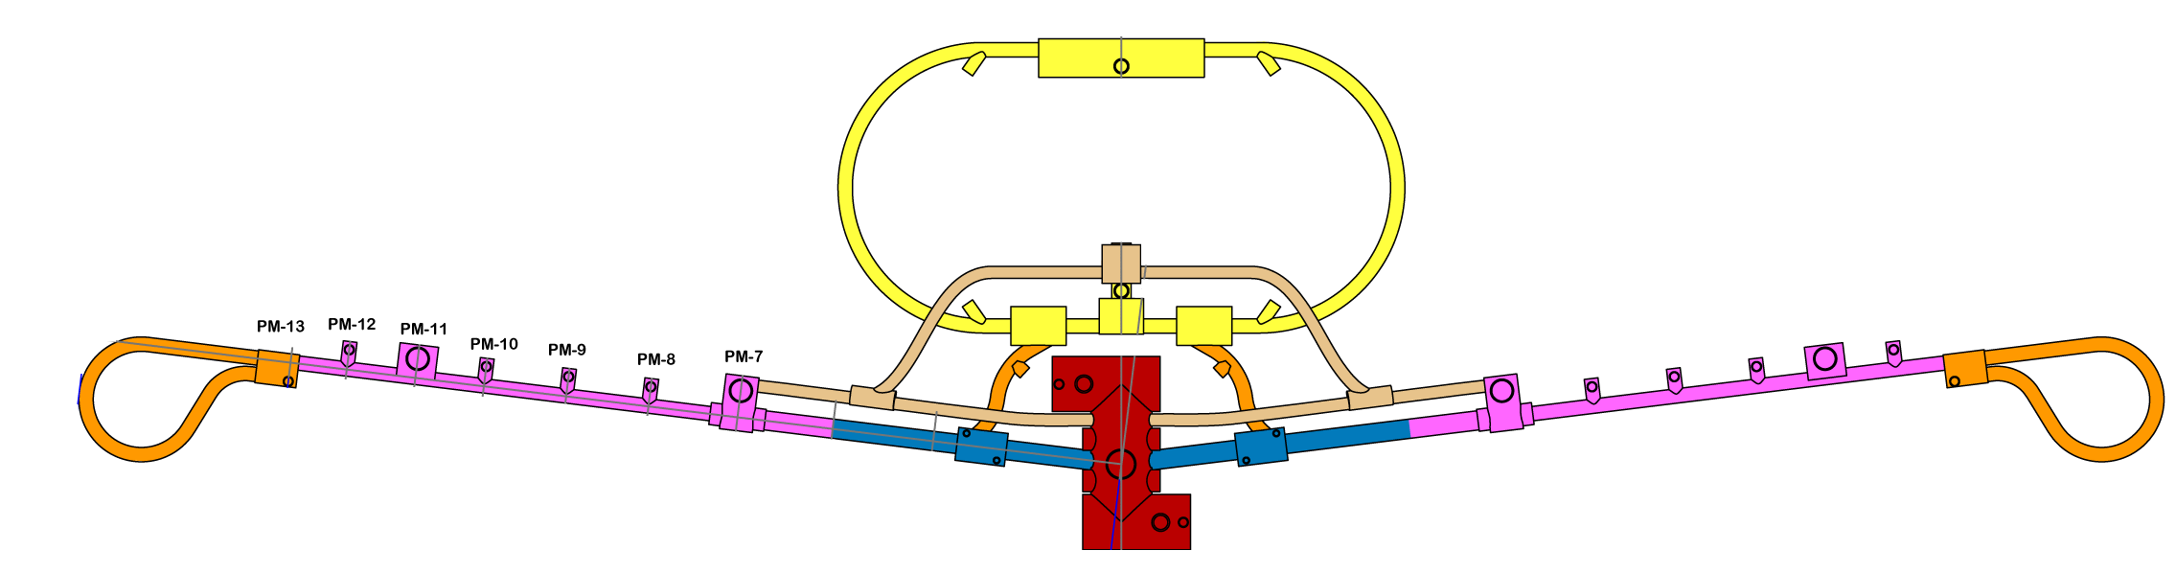
Shaft excavation
Flat Topography
PM+7
PM+9
PM+11
PM+13
PM+8
PM+10
PM+12
RTML
(0.6km)
e- Main Linac
(11.9km)
e-BDS
(3.2km)
e+BDS
(3.2km)
e+ Main Linac
(11.9km)
1
2
3
4
5
6
7
8
9
10

Slide 13
Access Tunnel ex.
Mountainous
AH-4
AH-3
AH-2
AH-1
AH+1
AH+2
AH+3
AH+4
RTML
(1.35km)
e- Main Linac
(11.19km)
e-BDS
(3.33km)
e+BDS
(2.25km)
e+ Main Linac
(11.07km)
RTML
(1.35km)
1
2
3
4
5
6
7
8
9
10

Slide 14
Year 1 – FT vs MR
Launch of works
  FT: Not all access shafts to the underground facilities are started together
  FT: 7 excavation crews in action over 4 sites
  FT: site setup not included, T0 is ground breaking
  MR: Quick deployment of resources to excavate all access tunnels
  MR: 9 excavation crews in action over 9 sites
  MR: Sites setup included?

Slide 15
Year 2 – Tunneling FT
Tunneling has to start in various parts of the facility
  Shafts excavation of PM8,9,10,11,12,13
  Shaft based caverns have to be excavated (IR cavern, US-7, US+7, USB0)
  Two 8m diameter TBMs: ML + BDS
  Two 5.2m diameter TBMs: ML
  One 5.2m diameter TBM: DR
Progress rates for European site:
  8m: 100m/w (3 shifts)
  5.2m: 150m/w (3 shifts)

Slide 16
Shaft excavation
Cavern excavation
TBM installation/extraction
8m tunnel excavation
5.2m tunnel excavation
PM+7
PM+9
PM+11
PM+13
PM+8
PM+10
PM+12
RTML
(0.6km)
e- Main Linac
(11.9km)
e-BDS
(3.2km)
e+BDS
(3.2km)
e+ Main Linac
(11.9km)
1
2
3
4
5
6
7
8
9
10

Slide 17
Year 2 – Tunneling MR
Tunneling has to start in various parts of the facility
  8 Access halls have to be excavated (AH-4, AH-3, AH-2, AH-1, AH+1, AH+2, AH+3, AH+4)
  Tunneling crews are sent from access tunnels AH-3, AH-2, AH-1, AH+1, AH+2, AH+3
  Excavation of IR Cavern started
  Start concrete lining in sectors IP-AH-1 and IP-AH+1
Progress rates:
  Tunneling: 20m/week
AH-4
AH-3
AH-2
AH-1
AH+1
AH+2
AH+3
AH+4

Slide 18
Access Tunnel ex.
Beam Tunnel excavation
BDS Tunnel excavation
Concrete Lining
BDS Service Tunnel excavation
Cavern ex.
Hall ex.
AH-4
AH-3
AH-2
AH-1
AH+1
AH+2
AH+3
AH+4
RTML
(1.35km)
e- Main Linac
(11.19km)
e-BDS
(3.33km)
e+BDS
(2.25km)
e+ Main Linac
(11.07km)
RTML
(1.35km)
1
2
3
4
5
6
7
8
9
10
18

Slide 19
Year 2 – FT vs MR
Tunneling effort is most significant in the Asian region
During Year 2 the Flat topography regions would be still providing access to the underground worksite by excavating shafts
The Asian worksite looks a lot more labor intensive with 8 access halls excavation proceeding in parallel with the IP cavern excavation.
The Asian also foresees the construction of 14 tunnels in parallel

Slide 20
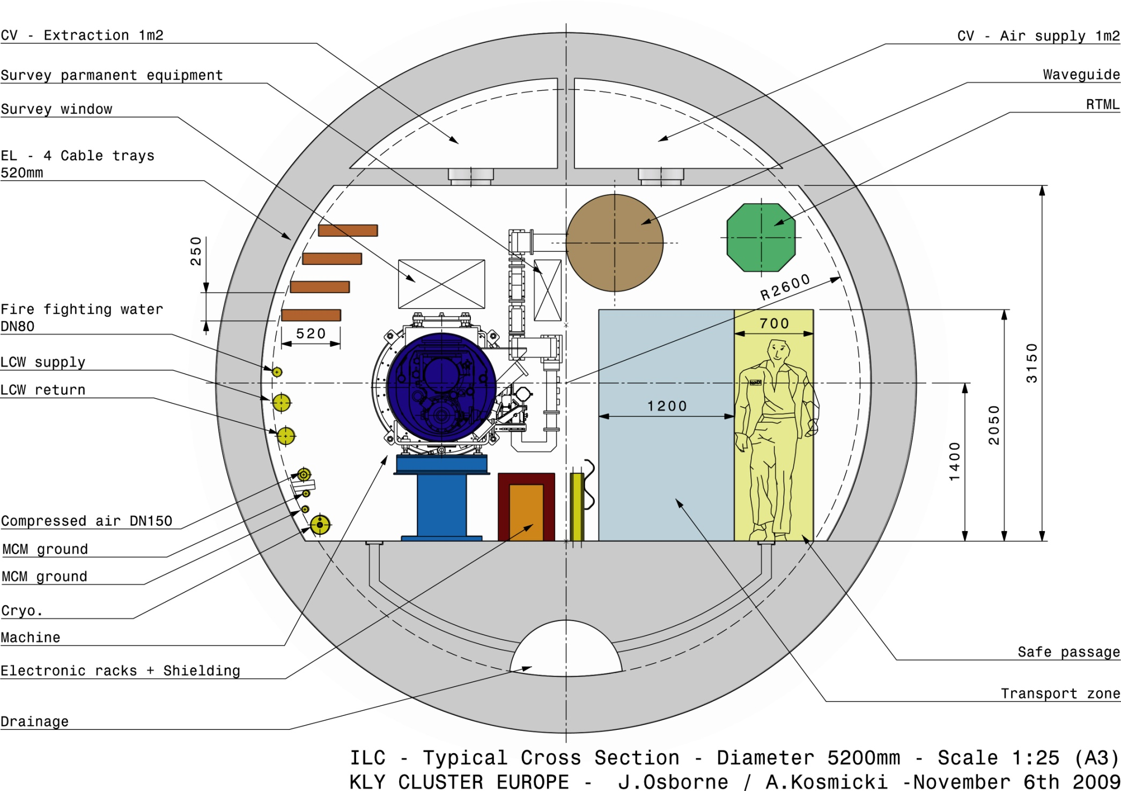

Year 3 – Tunneling, finishing, ceiling ducts
FT
Tunneling will proceed in BDS, ML and DR
  Spoil to be evacuated through PM8
Invert concreting and tunnel finishing will start as soon as spoil management allows
  Progress rate: 50m/d for 3 shifts
Ceiling ducts for fire safety purposes
  Progress rate: 50m/d for 3 shifts

Slide 21
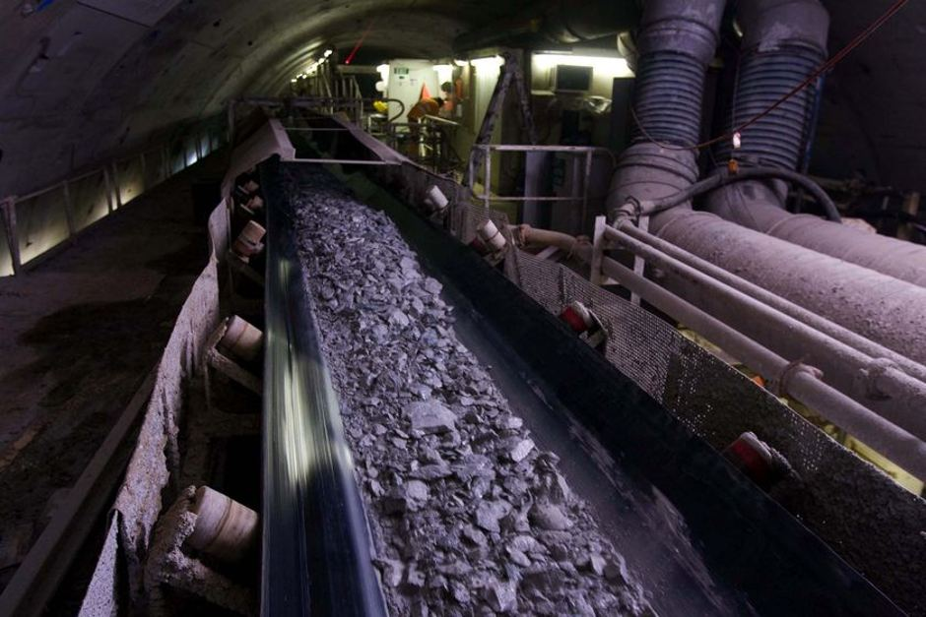
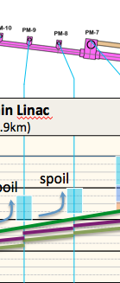
Spoil Management - FT
Work in a tunnel section, e.g. T-8, can only start once the conveyor belt evacuating the spoil produced by the TBM is redirected to the nearest shaft

Slide 22
Shaft excavation
Invert & finishing
Cavern excavation
Ceiling ducts
TBM installation/extraction
8m tunnel excavation
5.2m tunnel excavation
PM+7
PM+9
PM+11
PM+13
PM+8
PM+10
PM+12
RTML
(0.6km)
e- Main Linac
(11.9km)
e-BDS
(3.2km)
e+BDS
(3.2km)
e+ Main Linac
(11.9km)
1
spoil
spoil
spoil
spoil
spoil
spoil
2
3
4
5
6
7
8
9
10

Slide 23
Year 3 – Tunneling, and concrete lining
MR
Excavation of IP cavern
Tunneling will proceed in all 14 tunnels sections
Concrete lining to follow
  Progress rate: 25m/week
  Spoil to be carefully managed once concrete lining starts in the same tunnel section

Slide 24
Access Tunnel ex.
Beam Tunnel excavation
BDS Tunnel excavation
Survey & supports set-out
Concrete Lining
BDS Service Tunnel excavation
Electrical general services
Cavern ex.
Invert & Drainage
Piping & ventilation
Hall ex.
Shield Wall
Cabling
Supports
Machine installation
AH-4
AH-3
AH-2
AH-1
AH+1
AH+2
AH+3
AH+4
RTML
(1.35km)
e- Main Linac
(11.19km)
e-BDS
(3.33km)
e+BDS
(2.25km)
e+ Main Linac
(11.07km)
RTML
(1.35km)
1
2
3
4
5
6
7
8
9
10
24

Slide 25
Year 3 – FT vs MR
Thanks to a higher progress rate the tunneling in the FT site is catching up with the MR.
Spoil management will be a critical challenge

Slide 26
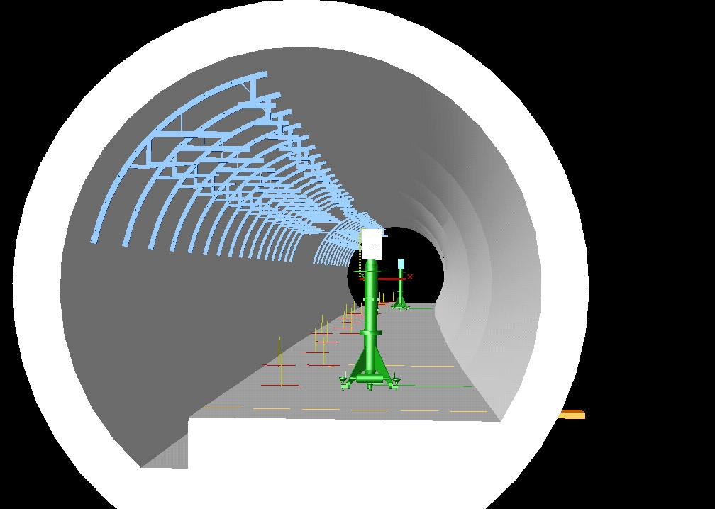
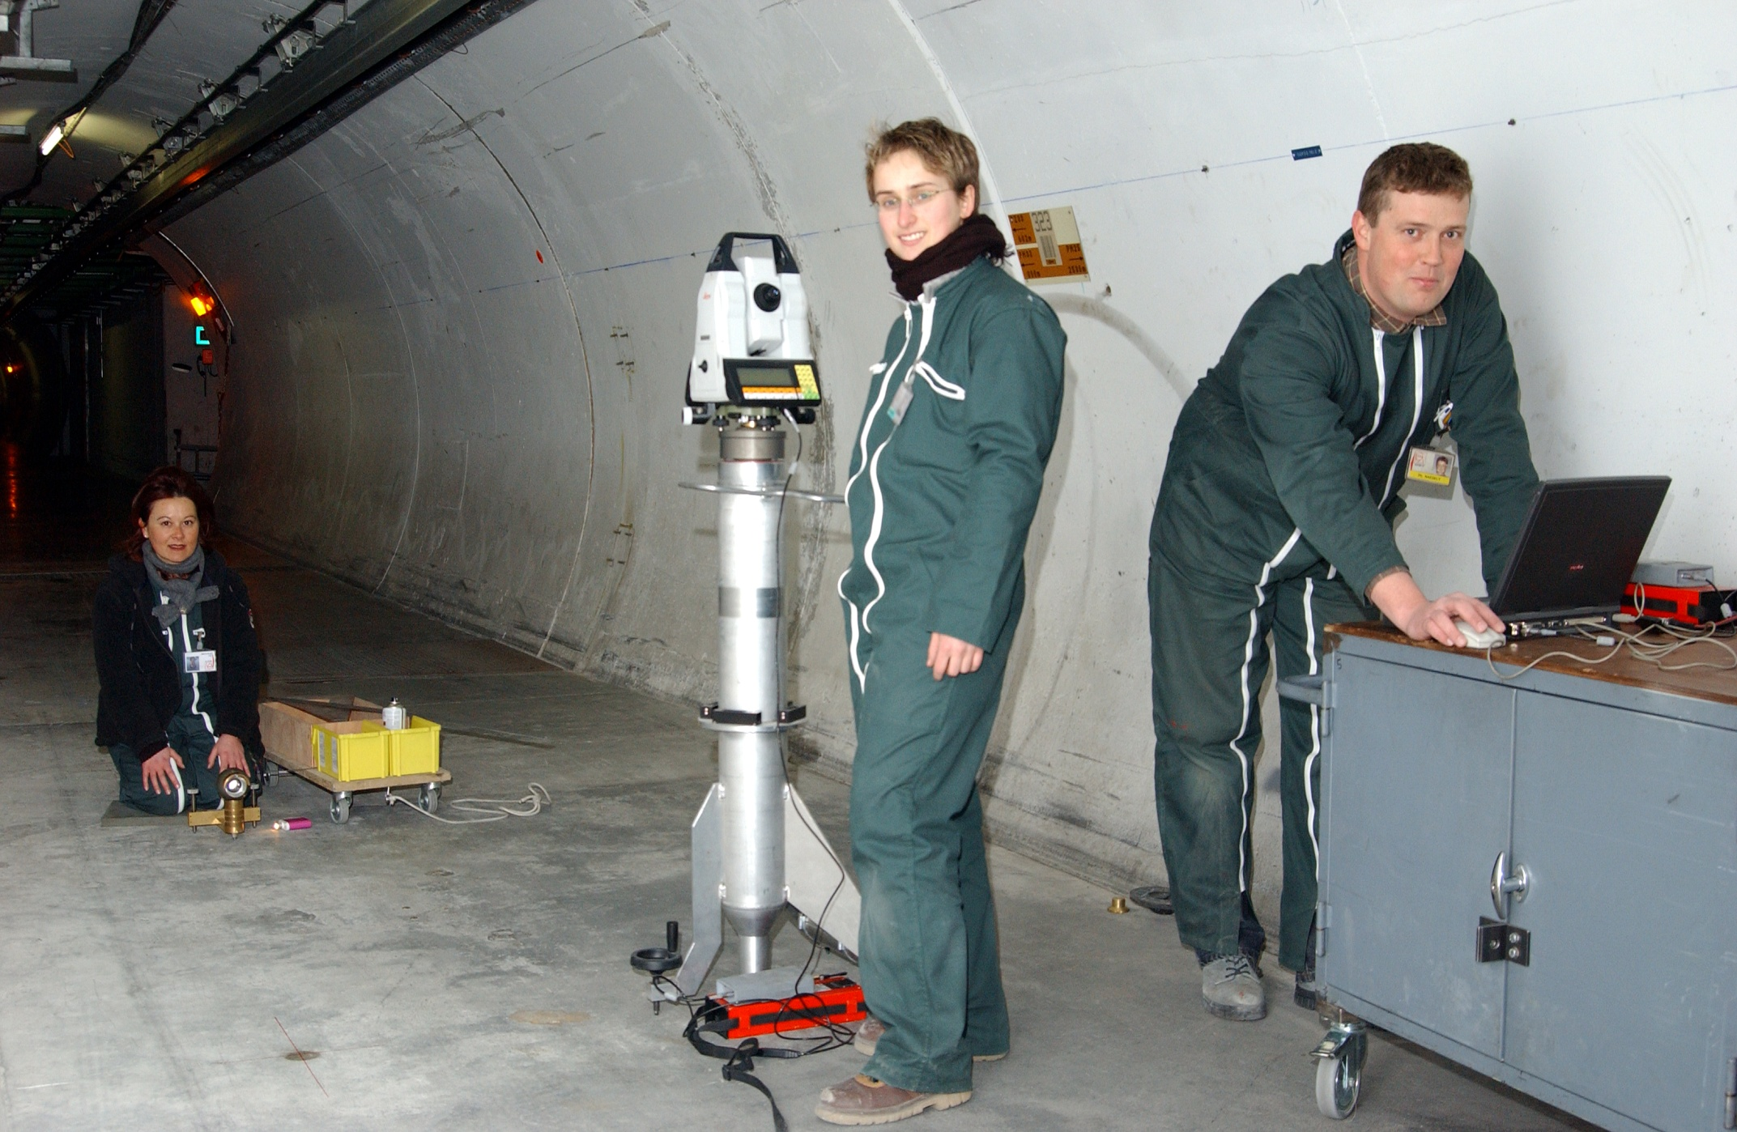
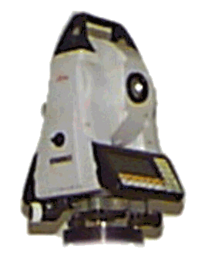
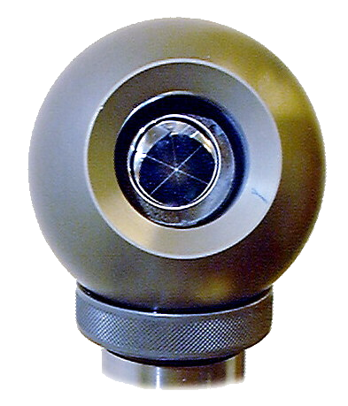
Year 4 – End of CE, infrastructure installation
FT
End of CE phase
  BDS: Q2 ; ML: Q4 ; RTML: Q4
Start of infrastructure installation
  Survey and set out of components supports
  Electrics General Services
  Piping and ventilation
  Cabling
Progress rate 120m/w for 1 shift
Courtesy of BE-ABP-SU

Slide 27
Shaft excavation
Invert & finishing
Cavern excavation
Ceiling ducts
TBM installation/extraction
8m tunnel excavation
5.2m tunnel excavation
PM+7
PM+9
PM+11
PM+13
PM+8
PM+10
PM+12
RTML
(0.6km)
e- Main Linac
(11.9km)
e-BDS
(3.2km)
e+BDS
(3.2km)
e+ Main Linac
(11.9km)
1
spoil
spoil
spoil
spoil
spoil
spoil
2
3
4
5
End of civil engineering: Y4 Q4
6
7
8
9
10

Slide 28
Survey & supports set-out
Electrics general services
Piping & ventilation
Cabling
PM+7
PM+9
PM+11
PM+13
PM+8
PM+10
PM+12
RTML
(0.6km)
e- Main Linac
(11.9km)
e-BDS
(3.2km)
e+BDS
(3.2km)
e+ Main Linac
(11.9km)
1
spoil
spoil
spoil
spoil
spoil
spoil
2
3
4
5
6
7
8
9
10

Slide 29
Year 4 – End of tunneling in Main Linac, finishing
MR
End of tunneling phase in Beam Tunnel and BDS
Tunneling to proceed in BDS service tunnel
Concrete lining to proceed in Beam Tunnel
Invert and drainage work to start
  Progress rate: 45m/week

Slide 30
Access Tunnel ex.
Beam Tunnel excavation
BDS Tunnel excavation
Survey & supports set-out
Concrete Lining
BDS Service Tunnel excavation
Electrical general services
Cavern ex.
Invert & Drainage
Piping & ventilation
Hall ex.
Shield Wall
Cabling
Supports
Machine installation
AH-4
AH-3
AH-2
AH-1
AH+1
AH+2
AH+3
AH+4
RTML
(1.35km)
e- Main Linac
(11.19km)
e-BDS
(3.33km)
e+BDS
(2.25km)
e+ Main Linac
(11.07km)
RTML
(1.35km)
1
2
3
4
5
6
7
8
9
10
30

Slide 31
Year 4 – FT vs MR
The civil engineering work reaches completion during Year 4 in the flat topography site
Due to slower tunneling progress rates the MR civil engineering work will need one more year to reach completion
Year 5 for MR is dominated by the construction of the Shield wall
  Progress rate: 45m/week
Milestones: Civil engineering work complete
  FT: Y4 Q4
  MR: Y5 Q1

Slide 32
Access Tunnel ex.
Beam Tunnel excavation
BDS Tunnel excavation
Concrete Lining
BDS Service Tunnel excavation
Cavern ex.
Invert & Drainage
Hall ex.
Shield Wall
AH-4
AH-3
AH-2
AH-1
AH+1
AH+2
AH+3
AH+4
RTML
(1.35km)
e- Main Linac
(11.19km)
e-BDS
(3.33km)
e+BDS
(2.25km)
e+ Main Linac
(11.07km)
RTML
(1.35km)
1
2
3
4
5
61.9
61.9
62.0
60.3
61.9
61.9
6
7
8
9
10
32

Slide 33
Year 5 6 7 8– Getting ready for machine components installation FT
Installation of infrastructure
  Survey and set out of components supports
  Electrics General services
  Piping and ventilation
  Cabling
Impact of the number of teams deployed is significant
  Baseline: 2 teams
  Option: 4 teams
Progress rate 120m/w for 1 shift

Slide 34
Survey & supports set-out
Electrics general services
Piping & ventilation
Cabling
PM+7
PM+9
PM+11
PM+13
PM+8
PM+10
PM+12
RTML
(0.6km)
e- Main Linac
(11.9km)
e-BDS
(3.2km)
e+BDS
(3.2km)
e+ Main Linac
(11.9km)
1
spoil
spoil
spoil
spoil
spoil
spoil
2
3
4
5
6
7
8
9
Assumption: 2 teams
10

Slide 35
Survey & supports set-out
Electrics general services
Piping & ventilation
Cabling
PM+7
PM+9
PM+11
PM+13
PM+8
PM+10
PM+12
RTML
(0.6km)
e- Main Linac
(11.9km)
e-BDS
(3.2km)
e+BDS
(3.2km)
e+ Main Linac
(11.9km)
1
spoil
spoil
spoil
spoil
spoil
spoil
2
3
4
5
6
7
8
9
Assumption: 4 teams
End of RTML 1.5year earlier
10

Slide 36
Year 6 7 8– Getting ready for machine components installation MR
Installation of infrastructure
  Survey and set out of components supports
  Electrics General services
  Piping and ventilation
  Cabling
4 teams deployed
  In the Asian schedule, teams from different activities are allowed to work in one same sector ex in e-BDS between electrical teams and piping teams
  Having shield wall might make this possible
Progress rate 120m/w for 1 shift

Slide 37
Access Tunnel ex.
Beam Tunnel excavation
BDS Tunnel excavation
Survey & supports set-out
Concrete Lining
BDS Service Tunnel excavation
Electrical general services
Cavern ex.
Invert & Drainage
Piping & ventilation
Hall ex.
Shield Wall
Cabling
AH-4
AH-3
AH-2
AH-1
AH+1
AH+2
AH+3
AH+4
RTML
(1.35km)
e- Main Linac
(11.19km)
e-BDS
(3.33km)
e+BDS
(2.25km)
e+ Main Linac
(11.07km)
RTML
(1.35km)
1
2
3
4
5
61.9
61.9
62.0
60.3
61.9
61.9
6
7
120m/week
8
9
10
37

Slide 38
Year 5 6 7 8– FT vs MR
Progress rates used for the Installation of infrastructure are the same for both regions
  Survey and set out of components supports
  Electrics General services
  Piping and ventilation
  Cabling
Allowing multiple types of activities in a same tunnel section allows the MR schedule to catch up slightly with the FT one
Milestones: Installation of infrastructure complete
  FT: Y7 Q3
  MR: Y8 Q1
Milestone: Installation of machine components in BDS started
  FT: Y6 Q1
  MR: Y7 Q2

Slide 39
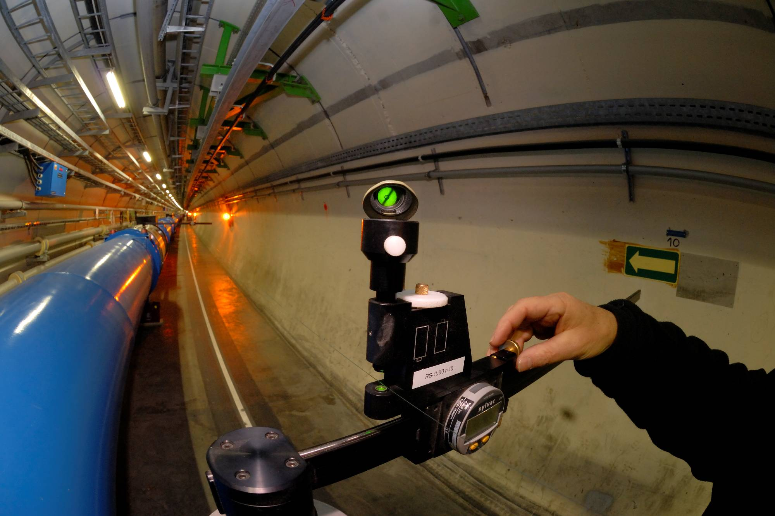
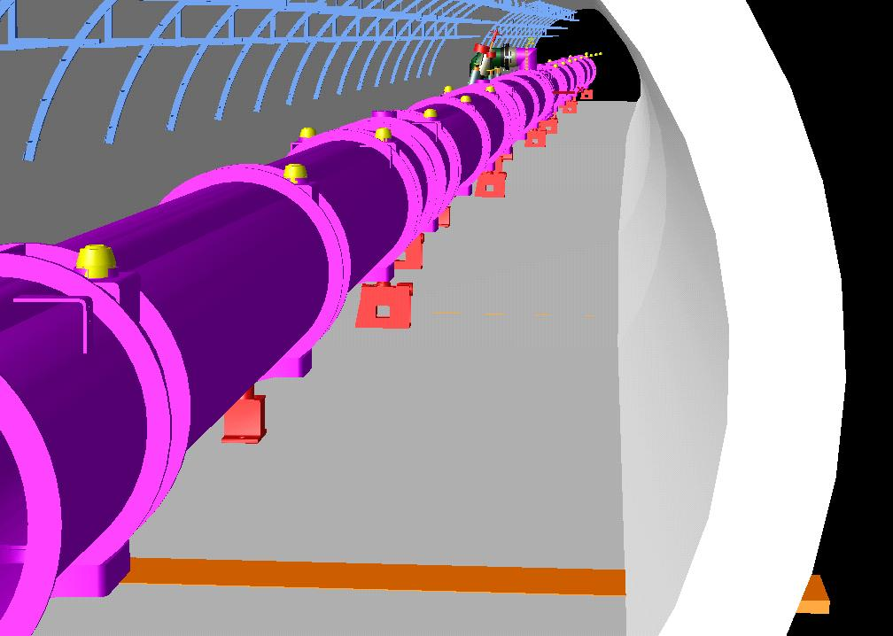
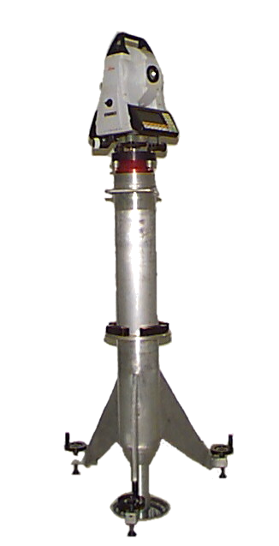
Year 7 8 9 10– Installing machine components
Installation of supports for machine components
  Progress rate: 250m/w for 1 shift
Installation of machine components
  Transport
  Interconnections
  Alignment
  Progress rate: 100m/w for 1 shift (Average value from LHC, to be further defined…)
2 teams for each activity for FT; 4 teams for each activity for MR

Slide 40
Supports
Survey & supports set-out
Machine installation
Electrical general services
Piping & ventilation
Cabling
PM+7
PM+9
PM+11
PM+13
PM+8
PM+10
PM+12
RTML
(0.6km)
e- Main Linac
(11.9km)
e-BDS
(3.2km)
e+BDS
(3.2km)
e+ Main Linac
(11.9km)
1
spoil
spoil
spoil
spoil
spoil
spoil
2
3
4
5
6
7
8
9
Assumptions: Infrastructure: 2 teams
Machine installation: 2 teams
10

Slide 41
Supports
Survey & supports set-out
Machine installation
Electrical general services
Piping & ventilation
Cabling
PM+7
PM+9
PM+11
PM+13
PM+8
PM+10
PM+12
RTML
(0.6km)
e- Main Linac
(11.9km)
e-BDS
(3.2km)
e+BDS
(3.2km)
e+ Main Linac
(11.9km)
1
spoil
spoil
spoil
spoil
spoil
spoil
2
3
4
5
6
7
8
Assumptions: Infrastructure: 4 teams
Machine installation: 2 teams
9
10
Completion date depends heavily on what happens in BDS region

Slide 42
Supports
Survey & supports set-out
Machine installation
Electrics general services
Piping & ventilation
Cabling
PM+7
PM+9
PM+11
PM+13
PM+8
PM+10
PM+12
RTML
(0.6km)
e- Main Linac
(11.9km)
e-BDS
(3.2km)
e+BDS
(3.2km)
e+ Main Linac
(11.9km)
1
spoil
spoil
spoil
spoil
spoil
spoil
2
3
4
5
6
7
8
9
Assumption: 4 teams in BDS, 2 teams in ML & RTML
Machine installation: 2 teams
10

Slide 43
Access Tunnel ex.
Beam Tunnel excavation
BDS Tunnel excavation
Survey & supports set-out
Concrete Lining
BDS Service Tunnel excavation
Electrical general services
Cavern ex.
Invert & Drainage
Piping & ventilation
Hall ex.
Shield Wall
Cabling
Supports
Machine installation
AH-4
AH-3
AH-2
AH-1
AH+1
AH+2
AH+3
AH+4
RTML
(1.35km)
e- Main Linac
(11.19km)
e-BDS
(3.33km)
e+BDS
(2.25km)
e+ Main Linac
(11.07km)
RTML
(1.35km)
1
2
3
4
5
61.9
61.9
62.0
60.3
61.9
61.9
6
7
8
9
10
43

Slide 44
Construction schedule – FT vs MR
The Asian site schedule is a lot more labor intensive
The faster rate of TBMs allows for a faster completion of the civil engineering work in the FT schedule
  Spoil management to be studied carefully
Building the shield wall takes an entire year in the MR schedule
The installation of infrastructure is slightly faster in the MR region thanks to the deployment of more teams and greater tolerance to coactivity
Allowing the installation of the machine components to be carried out by 4 teams allows the MR schedule to catch up with the FT schedule
Milestone: Ready for early commissioning (BDS and ML up to PM7/AH1)
  FT: Y7 Q2
  MR: Y8 Q2
Milestone: Ready for Full commissioning (whole accelerator available)
  FT: Y10 Q1
  MR: Y10 Q1
Milestone: ILC ready for beam
  FT: Y10 Q4
  MR: TO BE FURTHER STUDIED (commissioning program to be fine tuned)

Slide 45
Considerations of the high-tech mass production schedule
- Light blue: Pre-production or pre-industrialization stage (or preparation for full production)
- Yellow : Full production of material and components/parts.
- Orange: Full assembly stage and test stage in parallel.
yr | Step | SC material | SCRF cavity | CM parts | CM ass. and test | RF parts | RF ass. and aging
1
2
3
4
5
6
7
8
9
10
yr | Step | SC material | SCRF cavity | CM parts | CM ass. and test | RF parts | RF ass. and aging
1
2
3
4
5
6
7
8
9
10
Prep.
Production
Installation of machine components - FT

Slide 46
consideration of the high-tech mass production schedule
yr | Step | SC material | SCRF cavity | CM parts | CM ass. and test | RF parts | RF ass. and aging
1
2
3
4
5
6
7
8
9
10
yr | Step | SC material | SCRF cavity | CM parts | CM ass. and test | RF parts | RF ass. and aging
1
2
3
4
5
6
7
8
9
10
Prep.
Production
Installation of machine components - MR

Slide 47
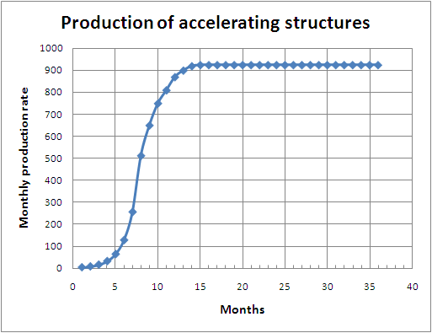
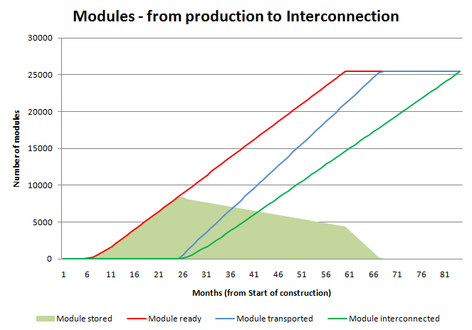
Considerations of the high-tech mass production schedule
The Asian region schedule allows for a longer production time of the accelerator parts
Next step: come up with a production schedule compatible with an installation schedule, ex for CLIC shown below

Slide 48
Commissioning
Early Commissioning : Draft program (Ewan):
  The e- injector system to 5 GeV and dump : 3 Months
  The e+ source and systems to 5 GeV and dump utilizing the auxiliary low current e- source to produce e+ : 3 Months
  Hardware commissioning of injection lines and both Damping rings : 3 months
  Commission both rings with beams from injectors with extraction only into first dump in the PLTR (beam still in injection/extraction tunnels): 9 months
Requires the availability of:
  BDS and ML up to PM7/AH1 (FT: Y7 Q2)
  PLTR
  Damping Rings
Draft schedule for the construction and installation of the DR+PLTR – FT only
  DR: One 6m diameter, 3240m long tunnel – excavation using TBM at a rate of 150m/w for 3 shifts
  PLTR: Two 6-8m diameter, 270m long tunnels – excavation using road headers at a rate of 30m/w for 3 shifts
  When possible, the RD and PLTR are treated as one 3780m tunnel

Slide 49
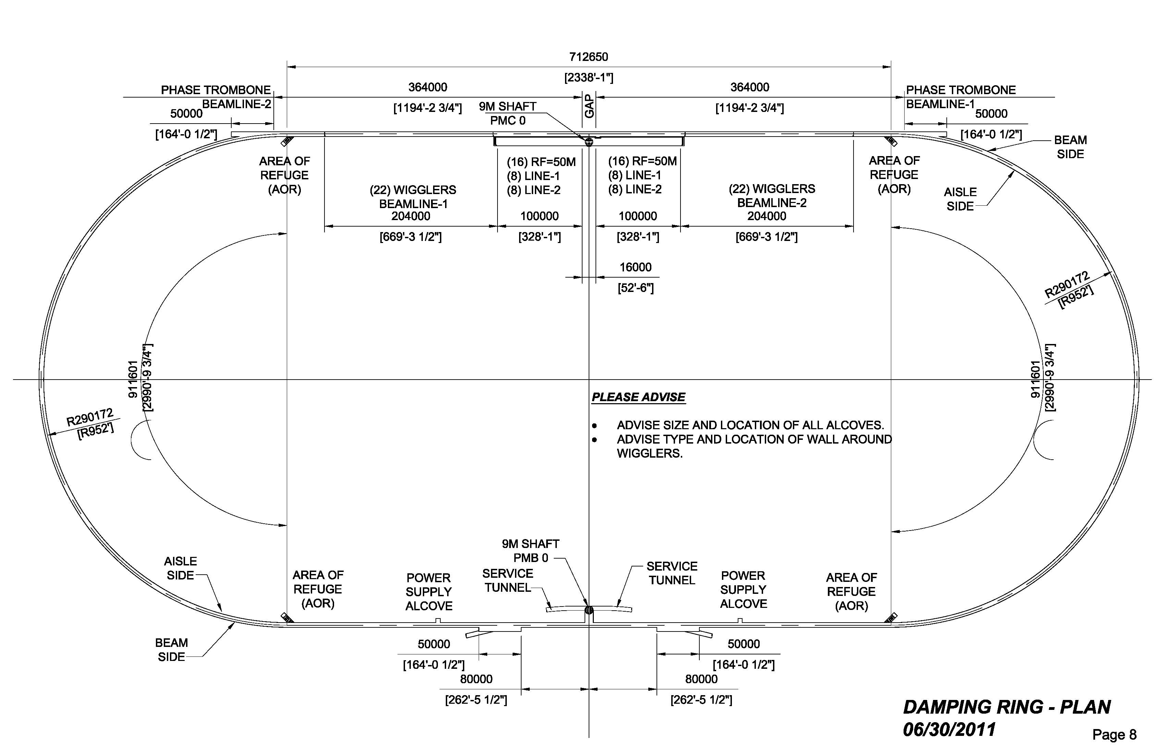
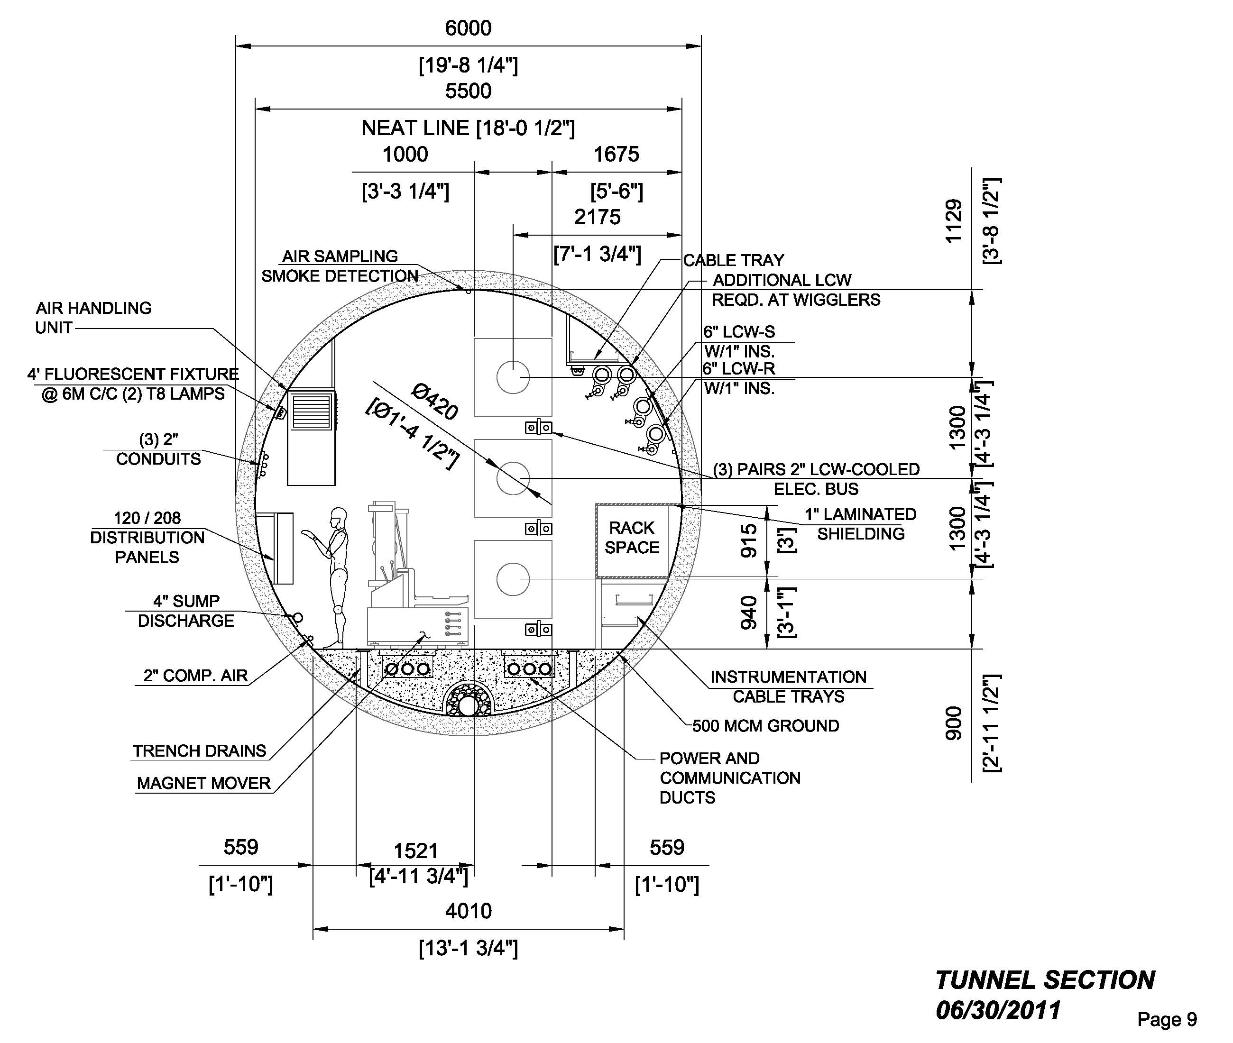
Early Commissioning – FT only
CE phase
  Invert and finishing: 250m/w
  Ceiling ducts: 250m/w
Installation of infrastructure in DR and PLTR
  Survey: 120m/w 120m/w
  Electrics: 80m/w 120m/w
  Piping & ventilation: 80m/w 120m/w
  Cabling: 80m/w 120m/w
Installation of machine components
  Supports: 250m/w
  Machine elements: DR: 50m/w ; PLTR: 100m/w
    Many more components per meter to install in DR

Slide 50
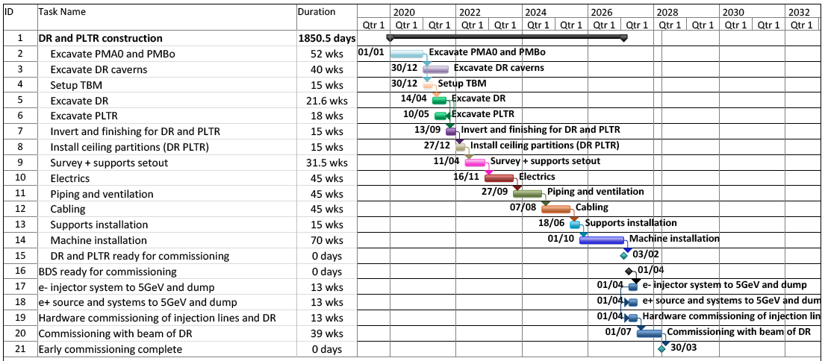
Delivery of DR and PLTR for commissioning
FT only
Under our set of assumptions, the DR and PLTR would be made available to commissioning before the BDS becomes available
The early commissioning would be over during Y8 Q3

Slide 51
Global Commissioning
FT only
Still quite early to come up with precise estimates
Based on LHC:
  6 month of pre-commissioning per sector
  12 months of global commissioning
Key dates
  BDS ready for commissioning: Y7 Q2
  ML ready for commissioning: Y9 Q3
Pre-requisite to launch commissioning with beam IF detectors not available
  Temporary vacuum pipe through IR area
  Temporary QD0
  Temporary shielding

Slide 52
Supports
Survey & supports set-out
Machine installation
Electrical general services
Commissioning
Piping & ventilation
Cabling
PM+7
PM+9
PM+11
PM+13
PM+8
PM+10
PM+12
RTML
(0.6km)
e- Main Linac
(11.9km)
e-BDS
(3.2km)
e+BDS
(3.2km)
e+ Main Linac
(11.9km)
1
spoil
spoil
spoil
spoil
spoil
spoil
2
3
4
5
6
7
8
9
10
Commissioning

Slide 53
Access Tunnel ex.
Beam Tunnel excavation
BDS Tunnel excavation
Survey & supports set-out
Concrete Lining
BDS Service Tunnel excavation
Electrical general services
Cavern ex.
Invert & Drainage
Piping & ventilation
Hall ex.
Shield Wall
Cabling
Supports
Machine installation
AH-4
AH-3
AH-2
AH-1
AH+1
AH+2
AH+3
AH+4
RTML
(1.35km)
e- Main Linac
(11.19km)
e-BDS
(3.33km)
e+BDS
(2.25km)
e+ Main Linac
(11.07km)
RTML
(1.35km)
1
2
3
4
5
61.9
61.9
62.0
60.3
61.9
61.9
6
7
8
9
10
Commissioning
53

Slide 54
Conclusion and next steps
This draft schedules shows how the ILC could be built in less than 9 years
Many additional studies will be necessary to finalise the work plans
New iteration would be necessary if layouts are modified
The commissioning of the Asian region has to be further studied
Next steps:
  Include waveguide and RTML (input needed from installation studies)
  Include Service Tunnel and its cavern
  Include Surface buildings
  Consolidate scheduling studies for the construction and installation of the detectors in both FT and RM regions – synergies with CLIC

