Slide 1
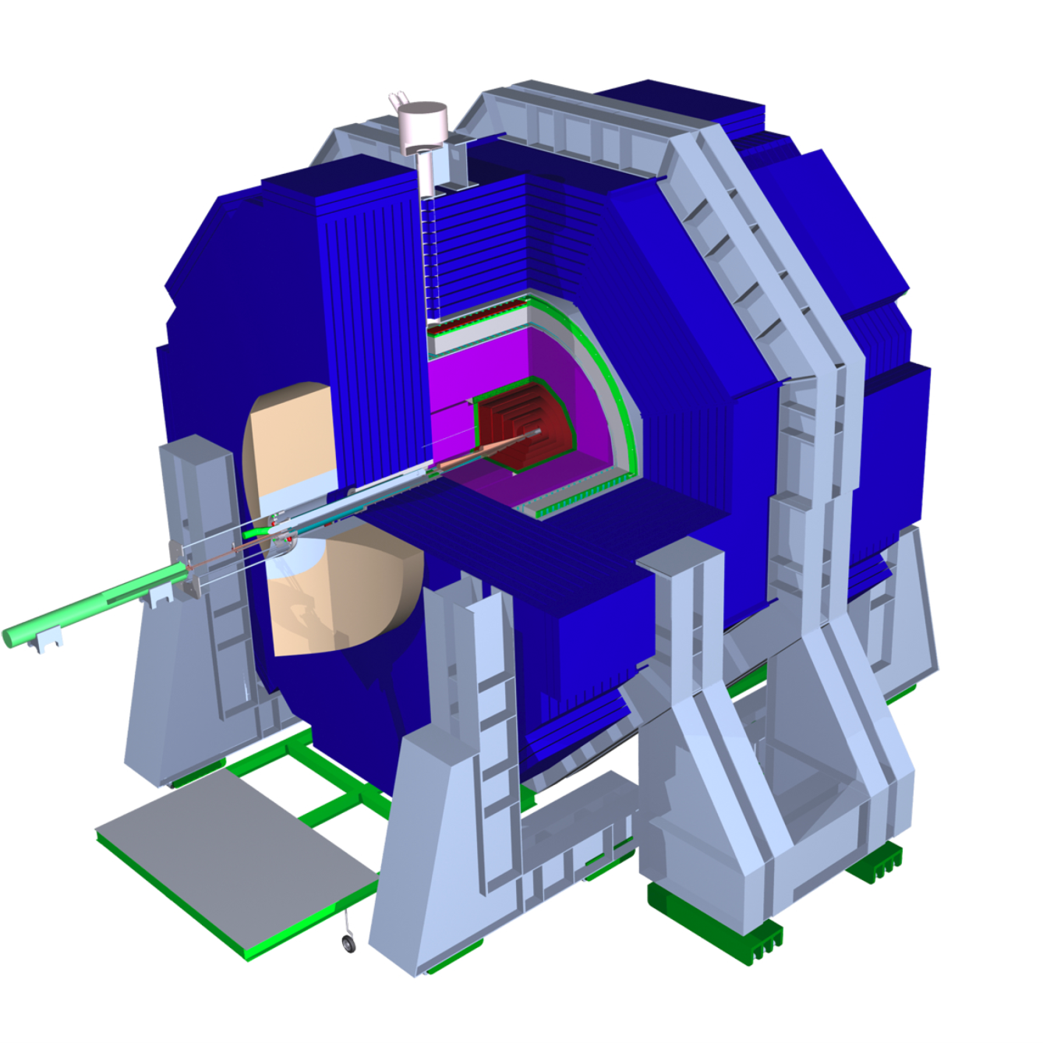
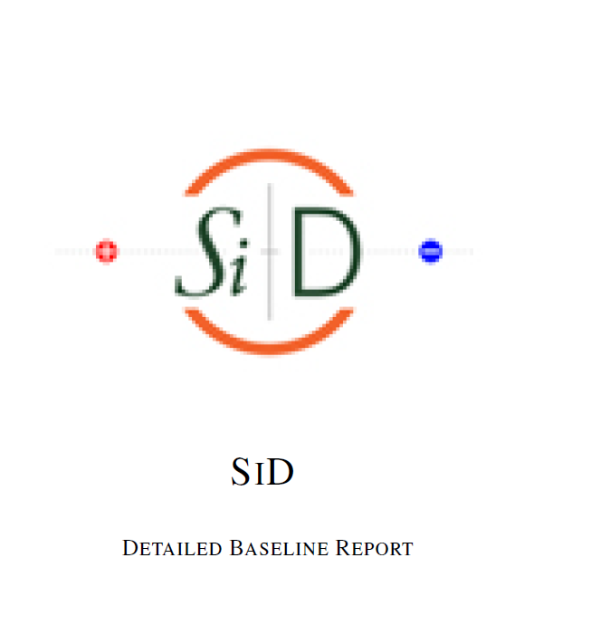

Charge to the SiD Workshop
Andy White
University of Texas at Arlington

Slide 2
The DBD !!

Slide 3
…but also:
The “Higgs” and consequences
The “Snowmass 2013” exercise
The future of Linear Colliders
Interworking with CLIC colleagues
The future of SiD
Completion of R&D

Slide 4
From SiD Workshop, December 2011
Preparing the SiD Detailed Baseline Design
A design/technology for each subdetector that has had sufficient R&D that it could be developed into a fully engineered component of SiD with the performance required by the ILC physics program.
A program of ongoing R&D to support the baseline technology choice for each subdetector and allow possible options.
A possible optimization cycle for each subsystem
Enhanced detailed simulation for some subsystems

Slide 5
From SiD Workshop, December 2011
Preparing the SiD Detailed Baseline Design
Demonstrated the ability of all the subdetectors to work together to achieve the required physics performance.
Demonstrated integration with the beam delivery system of the ILC (MDI studies, push-pull,…)
A plan for the level of engineering which can be achieved for the DBD
A reasonable and plausible estimate/breakdown of the cost (basis to be agreed).
- A projection of ongoing R&D activities post-DBD

Slide 6
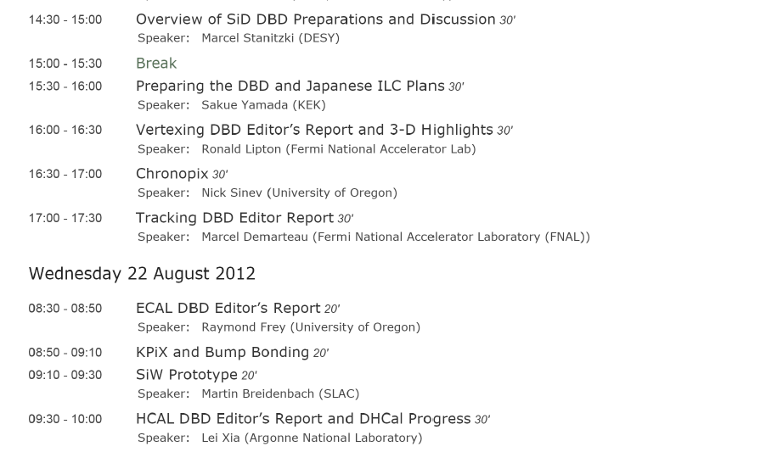
Status of the DBD
Marcel will tell us where we stand
https://confluence.slac.stanford.edu/display/ilc/SiD+DBD+Chapter+Status
Etc…..

Slide 7
Sakue’s Nine Points
Demonstrate proof of principle on critical components.
When there are options, at least one option for each subsystem will reach a level of maturity which verifies feasibility.
Define a feasible baseline design.
While a baseline will be specified, options may also be considered.
Complete basic mechanical integration of the baseline design accounting for insensitive zones such as the beam holes, support structure, cables, gaps or inner detector material.
Develop a realistic simulation model of the baseline design, including the identified faults and limitations.
Develop a push-pull mechanism, working out the movement procedure, time scale, alignment and calibration schemes in cooperation with relevant groups.
Develop a realistic concept of integration with the accelerator including the IR design.
Simulate and analyze updated benchmark reactions with the realistic detector model. Include the impact of detector dead zones and updated background conditions.
Simulate and study some reactions at 1 TeV, including realistic higher-energy backgrounds, demonstrating the detector performance.
Develop an improved cost estimate.

Slide 8
The DBD represents :
A statement of a viable detector concept for a future linear collider
The result of many years of study of detector components, software, and physics
Includes new approaches to detector technology – valuable for the whole of HEP
The expenditure of significant research funding
A lot of hard work!
…but – we have quite a way to go to make the DBD into a document for a wide audience and to support our case for a linear collider as the next major HEP facility.

Slide 9
DBD Editors
Overall editors: P. Burrows, M. Stanitzki, L. Linssen, M. Oreglia, H. Aihara
SiD Area | Section editors
VTX | R. Lipton, W. Cooper
TRK | M. Demarteau, T. Nelson, W. Cooper
ECal | R. Frey, M. Stanitzki
HCal | A. White, L. Xia
Muon | G. Fisk, H. Band
FWD | B. Schumm, T. Maruyama
Magnet | W. Craddock, M. Oriunno
MDI | P. Burrows, T. Markiewicz
Sim/Reco/PFA/Perf. | N. Graf, J. Strube
Benchmarking | T. Barklow, P. Roloff
Cost | M. Breidenbach, K. Krempetz
Elect/DAQ | G. Haller
Section editors:

Slide 10
SiD DBD Timeline
March 2012 – Outline presented to/ approved by IDAG
DBD Main and subsection editors appointed
SLAC Workshop – first draft
September 21 – Draft DBD due to IDAG
LCWS 2012 UT Arlington – IDAG considers draft DBD
Late November – final draft due to PAC
December – PAC meets, considers IDAG
Public distribution,…

Slide 11
Recent progress on SiD
SiD R&D has continued to make progress…
… momentum from earlier studies
… R&D funding issues this year – reviews, visit to DoE
… FWP/LCRD/FOA exercise in progress

Slide 12
SiD Detector R&D
There are many SiD/SiD-related R&D projects ongoing:
Most (all?) will extend beyond the completion of the DBD
Hopefully the FWP/FOA will result in sufficient support to allow our priority projects to continue
We will hear from DoE (Glen Crawford) on Thursday…
The results of the EU Strategy, Snowmass2013,…could lead to a major change…?

Slide 13
Future of SiD
(extract from a letter to Lyn Evans (July 2012))
Given this successful program to develop the SiD Concept , we would like to express how we see the future path for SiD. There are several aspects to this from the detector, physics, organizational, and resource perspectives. As a detector concept we strongly believe that, while technologies and/or their implementations may evolve over time, SiD will remain an excellent tool for exploration of physics at a linear collider. We therefore propose to further study and develop SiD as new information emerges in the Higgs and possibly other new physics areas. There are many areas of detector R&D that must be further developed and completed, followed by studies of specific implementations in a full technical design. In parallel, while a limited number of physics processes will be studied for the SiD DBD, there are many other processes that should be addressed in continued studies. The sum of all these detector and physics activities points towards a lively and sustained effort on SiD as a well identified concept moving forward into the next phase of linear collider development. We therefore see SiD as a vital element of the future program and a major component of the “Physics and Detectors” section of the new organization.

Slide 14
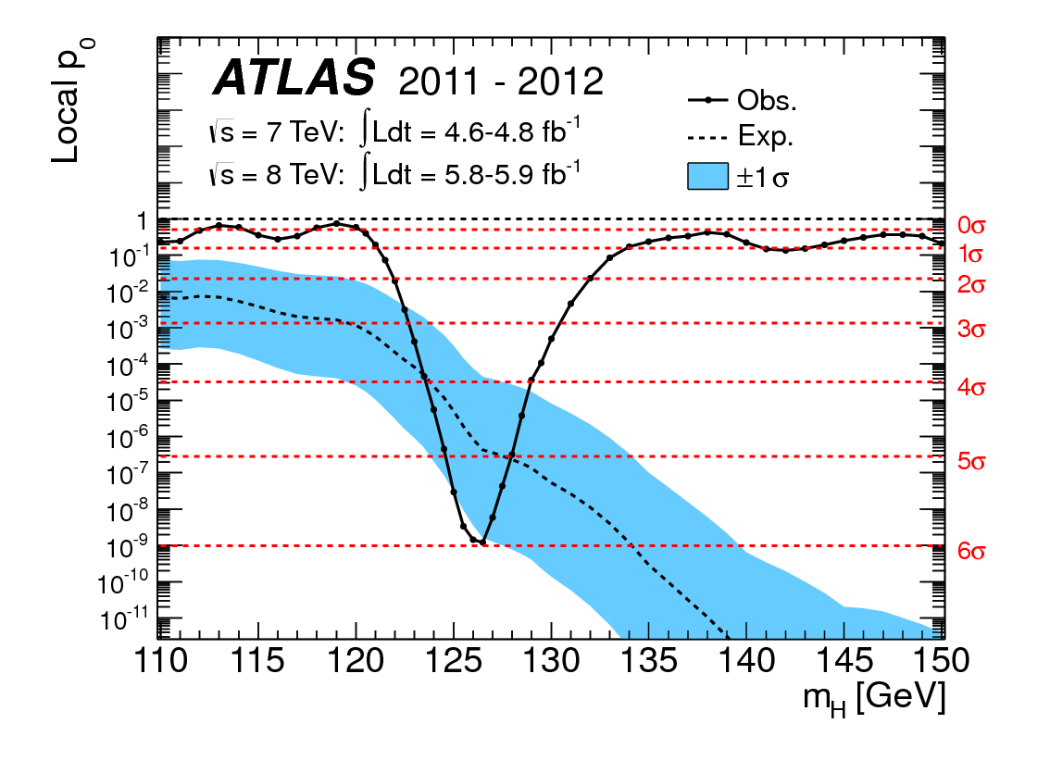
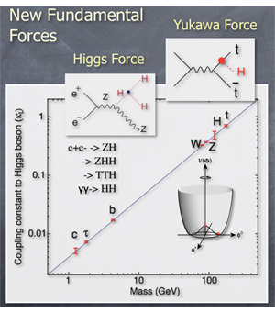
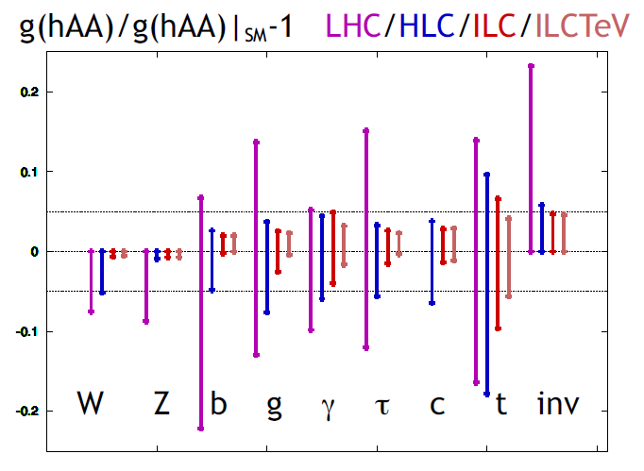
We have entered a new era!

Slide 15
Future of SiD
Opportunity for input to Snowmass2013 – how to organize SiD effort??
Several SiD people are already identified as convenors/contacts for Snowmass 2013.
Higgs – several (young) Higgs analyzers at ATLAS Workshop asked how we can make precision studies of Higgs…lively discussion of LHC ⊕ LC.
We also need to think about SiD in the context of the new LC organization:

Slide 16
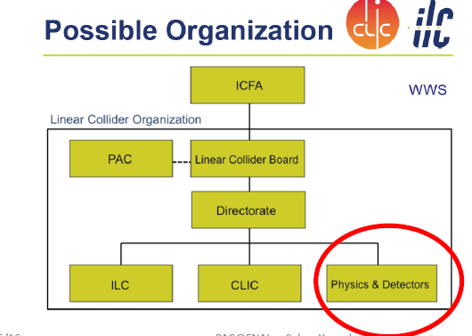
Future of SiD
Opportunity for discussion with Lyn Evans at LCWS 2012 at UTA.

Slide 17
Charge to this Workshop
Look at/work on the DBD sections that are relevant to you
Talk to the relevant DBD editors
Commit to providing missing sections, figures, etc.
Discuss, join preparations for Snowmass2013
Express your opinions on the future of SiD
Enjoy !!

