Slide 1
SLIC Z smearing

Slide 2
Introduction
The ILC beam has finite extension in z
Gaussian beam profile:
Luminous region is folding of one beam onto the other → Gaussian profile of is √2 times the width of single beam
Implementation:
Keep signal at z=0
Randomize γγ → hadrons (aa_lowpt) and guineapig pairs across the luminous region

Slide 3
Test
Use three different guineapig pair files
One particle per event
Simulate 200k events (=particles) with / without z spread, deltaZ = 450 μm
Compare the distributions for the origin of the particles (should change) and pz (should not)

Slide 4
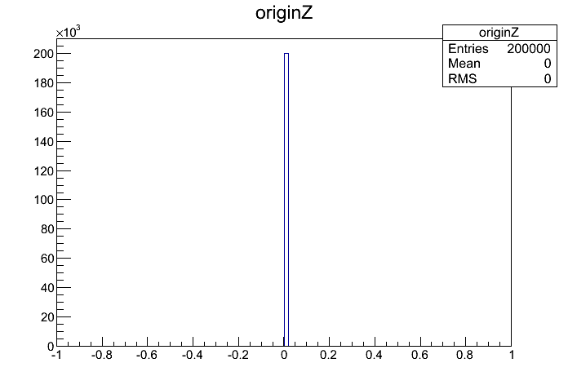
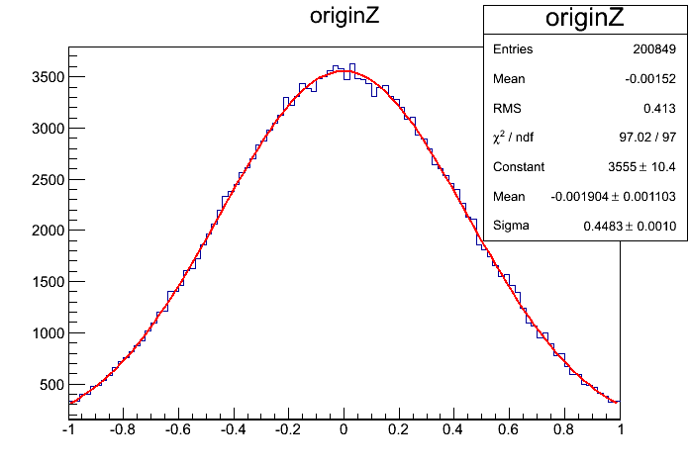
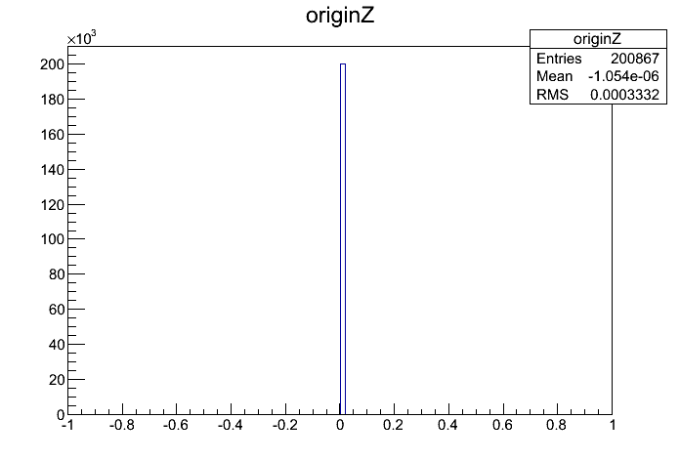
stdhep
finite z
z = 0

Slide 5
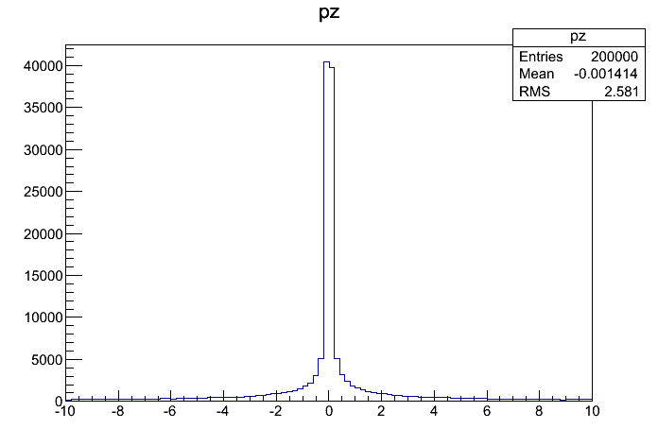
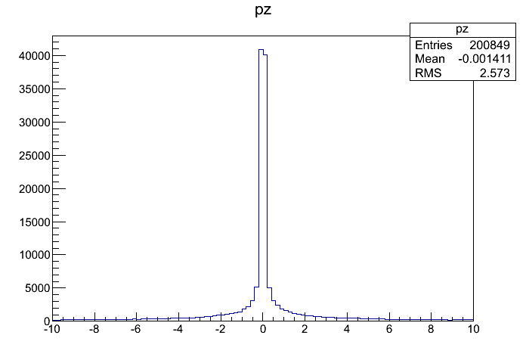
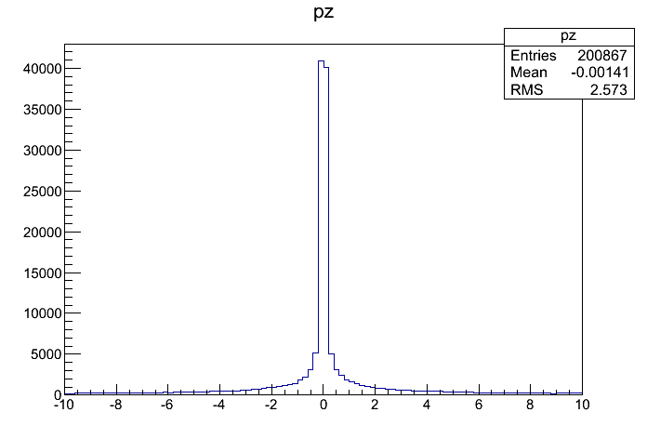
stdhep
finite z
z = 0

Slide 6
Results
Translating the particle origin in Z seems to work.
This is implemented to work on the whole Event in the same way, so aa_lowpt sample should work. Looks good by eye, proper test with vertexing tools remains to be done, but will come as part of the reconstruction.
Summary: We see nothing in this version of SLIC that hold up start of simulation.

