Slide 1
Analysis of cavity BPM data recorded on 13 June 2012
N. Blaskovic

Slide 2
Contents
Improved since presentation in June:
  I, Q, I’ vs. sample number
  ADC counts at chosen sample vs. setting
New analysis:
  Scatter plot of Q vs. I
  Theta vs. sample number
  I, Q jitter dependence on sampling window
  BPM pseudo-calibration using AQD0FF scan
  Cavity BPM resolutions using SVD
N. Blaskovic

Slide 3
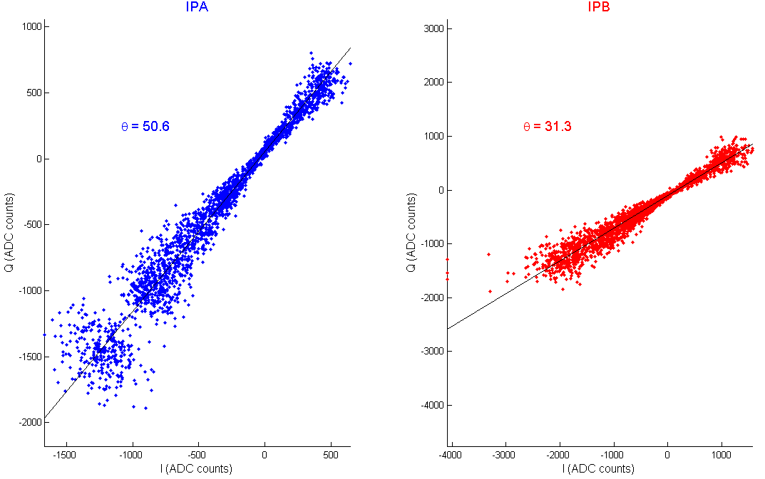
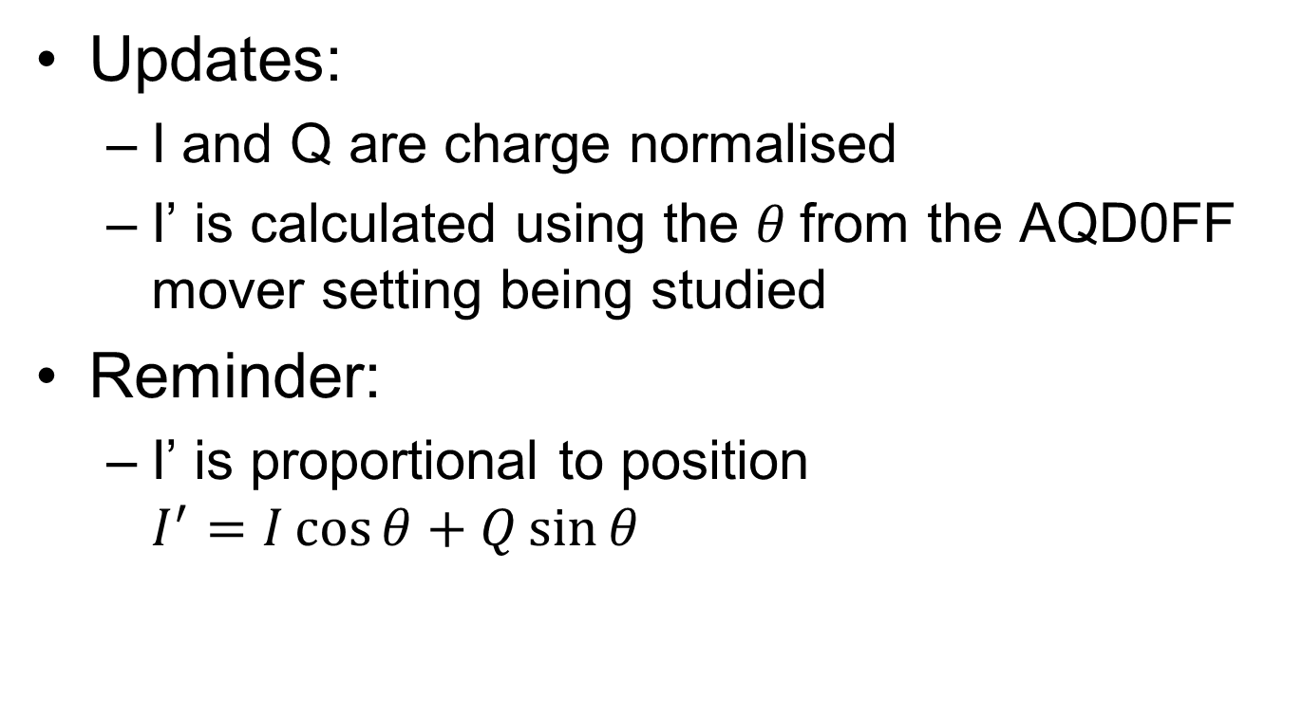
I, Q, I’ vs. sample number
Updates:
  I and Q are charge normalised
  I’ is calculated using the $θ$from the AQD0FF mover setting being studied
Reminder:
  I’ is proportional to position
  $I^{′}=I\cos{θ}+Q\sin{θ}$
  (Doug)
N. Blaskovic

Slide 4
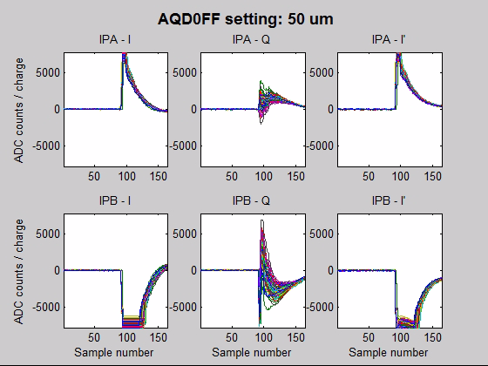
N. Blaskovic

Slide 5
ADC counts vs. file setting
File setting means AQD0FF mover setting
Only sampling at two sample numbers:
  Peak sample = 94
  Saturation free sample = 131
Updates:
  Following through the fact that I’ is now correctly calculated
N. Blaskovic

Slide 6
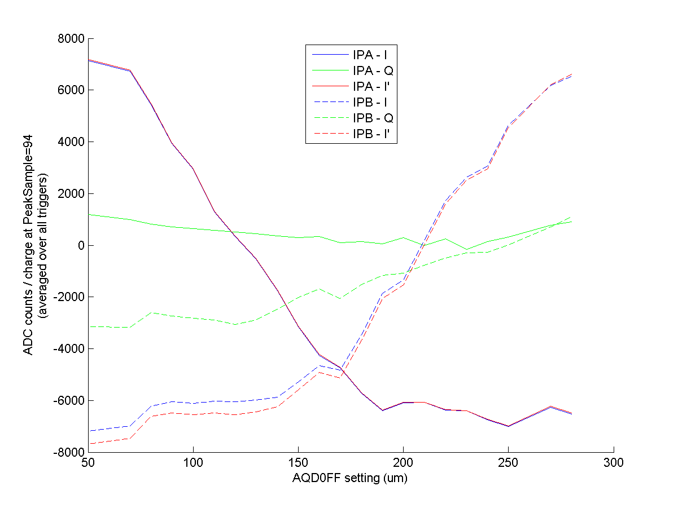
N. Blaskovic

Slide 7
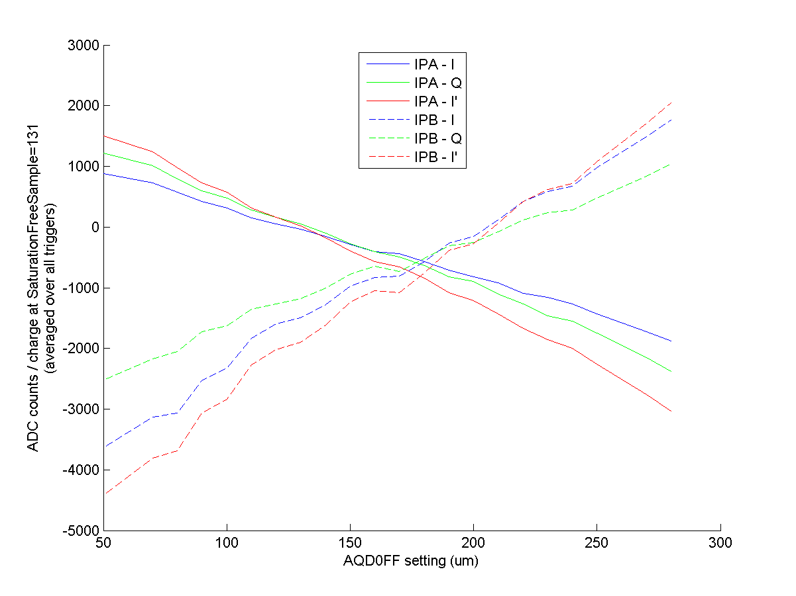
N. Blaskovic

Slide 8
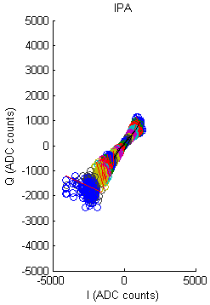
Scatter plot of Q vs. I
Single sampling point
Single BPM
Each circle is a trigger
Each colour is an
AQD0FF mover setting
Lines of fit can be made
to each mover setting
(shown) or to whole plot

Slide 9
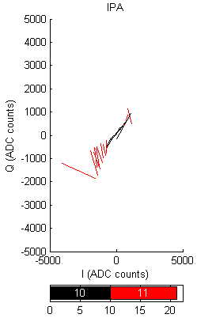
Scatter plot of Q vs. I
Scatter points removed to
visualise fits to individual
mover settings
Lines in red deviate from
global graph fit by more
than 22.5 degrees
Saturated data is removed

Slide 10
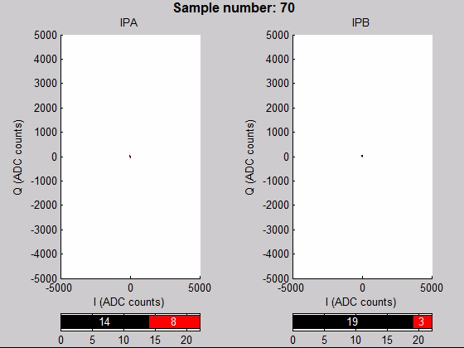
N. Blaskovic

Slide 11
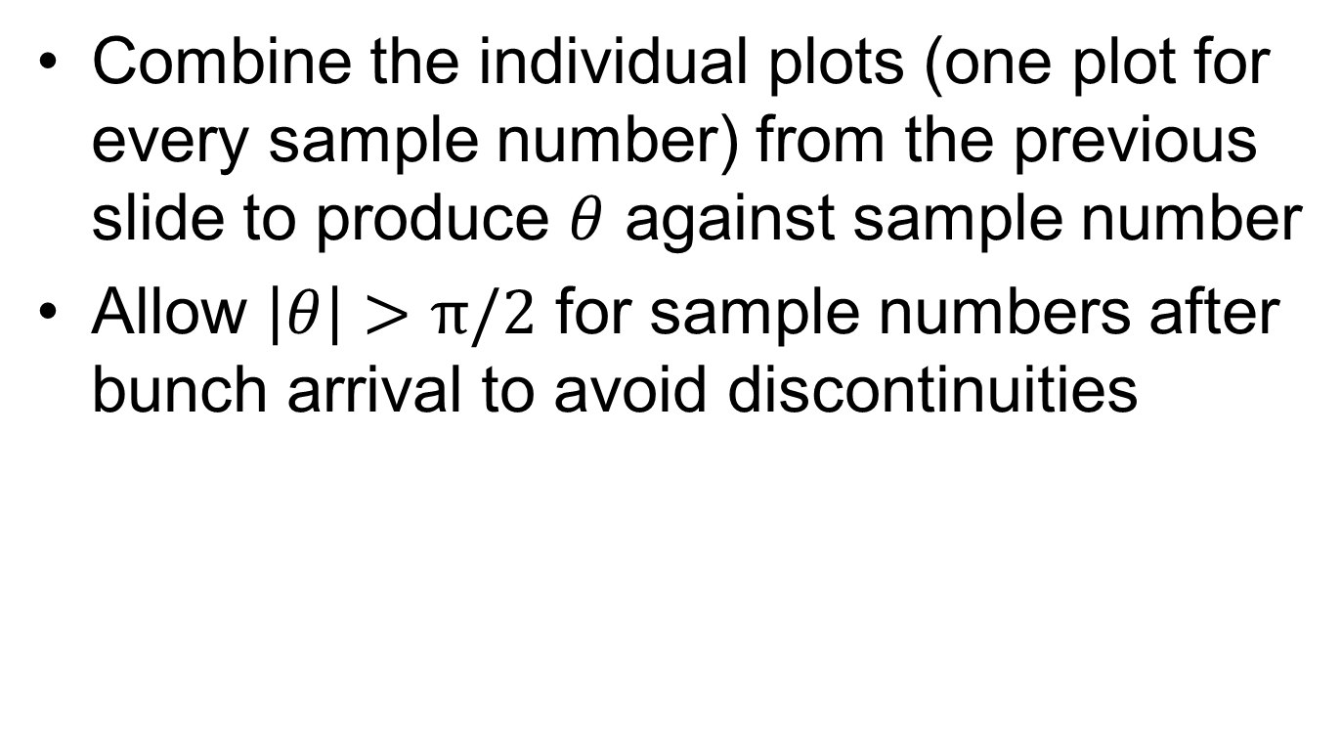
Theta vs. sample number
Combine the individual plots (one plot for every sample number) from the previous slide to produce $θ$ against sample number
Allow $\left|θ\right|>π/2$ for sample numbers after bunch arrival to avoid discontinuities

Slide 12
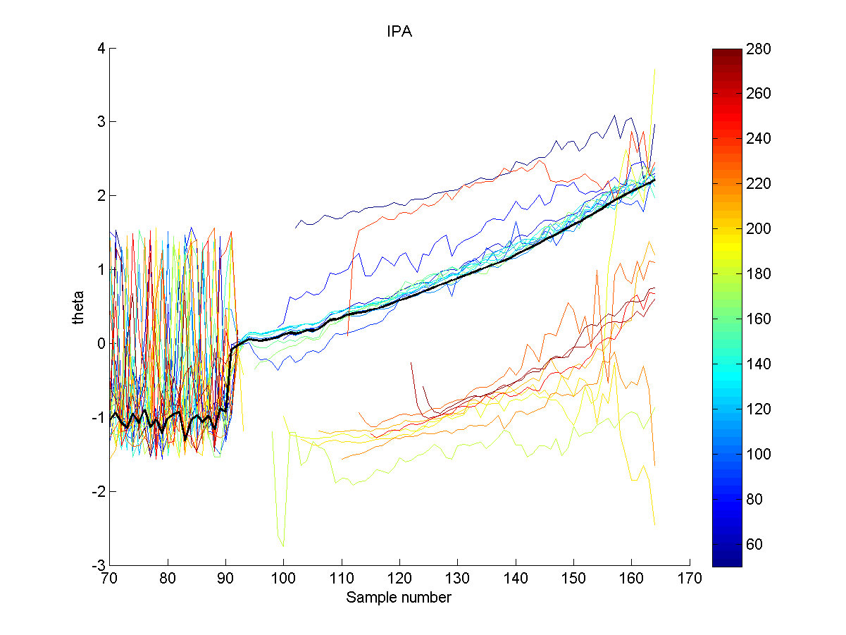
AQD0FF mover setting (um) colour coding
bold black line: average
N. Blaskovic

Slide 13
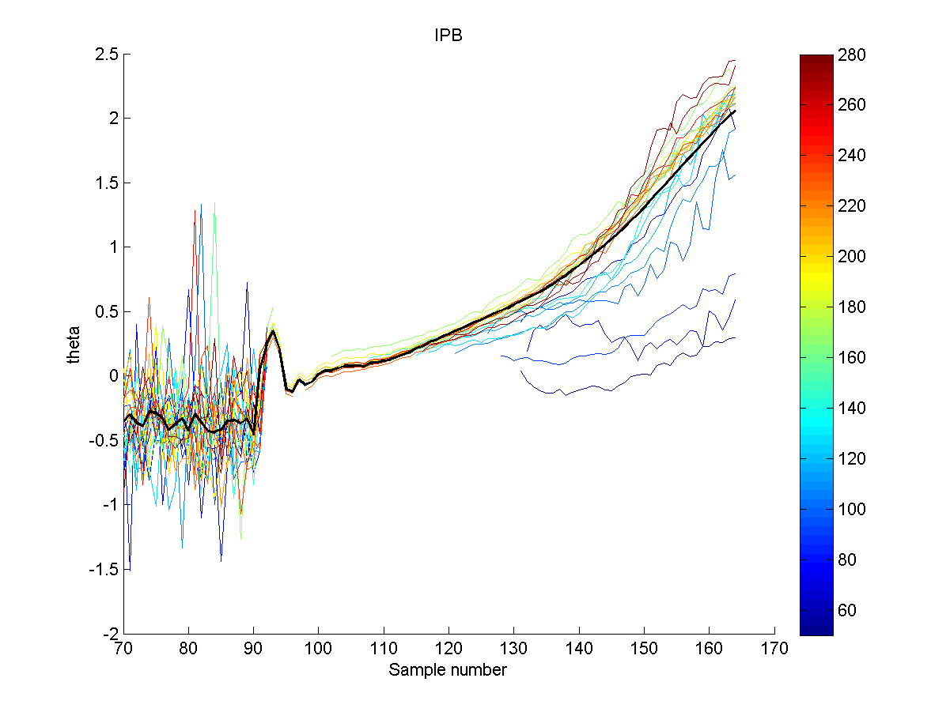
AQD0FF mover setting (um) colour coding
bold black line: average
N. Blaskovic

Slide 14
Jitter vs. sampling window
Integrate I and Q over a window of sample numbers
Look at the jitter in I and Q as a function of sample window start and end
Jitter is divided by window width (i.e. number of sample numbers in window) to allow comparison
A single file is analysed (AQD0FF: 50 um)

Slide 15
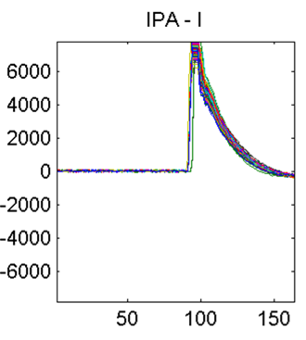
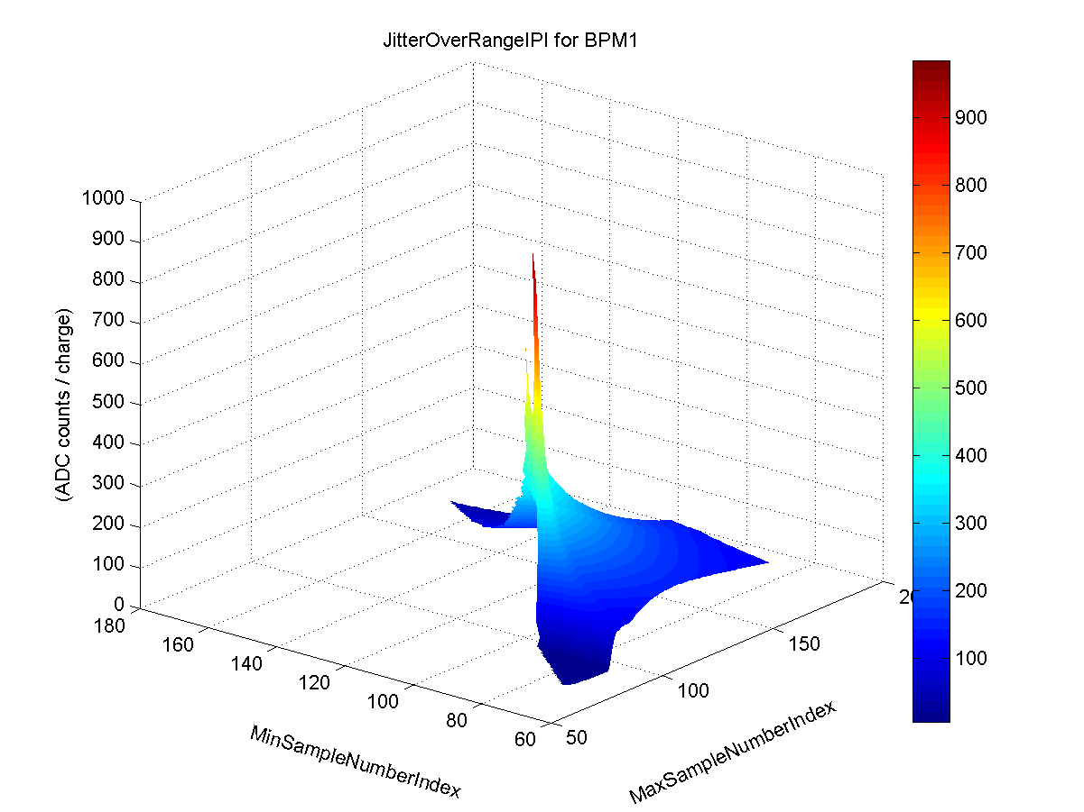
IPA - I
ADC counts / charge
sample number
N. Blaskovic

Slide 16
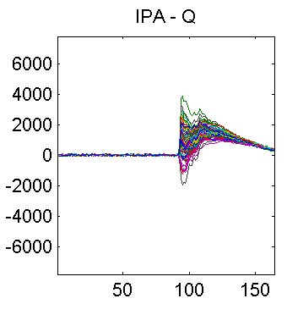
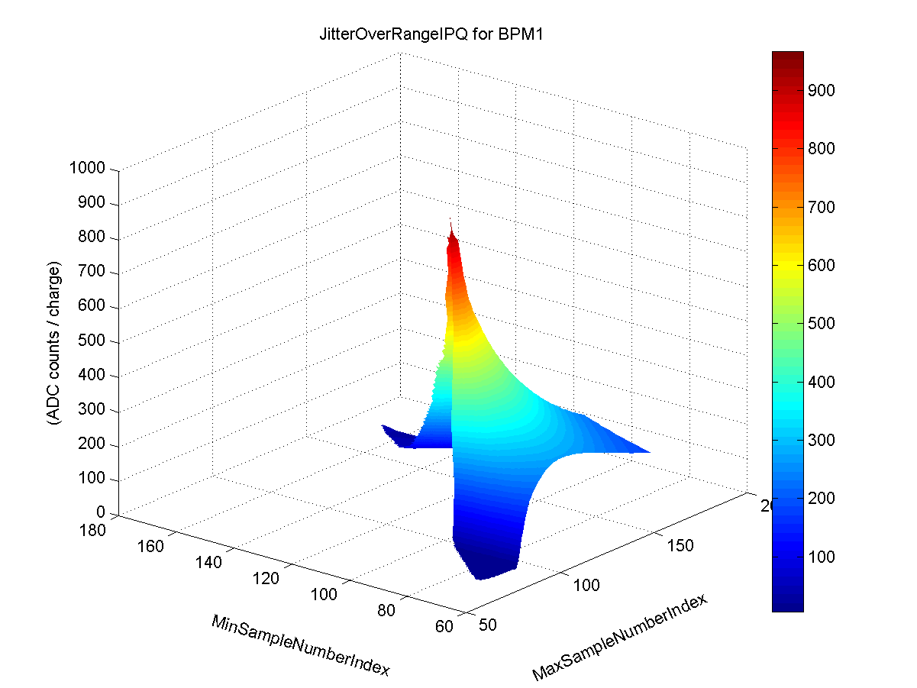
IPA - Q
ADC counts / charge
sample number
N. Blaskovic

Slide 17
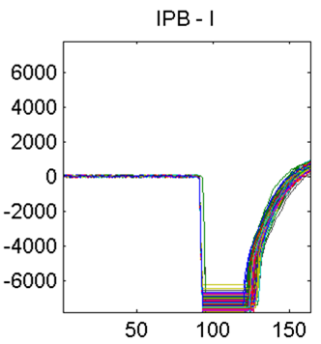
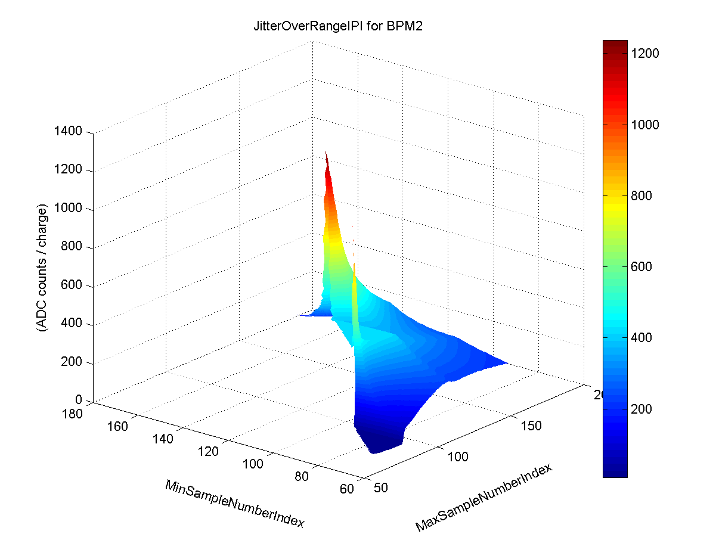
IPB - I
ADC counts / charge
sample number
saturation
saturation
flat surface
N. Blaskovic

Slide 18
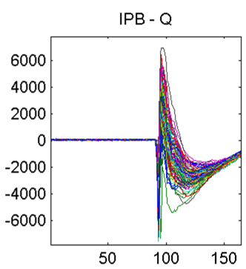
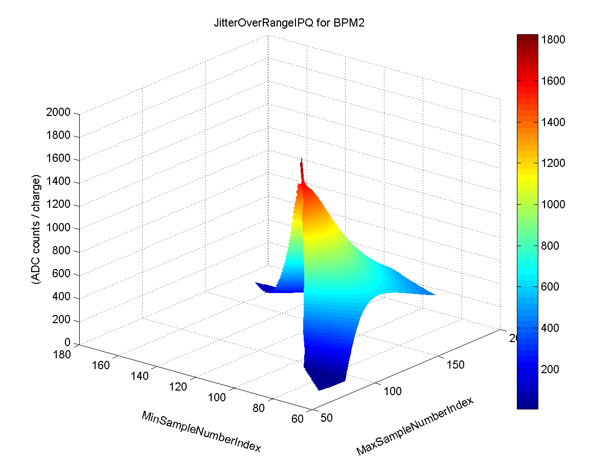
IPB - Q
ADC counts / charge
sample number
N. Blaskovic

Slide 19
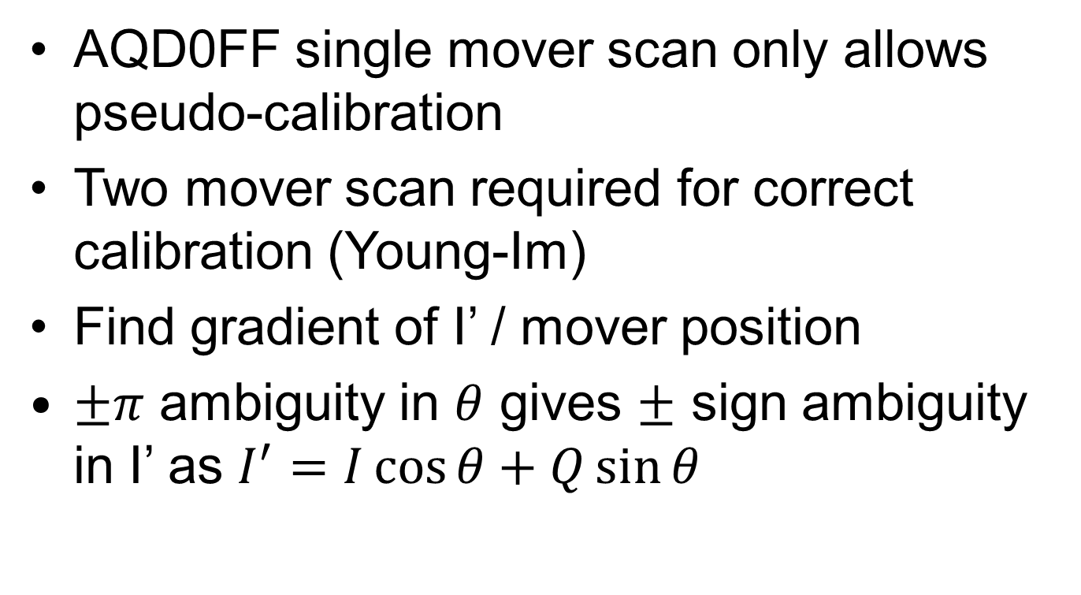
BPM pseudo-calibration
AQD0FF single mover scan only allows pseudo-calibration
Two mover scan required for correct calibration (Young-Im)
Find gradient of I’ / mover position
$±π$ ambiguity in $θ$ gives $±$ sign ambiguity in I’ as $I^{′}=I\cos{θ}+Q\sin{θ}$

Slide 20
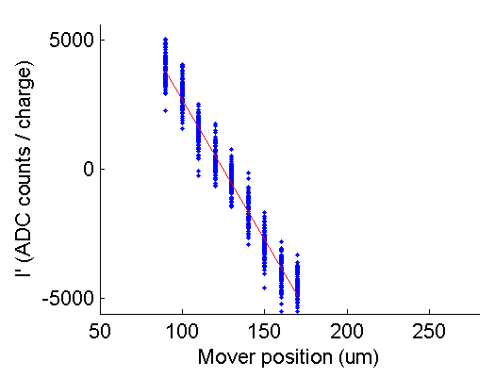
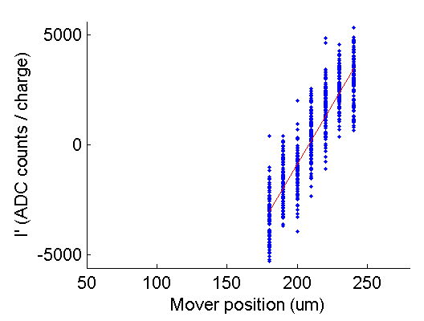
BPM pseudo-calibration
At sample number 95:
IPA
IPB
Gradient:
-108.897 ADC counts / (10^10 electrons * um)
Gradient:
108.701 ADC counts / (10^10 electrons * um)

Slide 21
Cavity BPM resolution
Using singular value decomposition (SVD)
Following Young-Im et al. (2012)
  http://prst-ab.aps.org/pdf/PRSTAB/v15/i4/e042801
Resolutions (um) using Epics position data
  Data: QD0FFscan1_106um_137.2A_130612.epx
 | PREIP | IPA | IPB | PIP
Neven: using 4 BPMs | 61.51 | 0.45 | 3.36 | 20.45
Neven: using all BPMs | 5.15 | 0.40 | 2.71 | 2.73
Young-Im: using all BPMs | 3.76 | 0.40 | 2.59 | 2.66

Slide 22
Spares

Slide 23
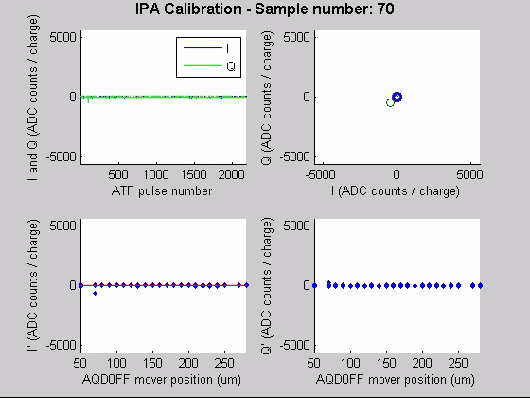
N. Blaskovic

Slide 24
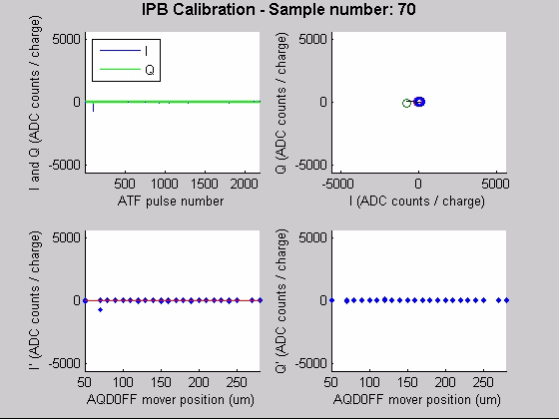

Slide 25
Plots
 | File setting | Sample number | Trigger | BPM
I, Q, I’ vs. sample number | 1/Plot | Axis | 1/Line | 1/SP
ADC counts at chosen sample vs. file setting | Axis | 1 | Mean | 1/Line
Scatter plot of Q vs. I | All | 1/Plot | All | 1/SP
Theta vs. sample number | 1/Line | Axis | Proc | 1/Plot
I, Q jitter dependence on sampling window | 1 | Axis | Proc | 1/Plot
Pseudo-BPM calibration using AQD0FF scan | Axis | 1/Plot | All | 1/Plot
1/Plot 1 <column header> per plot 1 1 <column header> only
1/SP 1 <column header> per subplot Proc Processed
1/Line 1 <column header> per line Mean Averaged
Axis <column header> used as axis

