Slide 1
Cavity BPM noise floor
N. Blaskovic

Slide 2
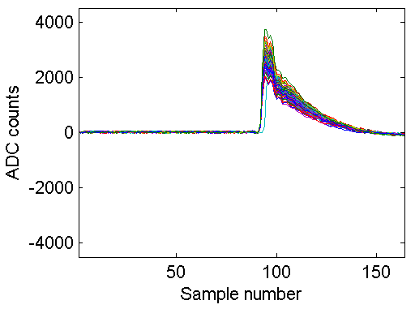
Outline
Generic waveform of I, Q or I’
Calibrate I’ using Epics positions
ADC counts / um
Find noise jitter in:
ADC counts
um
N. Blaskovic

Slide 3
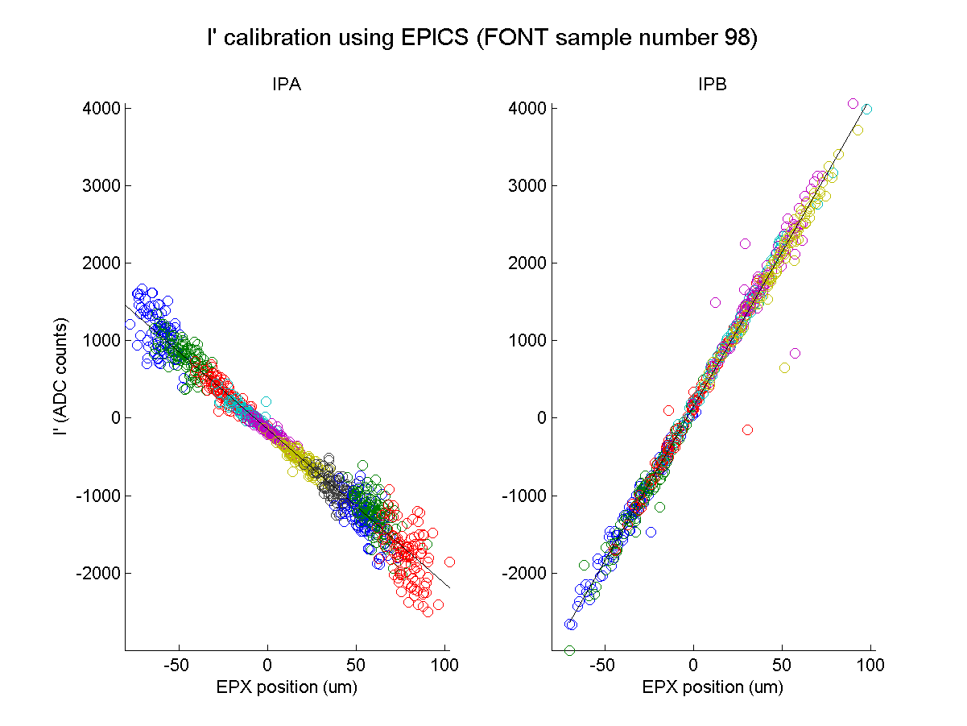
I’ calibration using Epics
Single sampling point
Single BPM
Each circle is a trigger
Each colour is an AQD0FF mover setting
N. Blaskovic

Slide 4
gradient
-38.64 ADC counts/um
gradient
40.87 ADC counts/um
N. Blaskovic

Slide 5
Noise floor
Looking at
arbitrary sampling point before bunch arrival
arbitrary file setting and BPM
Noise: 11-16 ADC counts
Using ~40 ADC counts/um, noise: ~0.3 um
This sets the BPM resolution lower limit (Colin)
N. Blaskovic

Slide 6
Spares

Slide 7
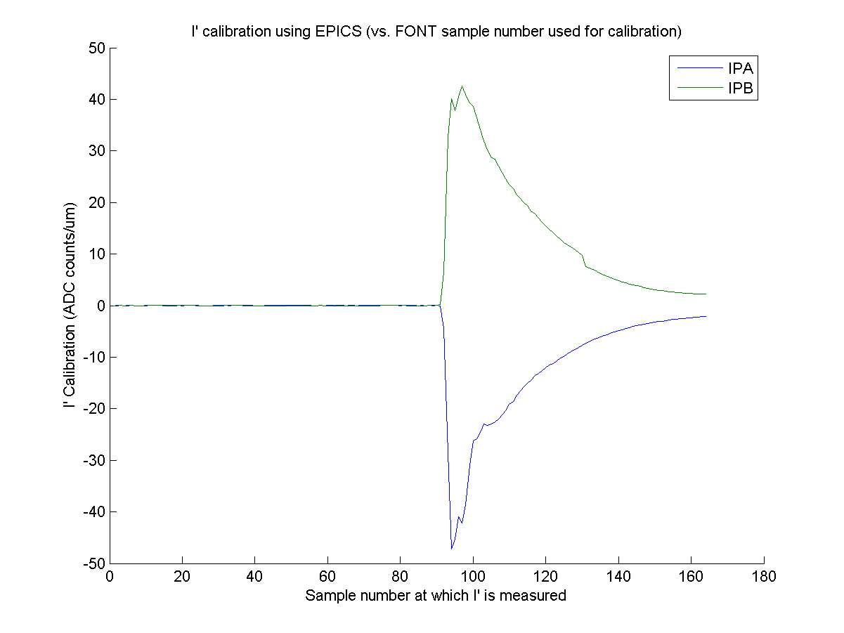
I’ calibration depends on the sample number used for calibration…
A calibration close to the peak value was chosen to provide the lowest limit on
the noise estimate in um
N. Blaskovic

