Slide 1
ML-SCRF: Monthly WebEx Meeting
August 22, 2012
Reports from PMs
  GDE activity and meeting plan
  LCWS2012: Arlignton Texas
  TTC-2012, Jlab
Reports from TA Group Leaders (very briefly, if any? )
  Cavity, Cavity Integration, Cryomodule, Cryogenics, HLRF, ML
Special Discussions on
  Progress in TDR-Part 1, 2 Drafting
    General status: John Carwardine
    Each section status: Editors/PMs/Writer

Slide 2
ML & SCRF Action/Meeting Plan (2012)
Month | Day | Place | Meeting
July | 4-11 12-13 25 |  | 36th ICHEP (Melbourne) GDE-EC face-to-face Meeting (TDR draft discussed) ML-SCRF Meeting
Aug. | 22 |  | ML-SCRF Meeting
Sept. | 10-14 19 | Telaviv | Linac-2012 ML-SCRF meeting
Oct. | 22-26 29-30 | Texas Annaheim | LCWS (TDR draft to be finalized) IEEE-NS (LC event)
Nov. | 5-6 15 | JLab | TTC Final Draft of TDR
Dec. | 13-14 | KEK | ILC-PAC (@ KEK)

Slide 3
LCWS 2012
Dates: Oct. 22 ~ 26
Held at: Arlignton, Texas
Registration and Accommodation Reservation
  LCWS12 (Int. Workshop on Future Linear Colliders 2012)
  http://www.uta.edu/physics/lcws12/
Program
  22(Mon): Joint plenary, Accelerator plenary
  23(Tue): ILC-CLIC Common issues
    a.m. Emittance preservation, Power consumption
    p.m. System tests, Cost&schedule
    P.m. 2:00. ： Higgs Factory session
  24(Wed): Accelerator: CLIC & ILC separate programs, TDR Discussion
  25(Thu): Ordinal Working Groups
  26(Fri): Accelerator plenary, Joint plenary (S13:00）

Slide 4
TDR Publication and Review
First-draft sections | * 23 April *
Complete edited draft | 22 October (LCWS 12)
Final draft (for PAC) | 15 November
PAC review | 15-16 December
Expect international reviews:
Both technical and cost
(Q1-22 2013)
Formal publication at Lepton Photon Conf.
(SF, June 2013)

Slide 5
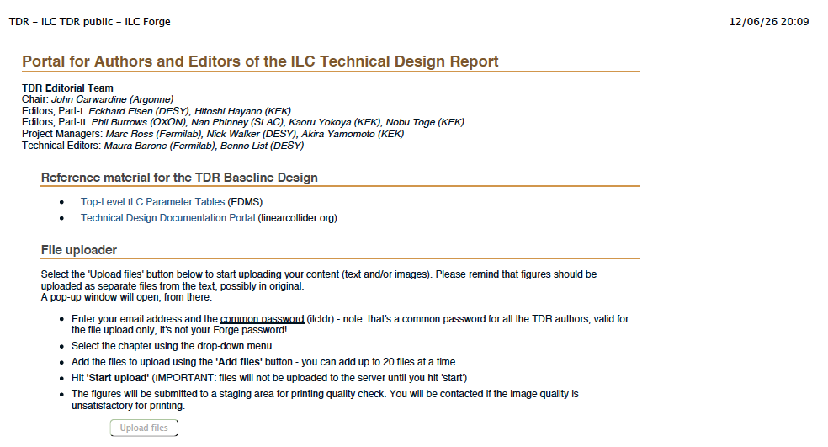
ILC TDR public https://forge.linearcollider.org/tdr
J. Carwardine, M. Barone

Slide 6
General Status of TDR1, Chapt. 3.
E. Elsen has worked hard to manage his editing work, and the result/status is given below:
  www.desy.de/~elsen/tdr1-chapter_scrf.pdf

Slide 7
General Status of TDR2, Chapt. 3 , 4, 5.
Nobu has worked hard to manage his editing work, and the result/status is given below:
Now, the above files uploaded to Forge (by J.C and M.

Slide 8
General Status of TDR2, Chapt. 3 ~ 5.
Nobu has worked hard to manage his editing work, and the result/status is given below:
Ch 3: http://ilc.kek.jp/~toge/Tdr2Chap3/
http://ilc.kek.jp/~toge/Tdr2Chap3/mltech20120819.pdf <-- PDF
http://ilc.kek.jp/~toge/Tdr2Chap3NKT20120819.tar.gz <-- tar.gz
Ch 4: http://ilc.kek.jp/~toge/Tdr2Chap4/
http://ilc.kek.jp/~toge/Tdr2Chap4/mltflat20120818.pdf <-- PDF
http://ilc.kek.jp/~toge/Tdr2Chap4NKT20120819.tar.gz <-- tar.gz
Ch 5: http://ilc.kek.jp/~toge/Tdr2Chap5/
http://ilc.kek.jp/~toge/Tdr2Chap5/mlmtn20120818.pdf <-- PDF
http://ilc.kek.jp/~toge/Tdr2Chap5NKT20120819.tar.gz <-- tar.gz
Now, the above files uploaded to Forge (by J.C and M.

Slide 9
My Comments
It might be easier for readers to merge Chapter 3, 4, and 5, to one chapter
Cryogenics system description may be a little more added specially in view of two KCS and DKS configuration: 6 plants v.s. 5 plants,
  Done by Tom’s effort, and appreciated
Power distribution system with DKS might be more described in (currently) Chapter 5.

Slide 10
Status of TDR Part-1: Chap-3, SCRF
Many thanks for Editing by E. Elsen!
Chap. | Subject | Draft provided by | Status/Plan
3 | SCRF R&D
 | Development of Infrastructure | J. Kerby | Received
 | R&D toward mass production | J. Kerby | Received
 | Overview | A. Yamamoto | Received
 | High gradient cavity R&D | R. Geng | Received
 | Cavity Integration | H. Hayano | Received
 | S1-Global experiment | H. Hayano | Received
 | CM, thermal balance / SCQ | P. Pierini, / J. Kerby | Received
 | RF-power and PDS | S. Fukuda, C. Nantista | Received
4 | Beam Test Facility ( SCRF related)
 | FLASH | J. Carwardine | progressed
 | Quantum Beam | H. Hayano | progressed

Slide 11
Status of TDR Part-2: Chap-3,4,5, ML Technology
Many thanks for Editing by N. Toge !
Chap. | Subject | Draft provided by | Status/Plan
3 | ML Technology (common)
 | ML Top-level parameters and general layout | C. Adolphsen
 | Cavity performance and production requirements | A. Yamamoto | Received
 | Cavity Integration (couplers, tuners, mag. shield) | H. Hayano | Received
 | CM design, SCQ, Cryog. | P. Pierini, J.K., T. Peterson | Received
 | RF-power source | S. Fukuda. C. Nantista | Received
 | Low-level RF control | J. Carwardine | Received
 | Cavity and CM tests | H. Hayano | Received
4 | ML for flat-topography layout
 | … Layout: Klystron Cluster RF Scheme (KCS) | C. Adolphsen | Received
 | … Low-level RF for KCS | J. Cawardine | progressed
 | … Power distribution system | C. Nantista | Received
5 | ML for mountainous-topography layout
 | … Layout: Distributed Klystron RF Scheme (DKS) | C. Adolphsen | Received
 | … Low-level RF for DKS | S. Michizono | Received
 | … Power distribution system | S. Fukuda | Received

Slide 12
ADI Action Items remaining:
Works still to be done w/ML-SCRF
 | # | Subjects | Prepared by | Status
SRF | 36 | Review local PDS design and cost estimate | S.F., C.N., A. Y, | done
 | 48 | Review/update He gas or liquid storage requirements | T. P, A.Y.,
 | 50 | Update CFS requirements to reflect Marx modulator | S.F., C.N. | done
MLI | 64 | Mechanical: Insulation for cavity RF loads
 | 65 | Documentation: Main linac layout for mountain topography. | A.E., A.Y., | done
 | 66 | Updated ML lattice file for Mountainous Topography site
 | 74 | RF power requirement accounting documentation (parameters) for EDMS KCS | M.R. | done
 | 75 | RF power requirement accounting documentation (parameters) for EDMS DKS | M.R. | reported

