Slide 1
Notes from 9mA meeting, 31st July 2012:
Klystron saturation studies planning
0. News / updates
Analysis of klystron saturation studies (Gustavo)
Drift during klystron saturation studies (Christian)
Detuning as a means of increasing flat-top power (Julien)
Update on klystron linearisation options (Wojciech)

Slide 2
9mA meeting notes, 31 July 2012 (1/6)
General
  September studies shifts start at 15:00 on Monday, 17th Sept and continue until 15:00 on Saturday 22nd Sept
  Studies requests are due to Katja and Bart by17th August
  Brian and Gustavo noted that of the key top-level requirements for an ILC LLRF system, linearisation of the klystron close to saturation is the one key top-level requirements that has yet been tested with beam loading
Upcoming 9mA meetings
  14th August
    Finish up the klystron saturation study discussions
    Gradient studies – operation close to quench
  28th August
    Gradient studies – operation close to quench
  11th September
    Last meeting before studies – solidify study plan

Slide 3
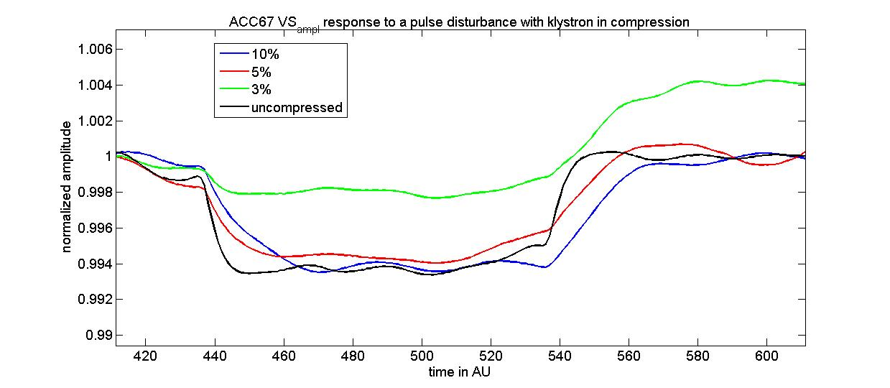
9mA meeting notes, 31 July 2012 (2/6)
Gustavo – RF power overhead data analysis
  Started analysis but not too much yet but will prepare a presentation for the 9mA meeting on 14th August
  Analysing recovery time from step up/down response to VS setpoint disturbance from four klystron working points: far from saturation; and then 10%, 5%, 3% away from saturation (see the step response below)

Slide 4
9mA meeting notes, 31 July 2012 (3/6)
Gustavo – RF power overhead data analysis
  There are some puzzling features, eg the recovery responses are quite different from the initial step down.
  For the initial step-down response, the apparent gain of the feedback regulator far from saturation is ~50, and then dropping to ~18, ~11, and ~6 for working points 10%, 5%, and 3% away from saturation respectively.
  Brian: this is not a linear problem and it’s possible the system could be running into hard compression. Should look at both the falling edge and rising edge. The initial step down response for the 3% case looks to be completely uncontrolled.
  John: on the step up recovery, the three responses close to saturation look identical, but are quite different on the initial step down

Slide 5
9mA meeting notes, 31 July 2012 (4/6)
Julien – modeling detuning as a way of increasing flat-top power for klystron studies
  See slides on Indico: http://ilcagenda.linearcollider.org/conferenceDisplay.py?confId=5772
  All cavities would be detuned by the same amount
  Looked at ratio of fill to flat-top power vs detuning at 3, 4.5, 6mA
  Then looked at ratio vs detuning at 300, 350, 400MeV
  Bottom line: the approach looks promising
  Could also reduce the amount of LFD compensation to get detuning effect
  Fill power also goes up – will need to make sure we don’t exceed coupler and circulator limits
  Brian: changing the detuning and Qexts also change the time-constant. The setpoint waveform is still derived on the basis of a 3e6 Qext. Should adjust the field setpoint profile during the fill to match the natural response, which could reduce the forward power during the fill

Slide 6
9mA meeting notes, 31 July 2012 (5/6)
  During the studies, we should look at the power cost to get flat gradients at different beam currents.
  Simulations show a significant tilt in fill power for flat-top optimized Qls
  Shin: why is the forward power not flat during the flat-top? Because Qls are optimized for flat gradients and not for flat klystron power (!)
  It might be helpful to look at absolute power deltas (and initial tilts) as well as percentage deltas – maybe that the absolutes are invariant
  For the simulation, ACC6 cavities 5&6 were kept in the vector sum but their Qexts were fixed at 3e6. The simulation shows that the cavity tilts could be corrected on all 16 cavities (because of the vector sum feedback). This is contrary to the Feb study when we detuned those cavities.
  John: it is puzzling why we always see that the Qexts converging to lower average values. Gustavo: the fill to flat-top ratio has an effect on where the average Qls settle (we should model this.

Slide 7
9mA meeting notes, 31 July 2012 (6/6)
Wojciech – options for klystron linearisation study in Sept
  Linearisation tests in the LLRF FPGA were done ~3yrs ago, mainly on ACC1 but the functionality was tested everywhere
  Since then, there have been many changes to the LLRF firmware and the linearization firmware isn’t there now. Would need to be reintegrated (WJ). There is some finite risk that making changes to firmware could break what already works. Wojciech / Julien will discus with MSK colleagues.
  The middleware server is still in place to manage the linearisation function and measure characteristics and prepares tables, but would need some re-integration with the front-end server, which doesn’t support linearization.
  Could measure the entire chain, linearise the feed-forward tables for the nominal working point (would be open loop)
  John: if we don’t have the linearisation firmware, what about a limited saturation study where we pick a few working points where we re-measure and re-optimize the MIMO controller? Julien will discuss this option with Christian and Sven
  Next meeting: 14th August

