Slide 1


Observations from Upstream Kicker Scans
Mikey Davis
10 August 2012
number

Slide 2
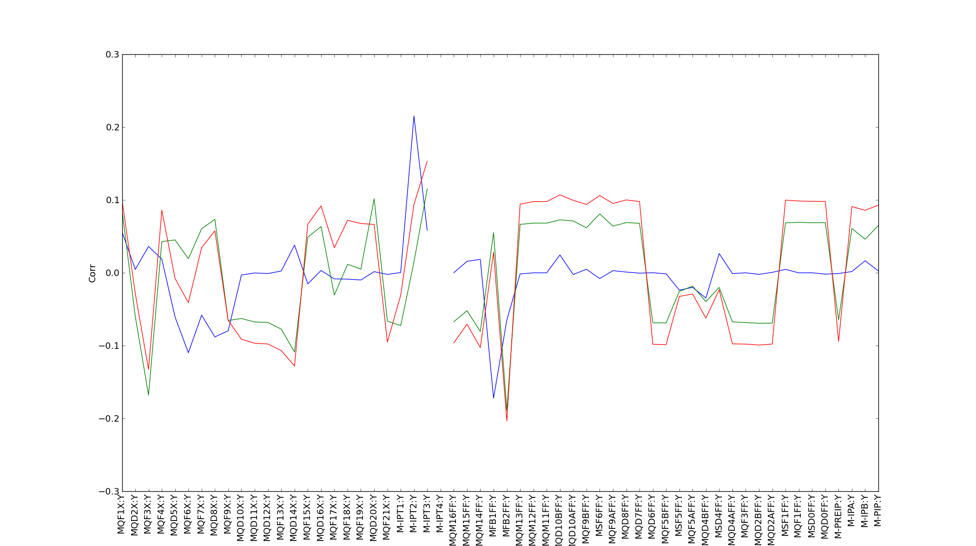
Correlation Down FF
P1 ---
P2 ---
P3 ---
Mikey Davis
10 August 2012
number

Slide 3
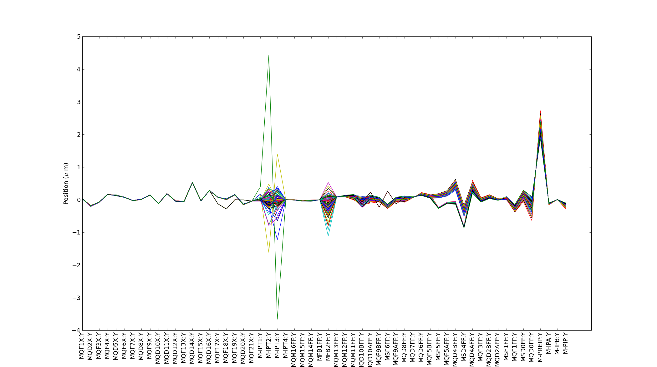
Beam Track Down FF
Mikey Davis
10 August 2012
number

Slide 4
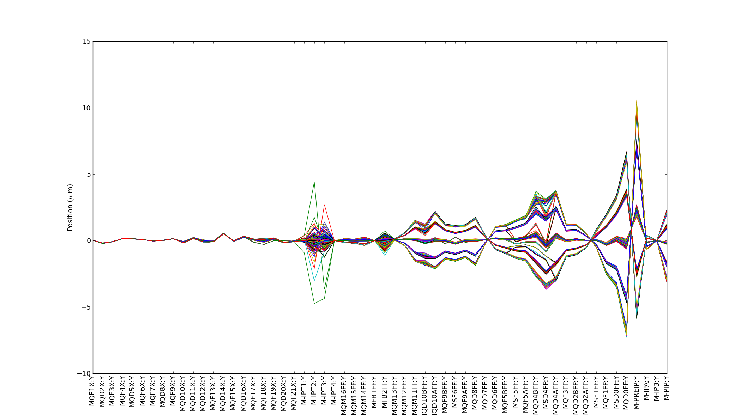
Beam with Kicks Down FF
Mikey Davis
10 August 2012
number

Slide 5
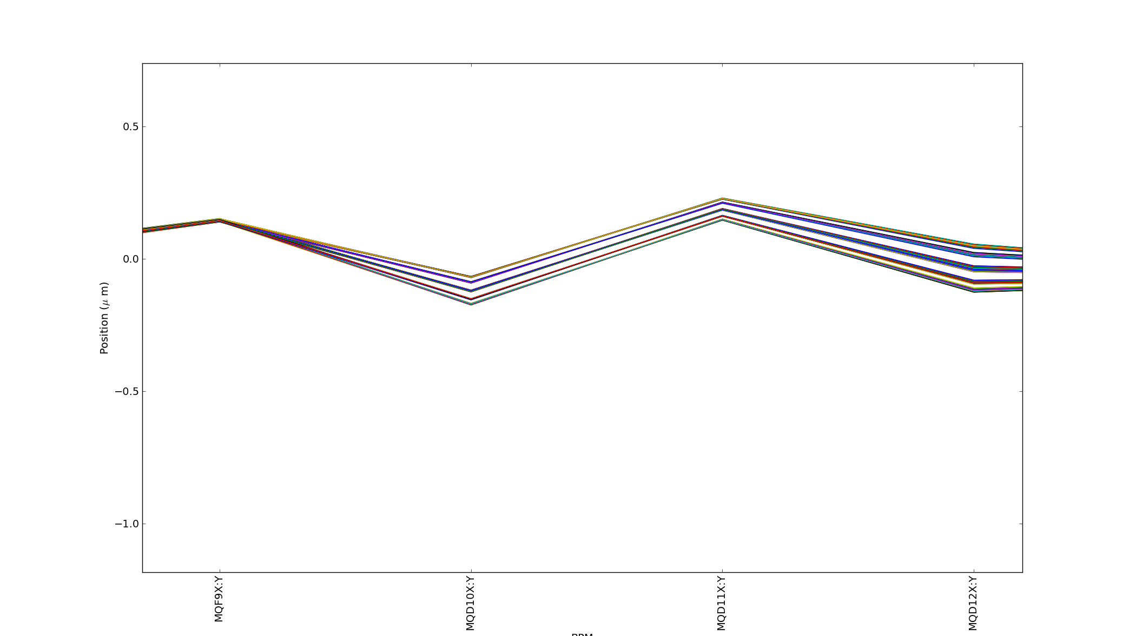
Zoomed in Section
Mikey Davis
10 August 2012
number

