Slide 1


Possible Cable Setups at ATF
Mikey Davis
10 August 2012
1/9

Slide 2
Introduction
There are a number of different options depending on what we want to do
  Keep Font V and second stage down mixer outside the tunnel
      Can adjust I and Q phase
  Put everything in the tunnel
      Can perform feedback
The first option allows for the second
Mikey Davis
10 August 2012
2/9

Slide 3
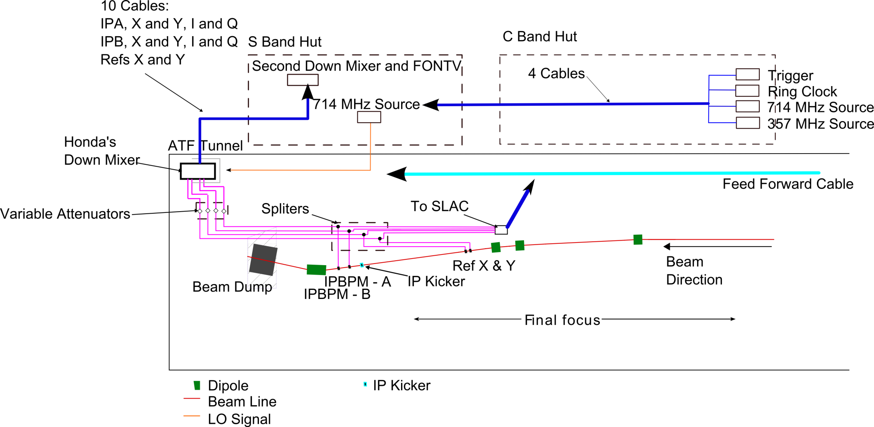
Setup 1
Mikey Davis
10 August 2012
3/9

Slide 4
Cables To Add at IP
11 cables from IP to S Band Hut
  I and Q for IPA:X
  I and Q for IPA:Y
  I and Q for IPB:X
  I and Q for IPB:Y
  Ref Cav X and Y
  714Mhz into tunnel
Ethernet Cable (already there?)
Mikey Davis
10 August 2012
4/9

Slide 5
Cables To Add Outside the Tunnel
4 Cables from C Band to S Band hut
  Trigger
  Ring Clock
  357MHz
  714MHz
These may already be there (Young Im?)
Mikey Davis
10 August 2012
5/9

Slide 6
Cables To Add in the Tunnel
By the Japanese
  Feed forward cable
By us
  Cables between cavities and Honda’s electronics
Mikey Davis
10 August 2012
6/9

Slide 7
Things to Think About
How are we going to split the 357, 714 signals in the C Band hut?
  Move the clock distribution box to the C Band hut?
How are we going to deal with the trigger?
  Buy a digital delay generator
  Fix the firmware
Mikey Davis
10 August 2012
7/9

Slide 8
Things to Buy
Digital Delay generator (maybe?)
More splitters (Young Im?)
Mikey Davis
10 August 2012
8/9

Slide 9
(Overly) Grand Plan
Explain
Mikey Davis
10 August 2012
9/9

