Slide 1
Progress on the ILC-BDS
(250GeV CoM)
15/08/12

Slide 2
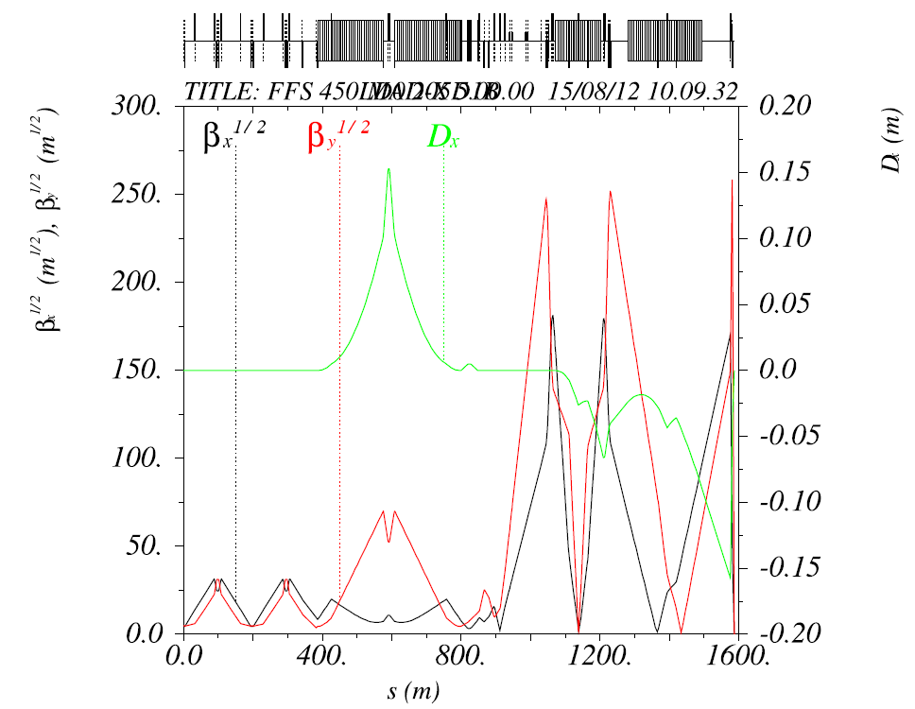
v.450LD0_205D1B –new optics
β_{x} = 0.01300000001 ;
β_{y} =0.000410000219;
α_{x} = O(e-010); α_{y} =O(e-9)
D_{x} =O(e-6);0
Used QDO, Qf1, QD2A,Qf3, QD6,Qf5,QD4, QD2B + matching quads to rematch to new Twiss
Used QDO, Qf1, QD2A,Qf3, QD6,Qf5,QD4, QD2B + sextupoles
Corresponding beam sizes:
σ_{x}¹ _{=7.29e-07}
σ_{y}¹ _{=7.66e-09}
σ_{x}² _{=7.41e-07}
`σ_{y}² _{=7.78e-09}
σ_{x}³ _{=7.521e-0}
`σ_{y}³ _{=8.01e-09 .}
σ_{x}⁴ _{=7.67e-07}
`σ_{y}⁴ _{=8.72e-09}
.
σ_{x}⁵ _{=7.54e-07}
`σ_{y}⁵ _{=8.52e-09}

Slide 3
v.450LD0_2055D1B-new optics
Corresponding beam sizes:
σ_{x}¹ _{=7.29e-07}
σ_{y}¹ _{=7.66e-09}
σ_{x}² _{=7.41e-07}
`σ_{y}² _{=7.78e-09}
σ_{x}³ _{=7.521e-0}
`σ_{y}³ _{=8.01e-09 .}
σ_{x}⁴ _{=7.67e-07}
`σ_{y}⁴ _{=8.72e-09}
.
σ_{x}⁵ _{=7.54e-07}
`σ_{y}⁵ _{=8.52e-09}

Slide 4
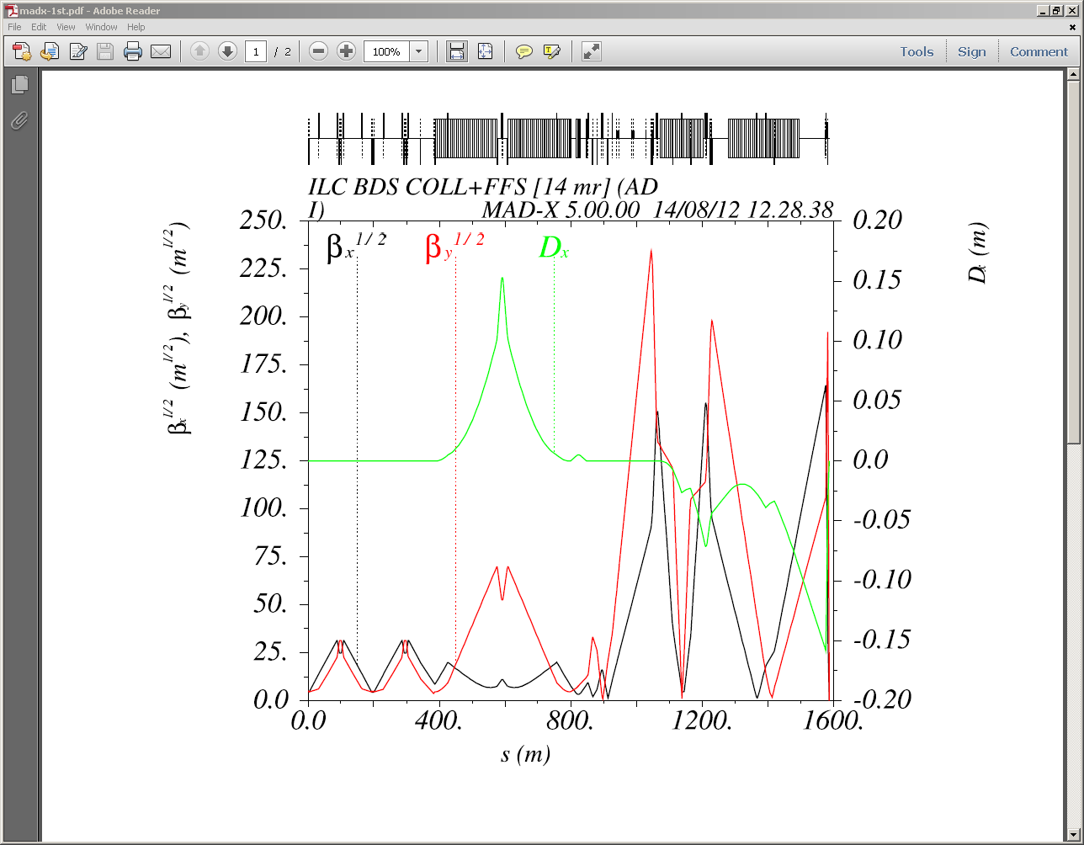
v.351LD0_135D1B (Half-quads)
Used QDO, Qf1, QD2A,Qf3, QD6,Qf5,QD4, QD2B + QF7,QD8,QD10, QF9+matching quads
β_{x} = 0.013;
β_{y} =0.0004100; α_{x} = 4e-05;
α_{y} =-1.5e-09; D_{x} =O(e-5);
Corresponding beam sizes:
σ_{x}¹ _{=7.30e-07}
σ_{y}¹ _{=7.69e-09}
σ_{x}² _{=7.67e-07}
`σ_{y}² _{=7.78e-09}
σ_{x}³ _{=7.86e-0}
`σ_{y}³ _{=7.88e-09 .}
σ_{x}⁴ _{=8.74e-07}
`σ_{y}⁴ _{=9.19e-09}
.
σ_{x}⁵ _{=8.58e-07}
`σ_{y}⁵ _{=9.09.e-09}

Slide 5
v.351LD0_135D1B-new optics
( Half Quads)
Corresponding beam sizes:
σ_{x}¹ _{=7.30e-07}
σ_{y}¹ _{=7.69e-09}
σ_{x}² _{=7.67e-07}
`σ_{y}² _{=7.78e-09}
σ_{x}³ _{=7.86e-0}
`σ_{y}³ _{=7.88e-09 .}
σ_{x}⁴ _{=8.74e-07}
`σ_{y}⁴ _{=9.19e-09}
.
σ_{x}⁵ _{=8.58e-07}
`σ_{y}⁵ _{=9.09.e-09}

Slide 6
Plans
Finish 250 Gev CoM lattice v.351LD0_304D1B with half quads at FF
Repeat the same exercise for 450D0_205D1B

