Slide 1


Further Investigation into ATF Results
Mikey Davis
10 October 2012
number

Slide 2
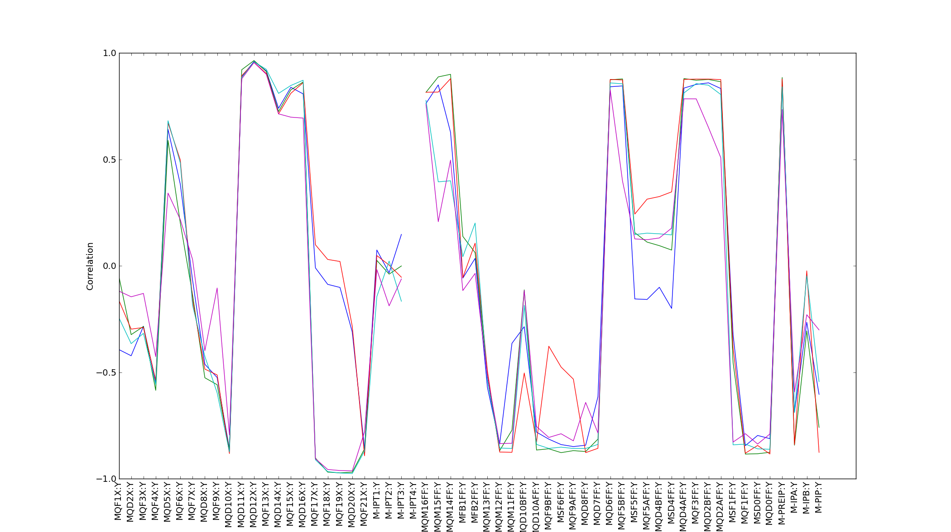
Correlation Down the FF Line from P3
--- -2000
--- -1000
--- 0
--- 1000
--- 2000
Mikey Davis
17 August 2012
number

Slide 3
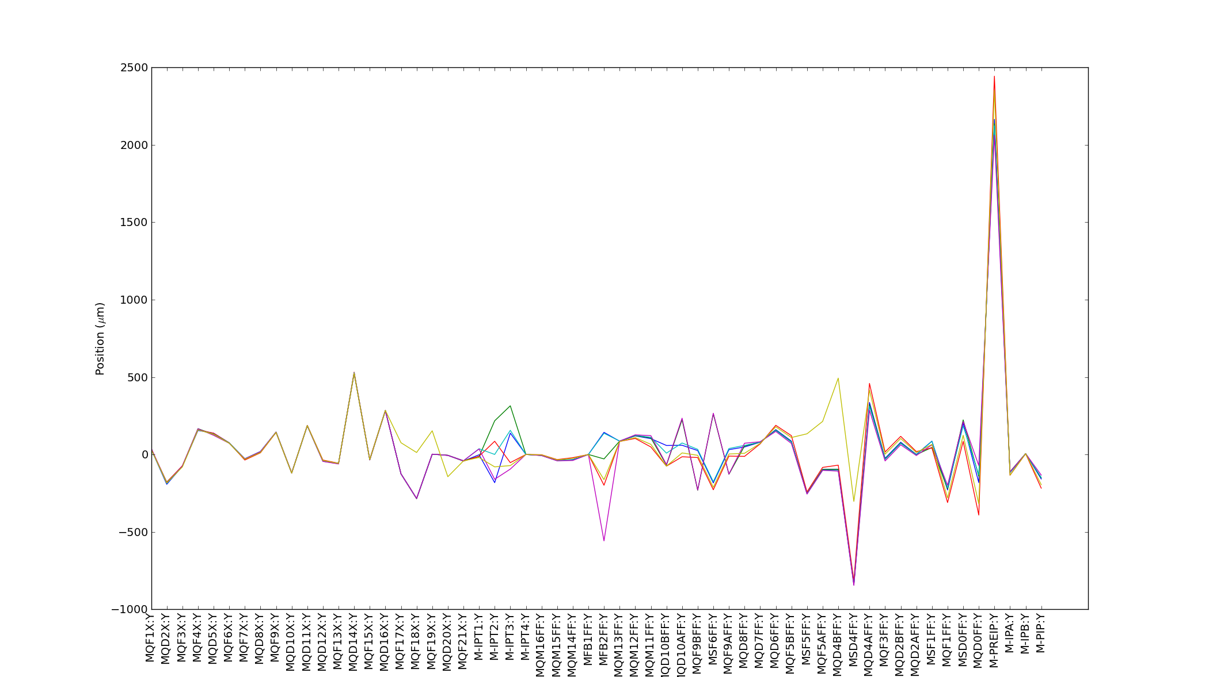
Positions Down FF
Typical Path
Mikey Davis
17 August 2012
number

Slide 4
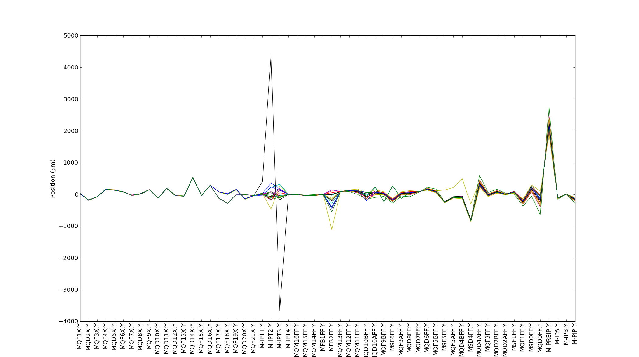
Positions Down FF
Typical Path
Mikey Davis
17 August 2012
number

