Slide 1


Oncoming Work at ATF
Mikey Davis
17 August 2012
1/8

Slide 2
Introduction
Regarding our discussions last week, I have changed the cable setup
Shown allows for the maximum number of experimental possibilities
Mikey Davis
17 August 2012
2/8

Slide 3
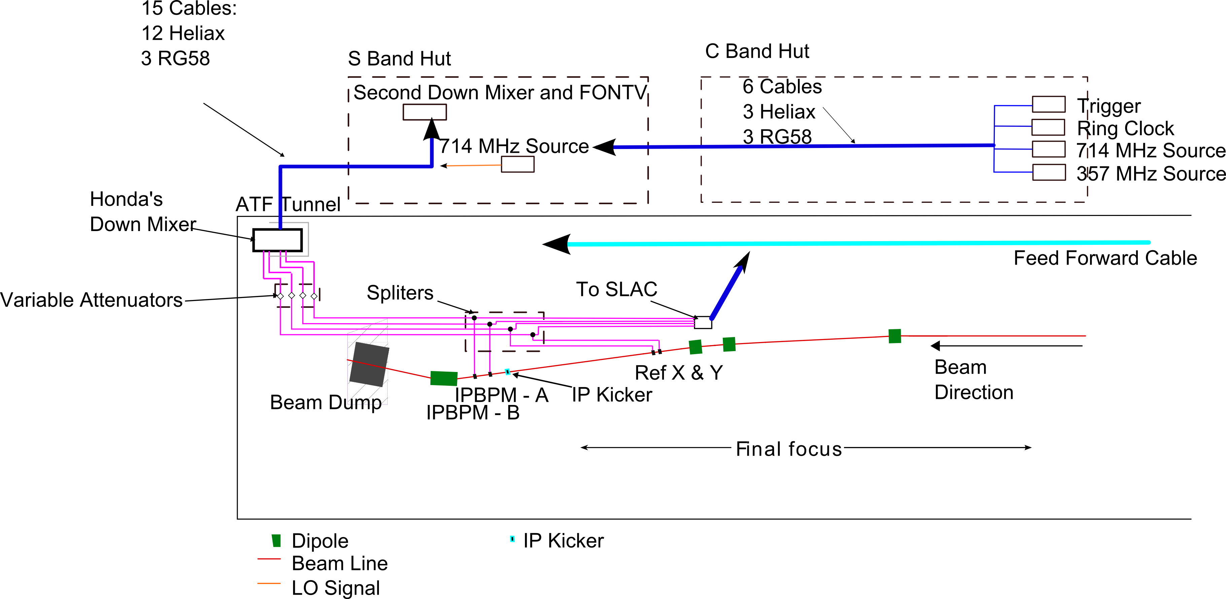
Setup
Mikey Davis
17 August 2012
3/8

Slide 4
Cables to Install
15 cables from IP to S Band Hut
12 Heliax (11 + 1 Spare)
3 RG58 (2 for kickers + 1 Spare)
Ethernet cable at IP
6 cables from C to S Band Hut
3 Helix (357 + 714 + spare)
3 RG58 (Trigger + Ring Clock + Spare)
FONT to IP feed forward cable
Trigger Setup
Mikey Davis
17 August 2012
4/8

Slide 5
Possible Options
2) Upstream Feedback
4) IP Feedback
1) Understanding IP BPMS
1) Focus at IPA
2) Focus at IP
3) Feedforward
Mikey Davis
17 August 2012
5/8

Slide 6
October week 1
In single bunch mode
Upstream Calibrations
IP BPMS Magnet Calibrations
Upstream Kicker Scan
Downstream Kicker Scan
Move IP and study the resolution (angle jitter)
Move IP to IPA
Switch to 2 Bunch mode
Repeat steps 2 – 5
Measure 2 bunch resolution and correlation
Try Banana correction upstream, measure correlation
Mikey Davis
17 August 2012
6/8

Slide 7
October week 2
Shift 1
Try upstream feedback
Take some data all the way down the FF for post analysis
Measure at IP
Shift 2
Try feedforward
How are we going to do calibrations (gain scans)
Measure at the IP
Mikey Davis
17 August 2012
7/8

Slide 8
November / December
What is happening at ATF?
Next step after readdressing in the UK:
feedback at IP
if upstream or feadforward is working well move ip to ip
Maybe use the upstream banana correction?
Mikey Davis
17 August 2012
8/8

