Slide 1


Oncoming Work at ATF
Mikey Davis
30 August 2012
1/9

Slide 2
Introduction
I have now tried to make this as simple as possible
There are two diagrams:
One for the bored and all Honda inside tunnel
One for the board and 2nd Stage Honda outside tunnel
One can see Option 2 allows for option 1
I have then made a map of what I think we should ask for
Mikey Davis
30 August 2012
2/9

Slide 3
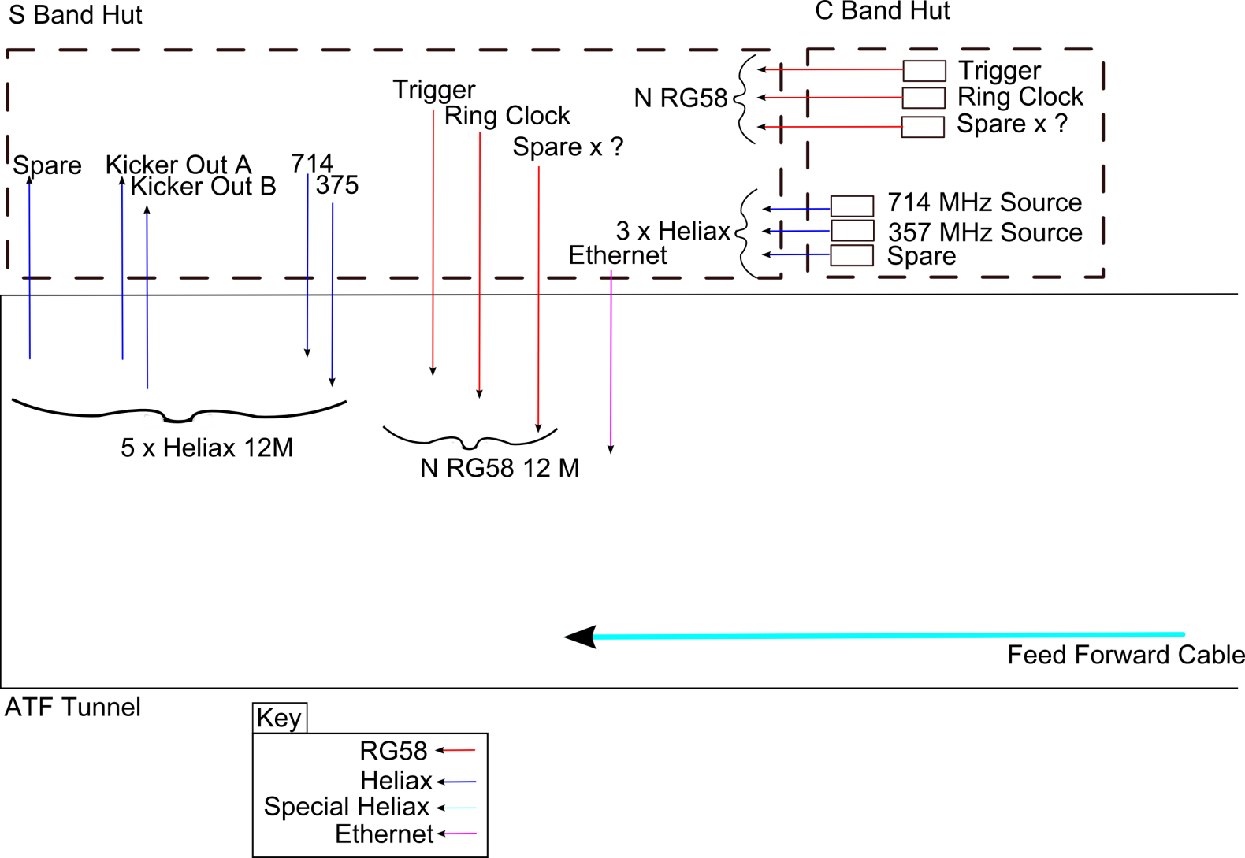
Option 1
Mikey Davis
30 August 2012
3/9

Slide 4
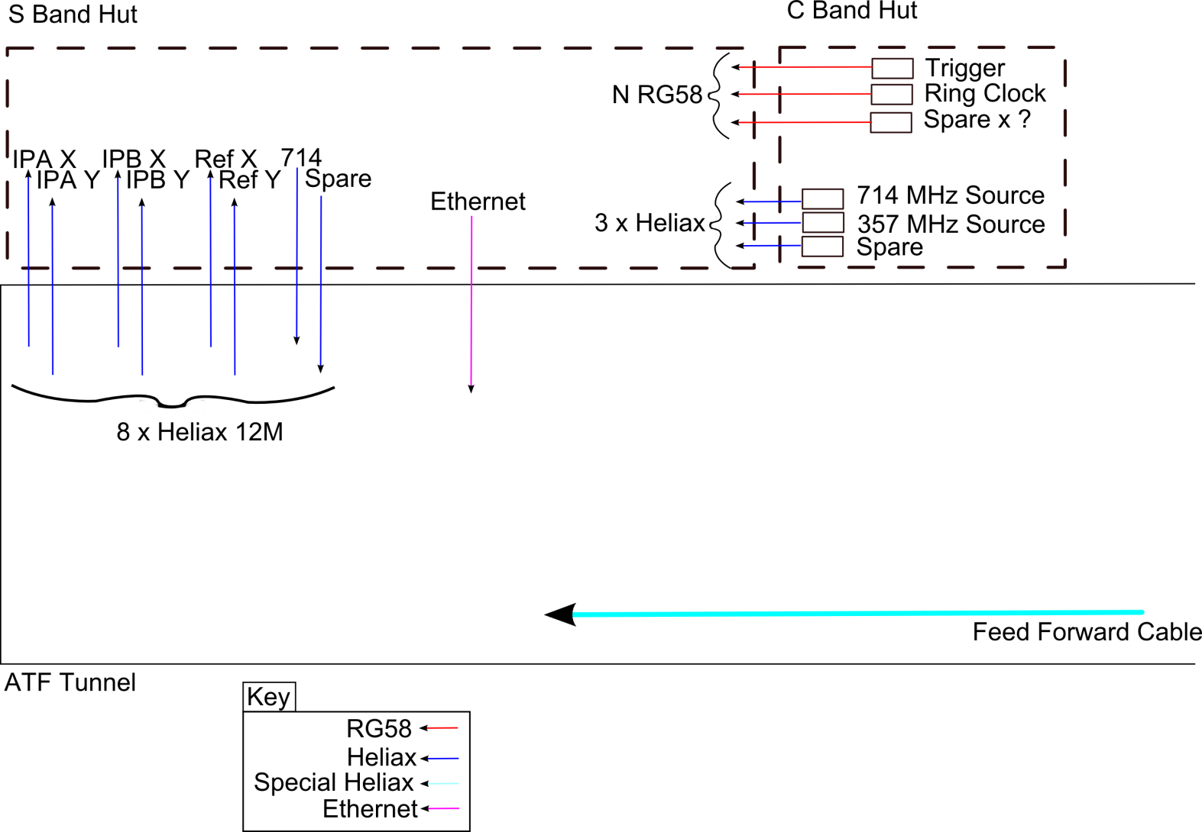
Option 2
Mikey Davis
30 August 2012
4/9

Slide 5
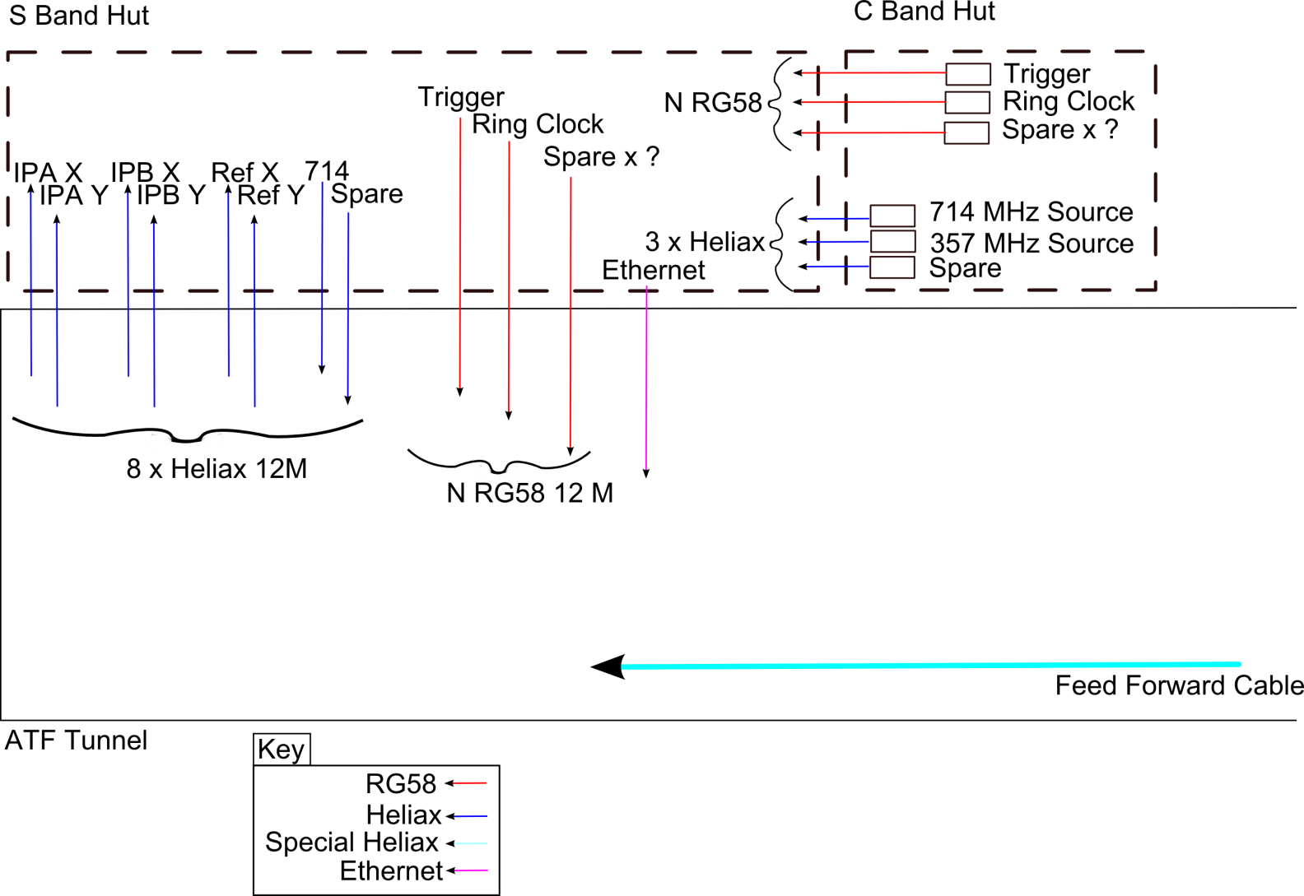
What I Think We Should Request
Mikey Davis
30 August 2012
5/9

Slide 6
Next Trip
I have tried to set out what we would do for the two possibilities of
Upstream Feedback
Feedback
From there I have tried to come up with a plan
Difficult without knowing what the shift situation at ATF will be
Mikey Davis
30 August 2012
6/9

Slide 7
1) Feedback
In single bunch mode
Upstream Calibrations
IP BPMS Magnet Calibrations
Move IP to IPA
Do a jitter run (resolution, jitter at FONT and IP)
Upstream Kicker Scan
Switch to 2 Bunch mode
Measure 2 bunch resolution and correlation
Do Upstream Kicker Scan (maybe)?
Do feedback, see if it works at the IP
Mikey Davis
30 August 2012
7/9

Slide 8
2) Feedforward
In single bunch mode
Upstream Calibrations
IP BPMS Magnet Calibrations
Downstream Kicker Scan
Move IP to IPA
Switch to 2 Bunch mode
Measure 2 bunch resolution and correlation
Single loop P2 and P3 gain scans
Single loop feedback
Coupled loop feedback
Go from there (depends on if it works I guess)
Mikey Davis
30 August 2012
8/9

Slide 9
October Plan
If we get two shifts in the first week I think we should dedicate one shift to feedback and one to feedforward
Even if feedback goes terribly I think we should push onto feedforward
We can then readdress our progress over the weekend and decide what to do in the second week
If we only get one shift in the first week then discuss as a group…
Mikey Davis
30 August 2012
9/9

