Slide 1
2012.09.04: Hayano
Cavity status; recent KEK activities
Only one VT(HIT-02) since last S0 meeting.
(1) STF CM-1 cavities are;
MHI-014: 3-rd VT:36MV/m (finished)
MHI-015: 4-th VT: 35.7MV/m(finished)
MHI-016: 2-nd VT:34MV/m (finished)
MHI-017: 1-st VT: 38MV/m (finished)
MHI-018: 1-st VT: 31MV/m -> 2-nd VT 10MV/m heavy field emission
MHI-019: 2-nd VT: 37MV/m(finished)
MHI-020: 1-st VT: 9MV/m heavy field-emission
MHI-021: 1-st VT: 38.9MV/m (finished)
MHI-022: 1-st VT: 31.5MV/m
(2) New bender/KEK cavities;
TOS-02(w/o HOM): 1-st VT: 31.2MV/m, 2-nd VT:32.7MV/m
HIT-02(with HOM): 1-st VT: 35.2MV/m, 2-nd VT:40.9MV/m
KEK-00(w/o HOM): 1-st VT: 26MV/m, 2-nd VT:29MV/m, 3-rd VT:24MV/m
KEK-01(with HOM): under fabrication
These three cavities were local grinding, and addtional-EP for removing abrasive.
After local grinding&EP, MHI-020 will be tested in this week (2nd test)

Slide 2
July 02
HIT-02(with HOM) 2-nd VT

Slide 3
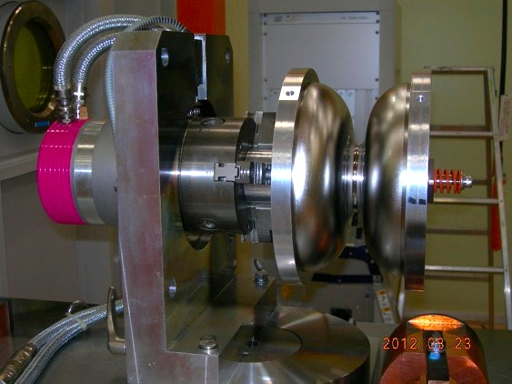
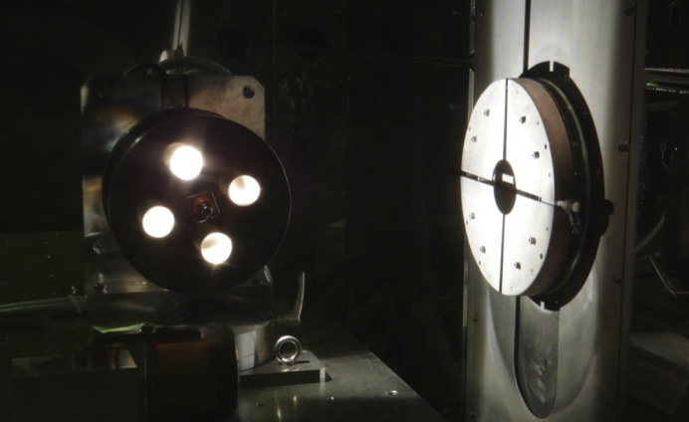
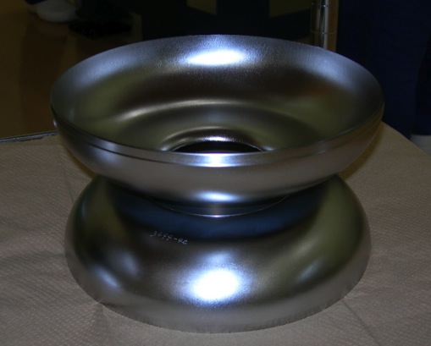
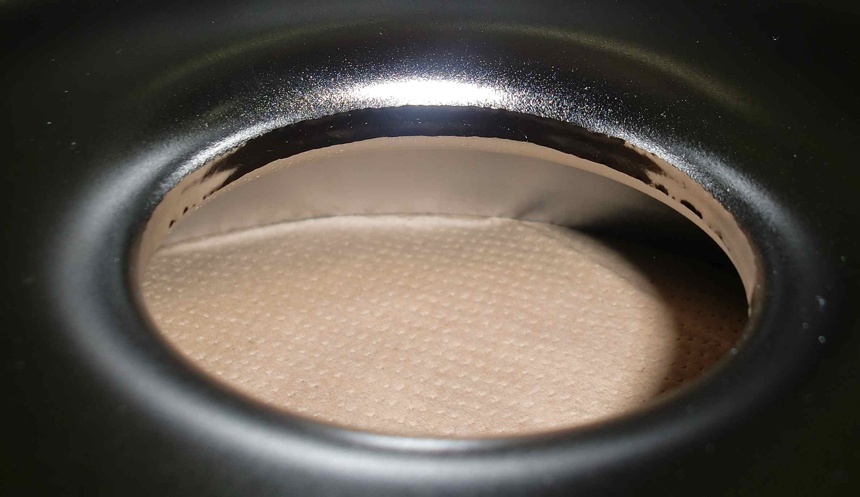
KEK-02(with HOM) under fabrication at KEK CFF
Dumbbell welding (Iris and stiffener) is on-going.
electron beam
mounted on the motor
under EBW (looking from window)
EBW completed
EBW seam looks good

