Slide 1
vvh @ 1TeV study for DBD
ILD analysis meeting
Sep. 05 2012
H. Ono (NDU)

Slide 2
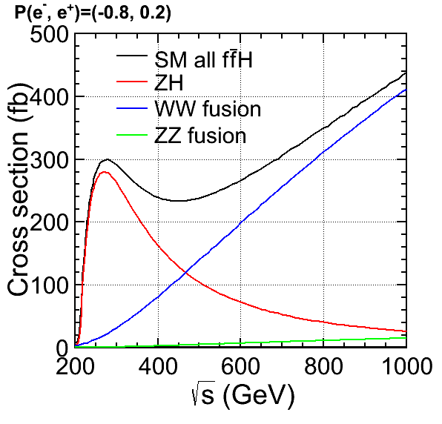
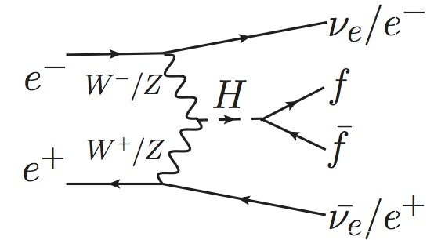
vvh @ 1TeV benchmark study
Main production: W-fusion process
e⁺e⁻→vvH
H→bb, cc, gg(2j),
H→WW(4j only), μμ(dilep)
Higgs samples simulation
w/o H→μμ (vvh_nomu) →0.5 ab⁻¹ for both polarization (-0.8, +0.2)/(+0.8, -0.2)
only H→μμ (vvh_mumu) →1k events simulated for every channel

Slide 3
Higgs study for DBD
Consideration of the report from the LHC results
Higgs-like boson around the mass of 125 GeV.
  Employ 125 GeV Higgs mass for vvh and tth study for DBD
  Use same Higgs BRs as LHC used instead of Pythia BR
Study condition of the Higgs BRs (vvh)
  Ecm=1 TeV for H→bb, cc, gg(2 jet), WW(4 jet) and μμ
  Assume Higgs mass of 125 GeV
  Employ same absolute Higgs BRs as LHC used
  Integrated luminosity:
  1 ab⁻¹ = 0.5 ab⁻¹ (-0.8, +0.2) + 0.5 ab⁻¹ (+0.8, -0.2)

Slide 4
New Higgs BRs for DBD
Employ LHC tuned Higgs BRs for DBD instead of Pythia BRs used in LOI
Pythia Branching ratio
Mh (GeV) | 120 (LOI) | 125
bb | 65.7% | 58.4%
ττ | 8.0% | 7.1%
μμ | 0.03% | 0.03%
ss | 0.03% | 0.03%
cc | 3.6% | 3.2%
gg | 5.5% | 5.3%
ϒϒ | 0.29% | 0.29%
Zϒ | 0.13% | 0.18%
WW | 15.0% | 22.6%
ZZ | 1.72% | 2.85%
LHC Branching ratio
Mh (GeV) | 120 | 125 (DBD)
bb | 64.9% | 57.8%
ττ | 7.1% | 6.4%
μμ | 0.02% | 0.02%
ss | 0.05% | 0.04%
cc | 3.0% | 2.7%
gg | 8.8% | 8.6%
ϒϒ | 0.23% | 0.23%
Zϒ | 0.11% | 0.16%
WW | 14.3% | 21.6%
ZZ | 1.60% | 2.67%
BR difference between 120 and 125 GeV looks small
but some discrepancy appears in LHC BR (especially H→gg)

Slide 5
Simulation and reconstruction condition
Simulation and reconstruction conditions
Beam setup: 1000-B1b_ws
Detector model: ILD_o1_v05
Mokka simulation: sv01-14-01-p00
Reconstruction: rv01-15-p00
file name
rv01-15-p00.
sv01-14-01-p00.
mILD_o1_v05.
E1000-B1b_ws.
I36151.Pvvh_nomu.
eL.pR-00001-DST.slcio
From the cut study from the stdhep and SVG sample study,
2f BGs were well suppressed
and only concentrate the 4f_WW and 4f_ZZ and 6f backgrounds
→ We also obtained 4f backgrounds of DSTs at KEK.

Slide 6
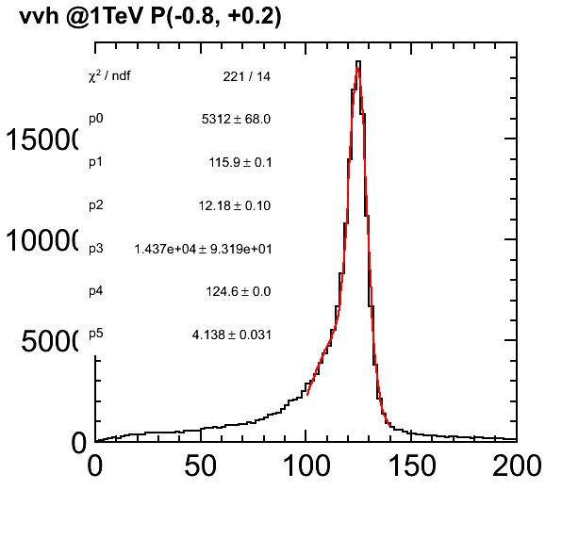
vvh w/o H→μμ signal sample
vvh_nomu, L=0.5 ab⁻¹, P(-0.8, +0.2), Mh=125 GeV
2-Gaussian fitting for
lough estimation
peak=124.6 GeV
σ=4.1 GeV
Invariant mass distribution (GeV)
Lough estimation with double-Gaussian fitting, σ=4.1 GeV
which looks almost consistent with LOI sample vvh width 4.5 GeV
(Ecm=250 GeV, Mh=120 GeV)

Slide 7
Test reconstructed DST samples
Collections in DST test sample
BCALClusters Cluster 0
BCALParticles ReconstructedParticle 0
BuildUpVertex Vertex 0
BuildUpVertex_RP ReconstructedParticle 0
MCParticlesSkimmed MCParticle 37
MarlinTrkTracks Track 2
PandoraClusters Cluster 9
PandoraPFANewReclusterMonitoringLCGenericObject 0
PandoraPFOs ReconstructedParticle 9
PrimaryVertex Vertex 1
PrimaryVertex_RP ReconstructedParticle 1
RecoMCTruthLink LCRelation 9
SITTrackerHits TrackerHitPlane 8
VXDTrackerHits TrackerHitPlane 12
How do we treat the Jet reconstruction and flavor tagging?
→Jets are not included in current test DST sample.

Slide 8
Incorrect polarization info in DST
Polarization parameters looks empty written in DST and Sim files
cf. I36151.Pvvh_nomu.eL.pR
parameter CrossSection_fb [float]: 747.626,
parameter Energy [float]: 1000,
parameter Pol_em [float]: 0,
parameter Pol_ep [float]: 0,
parameter Process [string]: vvh_nomu,
← Should be -1 and 1
Not to use pol values written in Sim or DST file
Pick up from file name or summary table.

Slide 9
Next step
Use new 125 GeV Higgs mass and LHC BRs for DBD vvh study
LCFIPlus will use in next step.
  Flavor tagging performance check
Compare BG reduction performance with SGV
Evaluate other BGs

Slide 11
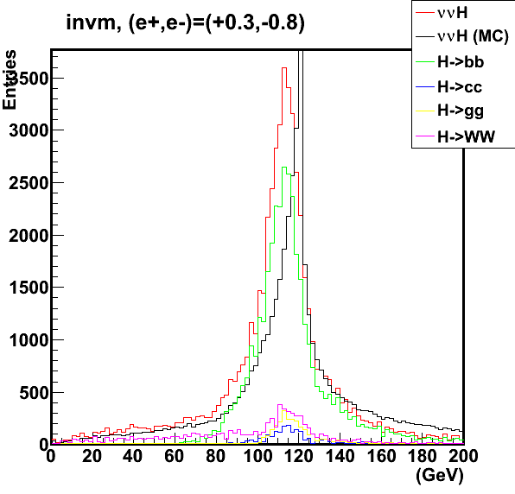
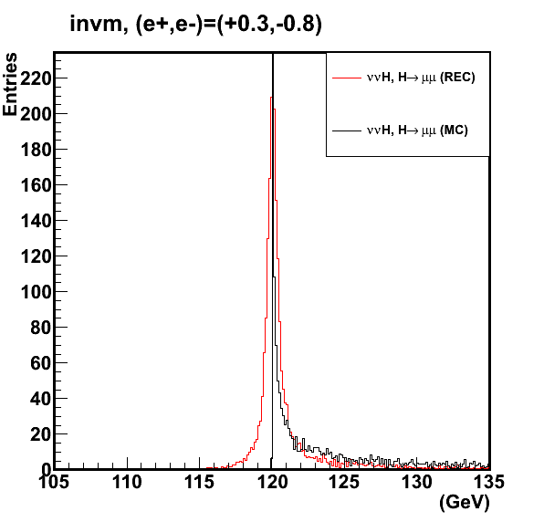
Previous samples with v01-13 with old beam parameters ILD_o1_v01
vvH@1 TeV with one older beam parameter set (Aug 2010)
mokka-07-07-p05 tag and the ILD_o1_v01 detector model
Higgs decay
w/o H→μμ
H→μμ
σ_{Mh}~400 MeV
with rough gaussian fitting
Invariant mass
Di-lepton invariant mass
Try to test latest version of ilcsoft v01-13-05 and latest beam parameter set
after samples become ready. (or reconstruct by my self)

Slide 12
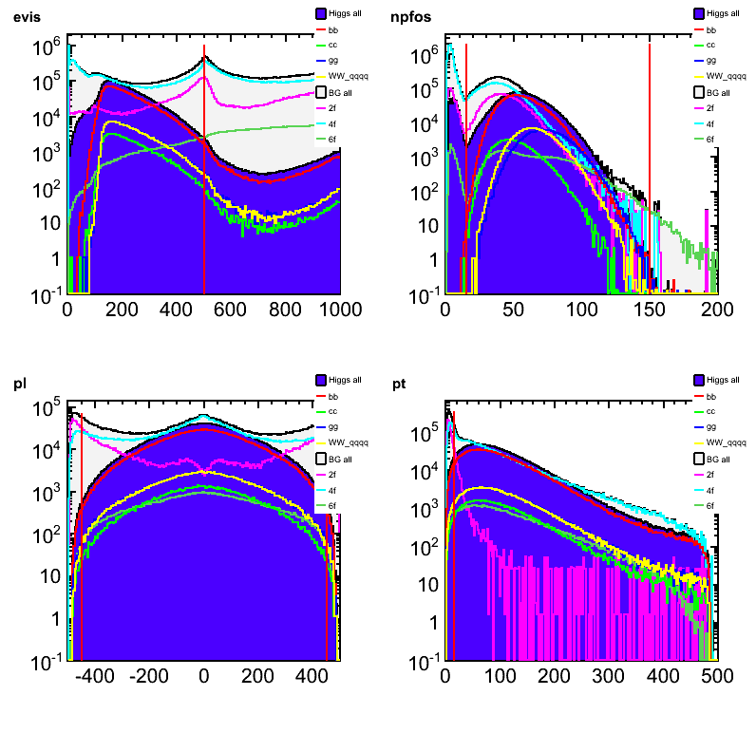
Evis < 500 GeV
15< nPFO < 150
Selection criteria
Check with SGVDST
H→All
BG All
2f
4f
6f
H→bb
H→cc
H→gg
H→WW→qqqq
|Pl|<450 GeV
Pt>15 GeV

