Slide 1
Future Accelerators
Marc Ross, SLAC - ILC
Higg’s factories and beyond:
ILC and alternate schemes

Slide 2
Outline
International Linear Collider (ILC)
  Parameters
  Superconducting RF and Nano-beams
  Staging: 250 GeV to 1 TeV
e+/e- Ring Colliders
  Parameters
  AC Power Consumption and Construction Cost
  Tunneling near CERN
μ+/μ- Colliders
  Staging and Parameters
  R & D

Slide 3
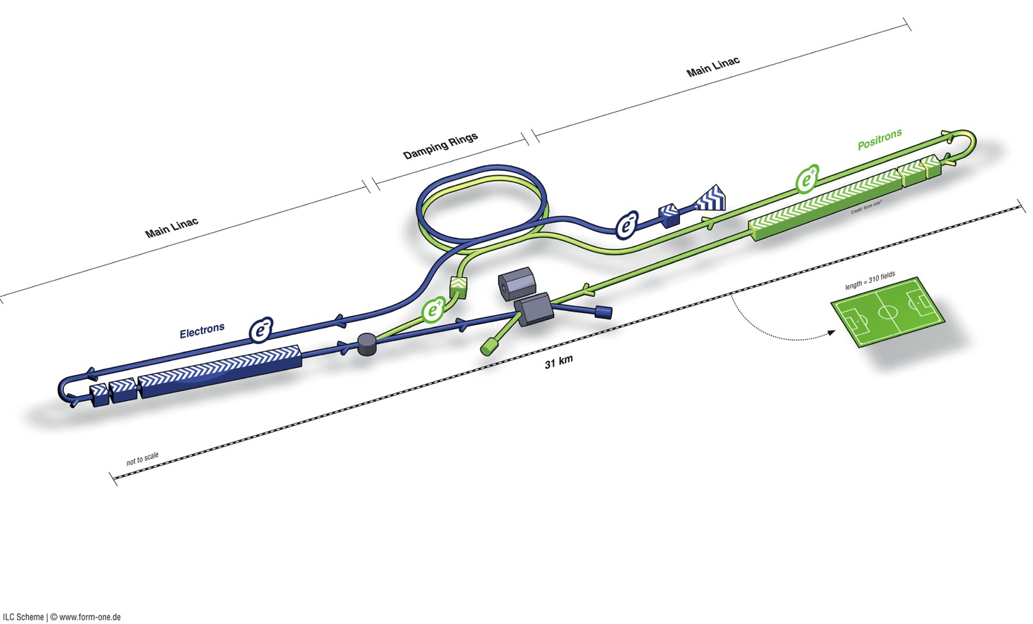
ILC in a Nutshell
Damping Rings
Polarised electron source
Ring to Main Linac (RTML)
(inc. bunch compressors)
Beam dump
310 x football pitch
e+ Main Linac
Beam Delivery System (BDS) & physics detectors
Polarised positron
source
Total site length (500 GeV CM) | 30.5 km
SCRF Main Linacs | 22.2 km
RTML (bunch compressors) | 2.8 km
Positron source | 1.1 km
BDS / IR | 4.5 km
Damping Rings (circumference) | 3.2 km
e- Main Linac
not too scale

Slide 4
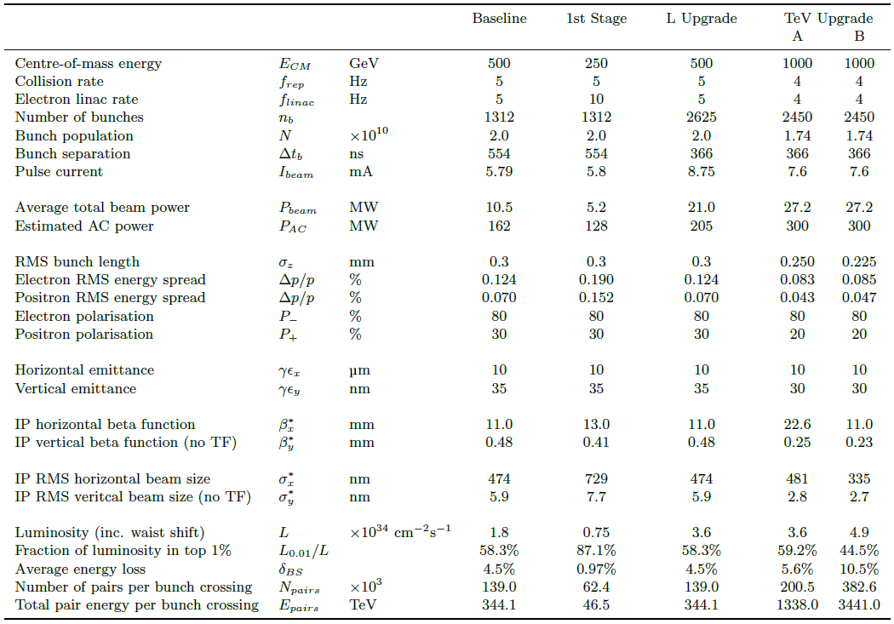
ILC Parameters

Slide 5
ILC Overview
Designed and optimized for 500 GeV E_{cm}; upgradeable to 1 TeV
L₅₀₀ ~ 1.8e34 with 162 MW wall plug
  L₁₀₀₀ ~ 5e34 with 300 MW wall plug
R & D program completed: Detailed Design
  Technology Demonstrated (SCRF)→
  8%-scale Demonstration ‘E-XFEL’ (DESY) in 2015
  IR optics & tuning Demonstration ‘ATF-II’ (KEK) →
Physics Studies, Detector / Machine Design Report completed 02.2013
  Culmination of 6 year design study

Slide 7
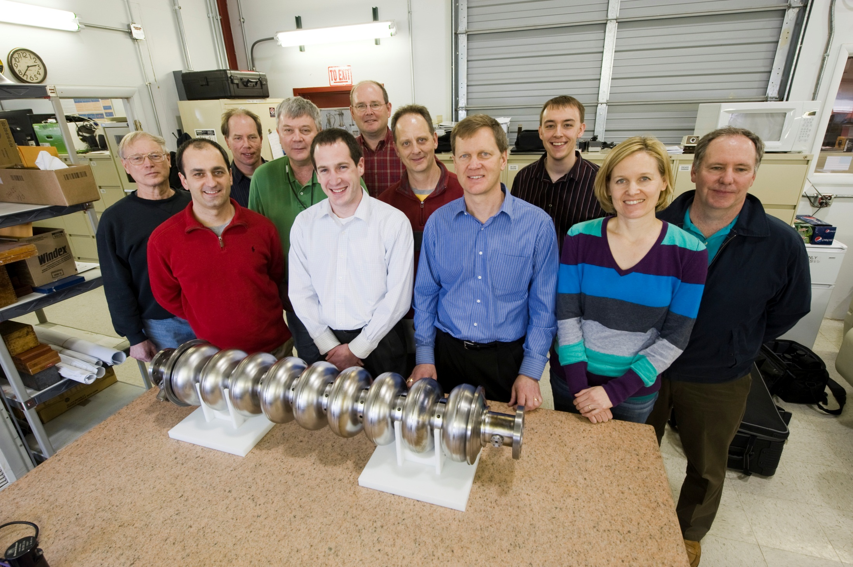
Fermilab – Niowave SCRF Cavity Team

Slide 8
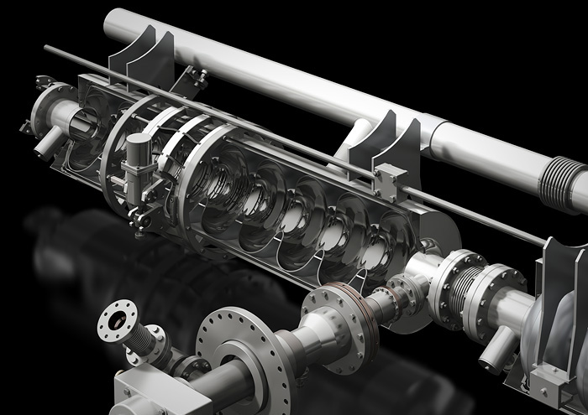
ILC Cavity Assembly
(Helium tank, mag. shield, tuner and coupler)
Graphics by Rey. Hori

Slide 9
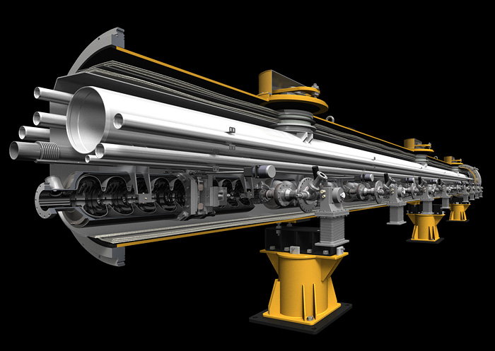
Linac building block: the Cryomodule:
Graphics by Rey. Hori

Slide 10
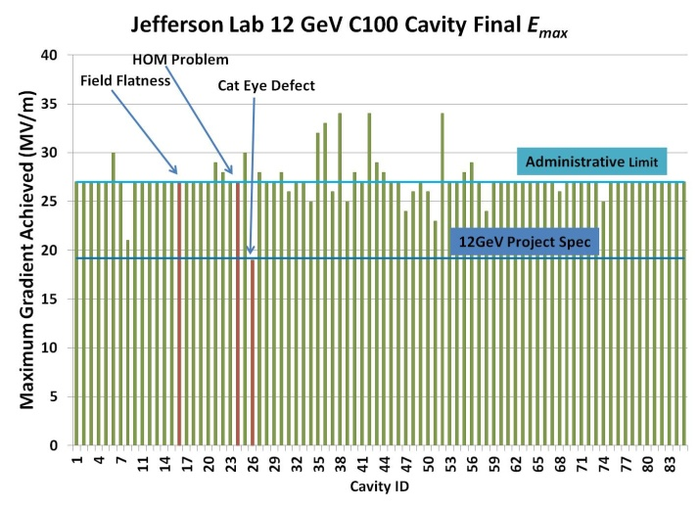
12 GeV cavities: overall performance
CEBAF 12 GeV upgrade
Vertical Test; 1500 MHz 7 cell; 10% gradient correction
72/85 @ admin limit (85%)
Cavities made by RI (Germany); Followed ILC Process
Reported 11.2012 by F. Pilat

Slide 11
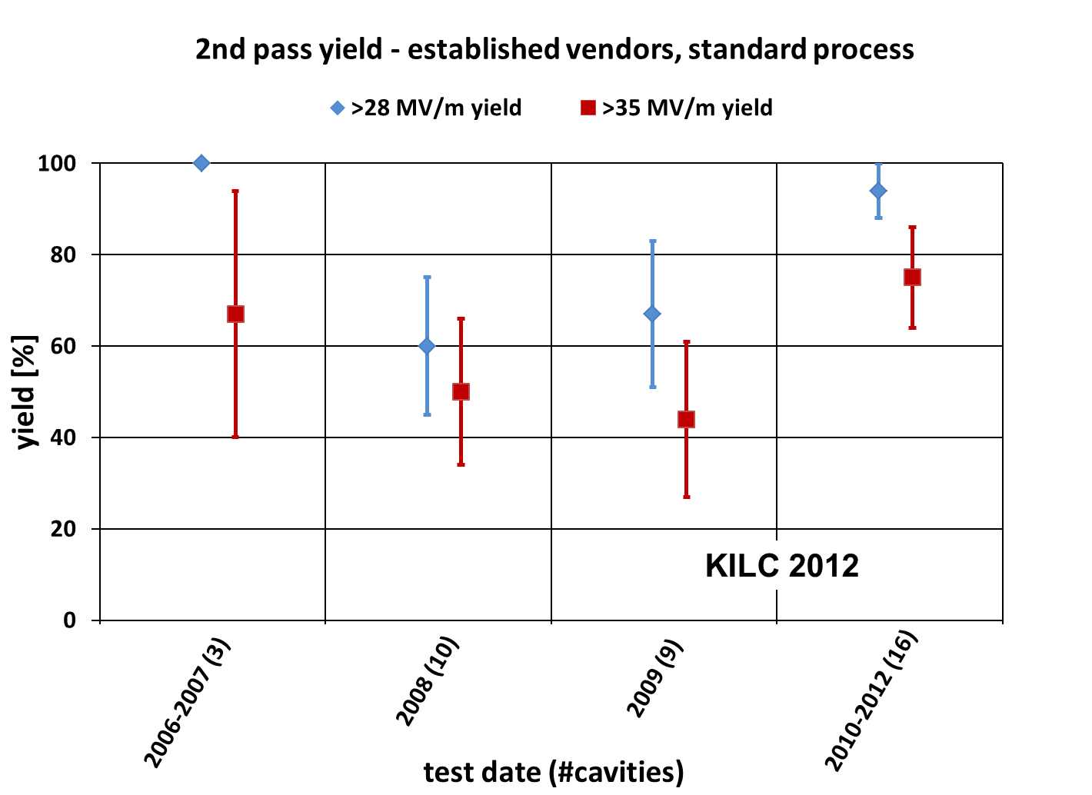
Global Progress in ILC Cavity Gradient Yield
(94+/-6)% acceptable for ILC mass production

Slide 12
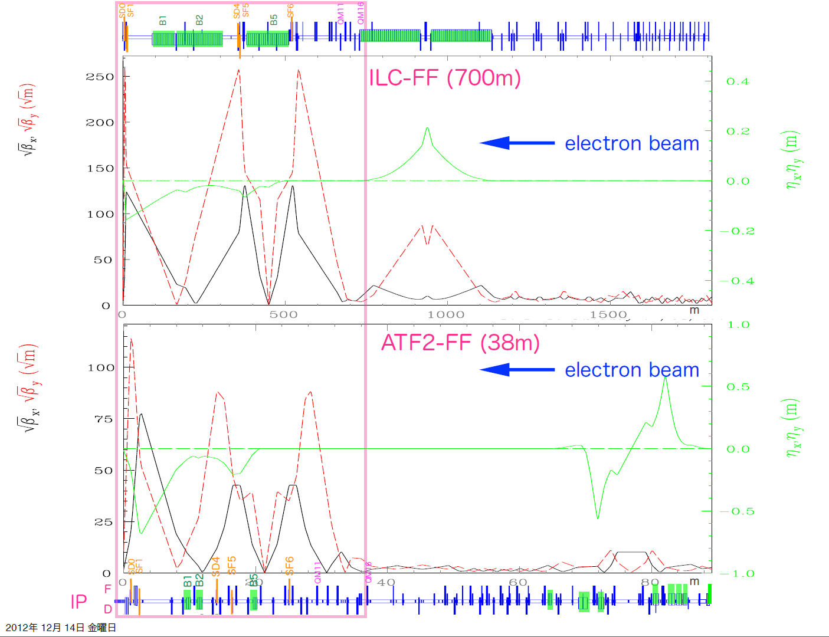
IT optics and tuning beam demonstration
ATF-II at KEK
Model Final-Focus optics system
Beam from ultra-low emittance damping ring

Slide 13
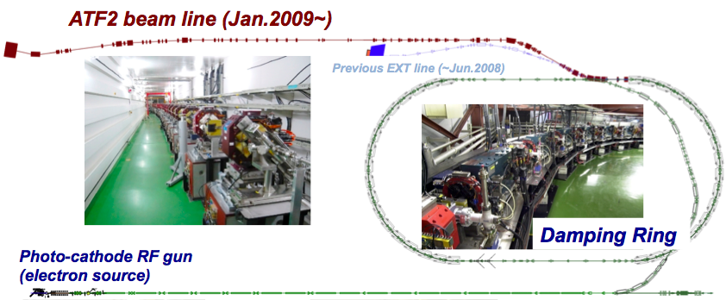
KEK - ATF2 Facility Layout
120 m

Slide 14
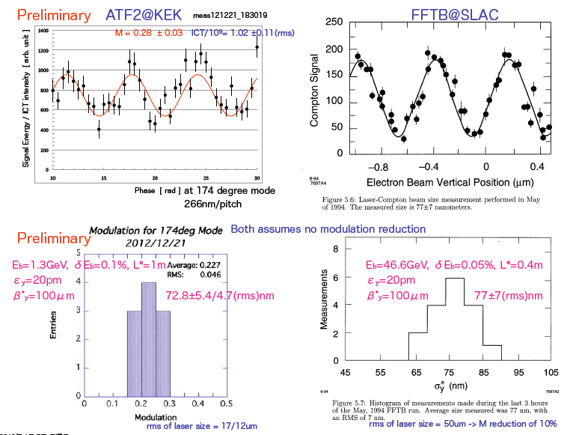
ATF-2 achieves 72.8 nm
2012
1994

Slide 15
Outline
International Linear Collider (ILC)
  Parameters
  Superconducting RF and Nano-beams
  Staging: 250 GeV to 1 TeV
e+/e- Ring Colliders
  Parameters
  AC Power Consumption and Construction Cost
  Tunneling near CERN
μ+/μ- Colliders
  Staging and Parameters
  R & D

Slide 16
Luminosity Upgrade
Concept: increase n_{b} from 1312 → 2625
  Reduce linac bunch spacing 554 ns → 336 ns
  Increase pulse current 5.8 → 8.8 mA
  Increase number of klystrons by ~50%
Doubles beam power → ×2 L (3.6×10³⁴cm⁻²s⁻¹)
Damping ring:
  Electron ring doubles current (389mA → 778mA)
  Positron ring: possible 2nd (stacked) ring (e-cloud limit)
AC power: 161 MW → 204 MW (est.)
  AC power increased by ×1.5
  shorter fill time and longer beam pulse results in higher RF-beam efficiency (44% → 61%)

Slide 17
TeV upgrade: Construction Scenario
500GeV operations
start civil construction
BC
Main Linac
BDS
e+ src
IP
civil construction + installation
500GeV operations
BC
Main Linac
BDS
e+ src
IP
Installation/upgrade shutdown
BC
Main Linac
BDS
e+ src
IP
final installation/connection
removal/relocation of BC
Removal of turnaround etc.
Installation of addition magnets etc.
Commissioning / operation at 1TeV
BC
Main Linac
BDS
e+ src
IP
Notes:
An obvious possible approach to minimizing downtime for physics.
Assume something like a total of 5 year construction with perhaps 12-18 months with no physics??

Slide 18
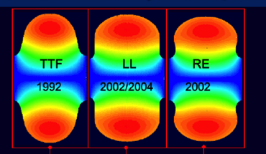
TeV Upgrade
<26 km ?
(site length <52 km ?)
1.1 km
<10.8 km ?
10.8 km
1.3 km
2.2 km
Main Linac
BDS
e+ src
IP
bunch comp.
Assume Higher Gradient
Main Linac
<G_{cavity}> = 31.5 MV/m
G_{eff} ≈ 22.7 MV/m
(fill fact. = 0.72)
central region
Snowmass 2005 baseline recommendation for TeV upgrade:
G_{cavity} = 36 MV/m ⇒ 9.6 km
(VT ≥ 40 MV/m)
Based on use of low-loss or re-entrant cavity shapes

Slide 19
250 GeV – Staged ILC
15.4 km
1.1 km
5.1 km
1.3 km
2.2 km
Main Linac
BDS
e+ src
IP
bunch comp.
125 GeV transport
central region
Half the linac
Full-length BDS tunnel & vacuum (TeV)
½ BDS magnets (instrumentation, CF etc)
1 RTML LTL
5km 125 GeV transport line
Extended tunnel/CFS already 500 GeV stage

Slide 20
ILC at low/high Ecm
Low E_{cm} operation of upgraded ILC:
  L₂₅₀ ~ 3e34; Wall plug 200 MW
  Possible Higgs Factory
High E_{cm} ~ 1.5 TeV
  L₁₅₀₀ ~ 6e34; Wall plug 340 MW
ILC - nominal
ILC - upgraded
80 km ring; per IP

Slide 21
ILC Parameters

Slide 22
Two Alternatives to ILC (1):
e+/ e- storage ring-based colliders
  Low Energy ‘factories’
  Assume substantial injection complex
  Enormous tunnel complex (step toward VLHC)
  Based on extrapolation of established technology
  R & D needed
Only 2 parameters:
  Ring Size and
  Site Power consumption
Civil engineering cost and strategy →

Slide 23
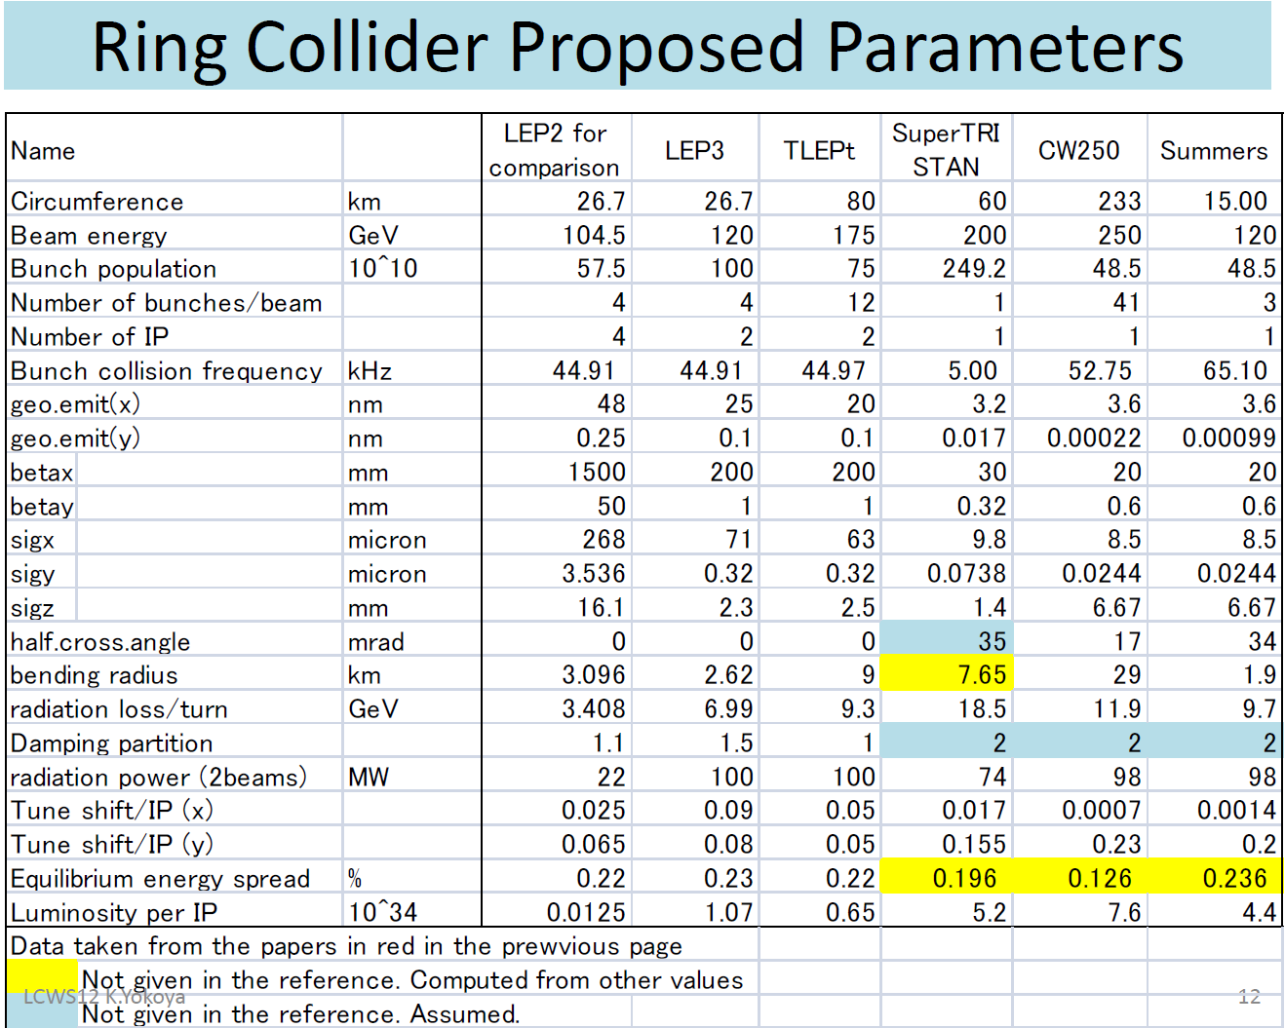
From K. Yokoya

Slide 24
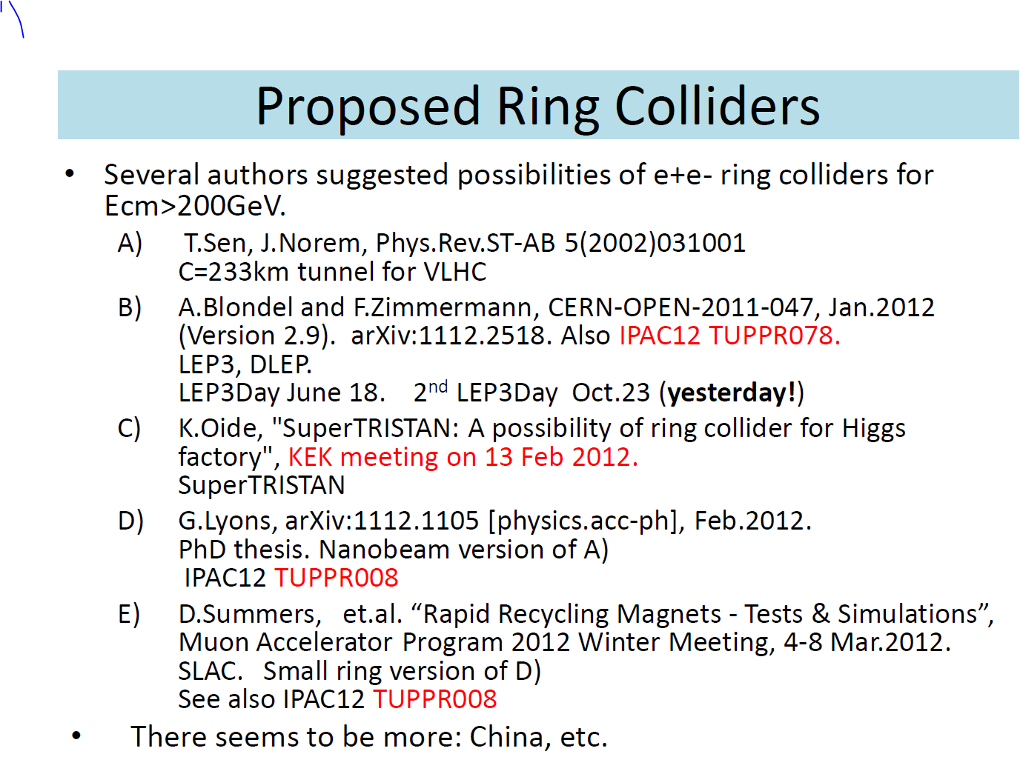
From K. Yokoya:

Slide 25
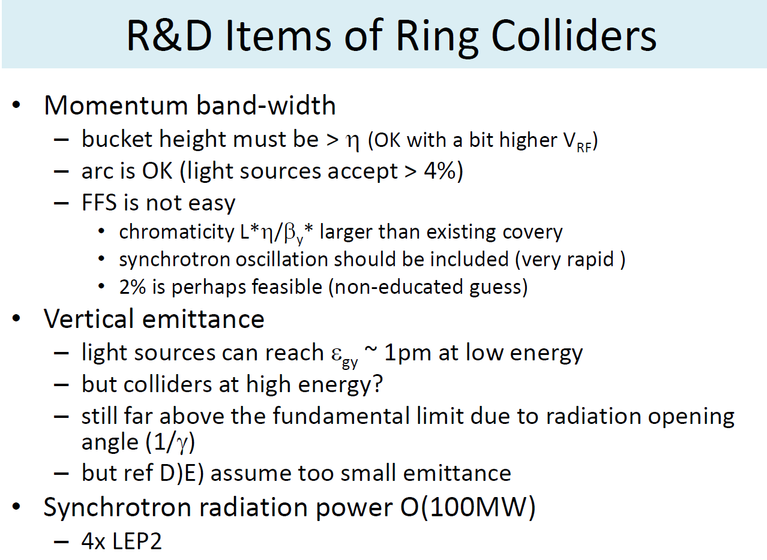
From K. Yokoya
Low emittance operation planned for Super KEK-B

Slide 26
Collider ‘Wall Plug’ AC Power use:
ILC and 80 km ring: | ILC -H | ILC-nom | Ring - H | Ring - t
E_cm (GeV) | 250 | 500 | 240 | 350
SRF Power to Beam (MW) | 5.2 | 10.5 | 100 | 100
Eff. RF Length (m) | 7,837 | 15,674 | 600 | 1200
RF klystron peak efficiency (%) | 65 | 65 | 65 | 65
klystron operating margin, HVPS, Klystron Aux and klystron water cooling (% inefficiency) |  |  | 20* | 20
Overall system RF efficiency (%) | 10 | 14 | 45 | 45
Cryo (MW) | 16 | 32 | 20 | 40
Normal Conducting (exc. Injector complex) (MW) | 6 | 10 | 120** | 120
Injector complex | 32 | 32 | 16*** | 16
Conventional (Air, lighting, ..) | 6 | 6**** | 18 | 18
Total (exc. detector) | 112 | 153 | 396 | 416
* 5% for operating margin, 2% for auxiliaries, 3% for HVPS and 10% for water cooling
** assume 1.5 kW / m tunnel inclusive (ILC avg. 3 kW / m)
*** from SSC / Fermilab injector (linac + LEB + MEB); assumes LHC not needed
**** 6 MW for 30 km beam tunnel complex; ~3x more for 80 ring

Slide 27
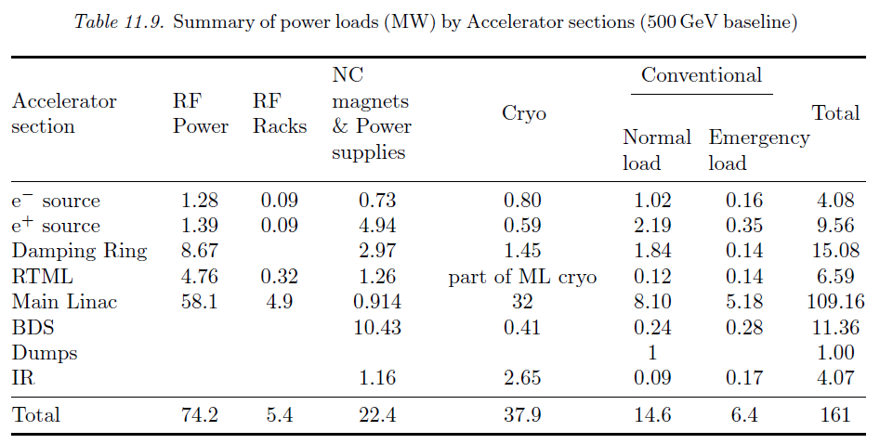
ILC AC Power loads:

Slide 28
Questions asked for ‘Snowmass’:
CSS2013 / P5 planning process:
What the required parameters and key characteristics of lepton / gamma colliders in the Higg's factory range? with physics capabilities far beyond the LHC? at what cost? How does a Higgs factory scale cost-wise to a TeV scale linear collider?
Cost comparisons with concepts can only be done parametrically.

Slide 29
ILC ‘value’ estimate:
‘Value’ is the direct cost of goods and services
Appropriate for in-kind projects
ILC: 7.8 B ILCU + 23 million labor person-hours

Slide 30
Parametric ‘value’ costing for TeV–class machines (KILCU)*:
Civil Construction: 35 / m
Utilities: 5000 / MW
Superconducting RF 180 / m (inclusive)**
‘Conventional Acc.’ 35 / m
 |  | TLEP-t quantity | MILCU | ILC quantity | MILCU
Civil Construction | km | 80 | 3000 | 34 | 1200
Power and cooling | MW | 416 | 2000 | 162 | 800
SRF (incl. packing) | km | 1.2 / .7 | 250 | 22 | 4000
‘Conventional’ | km | 160 | 5500 *** | 12 | 800
Installation | km | 80 | 100 | 34 | 100
Total |  |  | 11000 |  | 7800**
* 1 ILCU = USD 01.2012
** cryogenics not included – reuse LHC assumed; 900 MILCU included for ILC
*** Conventional Acc. (Magnets, vacuum, etc) cost – scale reduced 2x for ring
Institutional Labor is part of the project cost and must also be analyzed.

Slide 31
Outline
International Linear Collider (ILC)
  Parameters
  Superconducting RF and Nano-beams
  Staging: 250 GeV to 1 TeV
e+/e- Ring Colliders
  Parameters
  AC Power Consumption and Construction Cost
  Tunneling near CERN
μ+/μ- Colliders
  Staging and Parameters
  R & D

Slide 32
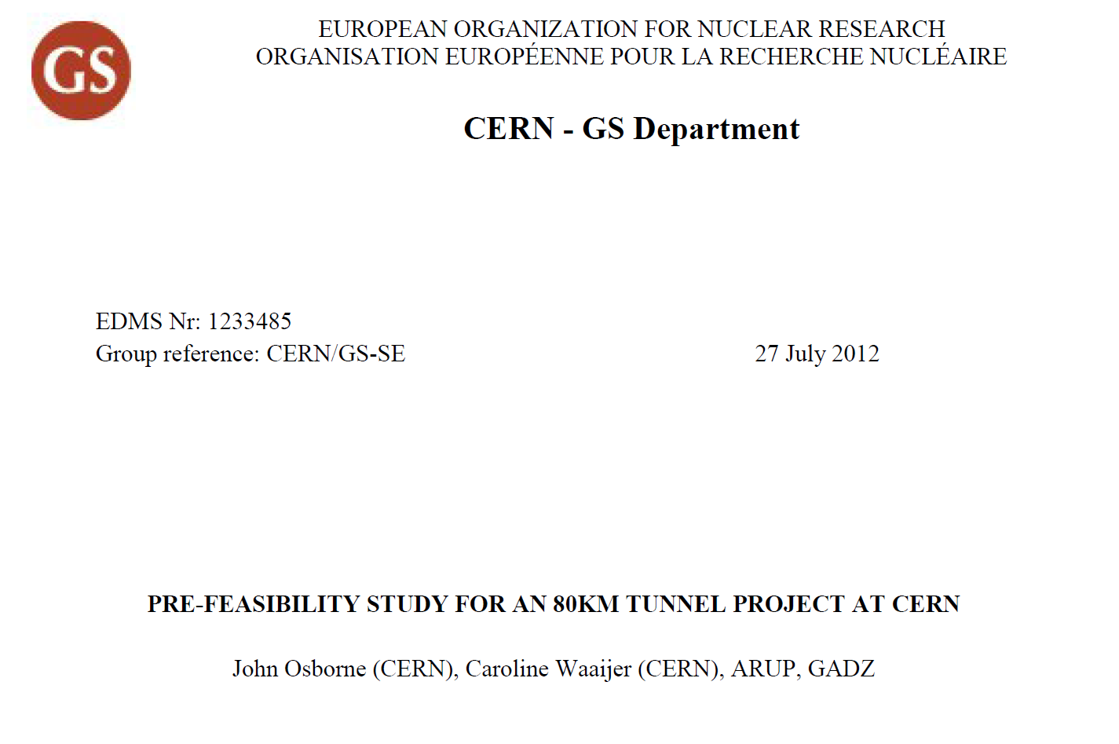

European Strategy Submission – Krakow 08.2012 by CERN Civil Engineering: John Osborne
Presented at:

Slide 33
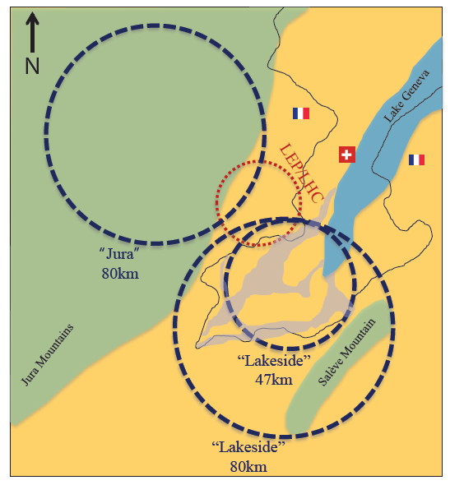
Jura & Salève: Karst Geology
Tunneling risk
Karst (green):
  “Dissolution by layers of soluble bedrock, typically limestone”
  “rocky ground, caves, sinkholes, underground rivers, and the absence of surface streams and lakes”
  France; Kwangsi in China; Yucatán Peninsula; Florida in the United States

Slide 34

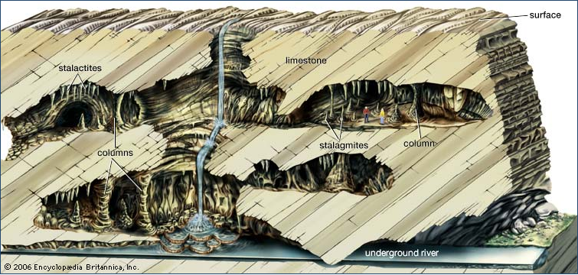
Karst geology:
Florida US 03.2013

Slide 35
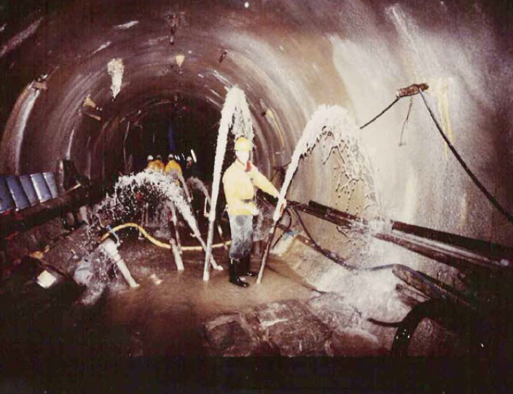
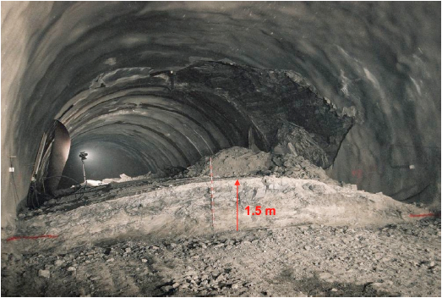
CE considerations Tunneling
Geneva plain
Underneath Lake Geneva
Through Jura and Salève Mountains
  Mountain area consists of Limestones and evaporates
    For 10% of tunnel
    Difficult tunneling conditions
      Local and unpredictable karst features
        Water conduits
        High flow rates (600L/sec)
      Water transports silt-clay sediments
        Difficult to drawing off water through
        pressure relief holes
        Increase of water inflow over time
        Difficulties in removal of the water
        Risk of aquifer pollution & depletion
      Anhydrites -> ‘badrock’ causes swelling
        Heaving of the tunnel invert
        Structural instabilities
        Probably low risk for 80km Lakeside option
        but high risk for 80km Jura option
LEP tunnel collapse
Example of tunnel invert heave Chienberg tunnel, Switzerland

Slide 36
Potential locations
Pre-feasibility study performed by CERN and the specialized firm ARUP.
  Focused on
    geology & hydrogeology,
    tunneling & construction,
    environmental impacts
  Result: for the 80km long tunnel location 2 ‘80km Lakeside’ is most feasible.
Risk
 | water ingress | heaving ground | weak marls | hydro carbons | support & lining | ground response & convergence | hydrostatic pressure & drainage | Pollution of aquifers | effect of shafts on nature | effects of shafts on urban areas | Total
Jura 80 | 5 | 3 | 0 | 0 | 5 | 4 | 5 | 5 | 4 | 2 | 33
Lake 80 | 2 | 0 | 3 | 3 | 3 | 3 | 2 | 2 | 3 | 2 | 23
Lake 47 | 1 | 0 | 2 | 2 | 2 | 2 | 1 | 1 | 2 | 5 | 18
Feasibility
Low
High

Slide 37
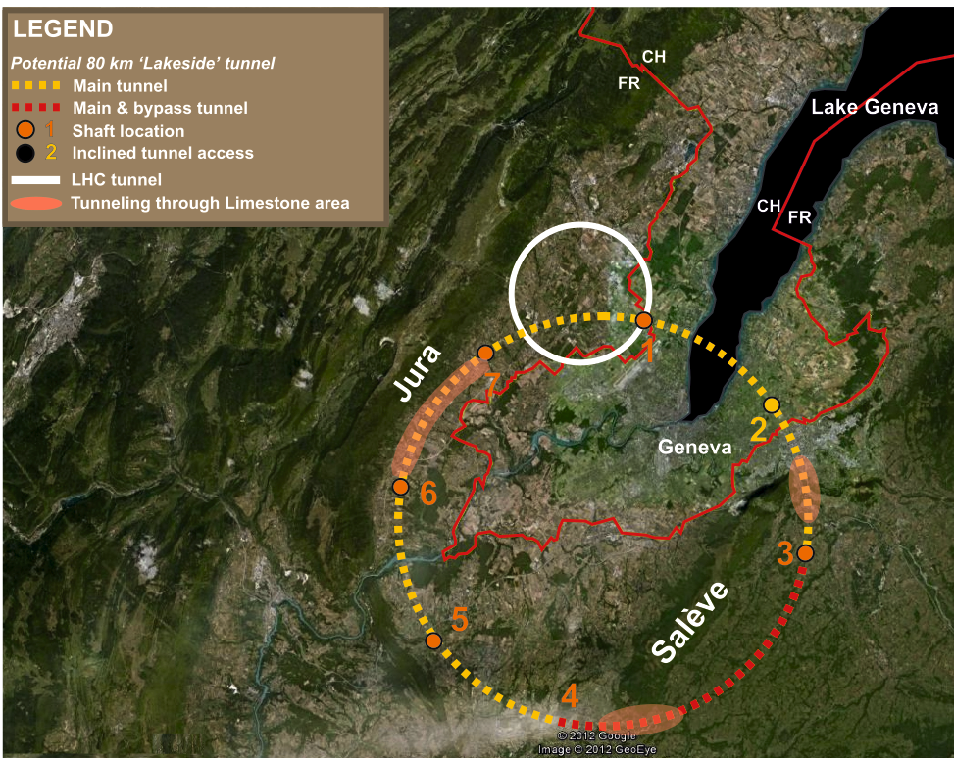
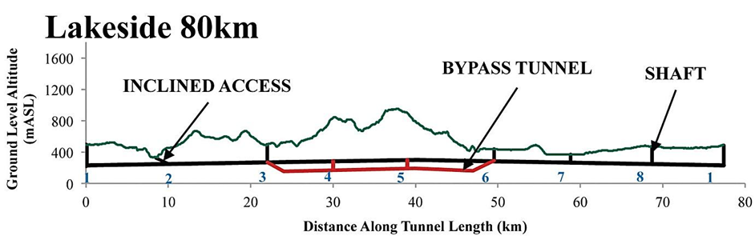
CE considerations Optimization
Optimization studies for the project configuration have been started
  Bypass tunnel in geological and environmental sensitive area
  Inclined access tunnel in urban area
More optimization studies needed
  Incline tunnel?
  More bypass tunnels?

Slide 38
Ring Collider R & D items:
Much related beam physics will be studied at Super KEK-B (2015 →)
  IR optics and vertical emittance will be checked. SuperKEKB will try to x10 smaller vert emittance (than LEP) with full beam-beam.
CERN-region ring ‘optimization’ work
  Avoiding Karst geology (conclusion of 21.02 meeting)
Large ring cost is not substantially smaller than ILC
  Energy consumption is excessive

Slide 39
Two Alternatives to ILC (2):
Muon colliders
  Very High energy without enormous tunneling
Basic R & D needed in four technical areas
  Normal Conducting RF
  Superconducting RF
  High Field magnets
  Targeting
System demonstrations:
  beam cooling and
  high power-on-target

Slide 40
The U.S. Muon Accelerator Program
Mark Palmer
Frontier Facilities Meeting
University of Chicago
February 25, 2013

Slide 41
Muon Accelerators
Program Baselines

Slide 42
The Muon Accelerator Program Timeline
 | 2010 |  | ~2020 |  | ~2030
Muon Accelerator R&D Phase
Proton Driver Implementation (Project X @ FNAL)
Intensity Frontier
Energy Frontier
MAP Feasibility Assessment
Advanced Systems R&D
Muon Ionization Cooling Experiment (MICE)
Indicates a date when
an informed decision
should be possible
Proj X Ph I
Proj X Ph II
Proj X Ph III & IV
IDS-NF RDR
Proposed Muon Storage Ring Facility (νSTORM)
Evolution to Full Spec ν Factory
Collider Conceptual ➔ Technical Design
Collider Construction ➔
Physics Program
Notes:
Yellow diamonds indicate potential start of DOE CD process

Slide 43
Muon Collider Concept
Muon Collider Block Diagram
Proton source:
For example PROJECT X at 4 MW, with 2±1 ns long bunches
Goal:
Produce a high intensity μ beam whose 6D phase space is reduced by a factor of ~10⁶-10⁷ from its value at the production target
Collider: √s = 3 TeV
Circumference 4.5km
L = 3×10³⁴ cm⁻²s⁻¹
μ/bunch = 2x10¹²
σ(p)/p = 0.1%
ε_{⊥N} = 25 μm, ε_{||N}=70 mm
β* = 5mm
Rep. Rate = 12 Hz

Slide 44
Muon Collider Parameters
3-4 MeV CoM
Energy Spread

Slide 45
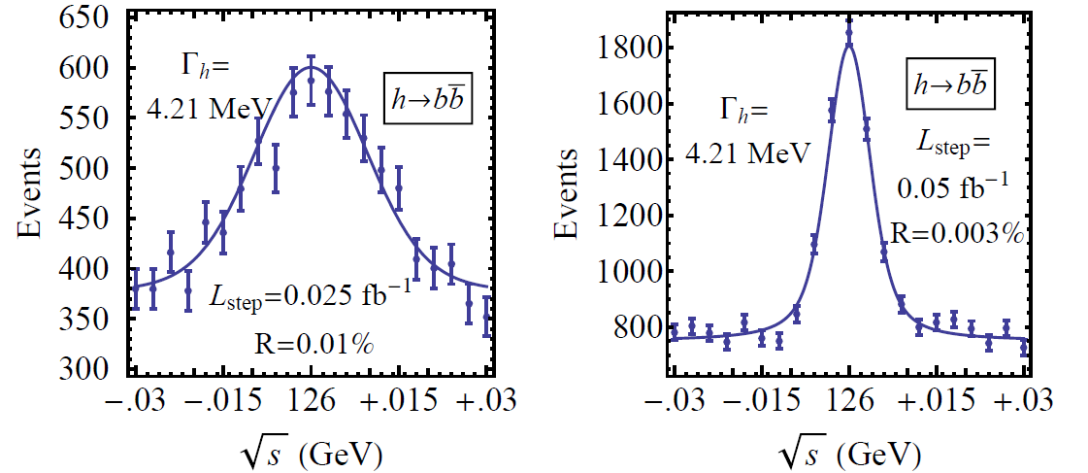
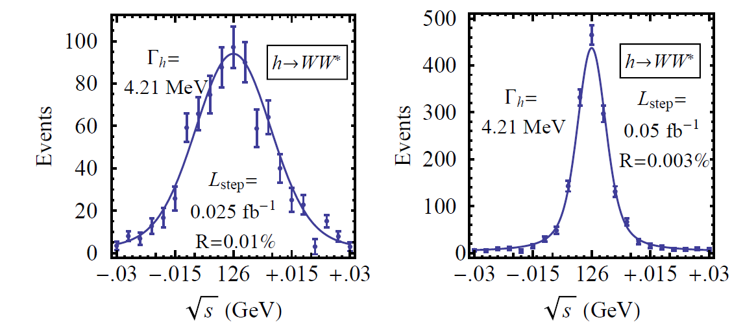
126 GeV Higgs Factory
s-channel coupling of Muons to HIGGS with high cross sections:
Muon Collider of with L = 10³² cm⁻²s⁻¹ @ 63 GeV/beam (50000 Higgs/year)
Competitive with e+/e- Linear Collider with L = 2. 10³⁴ cm⁻²s⁻¹ @ 126 GeV/beam
Sharp resonance: momentum spread ~ 4 × 10⁻⁵
Han and Liu
hep-ph 1210.7803
~30 T HTS Final
Cooling Solenoids
Reduced cooling:
ε_{⊥N} =0.3π⋅mm⋅rad,
ε_{||N} =1π⋅mm⋅rad
Major advantage for Physics of a μ⁺μ⁻ Higgs Factory: possibility of direct measurement of the Higgs boson width (Γ~4MeV FWHM expected)

Slide 46
Overview of R&D Areas
Design Studies
  Proton Driver
  Front End
  Cooling
  Acceleration and Storage
  Collider
  Machine-Detector Interface
  Work closely with physics and detector efforts
Major System Demonstration
  The Muon Ionization Cooling Experiment – MICE
    Major U.S. effort to provide key hardware: RF Cavities and couplers, Spectrometer Solenoids, Coupling Coils
    Experimental and Operations Support
Technology R&D
  Normal Conducting RF
    Vacuum RF Cavities with reduced breakdown rates in high magnetic fields
    Cavity Materials
    RF Cavities filled with high pressure gas
  Superconducting RF
    Demonstrating good Q₀ performance with Niobium on Copper cavities
      Performance
      Fabrication techniques
  Magnets
    High field solenoids for cooling channel application
    10T dipole design (synergistic with LHC upgrade activities)
    Rapid cycling magnets for high energy hybrid synchrotron
    Shielded magnets for μ decay in rings
  Target and Absorbers
    Liquid jet targets capable
    Capture solenoid technology

Slide 47
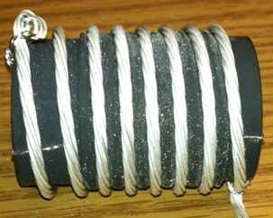
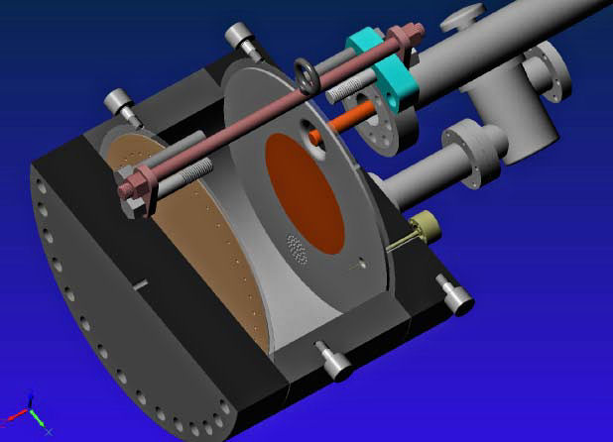
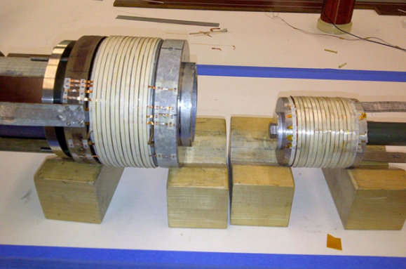
MAP Technology Highlights
Successful Operation of 805 MHz “All Seasons” Cavity in 3T Magnetic Field under Vacuum
MuCool Test Area/Muons Inc
World Record
HTS-only Coil
15T on-axis field
16T on coil
PBL/BNL
Demonstration of High Pressure RF Cavity in 3T Magnetic Field with Beam
Extrapolates to
μ-Collider Parameters
MuCool Test Area
Breakthrough in HTS Cable Performance with Cables Matching Strand Performance
FNAL-Tech Div
T. Shen-Early Career Award
The Path to a Viable
Muon Ionization
Cooling Channel
1% Dry Air (0.2% O2) in GH2
Pure GH2
1% Dry Air
(0.2 % O2)
in GH2 at
B = 3T
~50X reduction in
RF power dissipation
E₀ = 25 MV/m

Slide 48
Muon collider R & D

Slide 49
Summary:

Slide 50
