Slide 1


Further Simulations at IP
Mikey Davis
14 September 2012
1/7

Slide 2
Introduction
I have continued my simulation work at the IP
I am still confused by the naming convention of the IPBPMs
I think that IPA and IPB are actually correctly named in EPICS
I am not sure about the PRE and POST IP BPMs
Mikey Davis
14 September 2012
2/7

Slide 3
Jitters At FONT
Just FYI, as I was asked this last week, these are the jitters in the FONT region for the data sets
I have been looking at.
 | P1 | P2 | P3
Jitter (μm) | 3.54 | 3.49 | 3.31
Mikey Davis
14 September 2012
3/7

Slide 4
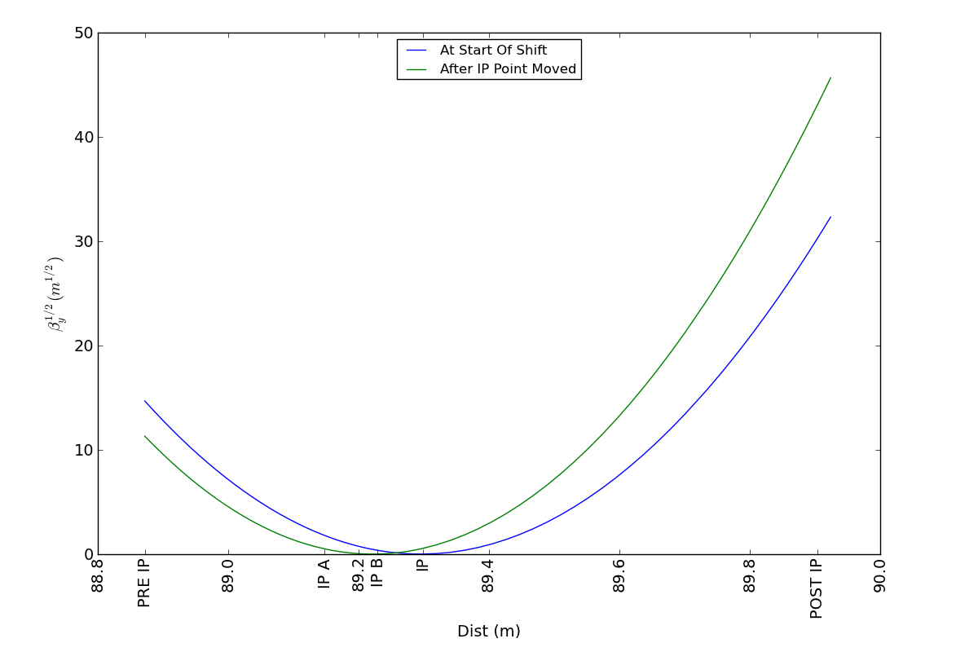
Beta Functions at the IP
Mikey Davis
14 September 2012
4/7

Slide 5
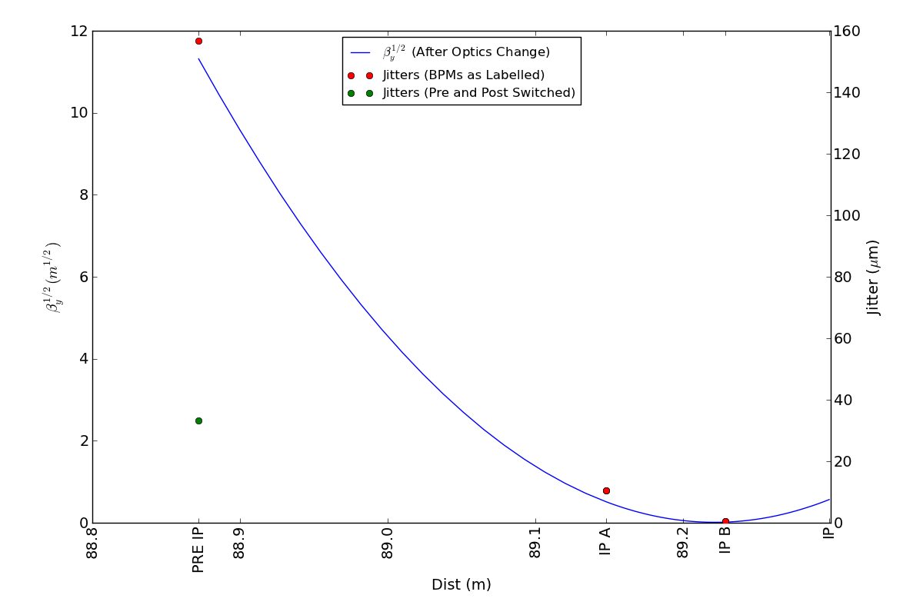
Jitter and Beta Up to IP
Mikey Davis
14 September 2012
5/7

Slide 6
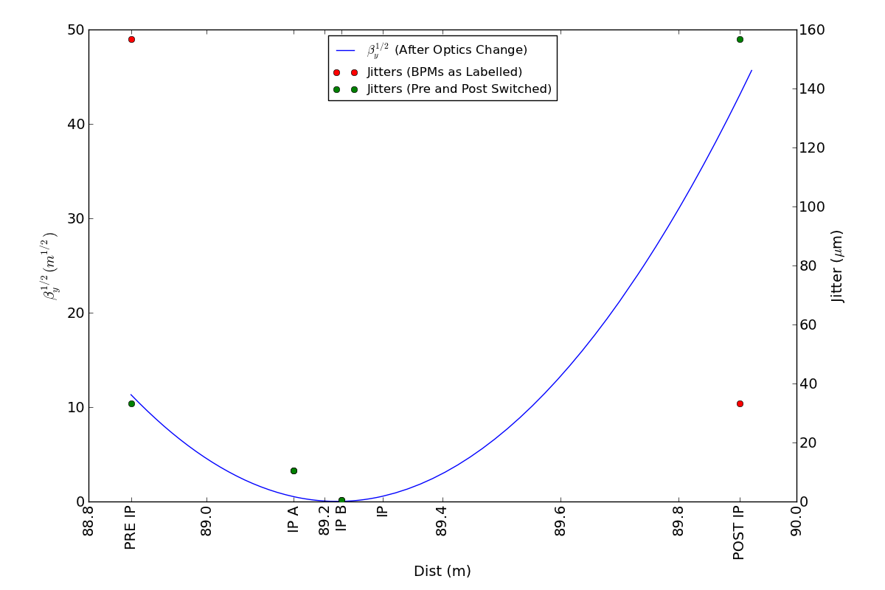
Jitter and Beta Through IP
Mikey Davis
14 September 2012
6/7

Slide 7
Conclusions
I think that as we see it in EPICS IPA and IPB are actually the correct way around
I am not sure about Pre and Post but my feeling is they are also right and Post is giving junk results
Mikey Davis
14 September 2012
7/7

