Slide 1


Tentative ATF Plan – Oct 2012
Mikey Davis
20 September 2012
1/6

Slide 2
Introduction
The aims of the trip are to try and establish a decrease in jitter at the IP as measured at IPB
A sub aim would be to show a decrease in jitter at IPA
Two methods could be tested
upstream feedback
feedforward
Mikey Davis
20 September 2012
2/6

Slide 3
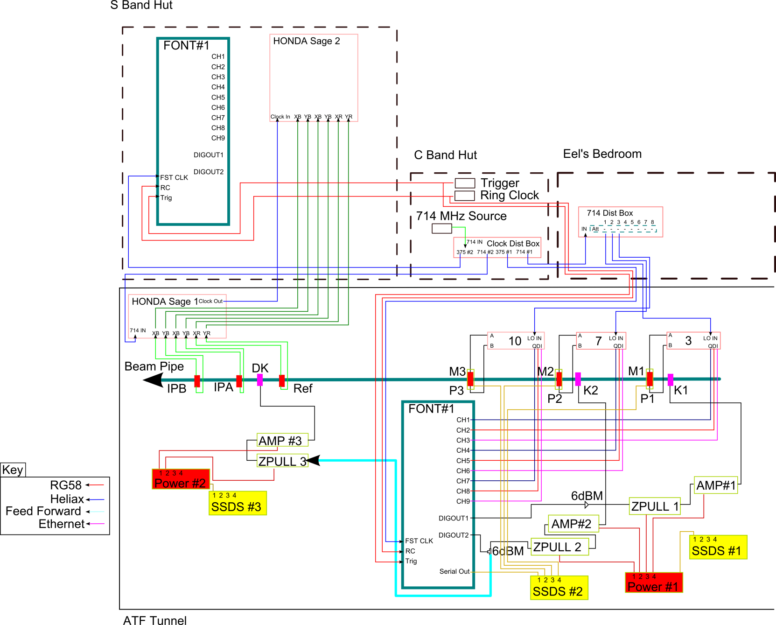
Setup
Mikey Davis
20 September 2012
3/6

Slide 4

1) Feedback
In single bunch mode
Upstream Calibrations
Downstream Calibrations
Move IP to IPA
Do a jitter run (resolution, jitter at FONT and IP)
Upstream kicker scan
Switch to 2 Bunch mode
Measure 2 bunch resolution and correlation
Do feedback, see if it works at the IP
Mikey Davis
20 September 2012
4/6

Slide 5
2) Feedforward
In single bunch mode
Upstream Calibrations
IP BPMS Magnet Calibrations
Downstream Kicker Scan
Move IP to IPA
Switch to 2 Bunch mode
Measure 2 bunch resolution and correlation
Single loop P2 and P3 gain scans
Single loop feedback
Coupled loop feedback
Go from there (depends on if it works I guess)
Mikey Davis
20 September 2012
5/6

Slide 6
Plans
Upstream feedback works 1st time what do we do
Upstream feedback doesn’t work 1st Time
Feedforward works 1st time
Neither work
Mikey Davis
20 September 2012
6/6

