Slide 1


ILD meeting
Thursday May 30, 2013
Ties Behnke, Yasuhiro Sugimoto

Slide 2
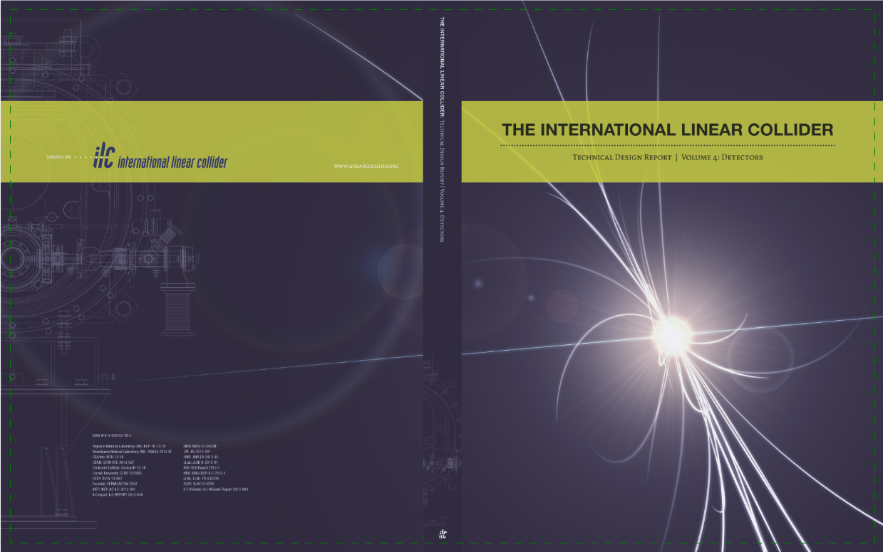
ILD structure post DBD
ILD has delivered successfully the DBD: this has been quite an achievement
and resulted in a excellent and important document:
Many thanks to all involved.
This will be the basis for ILD for the next steps.

Slide 3
ILD post DBD
What are the next steps:
We move towards a linear collider project (Japan)
We need to be prepared so that ILD can come forward ones this is required
We need to continuously improve and keep out design up-to-date
Short term: make sure ILD participates properly in ongoing strategy discussions
around the world (Snowmass, other countries and regions)
Results from the DBD
  Re-optimization in performance / cost space
  Adapt to the physics landscape post Higgs-discovery
  Understand hardware / technologies better

Slide 4
ILD structure
From concept towards collaboration
2013 → 20XX?
Goals of the transition phase organization:
Develop enough structure to push ILD forward
Make ILD attractive enough that it will be one of the two experiments at the ILC
Make ILD attractive enough that new groups will want to join as the ILC moves
towards reality
We need
transparent, simple structures
Adequate representation so that we can function as a community
Enough support to maintain stably the central tasks

Slide 5
Who is ILD
So far we have no clear rules concerning ILD membership.
We do not even know for sure who is ILD or not
Need a clearer (but still lightweight) procedure to identify groups who
consider themselves ILD members:
Groups interested to be ILD members declare this through a letter to the ILD
management (we probably will setup a WEB page for this, to make things easy)
To become a member a group
  Needs to express the intention to become a member
  Needs to declare its intention to follow the rules in ILD and to contribute
  constructivly to the development of ILD
  Needs to identify a contact person for ILD
  Should declare an area / detector / system of interest
  There is no requirement for any commitments or promises
  At this level we do not yet plan to initiate a formal MOU/MOA like process

Slide 6
ILD members
ILD membership is on an institutional basis.
There is no private ILD membership
Each ILD member institute has a seat and one vote in the institute assembly
Joining or leaving ILD is possible at any time
The management of ILD will maintain
  a list of ILD member institutes
  a list of ILD members at the institutes as far as they have been
  designated such by the institute contact
  A list of commitments / central services agreed to by member institutes

Slide 7
Institute Assembly
Speaker (2)
ILD operations board (>20)
ILD Management group (4)
Physco, detco,
2 free members
Detector Coordinator
Publication office
Physics Coordinator
Central design group
DAQ
Software/ Tools
top
MDI
Higgs
Integration
Documentation
….
…
SI
TPC
VTX
Central groups
FCAL
HCAL
ECAL
muon
Coil/ Yoke
Detector systems groups organise the connection
the the R&D collaborations

Slide 8
ILD “elections”
Management positions in ILD are elected from the institute assembly
How to we get a list of candidates:
proposal: we institute a search committee which in discussions with the
community and the ILD members proposes candidates for the different
positions.
Until these elections can take place the current management is charged with
organising the process
As a rule all ILD positions are for a period of 2 years with the possibility of renewal.

Slide 9
ILD meeting in 2013
Dedicated ILD meeting in 2013:
Propose a meeting in early fall 2013
Possible time slots:
Sept. 12/13/14 (right after the CALICE meeting, before VERTEX 2013)
Sept. 25/26/27
Oct 21/22/23 (but this gets very late and close to LCWS2013)
Location: Europe
A call for offers to host this meeting has been issues within the EB
So far we have received one offer from Poland (Cracow)

Slide 10

ILD meeting
And one last remark
(Winnie keeps reminding me)
This is not our
Official logo –
It is about time that
we get one.
Thursday May 30, 2013

