Slide 1
WG AC-5 Summary: AD & I
There were 6 talks :
1) EDMS Summary and Plans B. List
2) Timing / Survey Constraints E. Paterson
3) ITER Integration A. Yamamoto
4) Draft Schedule (ILC-Asia) M. Gastal
5) Site Investigation Report M. Miyahara
6) Beam/Service Tunnel config. A. Enomoto

Slide 2
1) EDMS (Benno List)
EDMS – TDD is the primary deliverable in support of the TDR:
  Design and policy documents; parameter tables
  Cost estimate
  CAD models
What is our EDMS ‘score’?
  How much intended content is properly in EDMS?
What is planned to consolidate etc?

Slide 3

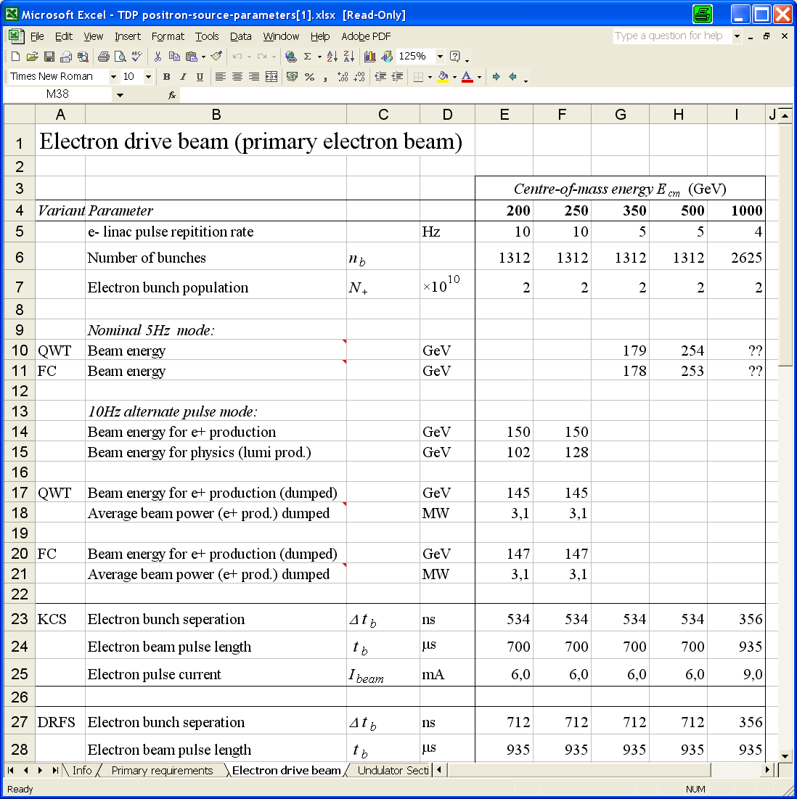
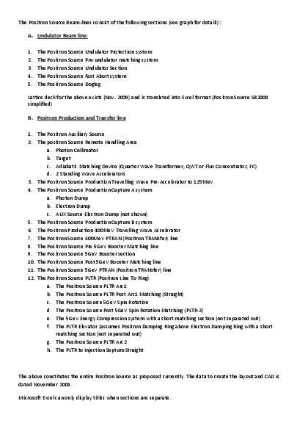
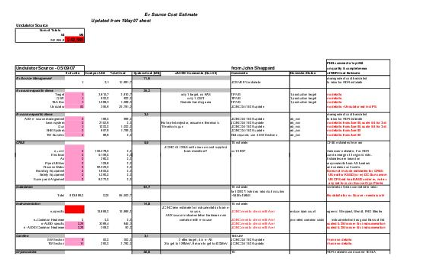
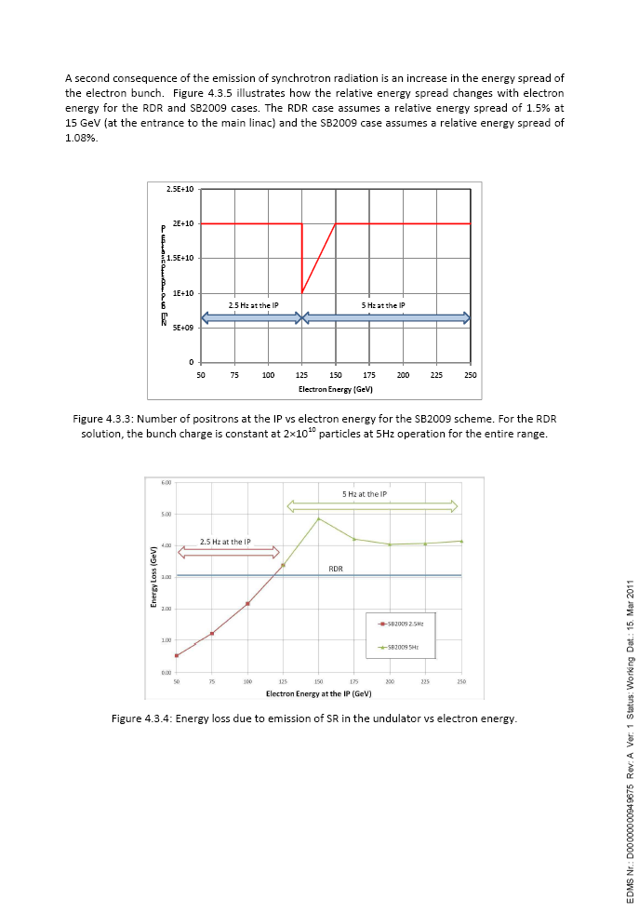
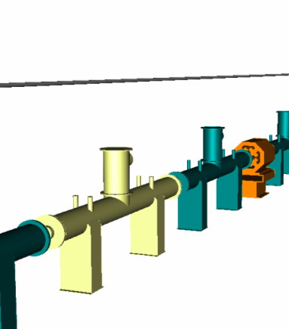
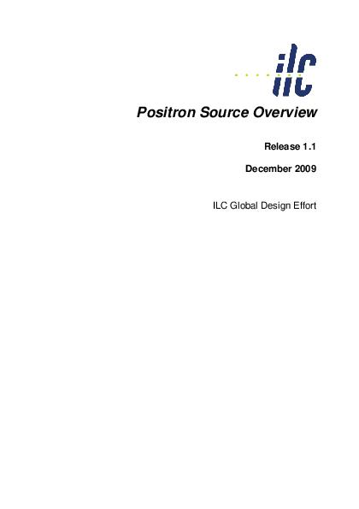
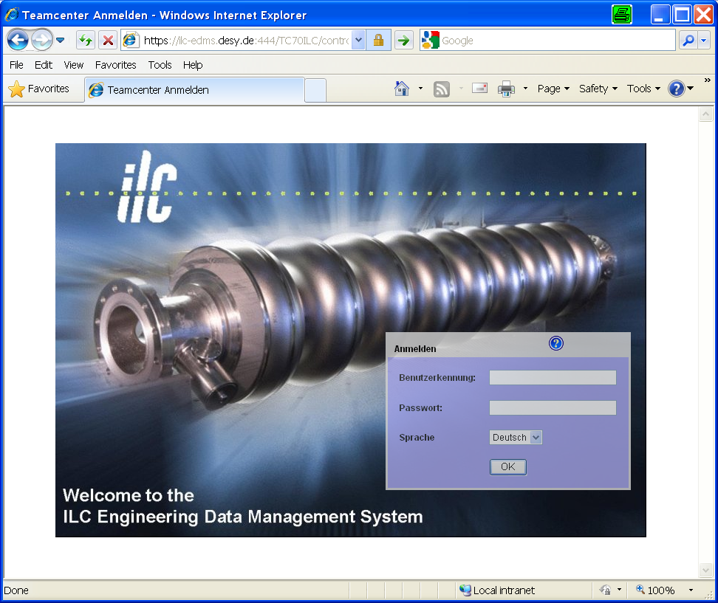
TDD, TDR and ILC-EDMS
Technical Design Report (TDR) summarizes TDD for publication
Technical Design Documentation (TDD) captures entire design efforts, results & rationale
...
Parameters
Specifications
Cost Estimation
Calculations
CAD Models
Design Summary
ILC-EDMS organizes the Technical Design Documentation,
providing structure, traceability, version & configuration mgt.,
and change control

Slide 4
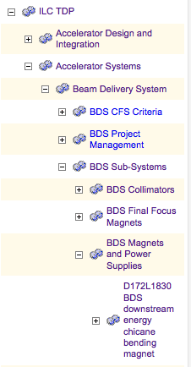
Plans: Reconciling Document & Cost Structure (WBS)
Work Breakdown Structure is a central tool in
modern project management for
  Scope management: What does the project entail?
  What is in, what is out?
  Cost management
  Project scheduling
  Progress monitoring (reporting, cost control /
  Earnend Value Management)
We currently use WBS’s for
  Structuring of the documentation
  Structuring of costs
The Goal: unify the cost and the documentation structure
Benefits:
  Better tracking of cost impact of design changes
  Better correspondence between cost items and people / groups working on them
  Better correspondence between cost estimate and technical documentation

Slide 5
Next Steps: Consolidation / Expansion of the WBS
Consolidate: Define what the WBS elements entail (WBS dictionary)
Expand: Identify the deliverables and work needed to complete the project (1-2 levels down from accelerator systems / technical areas)
Keep flexible to adjust to project structure as it emerges
Benefits:
Solid foundation for costing and scheduling
Foundation for risk analysis -> risk management: identify and react to
  Threats, e.g. by dedicated R&D or early prototyping
  Opportunities, e.g. larger gradient (-> provide enough RF to utilize that)

Slide 6
Plans and Interests at DESY
Support for ILC EDMS will continue!
Consolidation of existing design documentation has high priority
This includes support for uploading and cross-linking the final cost estimation documents
Work on design integration will continue
Medium / Longer Term Interests:
Continue our support for the project into the Engineering Phase
Develop / provide supporting tools (integration, documentation, cost estimation / control) and services for the TB / Project Management
Send us you wishlist!

Slide 7
2) ILC Path-Length Constraints / Suggestions
E. Paterson and D. Rubin
The TDR positron ‘circuit’ length requires trimming
  Considered a detail during the TDR
  To be reviewed and reset as part of staging scheme (and specific site)

Slide 8
There are 3 different scales to this E+/- path difference problem!
≈ 100 m Static in design for a given site layout.
≈ 1 m Static but unknown until full operation.
≈ 1 mm, daily,monthly
Needs final site and design layout and is required
before construction starts.
Originates in Survey and Alignment above and below ground and used during design, construction, installation and commissioning. Will need some adjustment during commissioning due to limits in survey and installation accuracy. Needs an adjustment system??? DIFFICULT CHICANE!
Need some fine path length adjustment system?
Required during final commissioning and operation. Used daily and might use slow feed forward?

Slide 9
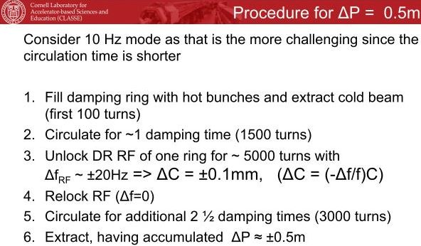
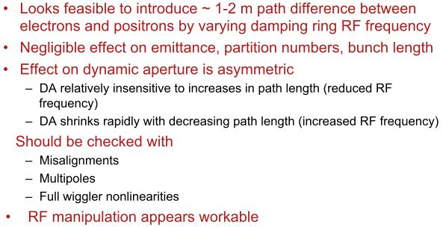
Change DR Circumference instead of
RTML and Linac
Example of technique
Promising results

Slide 10
3) ITER Integration - A. Yamamoto
Cost Review (02.2013) identified ‘other project costs’ for further study:
esp. cost of managing in-kind contributions
A very important aspect of ITER and EU-XFEL construction projects
E. Tada (Japan ITER Domestic Agency) provided overview of ITER in-kind management

Slide 11
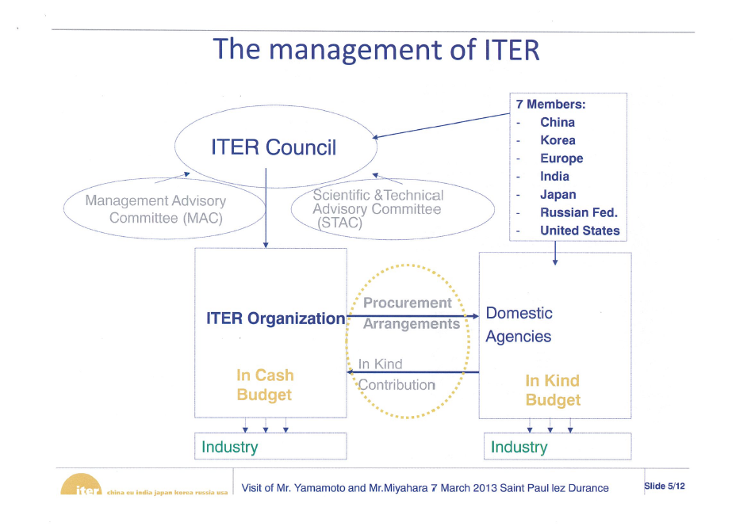

Slide 12

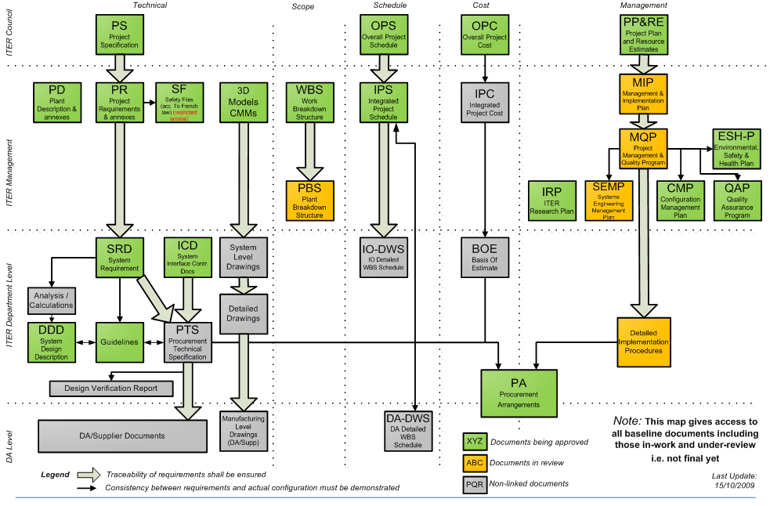
ITER Baseline Structure
Technical scope
Schedule
Cost
Management
Council
ITER
DG
Division
Group

Slide 13
Sharing of Work between IO and DA
Work sharing defined by frame chart
・ Construction：IO/DAs depending on the type of specifications
・ Transportation：IO to coordinate a global transportation
・ On-site installation/testing：IO in support of DAs
・ Project management & integration: IO
Type or specifications
- Functional: DA for preliminary design based on conceptual design by IO
- Detailed: DA for final design based on preliminary design by IO
- Build-to-print: DA for manufacturing design based on final design by IO

Slide 14
4) Draft Schedule (M. Region) - M. Gastal
Comprehensive look at schedule
(CFS, Technical, Detector, Staging)
How much time do we save with staging?

Slide 15
Commissioning & Staged options
The Asian site schedule is labor intensive
Building the shielding wall takes an entire year of the schedule
The installation of infrastructure is fast thanks to the deployment of many teams and great tolerance to coactivity
For the installation of machine components, 4 teams are deployed
Milestone: BDS and ML up to AH1 ready for early commissioning
  Y8 Q2… but what about DR and RTML?
Milestone: Ready for Full commissioning (whole accelerator available)
  Y9 Q4
Milestone: ILC ready for beam
  Y10 Q4 (commissioning program to be fine tuned)
Commissioning programs still under study…
What would be the impact on the construction schedule to choose a staged approach?

Slide 16
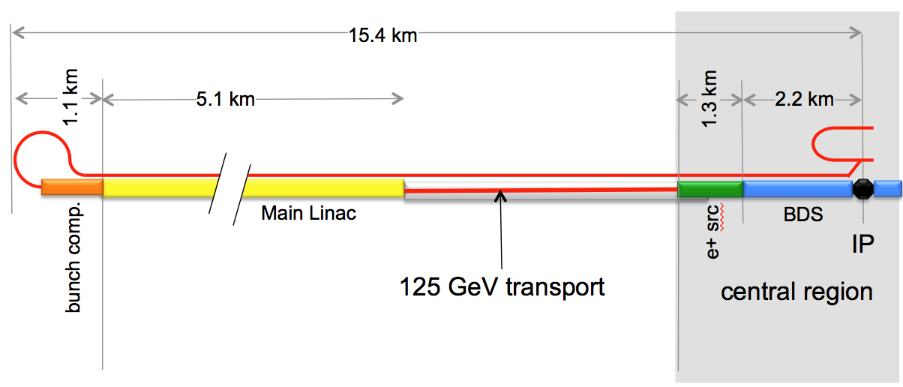
Staged Scenario 2
Scenario 2:
250 GeV
Costs and benefits of Option 2
  2a. Install all the final common facilities in the 125GeV transport tunnel section
    9 months could be save by redeploying the machine installation crews
    The installation of the final common facilities hardly comes on the critical path
    6 months could be dedicated to the installation of the 125GeV transport line
  2b. Install only minimum required services for 125GeV transport line
    1 year could be saved by redeploying the CF and machine installation crews
    2.8 years could be dedicated to the installation of the “temporary” CF and the 125GeV transport line
15 tunnelling
crews

Slide 17
5) Site Investigation Report – M. Miyahara
Focus of attention for LC2013
Multi-year study (led by KEK) now nearing completion
Critical for Japanese (internal) site recommendation
07.2013
Culmination of a major effort

Slide 18
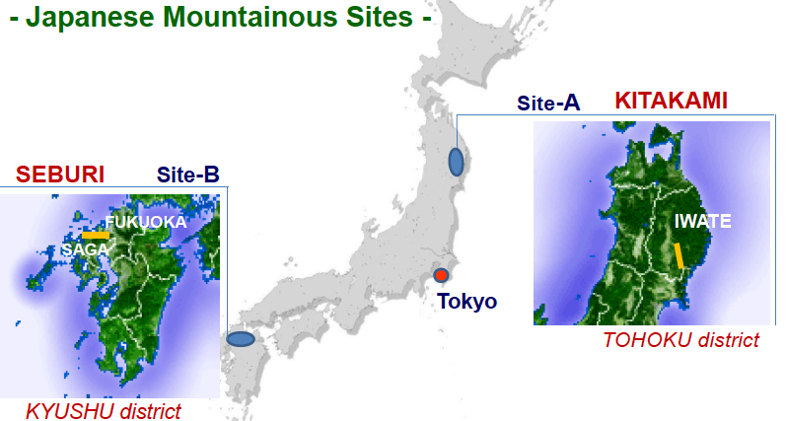
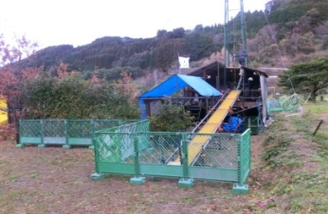
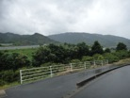
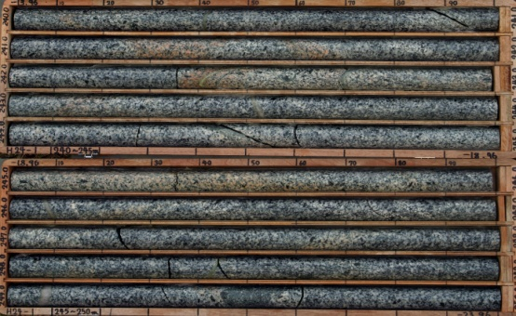
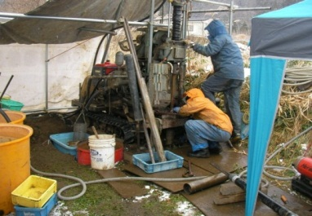
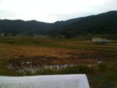
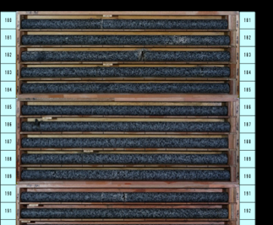
Geological Survey and
Common-Subject Study progressed in japan
KEK
Tohoku U. G. Survey
Nomura Research Inc. Common Subjects: Central Campus
Kyushu U. G. Survey.
Kitakami
Sefuri
-150m
-300m
Reports to be available in July, 2013

Slide 19
Evaluation of Possible ILC Sites: Background
Initial site-study promoted by local organizations (~ 2011)
  Reports given in 2012 (50 ~ 100 pages)
    Science Frontier Plans in Kyushu, and in Tohoku
Study with neutrality through KEK based on the Government requests (in 2011 ~ 2012)
  Including geo-technical studies and city/campus planning
  In cooperation with consultants/excerpts: Nomura Research Inc (NRI).
Further evaluation and plan
  Opinion Survey in ILC community to be proceeded after site selection in 2013

Slide 20
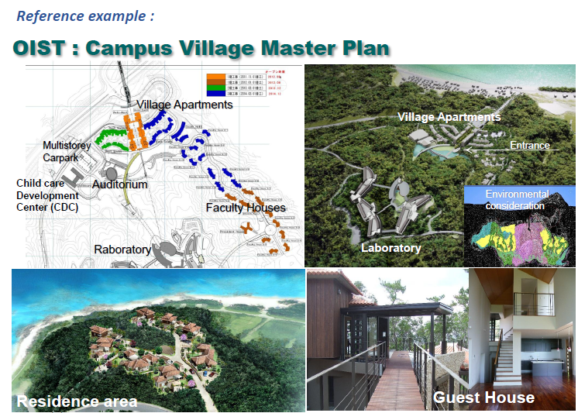
Conceptual Study of the ILC Central Campus Design (reported: AC-5, AD&I, May 30)
Survey/Study proceeded with visiting:
CERN
ITER,
CEA/Saclay,
OIST (Okinawa),
Universities,
KEK/JAEA,

Slide 21
A Plan for Opinion-Survey / Enquete to solicit inputs from ILC community: (to be done in 2013)
Objectives:
    To solicit your inputs to the conceptual design of the ILC laboratory/campus and environment :
Questions such as:
    Number of researchers ‘on-site’ (or nearby)
    Stay/visit - Duration
    Space and infrastructure requirements
    Specific requests, advices and or concerns

Slide 22
6) Beam/Service Tunnel Config. A. Enomoto
Adapting and checking the TDR configuration in preparation for a real site
Reconciliation of technical component / civil layouts

Slide 23
Beam/Service Tunnel Direction
Service tunnel is located on the opposite side of beam dumps.
Service Tunnel is on this side.
Beam Tunnel is on this side.

Slide 24
Acceleration Direction in Main Linac
Cryomodules are installed in the same way for both e+/e- linacs;
The directions of acceleration differ from each other.
Service Tunnel
Concrete Shield
e- Beam
e+ Beam
Beam Tunnel

Slide 25
Proposal for Direction To See Main Linac Section
Direction to see ML cross section should be kept always from upstream to downstream in the electron main linac.
To see in this direction
Upstream
Upstream
Downstream
Electron Main Linac
Positron Main Linac

Slide 26
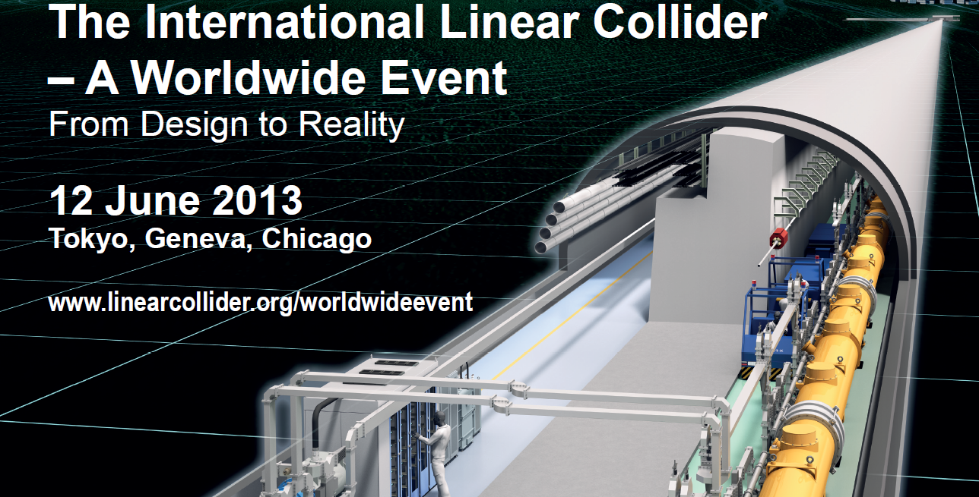
Then – this view is correct:

