Slide 1

  The ILC in the Linear Collider Collaboration
  Mike Harrison

Slide 2
ILC Technical Board – in LCC phase
LCC Directorate
ILC Collaboration
“Technical Organization”
Director – Mike Harrison (BNL)
Deputy Director – Hitoshi Hayano (KEK)
Technical Board
Nobuhiro Terunuma (KEK)
Yasuchika Yamamoto (KEK)
Nick Walker (DESY)
Olivier Napoli (CEA)
Marc Ross (SLAC)
Nikolay Solyak (Fermilab)
KEK LC Project Office Organization at KEK
Head: Akira Yamamoto
Deputy: H. Hayano (Acc.)
K. Fujii (Phys/Det)
T. Shidara (General
Working Groups

Slide 3
Function of the KEK LC Project Office
  Domestic Program
    ILC Accelerator Design, R&D, CFS design, Geological Survey
    Support for the ILC to be hosted by Japan
Co-ordination of International and domestic co-operation
    Interface to global co-operation with LCC
    Co-ordination of domestic co-operation
    Linkage to International co-operation to/from the KEK internal co-ordination activities

Slide 4
Function of the TB & Working Groups
The Technical Board
    Determine the ILC work plan
    Maintain the baseline design
Working Groups
    Provide technical updates to the baseline
    Refine and extend the existing design at the sub-system level.

Slide 5
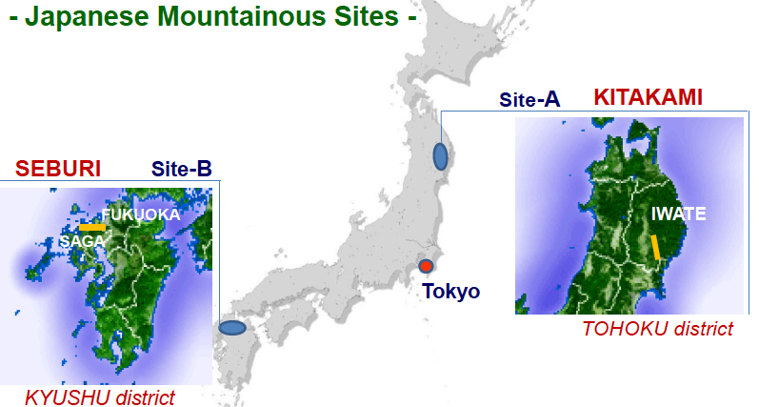
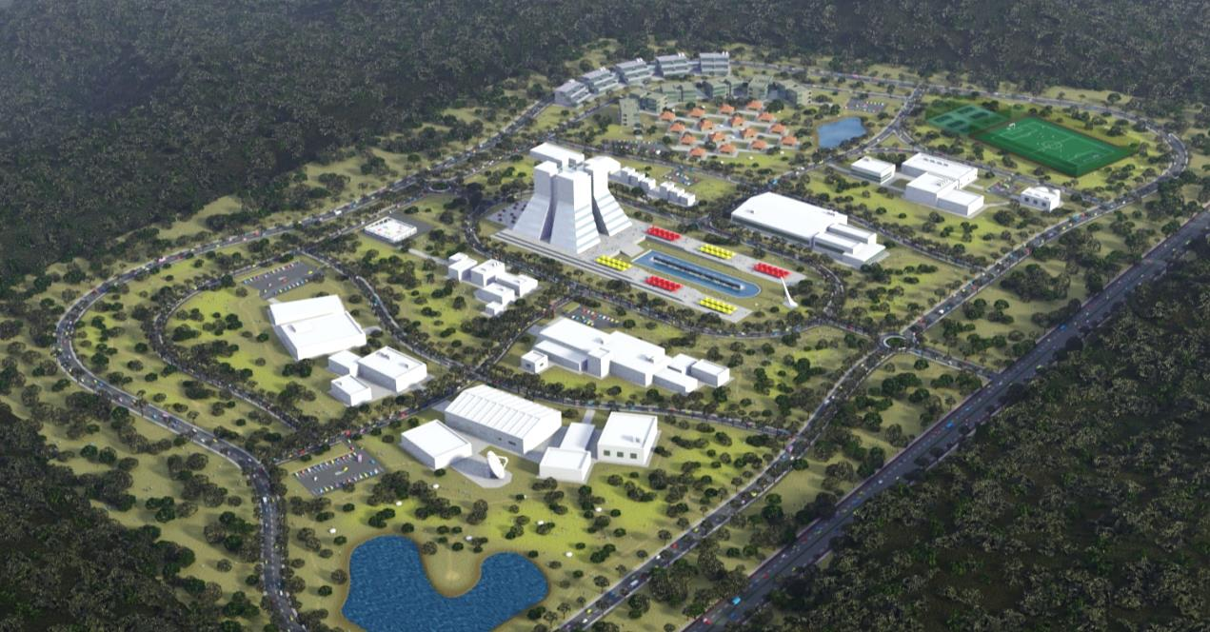
Program Considerations
Japanese Initiative
    A preferred site will be announced in July. The TDR generic site must then be replaced by a real one. This will certainly requiring modifying the baseline to some extent.
    The JPS ILC proposal calls for a phased approach to CoM energy (250 -> 500). While this is completely consistent with an LC approach it was not addressed in the TDR and will change aspects of the ML, schedule, cost, production rates etc..
Cryomodules
    While the GDE program did a decent job on cavities we were lacking on cryomodules. Integrating cavities into cryomodule strings loses gradient for no obvious reason. Fortunately we are about to benefit from the XFEL production program (90 cryomodules). We must take advantage of this situation.

Slide 6
Program Considerations
Cryomodules
    We need to review the current baseline design especially couplers, tuners, etc.. Again the XFEL experience will help greatly in this regard
    The quad package is not demonstrated yet.
  Other Hardware
    The R&D program to validate the positron targeting and capture design was not completed.
    How do we continue the cavity R&D efforts ?
    Vibration in the beam delivery system lurks
    Still plenty of scope for value engineering (cost containment)
      HLRF
      Modulators
      Cryogenics

Slide 7
Program Considerations
System tests
    We will plan to continue these activities – see Nick’s talk
  Baseline Design & Costs
    We will proceed using the TDR design and incremental changes under baseline control. For internal aspects of the machine this will mean the TB. For items that impact the high-level machine parameters then we need to figure something out in the context of the LCC. The concept is straightforward, quite often the reality less so.
    The TDR machine cost estimate and it’s basis needs to be captured in more formal way. The TB needs to decide how to do this. There is lots of GDE work in this area to build on.

Slide 8
Program Issues
Resources
    We are not scoped for a construction project at this time
    Japan is ~stable but KEK’s Ops budget is trending down. Trying to compensate via accelerator technology R&D requests.
    US has to a large extent ceased work after the GDE R&D program ended with the TDR- a wait-and-see approach. The recent MEXT-DOE umbrella agreement on science and technology co-operation has possibly opened the door a little. I do not expect the US to return to the $35M/yr level before we press the launch button.
    Explicit ILC work in Europe remains at a low level. A small programme at DESY (1Meuro/yr) will continue principally aimed at cavities & industrialisation.
    CLIC-ILC synergies can obviously help. Ideally this should be a win-win situation.

Slide 9
Program Issues
  Project Engineering
    Not much at this time. The two areas which can be legitimately described as engineering are the cryomodules and aspects of the MDI. We will plan to maintain this state of affairs.

