Slide 1
Strategy of detector solenoid construction
Yasuhiro Sugimoto
KEK
2013/5/28@ECFA2013

Slide 2
Introduction
Among the detector components to be transported to the cavern, superconducting solenoid is the biggest one, and the construction method gives impacts to other issues of ILC
  Surface assembly hall design
  Road, tunnels, bridges, and port for the access to the central region
  Overall schedule
Strategy of detector solenoid construction should be determined as soon as possible

Slide 3
Solenoid design
Global parameters
 | ILD | SiD
Coil outer radius [mm] | 3970 | 3112
Coil length [mm] | 7350 | 5586
Cryostat outer radius [mm] | 4400 | 3392
Cryostat length [mm] | 7810 | 6066
Cold mass [t] | 168 | 130
Number of modules | 3 | 2
Module length [mm] | 2450 | 2793
Module weight [t] | 56 | 65
Winding layers | 4 | 6

Slide 4
Coil winding option 1
Winding at a factory
  Each module is made at a factory
  Modules are transported to the surface assembly hall on site, and assembled into one solenoid
  Merits
    Construction of modules can be started before completion of the assembly hall construction
    We don’t need winding machine in the assembly hall → less space is needed for the assembly hall
  Demerits
    Module transportation issues

Slide 5
Coil winding option 2
Winding on site
  Superconducting cable is made at a factory
  Spools of SCC for one layer of one module (2.6km for ILD) is transported to the assembly hall on site
  Coil winding and assembly of modules in the assembly hall
  Merit
    No transportation issue (a spool of SCC is much smaller than a coil module)
  Demerit
    We have to wait for the completion of the assembly hall construction on site

Slide 6
Transportation issue
Coil modules are large (φ8mx2.5m for ILD) and heavy (65t for SiD)
Access road (and tunnels) should be wide enough and bridges should be strong enough

Slide 7
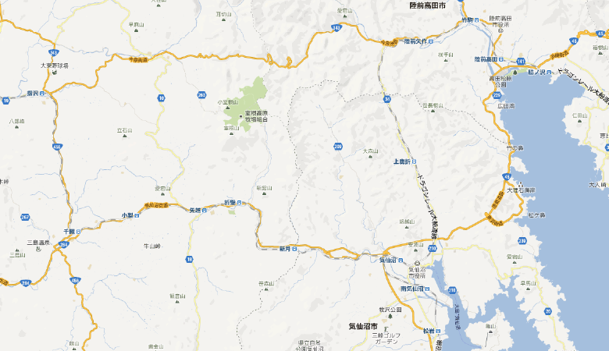
Access to the site
A possible route for Kitakami site (street view available for >50%)
IR
Port
Bypass road
under construction
© Google

Slide 8
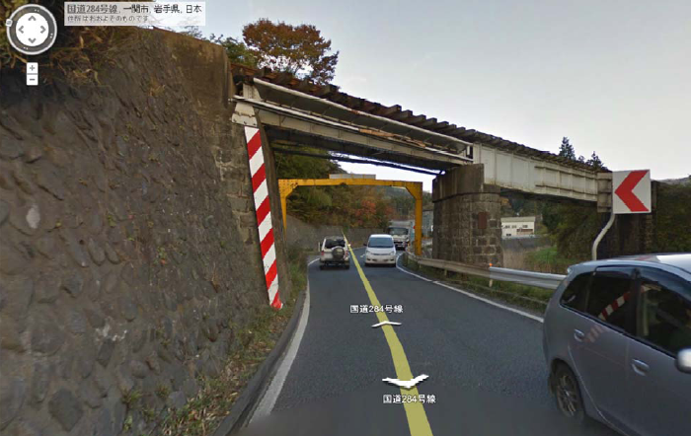
Access to the site
Present bottle neck will be solved by the bypass road
© Google

Slide 9
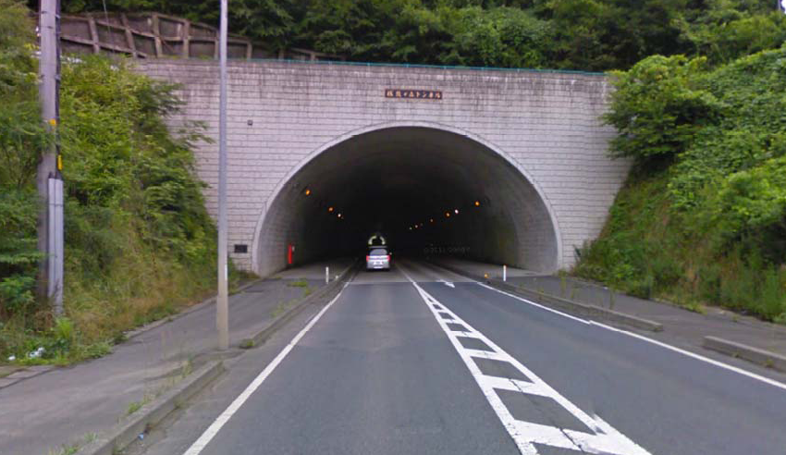
Access to the site
Tunnel looks OK
© Google

Slide 10
Solenoid construction method
Y.Makida and T.Okamura discussed construction of superconducting solenoid with people of a company
Suggestions of the company
  Both options are feasible
  They showed a construction time line which is much longer than we expected ➔ Coil winding on site has a risk of delay of overall schedule
  Coil winding on site might require an additional machine tool to make the mandrel → cost increase
They prefer coil winding at the factory rather than winding on site

Slide 11
A possible scenario
Detector Proposal
TDR
Sub-det. construction off site
TDR
TDR

Slide 12
Conclusion
There are two options of superconducting solenoid construction: winding on site or winding at a factory
Both options are feasible
Coil winding at a factory seems less risky and preferable
Detailed dimensions of access road/tunnels should be confirmed
More discussion on the time line is necessary

