Slide 1















Reinhard Brinkmann, DESY
Status of the European XFEL Accelerator Construction Project

Slide 2
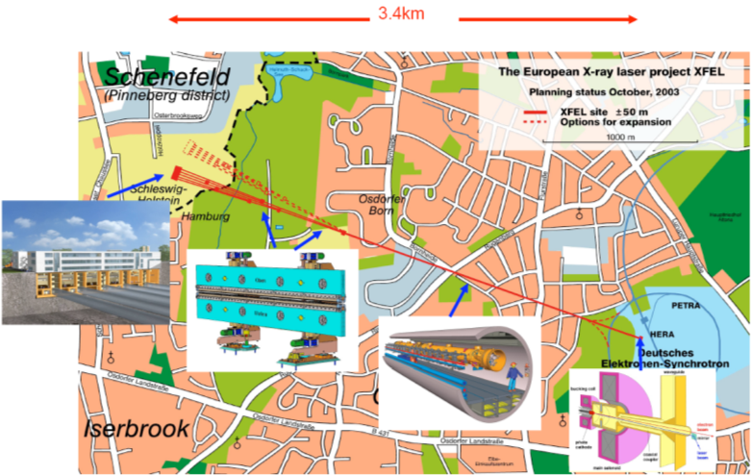
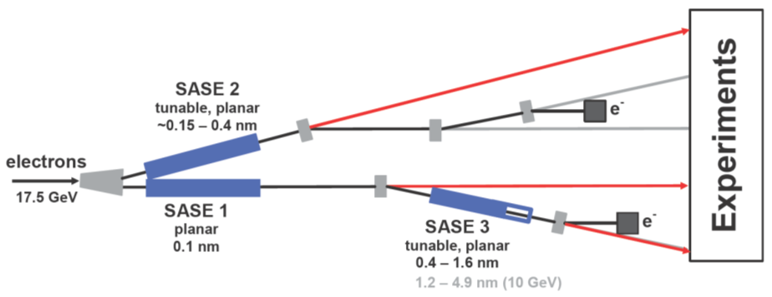
European XFEL Introduction
Some specifications
Photon energy 0.3-24 keV
Pulse duration ~ 10-100 fs
Pulse energy few mJ
Superconducting linac. 17.5 GeV
10 Hz (27 000 b/s)
5 beamlines / 10 instruments
  Start version with 3 beamlines and 6 instruments
Several extensions possible:
  More undulators
  More instruments
  …….
  Variable polarization
  Self-Seeding
  CW operation
First beam for users 2016
SASE2
(= SASE1)
17.5 GeV
SASE1, λ_{u}= 40 mm
0.2 – 0.05 nm
SASE3, λ_{u}= 68 mm
1.7 – 0.4 nm

Slide 3
Organization of the European XFEL Project
3
In-kind Contributions
European XFEL GmbH
Council
Chair R. Feidenhans’l
Accelerator Consortium
Management Board
Managing Directors
M. Altarelli, Chair
C. Burger, Admin. Director
Scientific Directors
S. Molodtsov
A. Schwarz
T. Tschentscher
Advisory Committees
Coordinator:
H. Weise, DESY
Institutes from D, F, I, CH, PL, ES, RU, CN, SE…
SAC
MAC
AFC
IKRC +
Det. AC
Lasers AC
Other In-kind
Contributors

Slide 4
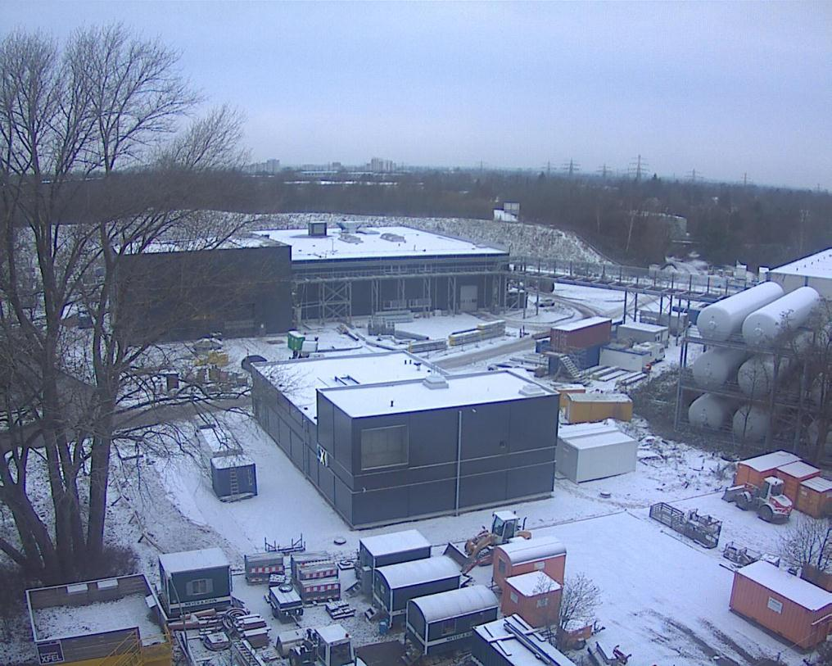
Civil Engineering Progress
18 January 2013

Slide 5
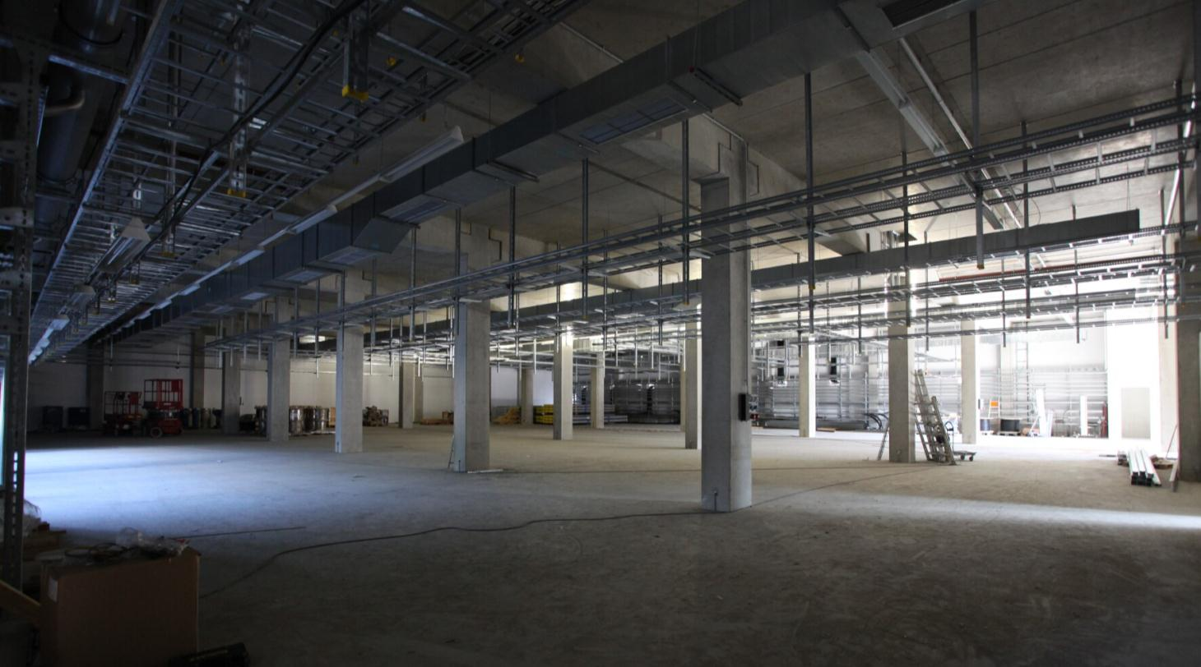
Modulator hall – modulators beginning to come

Slide 6
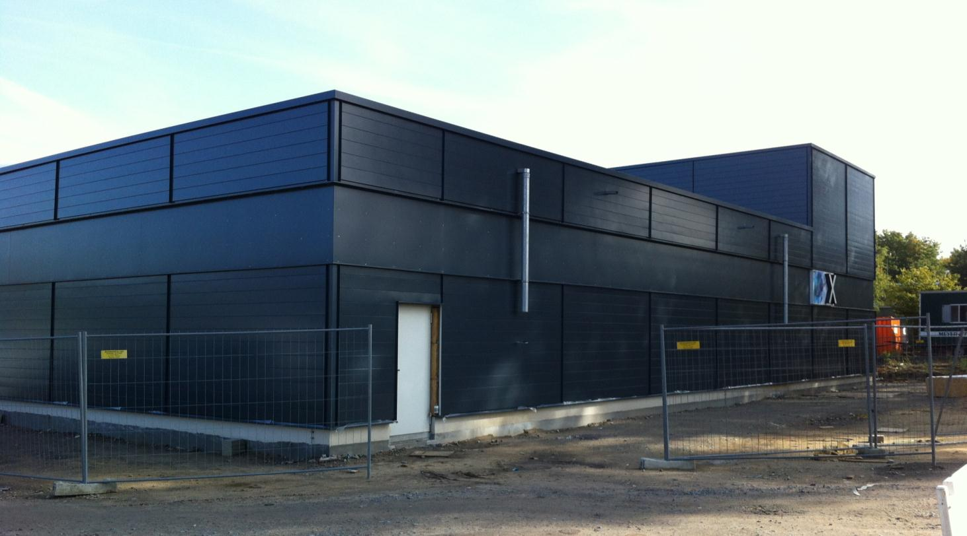
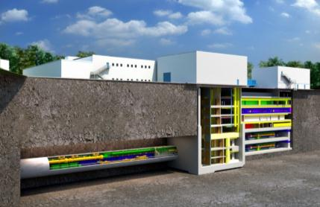
Injector shaft

Slide 7
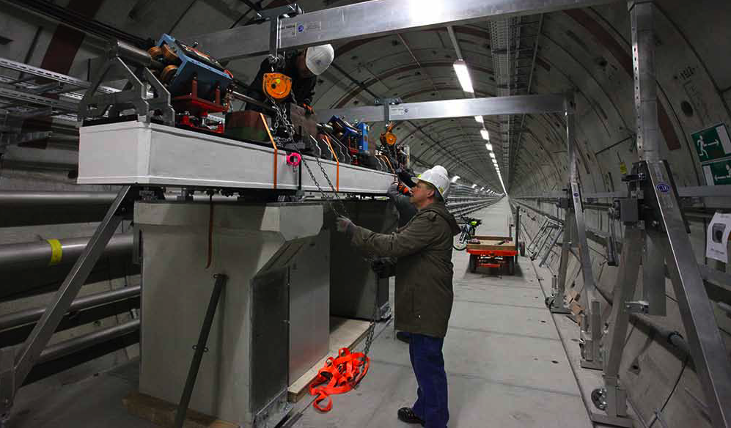
Prototype Linac girder installed in tunnel

Slide 8
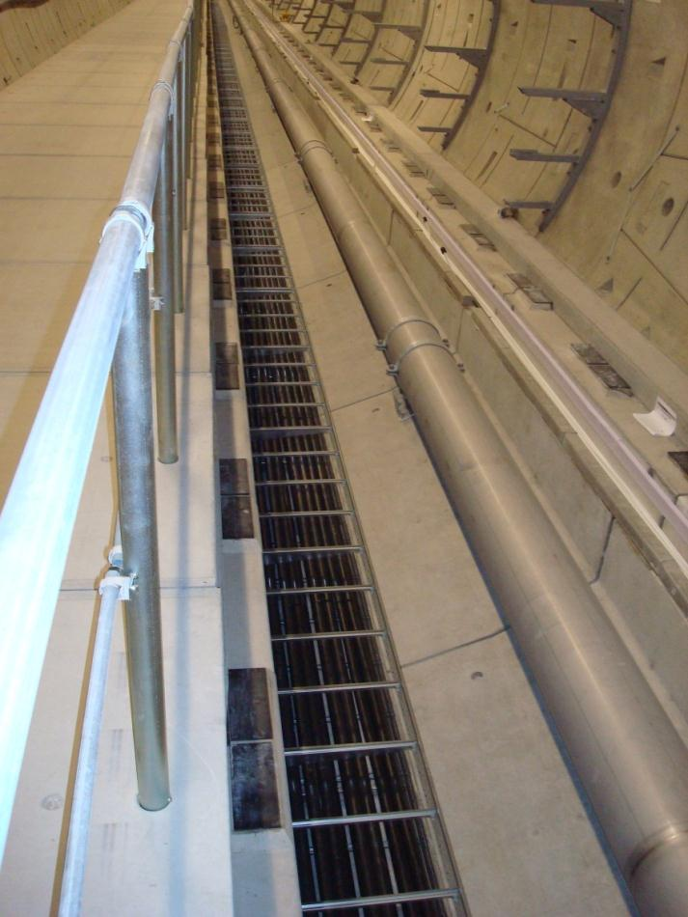
Tunnel infrastructure installation
Started March 2012
Well on schedule, completion Sept 2013
supports for water pipes
ductwork for fiber cables
pulse cables
30 ⁰C water pipe
Notes:
Before you start editing the slides of your talk change to the Master Slide view:
Menu button “View”, Master, Slide Master:
Edit the following 2 items in the 1st slide:
1) 1st row in the violet header:
Delete the existent text and write the title of your talk into this text field
2) The 2 rows in the footer area: Delete the text and write the information
regarding your talk (same as on the Title Slide) into this text field.
If you want to use more partner logos position them left
beside the DESY logo in the footer area
Close Master View

Slide 9
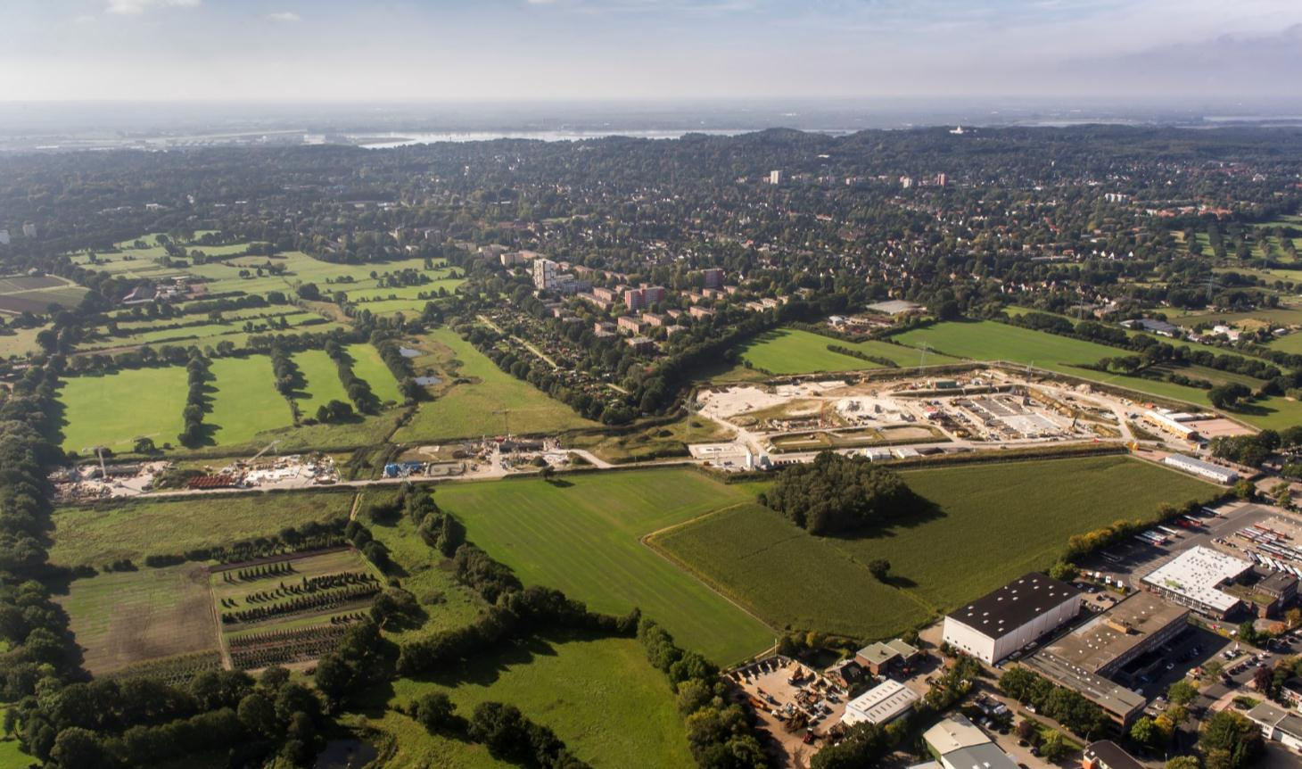
Schenefeld campus

Slide 10
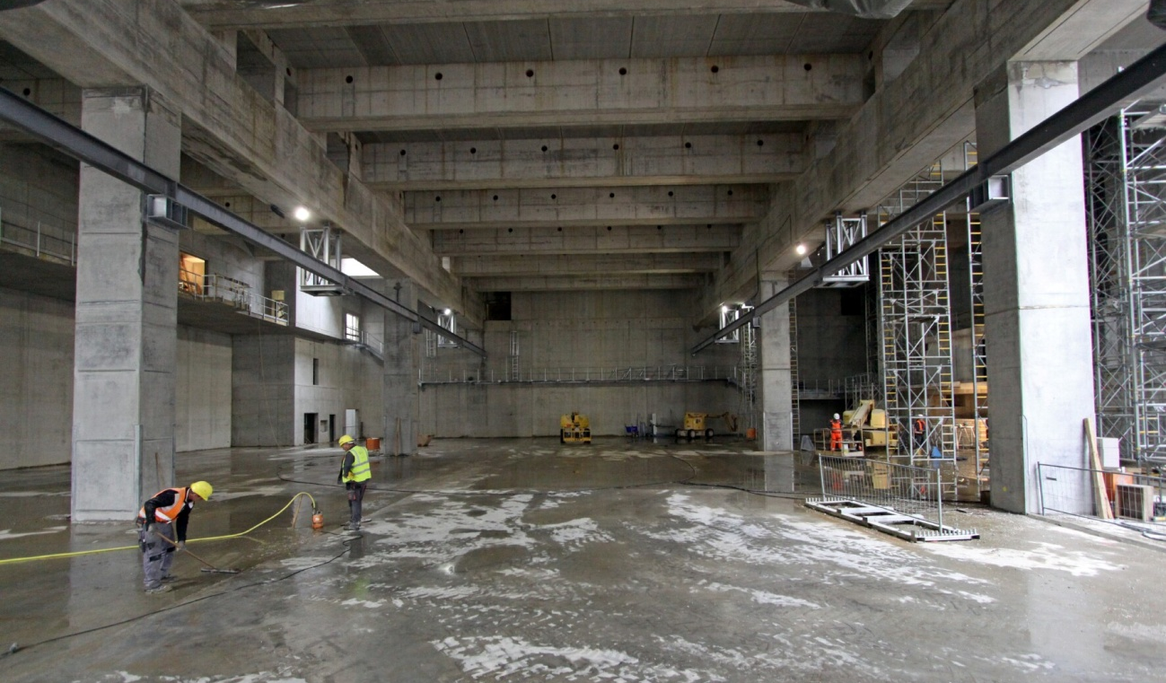
Experimental hall – essentially completed
24 October 2012

Slide 11
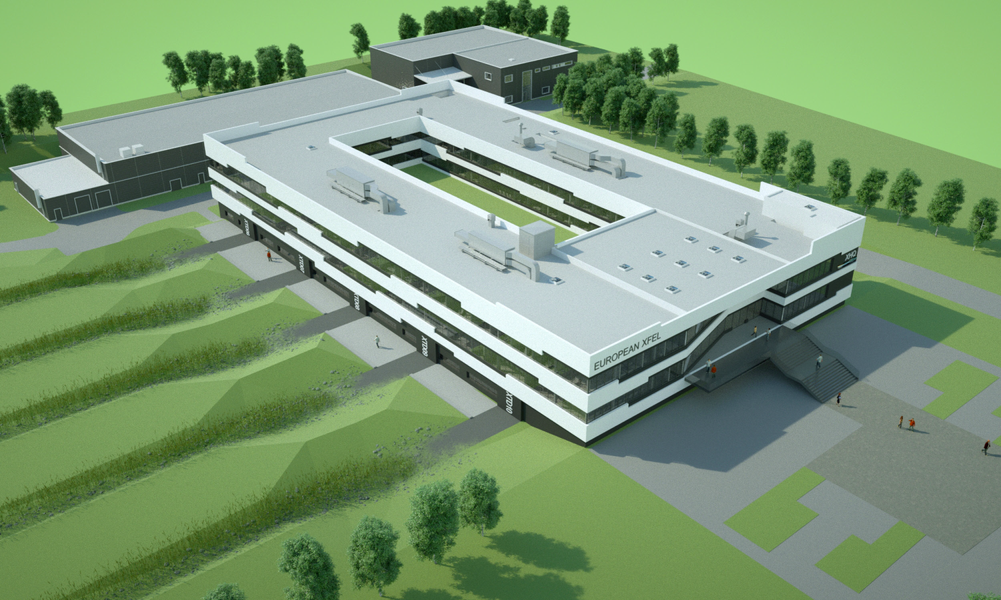
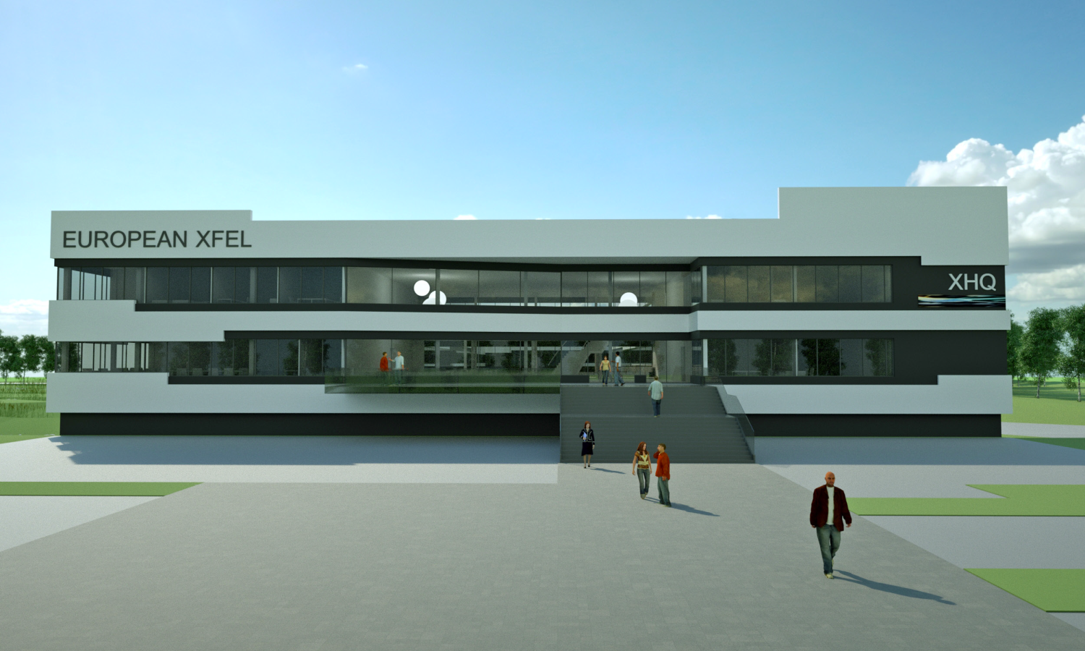
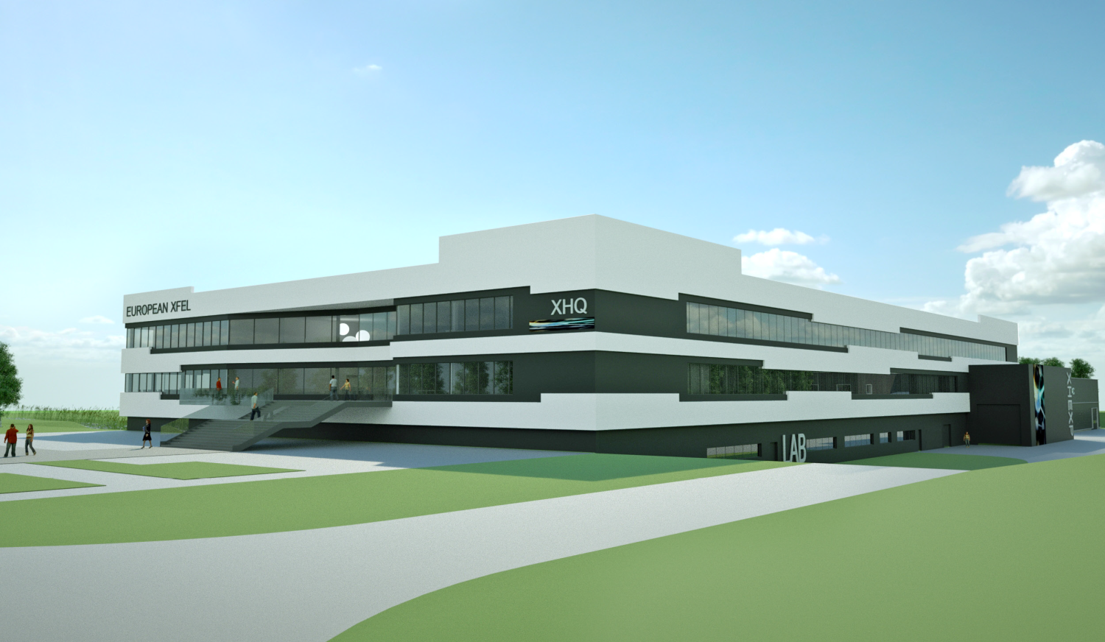
Architect’s concepts for the XHQ building

Slide 12
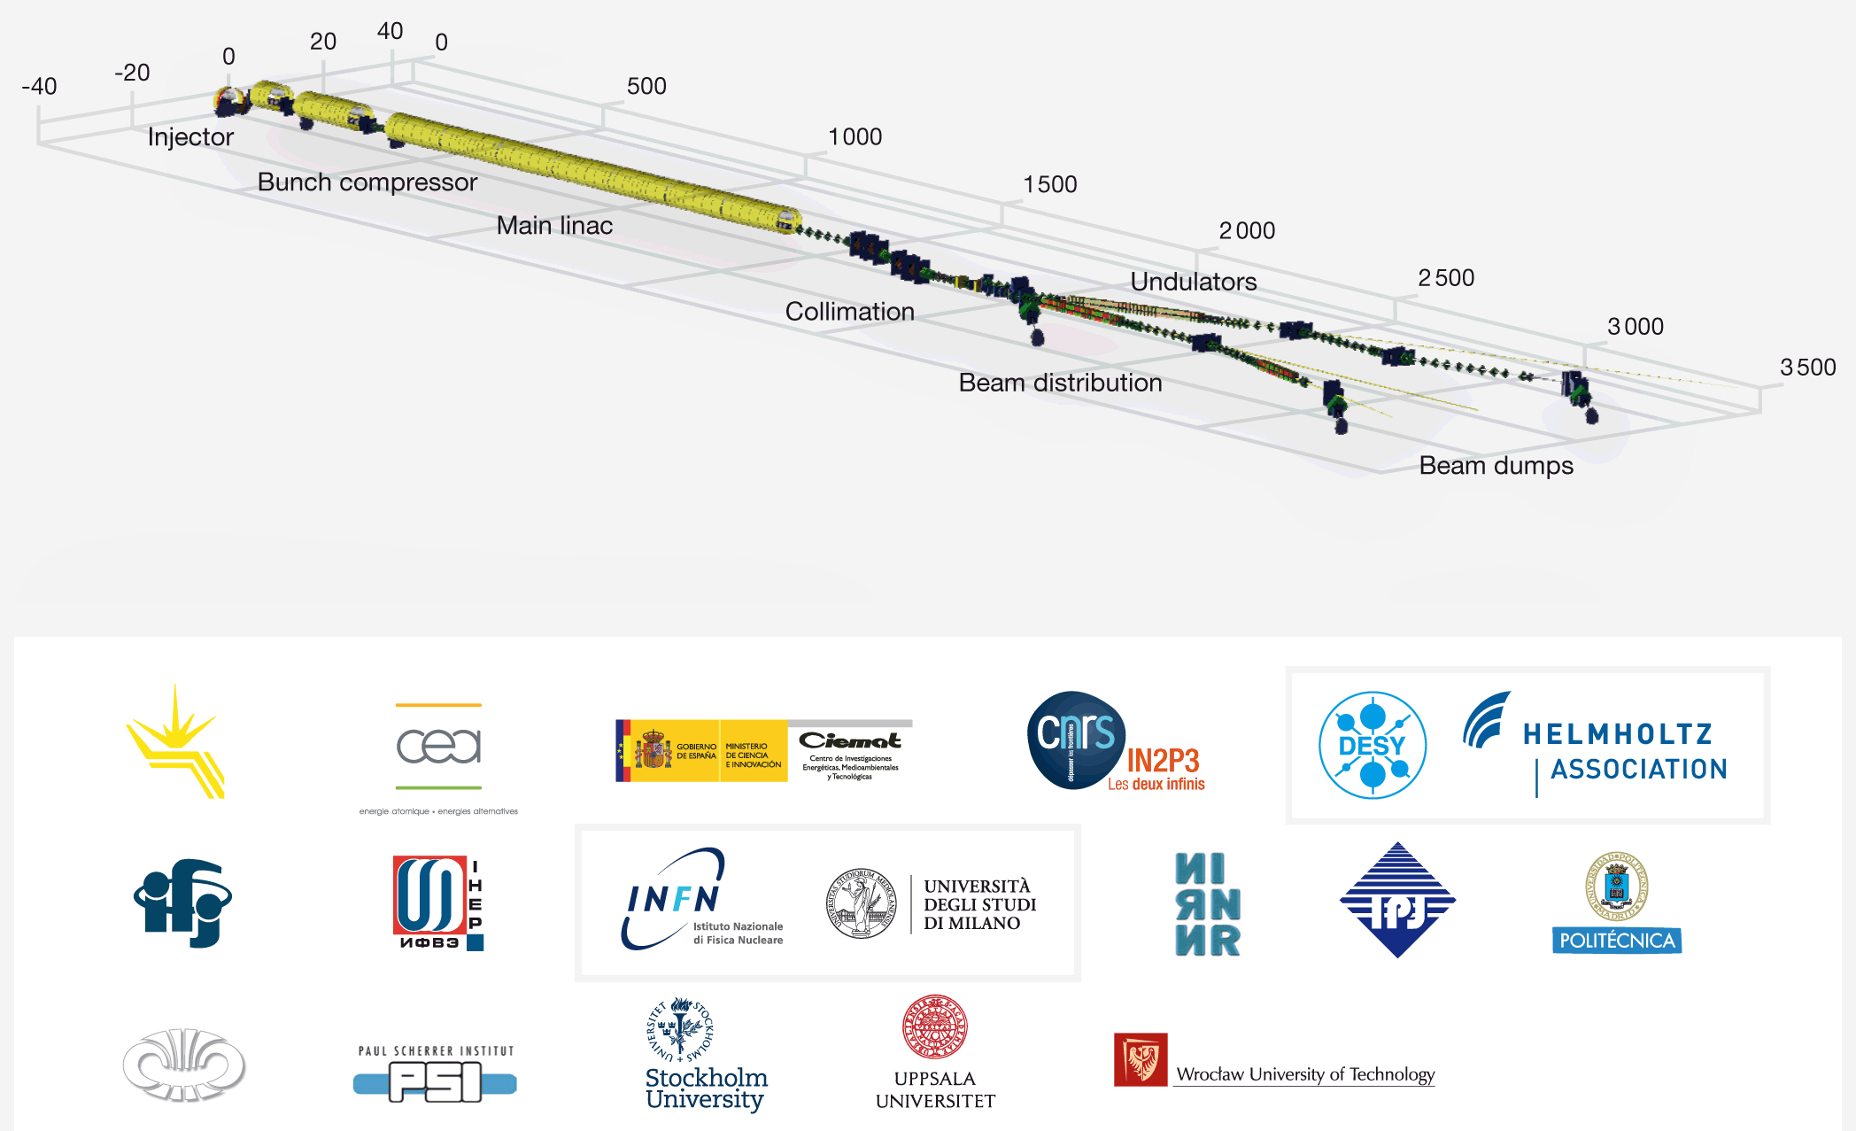
Accelerator Consortium

Slide 13
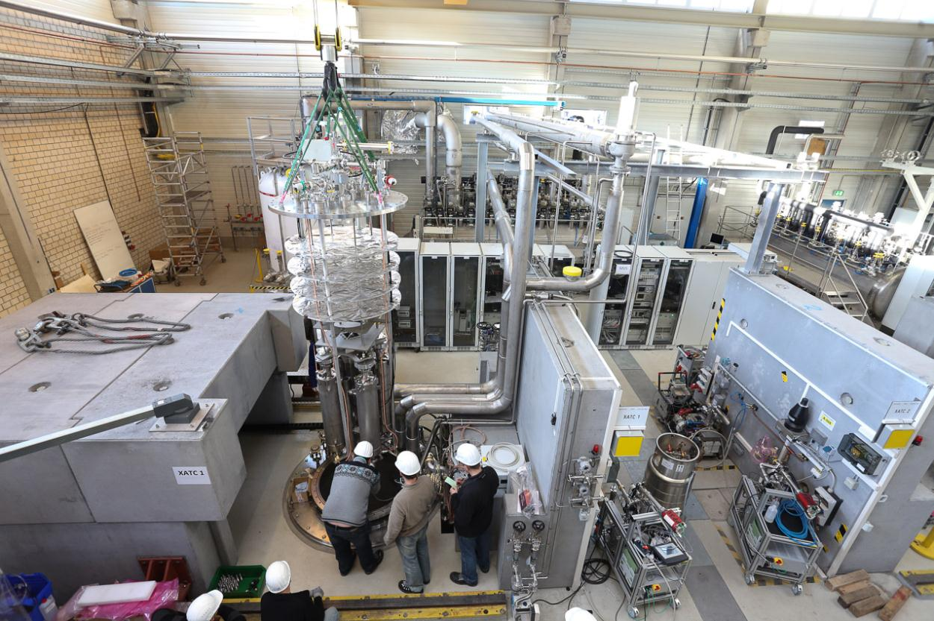



Test facility AMTF in operation

Slide 14
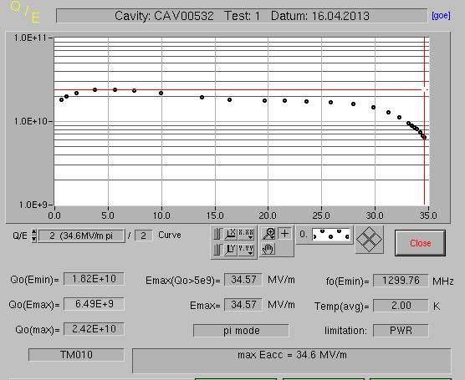
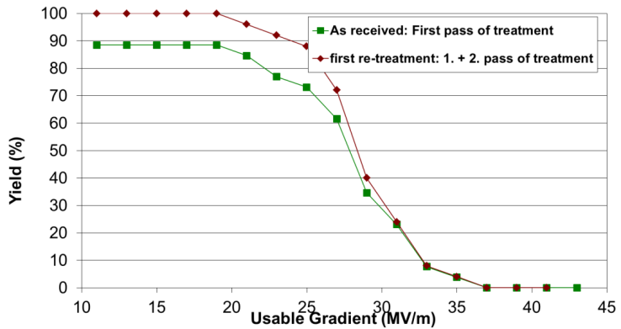
Successful start of cavity production
Cavity production (DESY – INFN/Milano) and test stand operation (DESY – Wroclaw Univ. – IFJ-PAN Kracow) started few months late, but remarkably smooth
By now >30 cavities (Zanon is ahead of RI…), increasing every week
  Average gradient 27.9MV/m well above XFEL spec 24 MV/m
  3 cavities with field emission rinsed at DESY with ultrapure water → good performance afterwards
1st batch of 8 cavities was delayed 2 months (for 1st pre-series module assembly), but by now have comforting buffer of cavities

Slide 15
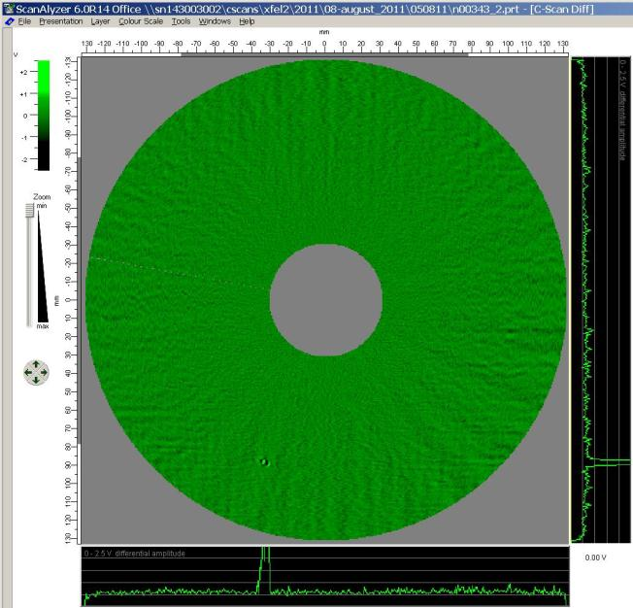
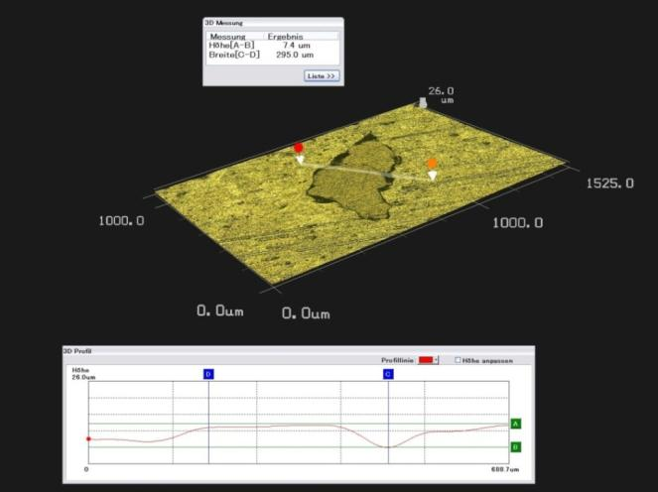
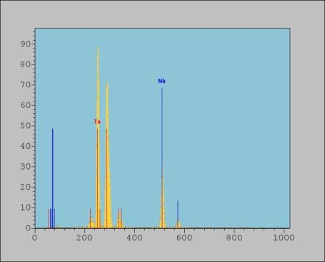
Nb material qualification at DESY
Example for Ta detection
eddy current scan
3D -microscope image
nondestructive element analysis

Slide 16
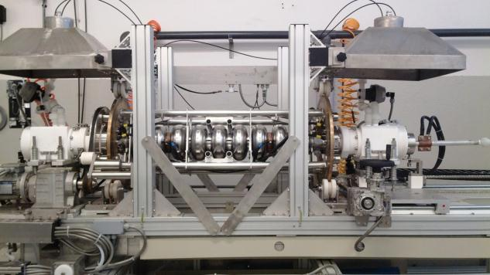
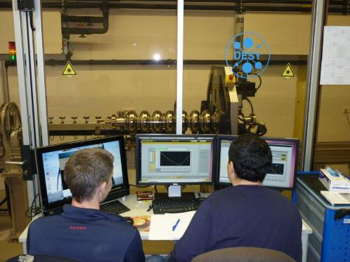
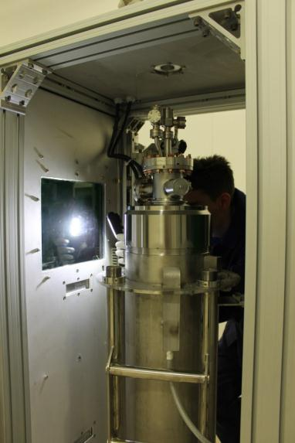
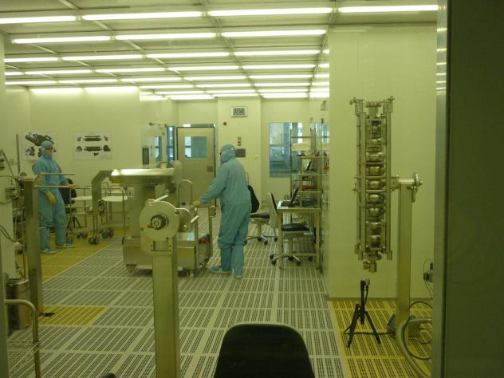
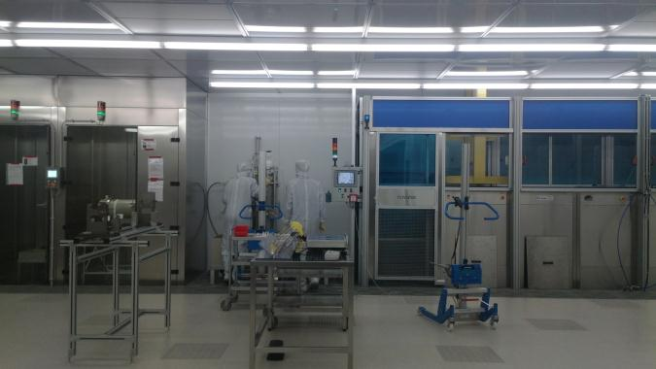

Impressions from cavity manufacturing…

Slide 17
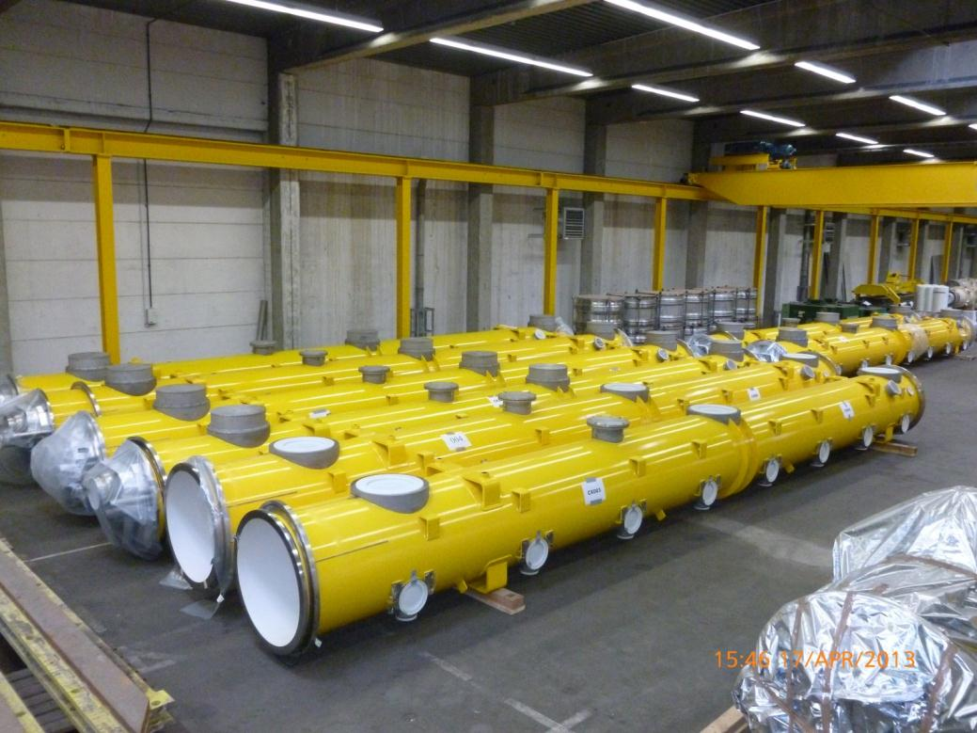
Cryostats/vessels
a total of 13 cryostats & cold masses delivered by E. Zanon
8 units delivered by IHEP/Beijing (not an IKC) but 7 need re-work due to non-conformities
next 4 IHEP cryostats & cold masses arrive in 5/2013; expected to be ok
overall delivery schedule ok

Slide 18
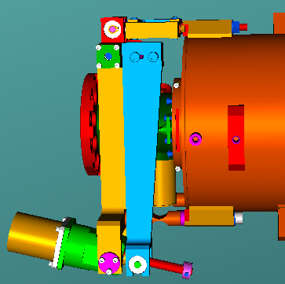
Frequency tuners
Frequency Tuner
Mechanics:
  Series fabrication ongoing.
Drive unit:
  Documentation reports decided.
  First units have FAT and been delivered to CEA and DESY.
  Ramp up to series rate has been achieved.
Piezo system:
  Continuing tests of permanent FLASH setup.
  Series production of fixtures ongoing.
QC testing:
  during module installation at Saclay (INFN contribution).
Piezo System
Mechanics
Drive Unit

Slide 19
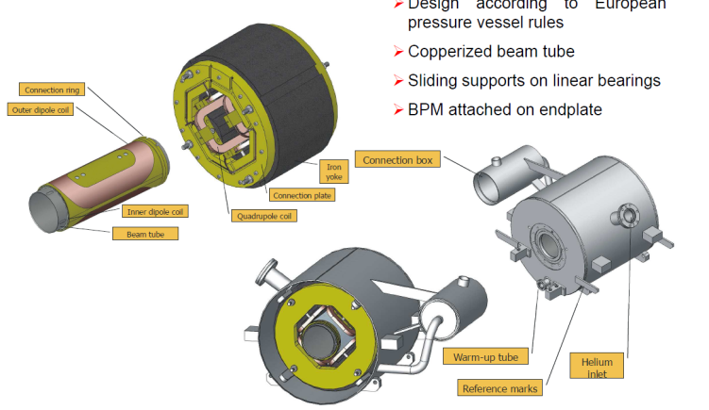
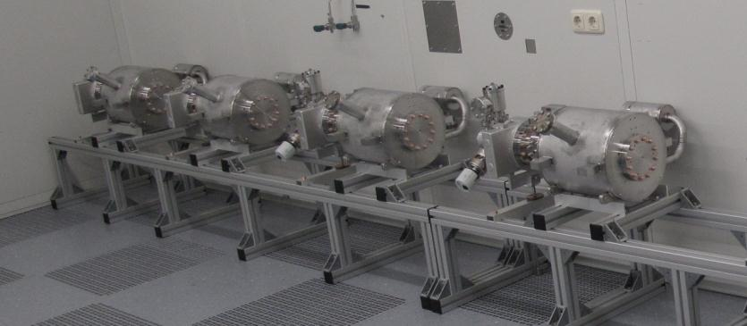
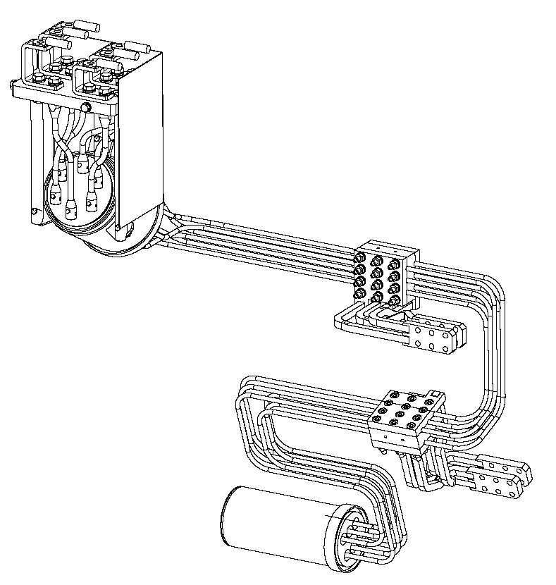

Sc quads and current leads
Cold Magnets and Current Leads
25 magnets (CIEMAT IKC) measured at DESY (IFJ-PAN IKC)
current leads (DESY IKC) for first modules available
assembly of quad packages stopped after 8 units due to buffer overflow

Slide 20
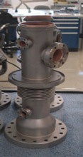
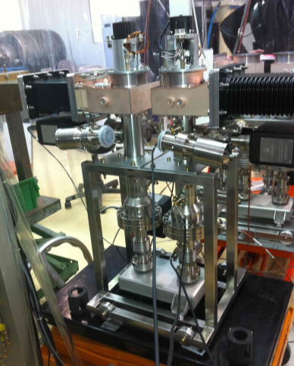

RF power couplers – critical schedule!
RF Power System
French contribution, manufacturing in industry, test/processing at LAL/Orsay
copper coating in industrial production took long time to reliably establish
by now two couplers /week delivered, ramp-up to 4/week soon, ramp up to required rate 8/week with additional infrastructure & shifts
most critical component to avoid further delays in the ramp-up of accelerator module assembly at CEA/Saclay

Slide 21
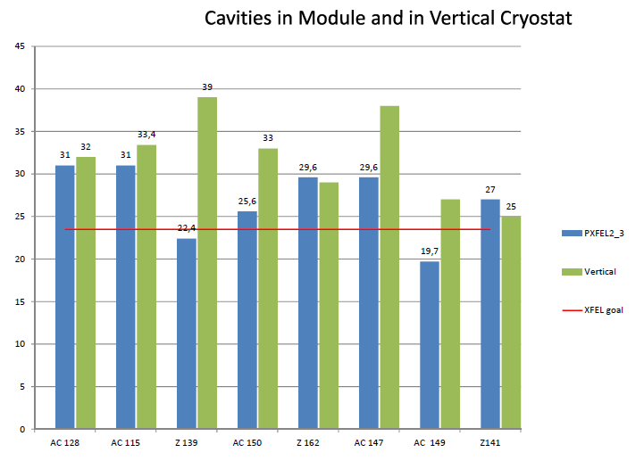
Module assembly (DESY – CEA/Saclay)
Performance drop after assembly not yet avoided…
(but this prototype module still performs above XFEL spec)

Slide 22
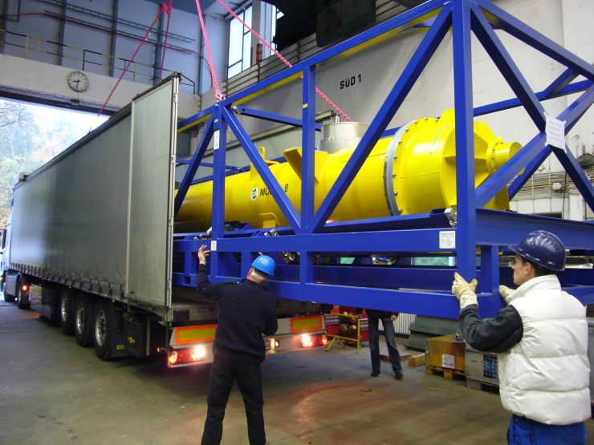
Module transport test Hamburg-Saclay-Hamburg 2008…
Vibration/shock-damped transport frame developed in industry
After truck transport to Saclay, back on CMTB at DESY for RF test:
  No mechanical damage, no vacuum leaks
  Cool-down and RF-powering without problems
  two of 8 cavities show reduced gradient (36→30, 26→18 MV/m)
  Possible reason (speculative): small dust particles shaken loose and changed position ??

Slide 23
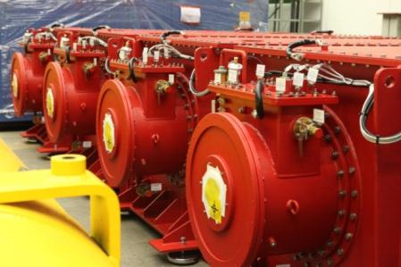
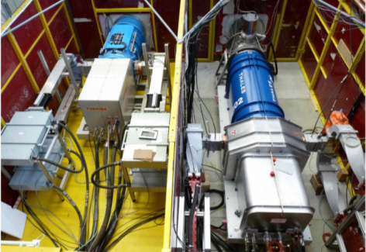
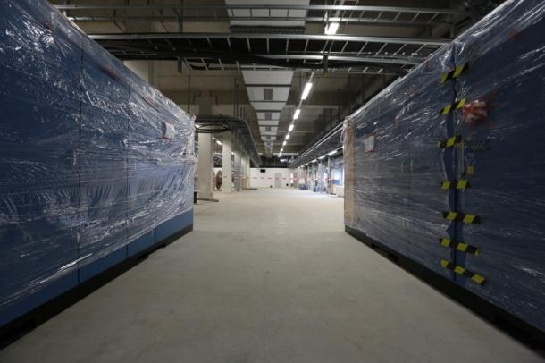
RF system components
RF Power System
all major components ordered
several components delivered, e.g.
  4 klystrons
  8 modulators
  12 pulse transformers
  18 connection modules
  100% pulse cables delivered and 80% installed
  22 preamplifiers
RF interlock in production
CFT for PS for RF racks done
Installation procedures to be finalized

Slide 24
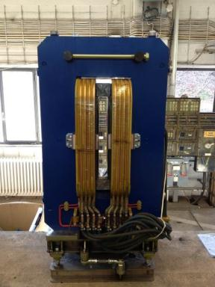
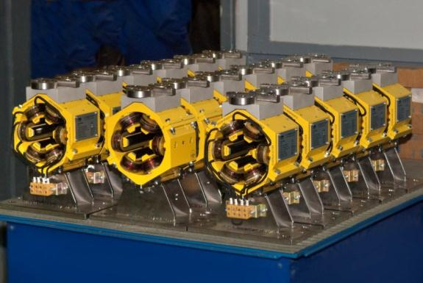
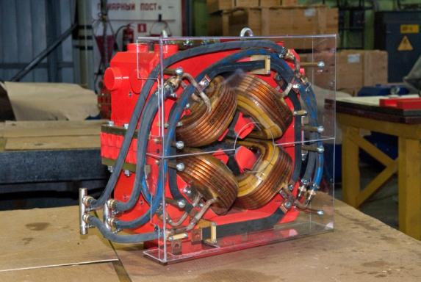

Warm magnet production
Magnet Production at Efremov
PRR for 19 out of 23 magnet types are finished; covers 95% of the more than 700 magnets
magnet fabrication is in full swing
quality control / magnetic measurement started at DESY
  XBB: 11 out of 14 magnets delivered
  XSC: All 17 magnets delivered
  XQE: 14 out of 43 magnets delivered
XBB
XSC
XQE

Slide 25
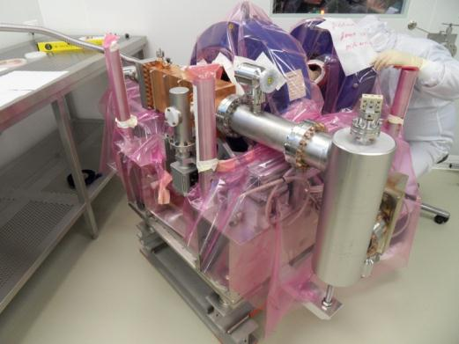
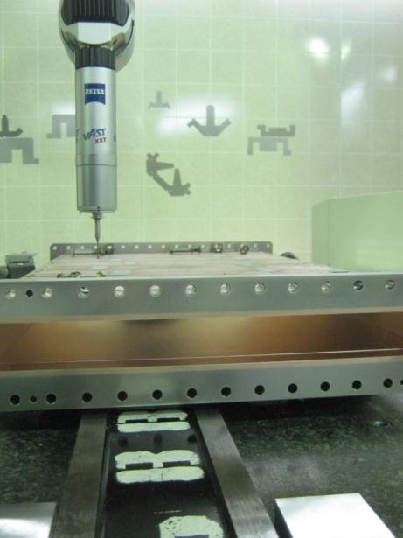
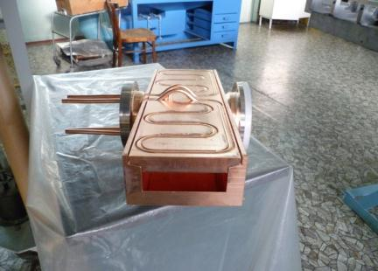
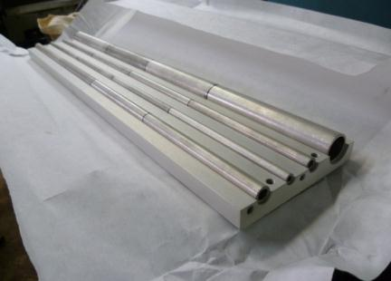

Warm vacuum components
Warm Vacuum
RF gun clean room assembly and shipping to DESY, Zeuthen (conditioning)
          BC chicane 2nd prototype at BINP
                Main collimator prototype at BINP
beam line reviews passed for injector, BC1 straight and main dump sections

Slide 26
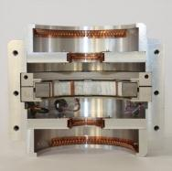
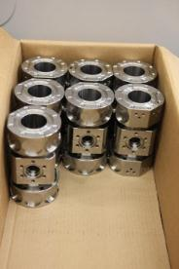
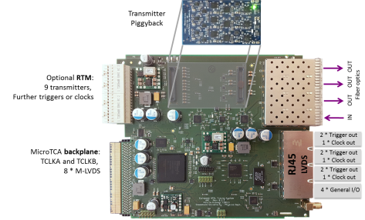
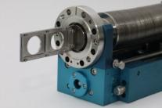
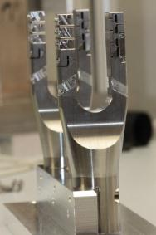
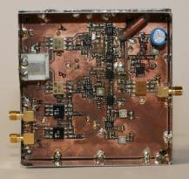








Beam diagnostics, timing, LLRF, …

Slide 27
Schedule, cost
Module assembly delayed due to delayed delivery of components
  This is the project’s critical path
  From present point of view, 6 – 9 months delay for completion of project → 1st SASE beam autumn 2016
  Will try to catch up by accelerating assembly (extra shifts) if possible (under discussion with CEA) – RF coupler delivery rate must be reached!
Accelerator complex cost (~520M€ y2005 incl. tech infrastructure) approximately 6% above original plan
  Most cost figures by now well known, residual uncertainty, incl. delays, few percent

Slide 28
Thank you for your attention!

