Slide 1
Tuners for 1.3 GHz Elliptical Cavities
Warren Schappert
Fermilab TD/I&C
Thursday May 29, 2013

Slide 2
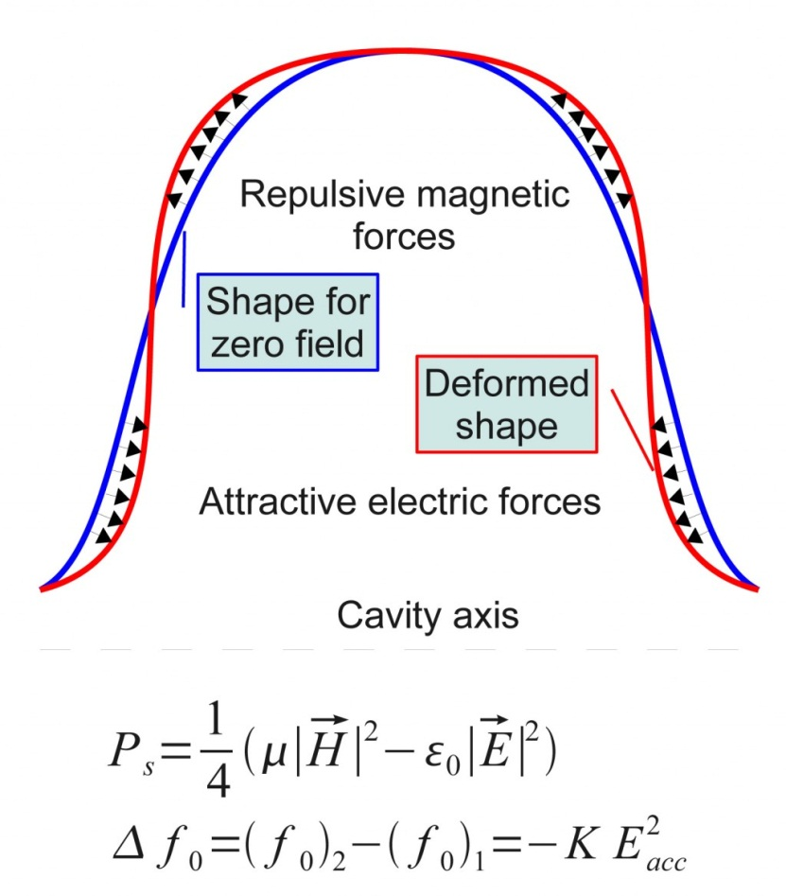
Cavity Detuning
SC cavities
  Operate with very narrow bandwidths
  Manufactured from thin sheets of niobium to allow cooling
  Resonance frequency sensitive to mechanical distortions of cavity walls
Tuner needed to
  Tune cavity resonance to RF frequency following cool-down
  Compensate for dynamic detuning
    Lorentz force
    Helium pressure variations
    Microphonics
  Tune cavities off resonance in case of failure
Image: Maurisz Grecki

Slide 3
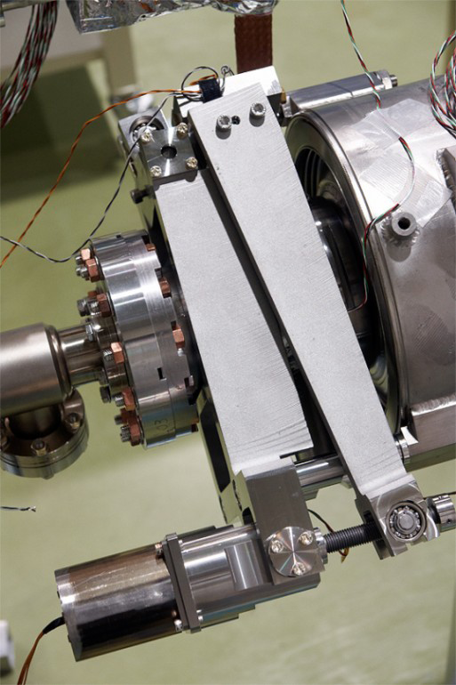
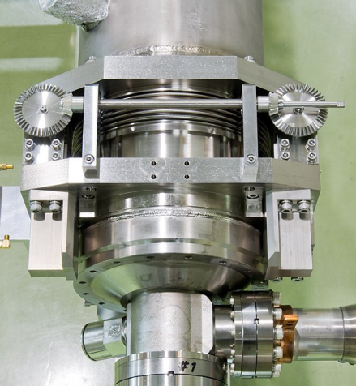
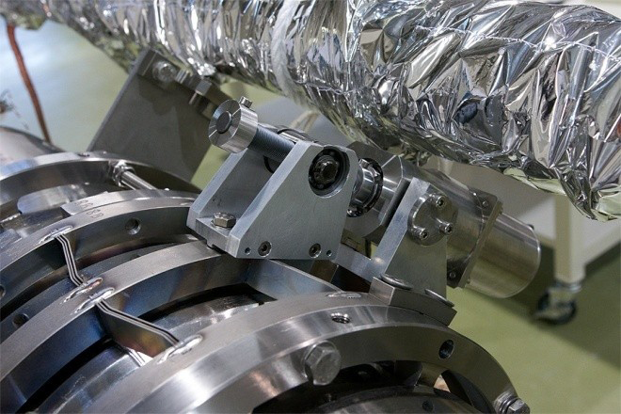
Mechanical Cavity Tuning
Variety of tuning methods
  Mechanical
  Reactive
  Pressure
    Previous surveys by Ed Daley and Stefan Simrock
      http://www.lns.cornell.edu/public/SRF2005/talks/thursday/ThA07_talk_srf2005.pdf
      http://www.jlab.org/intralab/calendar/archive04/erl/talks/WG3/WG3_Daly_Mon_1100.pdf
Mechanical tuner most common tuner for 1.3 GHz cavities consisting of
  Stepper Motor
  Reduction Gearbox
  Rotational-to-Linear Conversion Mechanism
  Piezo Stack Actuator

Slide 4
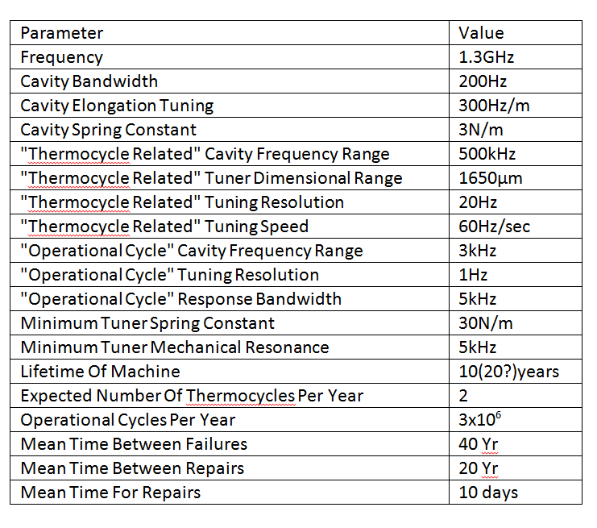
Tuner Performance Requirements
Range
  Static Tuner
    Sufficient to compensate for variations in resonance frequency following cool-down, e.g. 0.5 MHz
    Shift cavity off resonance by many (>20) bandwidths in the event of failure
  Dynamic Tuner
    Greater than maximum cavity dynamic detuning from all sources (e.g. 1kHz)
Precision
  Static
    Small fraction of fast actuator range (e.g. 100Hz/1kHz) should be adequate for normal operation
    Small fraction of a bandwidth (e.g. 10Hz/200 Hz) to provide for tuning in event of fast actuator failure
  Dynamic
    Small fraction of a bandwidth (e.g. <10Hz/200 Hz)
Stiffness
    High stiffness
      Bulk of actuator force should be transmitted to the cavity
Lash and Hysteresis
  No lash during dynamic operation
    Lash and hysteresis during static tuning may be acceptable
Reliability and Lifetime
  10 yr operation ≅ 30M motor steps, 10⁹ piezo cycles
Specifications must be tailored to specific cavity designs
  e.g. Spring constant, sensitivity, df/dP, etc.
Example FNAL Functional Requirements

Slide 5
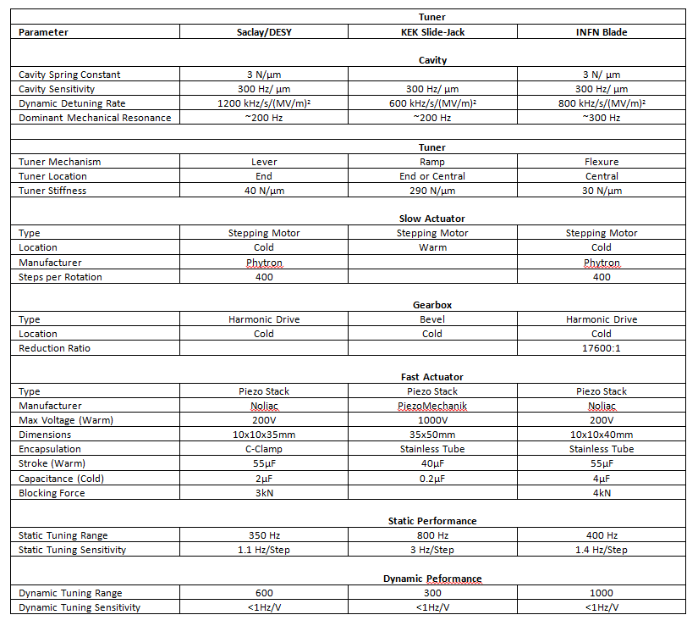
S1G Tuner Comparison
  S1 Global Cryomodule at KEK built with 4 distinctly different cavity/tuner types
    KEK Cavity/KEK Slide Jack-Central Mount
    KEK Cavity/KEK Slide Jack-End Mount
    DESY Cavity/Saclay-DESY Tuner
    FNAL Cavity/INFN Blade tuner
      http://accelconf.web.cern.ch/accelconf/IPAC2011/papers/mooda02.pdf
  Different design tradeoffs for each type
    Saclay-DESY tuner based on proven design in use at TTF
    KEK cavity/tuner very stiff to minimize dynamic detuning on flattop
    INFN blade tuner light and low cost
  Unique opportunity for back-to-back performance comparison

Slide 6
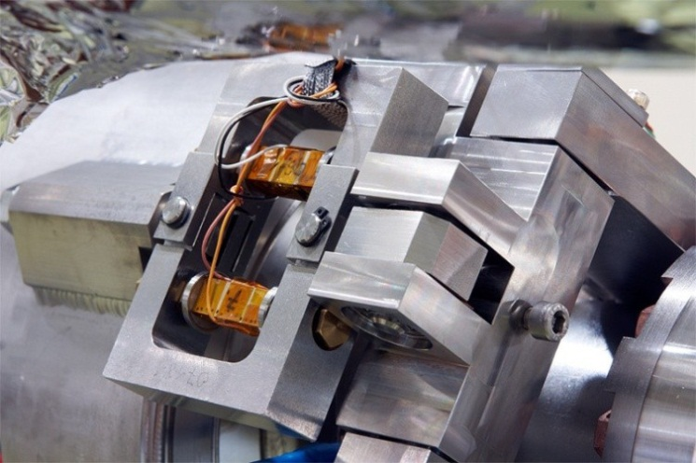
Saclay Lever Tuner
Compound lever mechanism acting at one end of the cavity
Saclay design
  Further development at DESY
In current use at TTF
http://www.fnal.gov/directorate/ILCPAC/May2011/Hayano.pdf

Slide 7
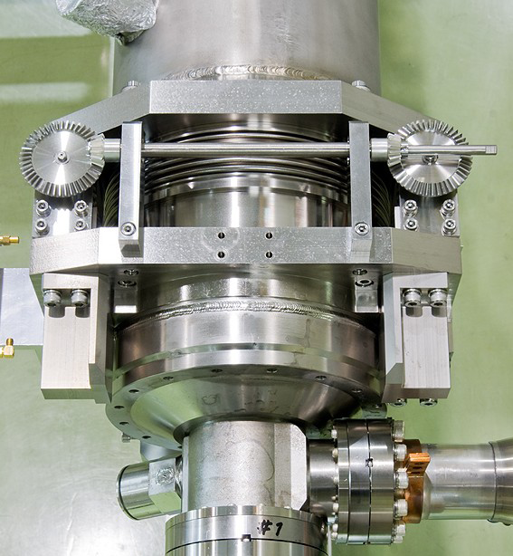
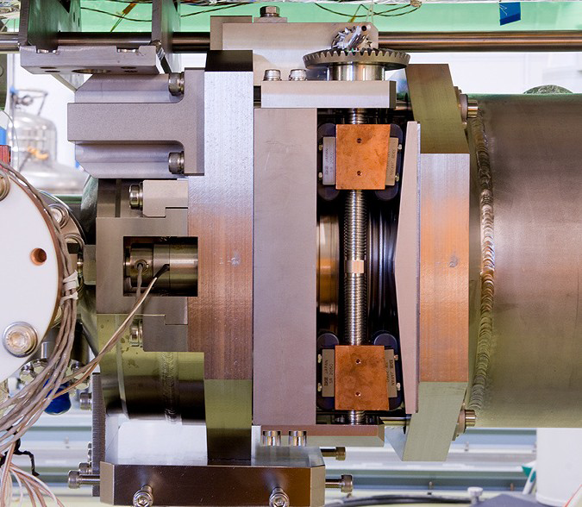
KEK Slide Jack Tuner
Ramp mechanism
End or central mount
External stepper motor
http://www.fnal.gov/directorate/ILCPAC/May2011/Hayano.pdf

Slide 8
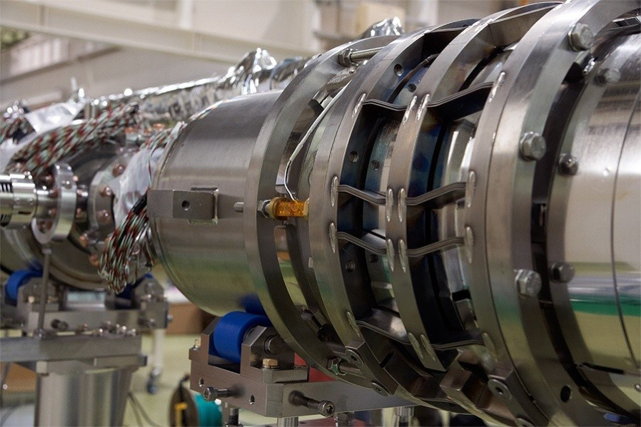
INFN Blade Tuner
Flexure mechanism
Central coaxial mount
http://www.fnal.gov/directorate/ILCPAC/May2011/Hayano.pdf

Slide 9
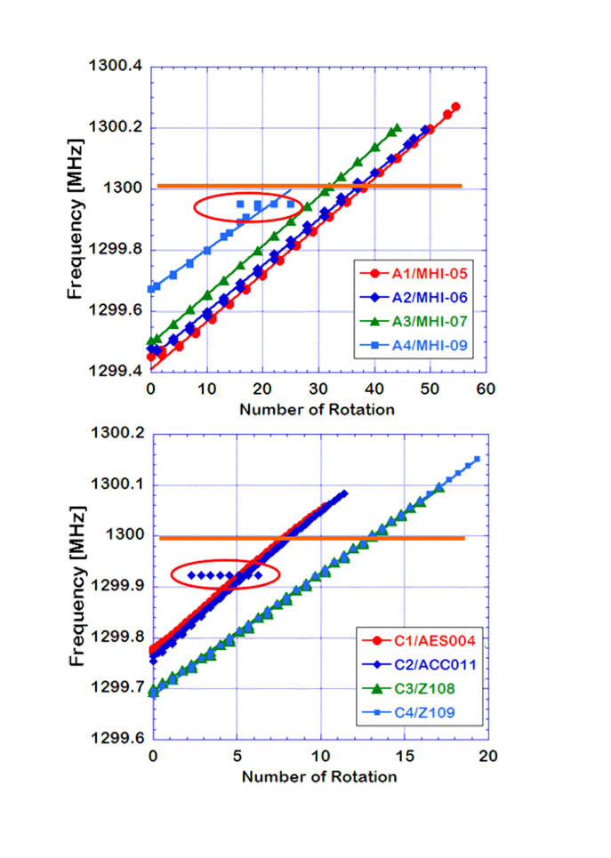
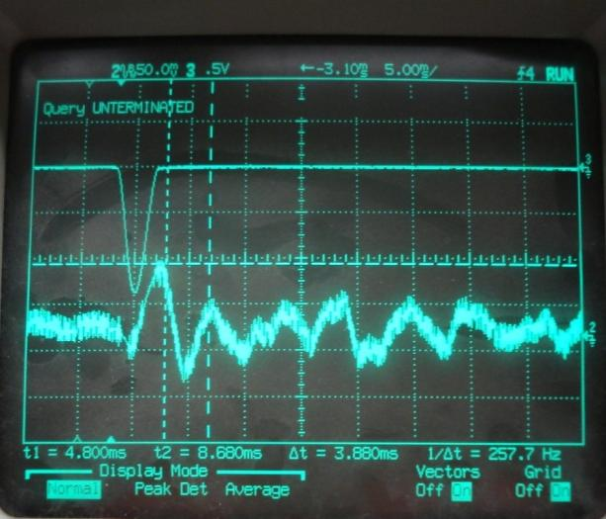
Tuner Operation
Static
  Cool-down
    Relax tuner to unload cavity during cool-down
  Operation
    Run motor until cavity resonance within specified tolerance band wrt RF frequency
Dynamic
  “Standard” approach
    Drive piezo with half sine pulse prior to RF pulse
    Tune pulse parameters to minimize detuning during flattop
      First demonstrated at DESY
  Adaptive algorithms
    FNAL, DESY,…
      LFD compensation during long RF pulses
  Both work well for RF pulses short with respect to period of dominant mechanical modes
    “Standard” performance degrades for longer pulses
  Adaptive algorithms able to automatically compensate for He pressure variations and other sources of long term drift

Slide 10
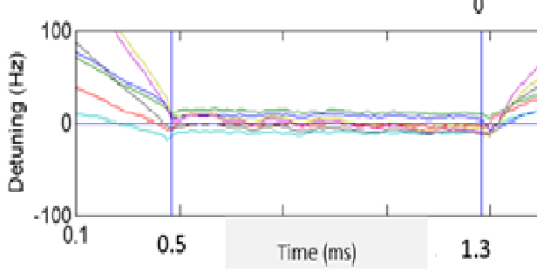
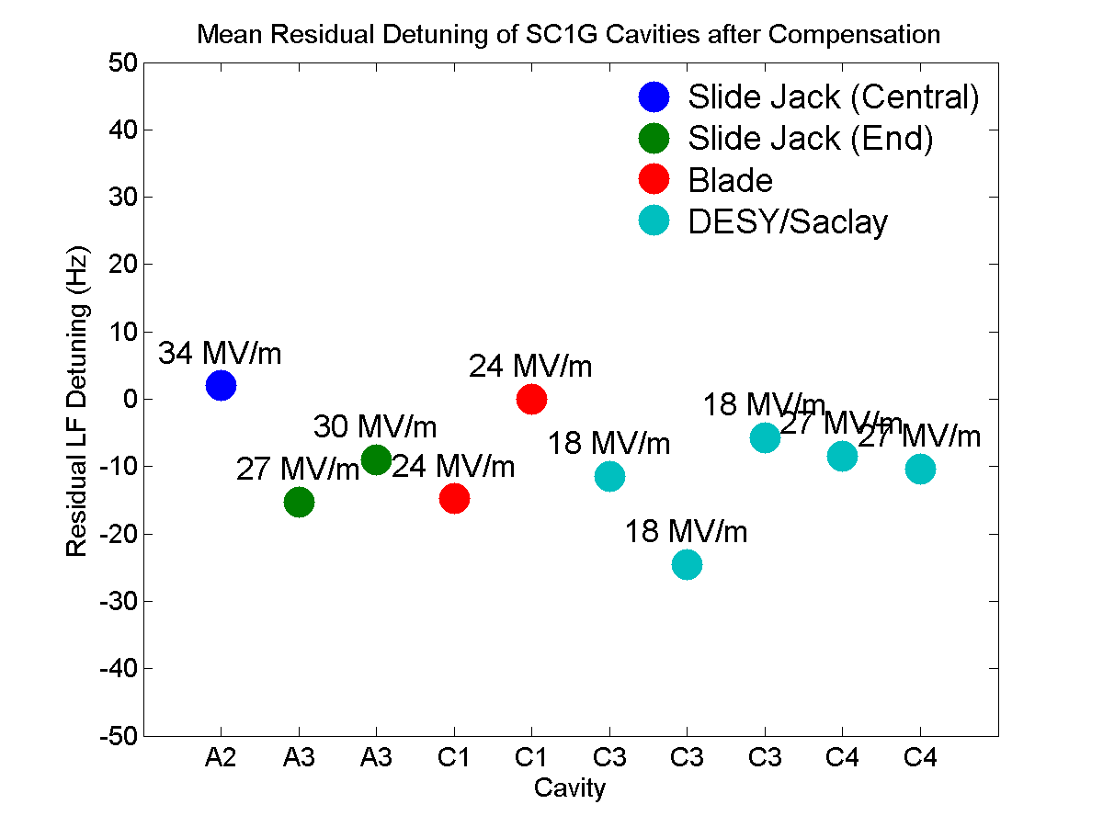
Dynamic Tuner Performance
Routinely reduce LFD from several hundreds of Hz to 10 Hz or better in FNAL/NML/CM1
S1G Performance comparable for all four different designs tested
FNAL/NML/CM1

Slide 11
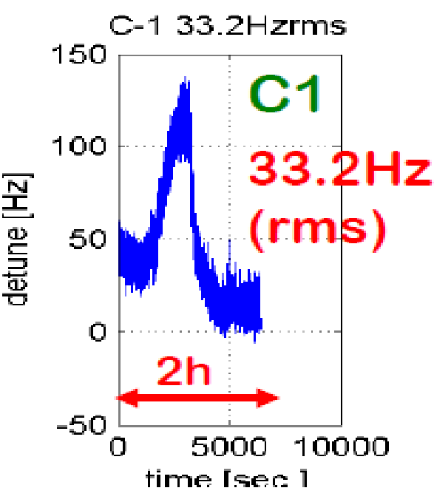
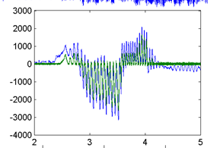
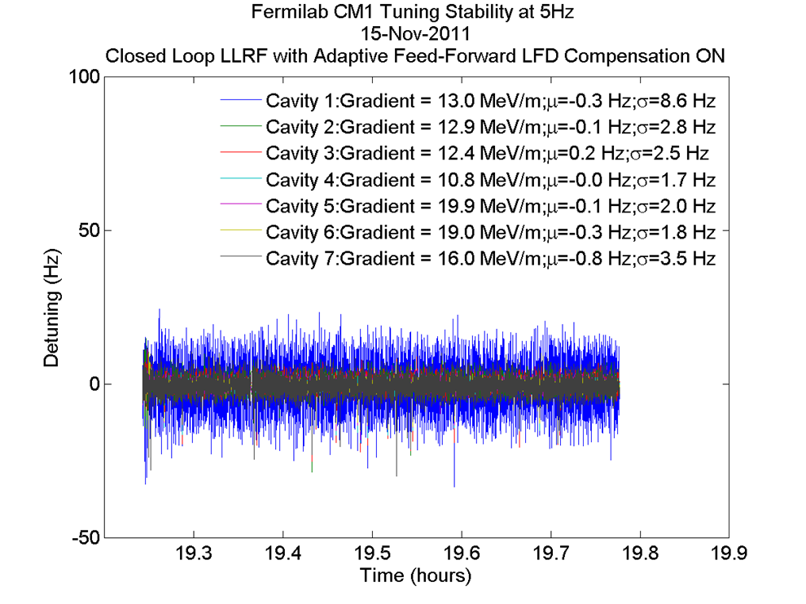
Feed-forward Resonance Stabilization in Pulsed Cavities
Cavities sensitive to changes in He pressure df/dP ≅ 50 Hz/Torr
  Can lead to large shifts in resonance frequency
Adaptive algorithm can adjust piezo bias based on running average of detuning during previous pulses
  Resonance can be stabilized to better than 1Hz on average
Residual pulse-to-pulse detuning (microphonics) small in FNAL/NML/CM1
  Lower in the middle (<2 Hz>
  Higher at the ends (9 Hz)
    Vacuum pumps
Microphonics compensation requires feedback
KEK/S1 Global
FNAL/NML/CM1
FNAL/NML/CM1

Slide 12
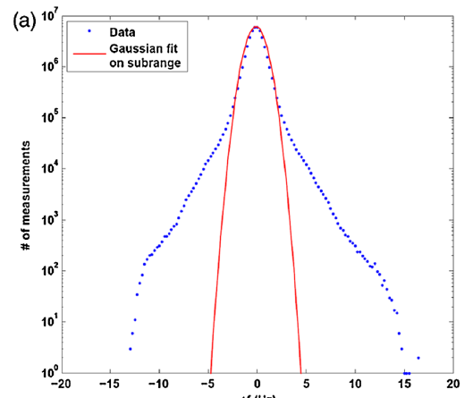
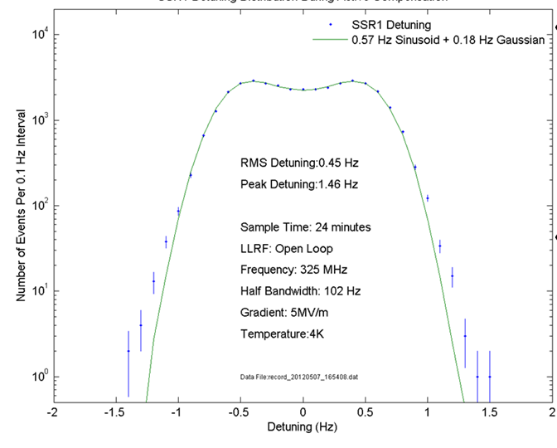
Microphonics in CW Cavities
Microphonics extensively studied in CW cavities
    HoBiCaT 1.3 GHz CW
  CW detuning dominated by He pressure variations
    Can be controlled to 1 Hz RMS or better
Same level may not be attainable in pulsed cavities
  Accurate detuning measurements possible only when RF pulse is present
HoBiCaT
σ_{Gaussian}=0.82 Hz
FNAL

Slide 13
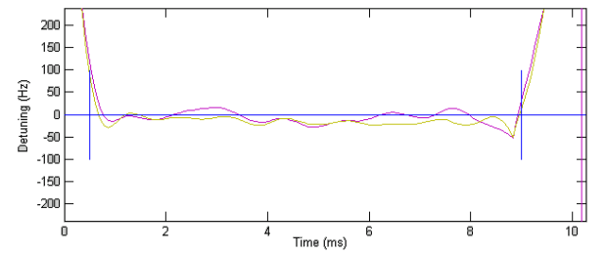
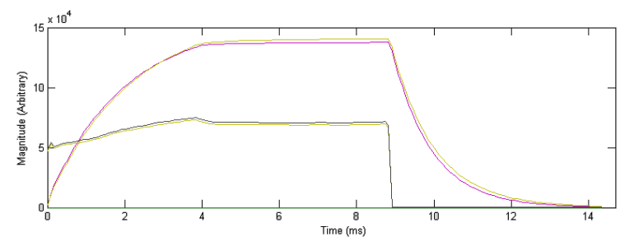
Narrow Bandwidths and Long Pulses
For some applications longer pulses and narrower bandwidths may be useful
  2011 Test using 9ms pulses in FNAL/NML/CM1/C5 and C6 for Project X
    Q_{L} ranged between 3x10⁶ and 3x10⁷
  Adaptive LFD control able to limit detuning to better than 50 Hz across the flattop and most of the fill
FNAL/NML/CM1/C5 and C6

Slide 14
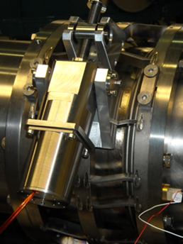
Tuner Reliability
Slow and fast tuners must operate reliably over the lifetime of the machine
  Failure prone components should be located outside vacuum vessel if possible
    Heat leaks
    Linkage spring constant and inertia
  Internal components must have high MTBF
    Stepper motor, Gearbox, Linkage, Piezo…
      Access ports for LRU repair or replacement
Experience varies widely
  Notable large scale “Piezo” failures at SNS
  Only a handful of tuner failures at DESY/FLASH
  Experience at FNAL shows there can be a long learning curve even with a “proven” design
Need to treat tuner design like “Rocket Science”
  Many of the same components used by space flight community
    Similar environmental and reliability requirements

Slide 15

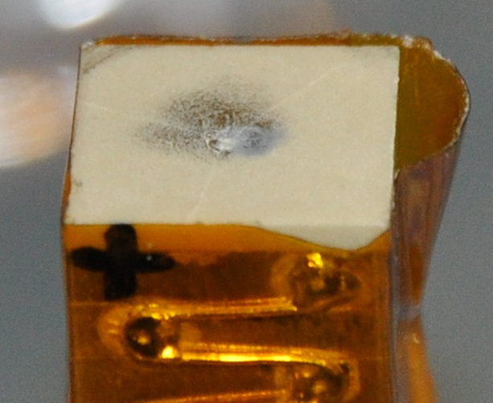

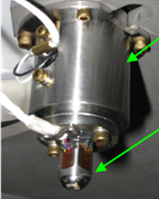
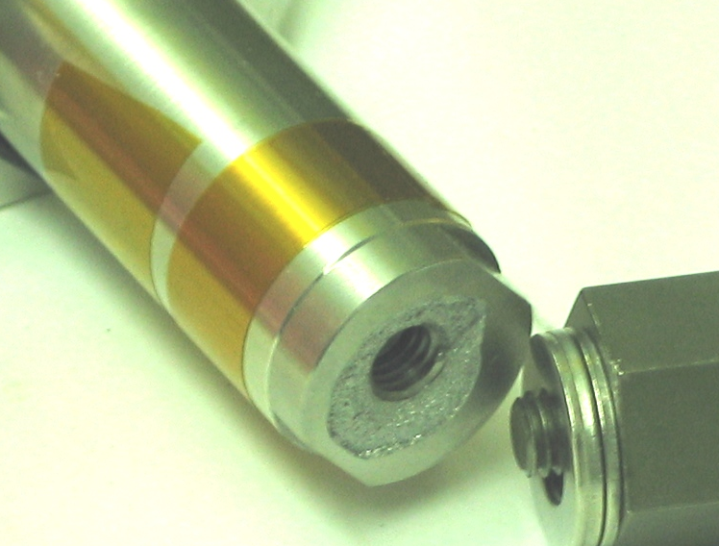
Piezo Actuator Reliability
FNAL
Piezo actuators can be extremely reliable if treated properly
  High piezo cryogenic lifetime demonstrated in several tests
    INFN – 1.5x10⁹ cycles ≅ 10 yr operation
    NASA – 10¹⁰ cycles
Can fail quickly if not treated properly
  Piezo lifetime strongly affected by
    Humidity, temperature and voltage
    Cryogenic vacuum should be close to ideal environment
  Shear forces can lead to rapid failure
    Encapsulation critical
      Careful encapsulation design
    “Piezo” failures at SNS caused by 1 bar pressure transients
      Capsule failed not actuator
SNS

Slide 16
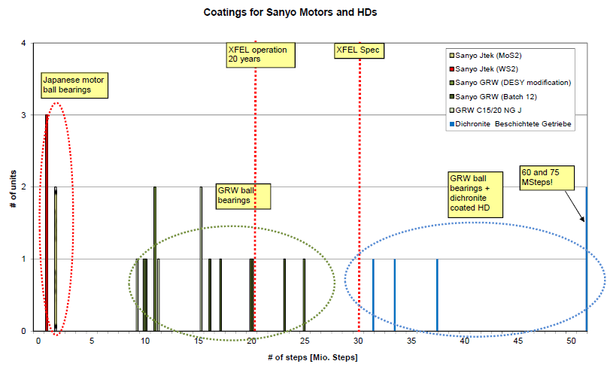
Stepper Motor Reliability
Stepper motor warm lifetime dominated by bearing wear
  Operation in cold vacuum requires bearing and other modifications
Vacuum and space qualified motors commercially available
DESY: 65MSteps
Phytron:65Msteps

Slide 17
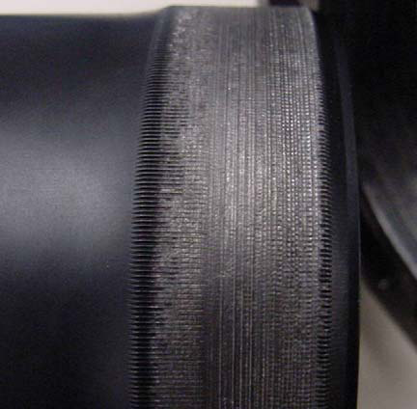

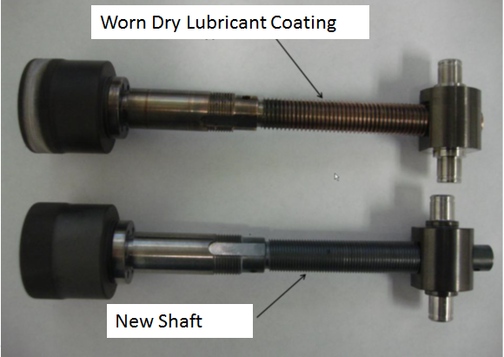
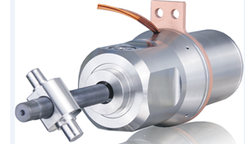
Limits to Tuner Reliability
Cold vacuum is difficult environment for electromechanical systems
  Every component is a potential point of failure, piezo, stepper, gearbox, linkage…
Reliable tuner design requires careful component selection and extensive warm and cold testing of individual components and of assembled tuners
  e.g. DESY experience with motors
  Suitable high-reliability components are commercially available
Tuner reliability program should be initiated and completed well prior to commencement of procurement and production
  Once production begins schedule will take priority over everything else
Life Test Failure of Harmonic Gears in a Two-Axis Gimbal for the Mars Reconnaissance Orbiter Spacecraft
Michael R. Johnson*, Russ Gehling**, Ray Head+

Slide 18
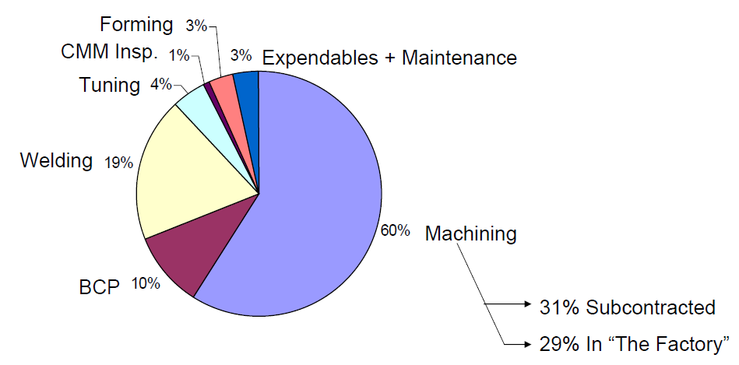
Tuner Cost
AES ILC Cost Study
  commissioned by Fermilab 2007/2011
  Tuning 4% of overall cryomodule cost

Slide 19
Summary
Variety of tuners for 1.3 GHz elliptical cavities have been built and tested
  Four distinctly different candidate cavity/tuner designs compared in ILC/S1G tests at KEK in 2010
    Each demonstrated excellent performance following compensation
Variety of control algorithms have been implemented and tested
  Feed-forward LFD compensation and resonance stabilization against He pressure variations are now well understood
  At narrower bandwidths microphonics becomes more important
    Feedback may be useful
  No fundamental reason detuning from all sources can’t be controlled to 1Hz or better
Tuner represents only a few percent of overall cryomodule cost
Selection of tuner for collider cavities should focus on lifetime and reliability
  Required reliability can be achieved
    Needs careful engineering of each element in the electro-mechanical chain
    Needs extensive cold testing of each component and of entire tuner assembly
Tuner reliability evaluation and improvement program should be initiated and completed well before commencement of procurement and production

