Slide 1
CLIC source update
CLIC main beam injectors reminder
Recent interest, cost savings improving efficiencies
Positron production using undulator

Slide 2
Layout
Pre-injector
e⁺ Linac
Primary 5 GeV e⁻ Linac
Injector Linac
gun
PDR
target
2.86 GeV
Booster Linac
2 GHz
e⁺ DR
BC1
0.2 GeV
Spin rotatator
DC gun
DL’s
Pre-injector
e⁻ Linac
e⁻ DR
9 GeV
PDR
Two hybrid positron sources (only one needed for 3 TeV)
Common injector linac
All linac at 2 GHz , bunch spacing 1 GHz before the damping rings

Slide 3
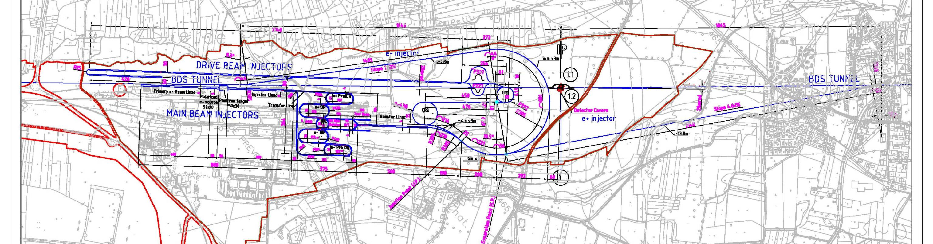
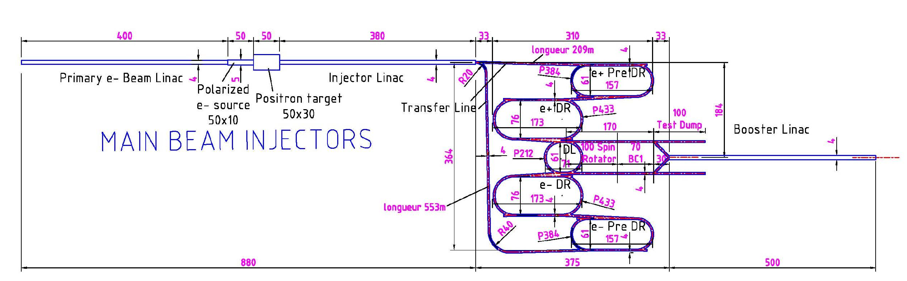
CLIC Main Beam complex
e⁻ transfer line
e⁻ and e⁺ sources
e⁻ and e⁺ Damping Rings
e⁺ transfer line
Zoom

Slide 4
Beam timing and operational modes
Before damping ring
(1 GHz bunch spacing)
After damping ring
(2 GHz bunch spacing)
156-556 ns
156-556 ns
156-556 ns
156-556 ns
156-556 ns
156-556 ns
e⁺
e⁺
e⁻
e⁻
e⁺
e⁻
717 ns
717 ns
1100 ns
2314 ns
Operational mode | Charge per bunch (nC) | Number of bunches
Nominal | 0.6 | 312
500 GeV | 1.2 | 312
Low energy scans | 0.6, 0.45, 0.4, 0.3, 0.23 | 312, 472, 552, 792, 1112

Slide 5
Beam parameters
Parameter | Unit | CLIC polarized electrons | CLIC positrons | CLIC booster
E | GeV | 2.86 | 2.86 | 9
N | 10⁹ | 4.3 | 4.3 | 3.75
n_{b} | - | 312 | 312 | 312
Δt_{b} | ns | 1 | 1 | 0.5
t_{pulse} | ns | 312 | 312 | 156
ε_{x,y} | μm | < 100 | 7071, 7577 | 600,10 ∙10⁻³
σ_{z} | mm | < 4 | 3.3 | 44 ∙10⁻³
σ_{E} | % | < 1 | 1.63 | 1.7
Charge stability shot-to-shot | % | 0.1 | 0.1 | 0.1
Charge stability flatness on flat top | % | 0.1 | 0.1 | 0.1
f_{rep} | Hz | 50 | 50 | 50
P | kW | 29 | 29 | 85

Slide 6
Polarized electron source
Classical polarized source wit bunching system
Charge production demonstrated by SLAC experiment
Simulations showed 87 % capture efficiency (F. Zou, SLAC)
DC-gun, 140 kV
GaAs cathode
1 GHz buncher
2 GHz buncher + accelerator
Polarized laser

Slide 7
Polarized electron source parameters
 |  | POLARIZED SOURCE FOR CLIC
 | Electrons | CLIC 1 GHz | CLIC DC/ SLAC Demo
Number of electrons per bunch (*10^9) |  | 3.72 | 1365
Charge/single bunch (nC) |  | 0.96 | NA
Charge/macrobunch (nC) |  | 300 | 300
Bunch spacing(ns) |  | 1 | DC
RF frequeny (GHz) |  | 1 | DC
Bunch length at cathode (ps) |  | 100 | DC
Number of bunches |  | 312 | NA
Repetition rate (Hz) |  | 50 | 50
QE(%) |  | 0.3 | 0.3
Polarization |  | >80% | >80%
Circular polarization |  | >99% | >99%
Laser wavelength (nm) | Laser | 780-880 | 865
Energy/micropulse on cathode (nJ) |  | 509 | NA
Energy/macropulse on cathode (μJ) |  | 159 | 190
Energy/micropulse laser room (nJ) |  | 1526 | NA
Energy/macrop. Laser room (μJ) |  | 476 | 633
Mean power per pulse (kW) |  | 1.5 | 2
Average power at cathode wavelength(mW) |  | 8 | 9.5
Laser scheme
For the 1 GHz approach cathode current densities of 3-6 A/cm² would be needed,
the dc approach uses < 1 A/cm²

Slide 8
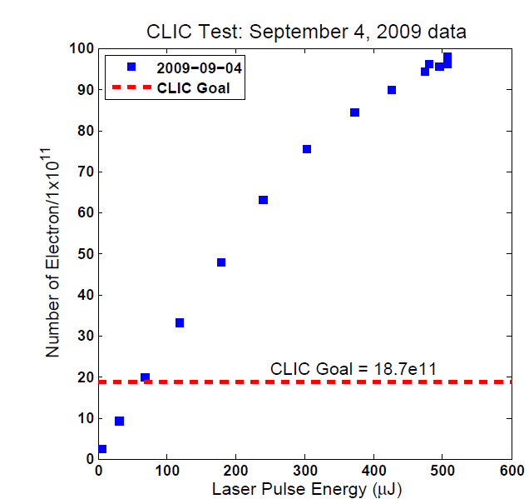
Polarized electron source
CLIC Goal 0.5 TeV: 35e11
J. Shepard

Slide 9
Positron source conventional ?
Hybrid target
Primary beam
Linac for e⁻
AMD
200 MeV
Primary beam
Linac for e⁻
Bunch compressor
Gun
5 GeV
RF-deflector
2 GHz
Hybrid target
Primary beam
Linac for e⁻
AMD
200 MeV
AMD: 200 mm long, 20 mm radius, 6T field

Slide 10
Hybrid target
Target Parameters Crystal
Material | Tungsten | W
Thickness (radiation length) | 0.4 | χ₀
Thickness (length) | 1.40 | mm
Energy deposited | ~1 | kW
Target Parameters Amorphous
Material | Tungsten | W
Thickness (Radiation length) | 3 | χ₀
Thickness (length) | 10 | mm
PEDD | 30 | J/g
Distance to the crystal | 2 | m

Slide 11
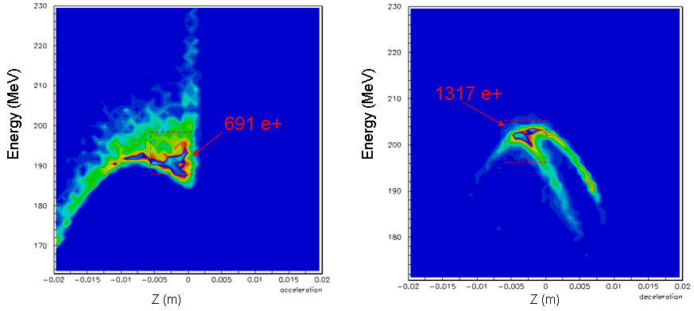
Yield simulations capture and pre-injector linac
Energy density at 200 MeV
Accelerating mode
decelerating mode
Positron yield: after target: ~8 e⁺/e⁻
at 200 MeV: 0.9 e⁺/e⁻
into PDR: 0.39 e⁺/e⁻
O. Dadoun

Slide 12
Linac Parameters
Pre-injector
e⁺ Linac
Primary 5 GeV e⁻ Linac
Injector Linac
gun
PDR
target
2.86 GeV
Booster Linac
2 GHz
e⁺ DR
BC1
0.2 GeV
Spin rotatator
DC gun
DL’s
Pre-injector
e⁻ Linac
e⁻ DR
9 GeV
PDR

Slide 13


Cost reduction for the main injectors
CDR design was focused on low risk, conventional, state of the art facility to guarantee excellent beam quality and not worry about cost or feasibility
It turned out that the injectors have a significant cost impact even on CLIC
→ In the frame work of the new base-line for CLIC, in particular optimizing a low energy first stage we decided to focus as well on cost and efficiency
Main proposals:
PDR for electrons not needed
Use 2 GHz bunch spacing through out the complex, shorter rf pulses in linac’s and no need for delay loop
Optimise timing of the beams to gain efficiency (PC optimisation)
Investigate to use booster linac as positron driver (saves positron driver)
Provide cost model for optimization

Slide 14
Alternative layout
Without positron driver linac and e⁻ PDR, 2 GHz bunch spacing everywhere
156ns
156ns
e⁻
e⁻
e⁺
Positron production pulse
3300 ns
Pre-injector
e⁻ Linac
2.86 GeV
0.2 GeV
PDR
Injector Linac
DC gun
e⁺ DR
BC1
target
e⁻ DR
Booster Linac
2 GHz
gun
6 GeV
Save two rings, positron driver linac, and tunnel length (saving potential 200 MCHF)

Slide 15
Cost of 1 vs. 2GHz system
The cost of the DR RF system was scaled with the total voltage
For the PDR the total voltage is 10MV in both options, so no potential cost saving
For the DR, the total voltage at 1GHz is 5.1MV, whereas it is 4.5MV for 2GHz. Taking 850kCHF/MV, the reduction for 2GHz is 0.5MCHF
At 2GHz, there is not delay loop necessary, and there is a reduction of around 9.8MCHF
The technological risk of choosing the 2GHz option, after Alexej’s conceptual design, seems equivalent with the train recombination for the 1GHz option
Yannis Papaphilippou

Slide 16

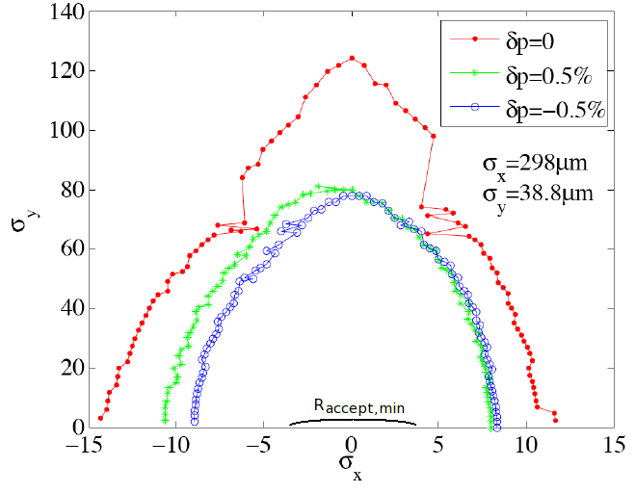
Electron linac requirements
For non-Gaussian beams the minimum required acceptance:
To avoid an e⁻ PDR:
  In horizontal R_{min} < 1 mm-rad
  In vertical R_{y}^{min} < 1.2 mm-rad
Required emittances from the electron injection linac in order to remove electron PDR
  ε_{x}^{rms}= 25 μm-rad
  ε_{y}^{rms}= 50 μm-rad
DA of the main DR
F. Antoniou

Slide 17
Injector linac rf system
Kly 1
Structure Parameter | Value
Frequency | 1998 MHz
Structure length (30 cells) | 1.5 m
Filling time | 389 ns
Cell length and iris thickness | 50 mm, 8 mm
Shunt impedance | 54.3 – 43.3 MΩ/m
Aperture a | 20 – 14 mm
Cell size b | 64.3 – 62.9
Group velocity vg/c | 2.54 -0.7 %
Phase advance per cell | 2π/3
50 MW, 8 μs
Mod
Pulse compressor
250 MW, 1.5 μs
Kly 2
BPM
Quad
Acc 1
Acc 2
Acc 3
Acc 4

Slide 18

Cost per linac
Cost estimate per linac (1.5 TeV parameters)
LINAC | Energy Gain (MeV) | Bunch charge (10^9) | rf pulse length (ns) | Power per structure (MW) | Loaded gradient (MV/m) | Configuration (structure/2 klystrons) | No of rf modules | pulse compressor gain | No of structures | Length (m) | Energy gain per module (MeV) | Cost
e- pre-injector | 200 | 4.3 | 1300-1700 | 54 | 18 | 4 | 2 | 2.3-2.5 | 8.0 | 30 | 108 | 5830
e+ pre-injector | 200 | 11 | 1300-1700 | 56 | 15 | 4 | 3 | 2.3-2.5 | 9.0 | 40 | 90 | 8745
injector linac | 2660 | 6 | 3600-4000 | 44 | 15 | 2 | 60 | 1 | 119.0 | 300 | 45 | 127950
positron drive linac | 5000 | 11 | 1300-1700 | 56 | 15 | 4 | 56 | 2.3-2.5 | 223.0 | 400 | 90 | 163240
booster linac | 6140 | 4 | 1700-2000 | 53 | 16 | 4 | 64 | 2-2.3 | 256.0 | 473 | 96 | 186560
Efficiency (%) | Structure efficiency for 312 bunches (%)
2.68
4.58
6.64 | 31
6.13 | 32
4.79 | 27
Bunch charge and gradient determine power/structure, optimized for a 2x 50 MW klystron + pulse compressor configuration to feed a maximum of structures
Cost of structure 13%
Cost of high power system 75%, ~ factor 2 of this could hopefully be gained (150M)

Slide 19
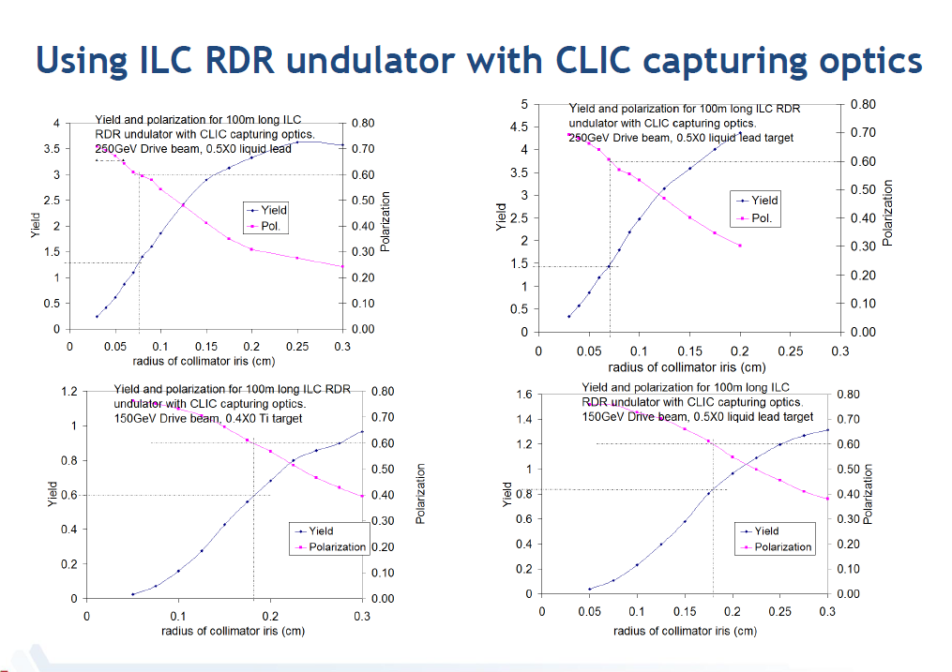
Undulator based positron source for CLIC
Together with the Argonne gang we decided to study in more detail this option which has a path to positron polarization and might have cost benefits as well
Wanming Liu

Slide 20

Layout with undulator based positron source
Main beam bypass line
Undulator
positron source
to transfer line, DR
Undulator 350 m
Photons 300 m
target
2.86 GeV linac ? 300m
~1000 m
Main Linac
BDS
IP
Main Linac
BDS
from injectors
Pre-injector
e⁻ Linac
2.86 GeV
0.2 GeV
PDR
Injector Linac
DC gun
e⁺ DR
BC1
target
to main linacs
e⁻ DR
Booster Linac
2 GHz
gun
6 GeV
Spin rotator
Minimum scenario for upgrade to positron polarization and fully compatible with conventional layout

Slide 21
Undulator based positron source
Consequences:
400 -1000 m more linac length (both sides ?)
Separate injector linac for positrons 2.86 GeV
transfer line from the tunnel to the injector complex
Spin rotator before and after damping ring (needed anyway for any polarized scheme)
Gap in damping ring due the delayed beams
Main beam bypass around positron production
Coupling of the two beams

Slide 22
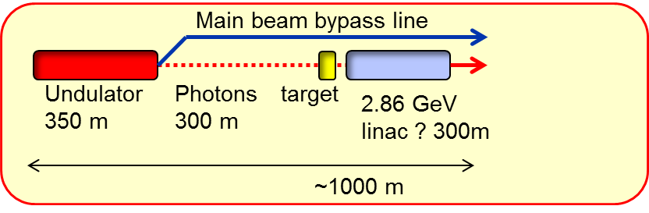
How about a dedicated scheme ?
Central Injectors and DR in deep tunnel
2.86 GeV
DC gun
e⁻ DR
Booster Linac
6 GeV
BC1
e⁺ DR
PDR
Main Linac
BDS
IP
BDS
Main Linac

Slide 23
How about a dedicated scheme ?
DR and injector at the end of each side
PDR
IP
e⁺ DR
Main Linac
BDS
BDS
Main Linac
e⁻ DR
2.86 GeV
Booster Linac
6 GeV
DC gun

Slide 24
Undulator based positron source
To be studied
Impact in cost, length and performance
Emittance preservation in undulator and bypass
Beam loading in PDR due to a likely gap of ~ 43 μs (500 GeV)
General timing consideration
Upgrade scenarios
Undulator parameters, can we get 60% polarization
Wei Gai, Wanming Liu and CLIC team

Slide 25
Conclusions
Small effort for CLIC sources after CDR
Focus on low energy first stage (375 GeV), cost, performance and efficiency optimization
Started to study an undulator based positron source for CLIC more seriously with the aim to document that before the end of the year.

