Slide 1
Overview of
300 Hz Conventional e⁺ Source for ILC
T. Omori (KEK)
29-May-2013
ECFA LC Workshop at DESY
Truly Conventional Collaboration
ANL, IHEP, Hiroshima U, U of Tokyo, KEK, DESY, U of Hamburg
Wei Gai, Jie Gao, Shin-ichi Kawada, Wanming Liu, Natsuki Okuda,
Tsunehiko Omori, Guoxi Pei, Sabine Riemann, Tohru Takahashi,
Junji Urakawa, and Andriy Ushakov
NIM A672 (2012) 52—56

Slide 2
300 Hz scheme
e+ generation in 63 m sec (cf. undulator : in 1 m sec)

Slide 3
How?
• Total Number of bunches: 2640
• Divide into 20 triplets
(1 Triplet = 3 Mini-Trains)
• Each triplet contains 132 bunches
• 2640 = 20 x 132
• 300 Hz creation of triplets
triplet to triplet time space = 3.3 m sec
• Create 20 triplets : 63 m sec
Stretching in time

Slide 4
Conventional e+ Source for ILC
Normal Conducting Drive and Booster Linacs in 300 Hz operation
e+ creation
go to main linac
20 triplets, rep. = 300 Hz
• triplet = 3 mini-trains with gaps
• 44 bunches/mini-train, T_{b_to_b} = 6.15 n sec
2640 bunches/train, rep. = 5 Hz
• T_{b_to_b} = 369 n sec
Drive Linac
Several GeV
NC
300 Hz
Booster Linac
5 GeV
NC
300 Hz
DR
Target
T_{b_to_b} = 6.15 n sec
Amorphous Tungsten
Pendulum or Slow Rotation
2640 bunches
60 mini-trains
Time remaining for damping = 137 m sec
We create 2640 bunches
in 63 m sec
Notes:
4

Slide 5
Conventional e+ Source for ILC
Normal Conducting Drive and Booster Linacs in 300 Hz operation
e+ creation
go to main linac
20 triplets, rep. = 300 Hz
• triplet = 3 mini-trains with gaps
• 44 bunches/mini-train, T_{b_to_b} = 6.15 n sec
2640 bunches/train, rep. = 5 Hz
• T_{b_to_b} = 369 n sec
Drive Linac
Several GeV
NC
300 Hz
Booster Linac
5 GeV
NC
300 Hz
DR
Target
T_{b_to_b} = 6.15 n sec
Amorphous Tungsten
Pendulum or Slow Rotation
2640 bunches
60 mini-trains
Time remaining for damping = 137 m sec
We create 2640 bunches
in 63 m sec
Stretching
Notes:
5

Slide 6
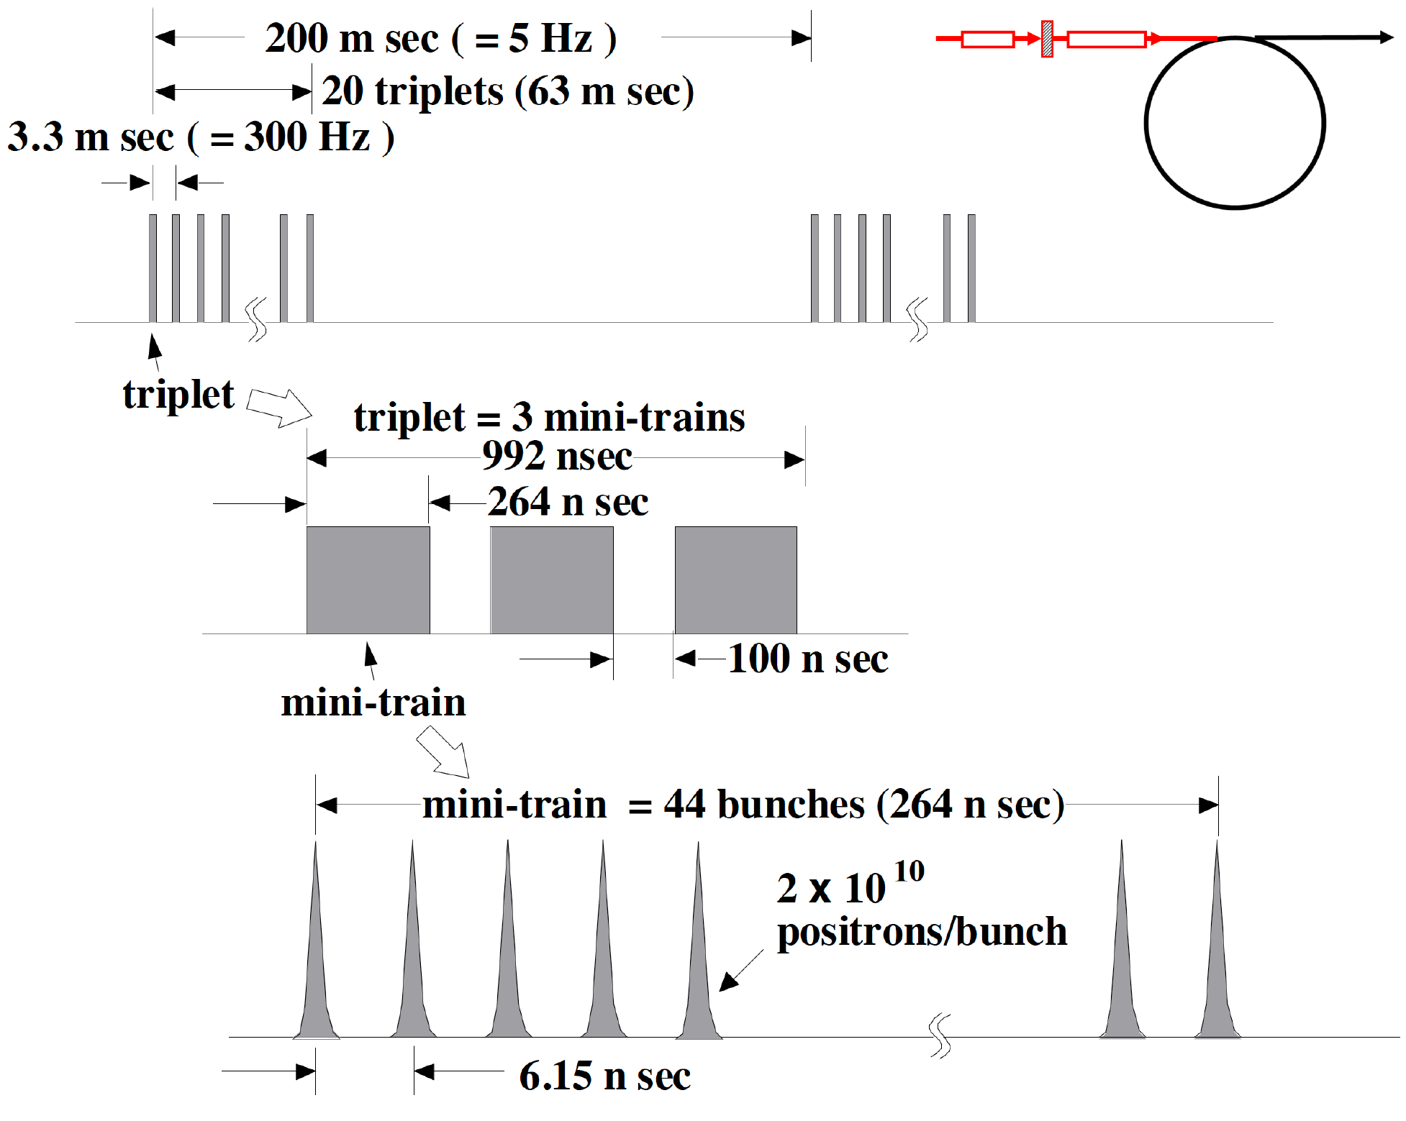
Beam before DR
=132 bunches
<-- the 100 ns gap is required to cure
an e- cloud problem in e+ DR.

Slide 7
Beam before DR
=132 bunches
Injection: usual kicker ( ~ 1 us)
no stacking is necessary
<-- the 100 ns gap is required to cure
an e- cloud problem in e+ DR.

Slide 8
Conventional e+ Source for ILC
Normal Conducting Drive and Booster Linacs in 300 Hz operation
e+ creation
go to main linac
20 triplets, rep. = 300 Hz
• triplet = 3 mini-trains with gaps
• 44 bunches/mini-train, T_{b_to_b} = 6.15 n sec
2640 bunches/train, rep. = 5 Hz
• T_{b_to_b} = 369 n sec
Drive Linac
Several GeV
NC
300 Hz
Booster Linac
5 GeV
NC
300 Hz
DR
Target
T_{b_to_b} = 6.15 n sec
Amorphous Tungsten
Pendulum or Slow Rotation
2640 bunches
60 mini-trains
Time remaining for damping = 137 m sec
We create 2640 bunches
in 63 m sec
Notes:
8

Slide 9
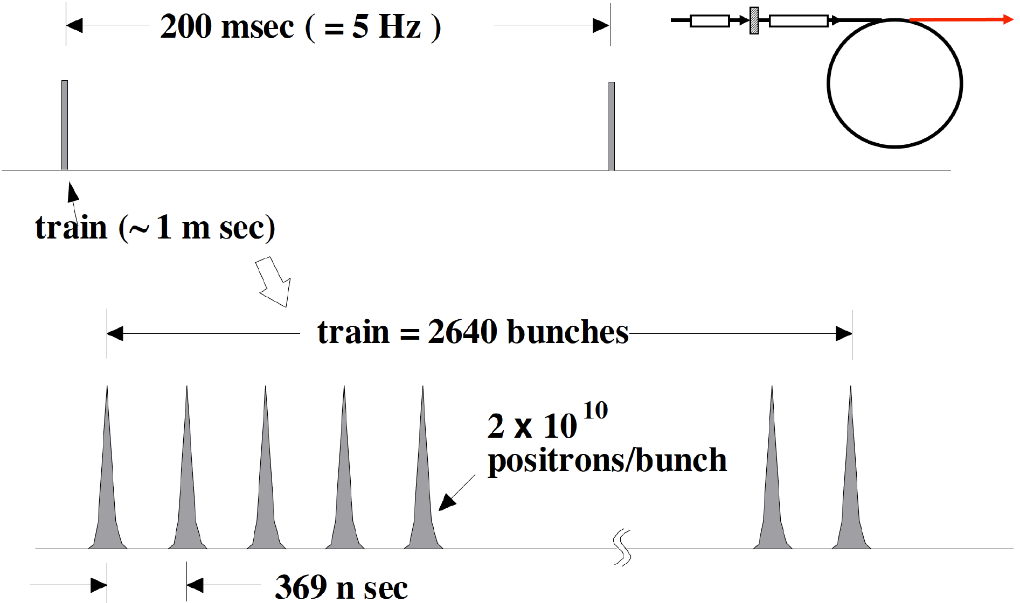
Beam after DR

Slide 10
Beam after DR
Extraction:
fast kicker ( 3 ns kicker: Naito kicker)
the same as the baseline

Slide 11
Target and Drive_Beam
Optimization for
Truly Conventional
e+ Source

Slide 12
Method
EM shower simulation
e+ capture efficiency
e+ yields
Peak Energy Deposit Density (PEDD)
total energy deposit
# of e+ in the Damping Ring
+
Empirical formula by CLIC note 465
Geant 4
EM shower and particle tracking w/ Geant 4

Slide 13
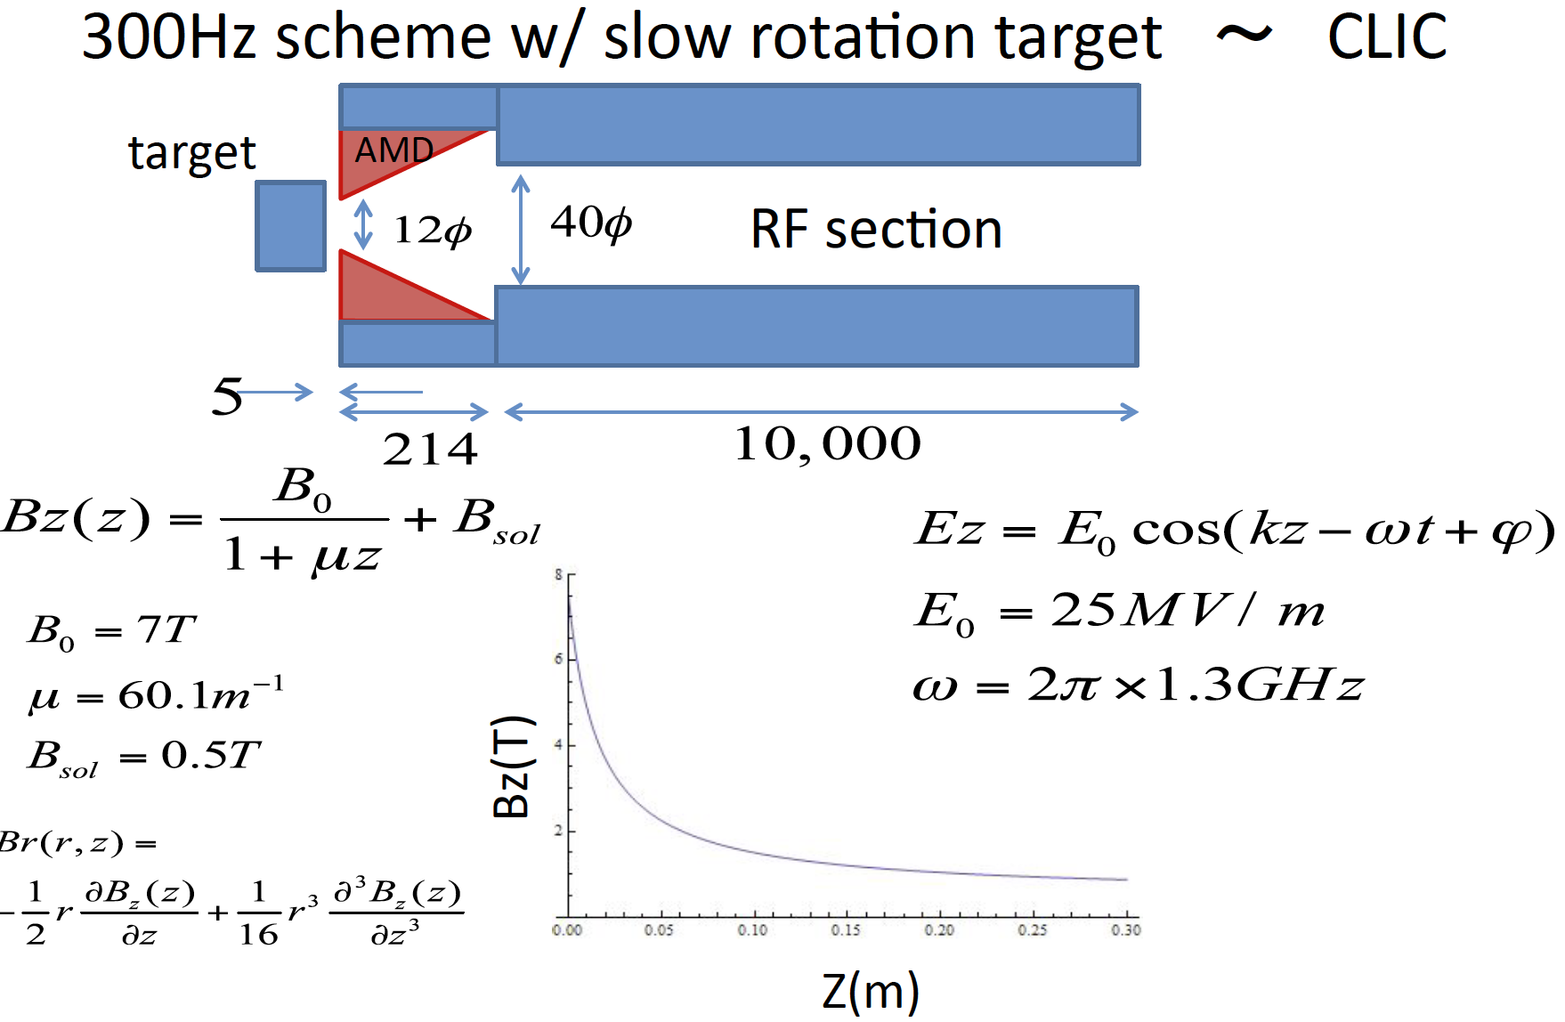
Parameters in capture section

Slide 14
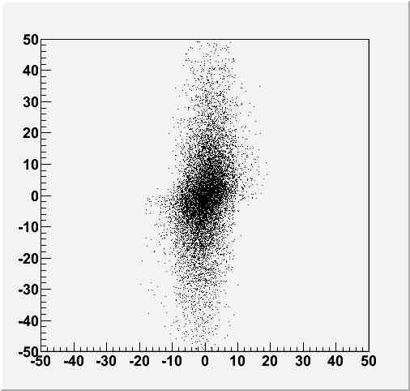
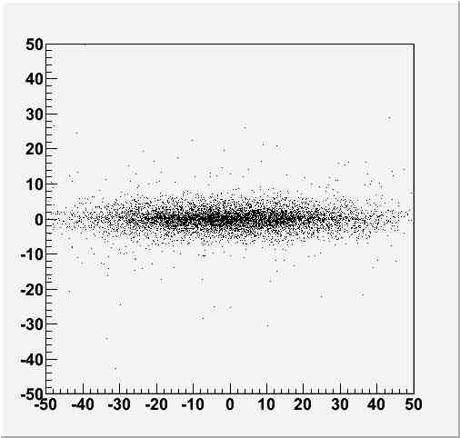
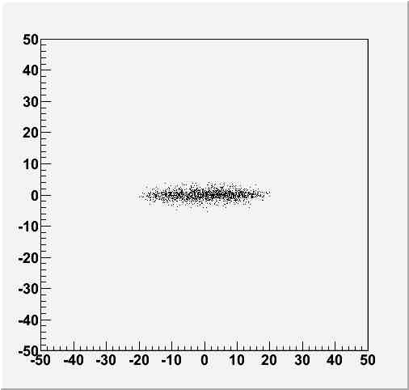
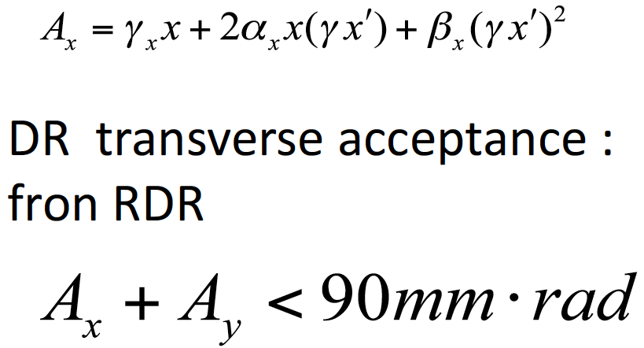
Simulation: Transeverse phase space
AMD Entrance
AMD exit
γx’
γx’
x(mm)
RF exit
γx’
x(mm)

Slide 15
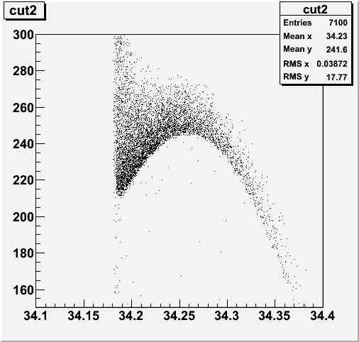

Longitudinal phase space
Pz(MeV)
Time (ns)

Slide 16
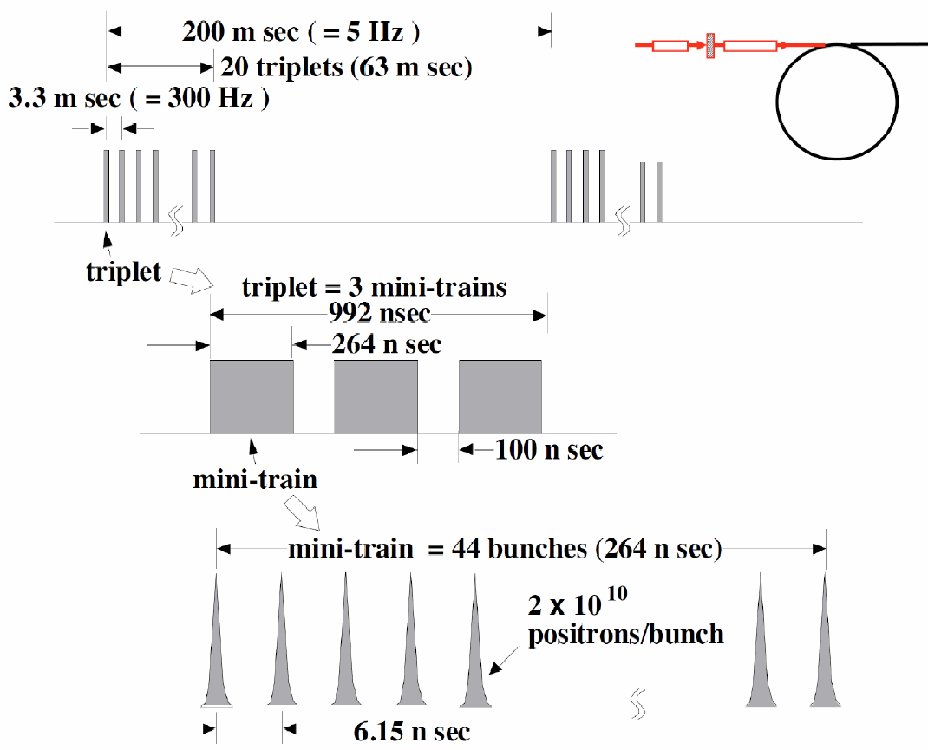
In the case of 300Hz scheme
spacing between triplets
=3.3ms
132bunches in 992ns
good for a FC
we can use existing FC technology

Slide 17
Assumptions
132 bunches
make a shock wave
heat same position on the target
drive electrons
2×10¹⁰/bunch
a triplet: 132 bunches 992ns
each triplet hits
different position on the target
3.3ms
a train: 20 triplet
= 2640 bunches 63ms
slow rotation target

Slide 18
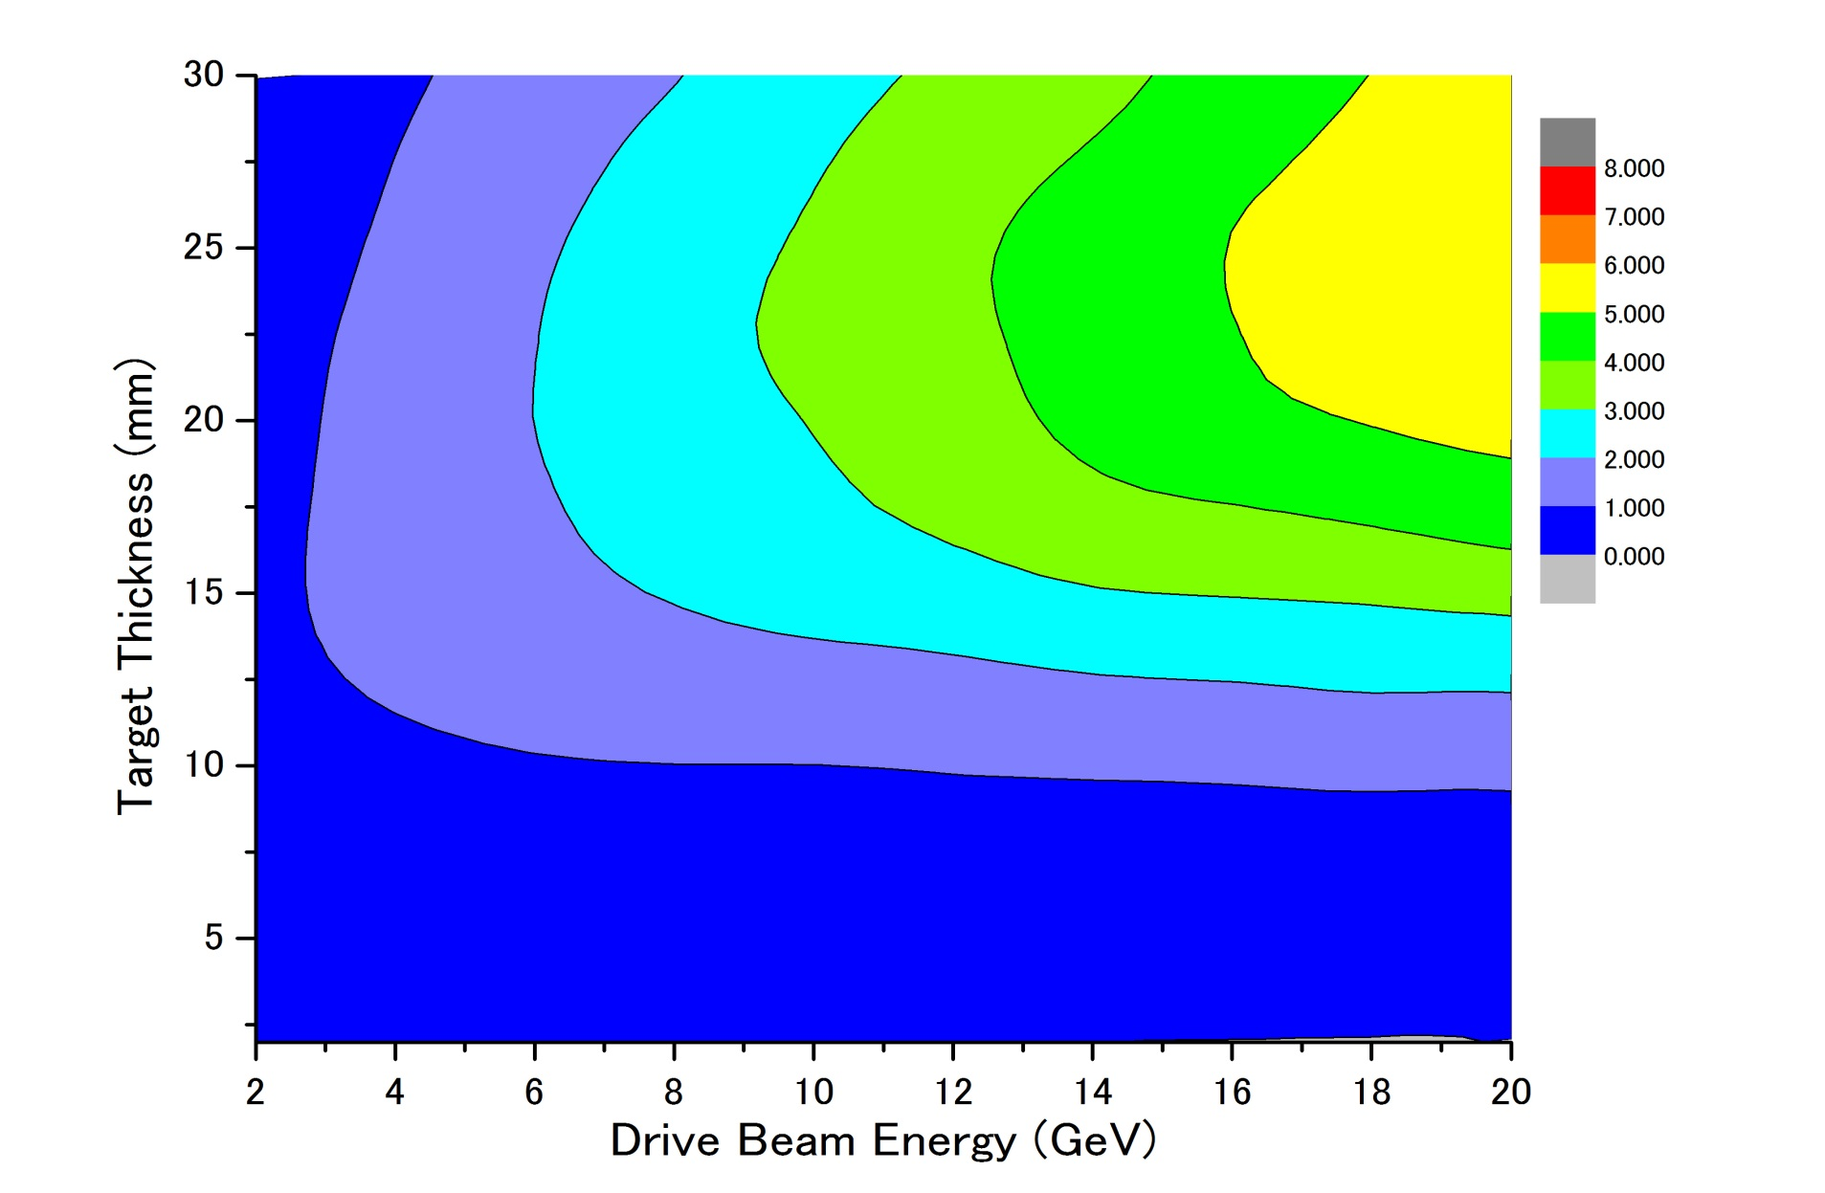
Parameter Plots for 300 Hz scheme
e- directly on to Tungsten
σ=4.0mm
colored band
accepted e+/e-
PEDD J/g
dT max by a triplet
Ne⁻(drive) = 2x10¹⁰ /bunch
１
２
３
４
5
35J/g
500k
100k

Slide 19
Parameter Plots for 300 Hz scheme
e- directly on to Tungsten
σ=4.0mm
colored band
accepted e+/e-
PEDD J/g
Ne⁻(drive) = 2x10¹⁰ /bunch
dT max by a triplet
１
２
３
４
５
35J/g
500k
there seems to be solutions
100k

Slide 20
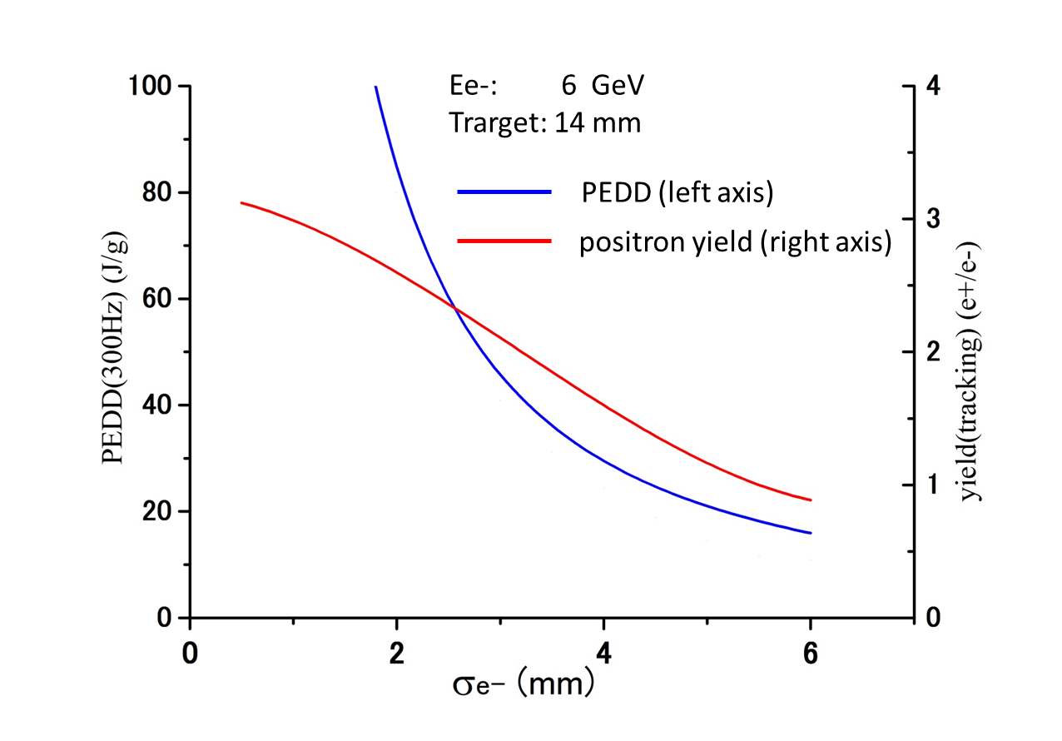
Dependence on Drive beam size
, Ne⁻/bunch = 2x10¹⁰
e+/e- =1.5
35J/g
σ of the Drive e- Beam (mm)

Slide 21
Numbers for a Reference Point
Parameters for target and captures |  | Parameters for 300Hz scheme
Drive beam energy | 6 GeV | # drive e- /bunch | 2×10¹⁰
Beam size | 4.0 mm (RMS) | # bunches/triplet | 132 (in 996ns)
Target material | Tungsten | # bunches/train | 2640 (in 63 ms)
Target thickness | 14 mm | repetition | 5 Hz
Max AMD field | 7 T | Results numbers in () are for 300Hz operation
Taper parameter | 60.1/mm | e+ yield | 1.6 /e-
AMD length | 214 mm | PEDD in the target | 1.04 GeV/cm³/e- (22.7 J/g)
Const. field | 0.5 T | E. deposit in the target | 823 MeV/e- (35kW)
Max. RF field | 25 MV/m | E. deposit in the AMD | 780 MeV/e- (33kW)
RF frequency | 1.3 GHz | E. deposit in the RF section | 470 MeV/e- (20kW)

Slide 22
Target Tangential Speed
SLC (actual achievement)：
0.1 m/s (Swinging/Troll target: Not really rotating)
ILC baseline (design: test is ongoing):
100 m/s
Truly Conventional (assumption)：
1 m/s
large spatial overlap between triplets --> But OK in temperature.
Design study on going.
shockwave : OK because triplet to triplet separation 3.3 ms in time.
Probably 0.5 m/s is OK.
.
.
.

Slide 23
Target Heat Simulation (Wanming)

Slide 24
Target Heat Simulation (Wanming)
assumption:
1 m/s

Slide 25
Conventional e+ Source for ILC
Normal Conducting Drive and Booster Linacs in 300 Hz operation
e+ creation
go to main linac
20 triplets, rep. = 300 Hz
• triplet = 3 mini-trains with gaps
• 44 bunches/mini-train, T_{b_to_b} = 6.15 n sec
2640 bunches/train, rep. = 5 Hz
• T_{b_to_b} = 369 n sec
Drive Linac
Several GeV
NC
300 Hz
Booster Linac
5 GeV
NC
300 Hz
DR
Target
T_{b_to_b} = 6.15 n sec
Amorphous Tungsten
Pendulum or Slow Rotation
2640 bunches
60 mini-trains
Truly Conventional
* We assume single solid target.
* NO Liquid Target or
NO Hybrid Target are assumed
Time remaining for damping = 137 m sec
Notes:
25

Slide 26
Higher Luminosity?
7.5 Hz main linac operation

Slide 27
Beam before DR
=132 bunches

Slide 28
Beam before DR
=132 bunches

Slide 29
5 Hz Operation
For 2640 bunches (High Power Option), which I showed so far.
200 ms
63 ms for
20 triplet
(2640 bunches)
137 ms for damping
For 1320 bunches (TDR baseline)
200 ms
30 ms for
10 triplet
(1320 bunches)
170 ms for damping

Slide 30
7.5 Hz Operation (x1.5 Lumi.)
For 2640 bunches (High Power Option)
133 ms
103 ms for damping
30 ms for
10 sextet
(2640 bunches = 10x6x44)
For 1320 bunches (TDR baseline)
133 ms
30 ms for
10 triplet
(1320 bunches)
103 ms for damping

Slide 31
7.5 Hz Operation (x1.5 Lumi.)
For 1320 bunch:
* We can adopt 7.5 Hz main-linac-rep.-rate for 300 Hz scheme.
* Average heat load on the target increase, but no major
difficulty.
For 2640 bunch:
* We can adopt 7.5 Hz main-linac-rep.-rate for 300 Hz scheme,
if we can employ sextet time structure in 300 Hz linec instead
of triplet.
* sextet : 44 bunches x 6 = 234 bunches , dulation ~ 2 usec.
* Need to increase pulse width of 300 Hz linac: 1 us -> 2us.
Need careful consideration.
* Instantaneous heat load on the target increase (x2).
Can be problem. Need careful consideration.

Slide 32
7.5 Hz Operation (x1.5 Lumi.)
For 1320 bunch: Possible
* We can adopt 7.5 Hz main-linac-operation for 300 Hz scheme.
* Average heat load on the target increase, but no major
difficulty.
For 2640 bunch: Need careful consideration.
* We can adopt 7.5 Hz main-linac-operation for 300 Hz scheme,
if we can employ sextet time structure in 300 Hz linec instead
of triplet.
* sextet : 44 bunches x 6 = 234 bunches , dulation ~ 2 usec.
* Need to increase pulse width of 300 Hz linac: 1 us -> 2us.
Need careful consideration.
* Instantaneous heat load on the target increase (x2).
Can be problem.
Need careful consideration on beam&target parameters.

Slide 33
Summary

Slide 34
Summary
Conventional e+ source can be a solution for
ILC, with 300Hz scheme and optimized
beam&target parameters.
to go forward
  Target R/D: motion, cooling, etc.
  shock wave tolerance ?
    better than GLC/NLC design.
    PEDD = 23 J/g ( < 35 J/g)
    But is it really OK
7.5 Hz main-linac operation for x1.5 luminosity.
  Possible for 1320 bunches (TDR baseline).
  Need careful consideration for 2640 bunches (High P).

Slide 35
backups

Slide 36
Comparison with
NLC/GLC

Slide 37
300 Hz scheme
• Stretching in time

Slide 38
300 Hz scheme
• Stretching in time
• The Same as Warm colliders
NLC 120 Hz
GLC 150 Hz
CLIC 50 Hz

Slide 39
300 Hz scheme
• Stretching in time
• The Same as the Warm colliders
NLC 120 Hz
GLC 150 Hz
CLIC 50 Hz
Employs 3-4 targets
Thermal Shockwave
• We try to employ single target.
Truly Conventional
Amorphous Tungsten
We assume
NO Liquid Target or
NO Hybrid Target
Just solid tungsten target is OK
with
Pendulum Motion or Slow Rotation.

Slide 40
300 Hz scheme
• Stretching in time
• The Same as the Warm colliders
NLC 120 Hz
GLC 150 Hz
CLIC 50 Hz
Employs 3-4 targets
Thermal Shockwave
• We try to employ single target.
Truly Conventional
Amorphous Tungsten
We assume
NO Liquid Target or
NO Hybrid Target
Just solid tungsten target is OK
with
Pendulum Motion or Slow Rotation.
Why just single solid target is
OK in ILC ?

Slide 41
What is the difference wrt GLC/NLC design
Old GLC/NLC design employed 3 targets.
Why single target can survive in ILC 300 Hz.

Slide 42
What is the difference wrt GLC/NLC design
Old GLC/NLC design employed 3 targets.
Why single target can survive in ILC 300 Hz.
Because, improved optimization in ILC 300 Hz.

Slide 43
300 Hz scheme
• Stretching in time
• The Same as the Warm colliders
NLC 120 Hz
GLC 150 Hz
CLIC 50 Hz
Employs 3-4 targets
Thermal Shockwave

Slide 44
300 Hz scheme
• Stretching in time
• The Same as the Warm colliders
NLC 120 Hz
GLC 150 Hz
CLIC 50 Hz
Employs 3-4 targets
Thermal Shockwave
• We try to employ single target.
Amorphous Tungsten

Slide 45
300 Hz scheme
• Stretching in time
• The Same as the Warm colliders
NLC 120 Hz
GLC 150 Hz
CLIC 50 Hz
Employs 3-4 targets
Thermal Shockwave
• We try to employ single target.
Truly Conventional
Amorphous Tungsten
We assume
NO Liquid Target or
NO Hybrid Target
Just solid tungsten target is OK
with
Pendulum Motion or Slow Rotation.

Slide 46
What is the difference wrt GLC/NLC design
Old GLC/NLC design employed 3 targets.
Why single target can survive in ILC 300 Hz.
ILC 300 Hz GLC(JLC) 3 targets NLC 3/4 targets
(for each) (for each)
Eb 6 GeV 10 GeV 6.2 GeV
Ne-/bunch 2x10¹⁰ 1x10¹⁰ 1.5x10¹⁰
N of bunches 132 (triplet) 64 (192/3) 63 (190/3)
t_target 14 mm 21 mm 14 mm
spot (σ) on target 4 mm 2.5 mm 1.6 mm
DR/preDR accpt ΔE<25 MeV ΔE<19.8 MeV ΔΕ<10MeV
ΔT< 115ps ΔT<? ΔΤ<30 ps
γA_{x}+γA_{y}=0.09 m γA_{x}&γA_{x}<0.03 m γA_{x}&γA_{x}<0.03 m
PEDD 23 J/g 35 J/g 35 J/g
e+/e- 1.5 1 1.8
Because, improved optimization in ILC 300 Hz.

Slide 47
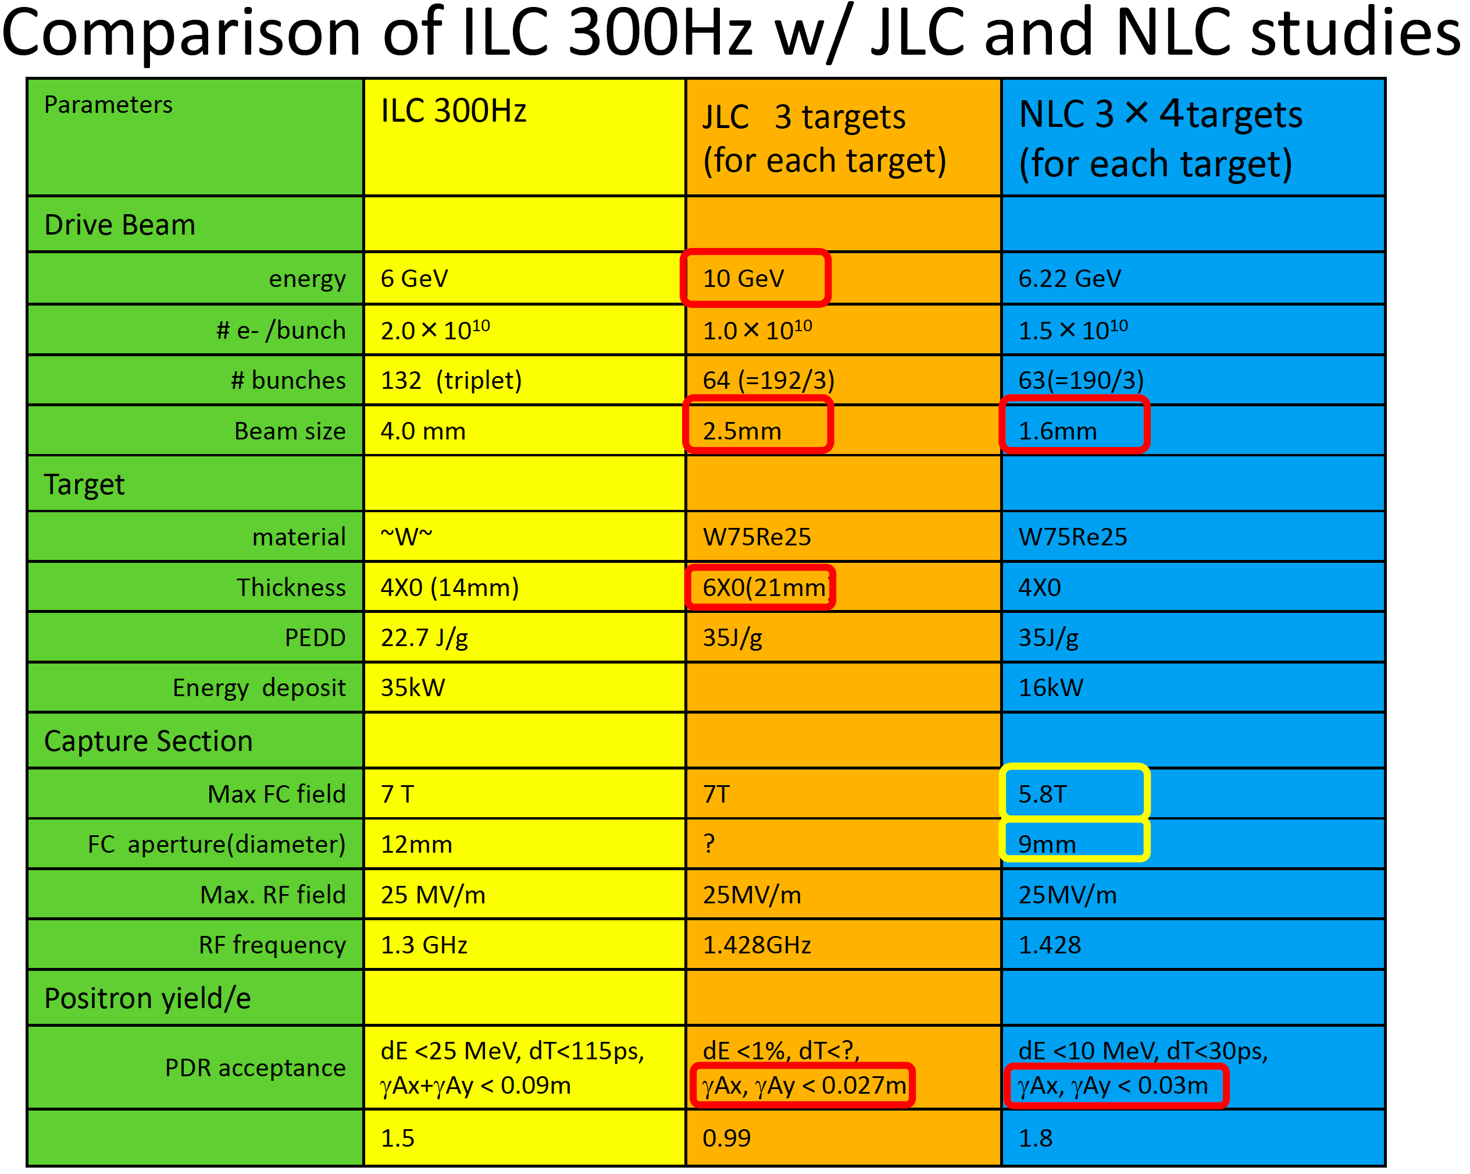
DR/
e+/e-

Slide 48
Target Issues
Two Issues
• Heat Load (by beam): Time Scale ~ 1 m sec.
• Thermal shock wave: Time scale ~ sub micro sec.
• Undulator Scheme (base line)
• In order to create e+s, it uses e- beam in the main linac.
• It creates 2600 bunches of e+s in 1 m sec.
• Heat load is a serious problem.
• It requires a challenging rotation target (100 m/s).
(spreads 2600 bunches in 100 mm length)
• 300 Hz Truly Conventional
• It creates 2600 bunches of e+s in 63 m sec. (stretching)
• Heat load is not a problem.
• Do we have a solution? Issue : shock wave

Slide 49
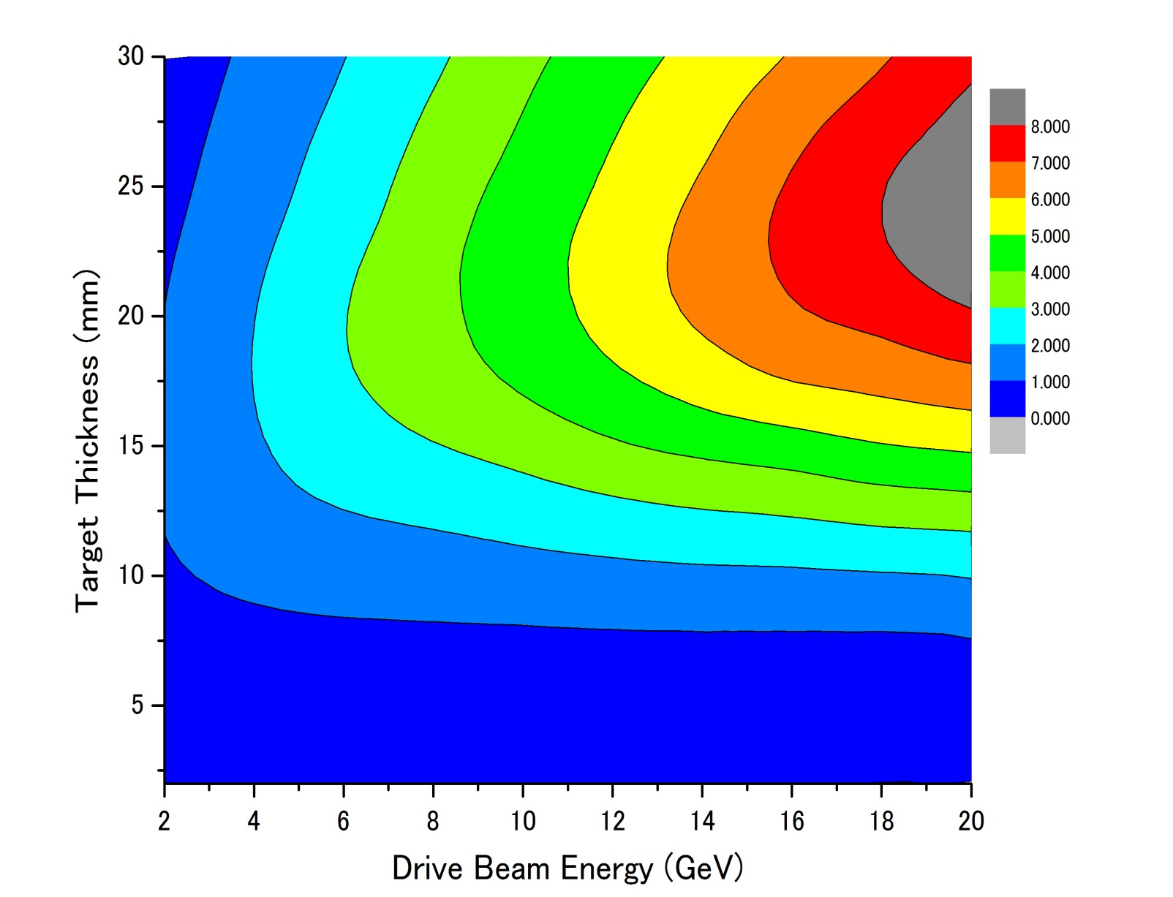
Parameter Plots for 300 Hz scheme
e- directly on to Tungsten
σ=2.5mm
colored band
accepted e+/e-
PEDD J/g
Ne⁻(drive) = 2x10¹⁰ /bunch
dT max by a triplet
１
２
３
４
５
６
７
８
1000k
35J/g
500k
100k

Slide 50
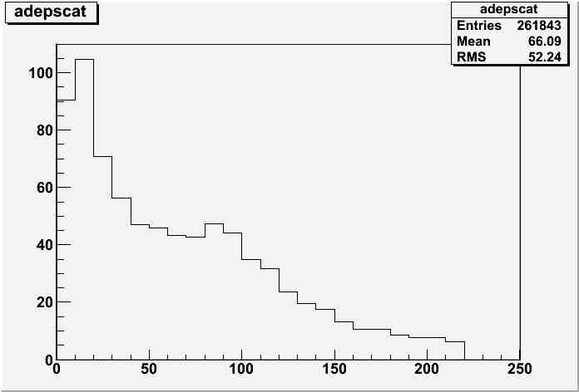
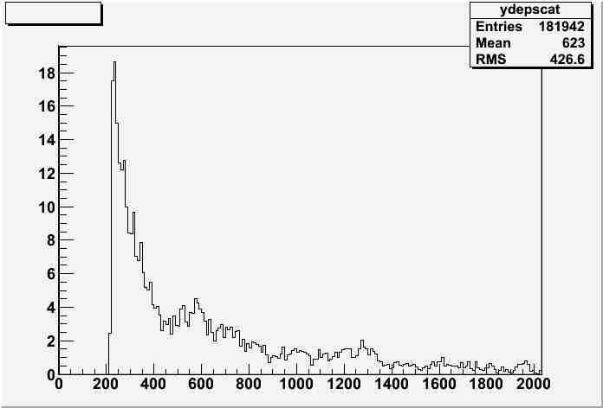
Energy deposit in capture section
MeV/10mm
MeV/10mm
Z(mm)
Z(mm)

Slide 51
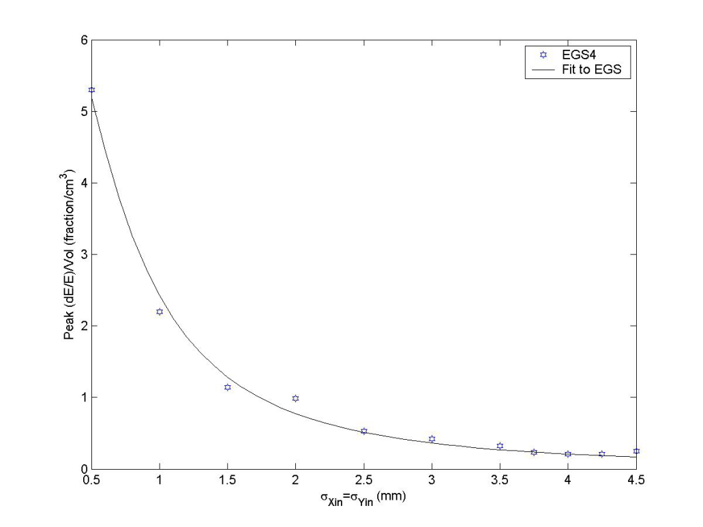
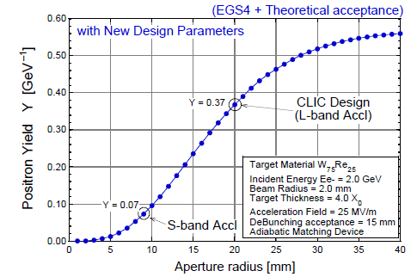
a few comments
numbers shown here are consistent w/
    independent calculation by a colleague in KEK and French colleague for Hybrid
comparison w/ SLC study
  both assumed AMD but acceptance for linac is;
    SLC S-band linac ←→ this study (CLIC) L –band
PEDD
John C. Sheppard
SLAC-TN-03-032
CLIC-note 465
consistent

Slide 52
Assumption
each triplet hits different position on the target
relatively low (1~2m/s)rotational target
duration of a triplet ~ dumping time of shock wave
shoter than time scale of thermal dissusion
132 bunches in a triplet contributes both shock wave and thermal damage

Slide 53
Target & Drive_Beam Optimization
Conventional e+ sources
thermal load,
shock wave
used to be
Well established
300Hz scheme
e+ gen. in 60ms rather than 1ms
targets
relax thermal
problem for
increase survivability w/
slow rotation targets
worth while
looking into
feasibility again
Capture section
larger aperture for RF section
larger acc. gradient

Slide 54
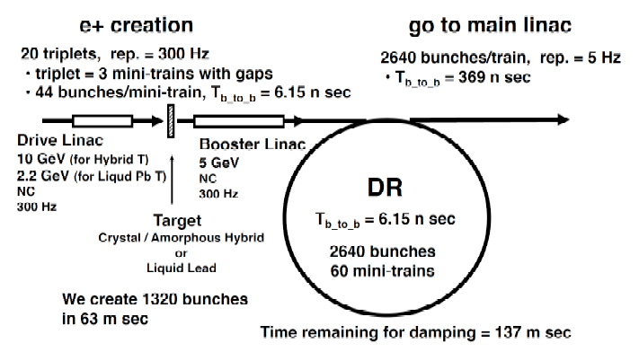
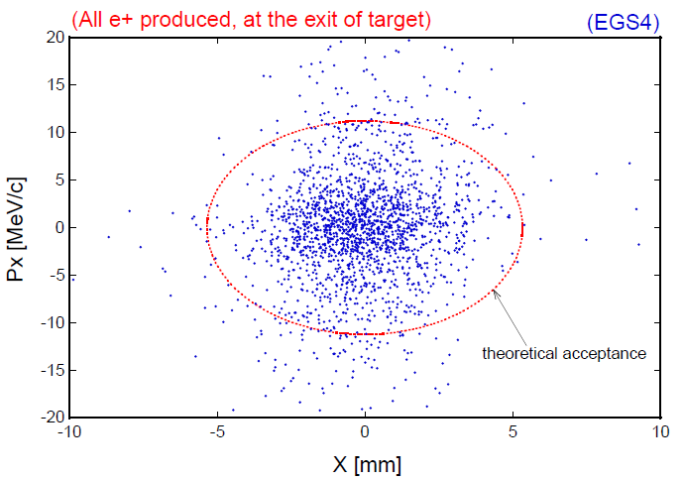
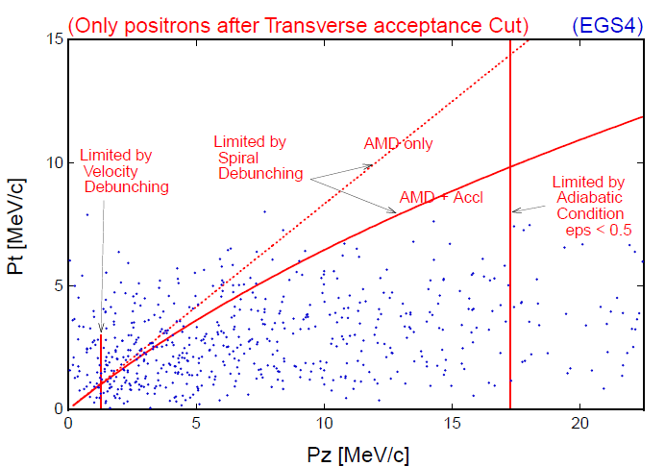
Acceptance estimate
CLIC note 465
[r/5.3[mm]]² + [pT[MeV]/11]² =＜1
pT < 0.1875 MeV/c + 0.625 pL
1.5 MeV/c < pL < 17.5 MeV/c
～# of e+ in DR (or booter linac)

Slide 55

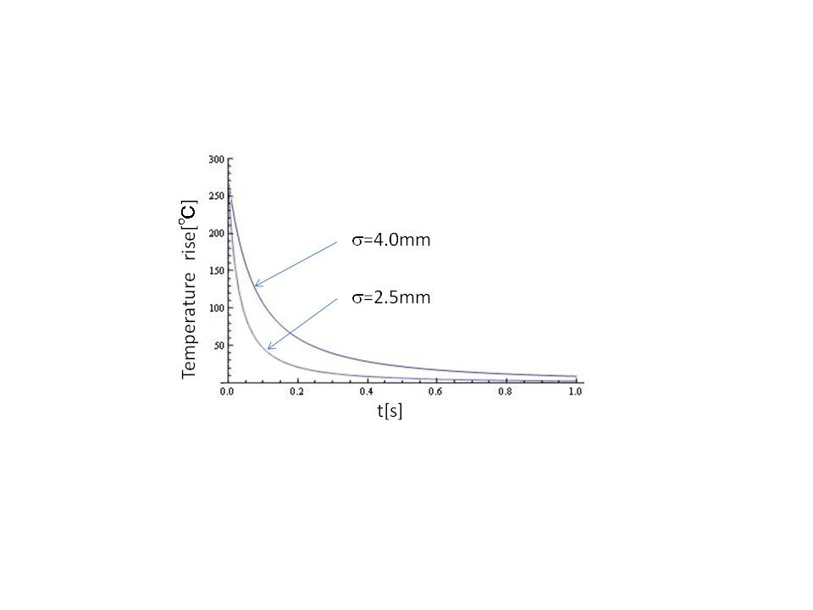
Thermal diffusion
time constant of the diffusion depends on beam spot size ~1/β
numerical calculation of
thermal diffusion shows
 |  | 1D | 2D | 3D
time constant | σ=2.5mm σ=4.0mm | 280ms 750ms | 80ms 200ms | 40ms 100ms
time constant is order of 100ms >> Ttriplet ~1μs

Slide 56
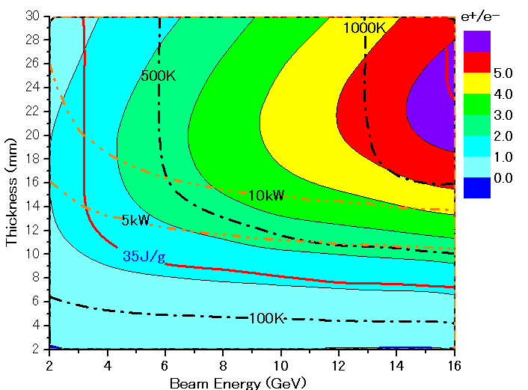
Parameter Plots for 300 Hz scheme w/ clic note formula
e- directly on to Tungsten
σ=2.5mm
colored band
accepted e+/e-
PEDD J/g
dT/triplet (132 bunc)
ToTal deposit kW

Slide 57
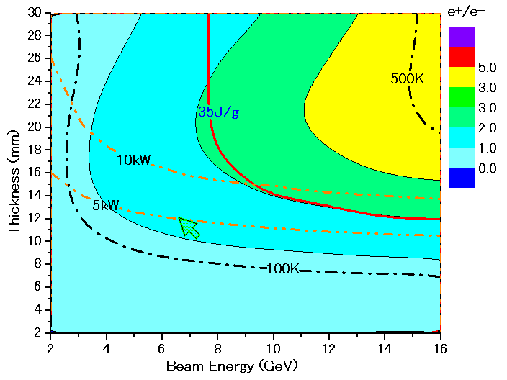
Parameter Plots for 300 Hz scheme w/ CLIC note formula
colored band
accepted e+/e-
e- directly on to Tungsten
σ=4.0mm
PEDD J/g
dT/triplet (132 bunc)
ToTal deposit kW

