Slide 1
ILC Technical Status Report
Akira Yamamoto
ILC-GDE/KEK
in cooperation with M. Ross and N. Walker
A plenary talk at ECFA-LC2013, DESY, May 27, 2013

Slide 2
Outline
Technical Status reached in TDR
  Design update from Reference Design Report (RDR’07) to Technical Design Report (TDR’12)
  Results from research & development
  Recommendations given by PAC
Further Plan beyond TDR
  Further work required for detailed engineering to prepare for realization of the ILC project,

Slide 3


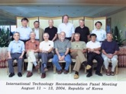
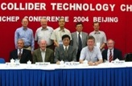
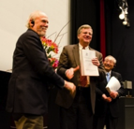
ILC Time Line
1980’ ~ Basic Study
2005
2006
2007
2008
2009
2010
2011
2012
2013
2004
ILC-GDE
LCC
Ref. Design (RDR)
TDR
Tech. Design：TDP1
TDP 2
LHC
Higgs particle
discovery
TDR completion
Selection of SC Technology
126 GeV

Slide 4


ILC R&D: Global Collaboration
TRIUMF, Canada
◉
STFC
IHEP, PKU, China
◉
Cornell
◉
DESY
◉
FNAL, ANL
◉
JLAB
◉
KEK, Japan
SLAC
◉
LAL
Saclay
◉
◉
◉
◉
INFN Milan
BARC, RRCAT,
I UAC India
◉
GDE/LCC
We would thank the global effort

Slide 5
Requirements from Physics Exp.
Basic requirements：
  Luminosity : ∫Ldt = 500 fb⁻¹ in 4 years
  E_{cm} : 200 – 500 GeV and the ability to scan
  E stability and precision: < 0.1%
  Electron polarization: > 80%
Extension capability：
  Energy upgrade: 500 → 1,000 GeV
5GeV e-, e+ Damping Ring (3.2km)
E+ production
Bunch compression
Bunch compression
e- ML
E+ ML
IP
E- production
Notes:
5

Slide 6
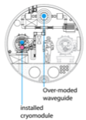
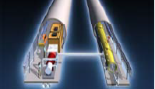
RDR (2007) to TDR (2012)
Cost Containing Effort
Single acc. Tunnel
Reducing # bunches
  w/ smaller damping rings
Allowing gradient spread
  31.5 MV/m +/- 20 %,
Site-dependent RF system:
  Clustered on surface (KCS),
  Distributed in tunnl (DKS)
RDR’07 →
(Reference Design Rep.)
TDR’12
(Technical Design Rep.)
5 m
Flat-land or Mountainous Tunnel Design

Slide 7
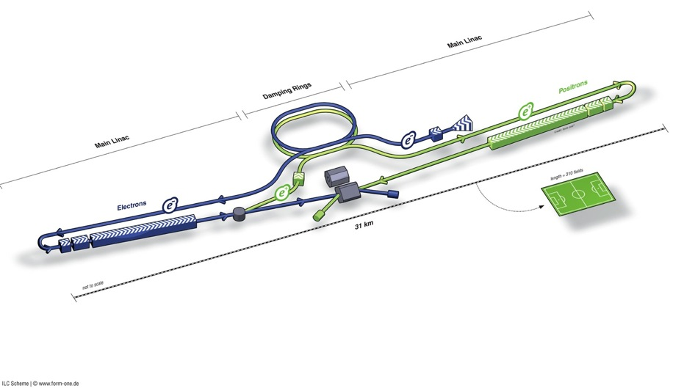
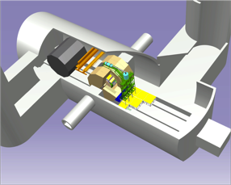
ILC TDR Layout
Damping Rings
Polarised electron source
Ring to Main Linac (RTML)
(including
bunch compressors)
e+ Main Linac
e- Main Linac
Parameters | Value
C.M. Energy | 500 GeV
Peak luminosity | 1.8 x10³⁴ cm⁻²s⁻¹
Beam Rep. rate | 5 Hz
Pulse duration | 0.73 ms
Average current | 5.8 mA (in pulse)
E gradient in SCRF acc. cavity | 31.5 MV/m +/-20% Q₀ = 1E10
E+ source

Slide 8
ILC Published Parameters
Luminosity Upgrade
Centre-of-mass independent:
Collision rate | Hz | 5
Number of bunches |  | 1312 | 2625
Bunch population | ×10¹⁰ | 2
Bunch separation | ns | 554 | 366
Pulse current | mA | 5.8 | 8.8
Beam pulse length | ms | 730 | 960
RMS bunch length | mm | 0.3
Horizontal emittance | mm | 10
Vertical emittance | nm | 35
Electron polarisation | % | 80
Positron polarisation | % | 30
http://ilc-edmsdirect.desy.de/ilc-edmsdirect/item.jsp?edmsid=D00000000925325

Slide 9
ILC-TDR: Baseline Parameters
Centre-of-mass dependent:
Focus of design (and cost!) effort
Centre-of-mass energy | GeV | 200 | 230 | 250 | 350 | 500
Electron RMS energy spread | % | 0.21 | 0.19 | 0.19 | 0.16 | 0.12
Positron RMS energy spread | % | 0.19 | 0.16 | 0.15 | 0.10 | 0.07
IP horizontal beta function | mm | 16 | 16 | 12 | 15 | 11
IP vertical beta function | mm | 0.48 | 0.48 | 0.48 | 0.48 | 0.48
IP RMS horizontal beam size | nm | 904 | 843 | 700 | 662 | 474
IP RMS veritcal beam size | nm | 9.3 | 8.6 | 8.3 | 7.0 | 5.9
Vertical disruption parameter |  | 20.4 | 20.4 | 23.5 | 21.1 | 24.6
Enhancement factor |  | 1.83 | 1.83 | 1.91 | 1.84 | 1.95
Geometric luminosity | ×10³⁴ cm⁻²s⁻¹ | 0.25 | 0.29 | 0.36 | 0.45 | 0.75
Luminosity | ×10³⁴ cm⁻²s⁻¹ | 0.50 | 0.59 | 0.75 | 0.93 | 1.8
% luminosity in top 1% DE/E |  | 92% | 90% | 84% | 79% | 63%
Average energy loss |  | 1% | 1% | 1% | 2% | 4%
Pairs / BX | ×10³ | 41 | 50 | 70 | 89 | 139
Total pair energy / BX | TeV | 24 | 34 | 51 | 108 | 344
http://ilc-edmsdirect.desy.de/ilc-edmsdirect/item.jsp?edmsid=D00000000925325

Slide 10
250 GeV staged (scenario 1)
15.4 km
1.1 km
5.1 km
1.3 km
2.2 km
Main Linac
BDS
e+ src
IP
bunch comp.
central region
Half the linac
Full-length BDS tunnel & vacuum (TeV)
½ BDS magnets (instrumentation, CF etc)
½ RTML LTL
Extended tunnel/CFS already 500 GeV stage
10Hz mode e- linac

Slide 11
250 GeV staged (scenario 2)
15.4 km
1.1 km
5.1 km
1.3 km
2.2 km
Main Linac
BDS
e+ src
IP
bunch comp.
125 GeV transport
central region
Half the linac
Full-length BDS tunnel & vacuum (TeV)
½ BDS magnets (instrumentation, CF etc)
1 RTML LTL
5km 125 GeV transport line
Extended tunnel/CFS already 500 GeV stage
10Hz mode e- linac
quasi-adiabatic energy upgrade?

Slide 12
TDR 500 GeV Baseline
15.4 km
(site length ~31 km)
1.1 km
10.8 km
1.3 km
2.2 km
Main Linac
BDS
e+ src
IP
bunch comp.
Main Linac
<G_{cavity}> = 31.5 MV/m
G_{eff} ≈ 22.7 MV/m
(fill fact. = 0.72)
central region
Cost: 100%
P_{AC}: 161 MW

Slide 13
Major R&D Efforts in TD Phase
SCRF technology and beam acceleration：
  Cavity Gradient required：31.5 MV/m
    ILC SCRF cavity R&D
      Effort for ~ 7 x Gradient (KEK-TRISTAN, CERN-LEP)
      Gradient Progress ： < 37 MV/m> （Record：46 MV/m at DESY)
      System engineering： S1-Global program with global effort
Electron Cloud Mitigation
Nano-beam handling :
  ILC requiring a beam size ~ 6 nm (vertical) and stability ~2nm:
    Progress in KEK-ATF:
      achieving ~70 nm (at 1.3 GeV),
      corresponding to 10 nm (at 250 GeV, ILC)

Slide 14
Global Plan for SCRF R&D
Year | 07 | 2008 |  | 2009 |  | 2010 |  | 2011 | 2012
Phase | TDP-1 |  |  |  |  |  | TDP-2
Cavity Gradient in v. test to reach 35 MV/m | → Yield 50% |  |  |  |  |  | → Yield 90%
Cavity-string to reach 31.5 MV/m, with one-cryomodule |  | Global effort for string assembly and test (DESY, FNAL, INFN, KEK)
System Test with beam acceleration |  |  | FLASH (DESY) , NML/ASTA (FNAL) QB, STF2 (KEK)
Preparation for Industrialization |  |  |  |  | Production Technology R&D
Communication with industry: | 1st Visit Vendors (2009), Organize Workshop (2010) 2nd visit and communication, Organize 2nd workshop (2011) 3rd communication and study contracted with selected vendors (2011-2012)

Slide 15
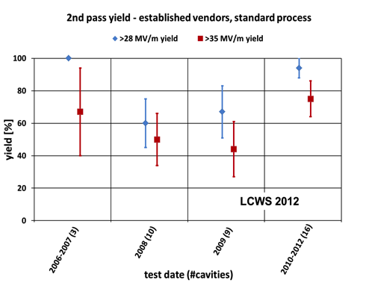
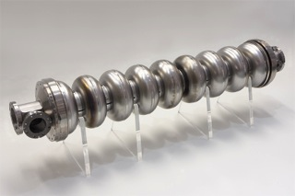
Progress in SCRF Cavity Gradient
Production yield:
94 % at > 28 MV/m,
Average gradient:
37.1 MV/m
reached (2012)

Slide 16
Progress in 1.3 GHz ILC Cavity Production
year | # 9-cell cavities qualified | Capable Lab. | Capable Industry
2006 | 10 | 1 DESY | 2 ACCEL, ZANON
2011 | 41 | 4 DESY, JLAB, FNAL, KEK | 4 RI, ZANON, AES, MHI,
2012 | (45) | 5 DESY, JLAB, FNAL, KEK, Cornell | 5 RI, ZANON, AES, MHI, Hitachi
Progress in EXFEL (800 cavity construction as of 2012/10):
(courtesy by D. Reschke: the 2nd EP at DESY)
  RI: 4 reference cavities with Eacc > 28 MV/m, (~ 39 MV/m max.)
  Zanon: 3 reference cavities with Eacc > 30 MV/m ( ~ 35 MV/m max.)

Slide 17
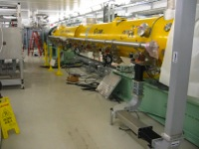
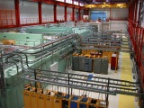
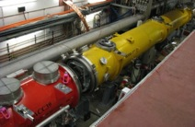
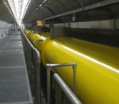
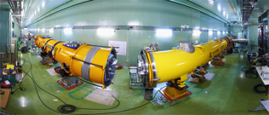
Accelerator System Tests
2009 ~
To be discussed by N. Walker, this aftenoon
Full systems integration testing
FLASH (DESY)
NML (FNAL)
STF (KEK)
TDP focus
Under construction
Up to 6 cryomodules
Operation: end 2012
“Quantum Beam” experiment 2011
1 CM with beam 2013
7 CM → 1.2 GeV beam
photon user facility
(2 CM 2015)
(3 CM)

Slide 18
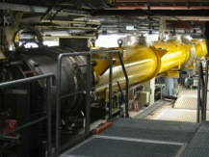
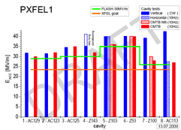
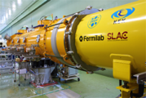
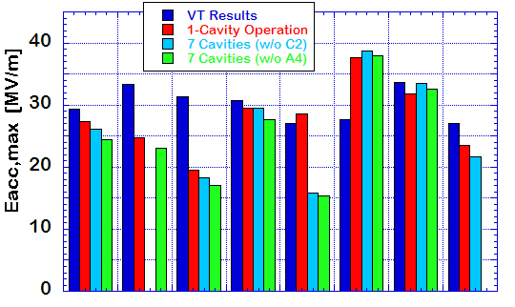

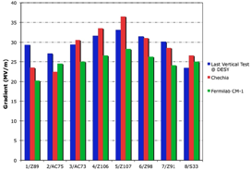
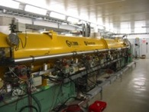
SCRF Beam Acceleration Test
DESY: FLASH
SRF-CM string + Beam,
  ACC7/PXFEL1 < 32 MV/m >
9 mA beam, 2009
800μs, 4.5mA beam, 2012
KEK: STF
S1-Global: complete, 2010
  Cavity string : < 26 MV/m>
Quantum Beam : 6.7 mA, 1 ms,
CM1 & beam, 2014 ~2015
FNAL: NML/ASTA
CM1 test complete
CM2 operation, in 2013
CM2 + Beam, 2013 ~ 2014

Slide 19
GDE 9mA experiment: Focus on ACC6 and ACC7
N. Walker
Operation with Gradient Spread
  From single RF source
  now ILC baseline
    Also expected for XFEL
Specifically: achieving constant gradients for each individual cavity during beam pulse
  to within few percent
  close to gradient limits
40.0
ACC6
ACC7
35.0
31.5 MV/m
30.0
25.0
20.0
15.0

Slide 20
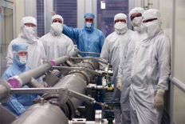
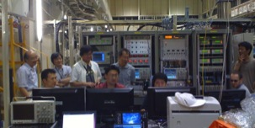
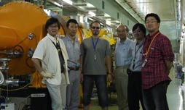
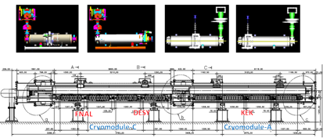
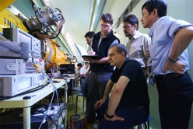
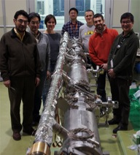
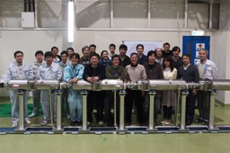
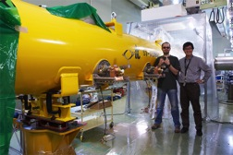
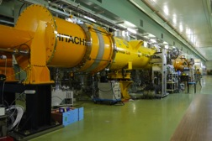
S1-Global hosted at KEK:
Global cooperation to demonstrate SCRF system
DESY, FNAL, Jan., 2010
DESY, Sept. 2010
Successful global cooperation hosted by KEK
with variety of cavity design
FNAL & INFN, July, 2010
INFN
and
FNAL
Feb.
2010
March, 2010
DESY, May, 2010
June, 2010 ~

Slide 21
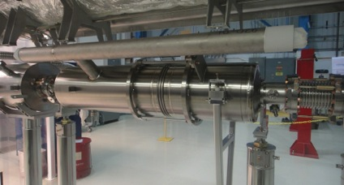
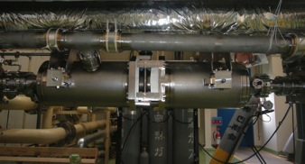
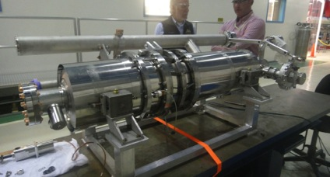
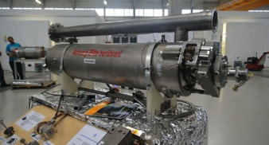
Variety of Cavity and Tuner Assembly
Slide-jack tuner at KEK
EXFEL tuner
Blade Tuner (originated by INFN)
An important conclusion:
These designs may meet the ILC functioning requirements.

Slide 22
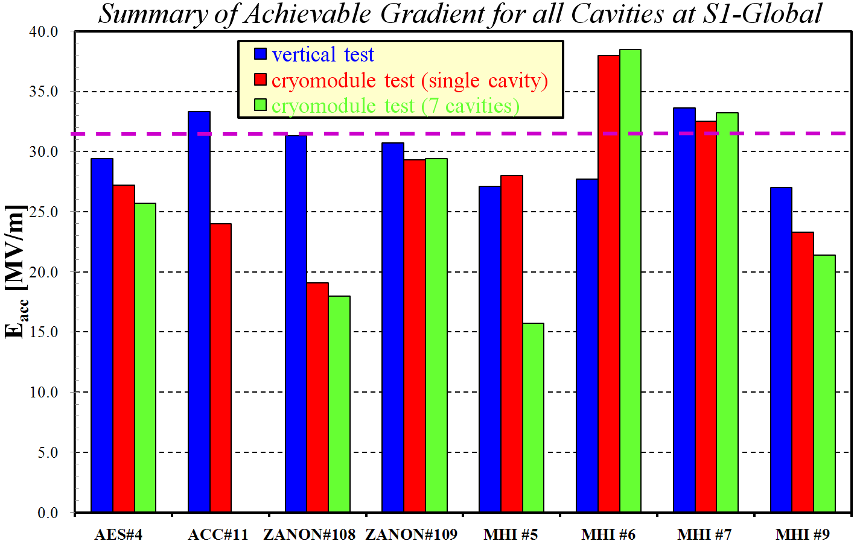
E. Kako, H. Hayano
S1G-Cavities Gradient Performance
31.5 MV/m
C1
C2
C3
C4
A1
A2
A3
A4
Before cryomodule installation
Average 30.0MV/m
after cryomodule installation
Average 27.7MV/m
7 cavities combined operation
Average 26.0MV/m

Slide 23
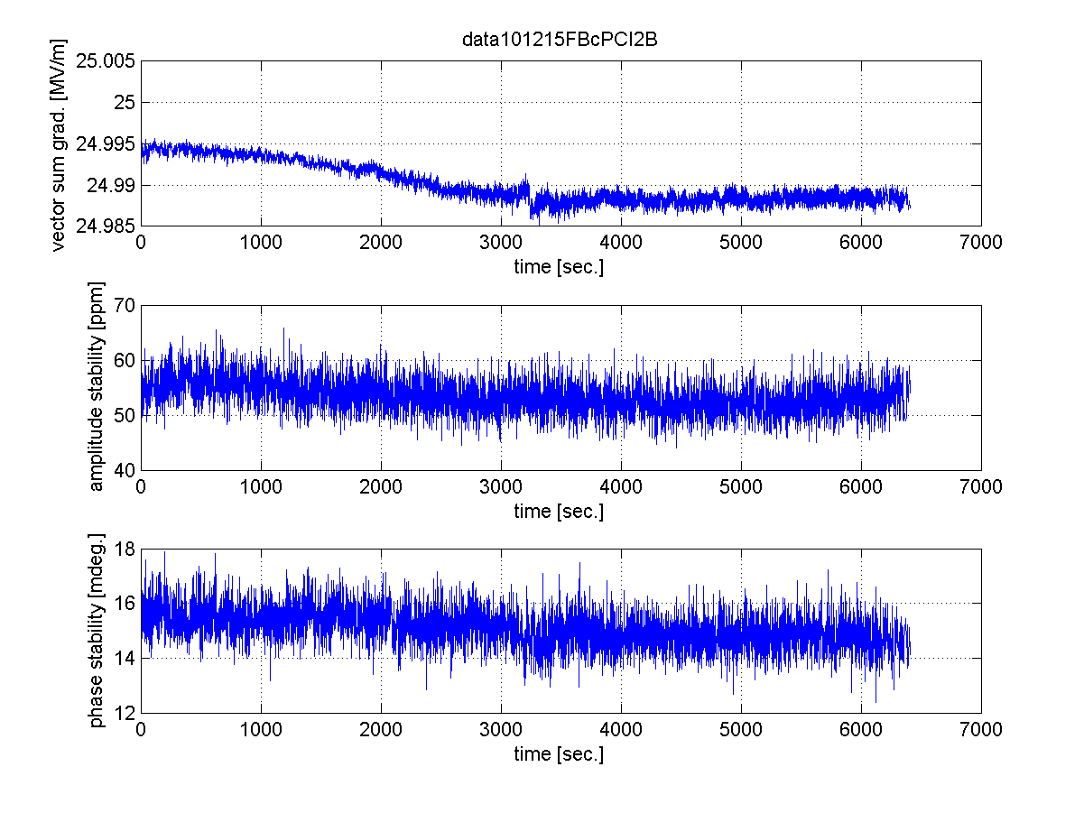
7-cavity operation by digital LLRF
LLRF stability study with 7 cavities operation at 25MV/m
Field Waveform of each cavity
Stability in 6300 sec.
vector-sum gradient
amplitude stability in pulse flat-top
phase stability in pulse flat-top
- Vector-sum stability: 24.995MV/m ~ 24.988MV/m (~0.03%)
- Amplitude stability in pulse flat-top: < 60ppm=0.006%rms
- Phase stability in pulse flat-top: < 0.0017 degree.rms

Slide 24
7-cavity operation by digital LLRF
LLRF stability study with 7 cavities operation at 25MV/m
Field Waveform of each cavity
Stability in 6300 sec.
vector-sum gradient
amplitude stability in pulse flat-top
An important conclusion:
All designs may meet the ILC functioning requirements.
phase stability in pulse flat-top
- Vector-sum stability: 24.995MV/m ~ 24.988MV/m (~0.03%)
- Amplitude stability in pulse flat-top: < 60ppm=0.006%rms
- Phase stability in pulse flat-top: < 0.0017 degree.rms

Slide 25
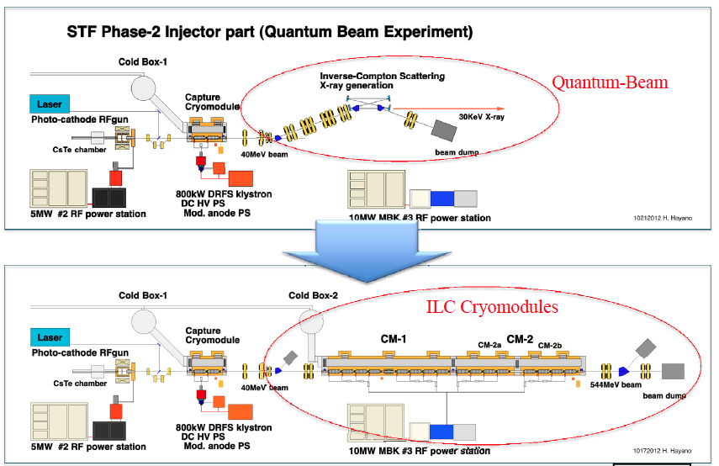
STF：Quantum Beam → ILC full-cryomodule Test

Slide 26
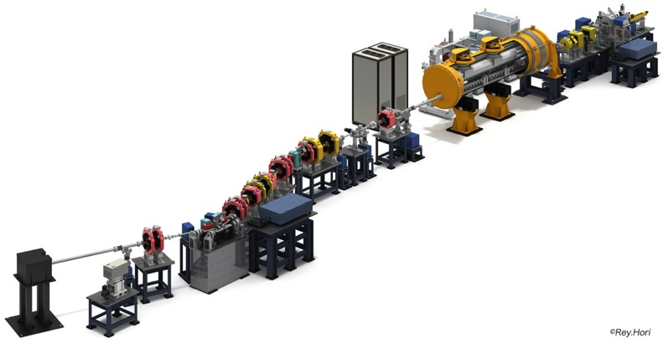
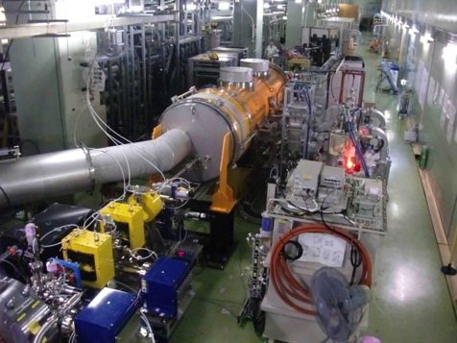
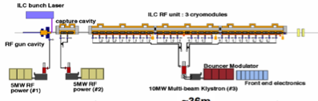
ILC beam condition demonstrated at QB
Quantum-Beam Accelerator
Starting as starting of KEK-STF-2
Beam acceleration (40 MV) and transport for 6.7 mA, 1 ms, succeeded in 2012
High-flux X-ray by Inverse-Comton scattering
10mA electron beam （40MeV, １ｍｓ, ５Ｈｚ）
4-mirror laser resonator cavity
head-on collision with beam
photocathode RFgun
Capture cryomodule ( 2 SC cavities )
collision point
(Laser, electron beam)

Slide 27
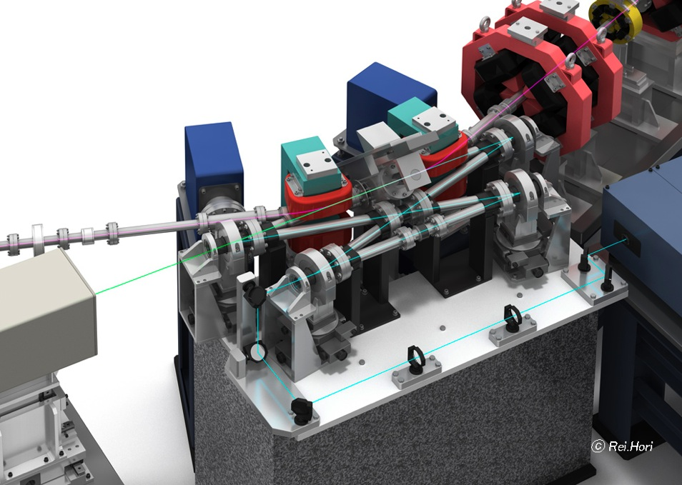
Quantum Beam Program:
Demonstrating
Compact X-ray source with
Inverse Compton Scattering
Using SCRF technology
e⁻
IP
laser
← Beam Dump
← X-ray
laser

Slide 28
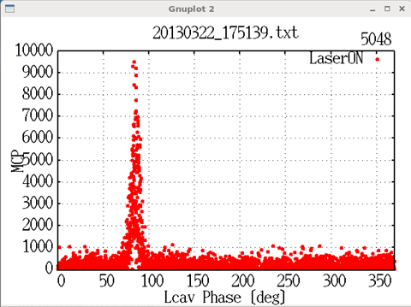
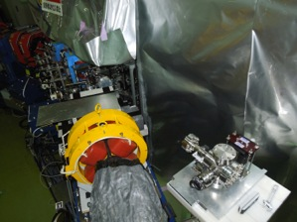
X-ray observed (w/ MCP, 22nd Mar.2013)
ADC-ch
Event Number
Laser Intensity Cut ≧ 2.5kW
Electron and Laser Collision confirmed
with observing an evidence using MCP ：
X-ray emitted by Inverse Comption scattering

Slide 29
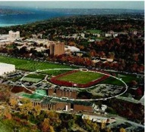
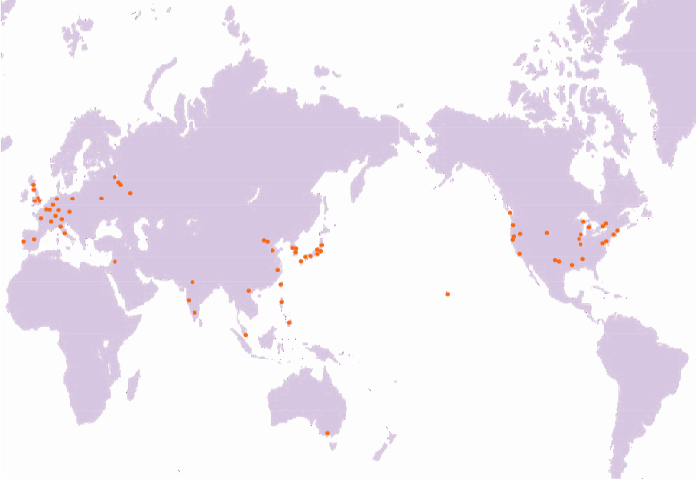
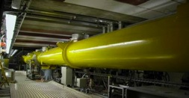
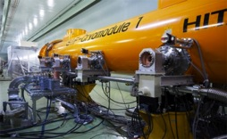
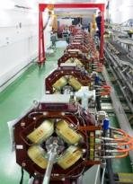
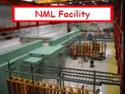
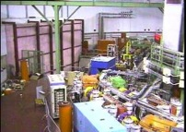
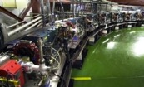
Global Cooperation for ILC Accelerator Beam Demonstration
TTF/FLASH (DESY) ~1 GeV
ILC-like beam ILC RF unit
(* lower gradient)
STF (KEK) operation/construction
ILC Cryomodule test： S1-Gloabal
Quantum Beam experiment
CesrTA (Cornell)
electron cloud
low emittance
DESY
◉
◉
INFN Frascati
KEK, Japan
FNAL
◉
◉
Cornell
◉
ATF & ATF2 (KEK)
ultra-low emittance
Final Focus optics
KEKB electron-cloud
NML facility ILC RF unit test
Under construction
DA^{f}NE (INFN Frascati)
kicker development
electron cloud

Slide 30


KEK-ATF Effort:
Ultra low emittance and nano-beam handling at final focusing
Laser Wire
ATF2 (2007~ )
37nm at final focusing, and
Stability
Ultra low-emittance beam
S band Linac
Photocathode RF gun
50m

Slide 31




KEK-ATF：Progress
Ultra-small beam
Low emittance : KEK-ATF
  Achieved the ILC goal (2004).
Small vertical beam size : KEK ATF2
  Goal = 37 nm,
    160 nm (spring?, 2012)
    ~70 nm (Dec. 2012) at low beam current

Slide 32



Technical Design Report Completed
2007
2011
2013*
TDR Part I:
R&D
~250 pages
Deliverable 2
ILC Technical Progress Report
(“interim report”)
AD&I
TDR Part II:
Baseline
Reference
Report
~300 pages
Deliverables 1,3 and 4
Technical Design Report
Reference Design Report
* end of 2012 – formal publication early 2013

Slide 33

ILC Road Map
Preparation Period
Construction

Slide 34
Outline
Technical Status reached in TDR
  Design update from Reference Design Report (RDR’07) to Technical Design Report (TDR’12)
  Results from research & development
  Recommendations given by PAC
Further Plan beyond TDR
  Further work required for detailed engineering to prepare for realization of the ILC project,

Slide 35

Report given by PAC

Slide 36

PAC Summary and Recommendations (1/3)

Slide 37

PAC Summary and Recommendations (2/3)

Slide 38

PAC Summary and Recommendations (3/3)

Slide 39
Further R&D/Engineering Study required
Positron source: Rotating target, alternate solution/backup
Damping ring: Undulators, 650 MHz SCRF
RTML: Quadrupole magnet with HTS?
ML: Cavity integration, CM design, HLRF demonstration…
BDS: Final focusing, alignment w/ tighter tolerance
Beam Dynamics: Accurate lattice design based on the specific site
CFS: Site specific work including Central Campus design and others
General engineering: such as drawing coordination (rules)

Slide 40
Positron Source
Current design: Rotating target w/ vacuum sealing,
    LLNL target and capture R&D: need to restart
Alternative options, or conventional design as back-up?,
    Any valuable candidates?
Short-period undulator,
    RHUL and/or ANL could do it?

Slide 41
Main Linac
Cavity gradient
    Surface process: Vertical EP w/ He-tank, and further optimization
    Cavity material (RRR, grain-size), shape,
    Diagnostics and repair technology
Cavity integration
    Coupler, tuner, and He-tank to be revisited for further efficient and cost-effective production/industrialization
Cryomodule assembly
    Mitigation of gradient degradation during the CM assembly process
    Further engineering work for the best optimum CM design
    Pre-Assembly of power distribution wave-guide) w/ CM, on surface
Cryogenics
    Demonstration of cooling performance with tilted CM installation to adapt possible tunnel slop (~0.5 %)
    Operation temperature down to 1.9 K (instead of 2.0 K)
HLRF/LLRF
    More statics for the Marx generator operation loaded by Klystron

Slide 42








Cavities, Tuners, Couplers in S1-G Cryomodule
TESLA Cavity (DESY/FNAL)
Tesla-like Cavity (KEK)
Slide-Jack Tuner (KEK)
Blade Tuner (INFN/FNAL)
Saclay Tuner
(DESY)
TTF-III Coupler
(DESY/FNAL/SLAC)
STF-II Coupler (KEK)

Slide 43
BDS and Beam Dynamics
BDS
    Final focusing with superconducting quadrupoles
    Tighter tolerance to achieve nominal luminosity with reduced beam-power
Beam Dynamics
    Re-evaluation of the beam dynamics with matching of the damping ring circumference and main linac length.
    Re-evaluation of acceptable tolerances

Slide 44
CFS and General Engineering
Site specific CFS works after the site selection established
    Access/approach to tunnel and transportation
    Tunnel slope to be optimized in relation with cryogenics and water handling
General Engineering
    Such as drawing coordination rules
      It was once fixed to writer electron ML at left and positron ML right
        In this way, CM lower/right and RFs upper/left in case of CAMABOKO tunnel in mountain site.

Slide 45







Geological Survey and
Common-Subject Study, going on, in japan
KEK
Tohoku U. G. Survey
Nomura Research Common Subject: Central Campus
Kyushu U. G. Survey.
Kitakami
Sefuri
-150m
Reports to be available in July, 2013
-300m

Slide 46
Study of a Common Subject: the ILC Central-Campus Design
Functions?:
  As the headquarters and a hub-laboratory
Location?:
  with adequate distance to the ILC facility and to public-city/living area
How many Persons to work/live ?:
  as employees, sub-contractors, scientific/technical user, families, and others,
  to dynamically change according to the project stages,
Which kind of facilities and buildings ?:
  For facilities/building, and area/environment design

Slide 47
Functions
Headquaters’ function:
  Center for Research and Administration including international cooperation
  Offices for employees and visitors/users
  Rooms for Conferences/seminars/lectures
Hub-laboratory’s function:
  Technical laboratories
    SCRF assembly and test stations, as an example
      (Detector main assembly may be located near ILC main-site)
Residence function
  For visitors in some fraction

Slide 48


Relative Location ?
ILC Facilities
Daily life Zone
30-60 min.
Research Bases
Central Campus
Residence area
Living and City area
Existing City Area
A concept: Relative distance from main campus, for moving time: ≤ ~ 30 min.

Slide 49
An Assumption for Numbers of Persons at ILC (whole) Laboratory
(more than the number in TDR)
 | Under construction Peak (8Th year.) | Operation start (11Th year.) | In operation (15Th year.) | In operation (20Th year.)
Laboratory Staffs #1 | 1,600 | 1,200 | 1,200 | 1,200
Experiment participants #2 | 500 | 700 | 800 | 1,000
Laboratory Supporters #3 | 300 | 300 | 400 | 500
Total | 2,400 | 2,200 | 2,400 | 2,700
#1: including the regular/permanent staff and temporary staff (Post-Doc),
#2: including researchers, engineers and students for two experiments,
#3: including subcontracted specialist to support acc. & exp. activities

Slide 50
Estimate Breakdown of the Numbers of Persons
 |  | Construction period |  |  |  |  |  |  |  |  |  | Operational Period
 | Annual | 1 | 2 | 3 | 4 | 5 | 6 | 7 | 8 | 9 | 10 | 11 | 12 | 13 | 14 | 15 | 16 | 17 | 18 | 19 | 20
 | Fiscal year | 2015 | 2016 | 2017 | 2018 | 2019 | 2020 | 2021 | 2022 | 2023 | 2024 | 2025 | 2026 | 2027 | 2028 | 2029 | 2030 | 2031 | 2032 | 2033 | 2034
■ Researcher, Engineer, Office worker Subtotal |  | 500 | 600 | 800 | 1,203 | 1,605 | 2,049 | 2,267 | 2,388 | 2,282 | 2,362 | 2,200 | 2,251 | 2,303 | 2,358 | 2,415 | 2,476 | 2,540 | 2,606 | 2,677 | 2,751
 | (1) ILC Laboratory staff (parmanent+temporary) | 500 | 600 | 800 | 1,000 | 1,200 | 1,400 | 1,600 | 1,600 | 1,400 | 1,400 | 1,200 | 1,200 | 1,200 | 1,200 | 1,200 | 1,200 | 1,200 | 1,200 | 1,200 | 1,200
 | ①Permanent staff | 400 | 500 | 600 | 700 | 800 | 900 | 1,000 | 1,000 | 1,000 | 1,000 | 1,000 | 1,000 | 1,000 | 1,000 | 1,000 | 1,000 | 1,000 | 1,000 | 1,000 | 1,000
 | -Research staff | 200 | 250 | 300 | 350 | 400 | 450 | 500 | 500 | 500 | 500 | 500 | 500 | 500 | 500 | 500 | 500 | 500 | 500 | 500 | 500
 | -Technical staff | 140 | 175 | 210 | 245 | 280 | 315 | 350 | 350 | 350 | 350 | 350 | 350 | 350 | 350 | 350 | 350 | 350 | 350 | 350 | 350
 | -Management staff | 60 | 75 | 90 | 105 | 120 | 135 | 150 | 150 | 150 | 150 | 150 | 150 | 150 | 150 | 150 | 150 | 150 | 150 | 150 | 150
 | ②Temporary staff (postdoctoral) | 100 | 100 | 200 | 300 | 400 | 500 | 600 | 600 | 400 | 400 | 200 | 200 | 200 | 200 | 200 | 200 | 200 | 200 | 200 | 200
 | (2) Experiment participant Subtotal |  |  |  | 203 | 405 | 649 | 667 | 788 | 882 | 962 | 1,000 | 1,051 | 1,103 | 1,158 | 1,215 | 1,276 | 1,340 | 1,406 | 1,477 | 1,551
 | ①Reseacher |  |  |  | 91 | 182 | 292 | 300 | 354 | 397 | 433 | 450 | 473 | 496 | 521 | 547 | 574 | 603 | 633 | 665 | 698
 | ②Student (graduaite student) |  |  |  | 71 | 142 | 227 | 234 | 276 | 309 | 337 | 350 | 368 | 386 | 405 | 425 | 447 | 469 | 492 | 517 | 543
 | ③Experiment supporter |  |  |  | 41 | 81 | 130 | 133 | 158 | 176 | 192 | 200 | 210 | 221 | 232 | 243 | 255 | 268 | 281 | 295 | 310
■ Construction, Maintenance worker Subtotal |  | 2,730 | 3,835 | 3,180 | 3,240 | 2,630 | 2,550 | 2,610 | 2,610 | 2,550 | 2,360 | 360 | 360 | 360 | 360 | 360 | 360 | 360 | 360 | 360 | 360
 | (3) Construction worker (Including supervisor) | 2,580 | 3,655 | 2,940 | 2,940 | 2,270 | 2,130 | 2,130 | 2,130 | 2,130 | 2,000 | 0 | 0 | 0 | 0 | 0 | 0 | 0 | 0 | 0 | 0
 | (4) Maintenance outsourcing workers | 150 | 180 | 240 | 300 | 360 | 420 | 480 | 480 | 420 | 360 | 360 | 360 | 360 | 360 | 360 | 360 | 360 | 360 | 360 | 360
■ Incidental family Subtotal |  | 782 | 956 | 1,215 | 1,571 | 1,927 | 2,303 | 2,570 | 2,668 | 2,580 | 2,481 | 2,536 | 2,599 | 2,662 | 2,728 | 2,996 | 2,866 | 2,940 | 3,015 | 3,094 | 3,175
 | (1) Family of ILC staff | 710 | 870 | 1,100 | 1,330 | 1,560 | 1,790 | 2,020 | 2,050 | 1,936 | 1,818 | 1,844 | 1,871 | 1,897 | 1,923 | 1,949 | 1,975 | 2,001 | 2,027 | 2,053 | 2,079
 | (Parmanent staff with family) | 320 | 400 | 480 | 560 | 640 | 720 | 800 | 800 | 800 | 800 | 800 | 800 | 800 | 800 | 800 | 800 | 800 | 800 | 800 | 800
 | (Temporary staff with family) | 35 | 35 | 70 | 105 | 140 | 175 | 210 | 210 | 140 | 70 | 70 | 70 | 70 | 70 | 70 | 70 | 70 | 70 | 70 | 70
 | (2) Family of experiment participants | 0 | 0 | 0 | 97 | 194 | 311 | 320 | 384 | 436 | 482 | 509 | 542 | 577 | 614 | 853 | 695 | 740 | 787 | 837 | 890
 | Experiment participants with family | 0 | 0 | 0 | 49 | 97 | 156 | 160 | 189 | 212 | 231 | 240 | 252 | 265 | 278 | 292 | 306 | 322 | 338 | 355 | 372
 | (3) Family of construction worker | 0 | 0 | 0 | 0 | 0 | 0 | 0 | 0 | 0 | 0 | 0 | 0 | 0 | 0 | 0 | 0 | 0 | 0 | 0 | 0
 | (4) Family of maintenance outsourcing workers | 72 | 86 | 115 | 144 | 173 | 202 | 230 | 234 | 208 | 181 | 183 | 186 | 188 | 191 | 194 | 196 | 199 | 201 | 204 | 206
■ Total |  | 4,012 | 5,391 | 5,195 | 6,014 | 6,162 | 6,902 | 7,447 | 7,666 | 7,412 | 7,203 | 5,096 | 5,210 | 5,325 | 5,446 | 5,771 | 5,702 | 5,840 | 5,981 | 6,131 | 6,286

Slide 51
General Plan for ILC Central Campus
(major fraction of persons having working spaces there)
Classification | Assuming facilities
 | Facilities | Area(m²)
Offices | Research office University & Institute | 35,000
laboratory facilities | Control center Assembly hall Technology development hall | 33,000
meeting and exchange | Lecture hall Meeting room | 3,500
Accommodation | Dormitory Visitor accommodation | 23,000
Service facilities | Reception, Users office Library, exhibition hall Cafeteria, Convenient store Health care & Training center | 3,200
Transportation | Parking, Bus Terminal | -
Energy plant, etc. |  | 1,100
Total |  | 99,800
Major facilities:
Offices
Laboratory
Meeting rooms
Visitor’s accommodation
General services
Parking
Utility plant, etc.
Assuming:
~ 100,000 m²
in total floor area

Slide 52





Case studies : Zoning and Facility Layout
High-Rise Type
Flatter Type
More spatial design
Area: ~ 30,000 m² ~ 40,000 m² ~ 80,000 m²
(Floor area: commonly ~10,000 m²)
To be more discussed in the ADI/CFS session

Slide 53
Summary
Progress and Status：
  TDR completed
  Technical- and Cost-Review proceeded
  ILC can be built from a technical view point, based on the TDR technology.
Further Technical Process Required：
  Detailed engineering, system demonstration, and preparation for industrialization
  Global participation and human-resource are critically required to prepare for the project realization.

Slide 54
backup

Slide 55
TeV upgrade: Construction Scenario
500GeV operations
start civil construction
BC
Main Linac
BDS
e+ src
IP
civil construction + installation
500GeV operations
BC
Main Linac
BDS
e+ src
IP
Installation/upgrade shutdown
BC
Main Linac
BDS
e+ src
IP
final installation/connection
removal/relocation of BC
Removal of turnaround etc.
Installation of addition magnets etc.
Commissioning / operation at 1TeV
BC
Main Linac
BDS
e+ src
IP
Notes:
An obvious possible approach to minimizing downtime for physics.
Assume something like a total of 5 year construction with perhaps 12-18 months with no physics??

Slide 56
ILC Time Scale required
 | 12 | 13 | 14 | 15 | 16 | 17 | 18 | 19 | 20 | 21 | 22 | 23 | 24 | 25
ILC TDP/TDR
ATF-II | Beam test
ATF-future |  |  | Extended program
STF
QB | Beam test
STF2- CM1+CM2a |  |  | Beam test
STF-Future |  |  |  | Extended program
CFS
Civil eng.
Site-survey
 |  |  | 14 19 |  | 16 21 |  |  | 19 24 |  |  |  |  |  | 25 30
ILC constr. |  |  |  |  |  |  |  |  |  |  |  |  |  | Commissioning
Fabrication |  |  | Preparation for the project |  | Preparation for industrialization |  | Fabrication and tests, preparation for installation
Inst/commission. |  |  |  |  |  |  |  |  |  |  | Installation
After getting Green Sign、
・Preparation for contract： ~ 2 years
・Construction period： ~ 10 years
・If the green sign given in 5 years、
ILC to be realized by 2030

Slide 57

Schedule for 500 GeV Machine

Slide 58
ILC-TDR evaluation (2013-2)
 | M&S Value (Ratio) | M&S Value (GILCU) | M&S Value converted (GJY) | M&S Prem.: | Labor (M person-hr) | Labor Prem.:
RDR-2007 | 1 | 6.31 ¹⁾ | --- |  | 24.4
RDR-2012 (15% inflation) | 1.15 | 7.27 ¹⁾ | --- |  | 24.4
TDR-2012 average for 3 region | 1.23 | 7.78 ¹⁾ | --- |  | 22.6
TDR- (Asia) mountain site | 1.26 | 7.98 ¹⁾ | 830 ²⁾ | 26 % | 22.9 | 24 %
1) Estimated by using PPP (purchasing power parity) methodology established by OECD
2) Conversion to Japanese Yen: using currency exchange rates
- assuming a model with 100JYen/USD, 115 Jyen/Ero
＊Budget not incluced, above：
- Project preparation, Operation (0.39GILCU, 850 FTE) 、Detectors (~ 2 x 0.4 GILCU

Slide 59
Base for Uncertainty Estimates
 | Value basis | Premium
1 | COTS or equivalent | 5%
2 | Procurement | 8%
3 | Vendor quote | 10%
4 | Industrial Study, mass production | 20%
5 | Engineering estimate: conventional technology | 15%
6 | Engineering estimate: R&D needed | 30%

Slide 60


SCRF Industrialization required
Parameters | Value
C.M. Energy | 500 GeV
Peak luminosity | 1.5 x10³⁴ cm⁻²s⁻¹
Beam Rep. rate | 5 Hz
Pulse duration | 0.73 ms
Average current | 5.8 mA (in pulse)
Av. field gradient | 31.5 MV/m +/-20% Q₀ = 1E10
# 9-cell cavity | 16024 (x 1.1)
# cryomodule | 1,855
# Klystron | ~400

Slide 61
Cooperation of ILC host- and hub-laboratories with worldwide industry (proposed)
ILC Host-Lab
Technical Coordination
for Lab-Consortium
Regional Hub-Lab:
A
Regional Hub-Lab:
E, & …
World-wide
Industry responsible to
‘Build-to-Print’ manufacturing
Regional Hub-Lab:
B
Regional Hub-Lab:
D
Regional Hub-Lab:
C: responsible to
Hosting System Test and Gradient Performance
Regional hub-laboratories responsible to regional procurements to be open for any world-wide industry participation
: Technical
coordination link
: Procurement link

Slide 62







KEK’ Own Effort for Industrialization
best cost-effective fabrication technology
KEK is preparing for SCRF
Industrial technology R&Ds
to provide the facility and to cooperate with industry in coming years.
Beam

Slide 63


Further Effort for Gradient for Effective Perfromance/cost
Gradient achieved at KEK-STF: > ~ 35 MV/m
Progress: > 90 % → Coming 5 years: ~ 100 %

Slide 64
Annual Profile of Persons Involved
Total population
Staff, Researches
Construction workers
5,100 people (11 years) ILC start of operations
Foreigner’s fraction, assumed to be ~ 50 %

Slide 65
Ⅲ. ILC central campus master plan (model)
1. Planning condition of ILC central campus (2)
■ Social infrastructure conditions of ILC central campus
Infrastructure | Requirements
Electric Power | ・Required Electric capacity: about 10,000kwh (26ha: Site area)
Traffic | ・Traffic base reinforcement: Improvement of international airport ・Public Transport reinforcement: between airport, nearest station ~ campus
Water Supply | ・Life Water supply: 1540 m³ /day
Waste | ・Waste Disposal amount: about 1.9t / day (684.9t / year)
Infrastructure development
Living environment infrastructure | On- Campus | Off-Campus
Childcare, Education | ○（Nursery) | ○(International School)
Medical care, Healthcare | △(Healthcare office) | ○(Hospital, Drugstore)
Life Support | ○(Users Office) | ○(Regional Service)
Finance, Settlement | △(ATM, UO-support) | ○(Bank, Insurance)
Shopping, Eating | △(Café ,Stand) | ○(Super, Restaurant)
Culture, Art, Information | △(UO-support) | ○(Hall, Religion relation)
Recreation, Sport | △(Jim, Swimming Pool) | ○(Regional Service)

Slide 66
■ Assumption of the Building area and Site area
Function | Facilities |  | Floor area Gross（㎡） | High-rise type |  | Low-rise type
 |  |  |  | Stories | Area（㎡） | Stories | Area（㎡）
■Research function Function | Research Building | - | 18,000 | 1 building 16-stories | 12,850 | 3 stories | 38,550
 |  | - | 9,000
 |  | - | 9,450
 | Administration building | - | 2,100
 | Facility | Number | 25,000 | 1 floor | 110,000 | 1 story | 110,000
 |  |  | 5,000
 | Control center | 1 | 3,000
■Conference function | Lecture hall | 1 | 1,500 | 1 building 16-stories | 1,300 | 1 story | 13,000
 |  | 1 | 600
 | Meeting | 2 | 900
 |  | 4 | 900
■Residence function | Visitor accommodation | 300 | 27,000 | 3 stories | 34,500 | 3 stories | 34,500
 | Guest house | 50 | 7,500
■Service function | Reception facility | 1 | 375 | 1 building 16-stories | 2,008 | 1 story | 20,083
 | Exhibition facilities |  | 900
 | Library center |  | 450
 | Cafeteria | 1 | 1,300
 | Medical care room |  | 150
 | Child care facility |  | 600
 | Recreation・Sport |  | 750
 | Users service center | 1 | 1,000
 | Convenience shop |  | 500
■Traffic function | Parking tower |  | 3,000 | - | 3,000 | - | 3,000
■Supply function | Electric room | 1 | 200 | 1 story | 3,667 | 1 story | 3,667
 | Machine room | 1 | 700
 | Disaster control room | 1 | 200
Total |  |  | 120,075 |  | 167,325 |  | 222,800
Green area | Park, Open space, Green belt | 25.0 % | 25％ |  | 79,226 |  | 105,492
Outer road | Road | 20.0 % | 20％ |  | 63,381 |  | 84,394
Adjust pond |  | 2.2 % | 2.2％ |  | 6,972 |  | 9,283
Site area |  |  |  |  | 316,903 |  | 421,970
 |  |  |  |  | Around 32ha |  | Around 42ha

Slide 67






■ Case study : Zoning and Facility Layout
High-Rise Type
Flatter Type
Zoning
Layout Plan

Slide 68

Image of ILC Central Campus, suggested
Model plan of assuming the site area 80ha
The main building and central open space as the core of the Campus
Residence in campus
Assembly Facilities for various Test, R&D
More detail will be discussed during this workshop

