Slide 1

Search for Invisible Higgs Decays at the ILC
Ayumi Yamamoto, Akimasa Ishikawa, Hitoshi Yamamoto
(Tohoku University)
Keisuke Fujii
(KEK)

Slide 2
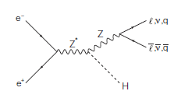
Invisible Higgs Decay
In the SM, an invisible Higgs decay is H → ZZ* →4ν process and its BF is small ~0.1%
If we found sizable invisible Higgs decays, it is clear new physics signal.
  The decay products are dark matter candidates.
At the LHC, one can search for invisible Higgs decays by using recoil mass from Z or summing up BFs of observed decay modes with some assumptions.
  The upper limit is O(10%).
At the ILC, we can search for invisible Higgs decays using a recoil mass technique with model independent way!
  e+e- → ZH
known
measured

Slide 3
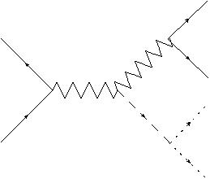
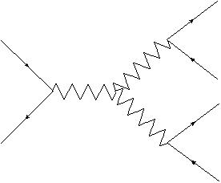
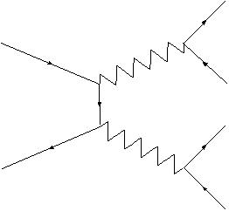
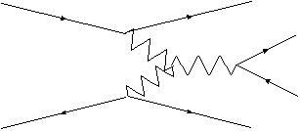
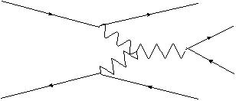
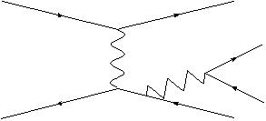
Signal and Backgrounds
q
e⁺
Z
Signal
  e+e- → ZH → (qq)(DM DM)
Backgrounds
  e+e- → ZZ, ννZ, WW, eνW, eeZ
  ZH → (qq)(ZZ*) →(qq)(4ν) : irreducible
  ZH → (νν)(ZZ*) →(νν)(qq)(νν)
Z*
q
DM
e⁻
H
signal
DM
q
Z
q
e⁻
ν
e⁻
W
e⁻
q
Z
q
W
q
Z
l
ν
W
q
e
W
e⁺
ν
e
Z
ν
ν
e⁻
e⁻
e⁻
e⁻
γ
W
q
γ
Z
q
W
q
e
e⁺
q
e
ν

Slide 4
MC setup and Samples
Generator : physsim
  for both signal and backgrounds
  E_{CM} = 250GeV
  Higgs mass 125GeV
  H→DM DM
    Fermion dark matter
    Dark matter mass 50GeV, well below the pair production threshold
  Polarization of P(e+,e-)=(-30%,+80%) to suppress W involving background
Fast simulator : JSFQuickSim
Samples
  Two sets of signal and backgrounds
  One used to determine selections, the other for efficiency and PDF for toy MC
    100000 events for each signal sample
    1ab⁻¹ data for each backgrounds samples.

Slide 5
Overview of the Selections
Durham jet algorithm
  Two-jet reconstruction
No isolated leptons
No forward going electrons
Z mass reconstructed from di-jet
  Also used for Likelihood ratio cut
cos(θ_{Z})
  Production angle of Z
  Just apply < 0.99 cut to eliminate peaky eeZ background before making likelihood ratio
Likelihood ratio of Z mass, cos(θ_{Z}), cos(θ_{hel})
  cos(θ_{hel}) : Helicity angle of Z
Recoil mass
  The final plot
  Fitted to set upper limit.

Slide 6
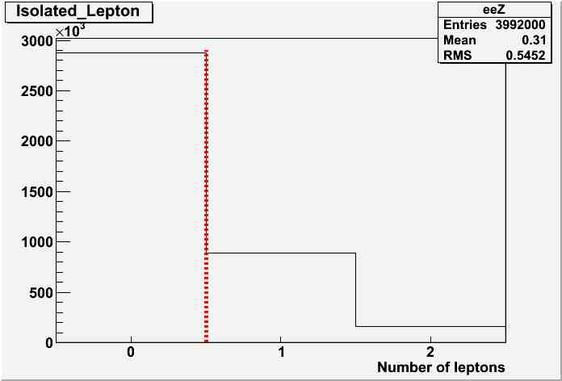
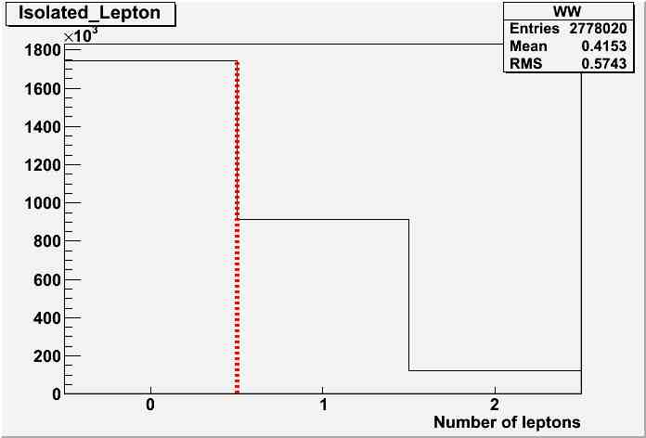
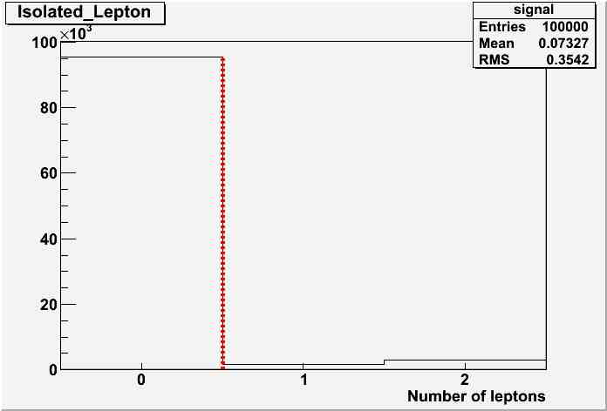
No Isolated Leptons
Isolated lepton selections
  Lepton candidate energy > 10 GeV
  Measured energy within a cone of cosθ = 0.94 < 10GeV
q
eeZ
signal
e⁻
e⁻
WW
q
e⁺
Z
e⁻
W
Z*
q
γ
q
Z
q
Z
l
DM
q
e
W
H
e
e⁻
e⁺
ν
DM
eeZ
WW
signal

Slide 7
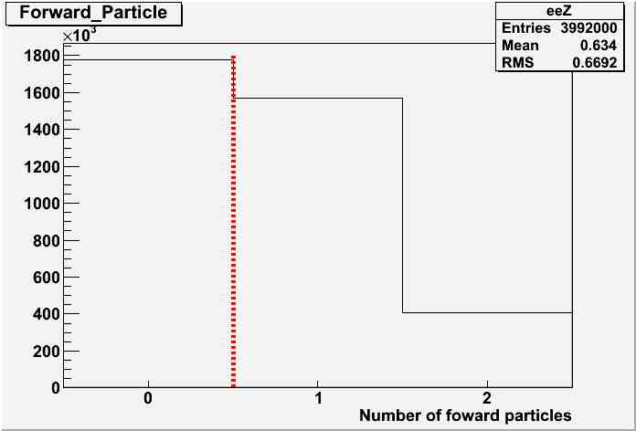
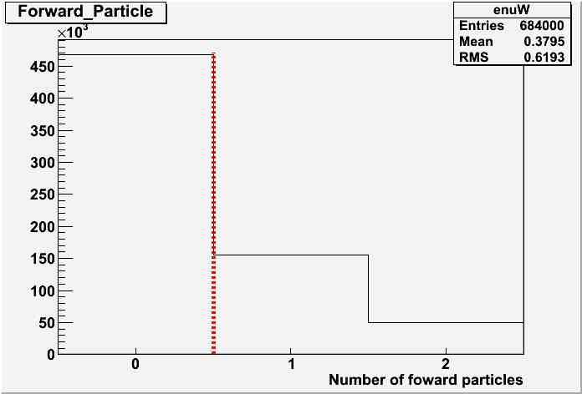
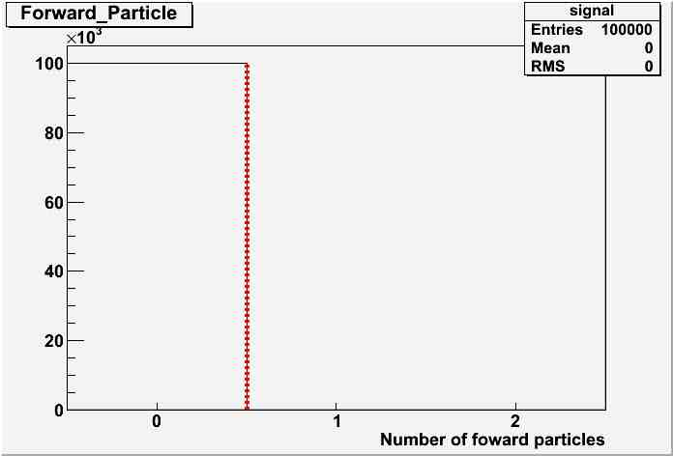
No Forward Going Electrons
Since no forward detectors in the QuickSim, we look at generator information.
  Electron with energy > 5GeV
  Electron within FCal acceptance, 0.98 < |cosq| < 0.9999875
e⁻
e⁻
e⁻
e⁻
q
q
γ
q
e⁺
Z
γ
W
Z*
q
Z
W
q
DM
e
q
e⁻
H
e⁺
e⁺
ν
DM
eeZ
eνW
signal

Slide 8
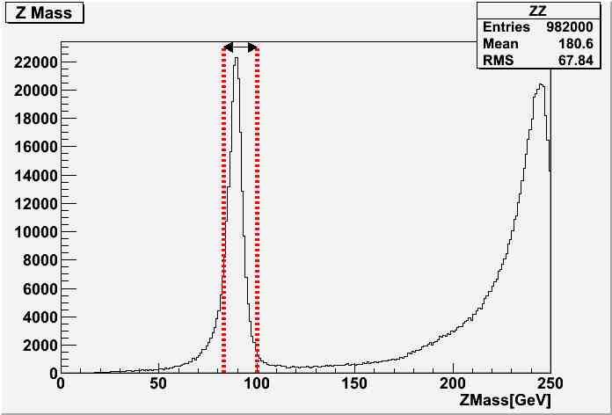
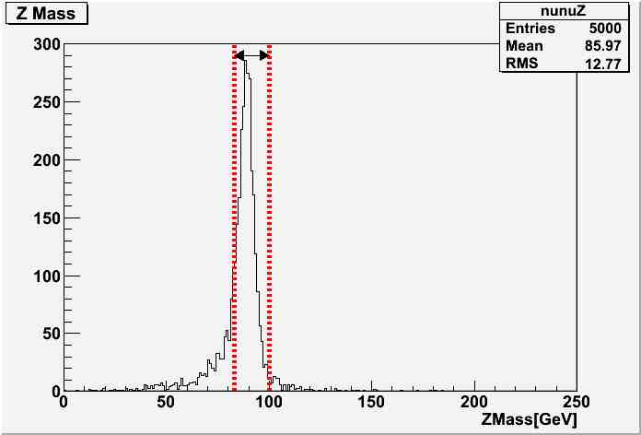
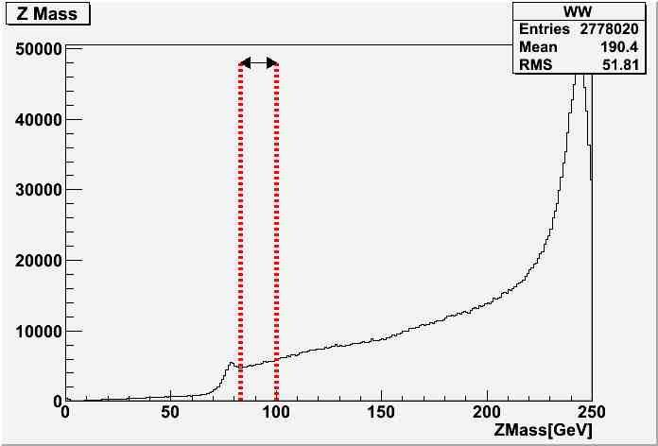
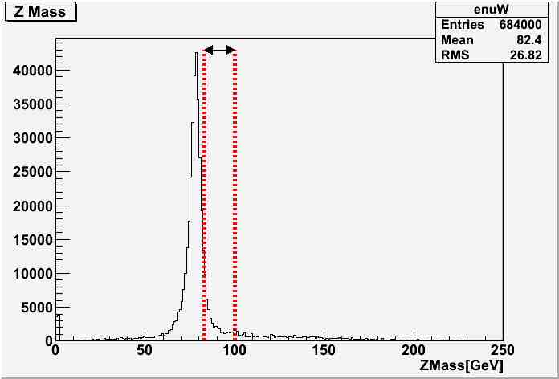
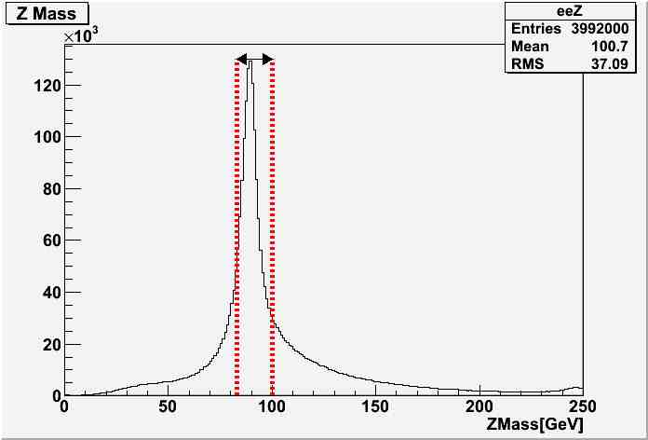
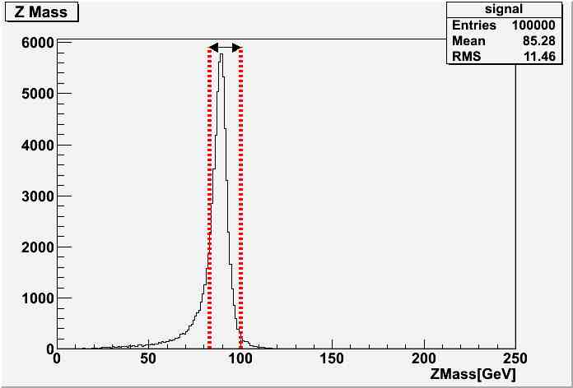
Z mass
To suppress backgrounds having W in final states
  83 GeV < mZ < 100GeV
ZZ
ννZ
WW
eνW
eeZ
signal

Slide 9
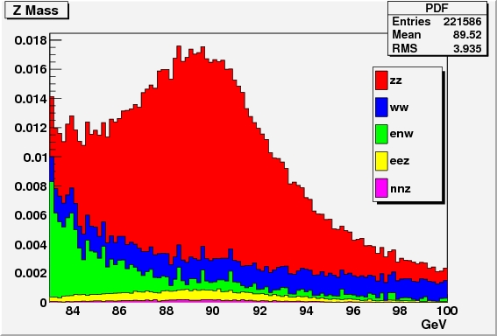
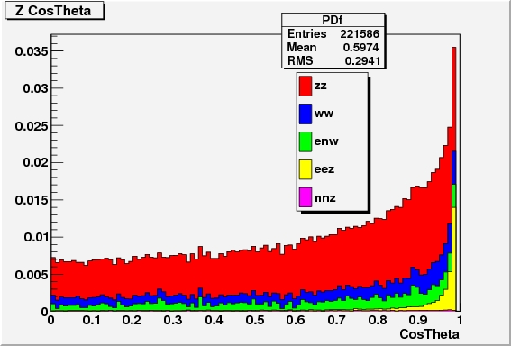
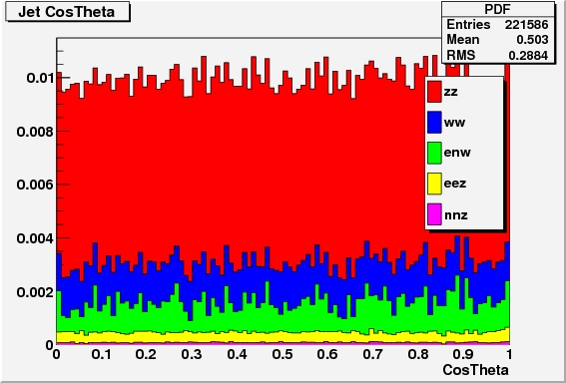
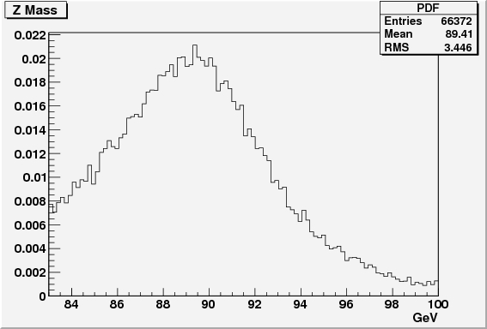
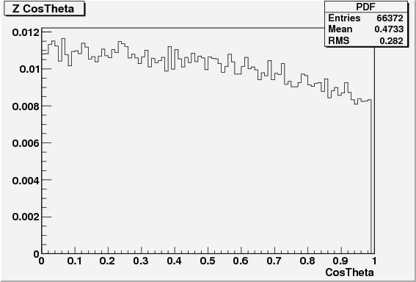
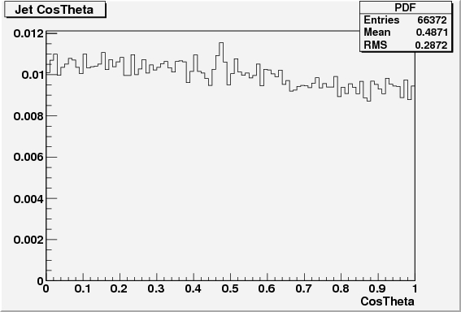
Variables for Likelihood Ratio
■Background
ZZ background
WW background
eνW background
eeZ background
ννZ background
Zmass
cosθz
cosθqq
■Signal
Zmass
cosθz
cosθqq
cosθZ < 0.955

Slide 10
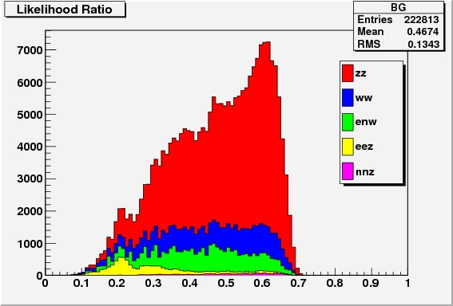
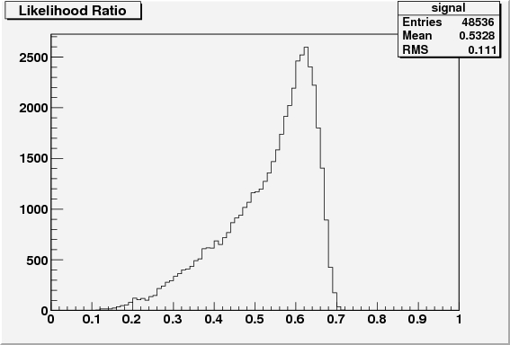
Likelihood Ratio
backgrounds
signal

Slide 11
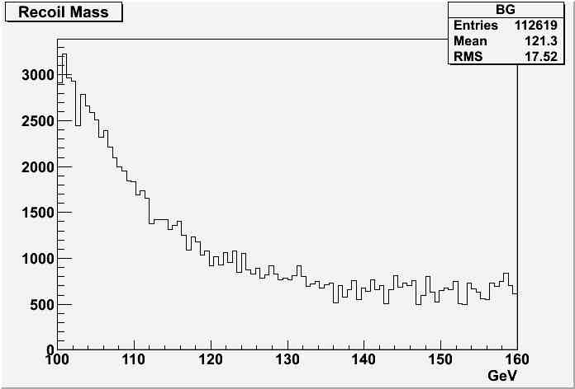
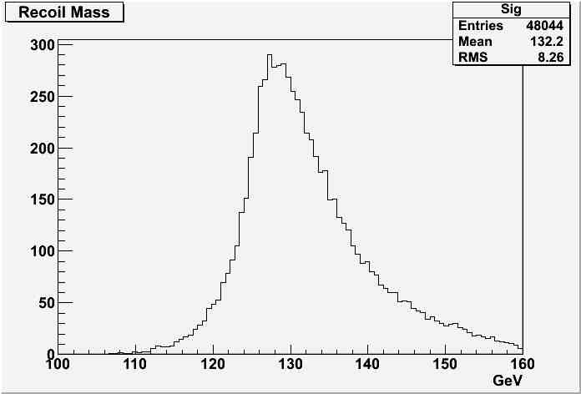
Recoil Mass
120 GeV < M_{recoil} < 140 GeV
background
signal

Slide 12
Signal eff and BG Cross Section
Signal Efficiency is 42% and background cross section is 22fb after all selections.
Cut / σ[ab] | Signal [%] | ZZ | ννZ | WW | eνW | eeZ
No cut | 100.00 | 982000 | 5000 | 2783000 | 684000 | 3992000
Isolated lepton | 95.55 | 835853 | 4767 | 1745868 | 545711 | 2878061
Forward electron veto | 95.55 | 586409 | 3971 | 1269207 | 455945 | 1709386
Z mass | 48.92 | 156627 | 1966 | 34445 | 26718 | 752847
Cos(θ_{Z}) | 48.54 | 153362 | 1920 | 33041 | 25806 | 8651
LR | 48.04 | 150800 | 1893 | 30629 | 24231 | 6542
Recoil mass | 42.10 | 20073 | 705 | 3695 | 7733 | 430

Slide 13
Set the upper limits on σ and BF

Slide 14
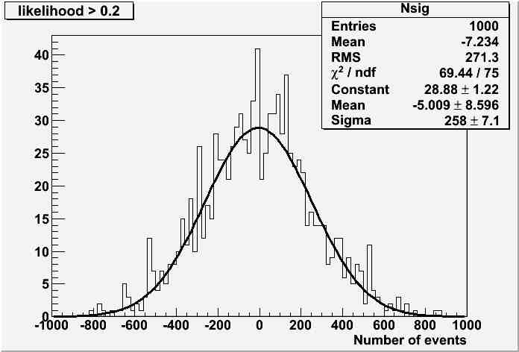
Toy MC
Recoil mass distributions before cut is used for ToyMC.
Recoil mass distributions with no signal are generated for each Likelihood ratio cut to minimize the upper limits.
  Two backgrounds from ZH process are added to toy MC
    ZH → (qq)(ZZ*) → (qq)(4ν) : irreducible, the BF~0.1%
    ZH → (νν)(ZZ*) → (νν)(qq)(νν) : can be suppressed by recoil mass
Fit to Recoil mass distributions and extract Number of signals
Repeat 1000 times and make Number of signals distribution.
Set the 95% CL Limits on signal yield and cross section.
upper limit
N_{sig}

Slide 15
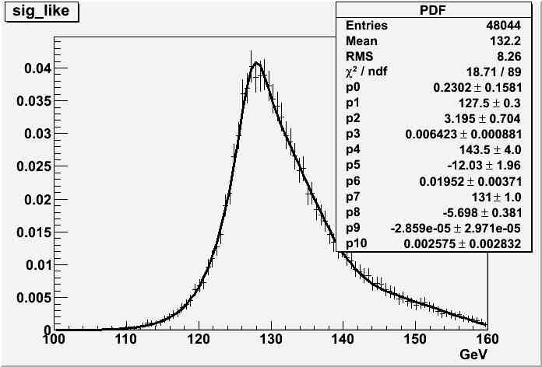
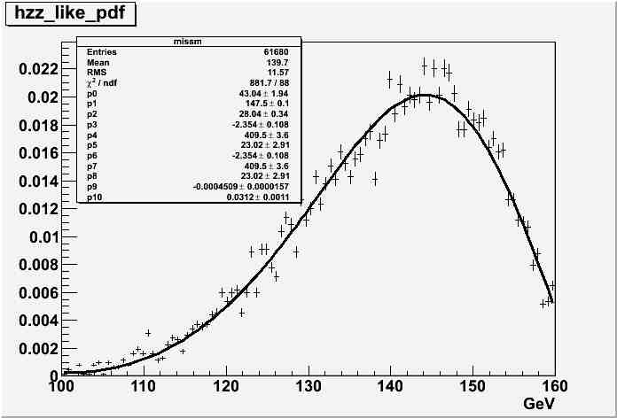
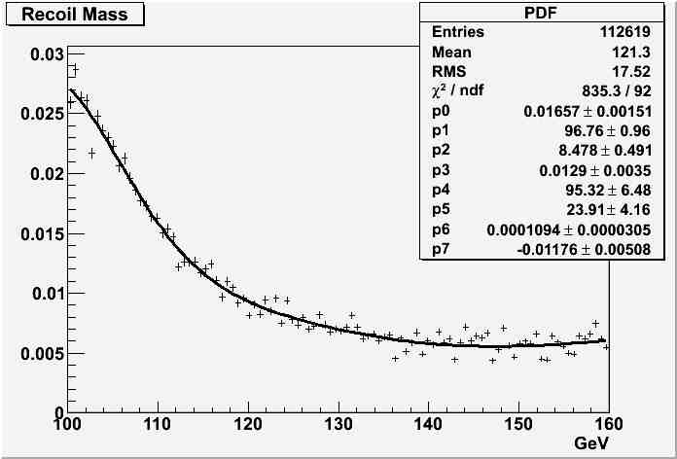
PDF for Toy MC Generation
Fit Parameters : N_{sig}, N_{bg}
Fixed values : N_{h→4ν,} N_{h→ZZ*→qq(νν)}
assuming the SM
BG:ZZ+ννZ+WW+eνW+eeZ

Slide 16
Results
Set the upper limit with 250fb⁻¹,
  σ (e+e- → ZH, H → invisible ) < 1.7 fb at 95% CL
From the σ(e+e- → ZH) = 240fb, upper limit on BF is obtained.
  BF (H→invisible) < 0.70% at 95% CL with 250 fb⁻¹
Note. This “invisible” does not include 4 neutrinos final state

Slide 17
Summary and Plan
We have estimated the upper limits on the cross section and BF of invisible Higgs decays at the ILC at the E_{CM} of 250 GeV, with an integrated luminosity of 250 fb⁻¹ and polarization of P(e+,e-)=(-30%,+80%) .
  σ (e+e- → ZH, H→ invisible) < 1.7 fb at 95% CL
  BF (H→invisible) < 0.70% at 95% CL with 250 fb⁻¹
Study with a full simulator.
Add leptonic Z decays.
Combine studies at E_{CM} = 350GeV and 500GeV.

