Slide 1
Status and update plan of the ATF DR
Nobuhiro Terunuma, KEK
European Linear Collider Workshop ECFA LC2013, May 28, 2013

Slide 2
ATF DR status
Present users on ATF DR
  Cavity Comptons
  ATF2
Low emittance for ATF2 (~10pm)
  Maintained in each startup of the beam weeks
  Usually done in a shift
Studies for the smaller emittance (2pm)
  It has not been done in 2012 because of the ATF2 priority.
  It should be re-scheduled from now on.

Slide 3
Emittance
Measured in DR
  XSR monitor
  ATF2
Measured in EXT
  wire scanners (Tungsten 10 um, Carbon 6 um)
  Multi-OTR monitor

Slide 4
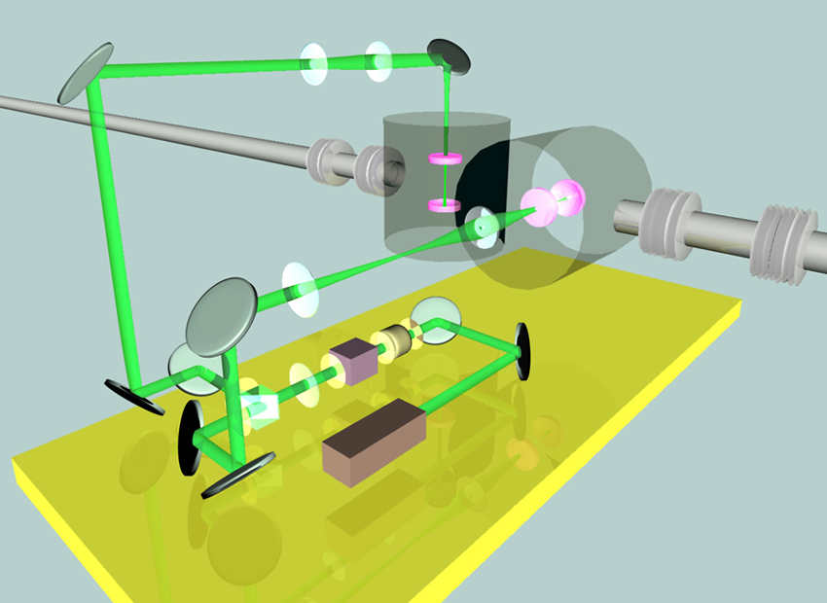
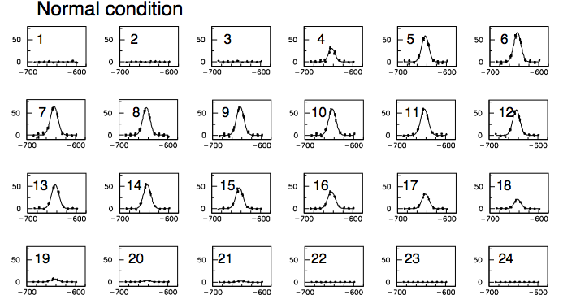
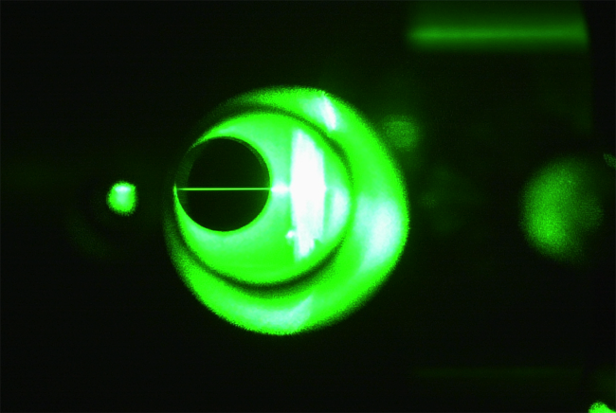
Laser Wire with Optical Cavity (DR)
The most accurate emittance monitor in ATF DR.
    14.7µm laser wire for X scan
    5.7µm for Y scan
But the measurement is
  time consuming.
  (scan: 15 min for X, 6 min for Y)
Multi-bunch separated measurement
Upgrade is ongoing!
Two mirror cavity
Difficult to maintain
low signal intensity
Not in function in recent years
300mW 532nm Solid-state Laser
fed into optical cavity

Slide 5
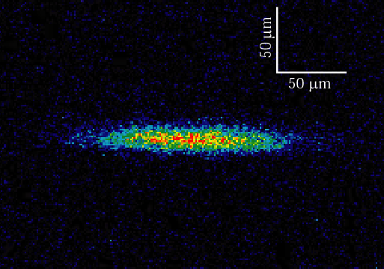
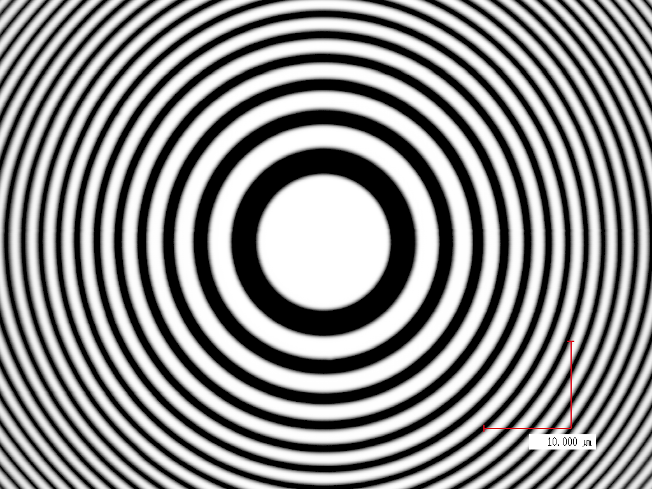
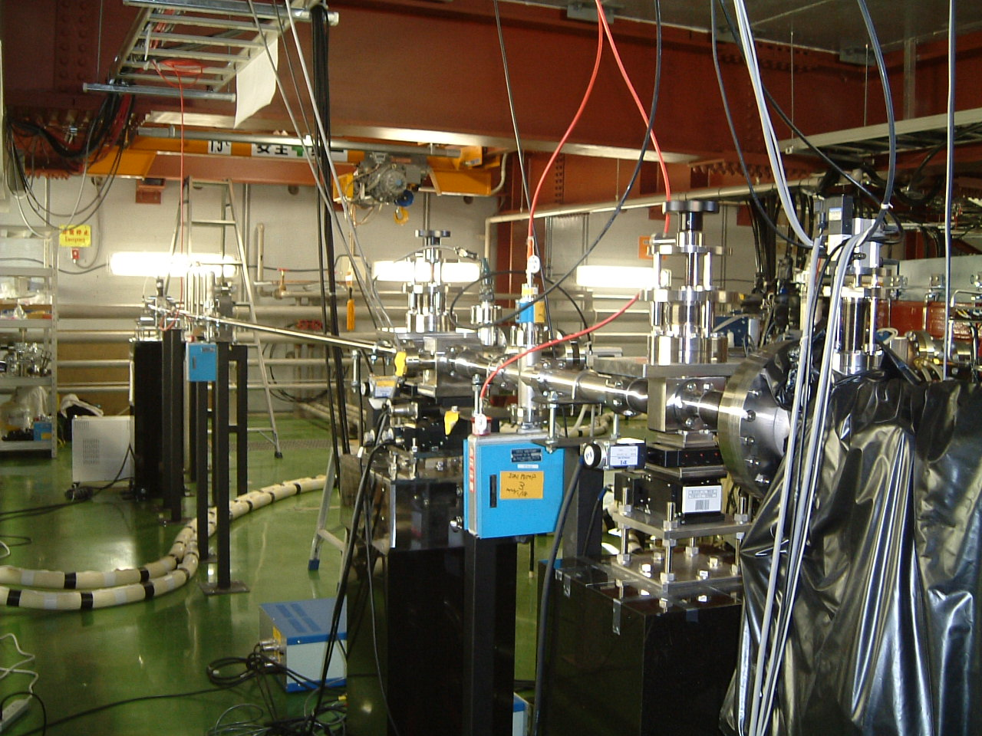
X-ray SR Monitor (XSR)
Real-time monitor for emittance tuning in DR
X-Ray Telescope using Zone Plate at 3.2KeV
magnification : 20
  Non destructive measurement
  High resolution (< 1μm)
  2D direct imaging of the electron beam
  Exposure time (1 ms ~ 20 ms)
image of 1ms exposure
σx = 48.2 ± 0.5 [μm]
σy = 6.4 ± 0.1 [μm]
Zone plate
SR X-ray beam line

Slide 6
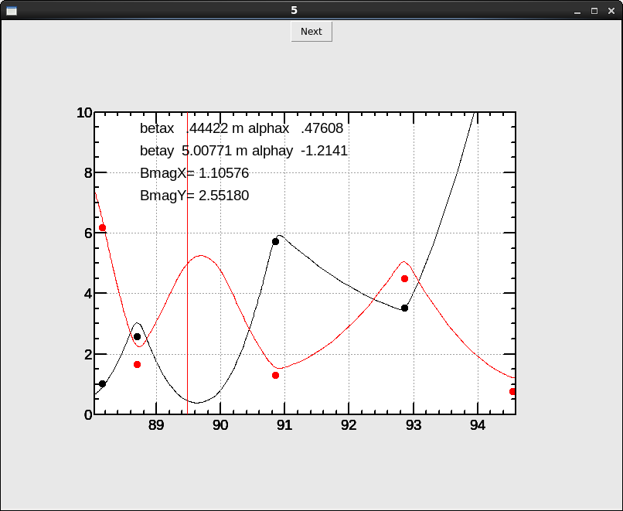
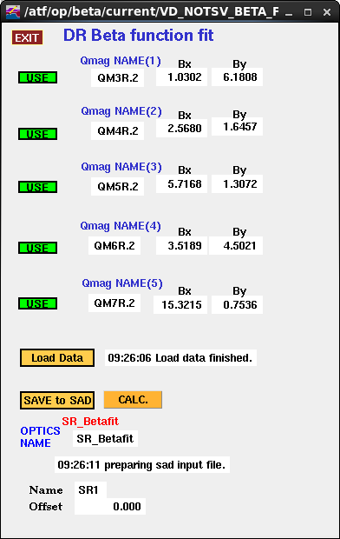
Beta Measurement
Emittance is calculated by the formula;
σ_{y}²=β_{y} ε_{y}
β is calculated by fitting the β s at near Qs,
which are measured by tune slope.
ex.)->
by S.Kuroda, ATF2 Review

Slide 7
Layout of Extraction Line
Skew Quads
(Coupling correction)
Dispersive area.
Quads and skew Quads
(Dispersion correction)
FF
Beam size monitors
(Emittance,
Optics measurement)
2nd kicker
Damping Ring
septum magnets
Kicker
Modified from figure in 13th ATF2 Project Meeting, January 12 2012, by Mark Woodley

Slide 8
OTR beam profile monitor
Measure Single pulse beam size (faster than wire scanner).
We have 4 monitors → Evaluate projected x, y emittance
  Could evaluate normal mode emittance (4-D analysis)
microscope
J. Alabau, et.al.

Slide 9
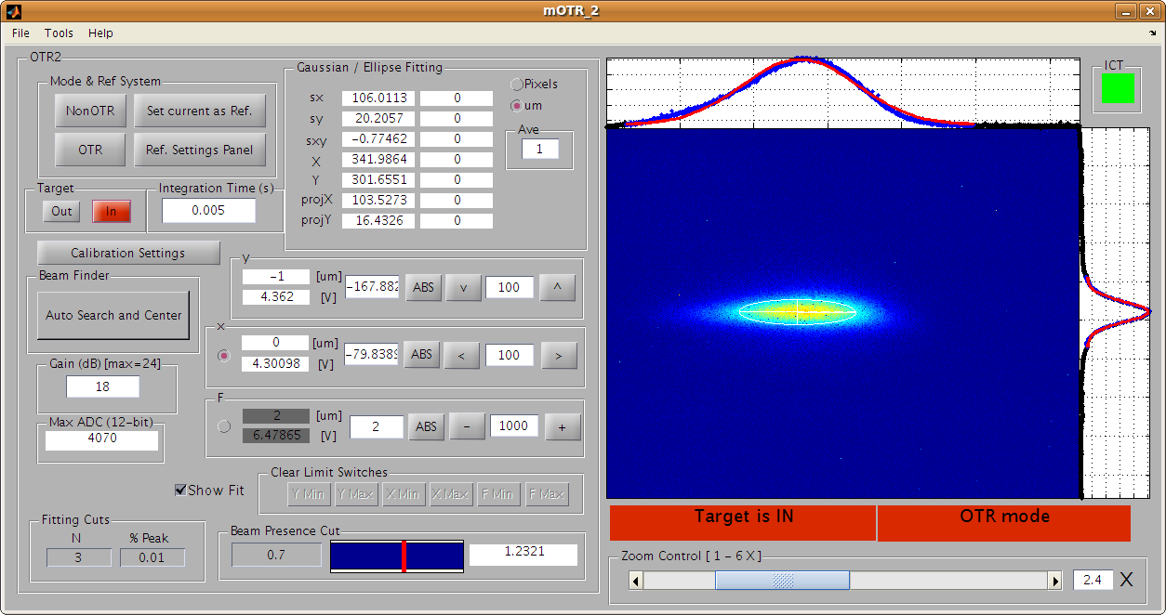
Example of OTR profile
from ATF Log Book

Slide 10
DR Emittance Summary
Terunuma, Kuroda
2009 spring
I=5-6x10⁹
2009 autum
I=4-5x10⁹
Low emittance was recovered in the operation 2008-2009.
Measured ε_{y}=8.56±0.46/ 8.43±1.79/ 3.50±1.78/ 2.00±1.61pm by XSR/ IF/ LW00/ LW01.
Study for the discrepancy is still on going.
by S.Kuroda, ATF2 Review

Slide 11
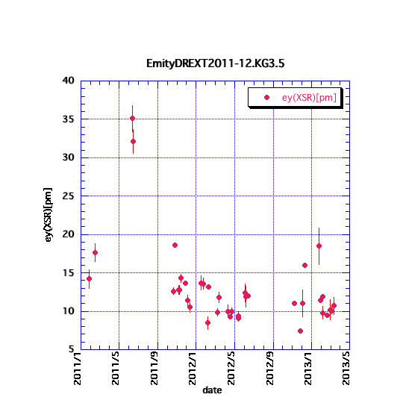
Emittance Summary 2011-2013
Test operation
Emittance in DR is around 10-12 pm
Big Earthquake
3.11 2011
⬇
by S.Kuroda, ATF2 Review

Slide 12
Emittance of extracted beam
Extracted emittance before May 2013 was bigger than that of DR about twice or more.
Is the DR emittance 10 pm?
Change of the coupling-correction scheme in May 2013, seems to remove the discrepancy between EXT and DR.

Slide 13
by T.Okugi , ATF operation meeting

Slide 14
by T.Okugi , ATF operation meeting

Slide 16
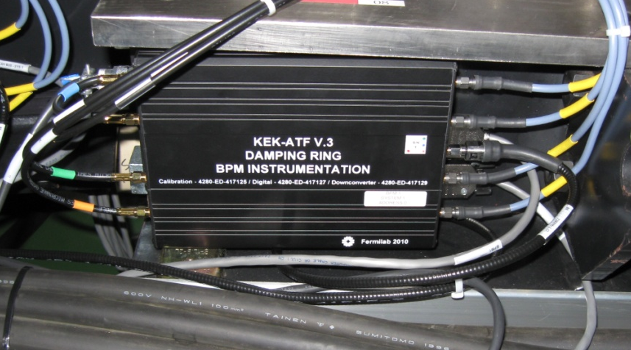
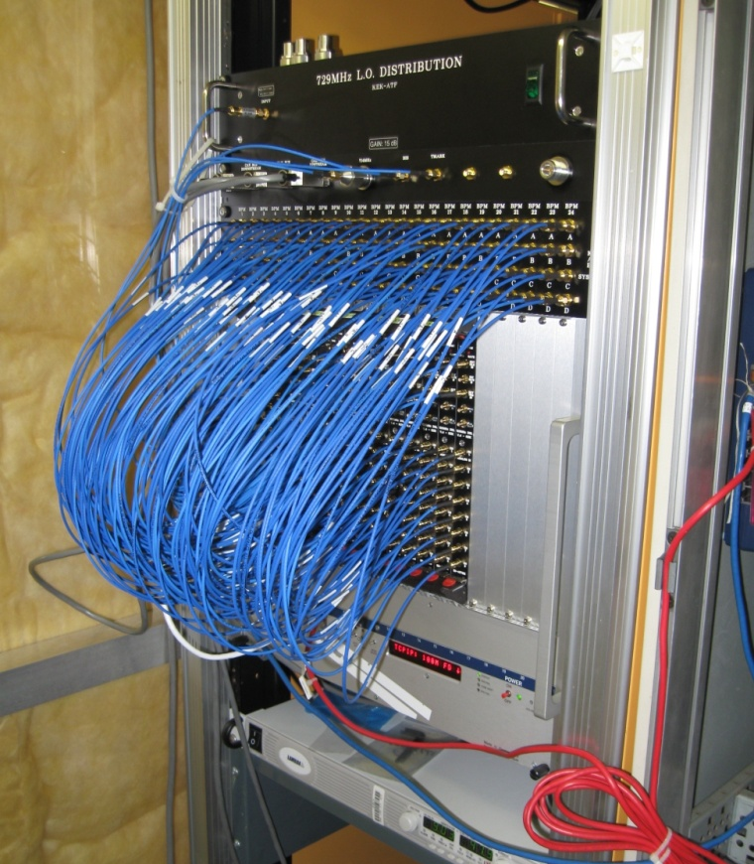
DR BPM Upgrade for 2 pm emittance
The original read-out system designed for the single path position measurement has a 10 μm resolution.
Upgraded BPM readout system:
  FNAL-KEK collaboration
Broadband turn-by-turn mode (< 10 µm resolution)
  Injection 1,000 turns
  Extraction 64 turns
Narrowband mode with high resolution (~ 100 nm range)
  160 ms, 500,000 turns after injection
Installed in 2010 for all DR BPMs (96)
Downmix box at the beamline
BPM digitizer station

Slide 17
Summary: Emittance in Damping Ring
We achieved minimum vertical emittance ~4pm in 2002~2003.
Recently, we have kept (nearly) the best condition.
For smaller vertical emittance (~ 2pm, ILC DR design),
  New beam size monitor for confirmation.
  Keep good alignment.
  Keep good BPM performance.
However, present priority is ATF2 study (Final focus test, demonstration).
  Damping Ring emittance is small enough for ATF2
by K.Kubo, ATF review, August 2012

Slide 18
Optical Cavities in ATF DR
High intense gamma-ray generation
Optical cavities: 2-mirror → 4-mirror
for the polarized positron source (Hiroshima/KEK)
for other application (LAL)
for the upgrade of Laser Wire scanner

Slide 19
Laser-Compton-Scheme &
Laser Pulse Stacking
for pol. e+ generation
France-Japan collaboration
French Labs. : LAL (Orsay) in Collaboration with
CELIA (Laser lab., Bordeaux) and
LMA (mirror coatings Lab., Lyon)
Japanese Labs. : KEK, ATF group,
Hiroshima University
by T.Omori

Slide 20
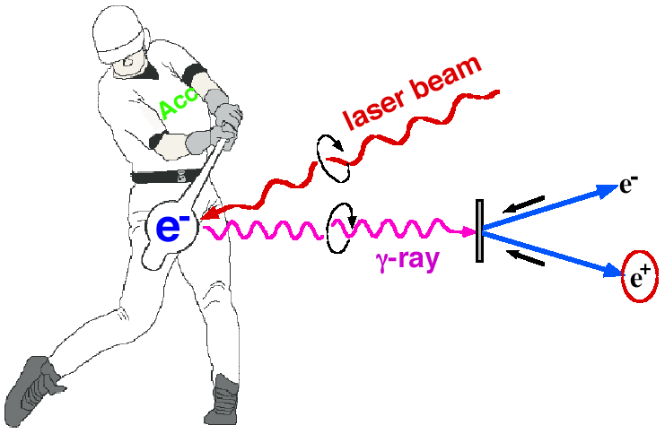

Introduction
Polarized e+ by laser Compton Scheme
Ee~1GeV for 10MeV gammas
easy to control polarization
Toward the positron sources
-> increase intensity of gamma rays
-> Laser Pulse stacking cavity
by T.Omori

Slide 21
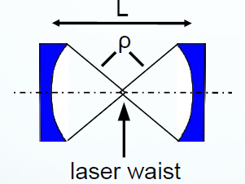
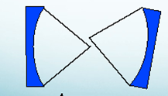
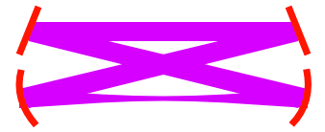
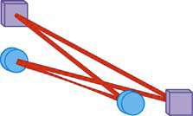
Way 4-mirror Cavity? get small sport size
α
2d 4M has astigmatism
2 mirrors is not stable
for small spot size
3D (or twisted)
4M ring cavity
by T.Omori

Slide 22
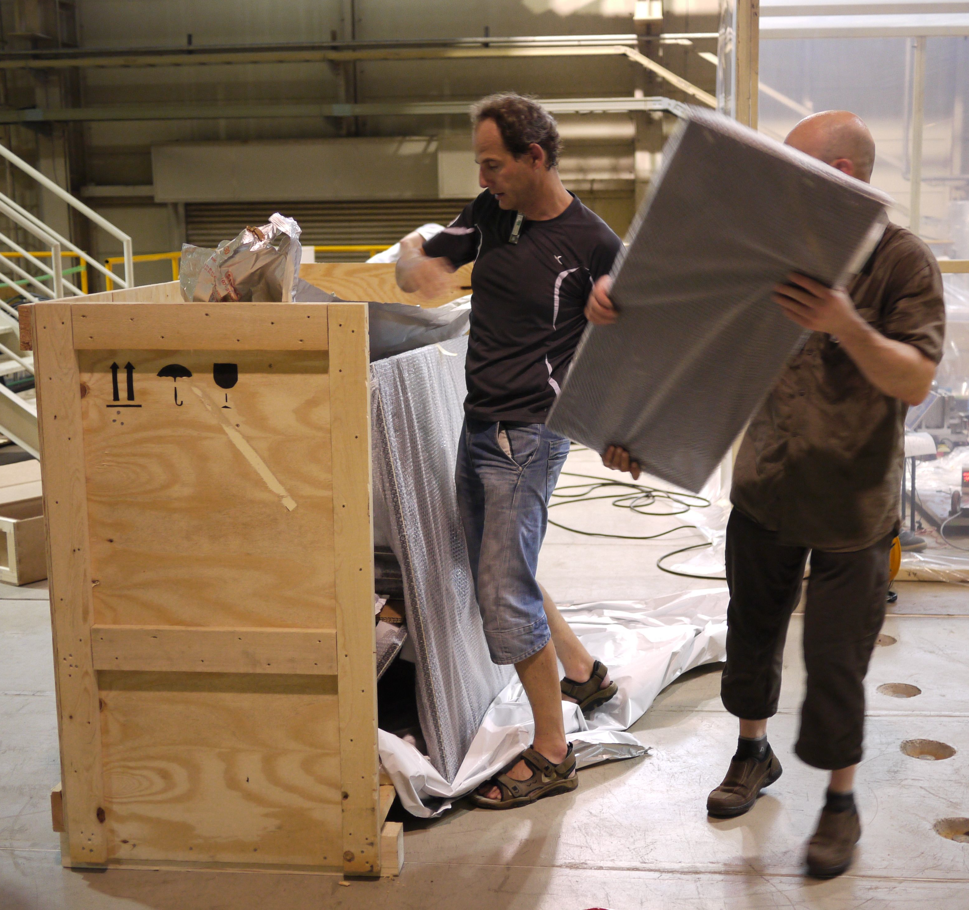
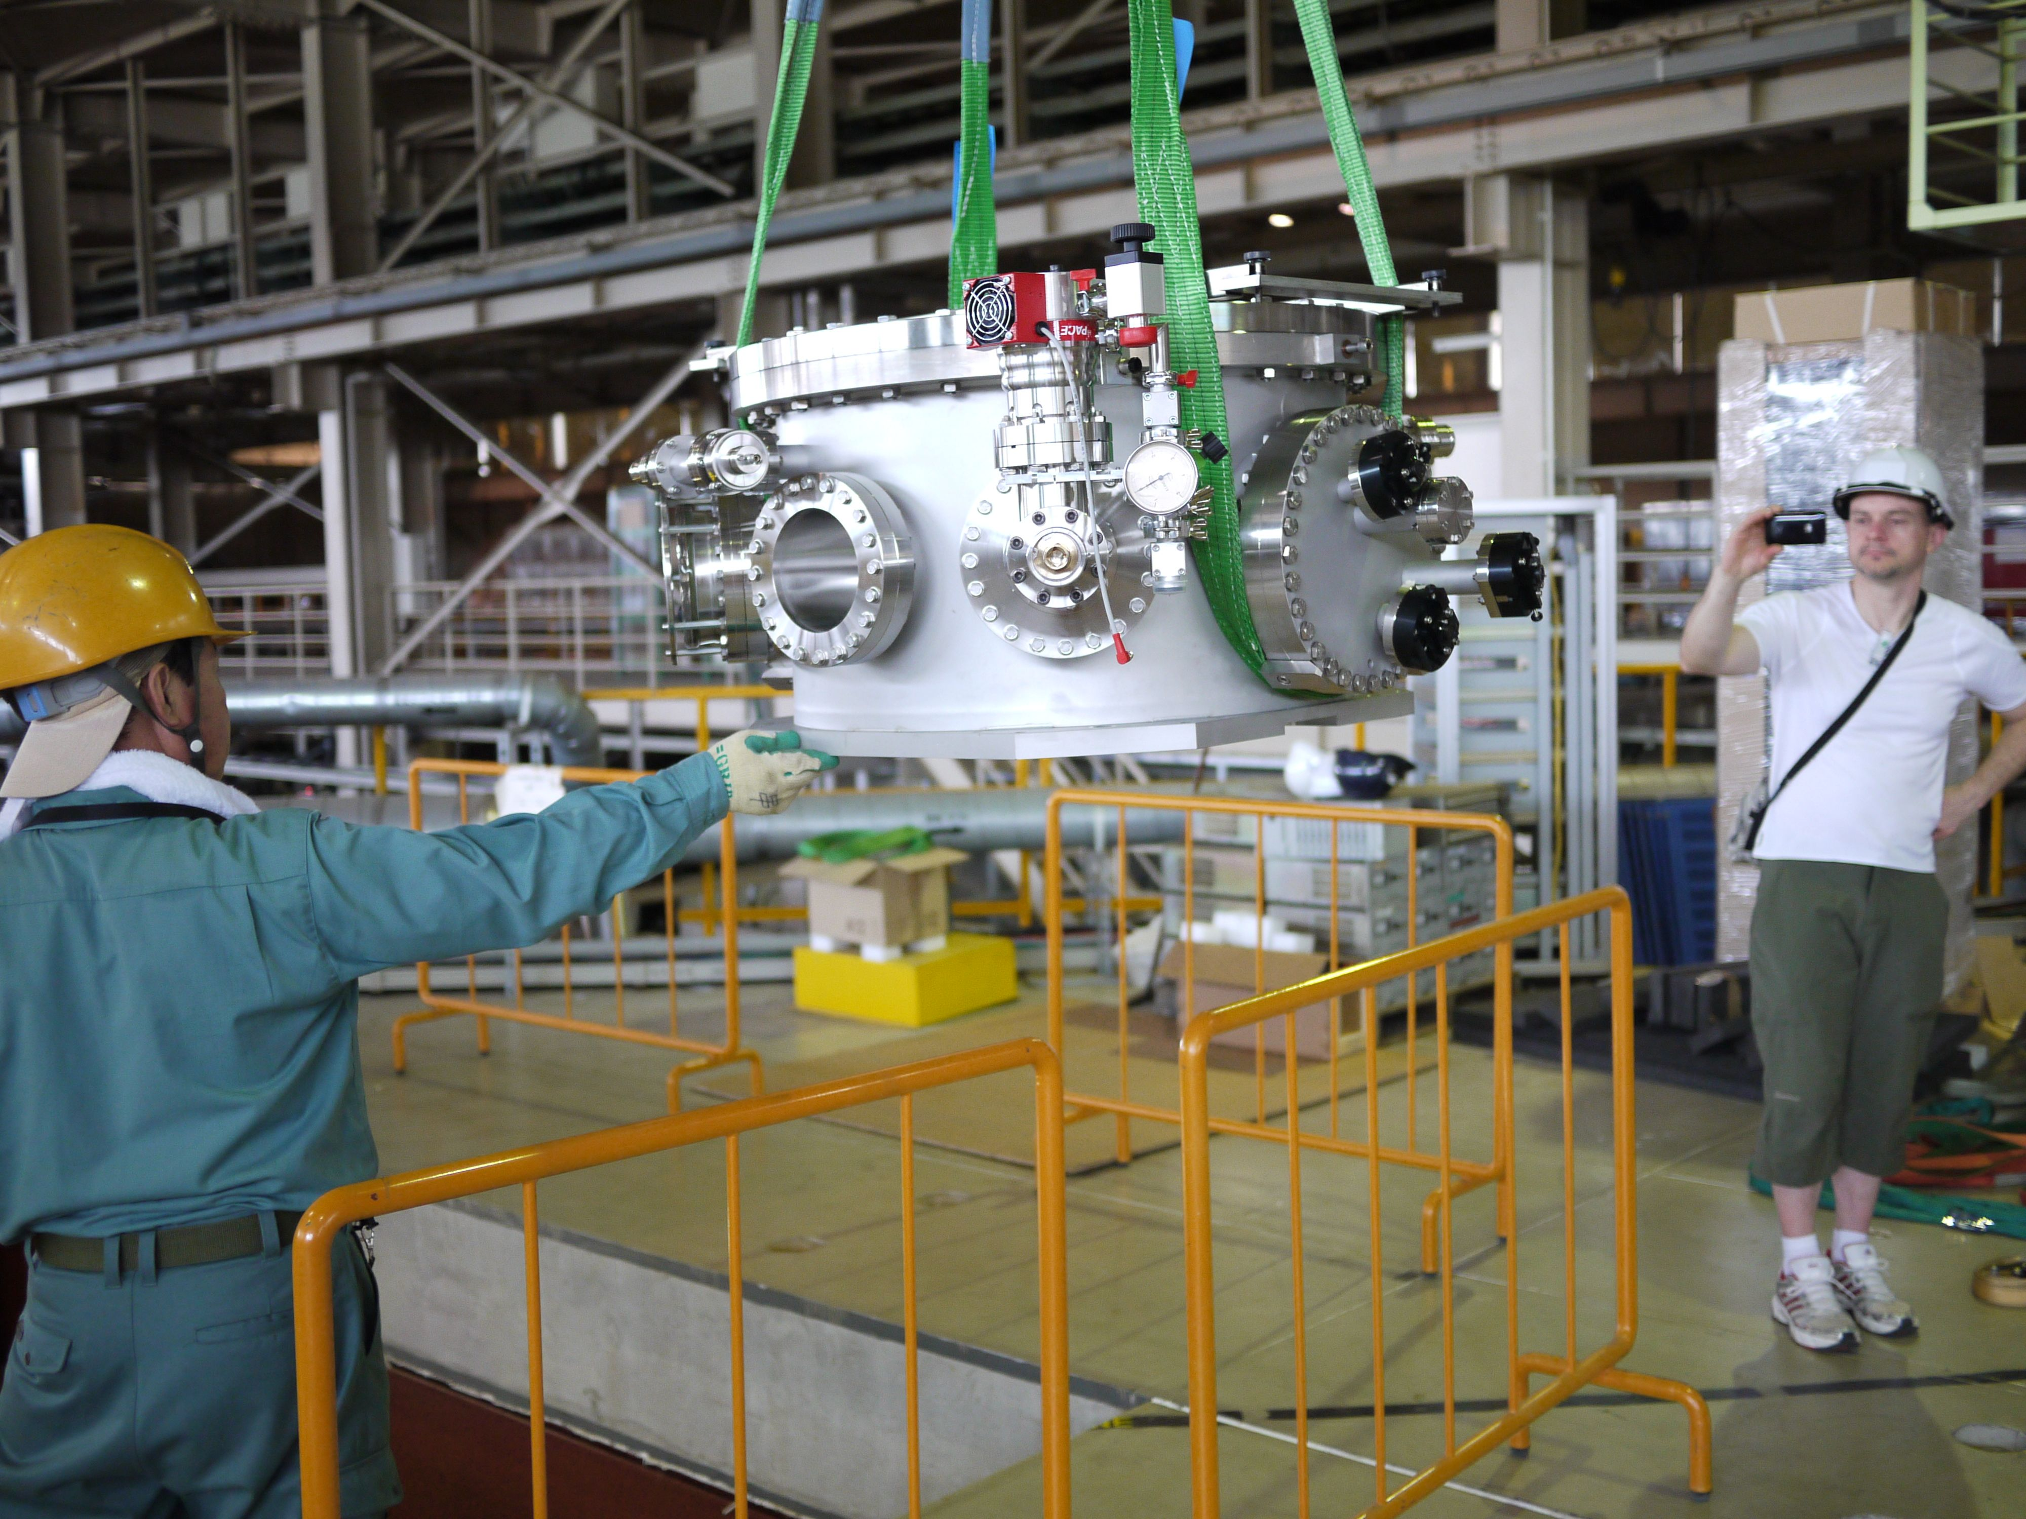
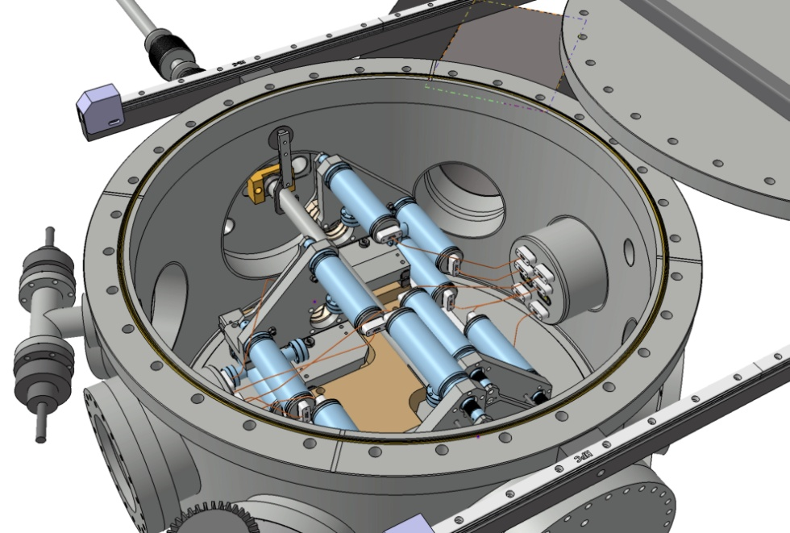
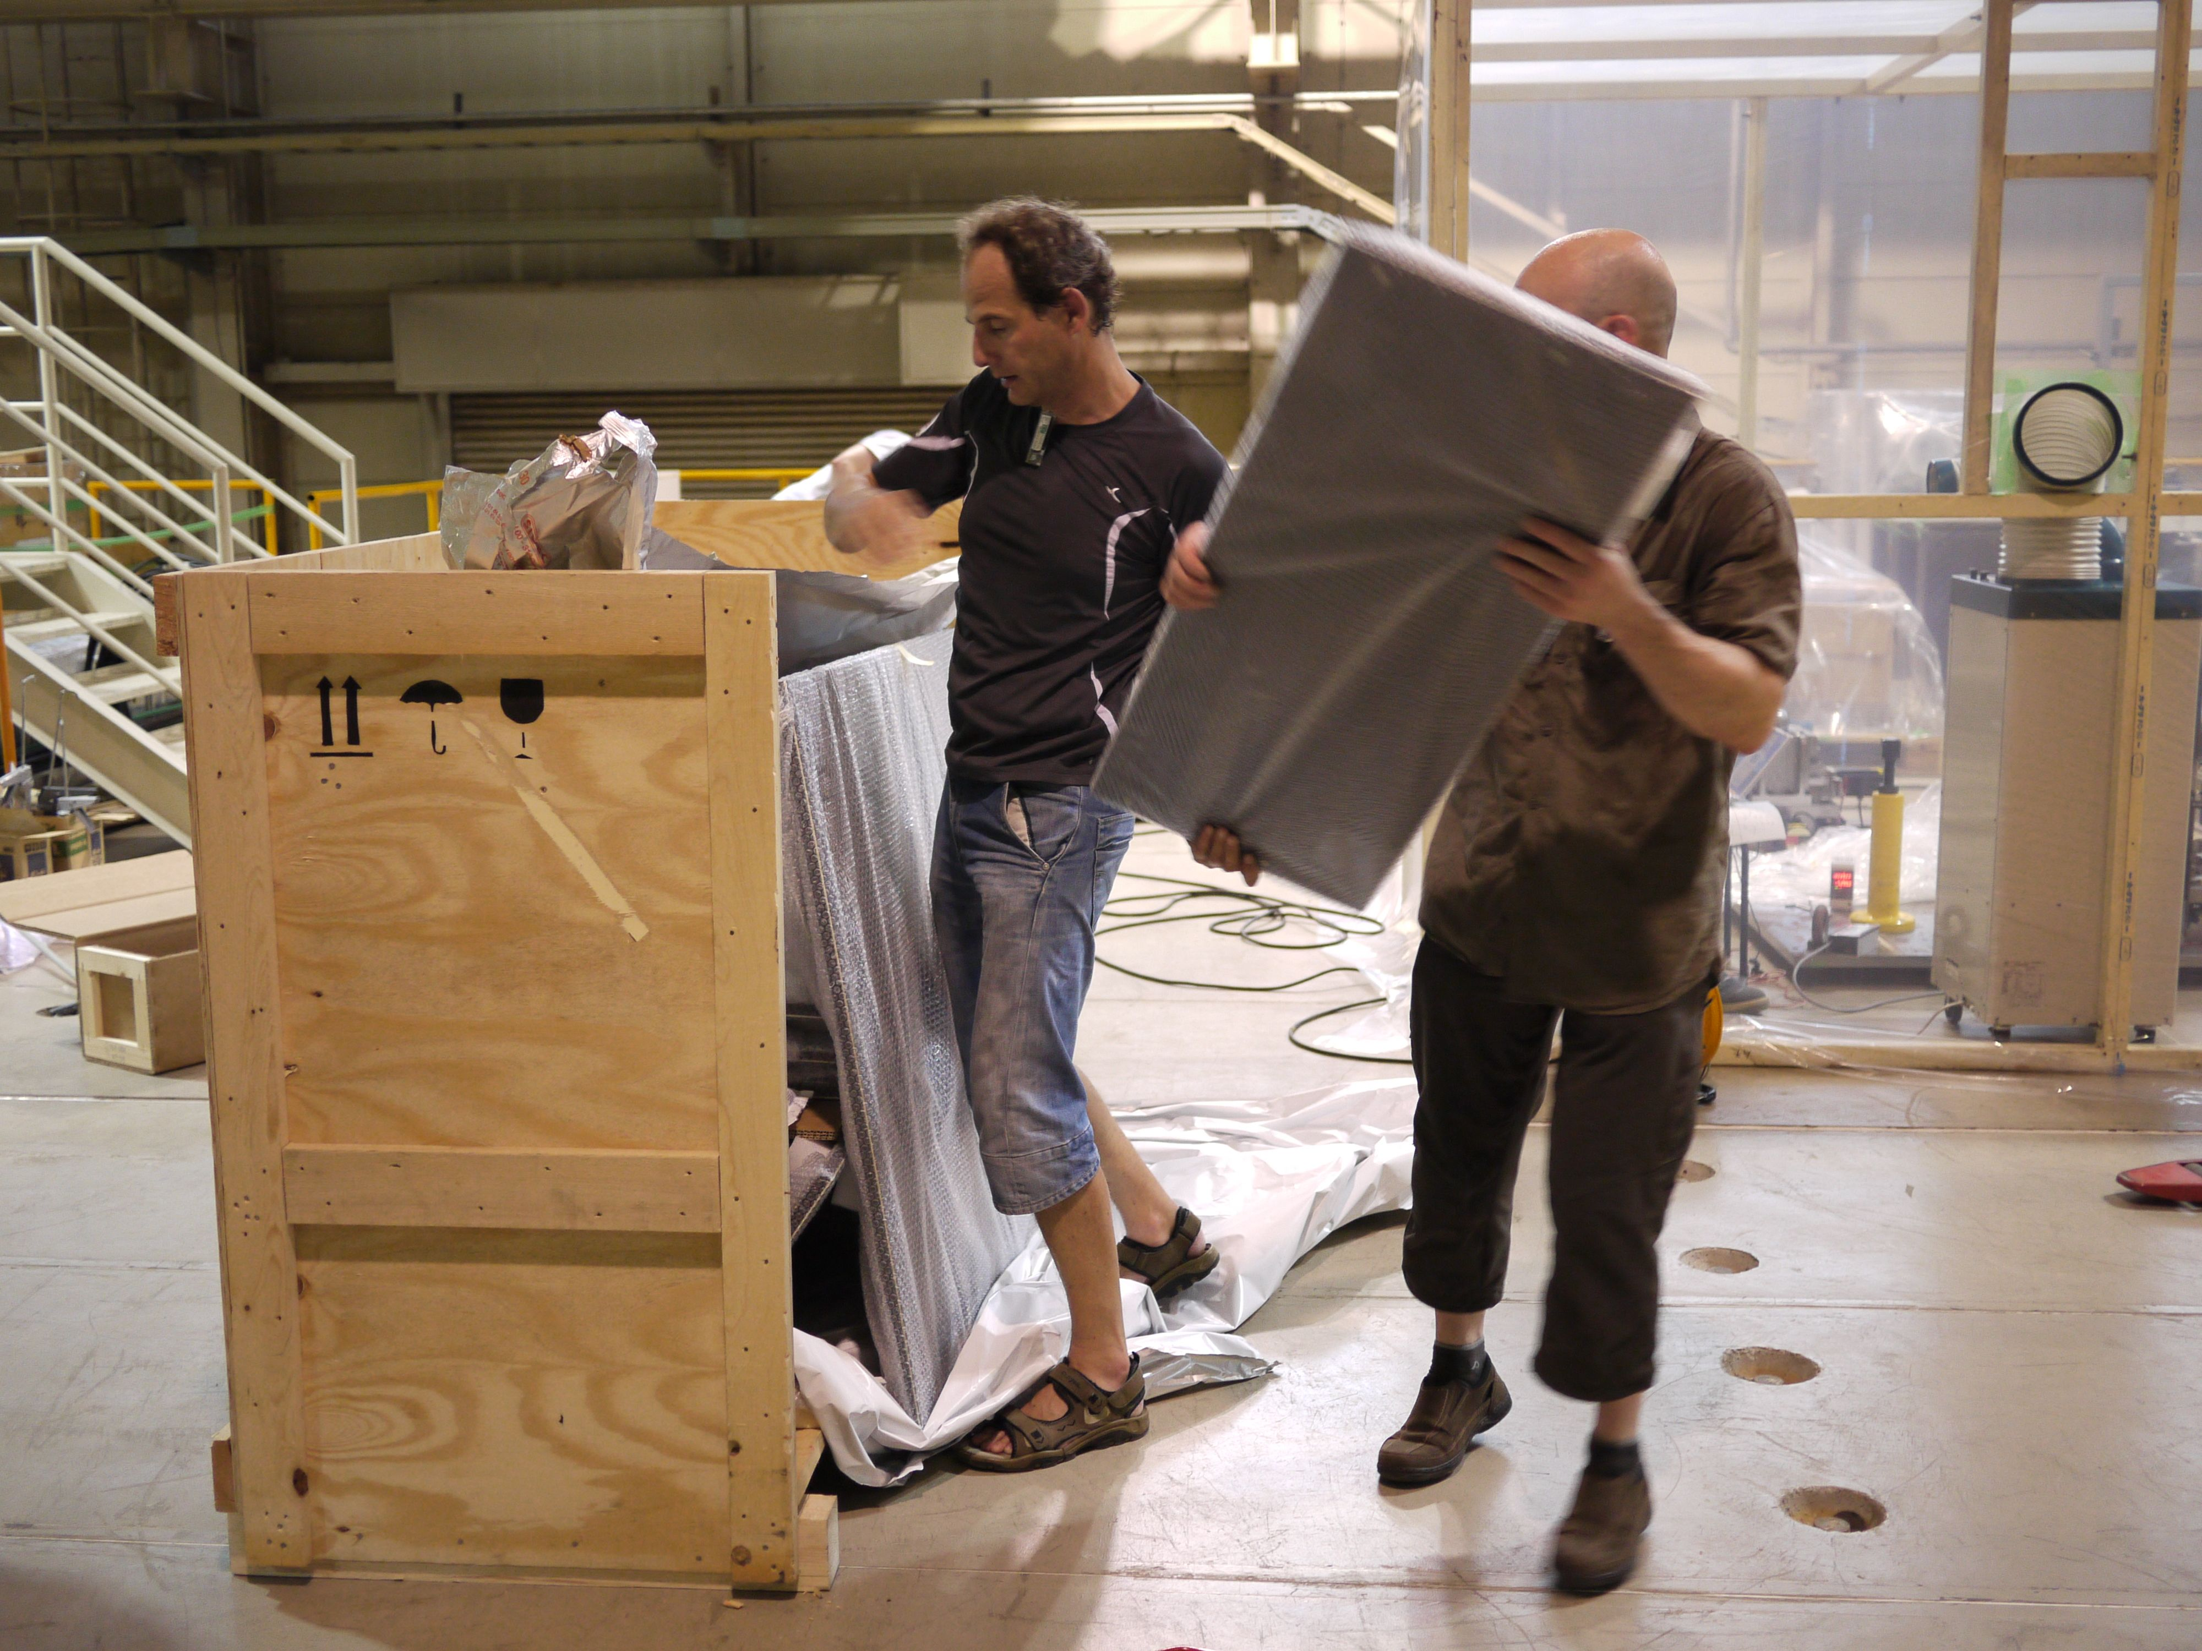
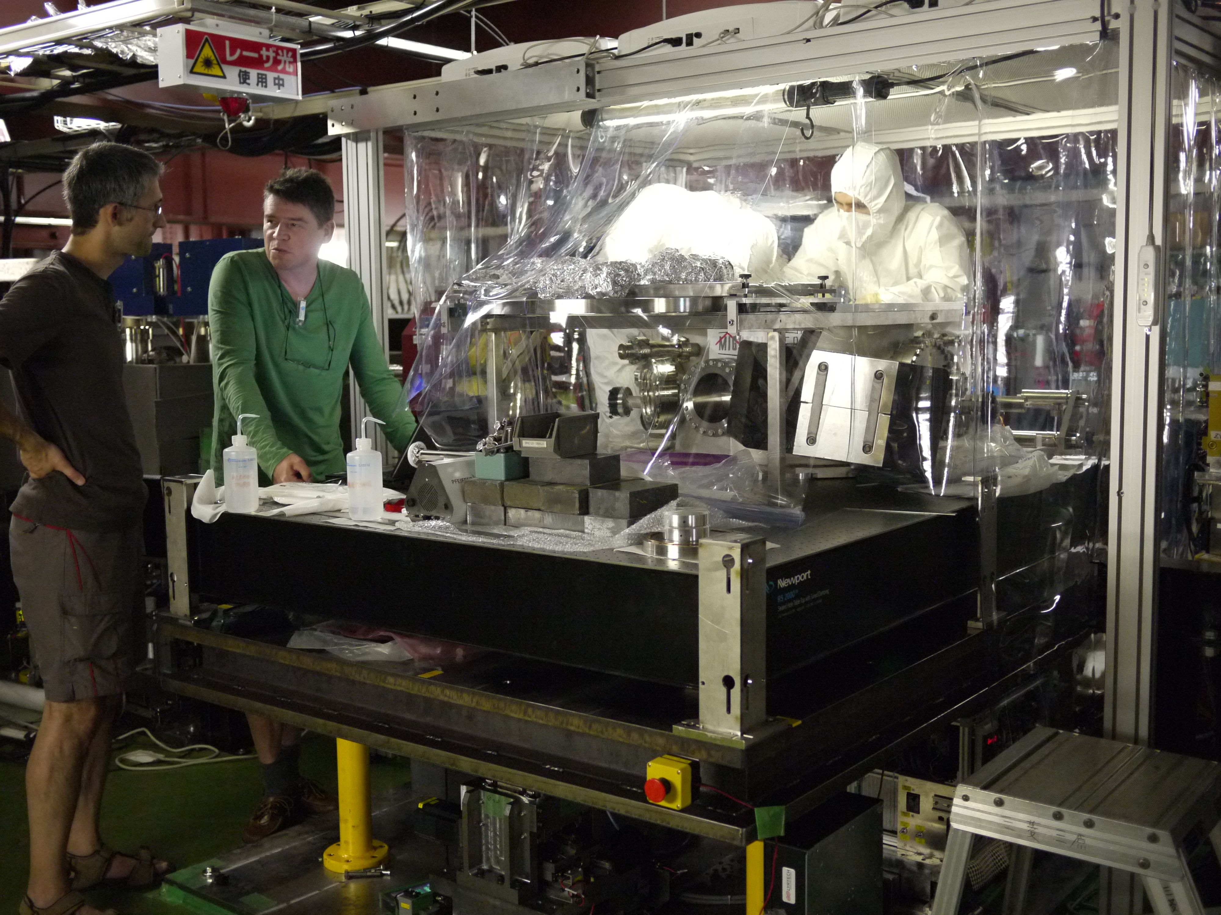
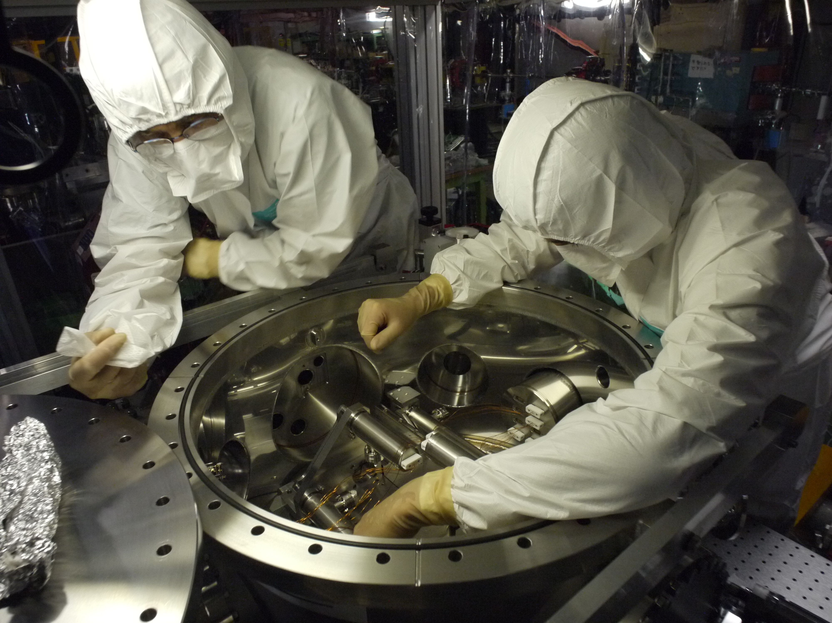
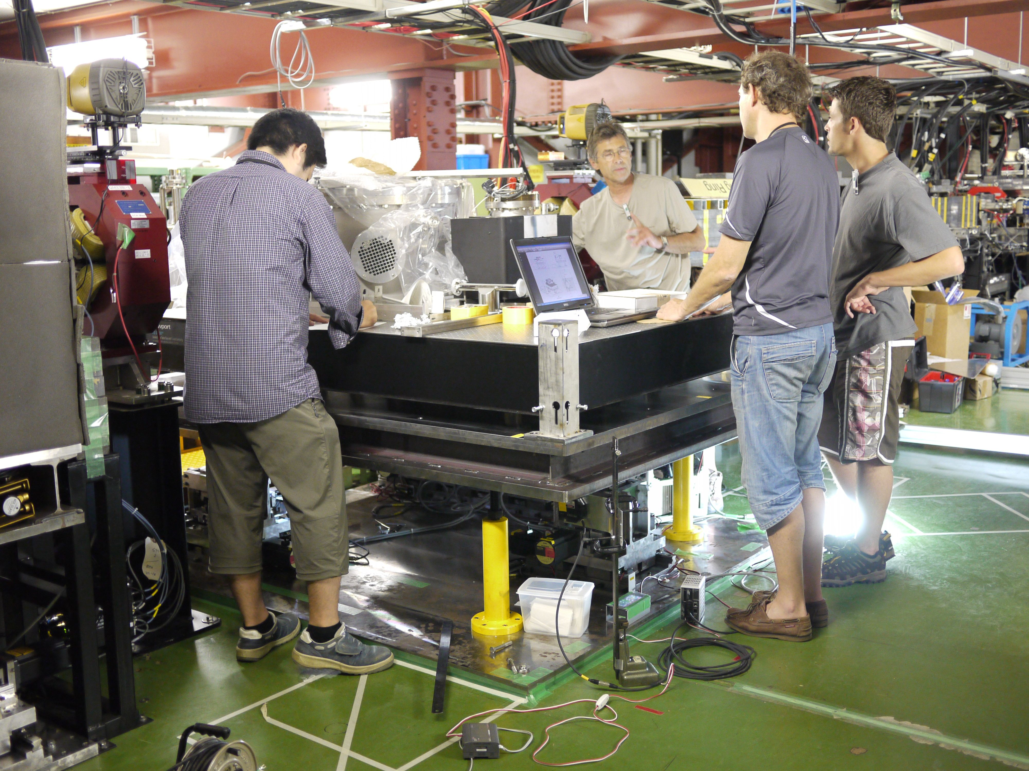
2010 Summer: French cavity Installation
by T.Omori

Slide 23
MightyLaser
Main Events Summary
21012.12.10
2010
2011
2012
10
11
12
01
02
03
04
05
06
07
08
09
10
11
12
01
02
03
04
05
06
07
08
09
10
11
12
γ
γ
ATF Recovering
New MENLO Laser + Fibre Amplifier under tests at LAL
10/25 :
γ observed
☒
12/08 :
γ observed
06/03 :
Fibre amp
damage
03/11 :
earthquake
☒
07/20 :
Laser Failure
☒
05/22
11/29
Equipments sent to Orsay
Origami Laser
sent to Orsay
10/20
Locking more stable using Frequency Shifter
60% coupling
New design required for
Fibre amplifier
Laser Mode-lock unstable
New laser ?
Request to Terunuma-san
Gamma observed
04/11
Setup on
Standby Mode
γ-ray
observation
CELIA
Eric CORMIER
MENLO
Laser Orange
Challenge
F=30000
Problem: Coupling Decrease in Vac.
CEP?
12/17
12/26
03/23
decision
Sapphire Mirrors
Finesse 30000
Coupling 15% on air
3% under Vacuum
New Mirrors Finesse 3000 installed
Coupling 59% on Air
20% on vacuum
by T.Omori

Slide 24
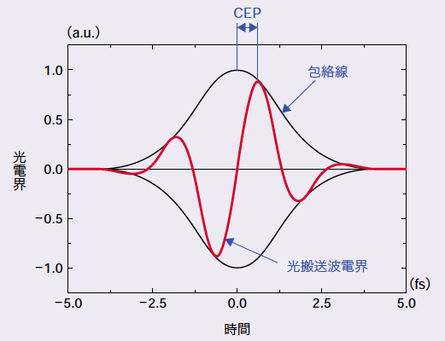
French Cavity aiming very high finesse.
Issue: Lost stacking when goes vacuum.
Carrier Envelope Phase (CEP)
Envelope
Carrier
Cure is on going at LAL
-> Cavity back to KEK this summer
by T.Omori

Slide 25
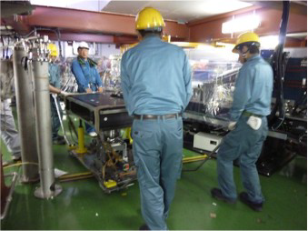
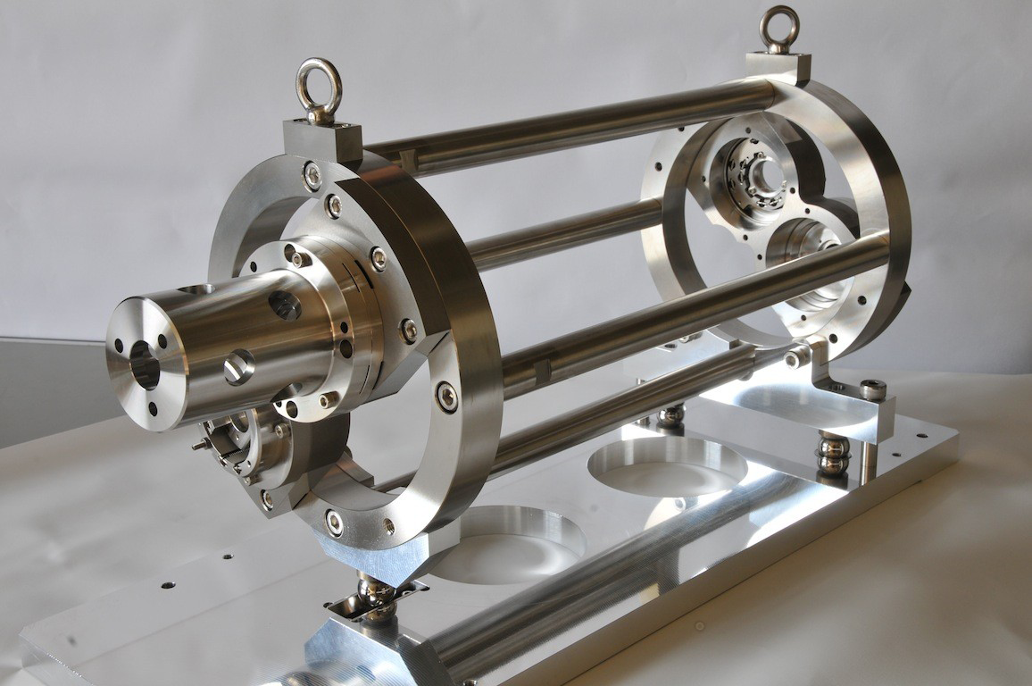
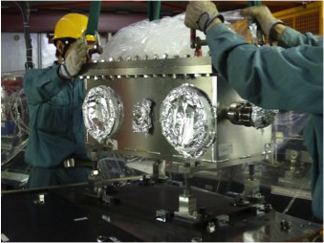
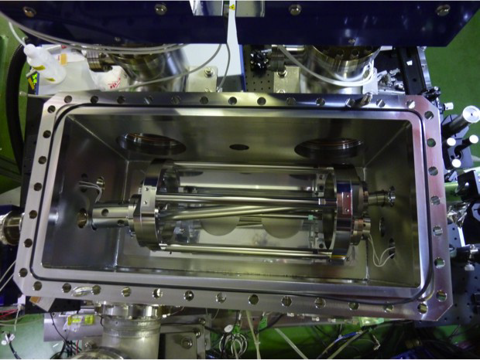
2011 Autumn: KEK-Hiroshima 4M Cavity Installation
by T.Omori

Slide 26
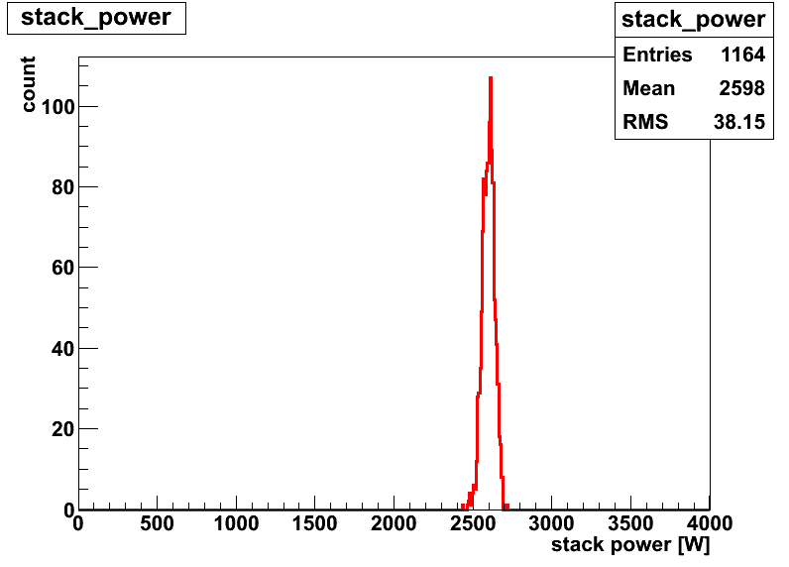
Stable resonance with small spot size
Stable resonance by new feedback sys. (analog)
2.6kW average power w/ 1.4% fluctuation
laser waist size at IP(σ)=13um (vertical scan)
Finesse 4040+-110 (Enhance = 1200)
2.6kW stacking
38W
4pm
(1.4%)
13um (V)
by T.Omori
stack power [W]

Slide 27
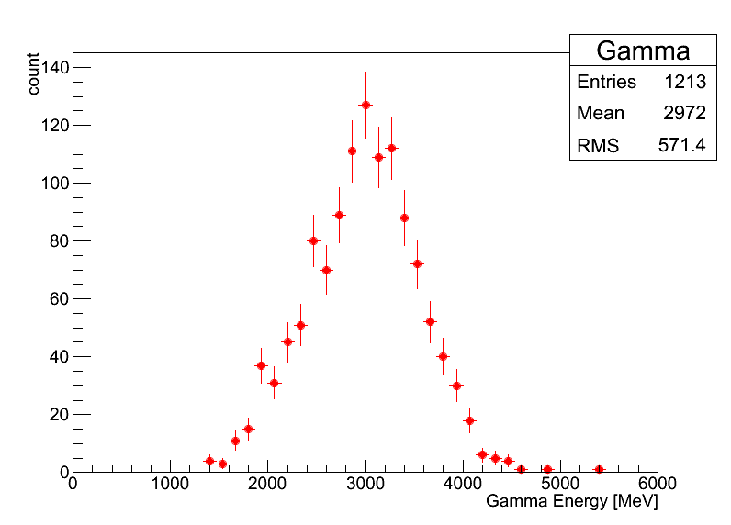
γ-ray Generation / electron
5bunches/train
laser
e-
γ
5.6ns
2970±20 MeV
⇒ ~128γs/trainのガンマ線に相当
ATF 2.16MHz
~2.6×10⁸/sec
Eγ[MeV]
by T.Omori

Slide 28
Summary
by T.Omori
Optical Cavity at the ATF is in progress for Polarized positron source for the ILC
  Good collaboration between France – Japan team
    information / technology exchange
R&D of 4 mirror ring cavities are in progress
  Sophisticated mechanism aminig very high laser power enhancement ,,, French team
  Relatively simple but new cavity control practical experience w/ the ATF ,,, Japanese team
Next Step (2013 and ,,,)
  France : Laser with CEP control (ongoing@LAL)
    Summer: Re Install whole system
  Japan: Finesse 48,000 (16600 enhancement)
  Japan: Digital Feedback (ongoing)

Slide 29
Application for the DR Laser Wire
2-mirror → 4-mirror
Improve the reliability of system
Pulsed laser→ increase intensity→ faster measurement

Slide 30
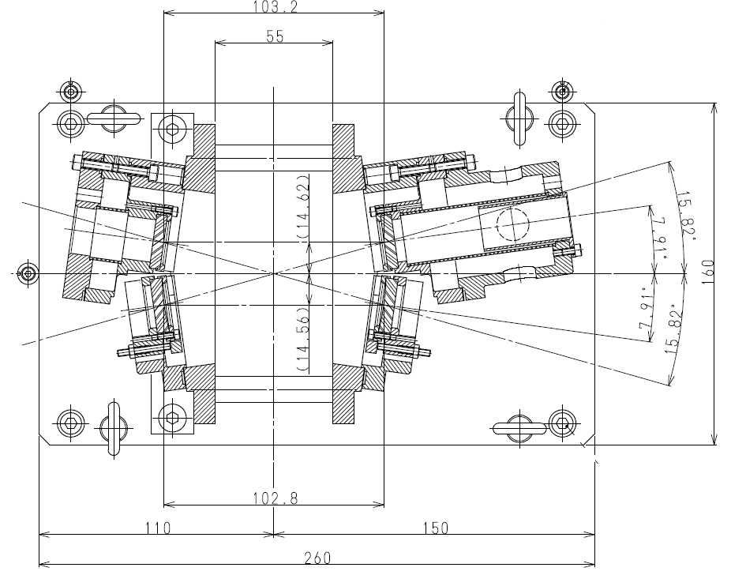
Design Of Mirror holders & Mirror Alignment scheme
Short PZT Actuator
Long PZT Actuator
Reflection
Plane
Injection
Transmission
Transmission
Concave
Concave
Cavity length is 102.8 mm only , and side by side mirror distance is kept to 29.2 mm
by R.Arpit, ATF2 project meeting

Slide 31
Parameters of Compact 4 mirror laser wire in comparison to old 2 mirror laser wirer system
Parameter | 2 mirror Horizontal wire | 2 mirror Vertical wire | 4 mirror laser wire
Reflectivity of mirrors | 99.1%, 99.9% | 99.8%, 99.9% | 99.9%,99.99%,99.99%,99.99%
Mirror curvature | 20 mm | 20 mm | 101.81 mm
Finesse (measured) | 620 | 1700 | 4126.6
Power gain | 660 | 1300 | 2000
Waist size ( value) | 5.7 um | 14.7 um | (6 um,14 um)
Wavelength | 532nm (CW green) | 532 nm (CW green) | 532 nm (Pulsed green, 714 M Hz)
MERITS
1. Four mirror resonator reduces the sensitivity to the misalignment of mirror compared to two mirror resonator, thus more stable.
2. CW laser wire system takes more time in scanning of electron beam compare to Pulsed laser. Pulsed Compact resonator will take less than one minute to scan electron beam profile
3. With pulsed laser wire, more efficient laser-beam collision can be realized
4. High Finesse and high enhancement factor is achieved in 4 mirror pulsed laser wire system in comparison to 2 mirror laser wire system
by R.Arpit, ATF2 project meeting

Slide 32



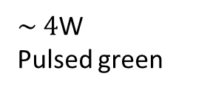
Preparation of Pulsed Green Laser oscillator
PCF based
Main Amplifier
SHG using Non Linear Crystal
4 Mirror
Compact Cavity
$\sim$20 W
$\sim 4$W
Pulsed green
2nd harmonics Generation
$2$ W
Yb doped
Fiber
Pre Amplifier
700 m W
Fiber coupler
714 M Hz IR LASER OSCILLATOR
We are now working on development of fiber amplifier in order to obtain high power green laser beam.
We achieved 2 W IR power after Yb doped fiber amplifier.
Conversion efficiency of Non linear crystal for 2nd harmonics generation is 15 -20 %, so we have to achieve good amount of IR pulsed power after Photonic crystal fiber based main amplifier system.
by R.Arpit, ATF2 project meeting

Slide 33
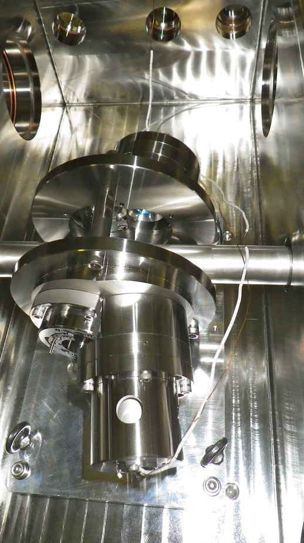
New Laserwire in ATF DR
It was installed in January 2013.
Unfortunately the cavity was out of the range for the possible DR frequency changes.
Removed from DR in May 2013.
Re-optimization of cavity and re-installation wil be done in this summer
The improvement of the laser amplifier is also ongoing.
Hope to run in following autumn runs.

Slide 34
Summary
Emittance of the ATF DR is typically 10 pm recently.
  It is tuned within a shift in every startup of ATF.
  No more tuning had not been done in recent years because of the ATF2 priority.
Small emittance study toward 2 pm should be resumed.
Cavity Compton studies are also resumed.
Others
  TBT by Yevs (next talk)
  CLIC issues will be planned but mostly at EXT/ATF2.

Slide 35
Schedule? of ATF-DR since 2013
JFY
2013
2014
4
7
10
1
4
7
10
1
ATF2(50%)
(10pm or less)
Others (50%)
1~2pm
DR-LW
installation
Cavity Comptons
Laser Re-installation
Return to LAL?
LAL
Hiroshima/KEK
CLIC etc.?

