Slide 1
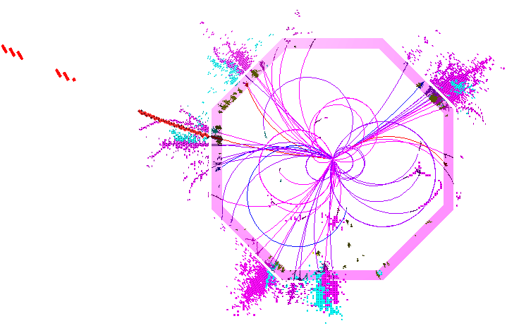
PandoraPFA: Status for ILD
ILD Analysis/Software Meeting, 26/09/2012
J.S. Marshall, University of Cambridge

Slide 2
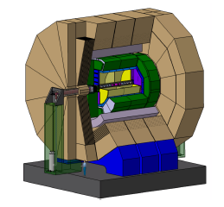
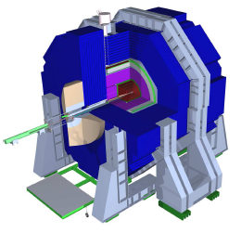
Overview
Recent Ilcsoft changes, especially new tracking, have affected the particle flow reconstruction.
Pandora algorithms are isolated from these changes by the MarlinPandora client app.
MarlinPandora is responsible for performing the following software/detector-specific tasks:
Providing calibrated energy values for each calorimeter cell,
Making quality cuts for all input inner-detector tracks and calorimeter cells,
Specifying information about inner-detector tracks and their relationships (kinks, prongs, etc.).
Will now discuss changes to MarlinPandora...
Isolate specific detector and software details, creating self-describing hits, tracks, etc.
Run registered algorithms/tools and perform book-keeping
Pandora Framework
Pandora Client Application
Algorithm Manager
CaloHit Manager
API
Cluster Manager, etc.
ILD/Marlin
SiD/org.lcsim

Slide 3
Single Particle Calibration
With any important change to simulation or reconstruction, need to perform calibration.
PandoraAnalysis package contains Marlin processors and simple binaries to ease this process.
Ensure that Mokka hits are calibrated, using following MC samples:
5,000 10GeV photons, with flat cos(θ) and φ distributions,
5,000 10GeV K_{L}, with flat cos(θ) and φ distributions,
5,000 10GeV muons, with flat cos(θ) and φ distributions.
Determine PandoraPFA MIP calibration constants, using the muon sample.
Identify the PandoraPFA constants (below). We might expect these to just be 1.0, but need to account for mip cuts applied in MarlinPandora and also for PandoraPFA isolation cuts.
ECAL_To_EM_GeV
ECAL_To_HAD_GeV
HCAL_To_EM_GeV
HCAL_To_HAD_GeV
MUON_To_GeV
Ultimately, aim to optimise jet energy reconstruction: quantify performance using Z→uds events.

Slide 4
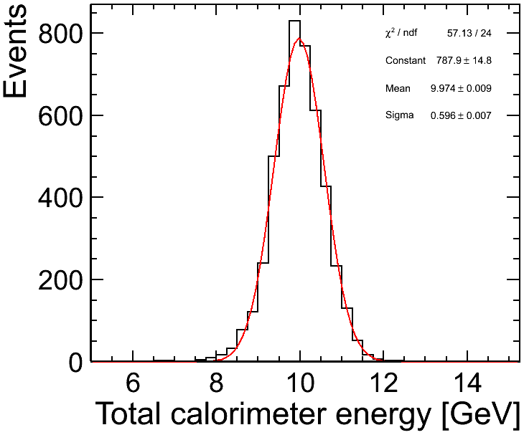
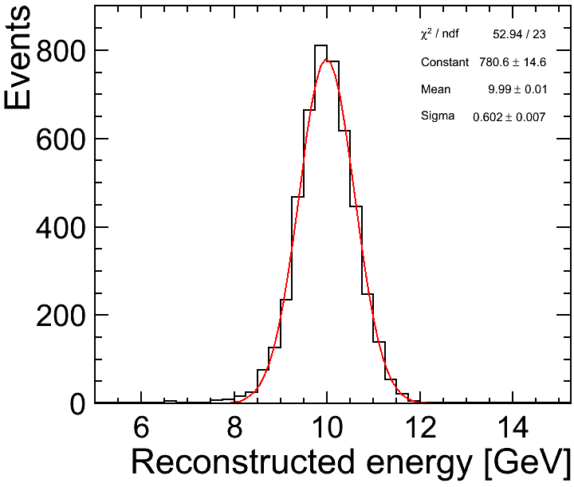
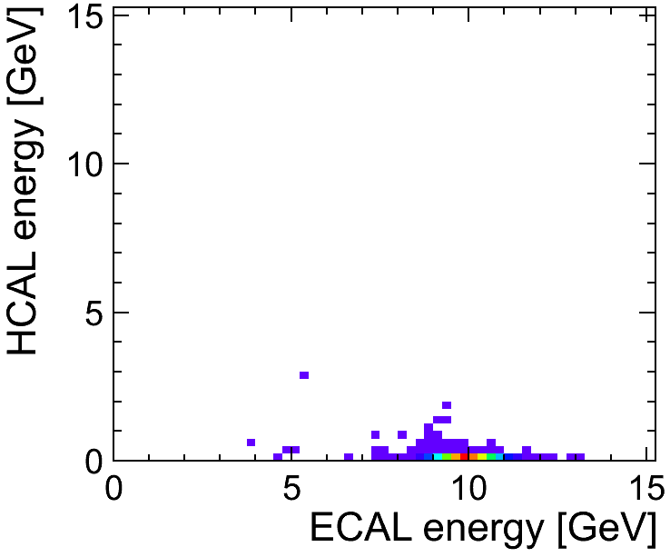
EM Calibration
EM calibration rather straightforward.
Change CalibrECAL from 40.91, 81.81 to 42.91, 85.82
Pandora constants: ECAL_To_EM_GeV=1.007
HCAL_To_EM_GeV=1.007
HCAL To EM constant not too important

Slide 5
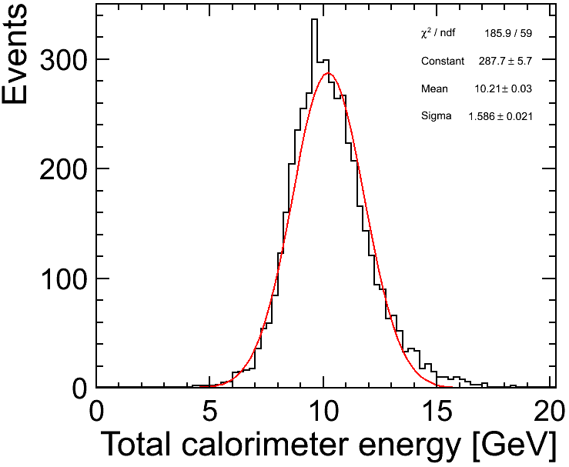
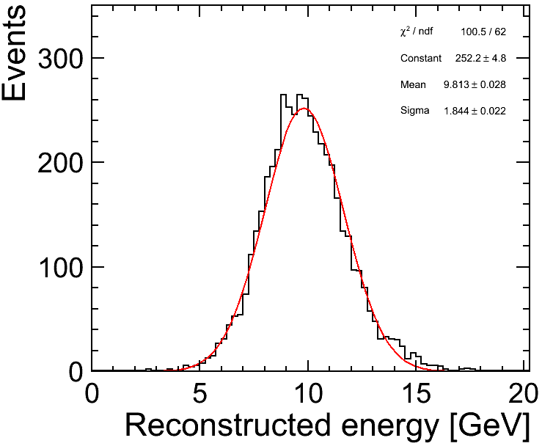
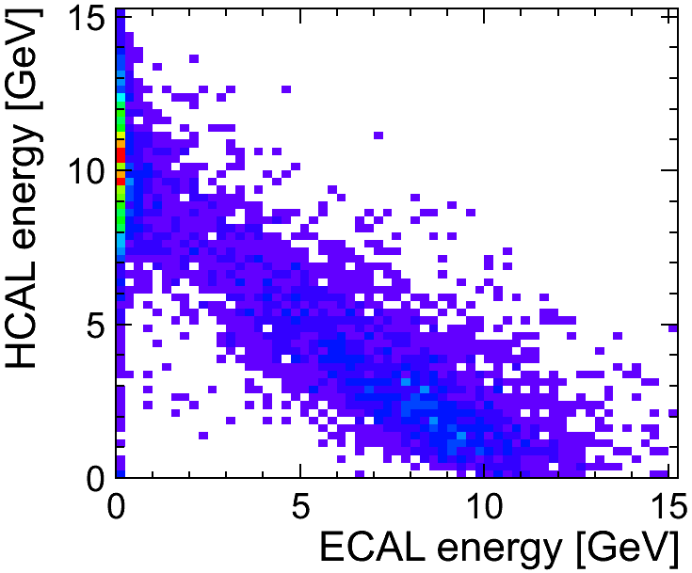
HAD Calibration
HAD calibration needs to account for division of K_{L} energy between ECAL/HCAL
Change CalibrHCAL from 34.80 to 54.70
Pandora constants: ECAL_To_HAD_GeV=1.12
HCAL_To_HAD_GeV=1.07

Slide 6
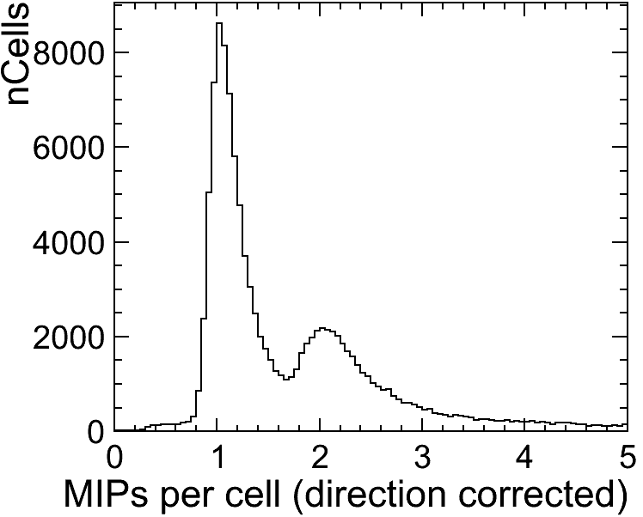
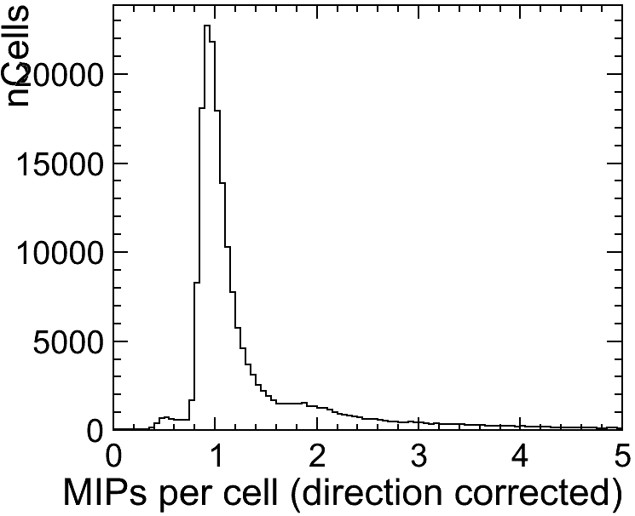
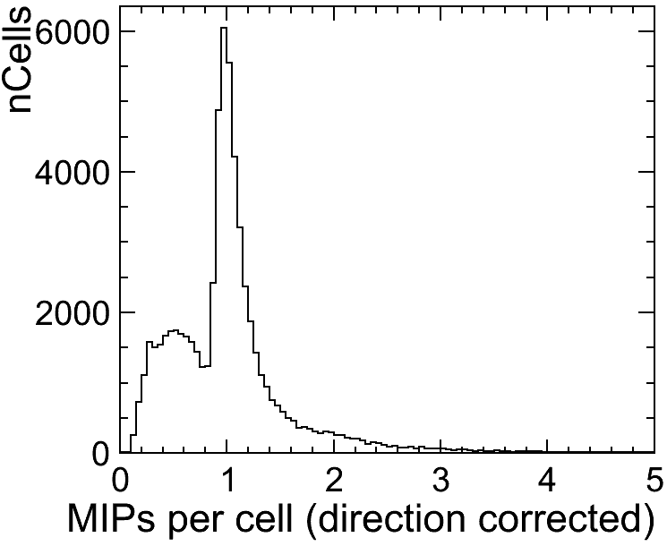
MIP Calibration
ECAL
HCAL
MIP constants: ECAL_To_MIP=160.0 HCAL_To_MIP=34.8 MUON_To_MIP=10.0
Need to change product of CalibrMUON and MUON_To_MIP from 100,000 to 567.
Choose to keep MUON_To_MIP unchanged, intermediate MUON_To_GeV becomes 56.7.
MUON

Slide 7
TruthTracker
Frank, Steve, Mark and I met in Cambridge in June to address impact of new tracking on PFA. Quickly decided best approach was to decouple PFA development from tracking development.
A “TruthTracker” was created, providing level of tracking performance to which full reconstruction aspires.
This TruthTracker (ask Frank or Steve for details) proved vital for understanding the PFA performance and then modifying the way that MarlinPandora handles input tracks:
Now copy track states directly from input lcio tracks to Pandora tracks, rather than performing helix fits in MarlinPandora TrackCreator class.
Small changes made to the way that Pandora track↔track relationships are handled in MarlinPandora and to the way these relationships affect Pandora track quality flags.
Initially focused on performance for low energy jets (using 91GeV Z→uds events), for which the track reconstruction, and the usage of low p_{T} tracks, has largest impact on final jet energies.

Slide 8
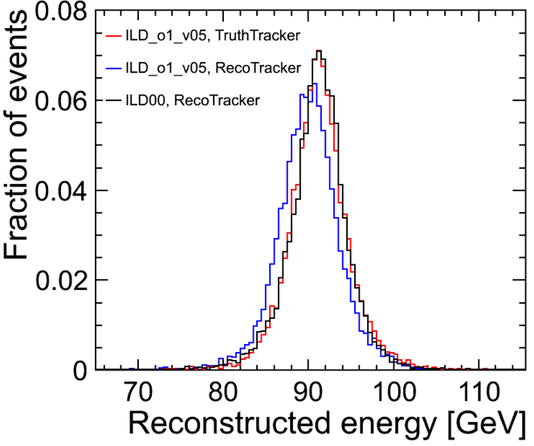
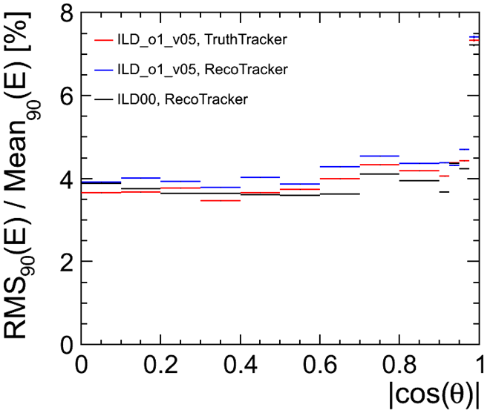
Ilcsoft v01-14
10,000 events
91GeV, 10,000 events
E_{jj} (= 2 * E_{j}) | 91GeV | 500GeV
ILD_o1_v05 TruthTracker | σ_{E}/E: 3.71 ± 0.05 mean: 91.24 GeV | σ_{E}/E: 3.30 ± 0.04 mean: 506.71 GeV
ILD_o1_v05 RecoTracker | σ_{E}/E: 3.98 ± 0.05 mean: 89.98 GeV | σ_{E}/E: 3.32 ± 0.04 mean: 504.79 GeV
ILD_00 RecoTracker | σ_{E}/E: 3.69 ± 0.05 mean: 91.59 GeV | σ_{E}/E: 3.43 ± 0.04 mean: 499.70 GeV

Slide 9
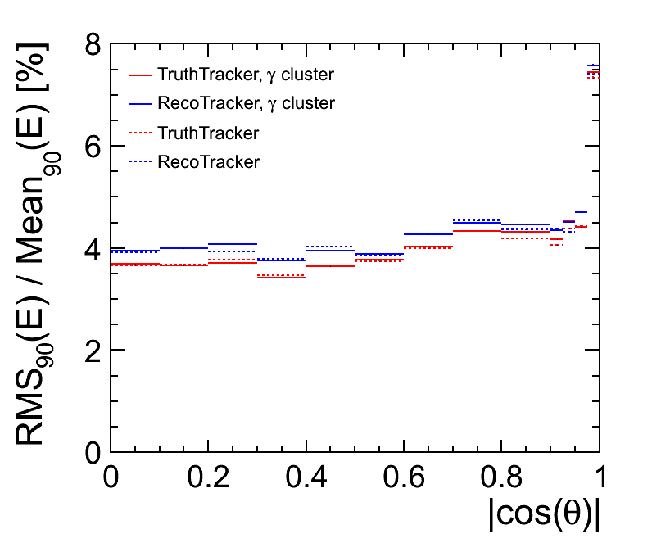
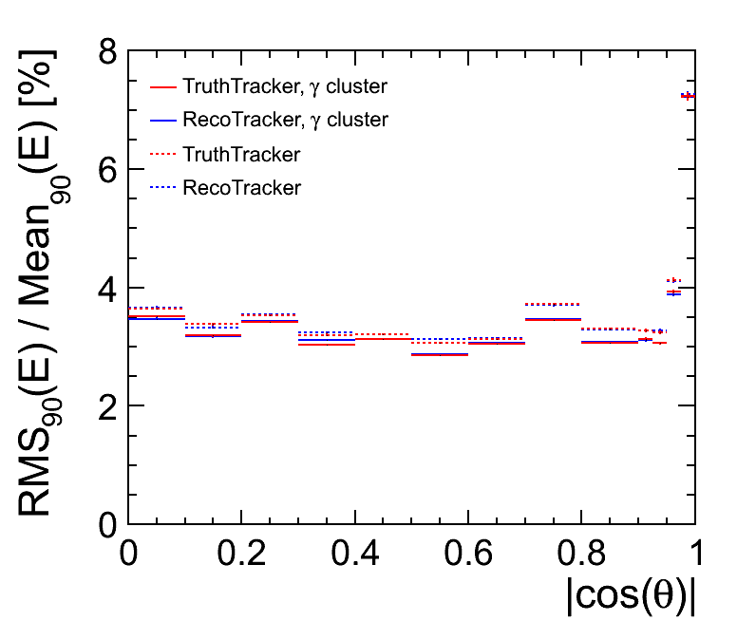
Pandora Settings
At this point, also adopted latest Pandora steering file: includes standalone muon and photon reconstruction algorithms (which reduce confusion), plus a managed transition to energy flow.
91 GeV, 10,000 events
500GeV, 10,000 events
E_{jj} (= 2 * E_{j}) | 91GeV | 500GeV | 91GeV γ Cluster | 500GeV γ Cluster
ILD_o1_v05 TruthTracker | σ_{E}/E: 3.71 ± 0.05 mean: 91.24 GeV | σ_{E}/E: 3.30 ± 0.04 mean: 506.71 GeV | σ_{E}/E: 3.69 ± 0.05 mean: 91.28 GeV | σ_{E}/E: 3.15 ± 0.04 mean: 507.06 GeV
ILD_o1_v05 RecoTracker | σ_{E}/E: 3.98 ± 0.05 mean: 89.98 GeV | σ_{E}/E: 3.32 ± 0.04 mean: 504.79 GeV | σ_{E}/E: 3.93 ± 0.05 mean: 90.29 GeV | σ_{E}/E: 3.16 ± 0.04 mean: 505.14 GeV

Slide 10
Ilcsoft v01-15-02-pre05
New tracking code finalised in Ilcsoft pre-release v01-15-02-pre05, giving performance figures:
E_{jj} (= 2 * E_{j}) | 91GeV | 500GeV
ILD_o1_v05 RecoTracker | σ_{E}/E: 3.73 ± 0.05 mean: 91.14 GeV | σ_{E}/E: 3.12 ± 0.04 mean: 506.39 GeV
Reconstruction now complete. However, can obtain further improvements if choose to optimise calibration for jet energy reconstruction, rather than single particle reconstruction.
Reducing hadronic energy scale improves jet energy resolution, reducing impact of fake neutral hadrons, created from charged hadron fragments. Cannot reduce much, as affects reclustering.
E_{jj} (= 2 * E_{j}) | 91GeV | 500GeV
1.00 * ECALToHAD, 0.95 * HCALToHAD | σ_{E}/E: 3.65 ± 0.05 mean: 90.75 GeV | σ_{E}/E: 2.99 ± 0.04 mean: 501.75 GeV
0.95 * ECALToHAD, 0.95 * HCALToHAD | σ_{E}/E: 3.64 ± 0.05 mean: 90.57 GeV | σ_{E}/E: 2.97 ± 0.04 mean: 499.06 GeV
0.96 * ECALToHAD, 0.96 * HCALToHAD | σ_{E}/E: 3.65 ± 0.05 mean: 90.49 GeV | σ_{E}/E: 2.97 ± 0.04 mean: 500.57 GeV
0.97 * ECALToHAD, 0.97 * HCALToHAD | σ_{E}/E: 3.68 ± 0.05 mean: 90.71 GeV | σ_{E}/E: 2.97 ± 0.04 mean: 501.73 GeV

Slide 11
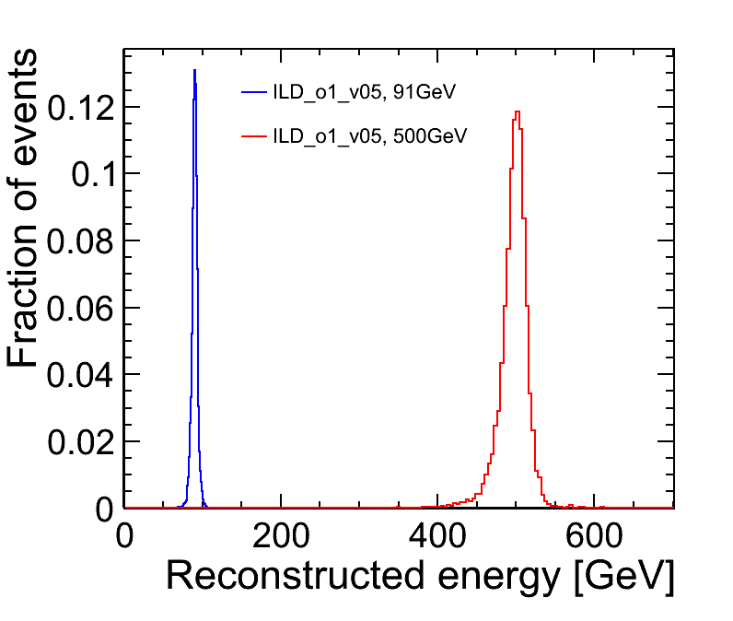
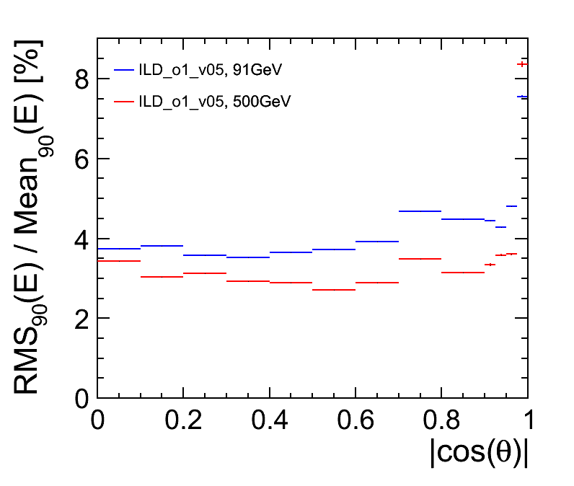
Final Z→uds Results
10,000 events
10,000 events
E_{jj} (= 2 * E_{j}) | 91GeV | 500GeV
ILD_o1_v05 v01-15-02-pre05 | σ_{E}/E: 3.65 ± 0.05 mean: 90.49 GeV | σ_{E}/E: 2.97 ± 0.04 mean: 500.57 GeV

Slide 12
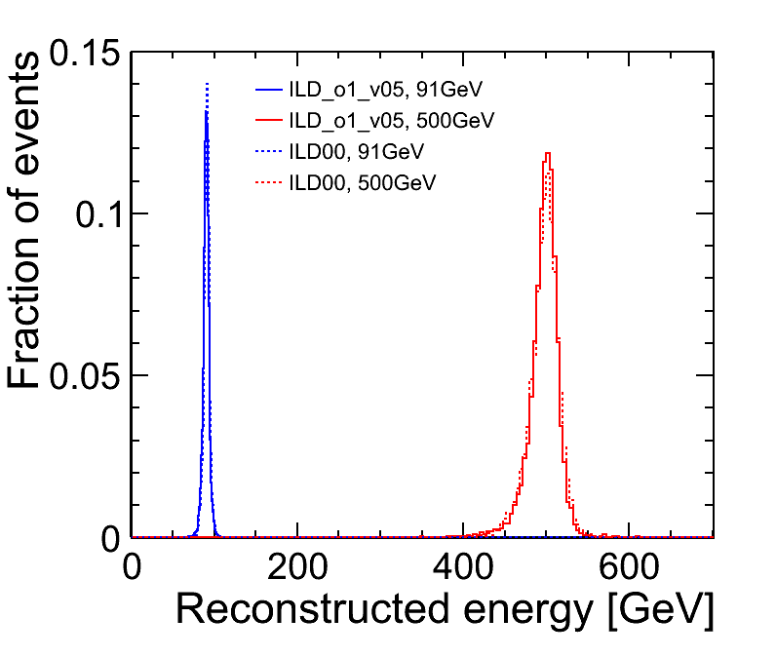
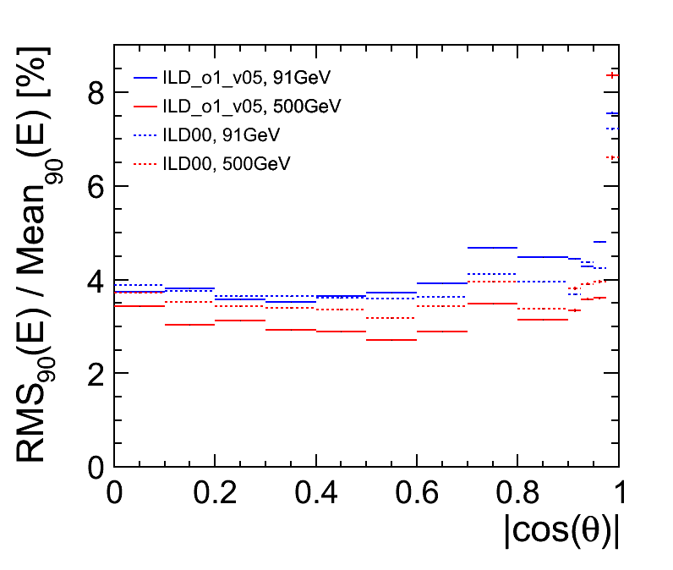
Final Z→uds Results
10,000 events
10,000 events
E_{z} (= 2 * E_{j}) | 91GeV | 500GeV
ILD_o1_v05 v01-15-02-pre05 | σ_{E}/E: 3.65 ± 0.05 mean: 90.49 GeV | σ_{E}/E: 2.97 ± 0.04 mean: 500.57 GeV
ILD00 v01-14, old steering | σ_{E}/E: 3.69 ± 0.05 mean: 91.59 GeV | σ_{E}/E: 3.43 ± 0.04 mean: 499.70 GeV

Slide 13
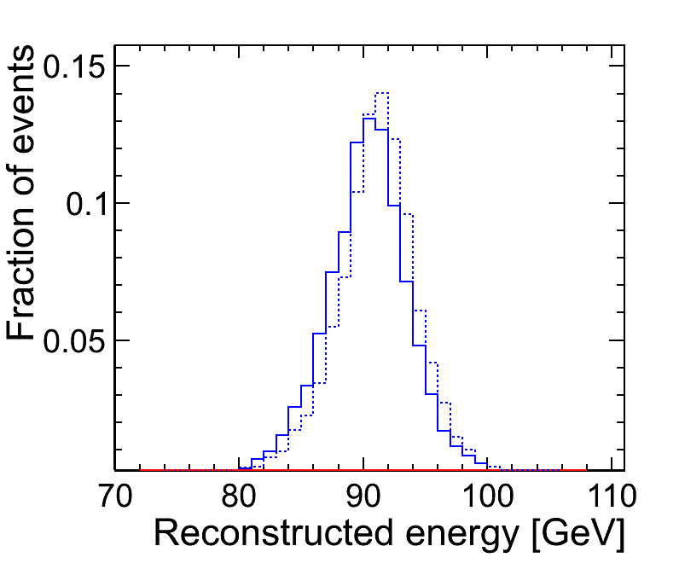
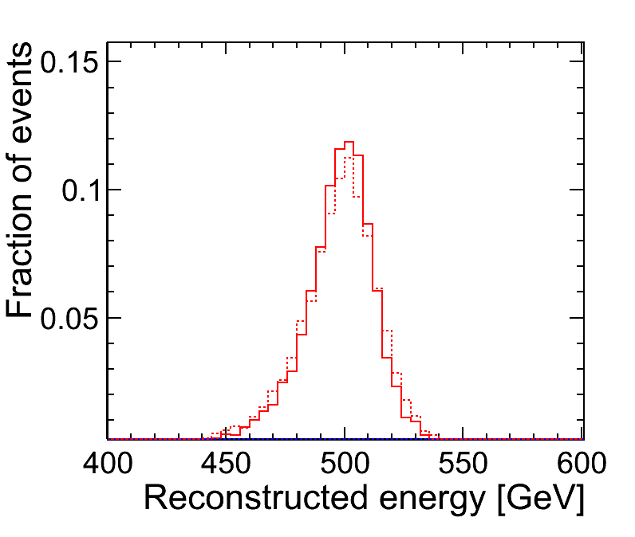
Final Z→uds Results
10,000 events
10,000 events
E_{z} (= 2 * E_{j}) | 91GeV | 500GeV
ILD_o1_v05 v01-15-02-pre05 | σ_{E}/E: 3.65 ± 0.05 mean: 90.49 GeV | σ_{E}/E: 2.97 ± 0.04 mean: 500.57 GeV
ILD00 v01-14, old steering | σ_{E}/E: 3.69 ± 0.05 mean: 91.59 GeV | σ_{E}/E: 3.43 ± 0.04 mean: 499.70 GeV

