Slide 1
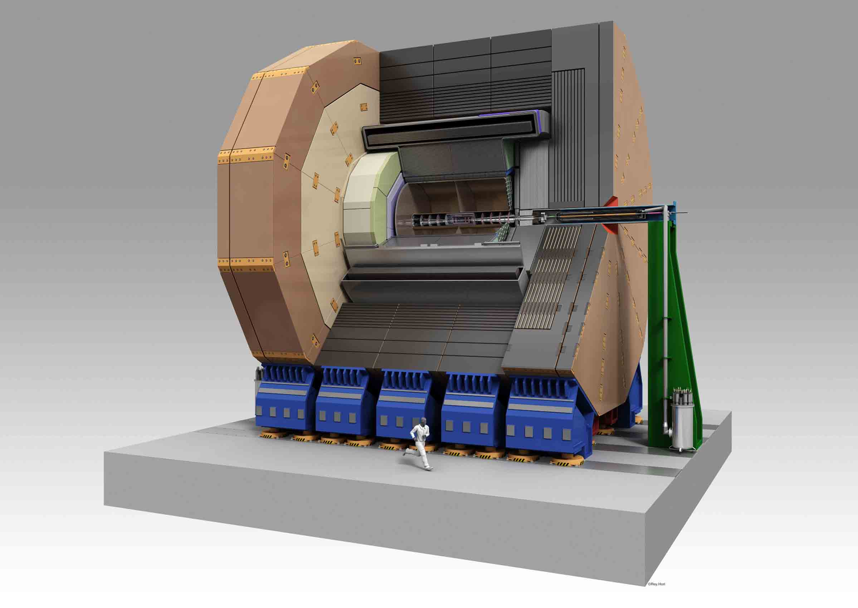
ILD
Yasuhiro Sugimoto (KEK)
for ILD concept group
2012/12/14
ILC PAC @KEK

Slide 2
Outline
Introduction
Sub-systems
ILD system
ILD performance
Cost
Summary

Slide 3
Introduction

Slide 4
Events on ILD since last PAC
May 15-16: ILC PAC @Fermilab
  ILD status report by Graham Wilson
May 23-25: ILD Workshop @Kyushu Univ.
Sep.28: ILD DBD 0th draft sent to IDAG
  Many holes, particularly in physics analysis section
Oct. 22-26: LCWS2012 @UTA
  IDAG review
  ILD meeting (discussed mainly physics analysis)
Nov. 30: Submission of ILD DBD draft
  Draft is quite complete
  Results of benchmark analysis is still preliminary
  Delay in finalization of the numbers of costing

Slide 5
ILD philosophy
Detector for precision measurement
Excellent jet energy resolution by PFA
  Calorimeters inside the solenoid of 3.5T
  High granularity calorimeters (ECAL + HCAL +FCAL)
  Large size detector for particle separation in space and excellent momentum resolution
Powerful tracking system (micro-pixel vertex detector + Si trackers + TPC) for high momentum resolution, efficient track reconstruction and flavor tagging
Hermetic coverage down to 5mrad

Slide 6
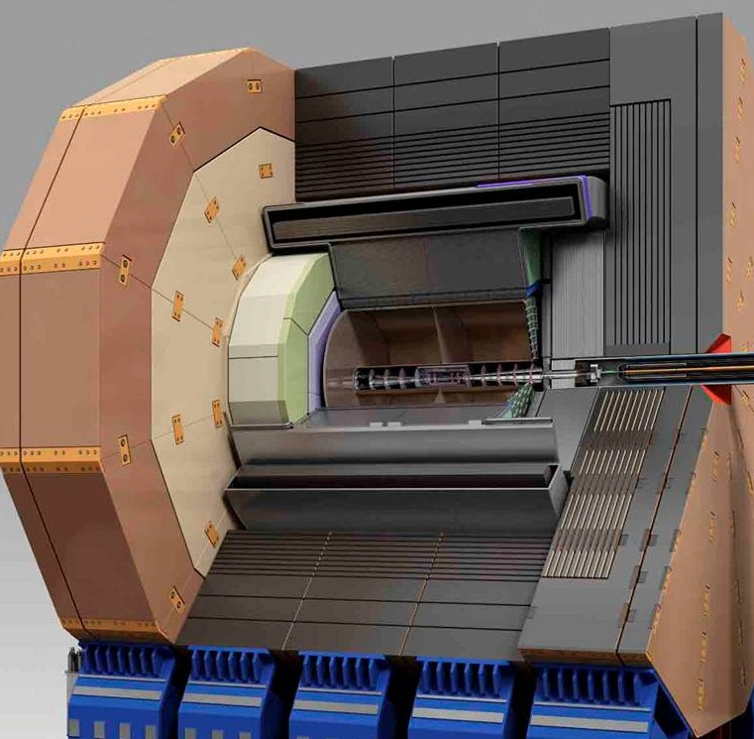
ILD
Muon system/yoke
Solenoid coil
HCAL
ECAL
TPC
LumiCAL
BeamCAL
FCAL
LHCAL
FTD
SIT
VTX

Slide 7
ILD baseline
 | Sensor options for baseline design |  |  | Alternative
VTX | CMOS | FPCCD | DEPFET
SIT | False double-sided strip |  |  | Double-sided strip
FTD 1-2 | CMOS | FPCCD | DEPFET
FTD 3-7 | False double-sided strip
TPC | GEM | MicroMEGAS |  | Pixel readout
ECAL | W-Si pad | W-Scintillator strip |  | W-Pixel
HCAL | Analog (Scintillator) | Semi digital (RPC) | ← Mechanical structure is also different
FCAL | W-Si / GaAs | W-Si / Diamond
Muon | Scintillator strip |  |  | RPC

Slide 8
Sub-systems

Slide 9
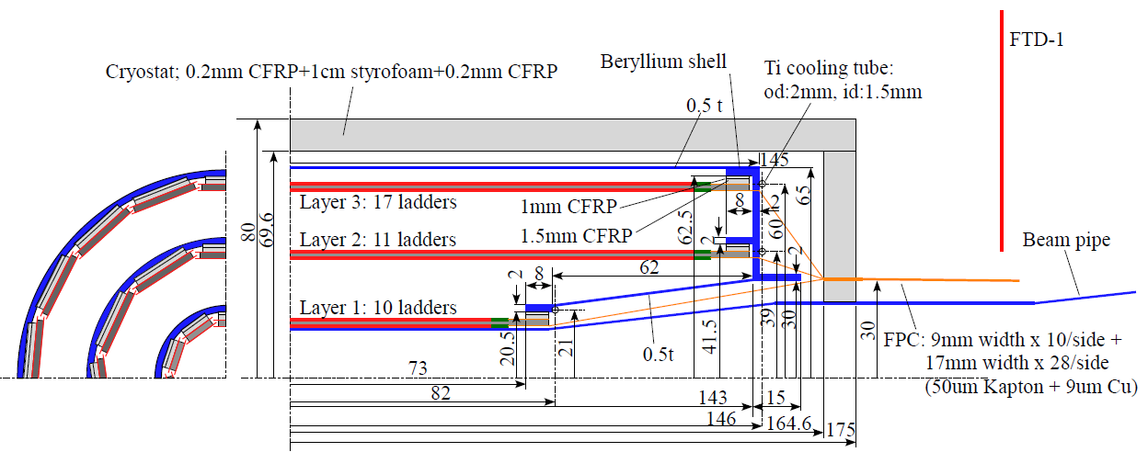
Vertex detector
Excellent impact parameter resolution better than 5⊕10/pβsin^{3/2}θ is required for efficient flavor tagging
3 layers of double-sided ladders (6 pixel layers)
  Effect on pair-background rejection is expected, but not demonstrated yet
Barrel only: |cosθ|<0.97 for inner layer and |cosθ|<0.9 for outer layer
Point resolution <3um for innermost layer
Material budget: 0.3%X₀/ladder=0.15%X₀/layer
Sensor options: CMOS, FPCCD, DEPFET

Slide 10
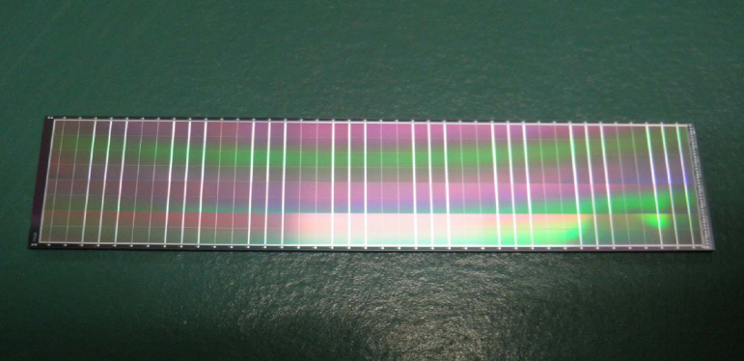
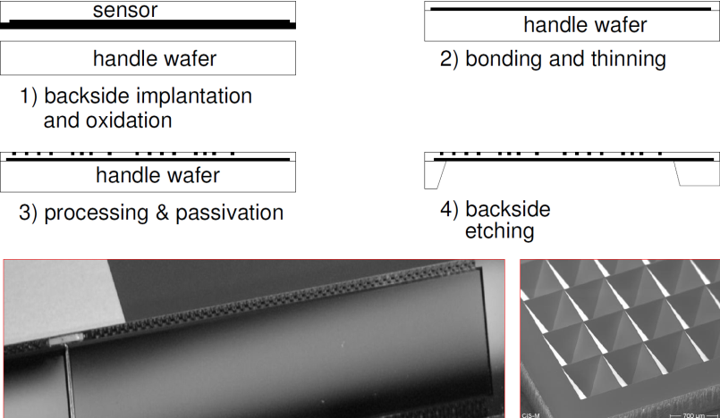
Vertex detector
CMOS option
  Pixel size: 17x17(L1), 17x85(L2), 34x34(L3-6)
  Frame readout time: 10us~100us
  Power consumption: 600W → 10W by power pulsing
FPCCD option
  Pixel size: 5x5 (L1-2), 10x10(L3-6)
  Readout between trains
  Power consumption: ~40W (no power pulsing)
DEPFET option
  Experience at Belle-II
  Frame readout time: 50us~100us
  5-single layer of all-Si ladder option
Cooling
  CO2 cooling for FPCCD
  Additional material budget is small: 0.3%X₀ in end-plate 0.1%X₀ in cryostat
  Air cooling for CMOS/DEPFET
FPCCD real size (12x62.4mm²) prototype
DEPFET all Si ladder

Slide 11
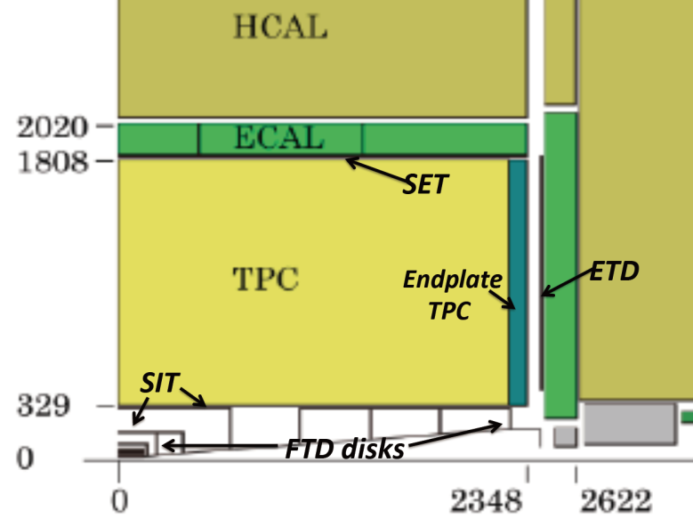
Silicon tracking system
Silicon tracking system
  SIT (Silicon Inner Tracker)
  SET (Silicon External Tracker)
  ETD (Endcap Tracking Detector)
  FTD (Forward Tracking Detector)
Role of Silicon tracking system
  Additional precise space points
  Improvement of forward coverage
  Alignment of overall tracking system
  Time stamping
SIT/SET/ETD
  Two/one/one false double-sided layers of Si strip
  Material budget: 0.65%X₀/layer
  Same silicon strip tiles of 10cmx10cm with 50um pitch, 200um thick, edgeless sensors will be used
  Point resolution of ~7um

Slide 12
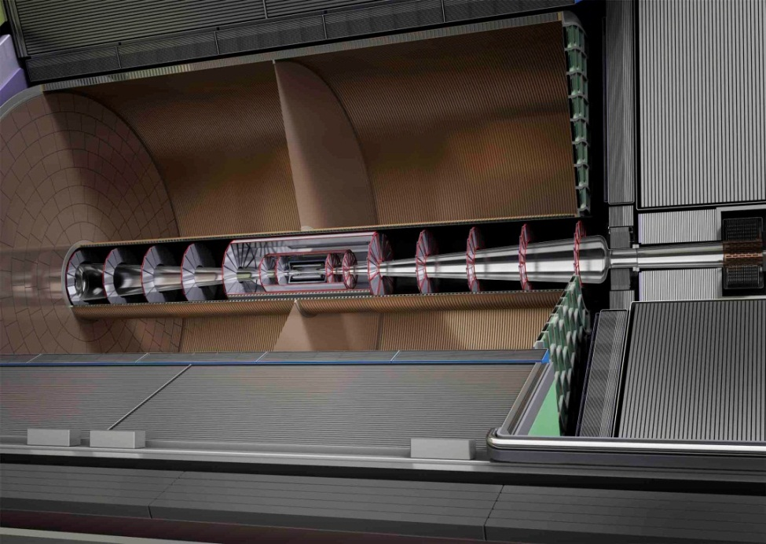
Silicon tracking system
FTD
  Two pixel discs and five false double-sided strip disks
  Pixel sensor options: CMOS, FPCCD, DEPFET
  Power consumption: 2kW/disk → 100W/disk by power pulsing
  Supercapacitor-based power distribution system
    Low current from outside and high pulse current on the readout electronics board
    Radiation hardness and lifetime to be studied

Slide 13
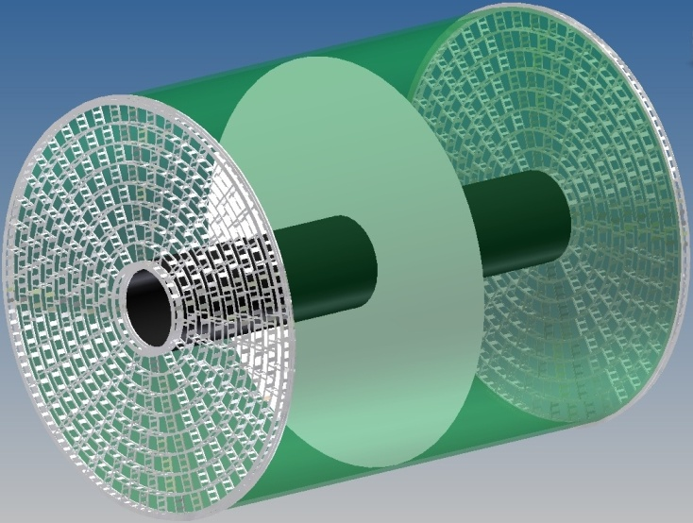
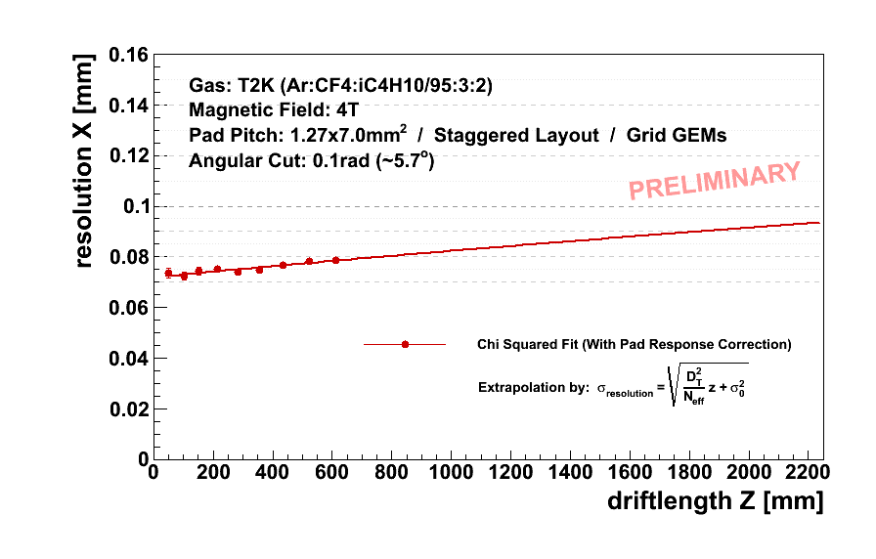
TPC
Time Projection Chamber: The central tracker of ILD
Tracks can be measured with many (~200/track) 3-dimensional r-φ-z space points
σ_{rφ}<100um is expected
dE/dx information for particle identification
Two main options for gas amplification: GEM or Micromegas
Readout pad size ~ 1x6mm² → 10⁶ pads/side
Pixel readout R&D as a future alternative
Material budget: 5%X₀ in barrel region and <25%X₀ in endplate region
Cooling by 2-phase CO2

Slide 14
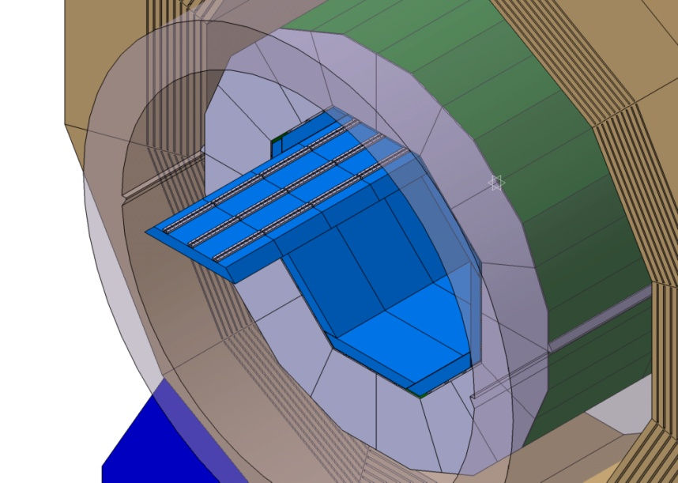
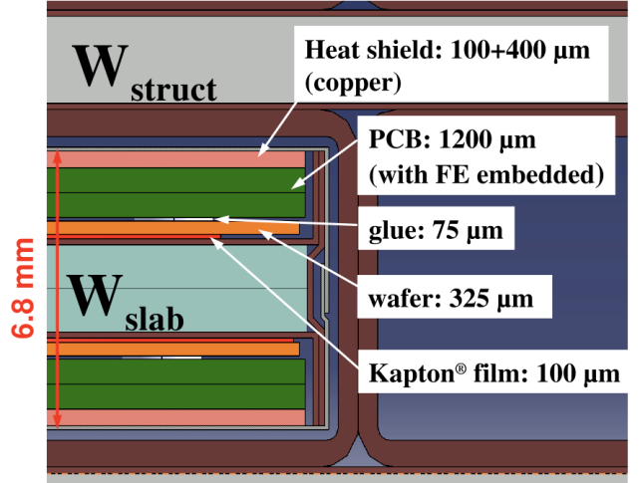
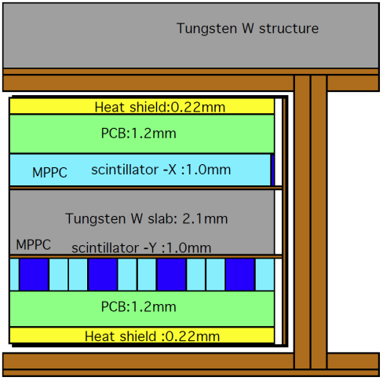
ECAL
Sampling calorimeter of tungsten absorber / Si or scintillator-strip sensitive layer sandwich
30 layers / 24X₀
Si sensor: 5x5mm² pixel size
Scintillator strip: 5x45mm², read out by MPPC
Leak-less water cooling → Other methods are also investigated

Slide 15
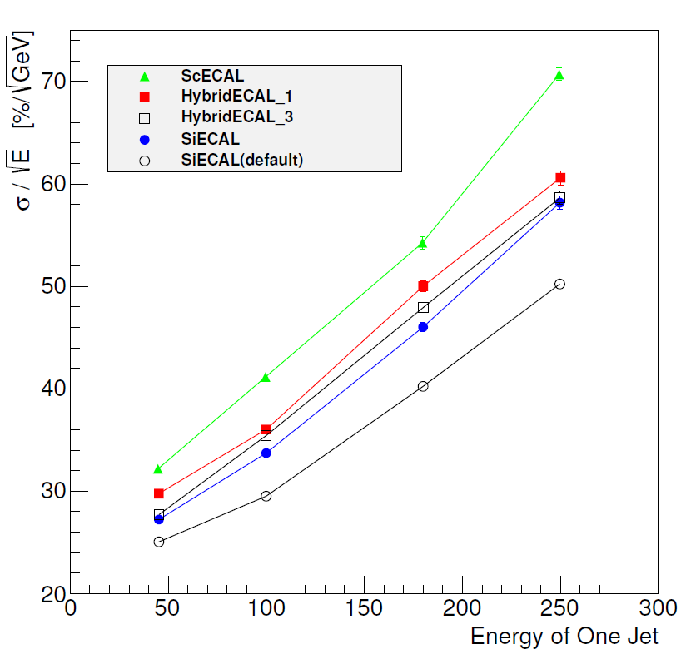
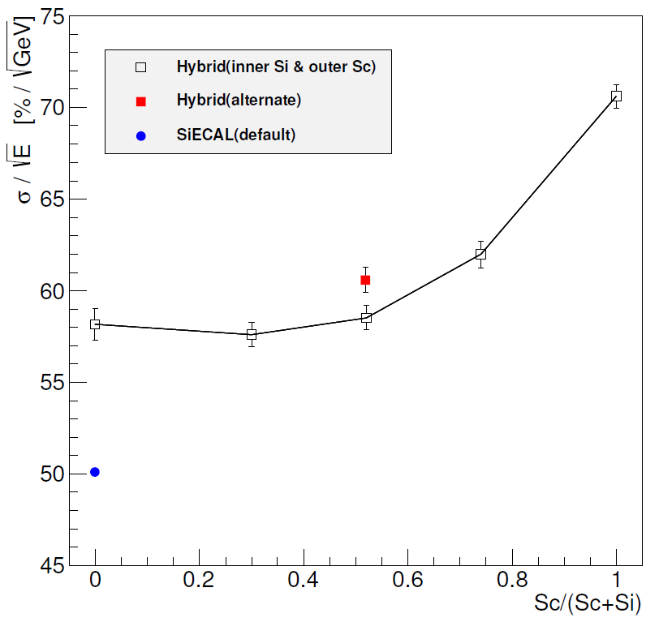
ECAL
Detector optimization
  Si sensor is one of the cost drivers of ILD
  How to reduce the cost
    Reduce inner radius ?
    Reduce number of layers ?
    Si-Scintillator hybrid →Performance is not degraded up to 50%
250 GeV jet
Number of layers is different
from the default configuration

Slide 16
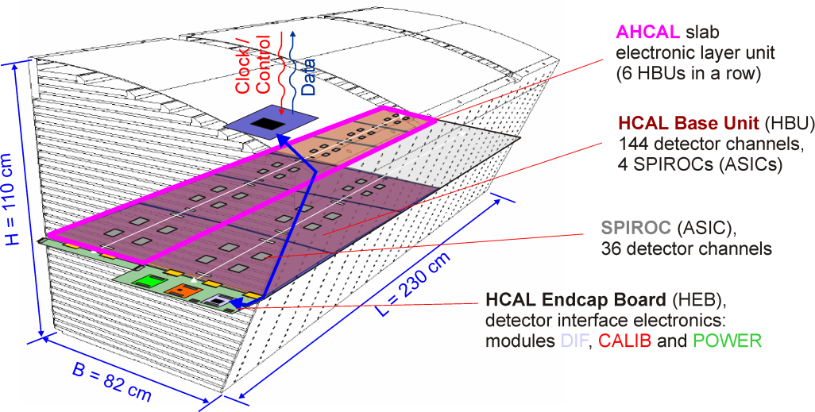
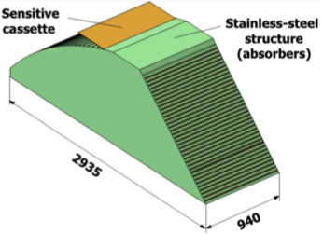
HCAL
Sampling calorimeter with steel absorber (48 layers, 6λ_{I} )
Two options for the active layer
  Scintillator tiles with analog readout → AHCAL
  Glass RPC with semi digital (2-bits) readout → SDHCAL
Different mechanical structure is proposed by the two groups
AHCAL module
SDHCAL module

Slide 17
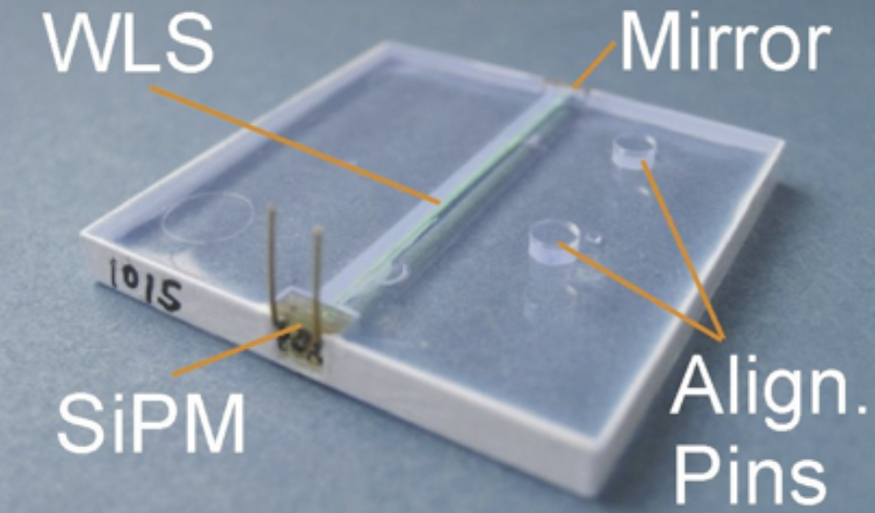
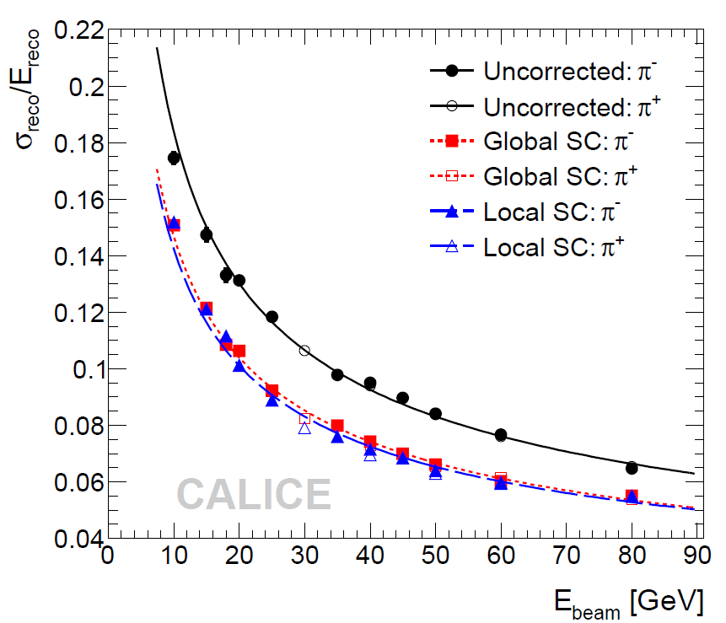
AHCAL
3x3cm² segmentation of 3mm thick scintillator read out by SiPM through wavelength shifting fiber (Elimination of WLS under study)
Software compensation (e/π ~1.2) technique was shown to work well through beam tests: 58%/E^{1/2} → 45%/E^{1/2}
Test beam results are also used for evaluation of GEANT4 physics list

Slide 18
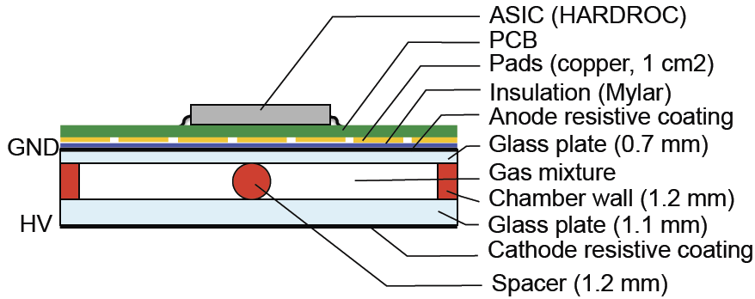
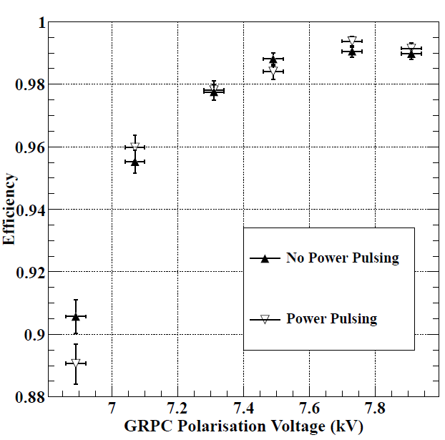
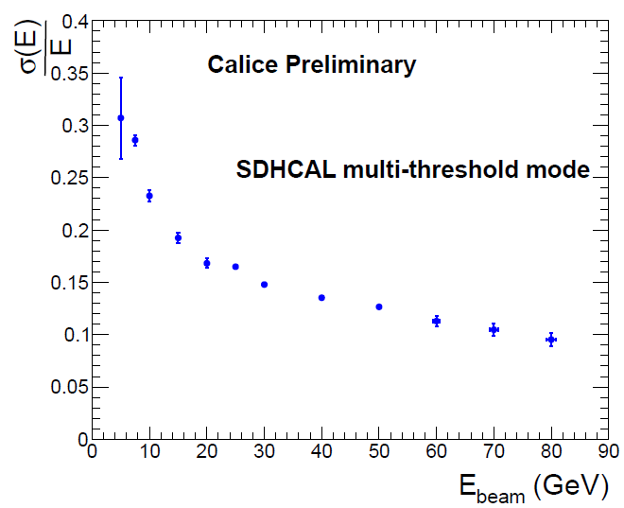
SDHCAL
Active layer: GRPC with 1.2mm gap with 1x1cm² signal pick-up pads
Demonstrated to work with power-pulsing in 3T B-field
Test beam at CERN PS and SPS
  Still better resolution is expected using more detailed analyses

Slide 19
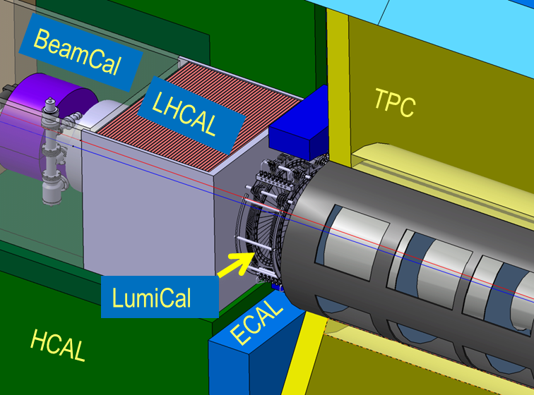
Forward calorimeters
LumiCal
  Precise (<10⁻³) luminosity measurement
BeamCal
  Better hermeticity
  Bunch-by-bunch luminosity and other beam parameter measurements (~10%)
LHCAL
  Better hermeticity for hadrons
 | Technology | Coverage
LumiCal | W-Si | 31 – 77 mrad
LHCAL | W-Si
BeamCal | W-GaAs / Diamond | 5 – 40 mrad

Slide 20
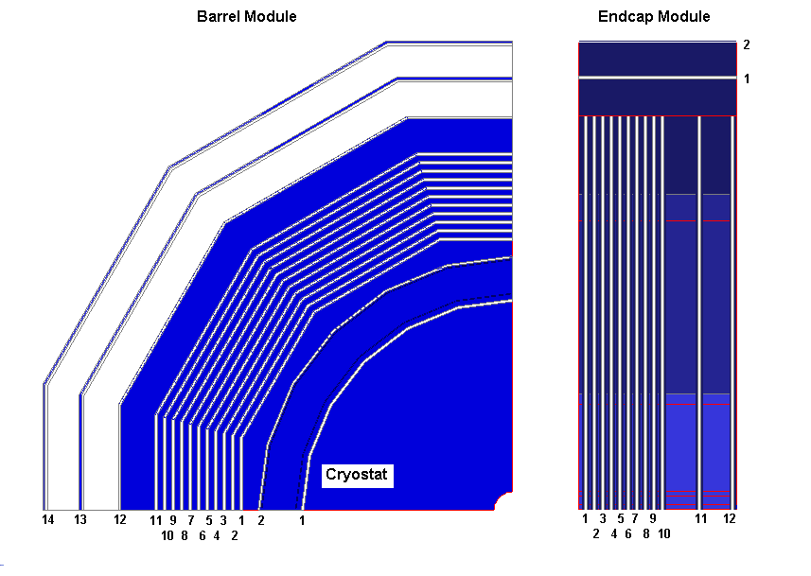
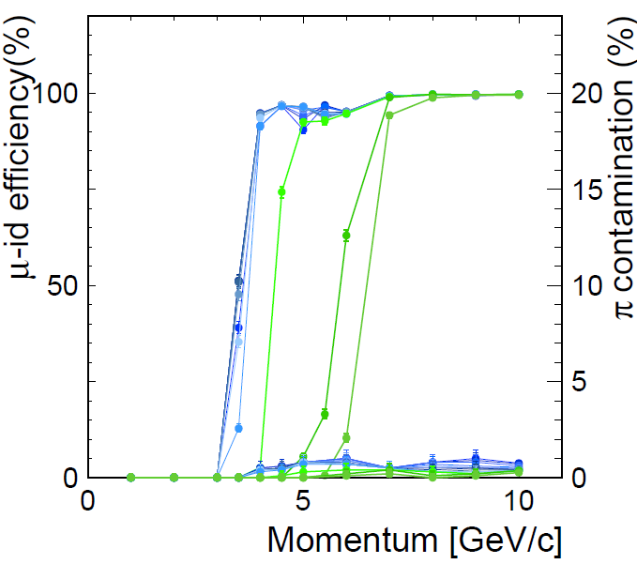
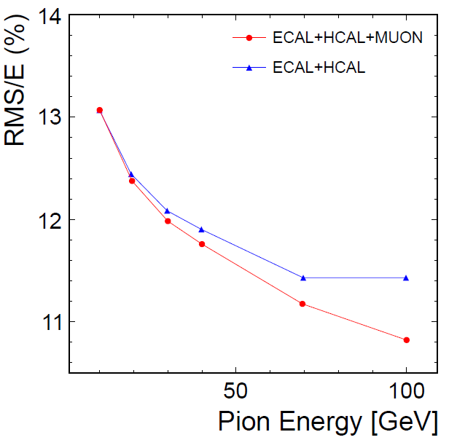
Muon system
Active layers (14 for barrel, 12 for endcap) interleaved with iron slabs of return yoke
Baseline design adopts scintillator strips + WLS fiber + SiPM readout as the active layer
RPC is considered as an alternative
Used for muon identification and as a tail catcher of the HCAL

Slide 21
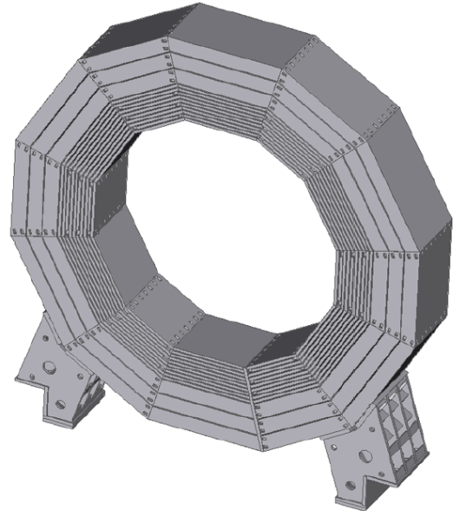
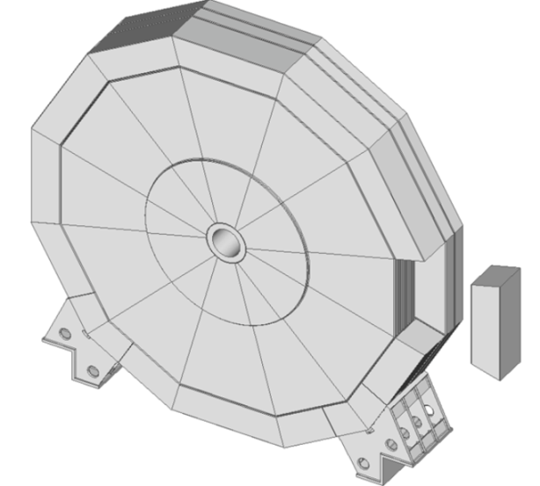
Coil and yoke
B field: Nominal 3.5T, maximum 4T
Anti-DID in the same cryostat
Self shielding in terms of radiation protection
Leakage field < 50G at 15m from IP
Magnet design
  Similar to CMS: 3 barrel rings + 2 endcaps
  Cryostat size: φ=8.8m, L=7.8m
  Coil is divided into 3 modules in z
  Cold mass = 168t
  Total weight = 13400t
  Stored energy ~2.3GJ
Yoke design
  Each barrel ring consists of 12 trapezoidal blocks of ~190t: 2300t for a ring
  Endcap yoke consists of 12 sectors: total weight~3250t/side

Slide 22
ILD system

Slide 23
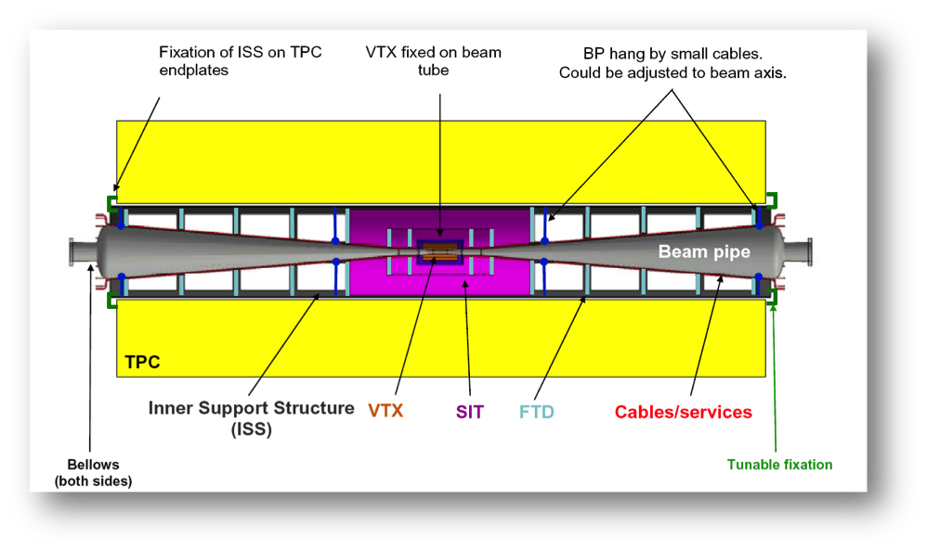
Detector integration
Yoke and magnet
  Solenoid cryostat, which supports all of the central detectors, is supported from central barrel yoke ring
  Maximum deformation of the cryostat <2.5mm
Barrel HCAL (~600t) is supported by 2 rails inside the cryostat
Barrel ECAL modules are supported by rails attached to barrel HCAL
Endcap calorimeters are supported from the endcap yoke
TPC is supported from the cryostat
Inner trackers (SIT, FTD, VTX) are housed in a inner support structure (ISS), and the ISS is supported from TPC end-plate
Forward detectors (LumiCal, BeamCal, LHCA) are supported together with QD0 from a support tube extended from the external pillar

Slide 24
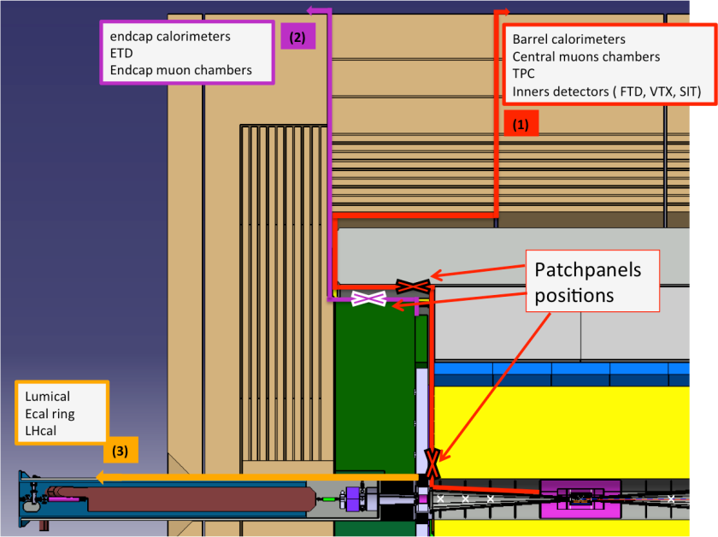
Detector integration
Detector assembly: site-dependent
  Non-mountain site: CMS style
    Pre-assembled and tested on surface
    Large pieces (3 barrel rings + 2 endcaps) are lowered through vertical shaft
    3500t crane for the vertical shaft
  Mountain site: Access through horizontal tunnel
    Yoke rings are assembled underground
    250t crane(/detector) in the underground experimental hall
Detector service path
  Detector services (cables and tubes) are considered seriously for ILD
  Barrel detectors
    services go through gap of central yoke rings
  Endcap detectors
    gap between endcap yoke and barrel yoke
  Forward detectors
    along the QD0 support structure

Slide 25
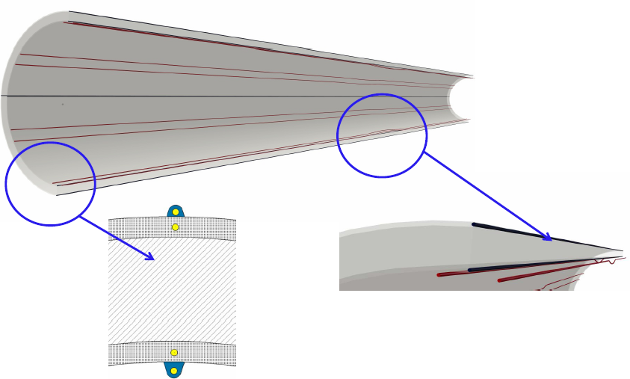
Calibration/alignment
Alignment procedure
  Accurate positioning during construction of sub-detectors by coordinate measuring machine
  Alignment at the installation phase by standard survey technique
  Hardware alignment system during operation
  Ultimate micro-meter order alignment by “track-based alignment”
Alignment techniques under R&D
  IR laser alignment for Si strip detectors
  Fiber Bragg Grating (FBG) sensors for mechanical structure alignment → Smart support structure

Slide 26
Data acquisition
ILD DAQ: Trigger-less
Compared to LHC, ILD DAQ is less demanding in throughput, but the number of readout channels is >x10 larger → Data suppression at detector level (digitization in front-end electronics)
Most of the data volume (99%) come from beam background
Design of the DAQ system is still at the conceptual design level

Slide 27
Software tools
Core tools
  LCIO
    Provides a hierarchical event data
    Commonly used by ILD, SiD, CLIC
  Gear: API for detector geometry
  Mokka: GEANT4 based full simulation
  Marlin: Framework for further processing of the simulated data
Detector models in Mokka
  Realistic model: Mechanical support structures, electronics, cables, dead materials, and cracks are also implemented
  Three models created
    ILD_o1_v05: AHCAL and SiECAL
    ILD_o2_v05: SDHCAL and SiECAL
    ILD_o3_v05: AHCAL and ScECAL

Slide 28
Software tools
Marlin
  Reconstruction and analysis system
  Some new/updated packages have been developed for DBD analysis
    Track reconstruction: Kaltest, IMarlinTrK, Clupatra, FwdTracking – replacing old Fortran code with C++ code
    Particle flow: PandoraPFA
    Secondary vertex tagging: LCFIVertex, LCFIPlus
  Background overlay
    Pair background is not overlaid in MC study
    Two-photon background events are overlaid before reconstruction

Slide 29
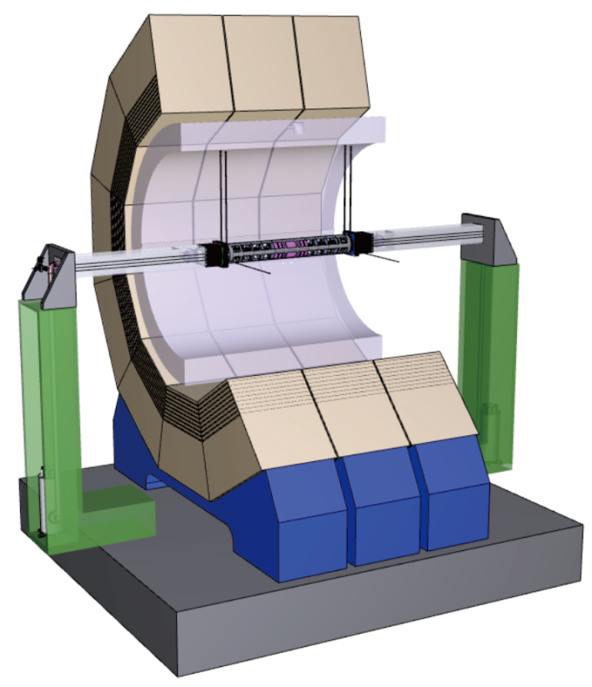
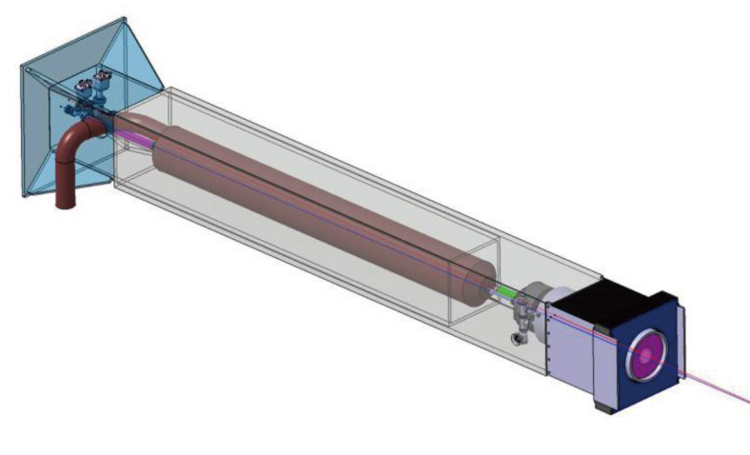
MDI and experimental area
Push-pull
  ILD (~14kt) is place on a platform (20x20x2.2m³) for push-pull operation
  ILD has its own moving system (air pads and grease pads) on the platform
  Alignment accuracy after movement should be <1mm
QD0
  QD0 is supported by a support tube which is supported from a pillar standing on the platform
  Vibration of QD0 has to be less than 50nm above 1Hz

Slide 30
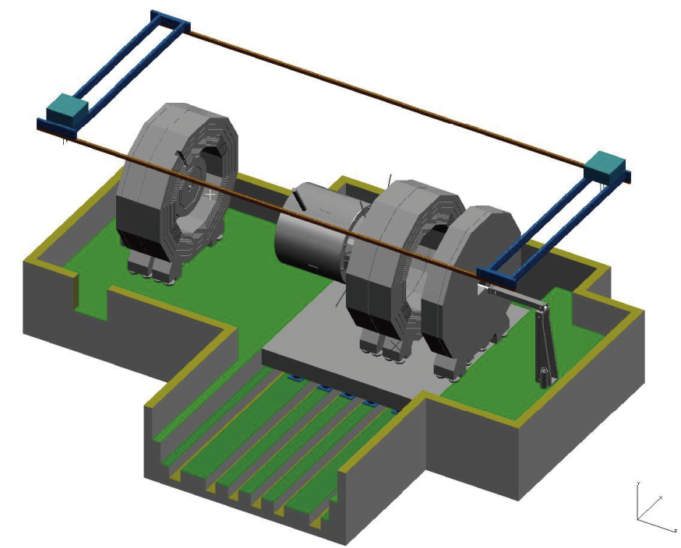
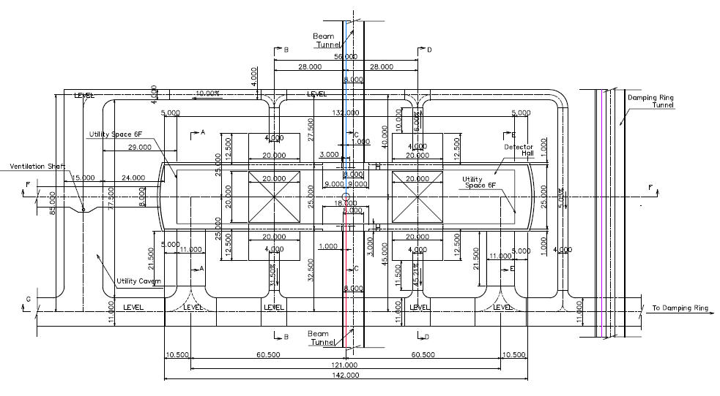
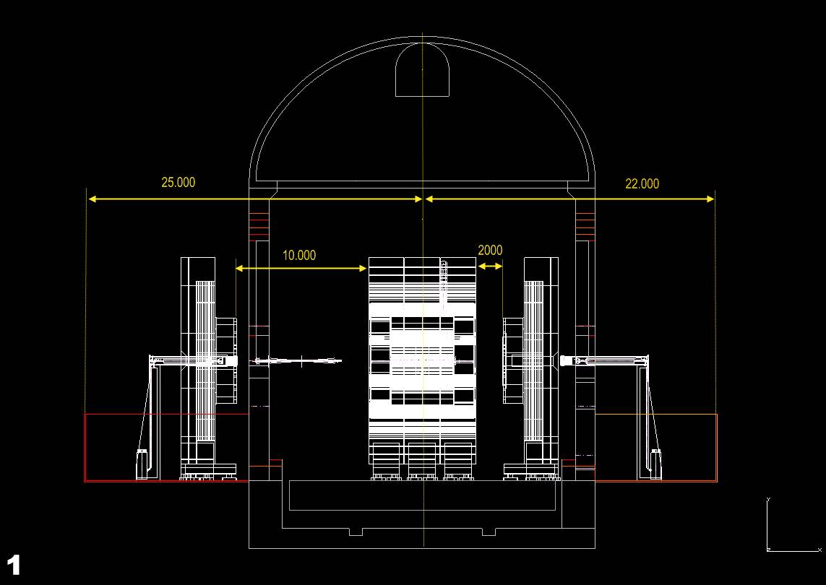
MDI and experimental area
Experimental area for flat surface
  Z-shape experimental hall
  φ18m vertical shaft above IP
  φ10m vertical shaft in ILD garage (φ8m for SiD)
  Two φ5m shafts for elevator/services
Experimental area for mountain site
  I-shape experimental hall with garage alcoves for detector maintenance
  Access through horizontal tunnel

Slide 31
ILD performance

Slide 32
ILD benchmark analysis is still on-going
All the numbers may change by the end of January 2013

Slide 33
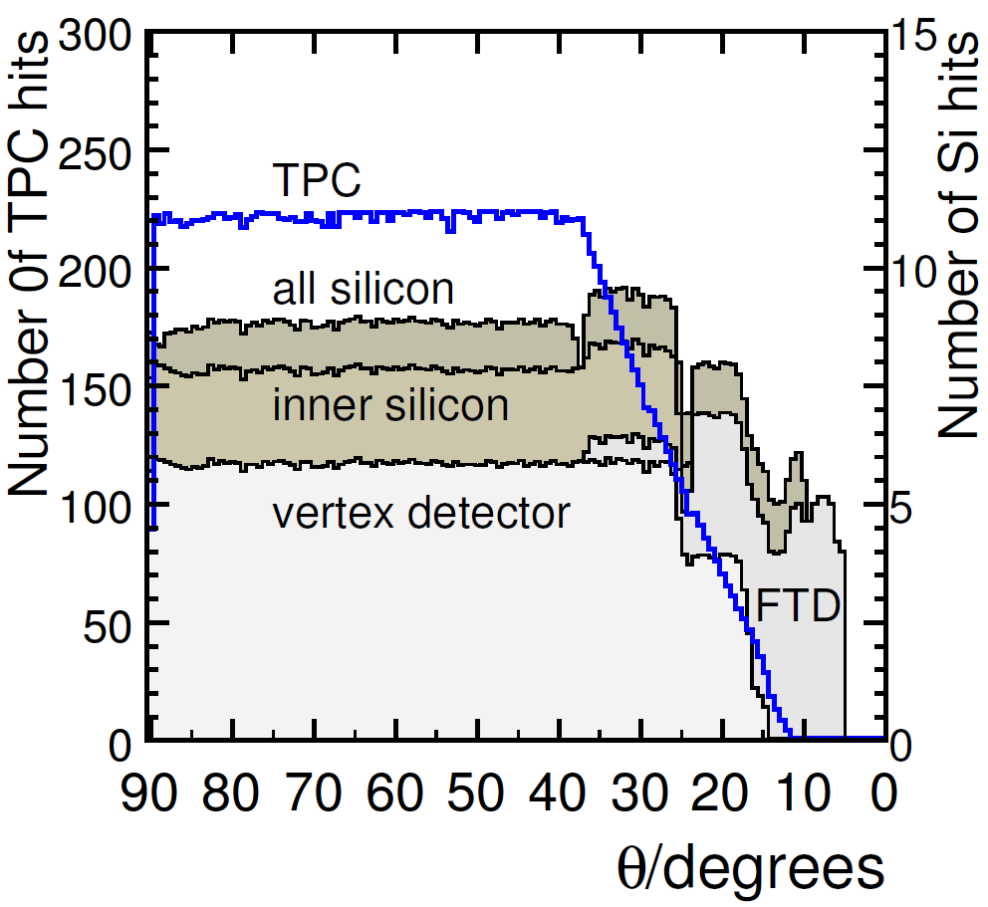
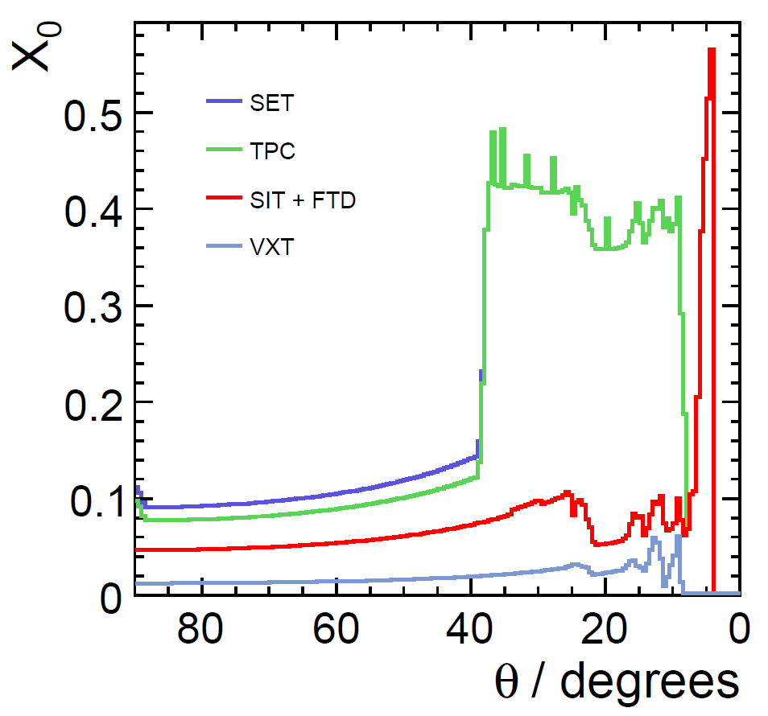
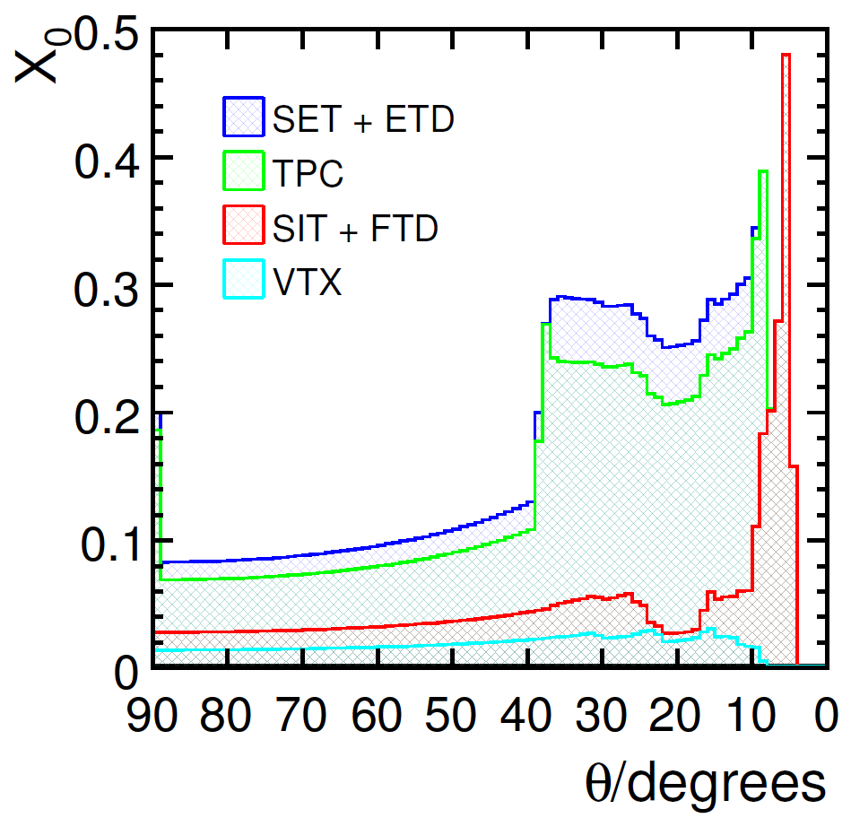
Tracking performance
Detector coverage and material budget
  More material budget than LOI because of more realistic detector implementation
LOI

Slide 34
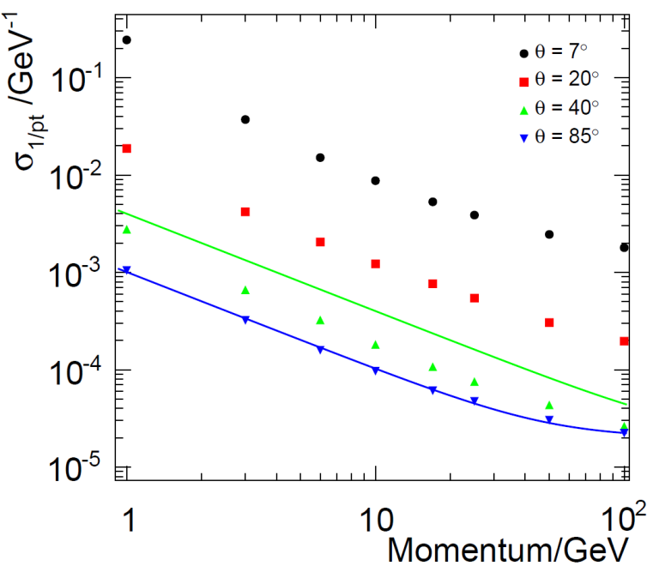
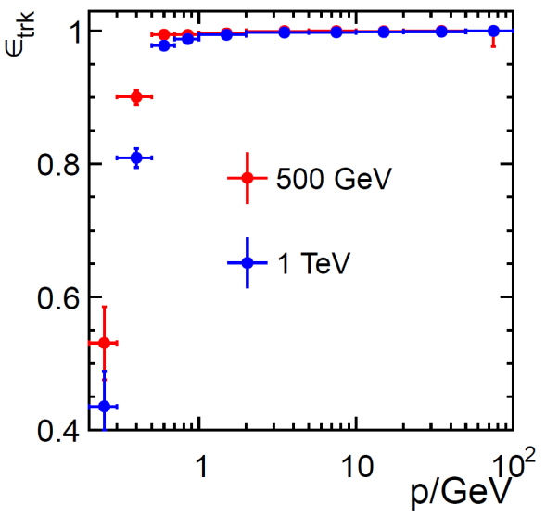
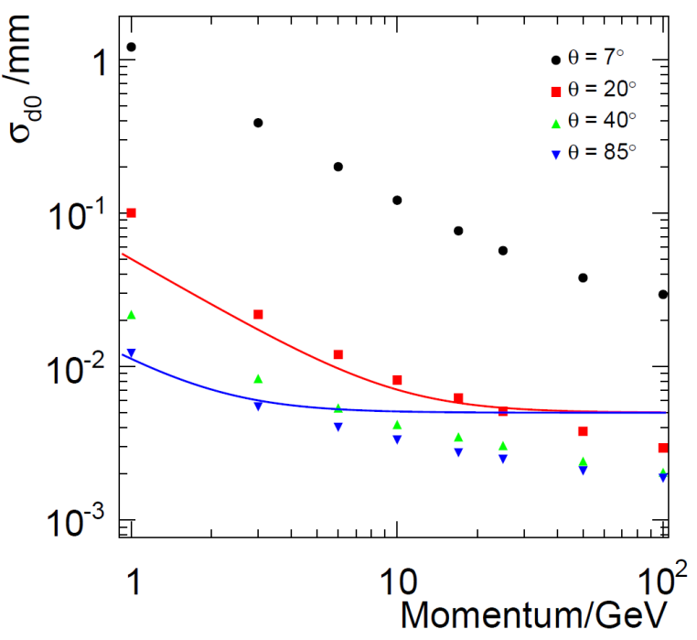
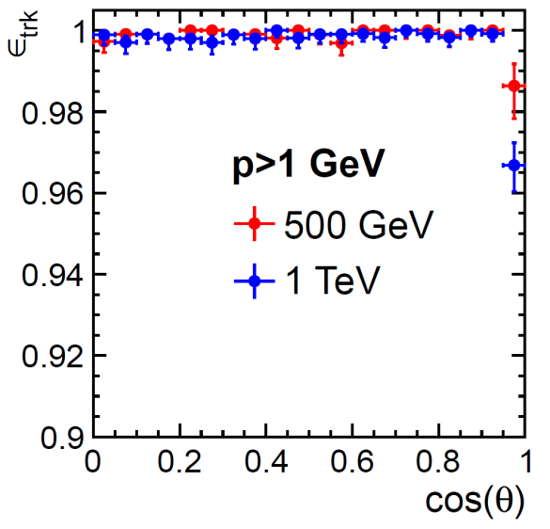
Tracking performance
Performance goal
  σ_{1/pT}~2x10⁻⁵GeV⁻¹
  σ_{rφ}=5⊕10/psin^{3/2}θ [um]
Pt resolution for muon tracks
Tracking efficiency for t t events
Impact parameter resolution

Slide 35
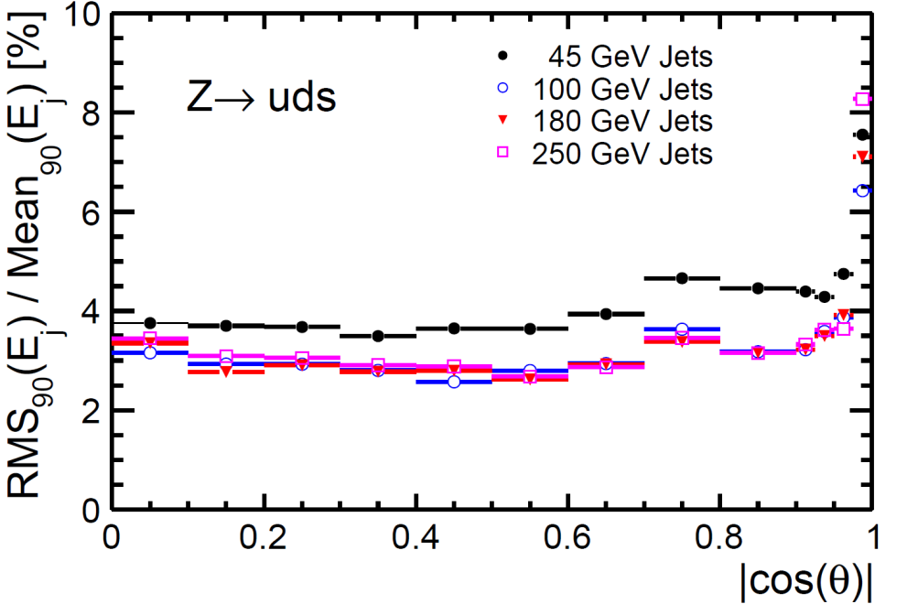
PFA performance
Performance goal
  Jet energy resolution < 3.5% for efficient separation of W, Z, and Higgs in hadronic mode
  σ_{E}/E = α/sqrt(E) is not applicable because particle density depends on Ejet
  Jet energy resolution is slightly better than LOI due to improvement of reconstruction software
Jet energy | σ_{E}/E
45 GeV | 3.66%
100 GeV | 2.83%
180 GeV | 2.86%
250 GeV | 2.95%
Z→u,d,s events
|cosθ|<0.7

Slide 36
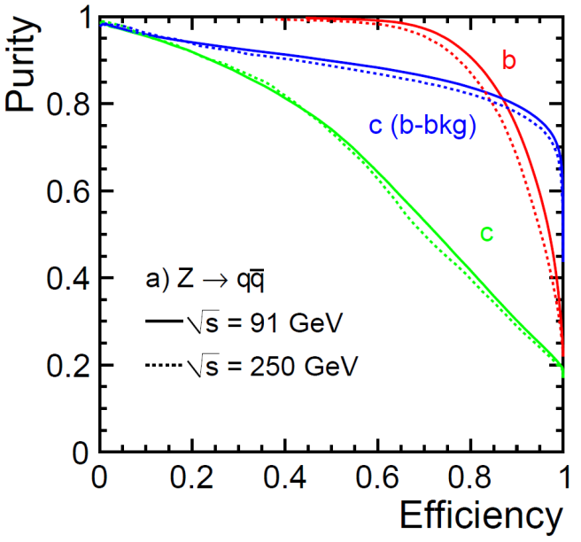
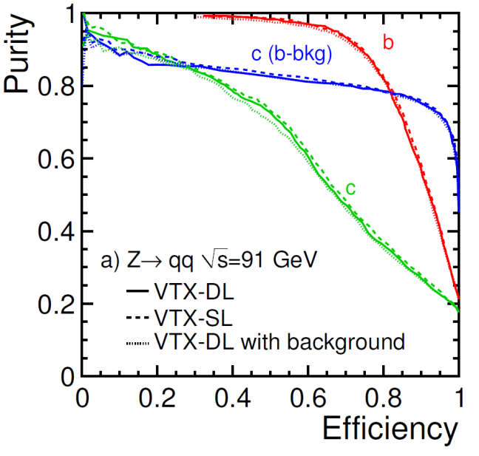
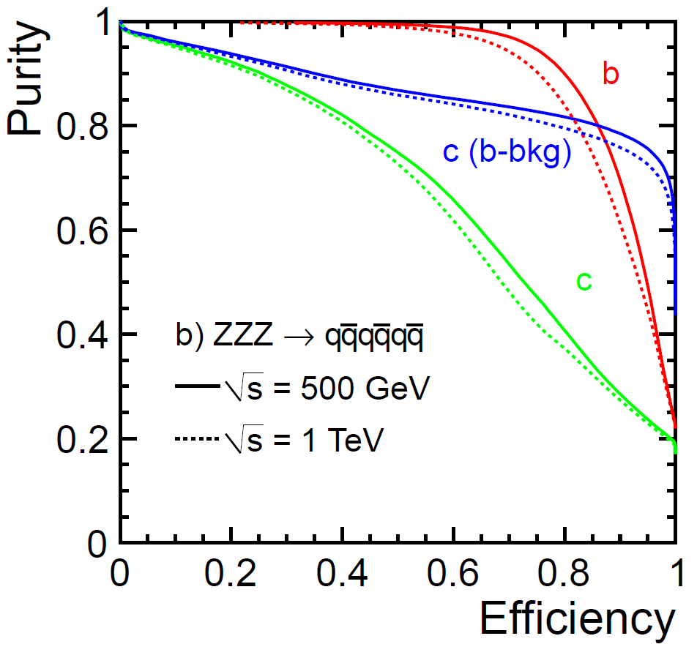
Flavor-tag performance
New software LCFIPlus is used
Improvement from LOI can be seen although VTX point resolution is worse in DBD
ＬＯＩ

Slide 37
LOI benchmark
ECM (GeV) | Observable | Precision | Comments | Post LOI analysis
250 | σ(e⁺e⁻ → Zh) | 2.5% | Model independent
 | m_{h} | 32 MeV | Model independent
 | m_{h} | 27 MeV | Model dependent
250 | Br(h→bb) | 2.7% | Includes 2.5% of σ(Zh) | 2.7%*
 | Br(h→cc) | 12% |  | 7.3%*
 | Br(h→gg) | 29% |  | 8.9%*
 | Br(h→ττ) |  |  | 4.9%
 | Br(h→WW*) |  |  | 8.6%
500 | σ(e⁺e⁻ →χ₁⁺χ₁⁻) | 0.6%
 | σ(e⁺e⁻ →χ₂⁰χ₂⁰) | 2.1%
 | m(χ₁⁺) | 2.4 GeV | From kinematical edges Two masses (LSP and χ₁⁺/χ₂⁰) are fitted simultaneously
 | m(χ₂⁰) | 0.9 GeV
 | m(χ₁⁰) | 0.8 GeV
* http://arxiv.org/abs/arXiv:1207.0300
H.Ono, Akiya Miaymoto

Slide 38
LOI benchmark
ECM (GeV) | Observable | Precision | Comments
500 | σ(e⁺e⁻→ττ) | 0.29% | θττ>178degree
 | A^{τ}_{FB} | 0.0025 | θττ>178degree
 | Pτ | 0.007 | Excluding a₁ν
500 | σ(e⁺e⁻ → tt) | 0.4% | (bqq)(bqq) only
 | m_{t} | 40 MeV | Fully hadronic only
 | m_{t} | 30 MeV | + semi-hadronic
 | Γ_{t} | 27 MeV | Fully hadronic only
 | Γ_{t} | 22 MeV | + semi-hadronic
 | A_{FB} | 0.0079 | Fully hadronic only
500 | σ(e⁺e⁻→μ_{L}⁺μ_{L}⁻) | 2.5% | SPS1a’ (smuon)
 | m(μ_{L}) | 0.5 GeV
500 | m(τ₁) | 0.1GeV⊕1.3σ_{LSP} | SPS1a’ (stau)
1000 | α₄ | -1.4< α₄ <1.1 | Strong EWSB in WW scattering
 | α₅ | -0.9< α₅ < 0.8

Slide 39
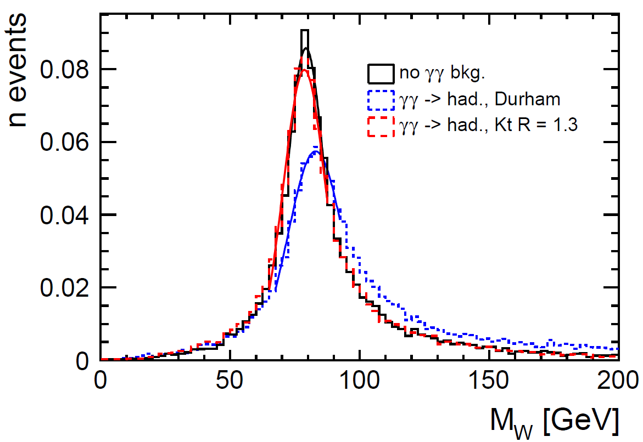
1TeV benchmark
Jet clustering algorithm
  k_{t} algorithm is used for jet clustering to reject low p_{t} and small θ particles from γγ background pile-up
WW→lνqq

Slide 40
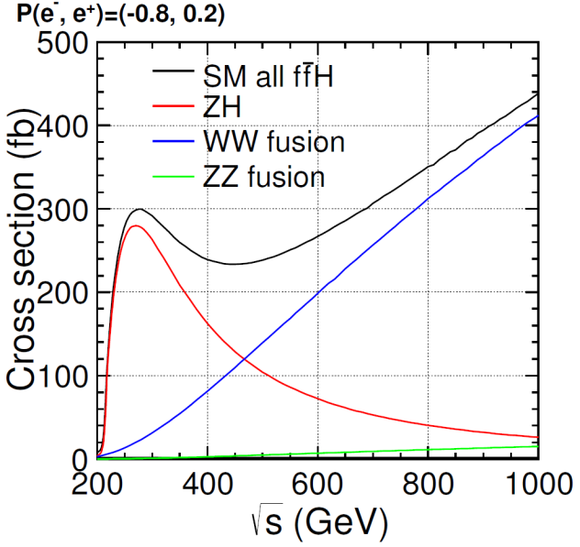
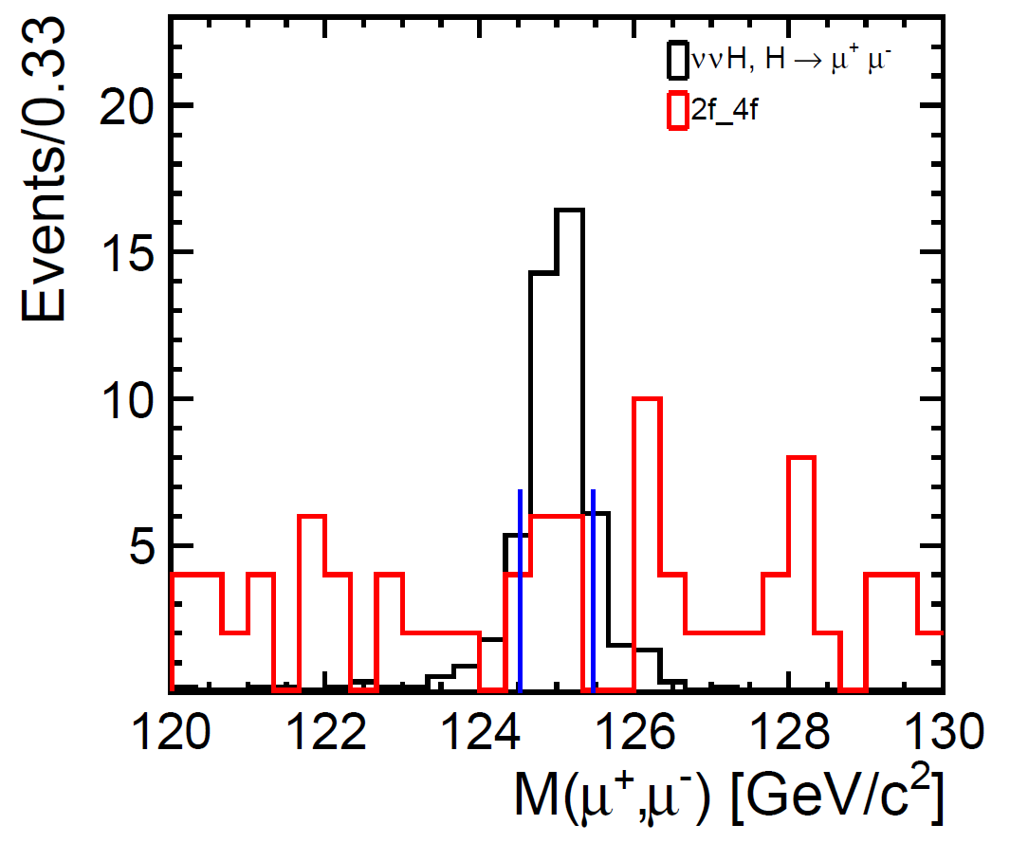
1TeV benchmark
e⁺e⁻ → ννh
  Higgs production cross section is larger than 250 GeV
  Luminosity is larger than 250 GeV
  Higgs → μμ channel can be measured
Decay mode | σBr accuracy (500fb⁻¹, -0.8,+0.2) | Comments
bb | 0.4%
cc | 5%
gg | 4%
WW* | 3% | Fully hadronic mode only
μμ | ??
Preliminary

Slide 41
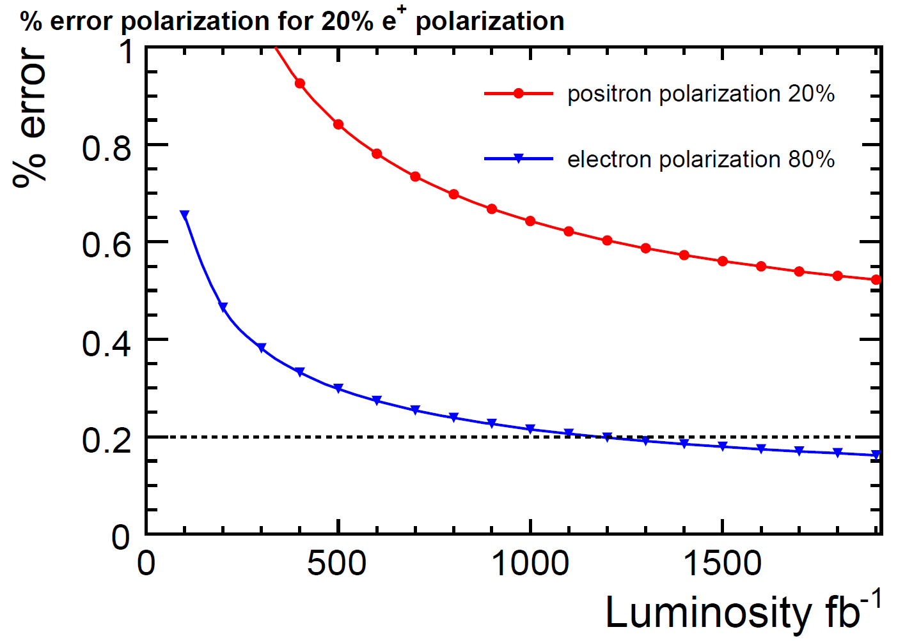
1TeV benchmark
e⁺ e⁻ → W⁺ W⁻
  Precise measurement of beam polarization
  Two methods
    Modified Blondel scheme: (+,+),(+,-),(-,+),(-.-) data required
    Angular distribution of W → Analysis not finished yet
Blondel method

Slide 42

1TeV benchmark
e⁺ e⁻ → t t h
  Fully hadronic mode (8 jets, no isolated lepton) and semi-leptonic mode (6 jets + 1 isolated lepton) were used
  Main background: ttbb, ttZ, and tt
  Multivariable analysis technique is effective to reduce the background
  Preliminary result on accuracy of top Yukawa coupling with 500fb⁻¹ (+0.8,-0.2) and 500fb⁻¹ (-0.8,+0.2)
    7.0% for semi-leptonic mode
    6.5% for hadronic mode
    4.8% for combined data

Slide 43
LOI-DBD common benchmark
We used e⁺e⁻ → t t channel for the comparison between LOI and DBD analysis @500 GeV
Forward-backward asymmetry is determined by hadronic decay mode
Vertex charge determination is needed → good benchmark for vertex detector/finding
Results with 500fb⁻¹, P(e⁻, e⁺)=(-0.8, +0.3) :
  A^{t}_{FB} = (DBD)
  A^{t}_{FB} = 0.334±0.0079 (LOI)
Coming soon

Slide 44





Other physics processes
Higgs self coupling
  Zhh final state at 500 GeV
    27% accuracy in Zhh cross section = 44% accuracy in λ with 2ab⁻¹
  ννhh final state at 1TeV
    17% accuracy in λ with 2ab⁻¹ (Fast simulation)
    Full simulation study on going
Further t t study
  A^{t}_{FB} by semi-leptonic decay mode
    1% measurement can be done
  A^{t}_{hel} (helicity asymmetry) measurement
  t t at threshold: measurement of m_{t} and α_{s}

Slide 45

Cost
Progress since LOI
  Development of technological prototypes close to final design → Information on costs
  Integration of whole detector has been studied
  New agreement on methodology and unit costs of cost drivers
ILD current cost evaluation
  Study is on-going
  ~500 MILCU including manpower

Slide 46
Summary
Detailed baseline design of ILD based on validated detector technologies has been presented
Compared with LOI, more realistic design including support structure, cables, other services, and dead material has been made
Although the material budget has been increased, better detector performance than LOI has been obtained thanks to the improvement of software tools and analysis methods
New benchmark processes at 1 TeV have been studied with 2-photon process background overlaid (We still need few weeks to finalize the results, though)
We still need detector R&D, particularly in the engineering aspect, after completion of DBD

