Slide 1

$H→ττ$ study
Current Status
Shin-ichi Kawada
Hiroshima University

Slide 2
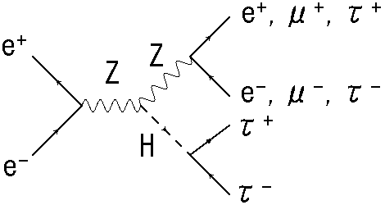
Review
Analysis of Z->ll mode (E_{CM} = 250 GeV, L = 250 fb⁻¹, P(e+, e-) = (+0.3, -0.8))
Z boson selection
(today’s topic)
tau jet clustering
(next step)

Slide 3
Analysis method
Previous: most energetic particle = isolated lepton
Current: using parameters to select isolated leptons & FSR/Bremsstrahlung recovery
  lepton ID
  suppress the combinatorial background
  unify neutral particles to isolated lepton

Slide 4

Lepton ID (1)
Separating pfos to 3 categories: $e$ / $μ$ / $π$ (from $τ$)
Parameters: $\frac{E_{ECAL}}{E_{ECAL}+E_{HCAL}},\frac{E_{ECAL}}{P}$

Slide 5
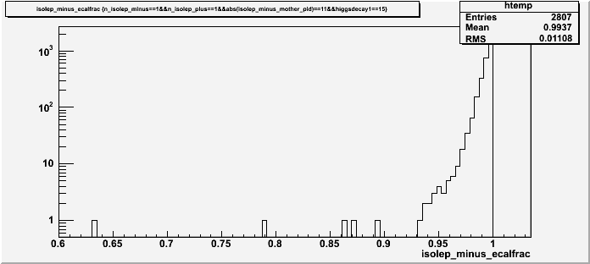
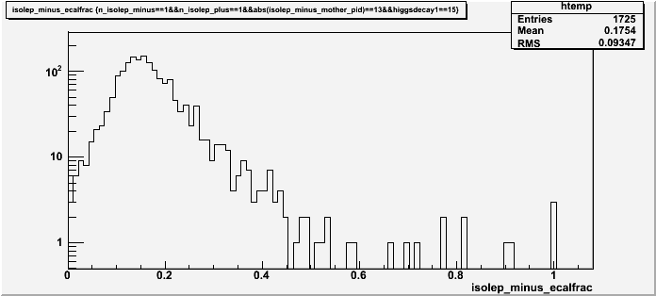



Lepton ID (2)
plots of $\frac{E_{ECAL}}{E_{ECAL}+E_{HCAL}}$
$$e$$
$$μ$$

Slide 6
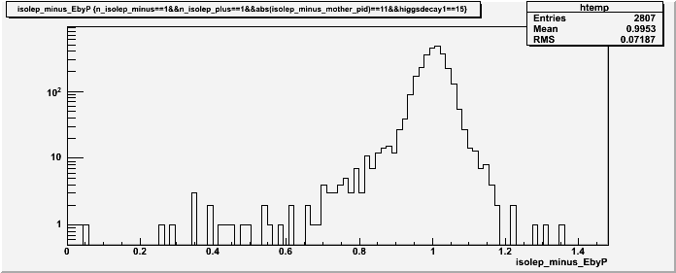
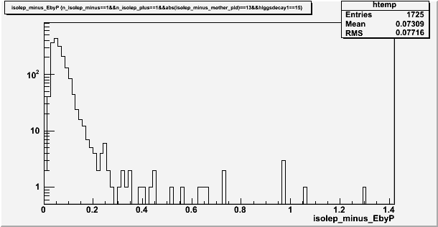

Lepton ID (3)
plots of $\frac{E_{ECAL}}{P}$
$$e$$
$$μ$$

Slide 7

Lepton ID (4)
Electron ID
  $\frac{E_{ECAL}}{E_{ECAL}+E_{HCAL}}>0.92$
  $\frac{E_{ECAL}}{P}>0.5$
Muon ID
  $\frac{E_{ECAL}}{E_{ECAL}+E_{HCAL}}<0.6$
  $\frac{E_{ECAL}}{P}<0.5$

Slide 8
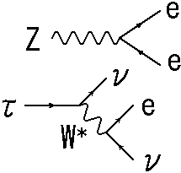
Suppress combinatorial BG (1)
Separating leptons to 2 categories: leptons from Z boson & leptons from tau (= Higgs)
  In order to suppress combinatorial background.
from Higgs

Slide 9
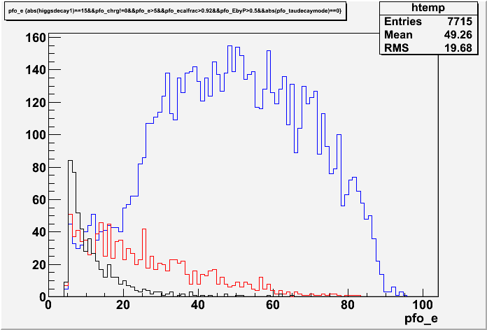
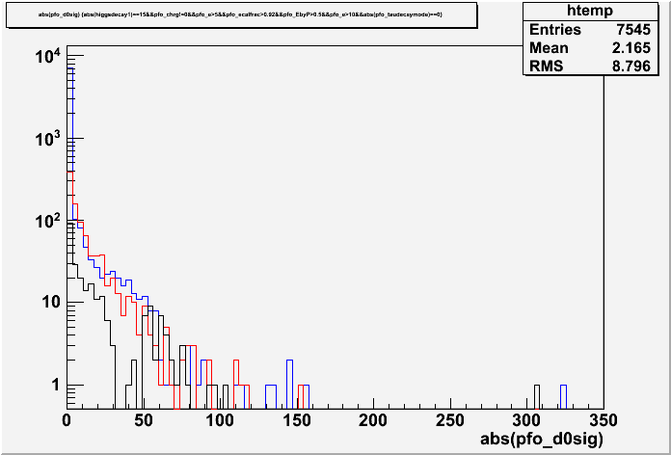
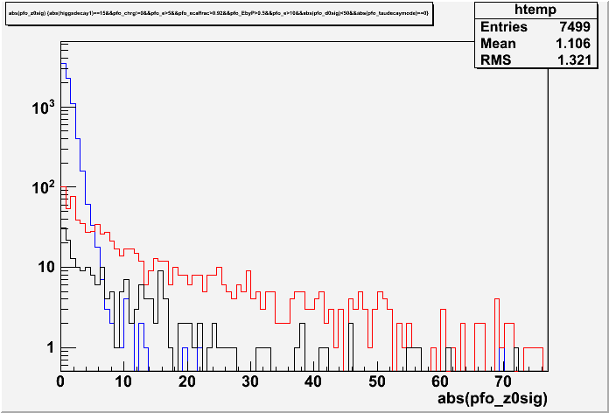


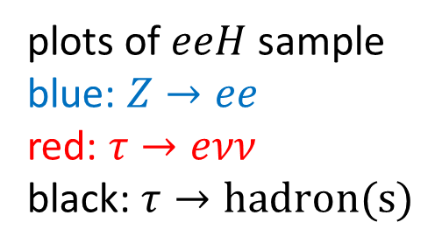
Suppress combinatorial BG (2)
pfo_e
$$|d0sig|$$
$$|z0sig|$$
plots of $eeH$ sample
blue: $Z→ee$
red: $τ→eνν$
black: $τ→hadron(s)$

Slide 10
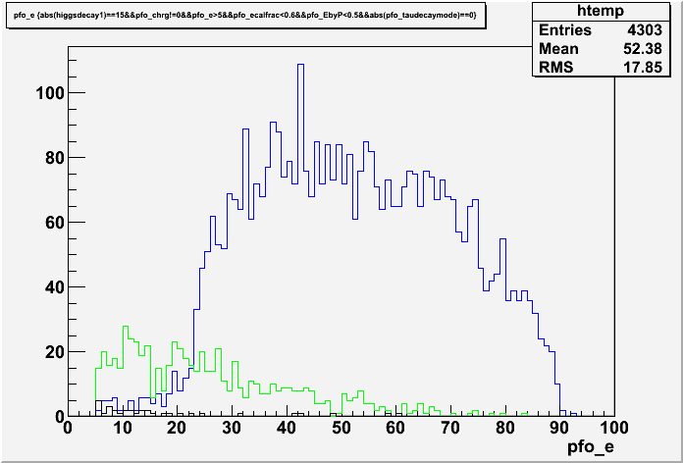
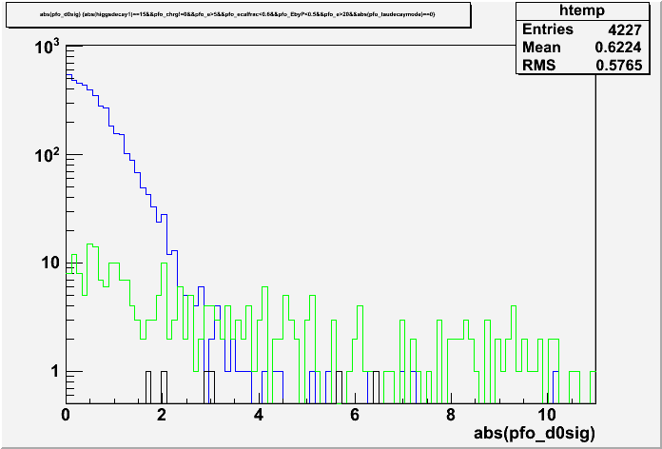
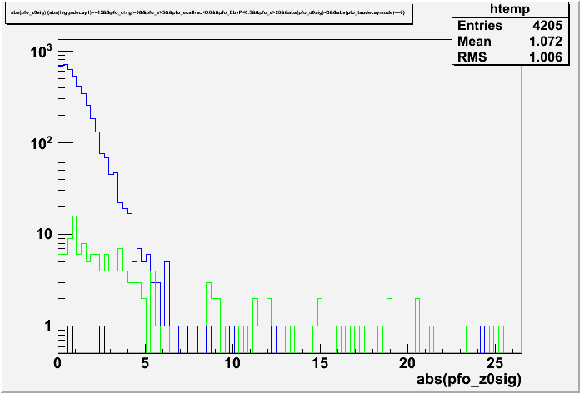
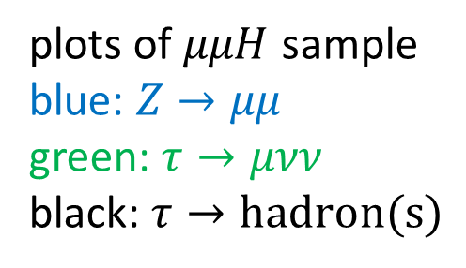
Suppress combinatorial BG (3)
pfo_e
$$|d0sig|$$
$$|z0sig|$$
plots of $μμH$ sample
blue: $Z→μμ$
green: $τ→μνν$
black: $τ→hadron(s)$

Slide 11

Suppress combinatorial BG (4)
$eeH$ sample
  pfo_e > 10
  |d0sig| < 50
  |z0sig| < 5
$μμH$ sample
  pfo_e > 20
  |d0sig| < 3
  |z0sig| < 7

Slide 12
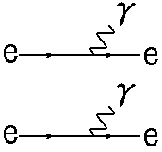

FSR / Bremss recovery (1)
In order to reconstruct the original Z boson.
Example
from Z boson
$$Z=e+e+γ+γ$$
FSR / Bremss effect

Slide 13
FSR / Bremss recovery (2)
Defining the cone with hole
Particles in this region
are used for calculating
cone energy.
isolated
lepton
Neutral particles in this region (hole)
are unified with the isolated lepton.

Slide 14
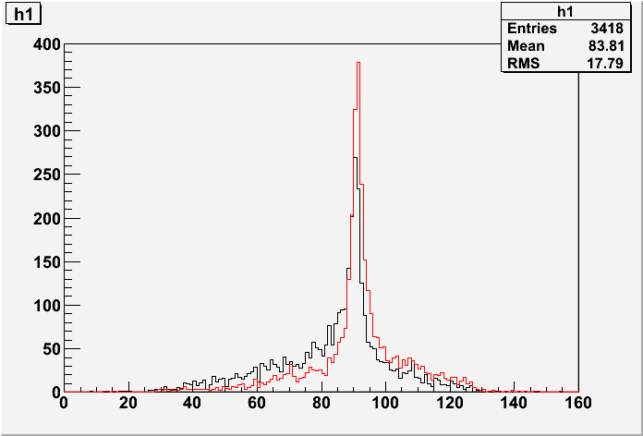
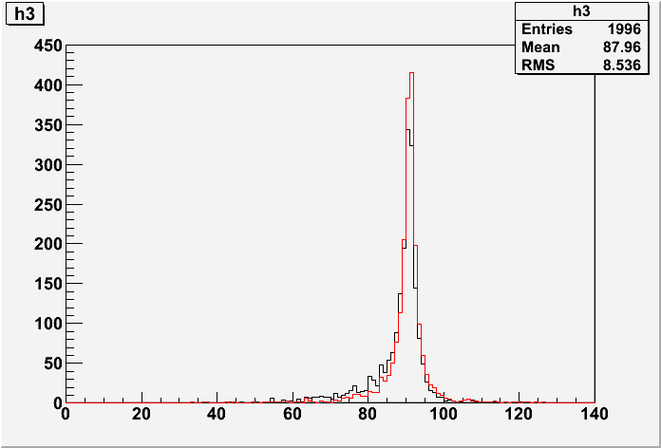



FSR / Bremss recovery (3)
Z mass plots $(0.99<cosθ_{cone}<0.999)$
$eeH$ sample
$μμH$ sample
Black: w/o recovery Red: w/ recovery

Slide 15

FSR / Bremss recovery (4)
Optimization for $cosθ_{cone}$ is needed. It wii be finished soon.
After this optimization, the analysis of Z boson selection is finished. I will move on the tau jet clustering.

Slide 16
Summary
Z boson selection
  lepton ID: finished
  suppress the combinatorial background: finished
  FSR / Bremss recovery: will finish soon
After the Z boson selection, analysis of tau jet clustering will start.

