Slide 1


Continued October 2012 ATF Planning
Mikey Davis
28 September 2012
1/7

Slide 2
Introduction
Tried to continue from last week bearing in mind what was said
Have come up with a plan for the first shift
Then all up in the air
First Feedforward gain calculation…
Mikey Davis
28 September 2012
2/7

Slide 3
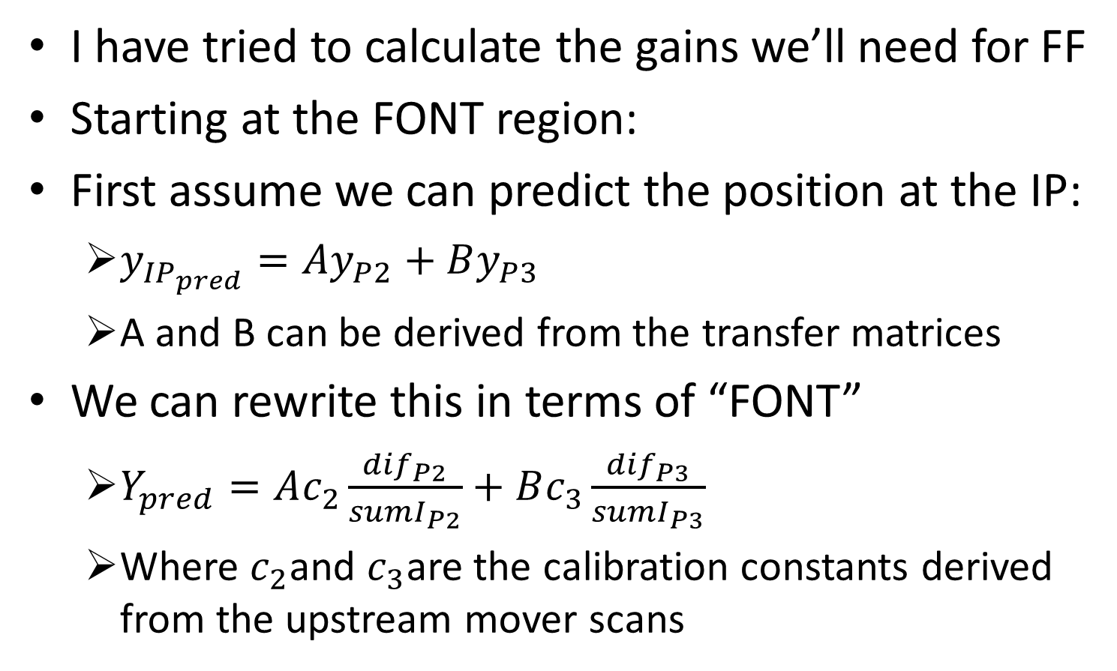
Feedforward Gain Calculation
I have tried to calculate the gains we’ll need for FF
Starting at the FONT region:
First assume we can predict the position at the IP:
$y_{{IP}_{pred}}=Ay_{P2}+By_{P3}$
A and B can be derived from the transfer matrices
We can rewrite this in terms of “FONT”
$Y_{pred}=Ac_{2}\frac{{dif}_{P2}}{{sumI}_{P2}}+Bc_{3}\frac{{dif}_{P3}}{{sumI}_{P3}}$
Where $c_{2}$and $c_{3}$are the calibration constants derived from the upstream mover scans
Mikey Davis
28 September 2012
3/7

Slide 4
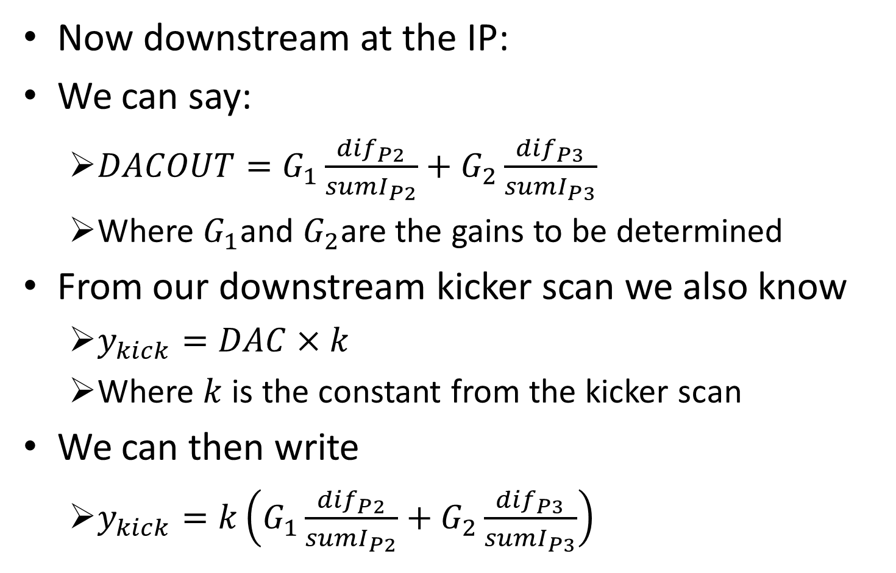
Feedforward Gain Calculation
Now downstream at the IP:
We can say:
$DACOUT=G_{1}\frac{{dif}_{P2}}{{sumI}_{P2}}+G_{2}\frac{{dif}_{P3}}{{sumI}_{P3}}$
Where $G_{1}$and $G_{2}$are the gains to be determined
From our downstream kicker scan we also know
$y_{kick}=DAC×k$
Where $k$ is the constant from the kicker scan
We can then write
$y_{kick}=k\left(G_{1}\frac{{dif}_{P2}}{{sumI}_{P2}}+G_{2}\frac{{dif}_{P3}}{{sumI}_{P3}}\right)$
Mikey Davis
28 September 2012
4/7

Slide 5
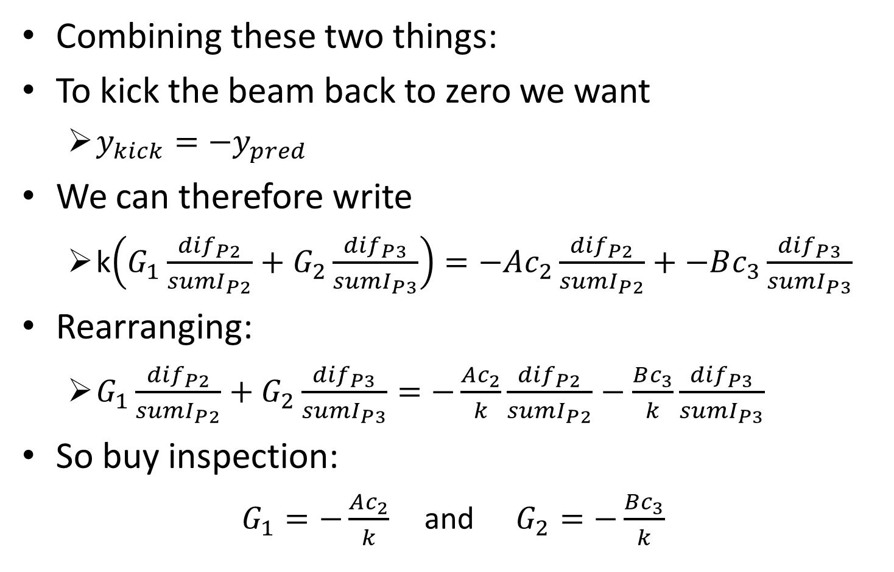
Feedforward Gain Calculation
Combining these two things:
To kick the beam back to zero we want
$y_{kick}=−y_{pred}$
We can therefore write
k$\left(G_{1}\frac{{dif}_{P2}}{{sumI}_{P2}}+G_{2}\frac{{dif}_{P3}}{{sumI}_{P3}}\right)=−Ac_{2}\frac{{dif}_{P2}}{{sumI}_{P2}}+−Bc_{3}\frac{{dif}_{P3}}{{sumI}_{P3}}$
Rearranging:
$G_{1}\frac{{dif}_{P2}}{{sumI}_{P2}}+G_{2}\frac{{dif}_{P3}}{{sumI}_{P3}}=−\frac{Ac_{2}}{k}\frac{{dif}_{P2}}{{sumI}_{P2}}−\frac{Bc_{3}}{k}\frac{{dif}_{P3}}{{sumI}_{P3}}$
So buy inspection:
$G_{1}=−\frac{Ac_{2}}{k}$ and $G_{2}=−\frac{Bc_{3}}{k}$
Mikey Davis
28 September 2012
5/7

Slide 6

Shift 1 Plan (Single Bunch)
LO Phase Scan
Upstream Calibration (mover scan)
IPBM Calibration
Move IP to IPA
Do a jitter run (resolution, jitter at FONT and IP, Correlation)
Upstream kicker scan
Downstream kicker scan
Mikey Davis
28 September 2012
6/7

Slide 7
Shift 1 Plan (Two Bunch)
Jitter Run (measure 2 bunch resolution and correlation)
Upstream feedback (several runs, see results at IP)
Single loop feedforward at notional gain
Single loop gain scans
Coupled loop feedforward at optimal gain
Mikey Davis
28 September 2012
7/7

