Slide 1
Properties of isolated leptons in 4qlnu
Jan Strube, CERN

Slide 2
Introduction
In order to properly reconstruct leptonic W decays, we need to find isolated leptons.
Energy resolution probably not sufficient (missing energy, mis-reconstructed leptons) for full reconstruction
Tag events with one iso lepton and one reconstructed W
Marlin has an IsolatedLeptonFinder Processor
First shot at Processor Performance:

Slide 3
Setup
Christian Grefe has developed truth matching algorithm during CLIC CDR
Maps ReconstructedParticle to the MCParticle that contributed most energy in form of hits
Samples considered:
10k each tth-6q, tth-ln4q, tth-2l2nbb
Leptonic W decays include τ decays
Matching criteria:
Find reconstructed lepton and match to W decay (including τ)

Slide 4
Three parameters to optimize
Isolation
Consider energy in a cone around the track
Leptonic W decays are more isolated
Particle ID
Look only for electrons or muons, not pions
Impact Parameter
W decays are prompt

Slide 5
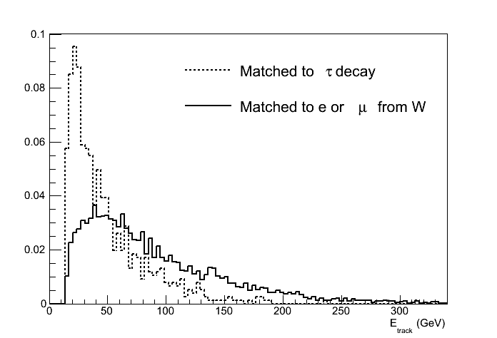
Starting Point
PandoraPFA reconstruction
All tracks, E > 15 GeV
10,000 events tth_4qln
(only) 764 events matched to τ
1183 without E cut
Reconstructed Particle type | Matched to W | Not matched to W
electron | 3331 | 3822
muon | 3536 | 3289
pion | 180 | 60701
SUM | 7047 | 67812

Slide 6
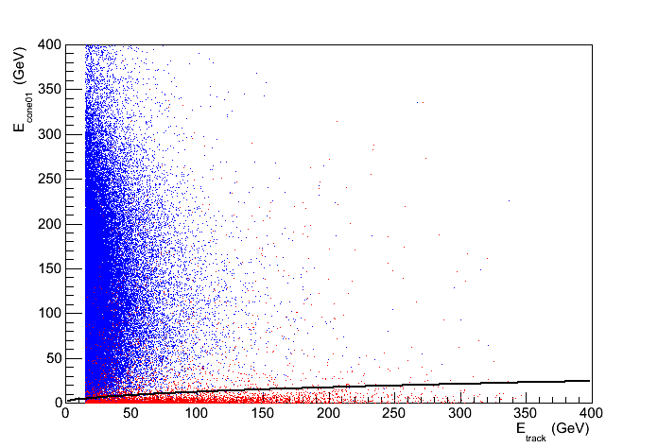
Isolation properties of W daughters
Truth-matched W tracks in tth_4qlnu
Other leptons and pions in tth_4qlnu
y = √(3.0x)

Slide 7
Isolation Performance
Optimal cuts (found by parameter scan):
E > 15 GeV
Remove large forward clusters (about 20○)
Cone cos(θ) = 0.99: E_{cone}< √(3.0 E_{lepton})
Signal efficiency (including τ): 86%
Purity (in tth-4qln events): 96%
Should be properly evaluated in full (signal + bg) sample

Slide 8
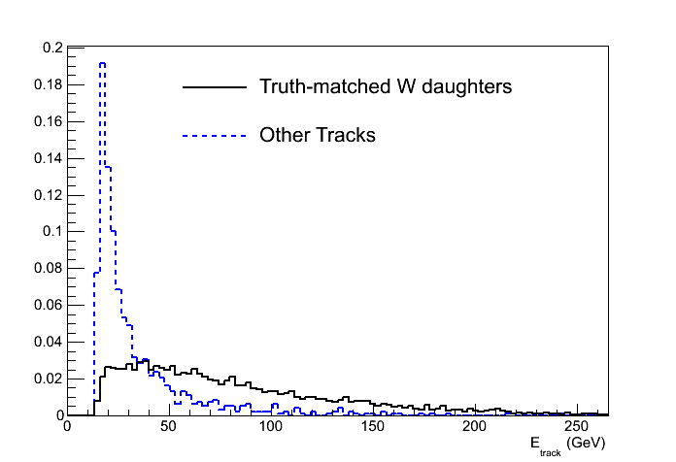
Energy of Isolated Tracks

Slide 9
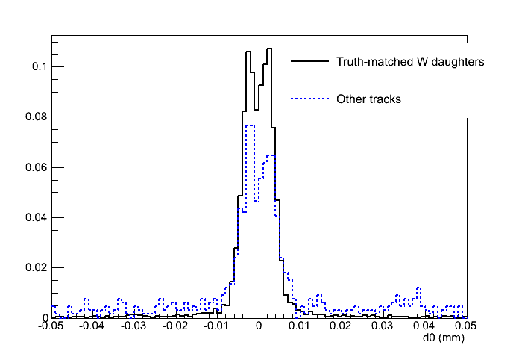
Impact Parameter of Isolated Tracks

Slide 10
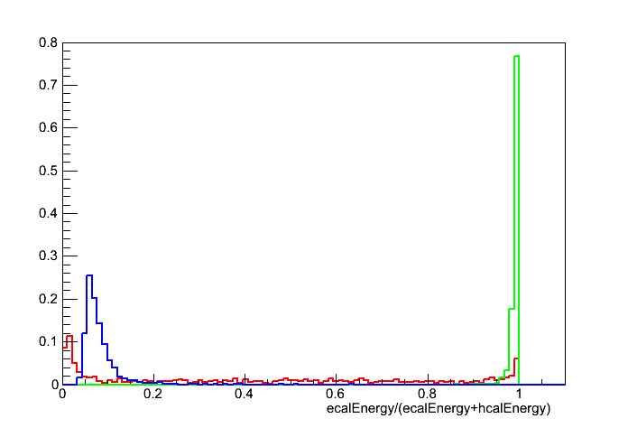
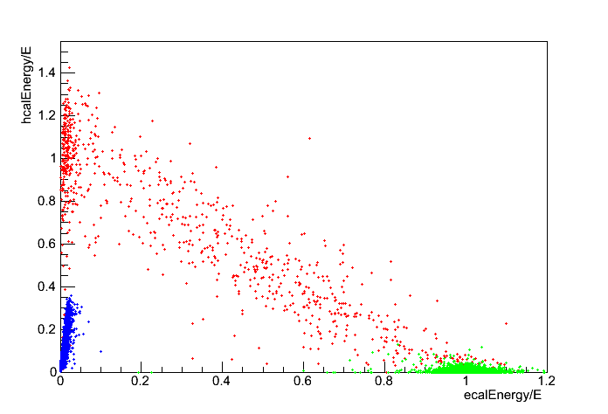
PandoraPFA Particle ID
Isolated Tracks in tth_4qln events
E > 15 GeV
Contains fakes
electrons
muons
pions
IsolatedLeptonFinder
has option to use simplistic PID:
ratio of ECal / total energy
ratio of HCal / ECal energy
Could be used to purify selection further

Slide 11
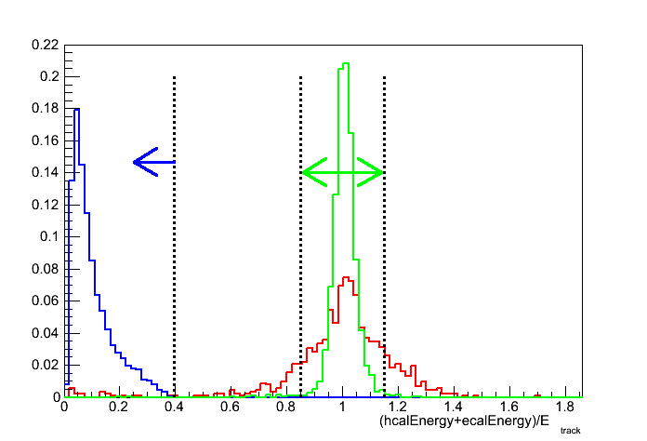
Performance of Crude Lepton ID
Using the available facilities of the IsolatedLeptonFinder with cuts detailed on the previous slides:
Isolated Leptons found in:
- 0.6% of fully hadronic tth events
- 61.5% of 6 semi-leptonic tth events
- 99% of those matched to W decay
Code is available under (if you have a CERN account) svn+ssh://svn.cern.ch/reps/clicdet/trunk/Users/proloff/tth/isolated_leptons/Marlin/steer
On the CERN Trac otherwise

Slide 12
IsolatedLeptonFinder efficiencies
Before isolation selection
(but including cuts E>15GeV and abs(cosTheta) < 0.94):
Fraction of W electrons reconstructed and truth matched: 89.3%
Fraction of W muons reconstructed and truth matched: 90.6%
Fraction of tau electrons and muons reconstructed and truth matched: 59.0%
IsolatedLeptonFinderSelection:
Relative W electron ID efficiency: 81.3%
Relative tau electron ID efficiency: 37.9%
Relative W muon ID efficiency: 85.7%
Relative tau muon ID efficiency: 38.1%
The fraction of W produced to those tagged is the product of the reconstruction efficiency and the identification efficiency

Slide 13

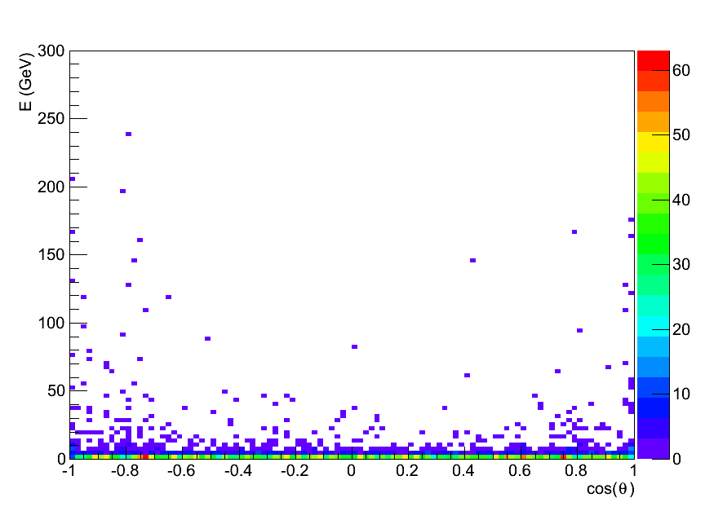
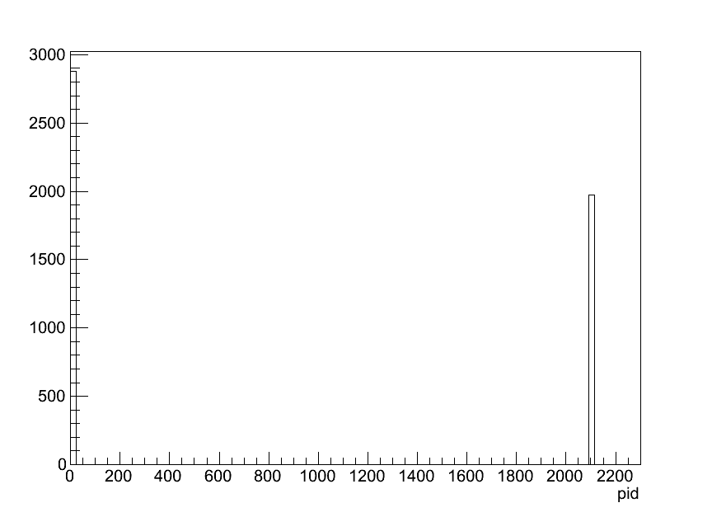
Outlook
53 / 1000 events merged with forward 2 TeV clusters
not shown on plot
Energy of reconstructed neutrals that are truth-matched to an electron or muon from a W
This is not bremsstrahlung, but rather clustering gone wrong

