Slide 1


Roundup of ATF Trip
Mikey Davis
02 November 2012
number

Slide 2
Introduction
Will first go through what we did on each shift
I’ve looked at most of the data we took
Will show lots here
Will show some of the more detailed analysis I’ve been trying
Report on Feedforward
Mikey Davis
02 November 2012
number

Slide 3
Shift 1
Took first set of IPBMP calibrations with 20 dB attenuation
Resolutions of the upstream BPMs of 0.5 with P.C
Had trouble moving the waist as the beam was not centred through MQD0FF
Once we’d centred the beam we got an effective IP waist scan
We then moved successfully to two bunch mode, feedback didn’t work as we didn’t have K1 Bunch Strobe Select on
Mikey Davis
02 November 2012
number

Slide 4
Shift 2 - Attenuation
We removed 14 dB of attenuation from the output of the cavity BPMs and the input of Honda’s first stage downmixer
This left us with 6 dB attenuation
Turned out to be a mistake
Mikey Davis
02 November 2012
number

Slide 5
Shift 2 - Continued
Picked up from where we’d left off in Shift 1
Did another IPBPM calibration, we thought this was ok…
Turned out much later in the shift we were in saturation
Positives – Upstream feedback worked
Corrections down to 1 μm in P2 and 0.5μm in P3
Agree with resolutions (0.7 μm in P2, 0.5 μm in P3)
Mikey Davis
02 November 2012
number

Slide 6
Shift 2 - Conclusions
Phil and I wanted to take out more attenuation as histograms looked good
We realised too late the BPMs were in saturation
This meant the histograms were a false positive (maybe) and led us down a blind alley
Mikey Davis
02 November 2012
number

Slide 7
Week 1 - Conclusions
I think we really spent the first week getting to grips with what we were going to be doing
I had a look at the data over the weekend and got some promising plots
A pity about the saturation but without the variable attenuators maybe to be expected
Not properly checking the FF was a mistake
Mikey Davis
02 November 2012
number

Slide 8
Shift 3
Over the weekend variable attenuators were installed
These were tested on the shift and clearly worked
We took IPBMP calibrations at 10 dB, 20 dB, 30 dB and 40 dB in both x and y in both 1 and two bunch mode
Then moved onto feedback
Mikey Davis
02 November 2012
number

Slide 9
Shift 3 - Continued
We still had problems with the analysis of the IPBPM calibrations which was unfortunate as we weren’t sure exactly what effect we were having
Ended up running with 20 dB of attenuation in
We took some very long feedback runs (4000 triggers)
These runs have turned out to be some of best runs -> clear improvement of the jitter at the IP
Mikey Davis
02 November 2012
number

Slide 10
Shift 3 - Feedforward
We tried to kick the beam at the end of the shift with the feedforward system
Couldn’t get it to work – were very confused
Basically ran out of time
Mikey Davis
02 November 2012
number

Slide 11
Shift 4 - Feedforward
As this was are last shift and we had got lots of good feedback data the previous shift decided to concentrate on FF
Took our first access of the trip and found that the ZPUL was broken
The TMD amplifier triggered
Rejigged upstream setup so no need for extra amp
Tested FF cable and found it was not lossy
Mikey Davis
02 November 2012
number

Slide 12
Shift 4 - Feedforward
As this was are last shift and we had got lots of good feedback data the previous shift decided to concentrate on FF
Took our first access of the trip and found that the ZPUL was broken
The TMD amplifier triggered
Rejigged upstream setup so no need for extra amp
Tested FF cable and found it to not be lossy
Mikey Davis
02 November 2012
number

Slide 13
Shift 4 - Feedforward
Long story short we still couldn’t kick the beam
Tried many different settings, latency etc
Tried a kicker scan to see if we were having any effect, results showed nothing
Tested the monitor on both the TMD amp and Kicker – Explain
I’m pretty mystified
Mikey Davis
02 November 2012
number

Slide 14
Shift 4 – Other Stuff
We also did a whole load more calibrations at different attenuations
Did some more feedback runs at different attenuation settings
I think the ones at 10dB are saturation
20dB are fine but a bit confused about the results (see later)
Mikey Davis
02 November 2012
number

Slide 15
After Shifts
The IPBSM was broken so they didn’t shut the accelerator down
We went up at 1am on Saturday morning and was still running
Still going at 6am when we left so no chance to get our stuff out
We brought back a FONT V board but left everything else there setup
Mikey Davis
02 November 2012
number

Slide 16
Calibration Results
Took lots of calibrations in both bunch modes
Calibrations from the first week were in saturation
Calibrations at 10dB were generally saturated in IPB
Still not sure about the x scale (beam position) in the plots to get the value of k
I’ve tried to analyse the data a number of different ways
Mikey Davis
02 November 2012
September 2012
number

Slide 17
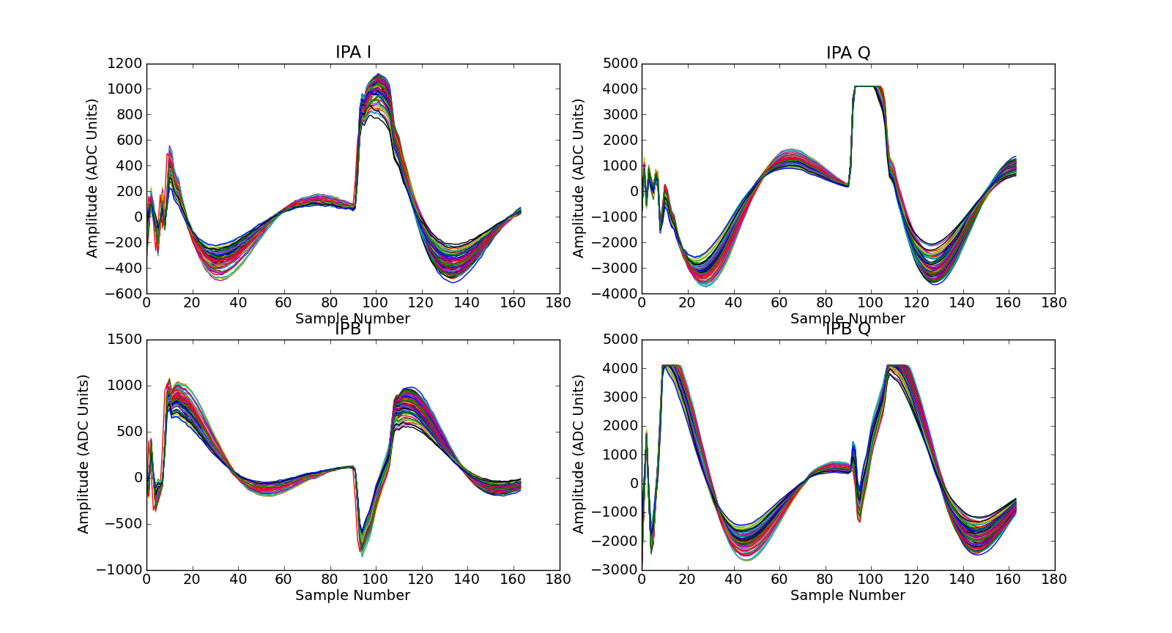
Calibrations – Raw Waveforms 10dB
Mikey Davis
02 November 2012
number

Slide 18
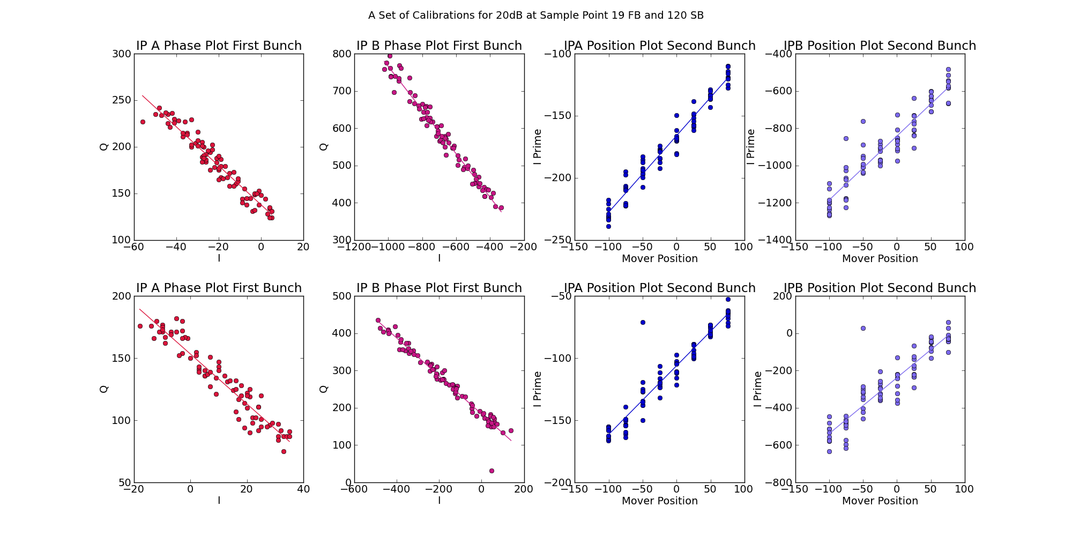
Calibrations – Results with Fits 20dB
Mikey Davis
02 November 2012
number

Slide 19
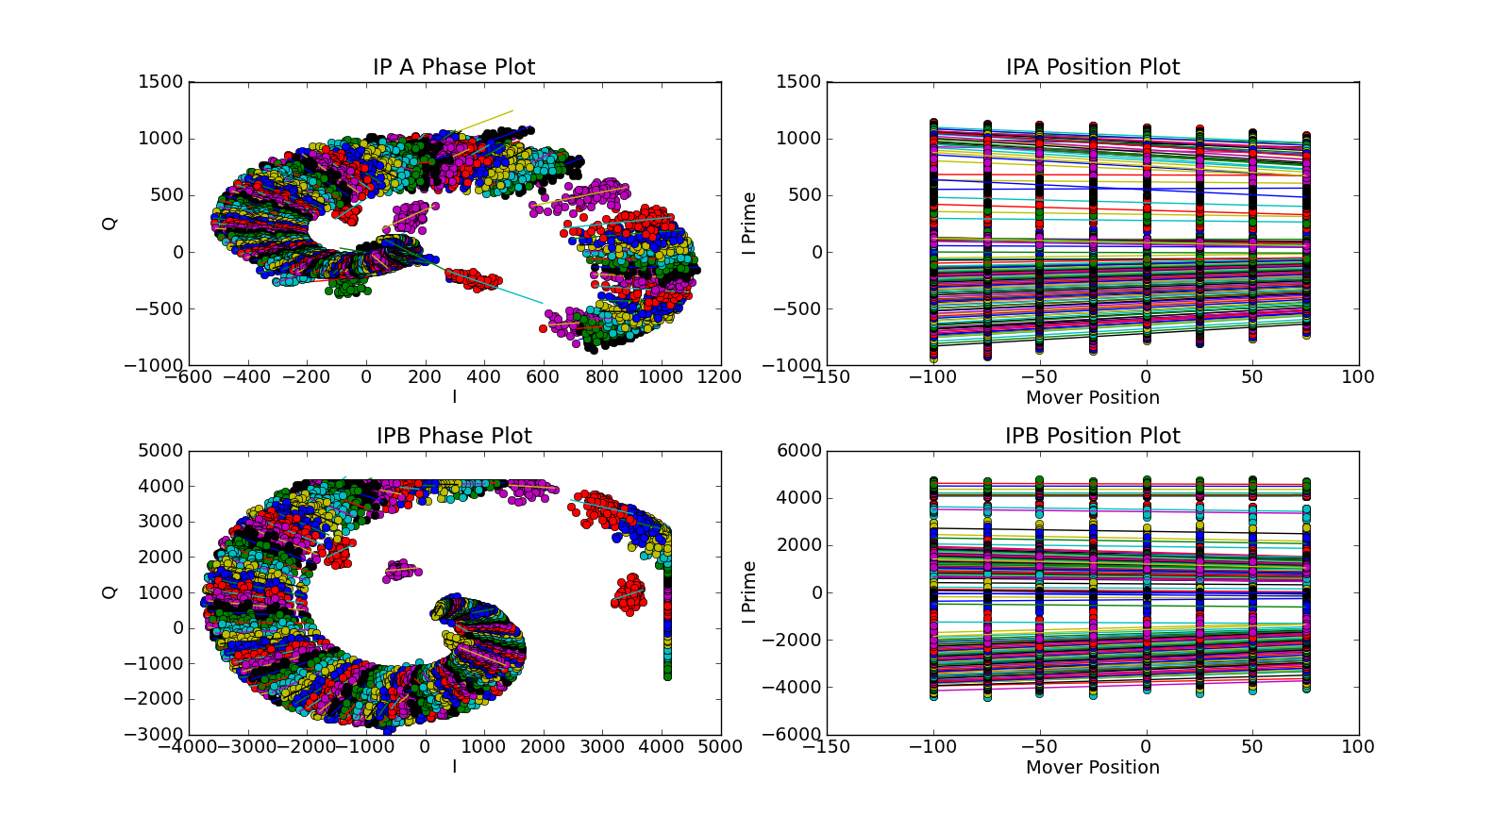
Calibrations – Circle Plots 10dB
Mikey Davis
14 02 November 2012
2012
number

Slide 20
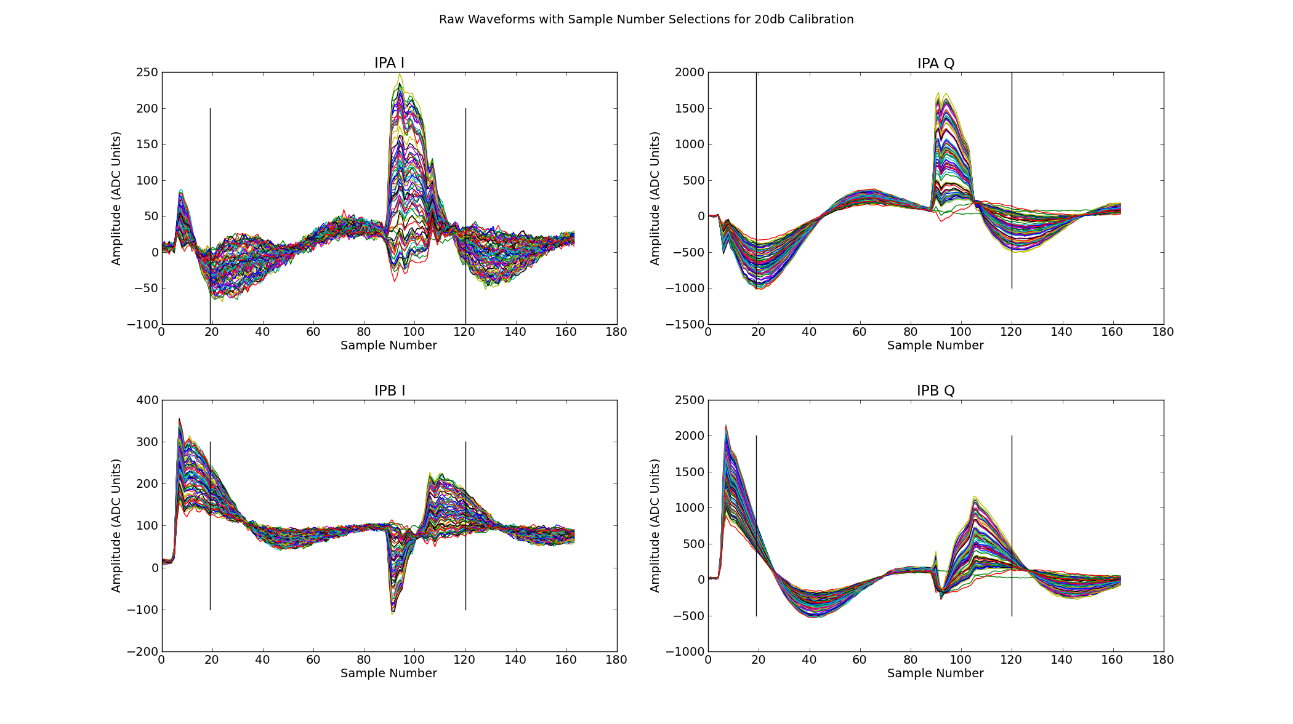
Calibrations – Raw Waveforms 20dB
Mikey Davis
02 November 2012
number

Slide 21
Calibrations – Results with Fits 20dB
Mikey Davis
02 November 2012
number

Slide 22

Calibrations – Raw Waveforms 20dB
Mikey Davis
02 November 2012
number

Slide 23
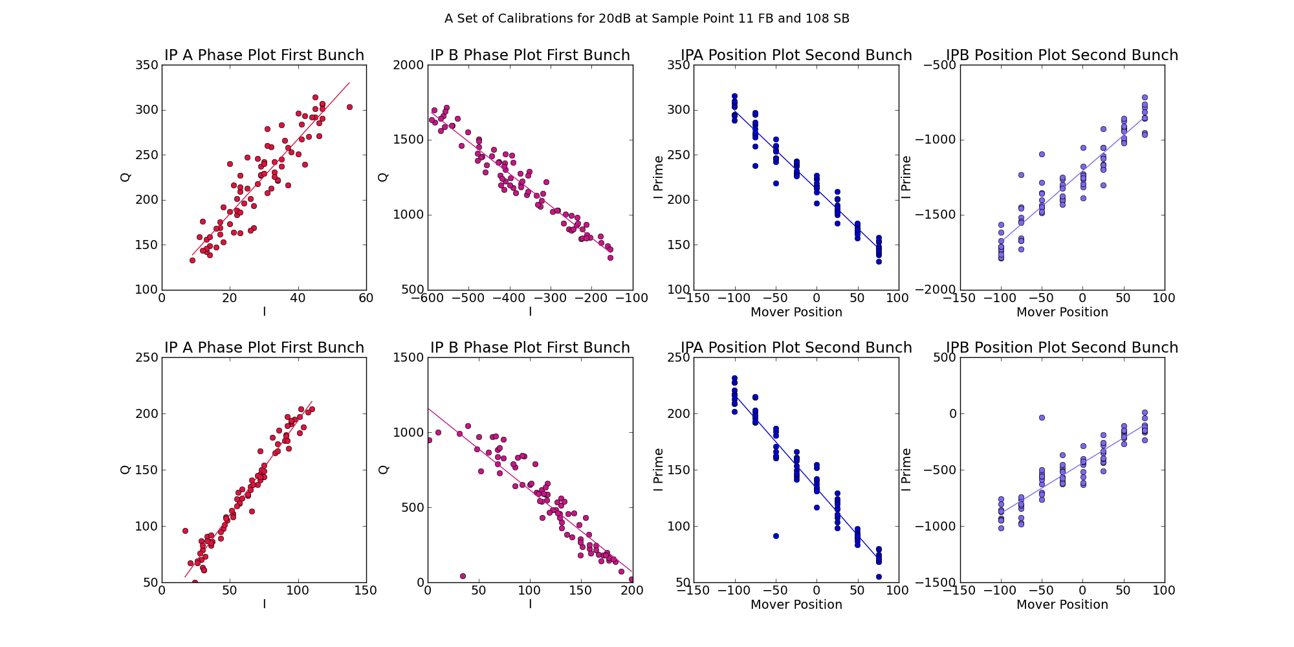
Calibrations – Results with Fits 20dB
Mikey Davis
02 November 2012
number

Slide 24
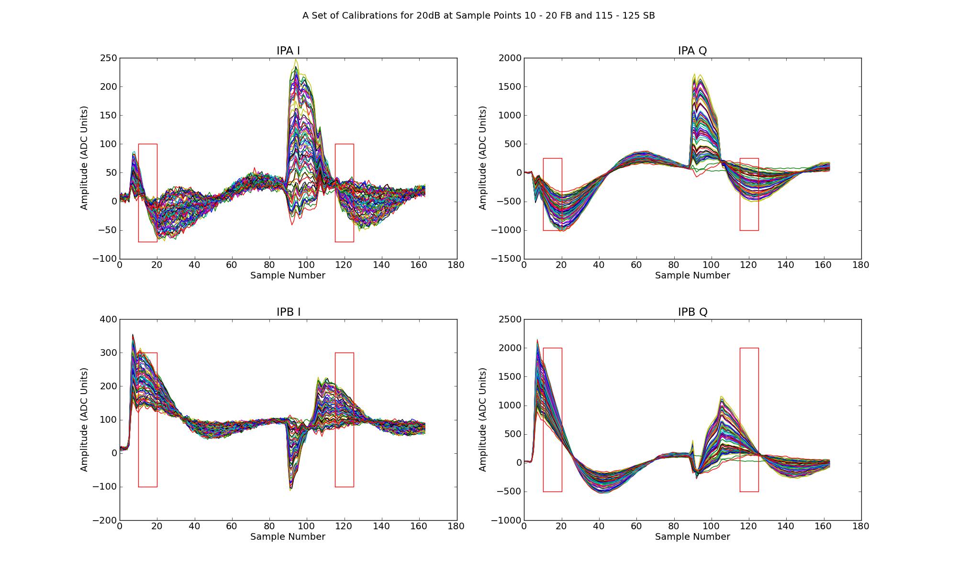
Calibrations – Raw Waveforms 20dB
Mikey Davis
02 November 2012
number

Slide 25
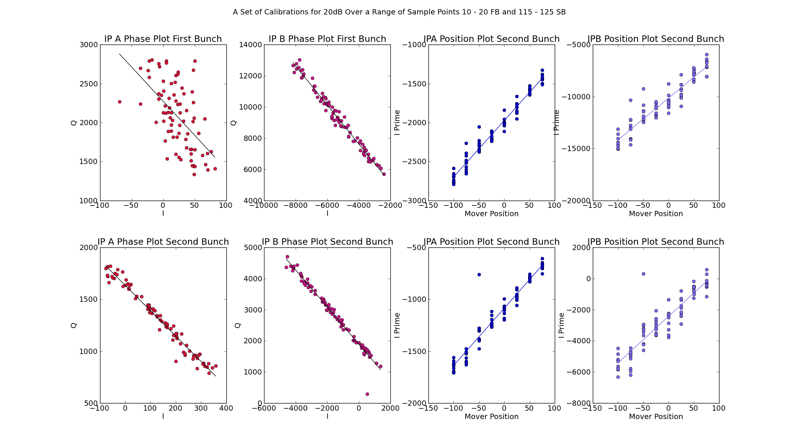
Calibrations – Results with Fits 20dB
Mikey Davis
14 September 2012
number

Slide 26
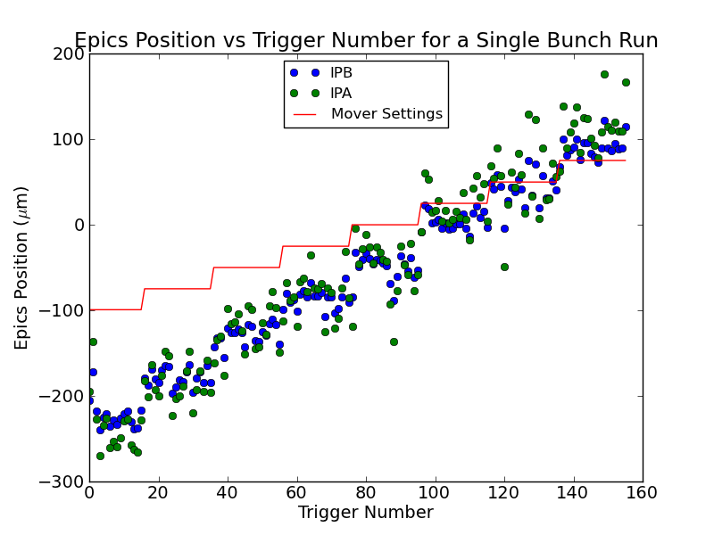
Calibrations – Epics Results
Mikey Davis
02 November 2012
number

Slide 27
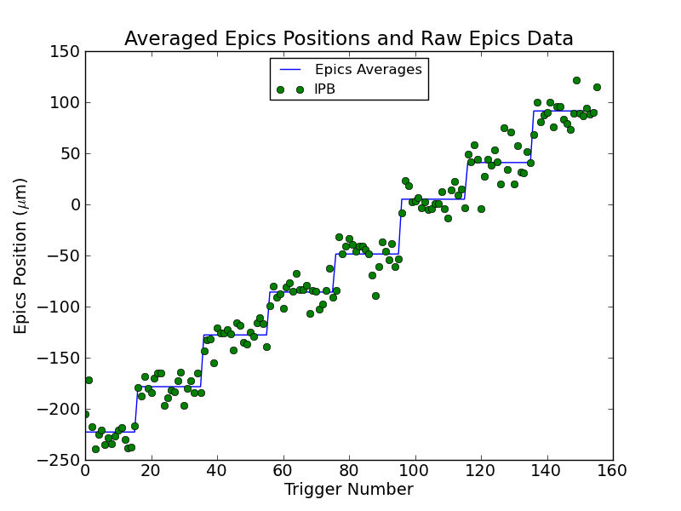
Calibrations – Epics Results
Mikey Davis
02 November 2012
number

Slide 28
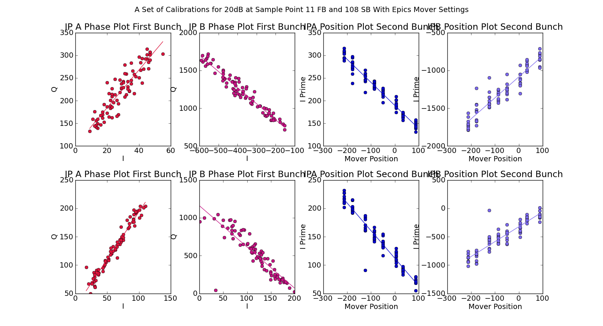
Calibrations – Epics Results
Mikey Davis
02 November 2012
number

Slide 29
Calibrations – Epics Results
Mikey Davis
02 November 2012
number

Slide 30
IP Waist Scan
We took lots of IP waist scans, at least one each shift
The results seemed fairly consistent
> The waist was focused at IPB with a QD0FF current of around 140A
The EPICS results don’t agree very well with the HONDA results, (admittedly I haven’t spent much time on this yet)
Mikey Davis
02 November 2012
number

Slide 31
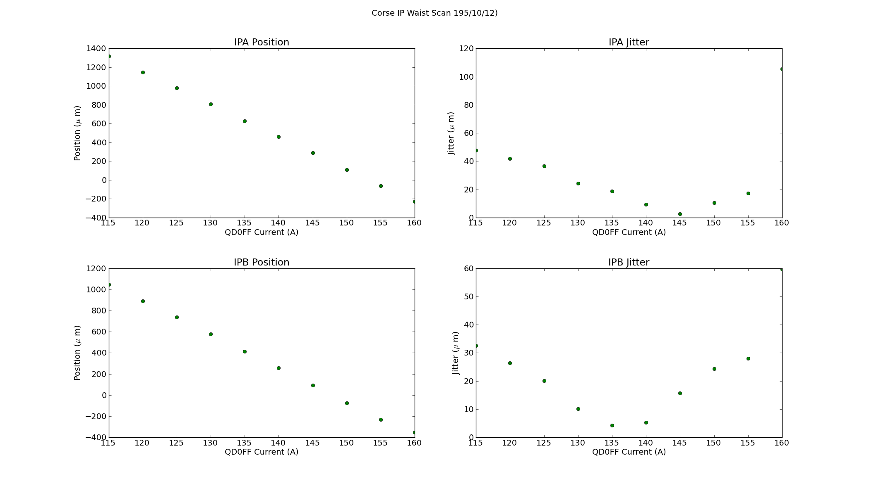
IP Waist Scan
Mikey Davis
02 November 2012
number

Slide 32
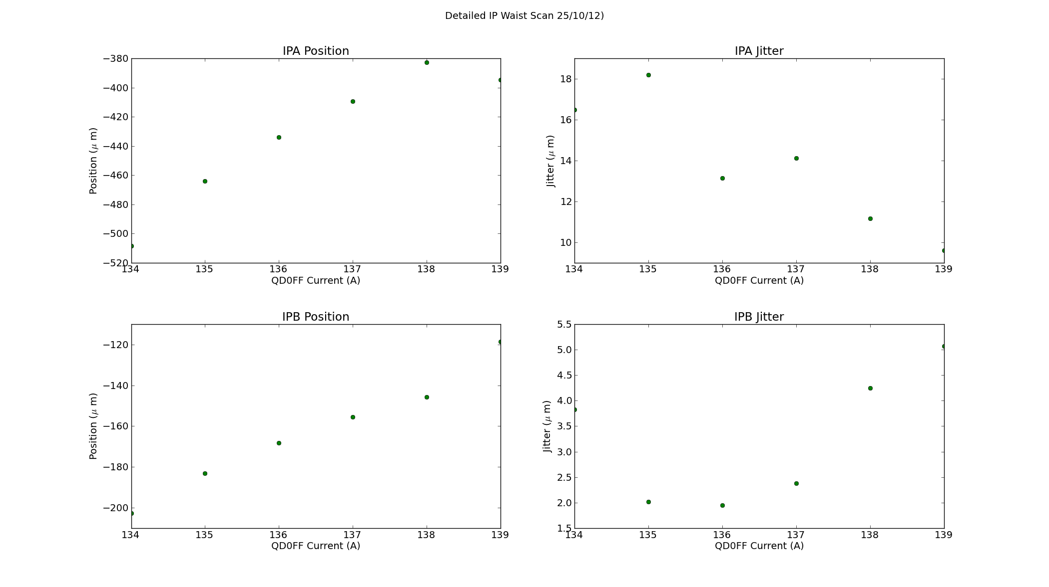
IP Waist Scan
Mikey Davis
02 November 2012
number

Slide 33
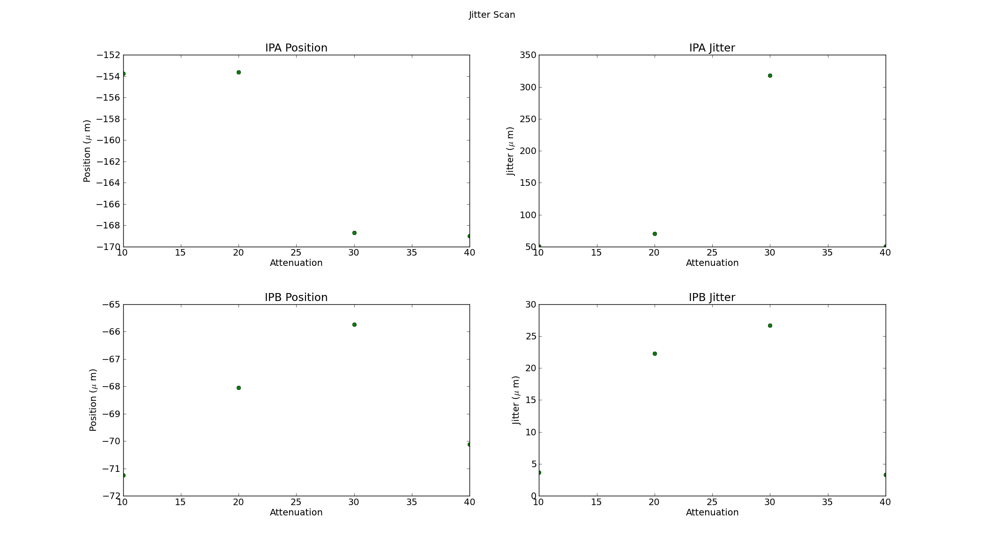
Jitter Scan
Mikey Davis
02 November 2012
number

Slide 34
Feedback Results
I will show a range of different feedback results
There are lots of different runs
Shift 1 results are rubbish
Shift 2 results are saturated
Shift 3 results are the best (in my opinion)
Shift 4 results are interesting
I will show a selection of results with different calibrations
Mikey Davis
02 November 2012
number

Slide 35
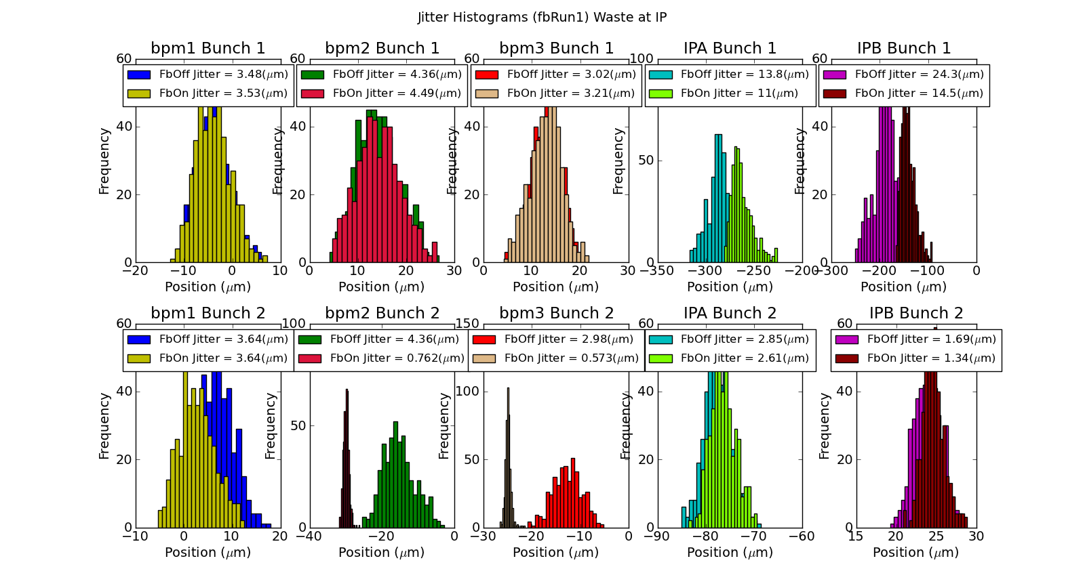
Shift 3 – Fb Run 1
Mikey Davis
02 November 2012
number

Slide 36
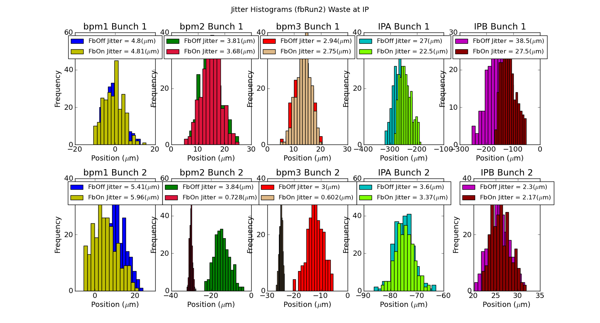
Shift 3 – Fb Run 2
Mikey Davis
02 November 2012
number

Slide 37
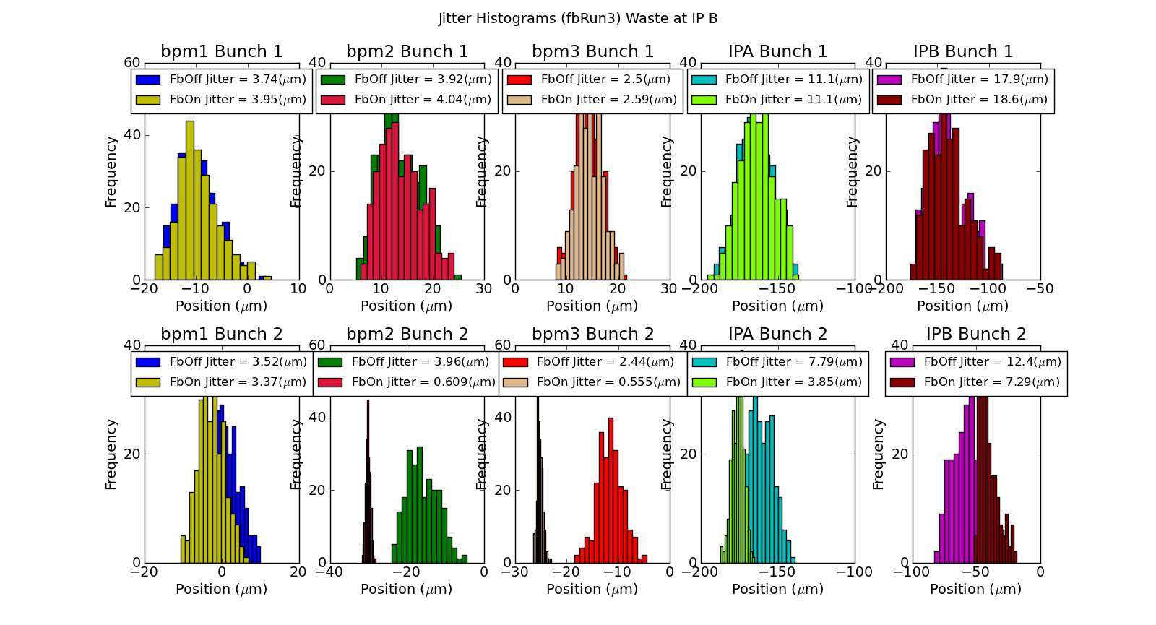
Shift 3 – Fb Run 3
Mikey Davis
14 S02 November 2012
eptember 2012
number

Slide 38
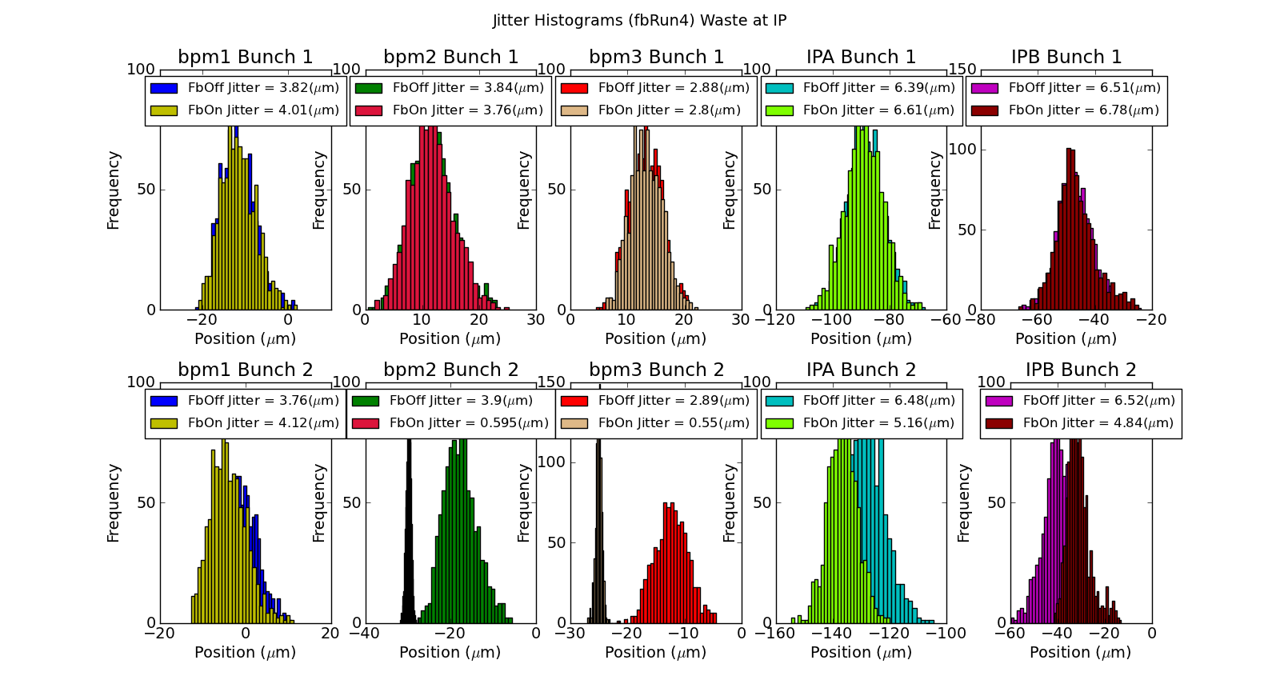
Shift 3 – Fb Run 4
Mikey Davis
02 November 2012
number

Slide 39
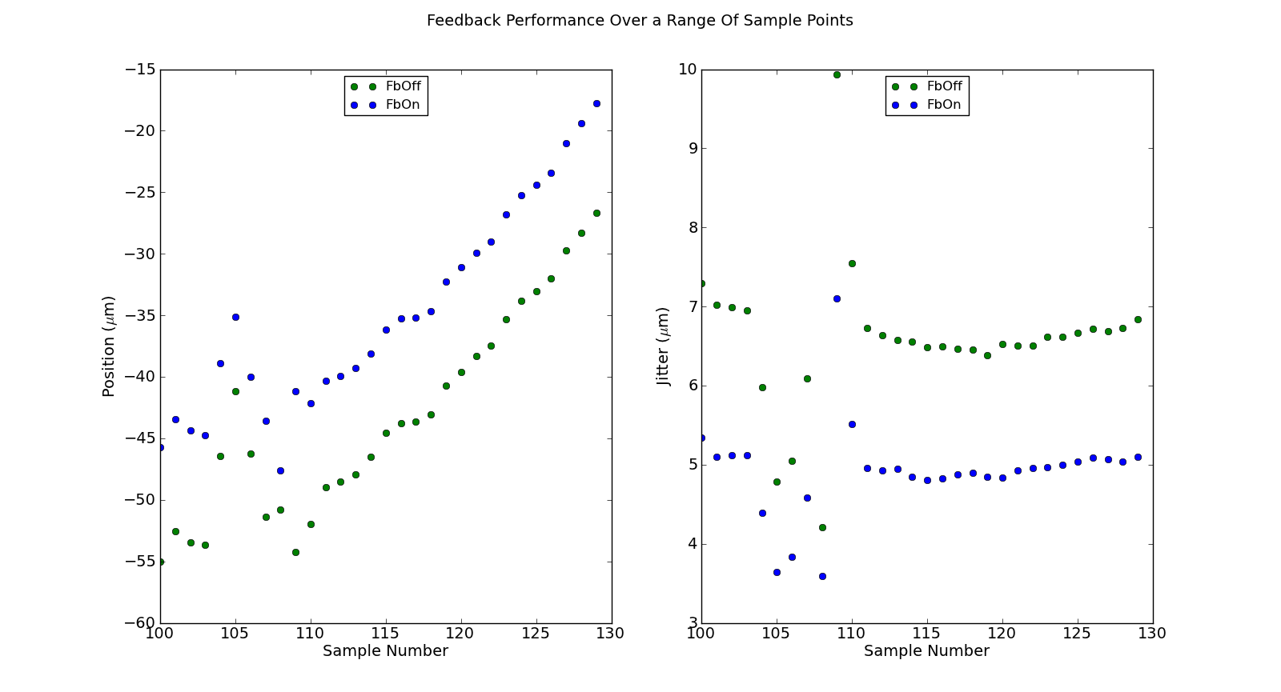
Over a Range of Sample Points
Mikey Davis
02 November 2012
number

Slide 40
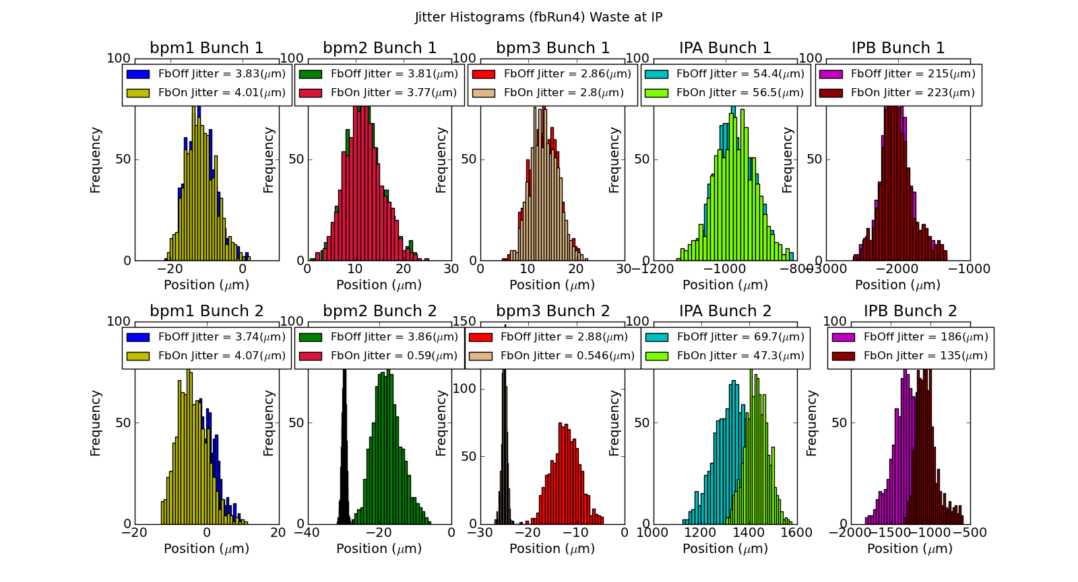
Shift 3 – Fb 4 with Calibration from EPICS
Mikey Davis
02 November 2012
number

Slide 41
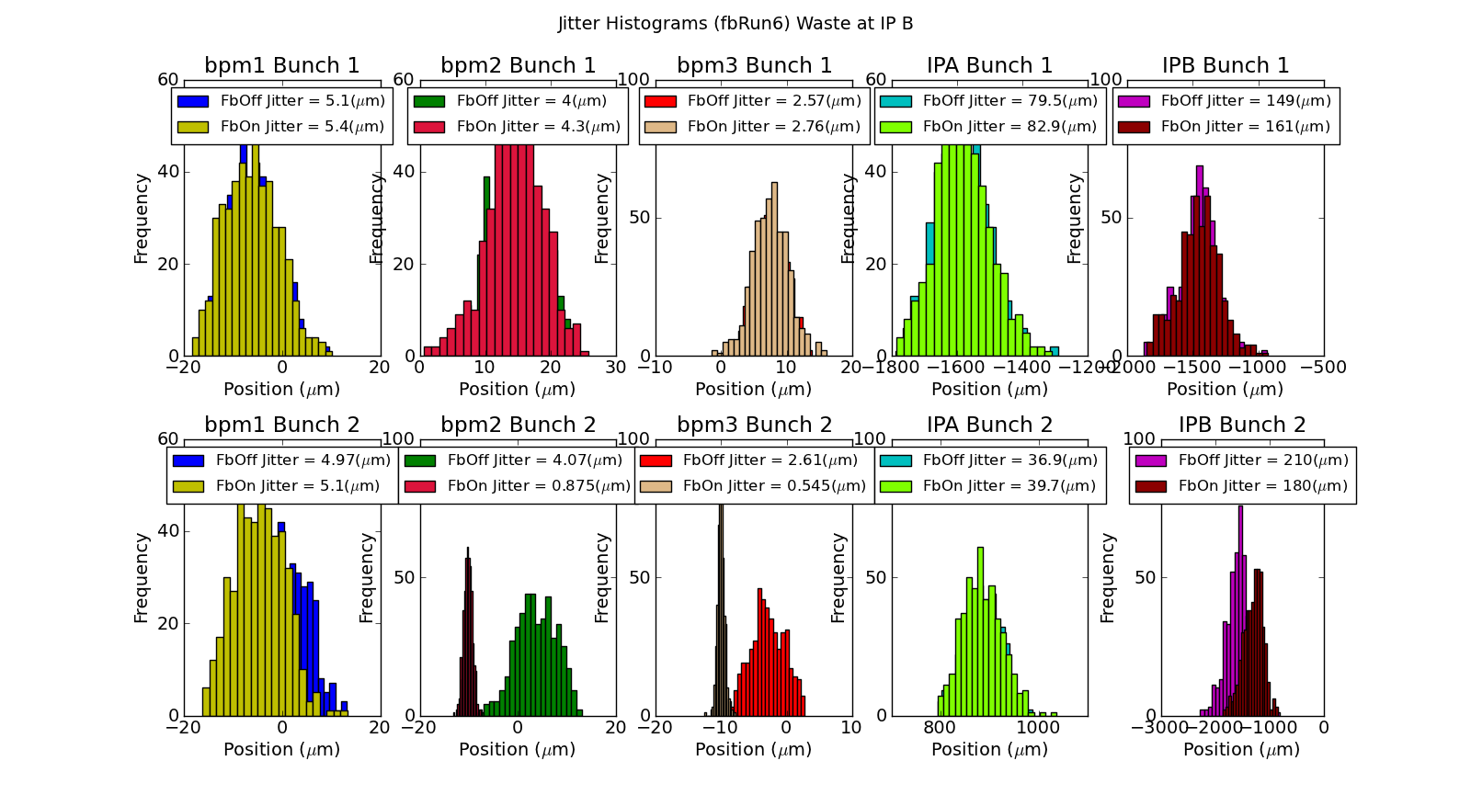
Shift 4 – Fb Results Without Averaging
Mikey Davis
02 November 2012
number

Slide 42
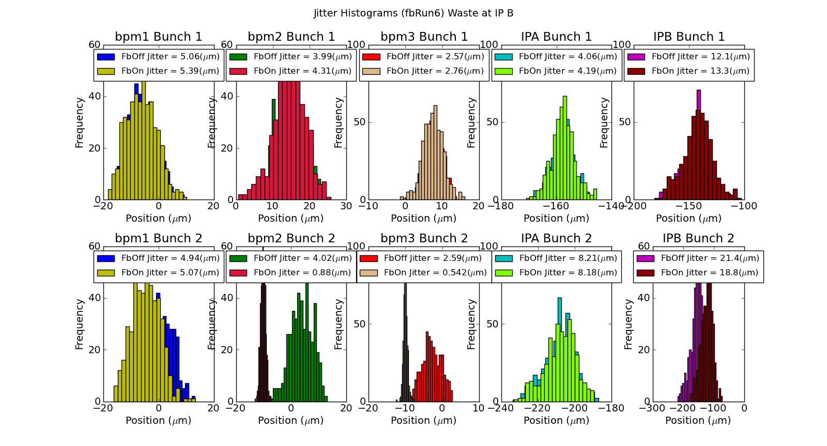
Shift 4 – Fb Results With Averaging
Mikey Davis
02 November 2012
number

Slide 43
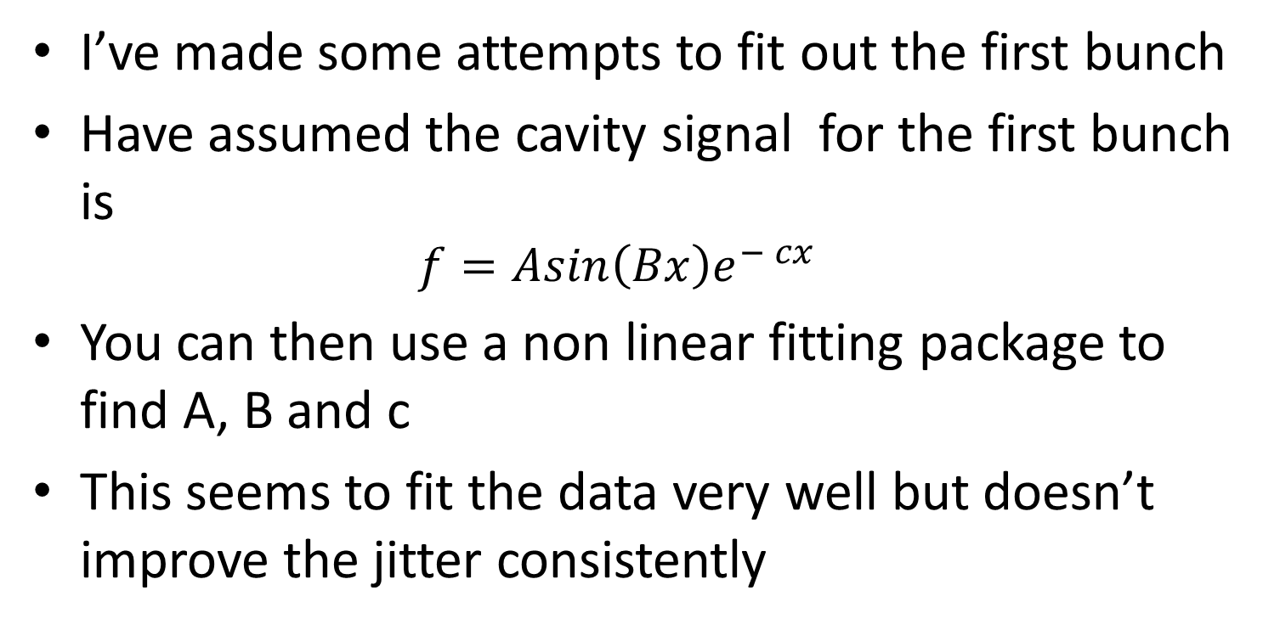
Attempts at Fitting out First Bunch
I’ve made some attempts to fit out the first bunch
Have assumed the cavity signal for the first bunch is
$$f=Asin\left(Bx\right)e^{− cx}$$
You can then use a non linear fitting package to find A, B and c
This seems to fit the data very well but doesn’t improve the jitter consistently
Mikey Davis
02 November 2012
number

Slide 44
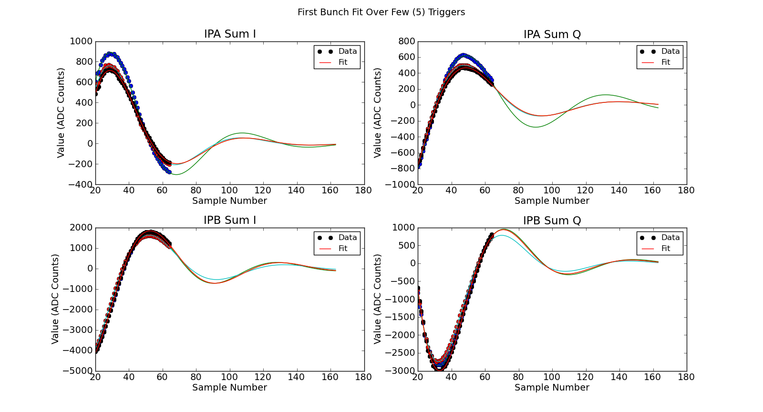
Attempts at Fitting out First Bunch
Mikey Davis
02 November 2012
number

Slide 45
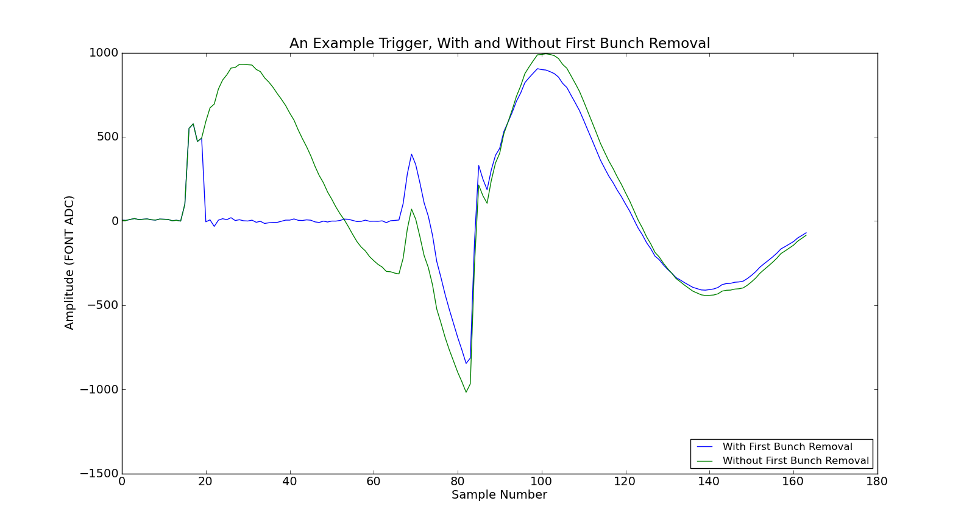
Attempts at Fitting out First Bunch
Mikey Davis
02 November 2012
number

Slide 46
Attempts at Fitting out First Bunch
Mikey Davis
02 November 2012
number

Slide 47
Conclusions
Feedback was successful I think
Feedforward obviously a bust
We took a lot of data, sifting through it is proving useful
K is still giving me the most difficulty
I will continue to work on this
I also need to charge normalise, although should be able to do this by this pm
Overall I think actually a very successful trip
Mikey Davis
02 November 2012
number

