Slide 1
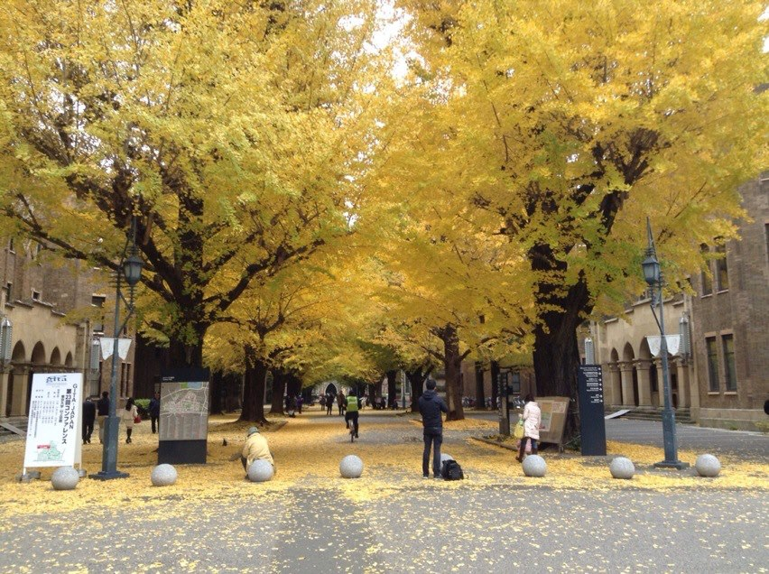


France-Japan ECAL meeting
2012 December 17, Tokyo
K. Kawagoe
Kyushu University

Slide 2
History
FJPPL (TYL) since 2007
  A common R&D on the new generation detector for the ILC
CNRS-JSPS bilateral program 2011-2012
  Electromagnetic Calorimetry for a linear collider
  Submitted a new proposal for 2013-2014
Collaboration agreement between CNRS/IN2P3 and Kyushu University on
  The development of silicon sensors for an electromagnetic calorimeter

Slide 3

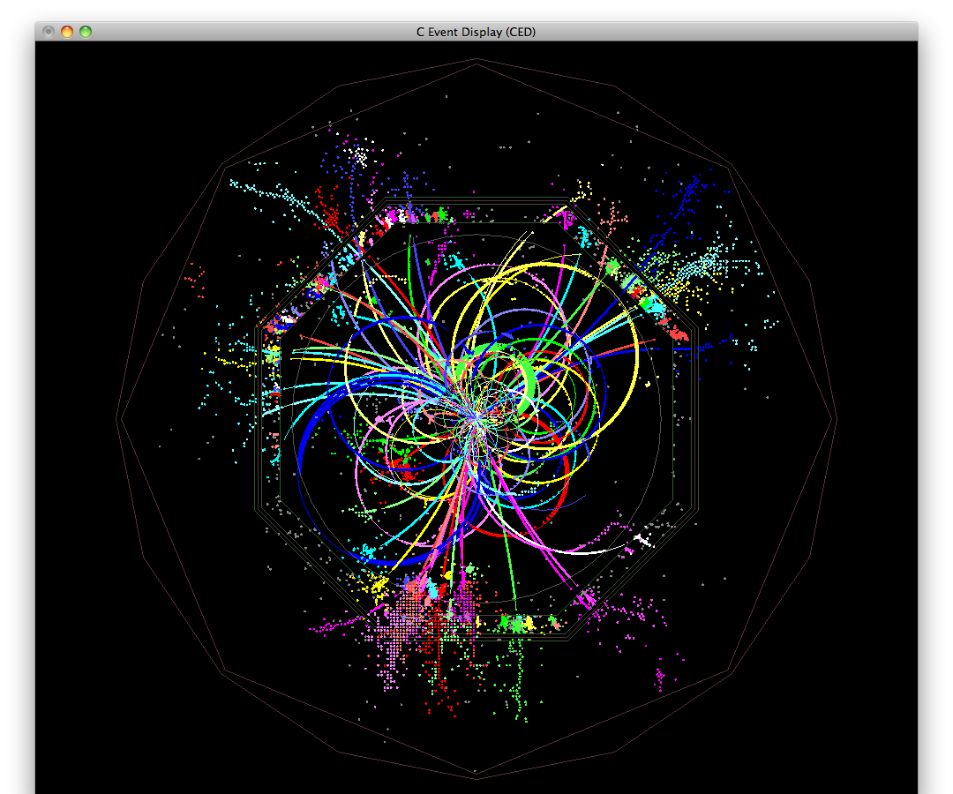
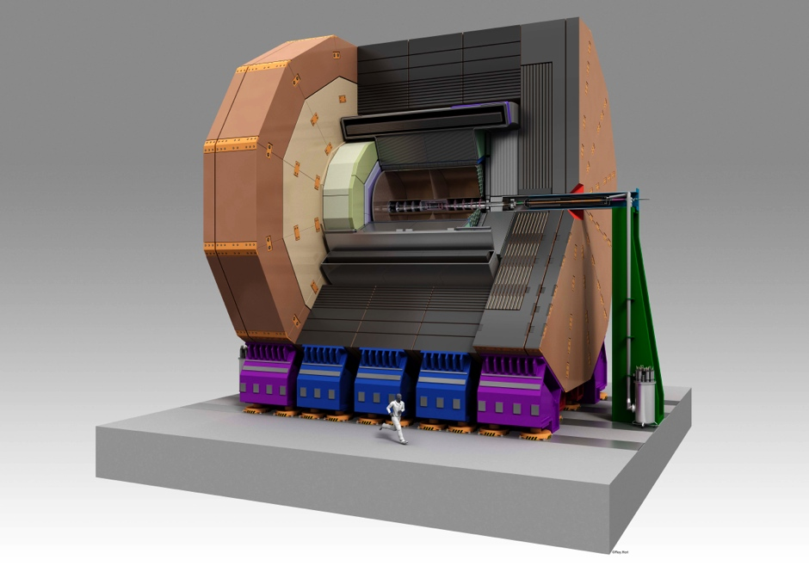
CALICE and ILD
2007: Japanese calorimeter team joined CALICE, where French team have been playing a main role from its beginning.
2008: Two detector concepts for ILC (LDC and GLD) were merged to make a new concept “ILD”.

Slide 4
Schedule of this week
Dec 17 (Mon)
  Meeting 10:30-12:30, 13:30-17:00
  Meeting dinner 19:00-
Dec 18 (Tue)
  Meeting 09:30-12:00, 13:00-15:00
  Travel to Hamamatsu
  Dinner with HPK people
Dec 19 (Wed)
  Meeting with HPK on Si sensors, morning
  (Meeting with HPK on MPPC, afternoon)
Dec 20-21 (Thu-Fri)
  Annual ILD physics and Detector meeting at KEK

