Slide 1


Further Analysis of Feedback Results
Mikey Davis
8 November 2012
1/14

Slide 2
Introduction
I’ve continued to look at the data from the trip
Have concentrated mainly on the calibrations and the IP waist scans as these seem simplest
The Epics data seems to work in two bunch mode
Have looked at this and contrasted it with Honda
Mikey Davis
8 November 2012
2/14

Slide 3
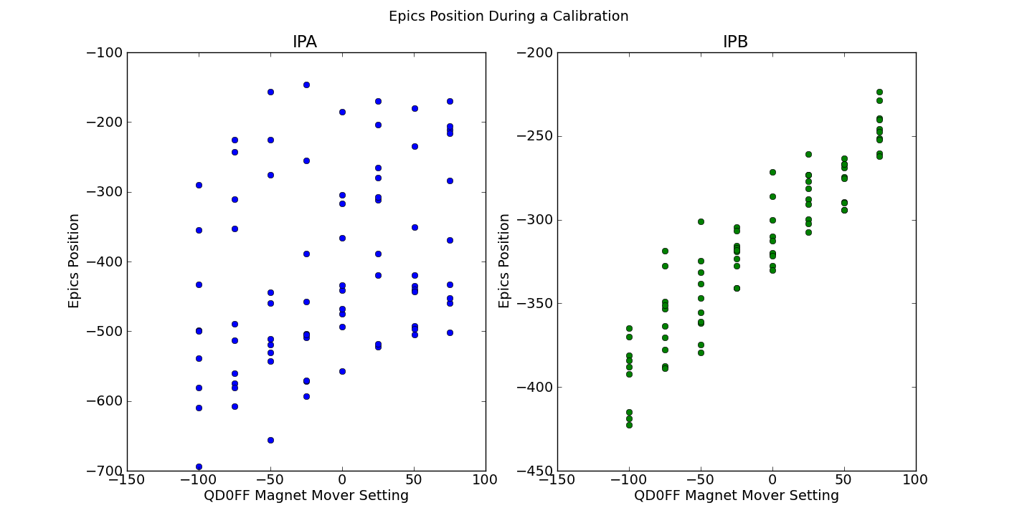
Epics During a Mover Calib
Mikey Davis
8 November 2012
3/14

Slide 4
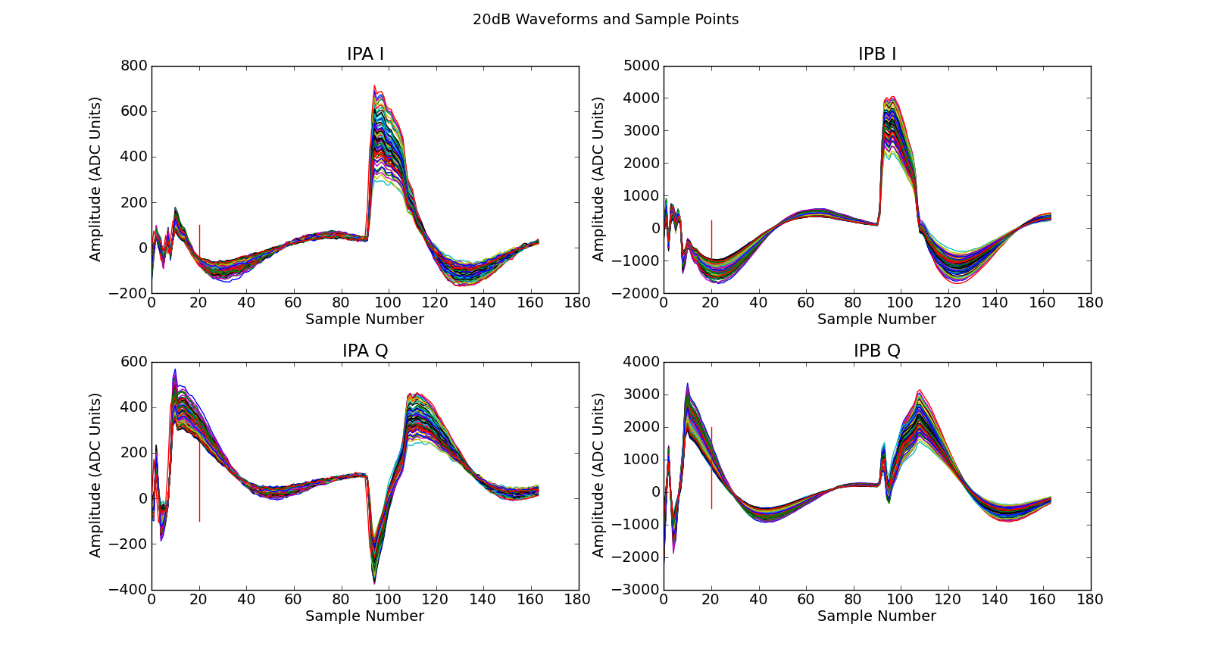
Raw Waveforms
Mikey Davis
8 November 2012
4/14

Slide 5
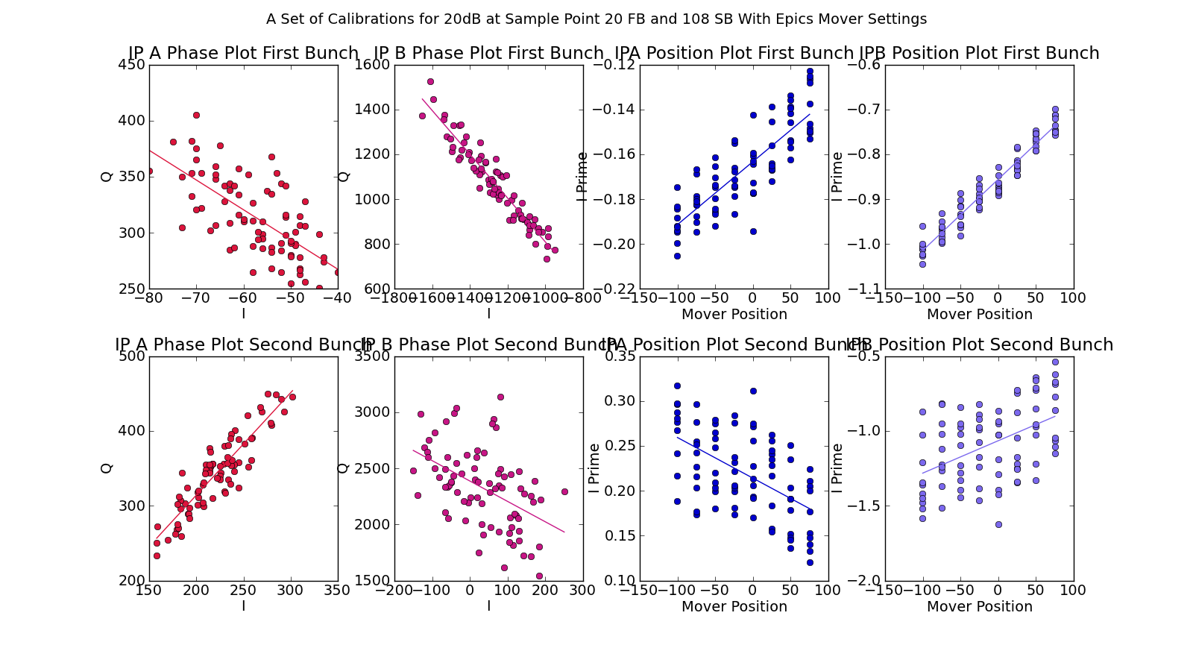
20 dB Calibration
Mikey Davis
8 November 2012
5/14

Slide 6
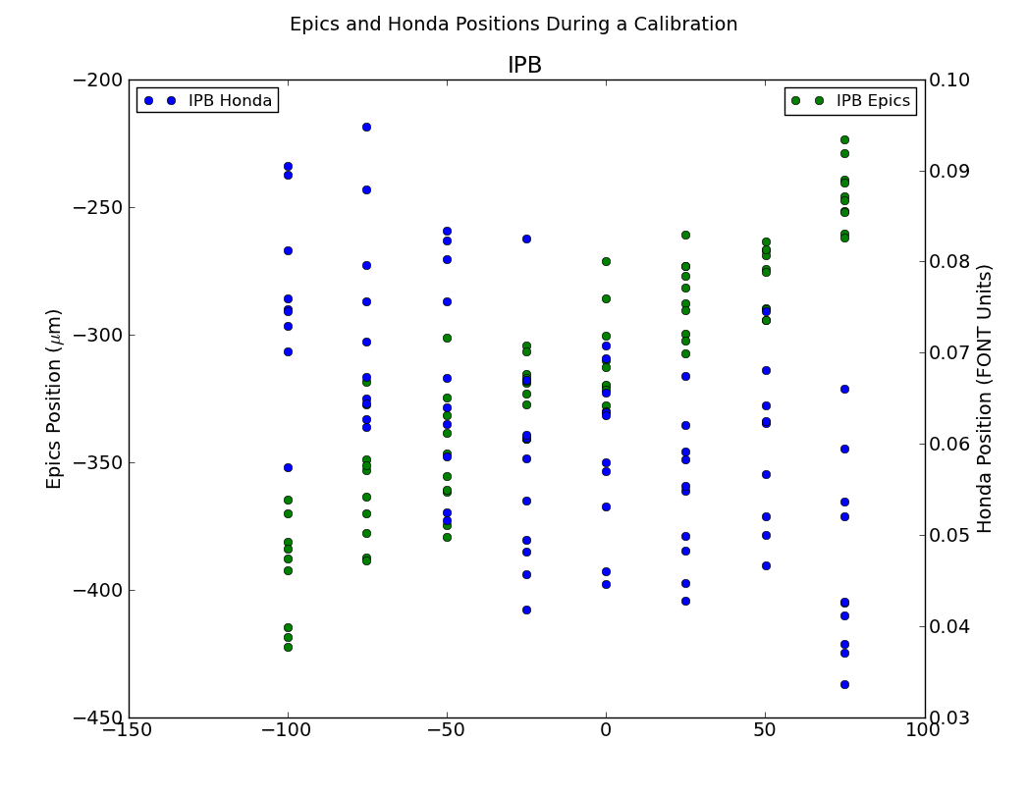
20 dB Calibration
Mikey Davis
8 November 2012
6/14

Slide 7
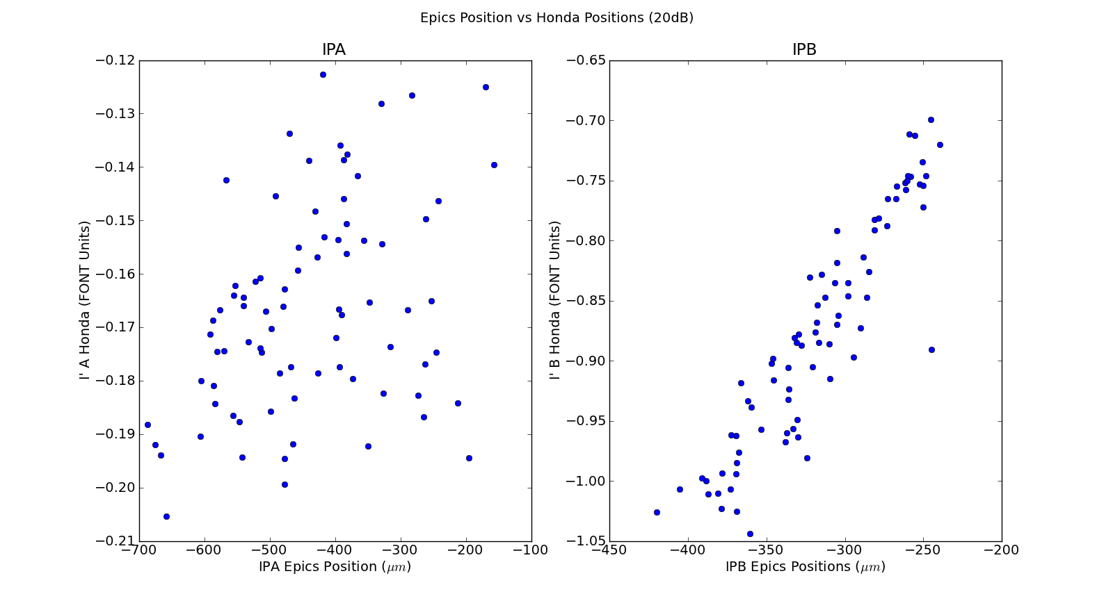
Epics vs Honda Position
Mikey Davis
8 November 2012
7/14

Slide 8
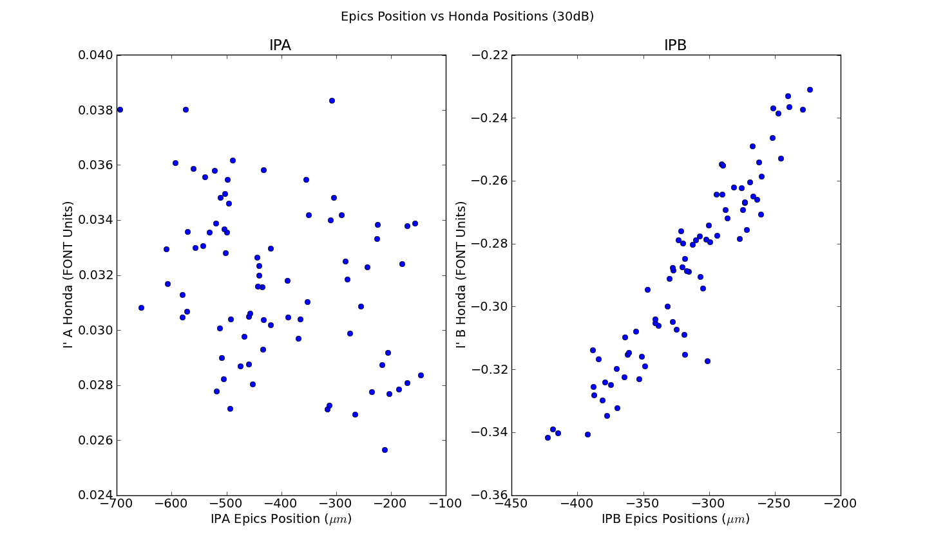
Epics vs Honda Position
Mikey Davis
8 November 2012
8/14

Slide 9
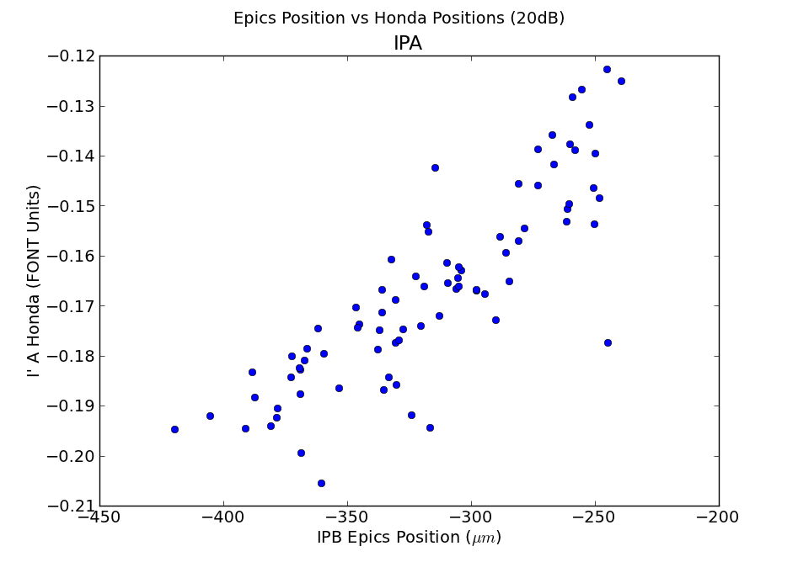
Introduction
Mikey Davis
8 November 2012
9/14

Slide 10
IP Waist Scans
We have a set of decent IP waist scans with EPICs and Honda from 25th October
One problem is that we don’t have a single bunch calibration from this day
I’ve been trying to use the two bunch calibration (it should be the same)
The results seem to be quite sample number dependent
Mikey Davis
8 November 2012
10/14

Slide 11
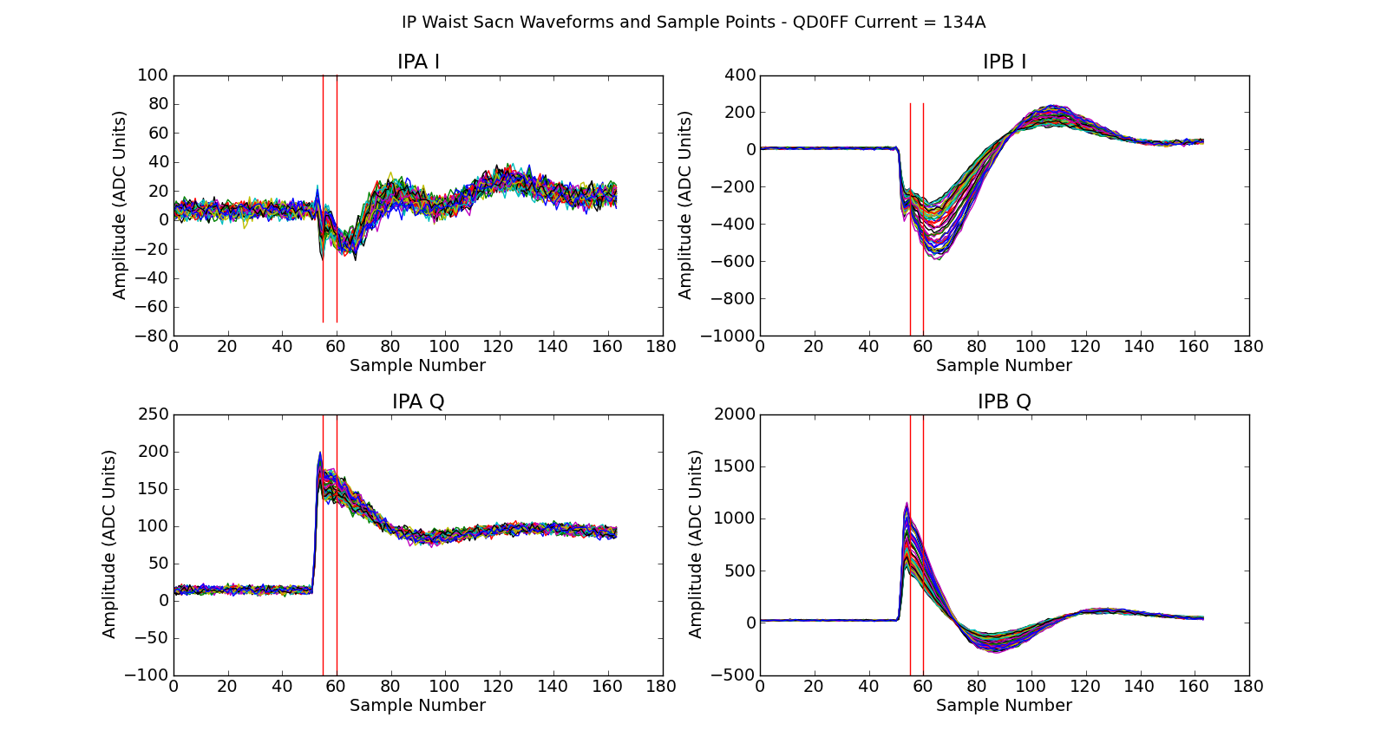
IP Waist Scan Waveforms and Sample Points
Mikey Davis
8 November 2012
11/14

Slide 12
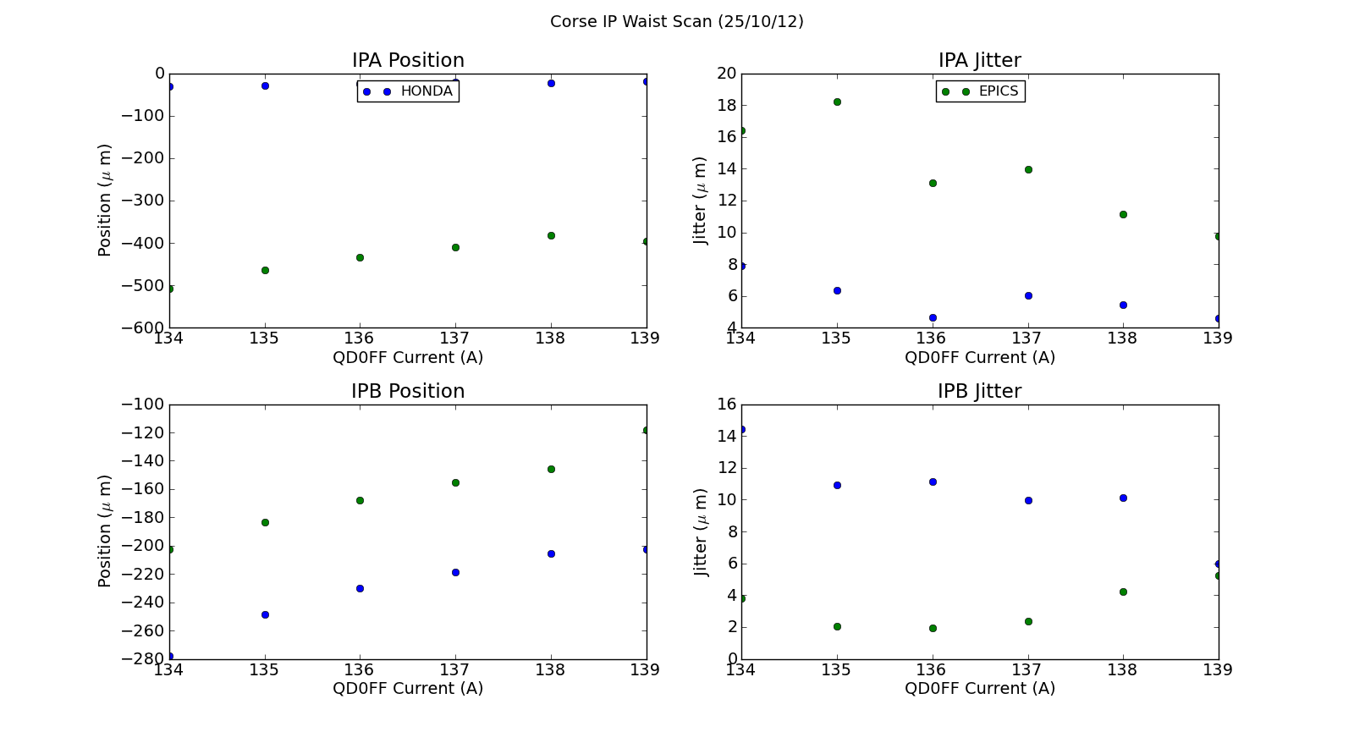
Epics vs Honda IP Waist Scan (Sample Point = 57)
Mikey Davis
8 November 2012
12/14

Slide 13
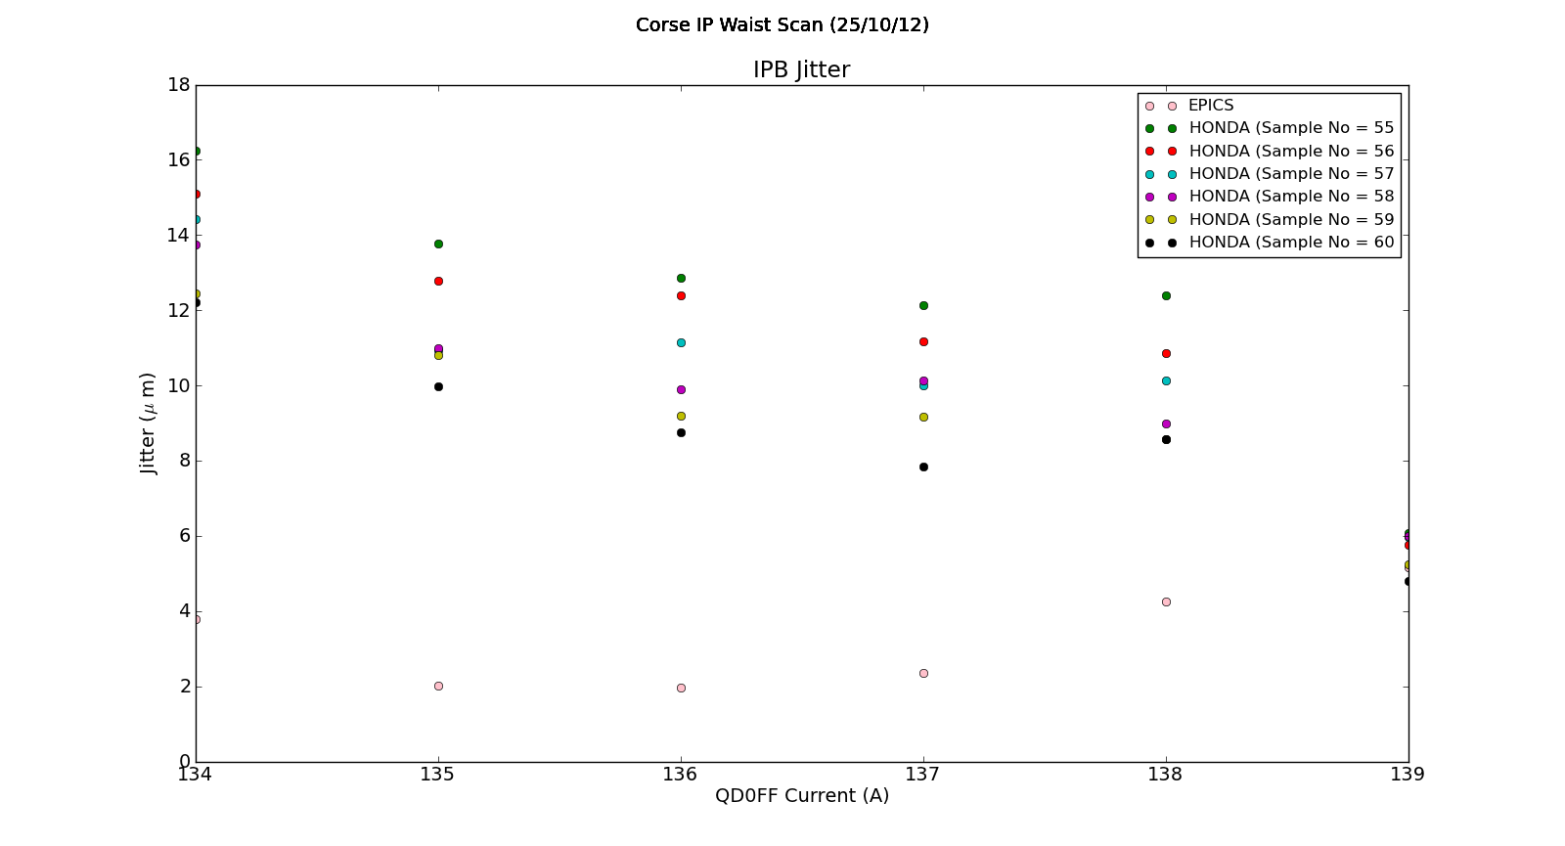
IPB Position Over Different Sample Points
Mikey Davis
8 November 2012
13/14

Slide 14
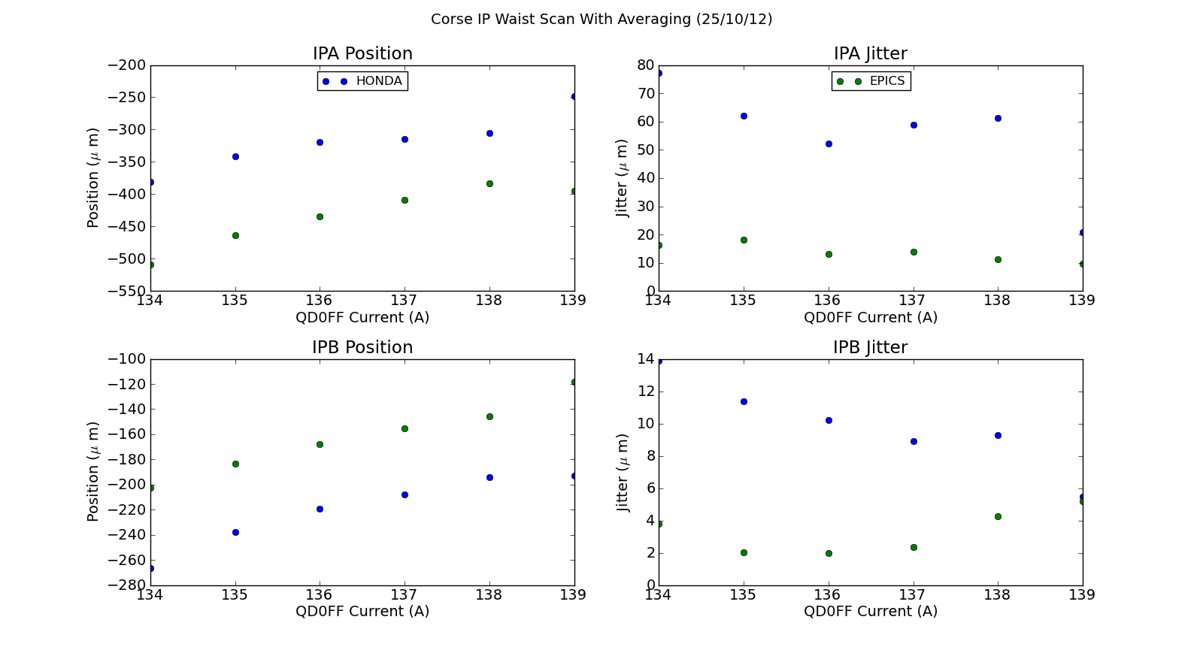
Epics vs Honda Position With Averaging
Mikey Davis
8 November 2012
14/14

