Slide 1
vvh 1TeV study for DBD
ILC Physics and software meeting
Nov. 16 2012
H.Ono (NDU)

Slide 2
Status of Higgs study
Higgs BR study paper
  Comments came last week and now preparing reply for each comment
    Beam polarization benefit and effect to result
    Template fit parameter (free or fix)
  English correction by native speaker
    Daniel-san accept to read and correct
DBD benchmark chapter
  Now revise with Tino by Nov. 18 to send Mikael

Slide 3
Status and to do list
h→bb, cc, gg channel
(Preliminary results are obtained with template fitting)
  Increase BG statistics (sznu_sl are available)
  Check 3f BGs (simulated samples are available)
h→WW*→4j channel
(Preliminary result will come soon)
  Optimize kt R parameter for 4 jet reconstruction (now)
  Improve BG reduction and h→others suppression
γγ→hadron BG suppression
  Check more detail with PFO based study (kt clustering)

Slide 4
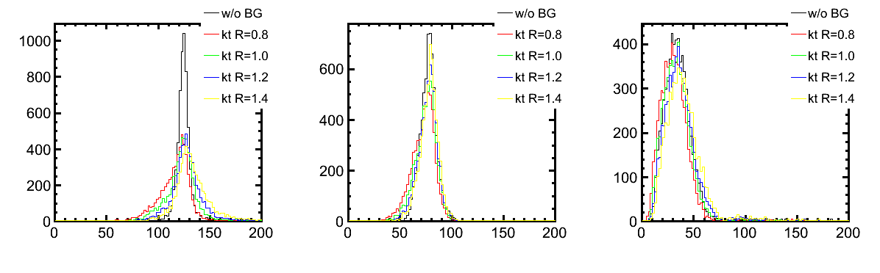
Treatment of aa background
h→WW*→4j channel reconstruction with diff. R parameters
Higgs mass
W1 mass
W2 mass
Reconstructed Higgs mass distribution is shifted with R
→Check also other variables for further improvement

Slide 5
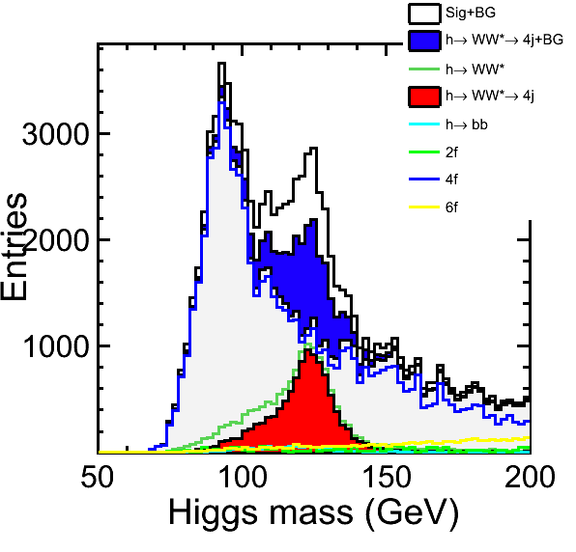
What to do in H→WW*
Cut based preliminary result will obtain soon.
Need to reduce BG fluctuation with
increasing the 4f BG statistics
→Already simulated/reconstructed,
need to reprocess them.
Need to improve for further reduction
especially in h→others channel

